Slide 1
2023 VERTICAL & HORIZONTAL ALIGNMENT
Understanding how CTE pathways can be better integrated

Slide 2
WHO WE ARE
CTE IS A FAMILY

Slide 3
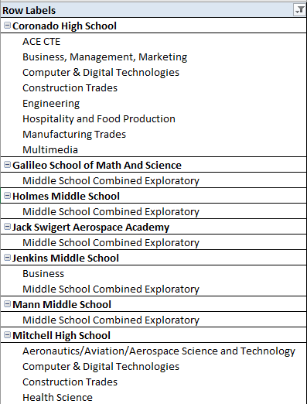
PROGRAM APPROVALS AT THE STATE

Slide 4
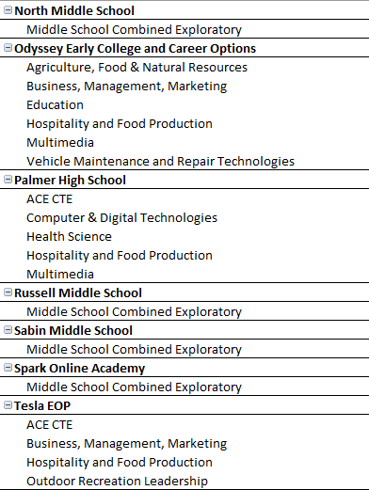
PROGRAM APPROVALS AT THE STATE

Slide 5
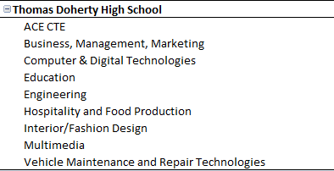
PROGRAM APPROVALS AT THE STATE

Slide 6
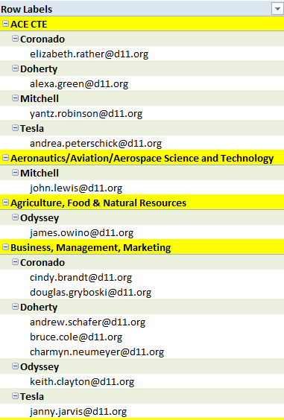
WHO ARE OUR TEACHERS
59 CERTIFIED CTE Teachers
2 more getting their credential
2 more* in process
12 (14*) CTE teachers with their CTE Authorization
4 veterans with 20+ years of service

Slide 7
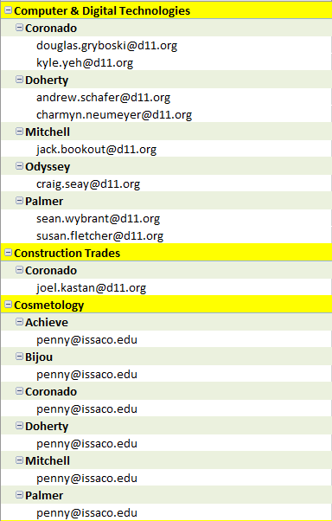
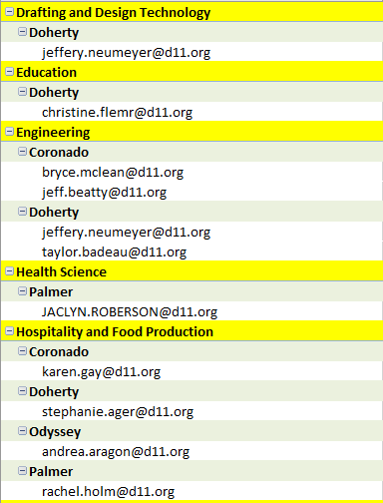
WHO ARE OUR TEACHERS

Slide 8
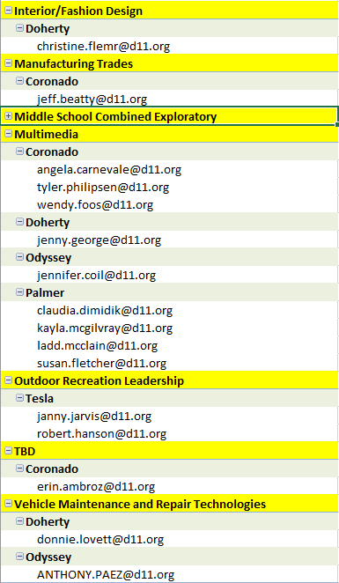
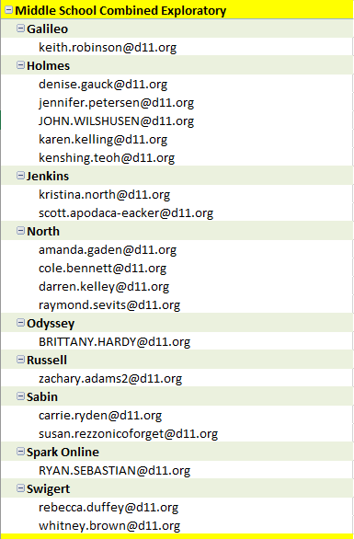
WHO ARE OUR TEACHERS

Slide 9
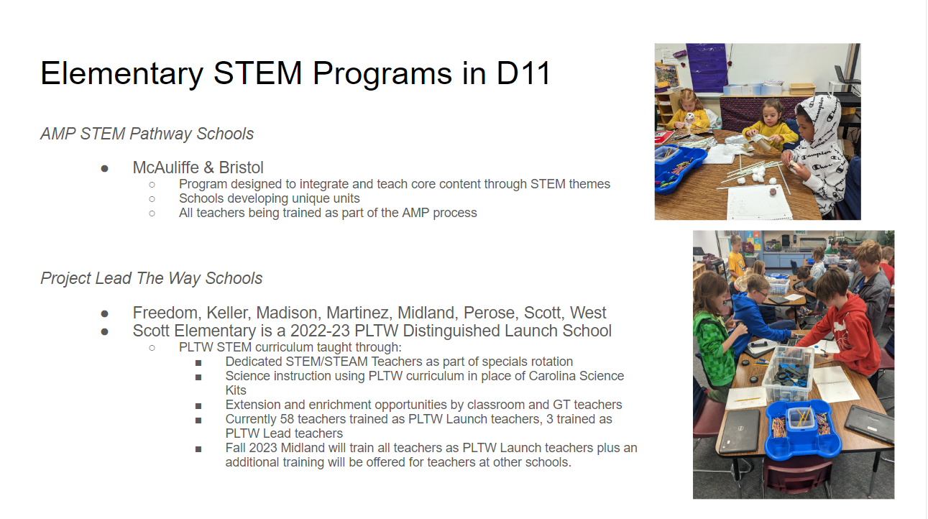

Slide 10


