Slide 1
2023 BUDGET PD
Understanding how CTE budgets works and preparing for the year

Slide 2
PAY ATTENTION TO THE PRESENTATION
AS we hand out your budget packets, we will give plenty of time to review these. Let’s go over the presentation together.
Close your folders, put your cell phones away ☺

Slide 3
Understanding how budget works for spending categories:
  Perkins
  Career Development Incentive Program (CDIP)
  CTE General Funds
  Building Funds
    School Funds
    SSA accounts (CTSO, microgrants)

Slide 4
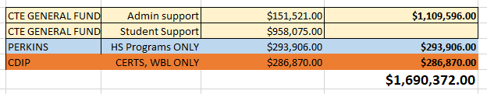

WHAT IS THE BUDGET?

Slide 5
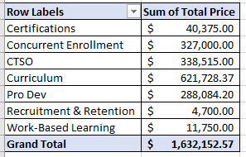
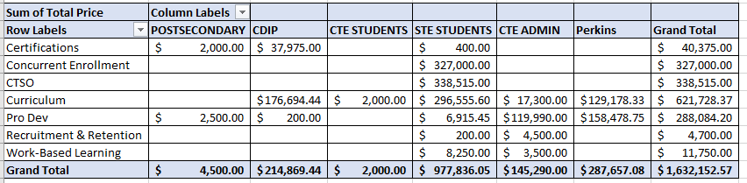
WHAT IS THE BUDGET?

Slide 6
WHAT IS THE BUDGET?

Slide 7
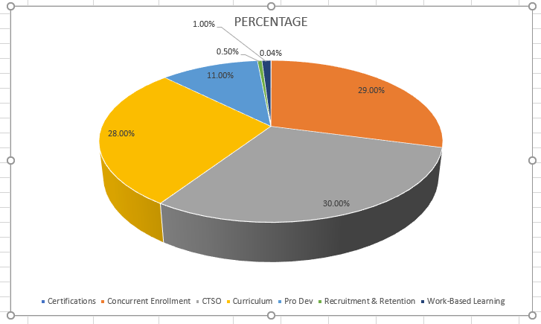
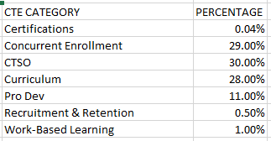
WHAT IS THE BUDGET?

Slide 8
HOW TO READ YOUR BUDGET
YOUR SITE BUDGET MIGHT HAVE TWO COPIES – 1 current and 1 from June 15
Rollover in September/October – How to check an S: Drive
Perkins – Conferences
Perkins Capital ( over $5K)
CTE GENERAL FUND
CDIP

Slide 9
CDIP
WHY DOES IT MATTER.
HOW WE SPEND IT
HOW I MANAGE FUNDS

Slide 10
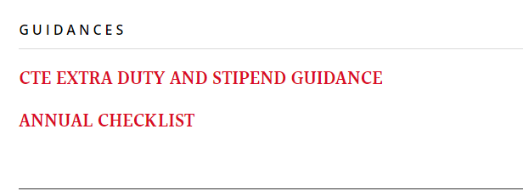
STIPENDS & EXTRA DUTY
READ THE GUIDANCE IN STAFF RESOURCES

Slide 11
STIPENDS & EXTRA DUTY
WE CANNOT PAY EXTRA DUTY PAST 1 MONTH. MUST BE TURNED IN BY END OF MONTH, including the last day of the month.
Julie sends out a reminder monthly. We will start using Charmyn’s fillable form.
Please no photos

Slide 12
STIPENDS & EXTRA DUTY
ADVISORY EXPECTATION IS TWO TIMES, COVERED BY CTE STIPEND (.0223% per class) and follow up data.
Register for advisory or attend D11 run advisory

Slide 13
STIPENDS & EXTRA DUTY
CTSO Covers ALL activites through STATE level competition
Professional rate only applies to non-contract dates after state level competition
Extended season only applies to the national level event for advisors only

Slide 14
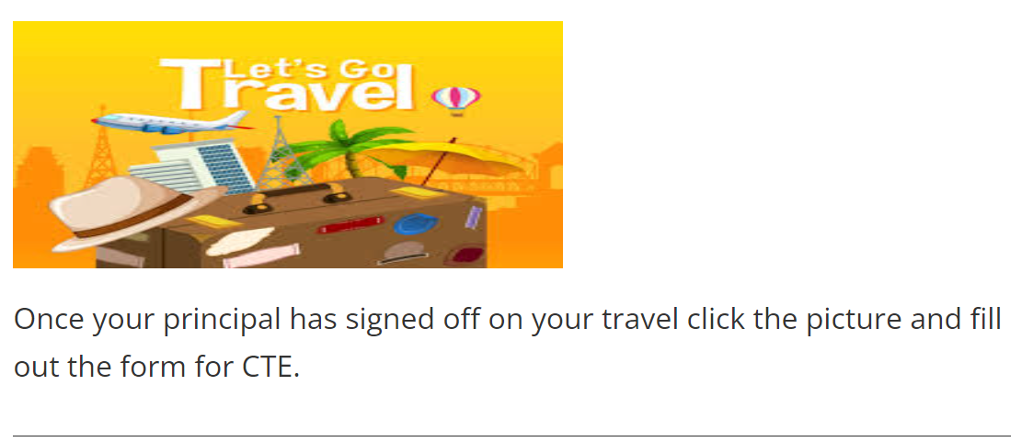
CTSO AND PROFESSIONAL DEVELOPMENT
We will no longer arrange any buses. That will all be done through your school. You will have to fill out permission slips through your school as well.
WE NEED YOU TO COMPLETE OUR QUICK TRIP SUMMARY IN STAFF RESOURCES

Slide 15
CTSO AND PROFESSIONAL DEVELOPMENT
For us to pay for anything there are a few things we need you to do first.
If you are traveling out of state:
First you must fill out the Out of State Travel Justification then email that to Lynnette. I will get it signed then we can start the next process.
Fill out the permission slip for your school.
Fill out the new CTE travel FORM.
Lynnette will make arrangements for airline travel, hotel and ground transportation from the airport to the hotel and back.

Slide 16
CTSO AND PROFESSIONAL DEVELOPMENT
If you are traveling in state but overnight:
Fill out the permission slip for your school.
Fill out the new CTE travel FORM on the CTE website
Lynnette will make hotel reservations if needed.
Your school must make bus reservations. There have been a few changes in busing….
More activity buses and 45 day request

