Slide 1
2023 POSTSECONDARY CTE ANALYSIS SUMMARY
Growth from 2022 to 2023 in postsecondary access and CTE

Slide 2
TALKING POINTS
More than doubled college access in 2023. Grew from approximately 673 instances of student access (think a class) to 1460.
117% growth in access
Grew from approximately 6294 credits in 2022 to 9164 credits in 2023.
Cost per year was flat at $950,000.00. We kept cost down by bringing more on campus access through more cost effective partners.
Increased from 6 active college partners to 9.
Saved families an estimated 3.6 million dollars in college tuition and fees in 2023

Slide 3
TALKING POINTS
Introduced CLEP testing. 119 students tested and earned over 800 credits. Multiple instances of CLEP counting for ASCENT and TREP qualification.
ASCENT (1 year free college post graduation) grew from less than 10 to over 30 students.
Introduced TREP and qualified 4 students (state caps district enrollment)

Slide 4
TALKING POINTS
Career Development Incentive Program qualifying industry certifications were 215.
INTERNSHIPS at 206; Pre-Apprenticeship at 155
Over 300% growth in CTE in the past 6 years.
2230 students enrolled in a pathway in high school; 1653 students in a CTE class in middle school.
  361 high school students completed between 4 and 7 courses in a single pathway; 16 students completed eight or more courses in a single pathway.
  676 students participated in a qualifying work-based learning activity

Slide 5
TALKING POINTS
44 programs offered across 6 locations
17 distinct CTE pathways in D11; 7 uniquely offered at only 1 location
TOP 4
  Multimedia,
  Hospitality and Culinary Arts,
  Computer & Digital technology
  Business, Management and Administration

Slide 6
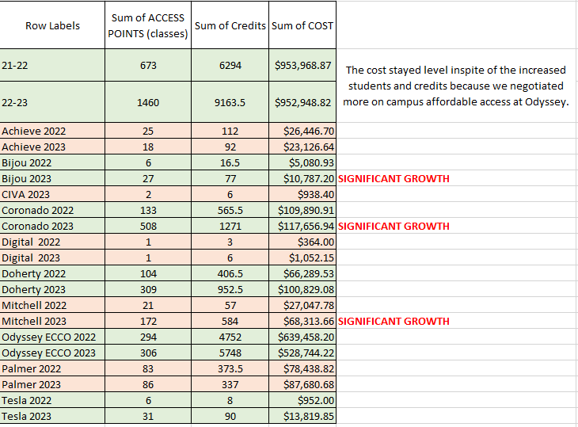
Postsecondary ACCESS GROWTH by School

Slide 7
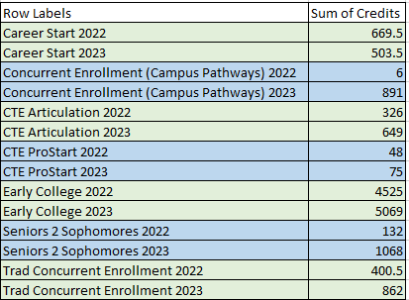
Postsecondary CREDIT GROWTH by PROGRAM

Slide 8
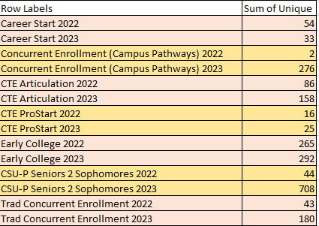
Postsecondary STUDENT GROWTH by PROGRAM

Slide 9
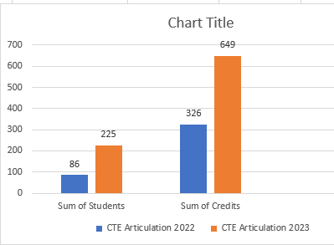
CTE ARTICULATED CREDIT GROWTH

Slide 10
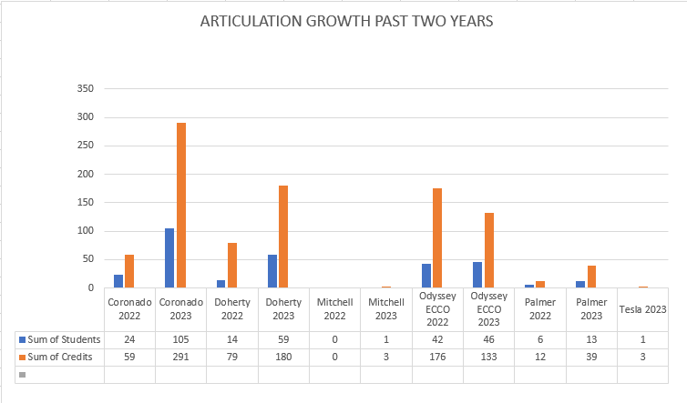
CTE ARTICULATED CREDIT GROWTH

Slide 11
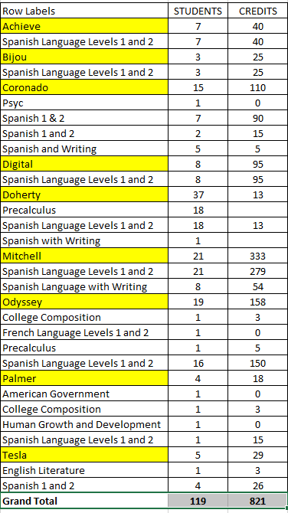
CLEP testing

Slide 12
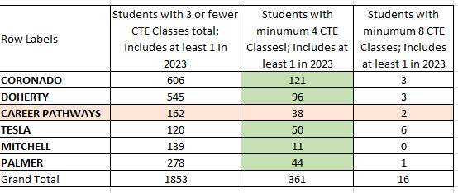
CTE HIGH SCHOOL PARTICIPATION

Slide 13
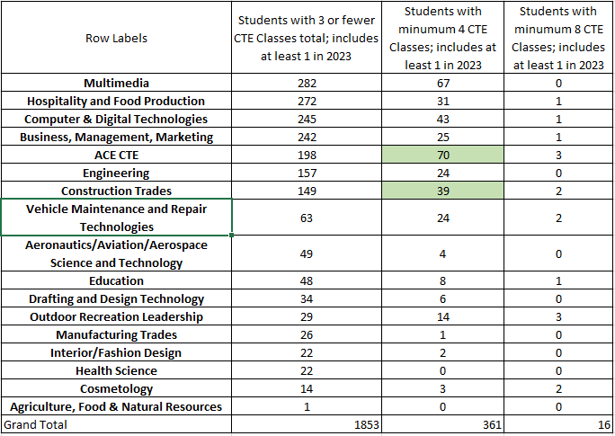
CTE HS PROGRAM PARTICIPATION

Slide 14
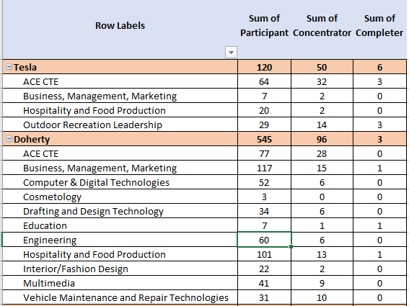
CTE HIGH SCHOOL PARTICIPATION BY PROGRAM

Slide 15
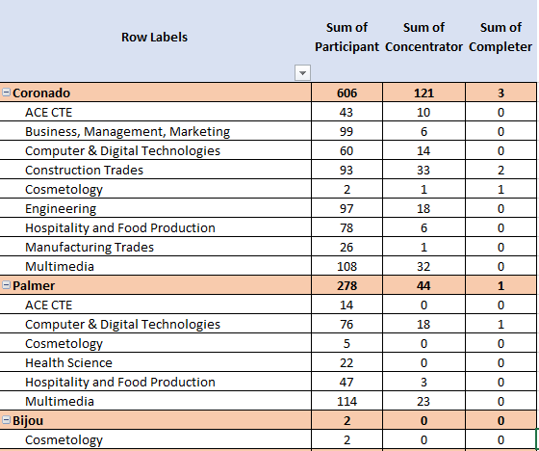
CTE HIGH SCHOOL PARTICIPATION BY PROGRAM

Slide 16
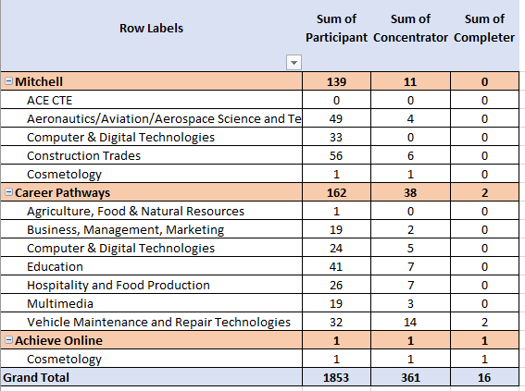
CTE HIGH SCHOOL PARTICIPATION BY PROGRAM

Slide 17
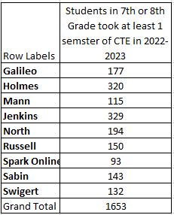
CTE MIDDLE SCHOOL PARTICIPATION

Slide 18
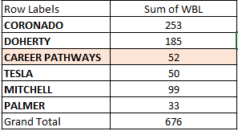
CTE REPORTABLE WORK-BASED LEARNING

Slide 19
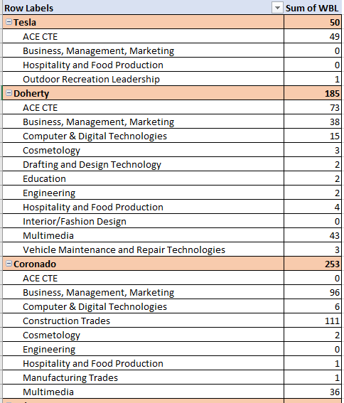
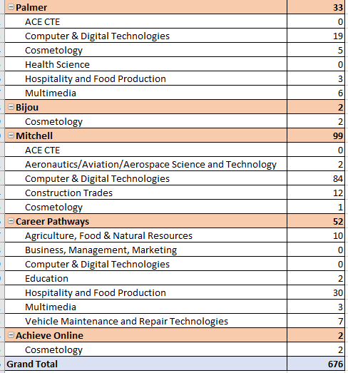
CTE REPORTABLE WORK-BASED LEARNING

Slide 20
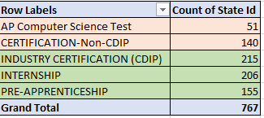
CTE CERTIFICATIONS & WORK-BASED LEARNING

Slide 21
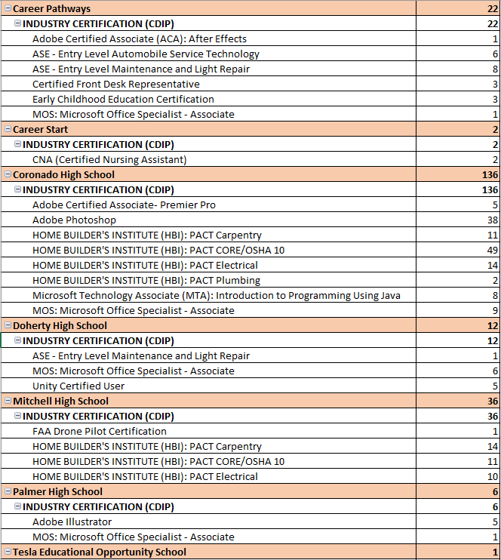
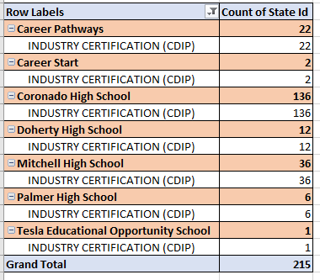

CDIP CERTIFICATIONS BY SCHOOL

Slide 22
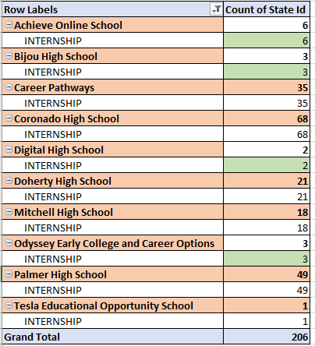
INTERNSHIPS BY SCHOOL

