Slide 1
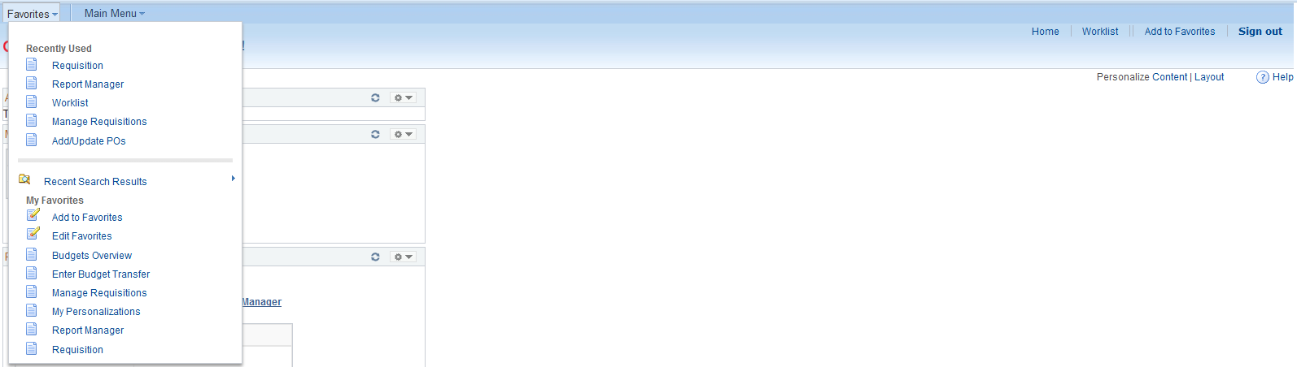
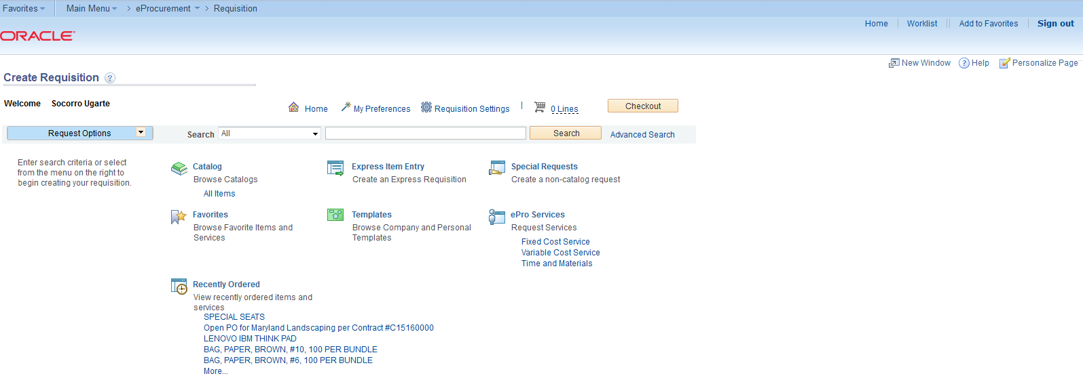
Store Requisition
DRAFT
1. From My Favorites, click on Requisition.
2. On Create Requisition screen, click on Express Item Entry.
1
2

Slide 2
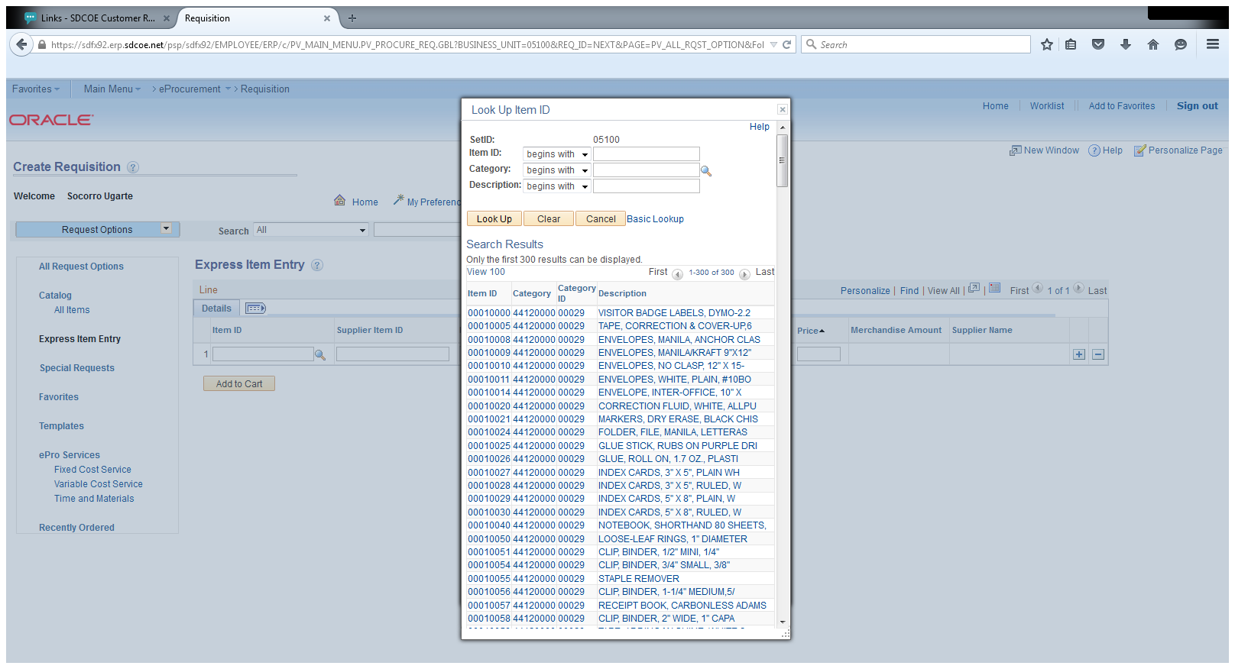
3. For store/warehouse items, click on lookup icon and choose Item ID.
Click on items/s you want to order from here.

Slide 3
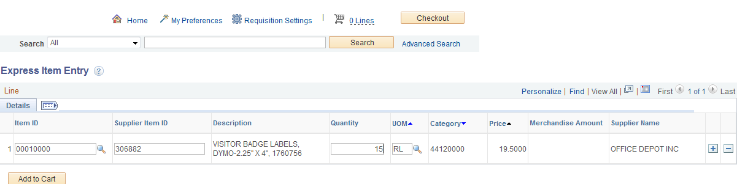
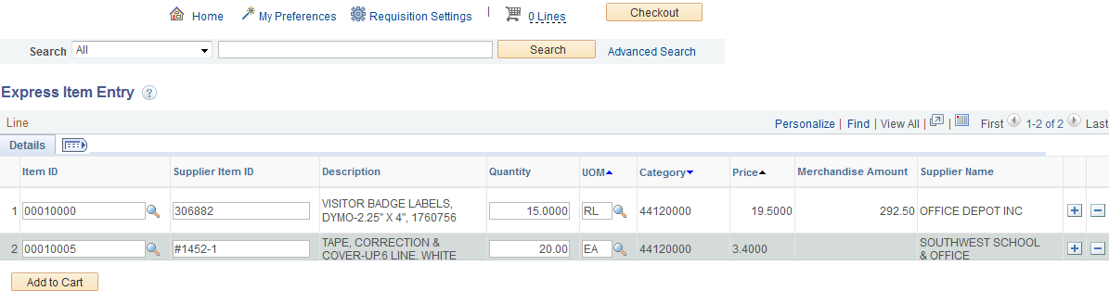
4. When you click on Item ID: Supplier Item ID, Description, UOM, Category, Price, & Supplier Name will be automatically filled.
5. Type in Quantity. If you need additional items, click on plus sign (+) and repeat steps 3 to 5 as needed.
6. Click Add to Cart.
7. Item on cart will indicate number of lines.
8. Click on Checkout.
4
7
5
8
Click here for
additional items
This will change to two(2)
6

Slide 4
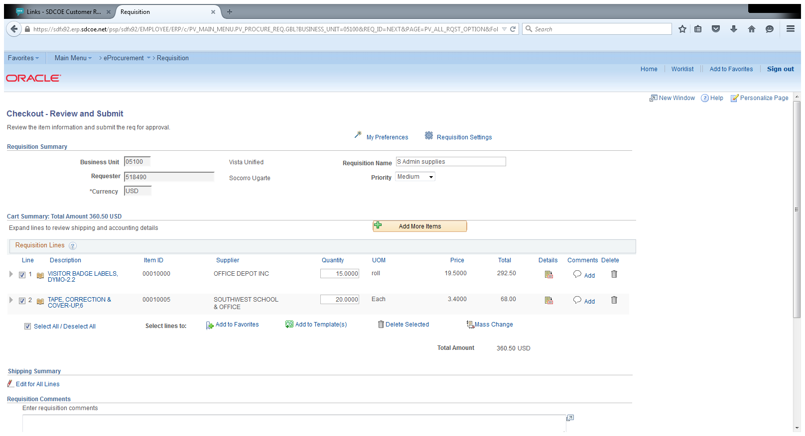
9. Enter Requisition Name. For stores, requisition name should start with SXXXXXXXX.
10. If you are using the same chartstring for multiple lines, click on Select All/Deselect All. (If not, click on line items and add chartstring individually.)
11. Click on Mass Change link.
9
9
9
11
10
11
11
10
10

Slide 5
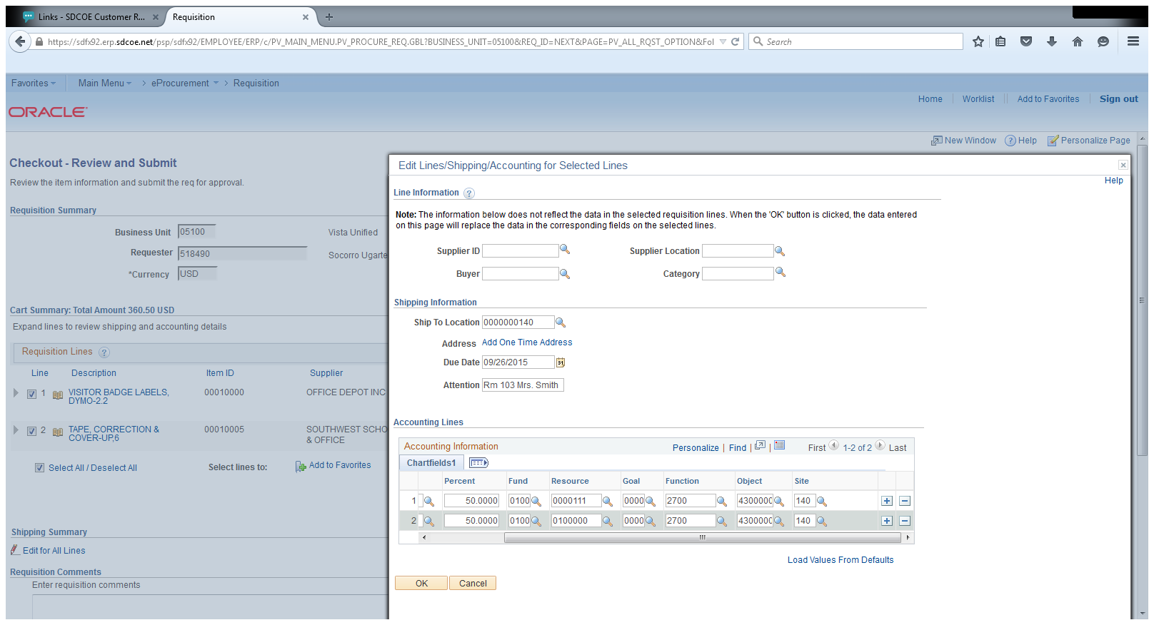
12. Enter Ship to Location , Due Date and Attention information.
13. Enter Percent and Chartstring. If using more than one (1) chartstring, indicate % to be charged to each account. Click on to add or delete lines as needed.
14. Click OK.
Will appear. Click OK.
For stores: No need to fill this out
12
13
14

Slide 6
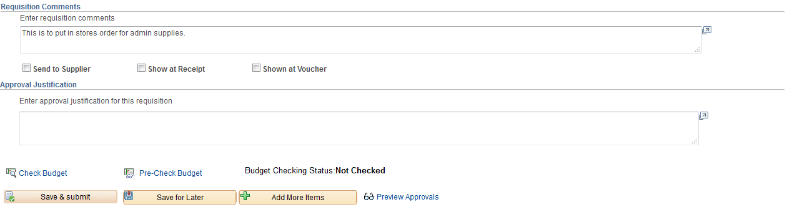
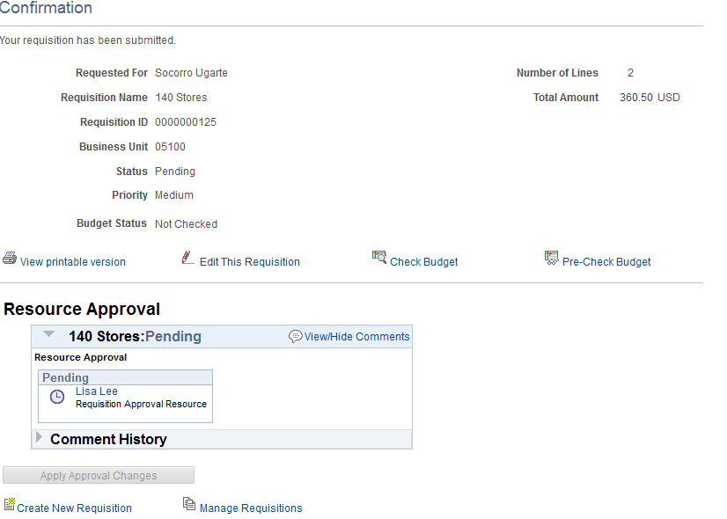
15. Type Requisition Comments and Approval Justification. Click Save and Submit.
16. System assigns Requisition ID. Screen shows workflow (Requisition is with Lisa Lee for resource approval.)
17. Click on Check Budget. Budget status should change to Valid.
15
Type justifications and notes here.
This will change to Valid after budget check (#17), and req will be pre-encumbered.
16
Pre-encumbrance will show here
17

