Slide 1
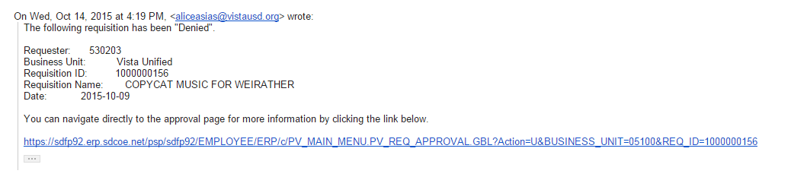
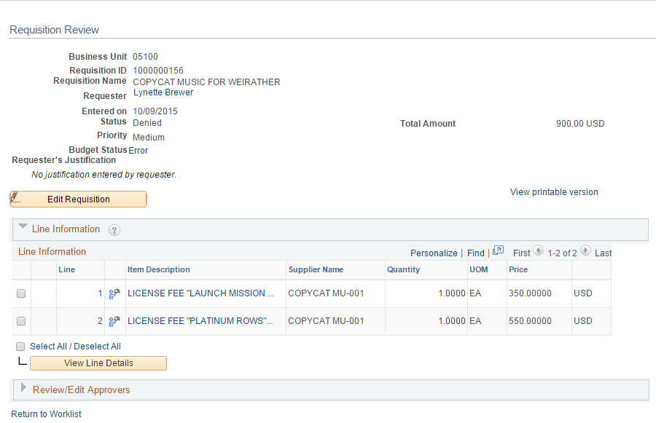
1. When your Budget transfer or Purchase requisition is denied, you will get e-mail notification. Click on link to open item that was denied. (This example is for a purchase requisition).
-You may also access denied requisitions by going to Manage Requisition screen and click on Search.
-You may also access denied budget transfer by going to Enter Budget Transfer, click Find an Existing Value tab and click Search.
2. Click on triangle before Review/Edit Approvers.
1
2

Slide 2
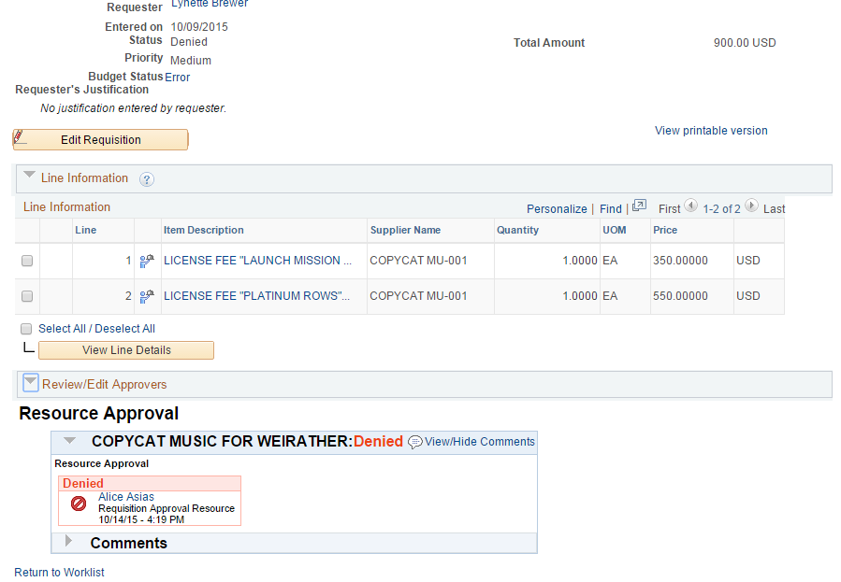
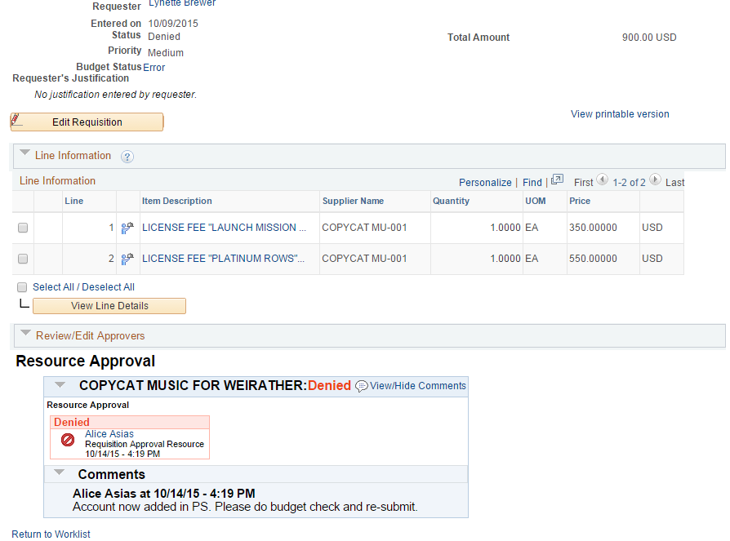
3. Click on triangle before Comments.
4. Comments box opens up – to show approver’s reason for denial.
3

