Slide 1
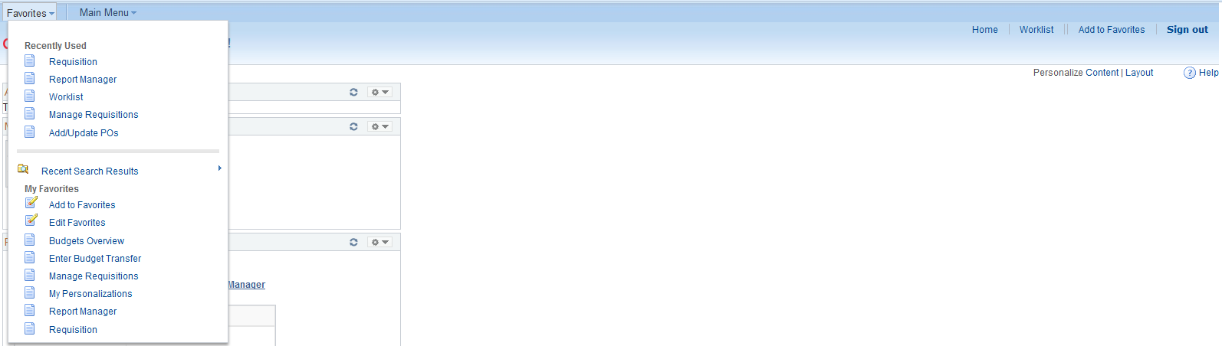
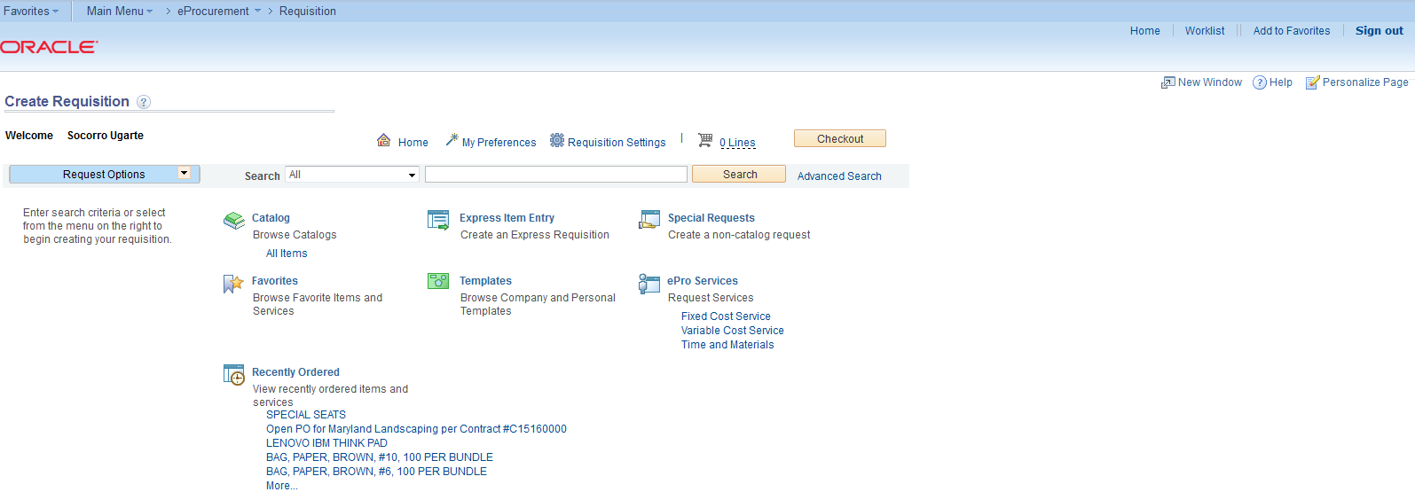
Amount Only PO
1. From My Favorites, click on Requisition.
2. On Create Requisition screen, click on Express Item Entry.
1
2

Slide 2
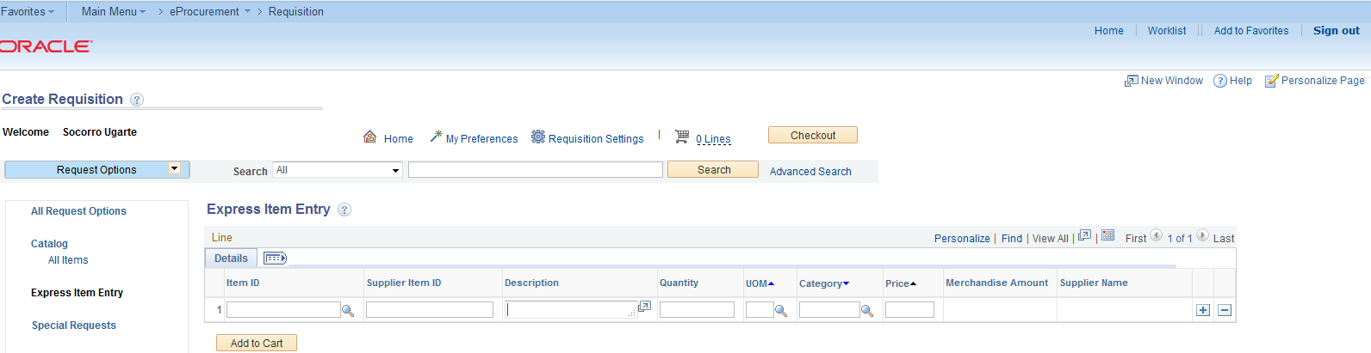
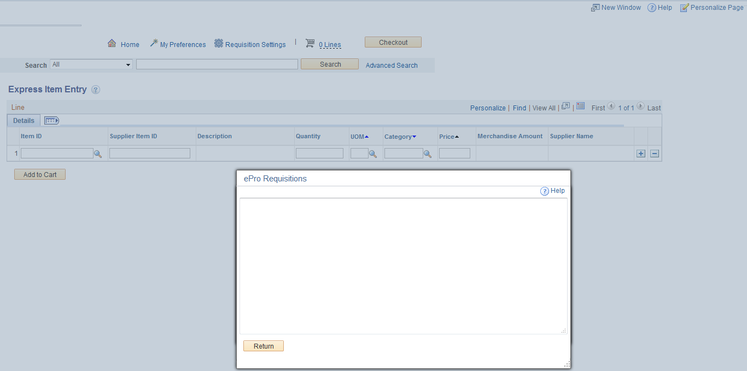
3. Click on to expand Description line and type up to 254 characters. Click Return.
For Stores Use Only
Click here to expand
3
Type up to 254 characters here, then click return.

Slide 3
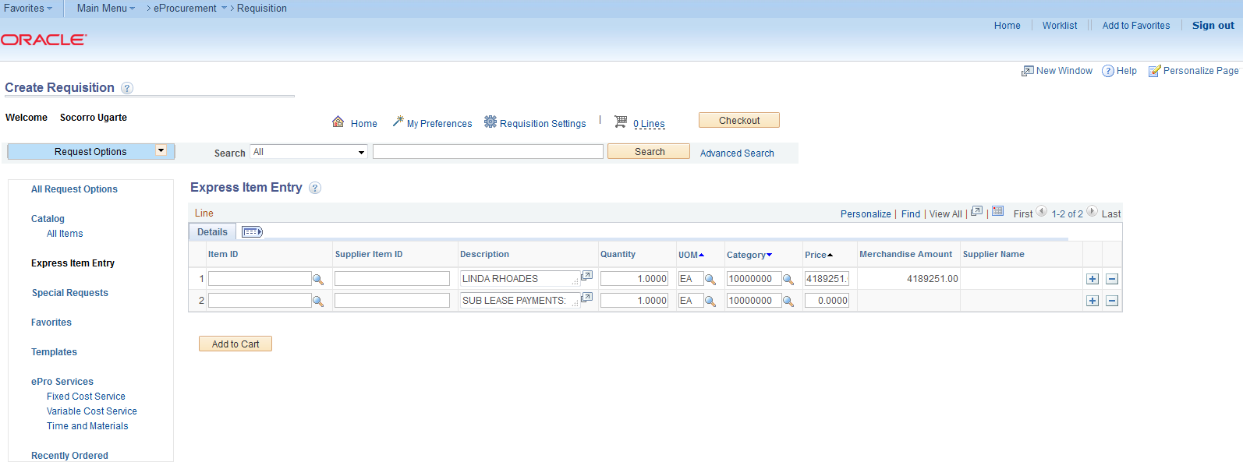
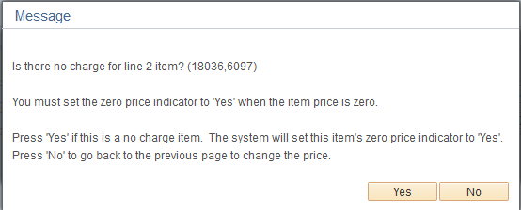
4. Fill out Quantity, UOM, Category and Price.
5. Use to add/delete lines as needed.
6. Click Add to Cart. Item on cart will indicate number of lines.
7. Click on Checkout.
This will change to 2
7
4
5
6
Additional line item added with zero amount to complete description that exceeds 254 characters. When message comes up, click Yes.

Slide 4
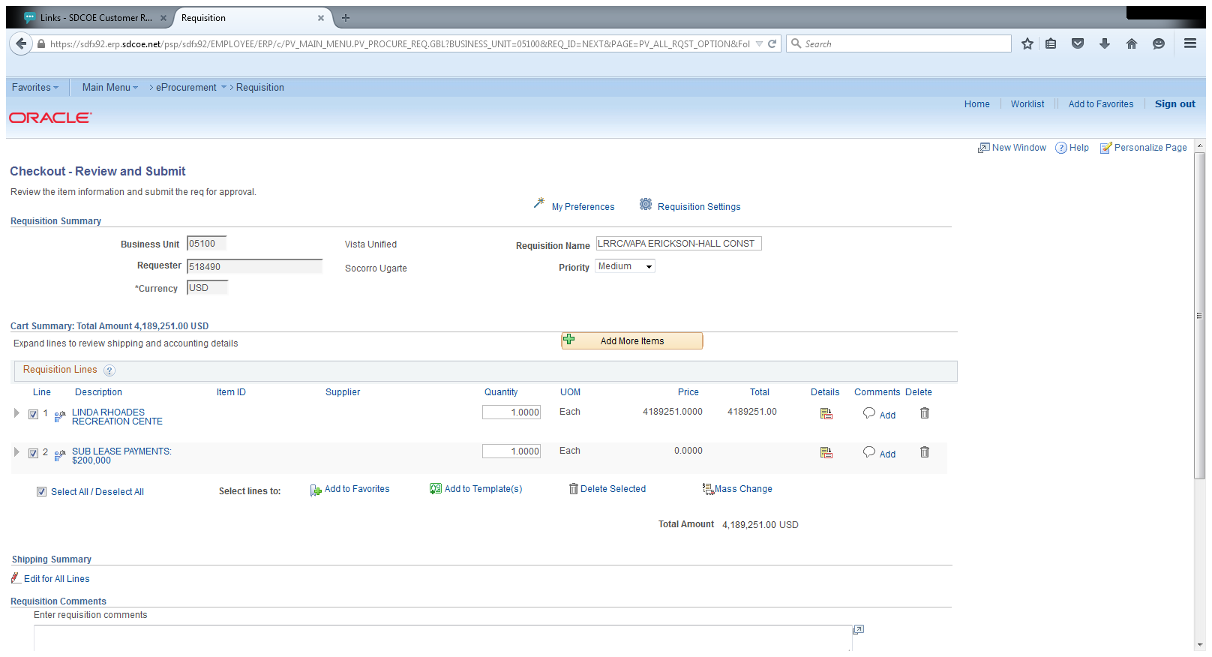
8. Enter Requisition Name and choose level of Priority.
9. If you are using the same chartstring for multiple lines, click on Select All/Deselect All. (If not, click on line item and add chartstring individually.
10. Click on Mass Change .
8
10
9

Slide 5
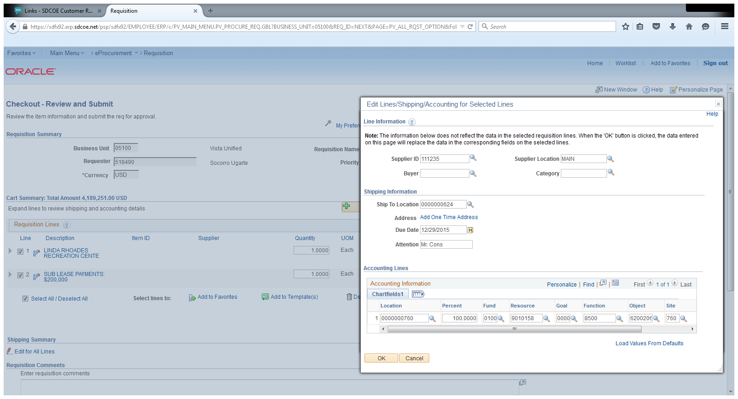
11. Enter Supplier ID, Ship To Location , Due Date and Attention. Ship to Location for services will be provided on training. No need to fill Buyer, Supplier Location and Category.
12. Enter Location, Percent and Chartstring. If using more than one (1) chartstring, indicate % to be charged to each account. Click on to add or delete lines as needed.
13. Click OK. On Distribution Change Options, click OK.
11
12
13

Slide 6
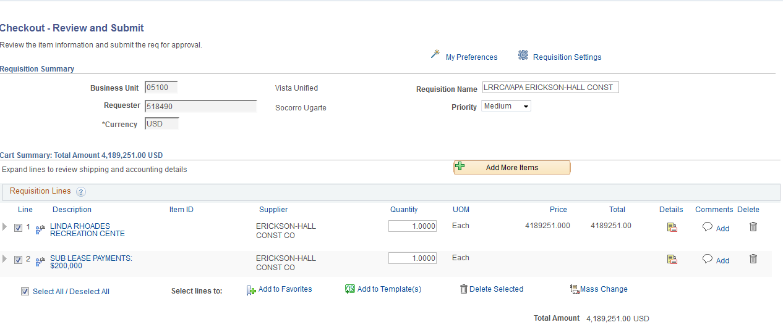
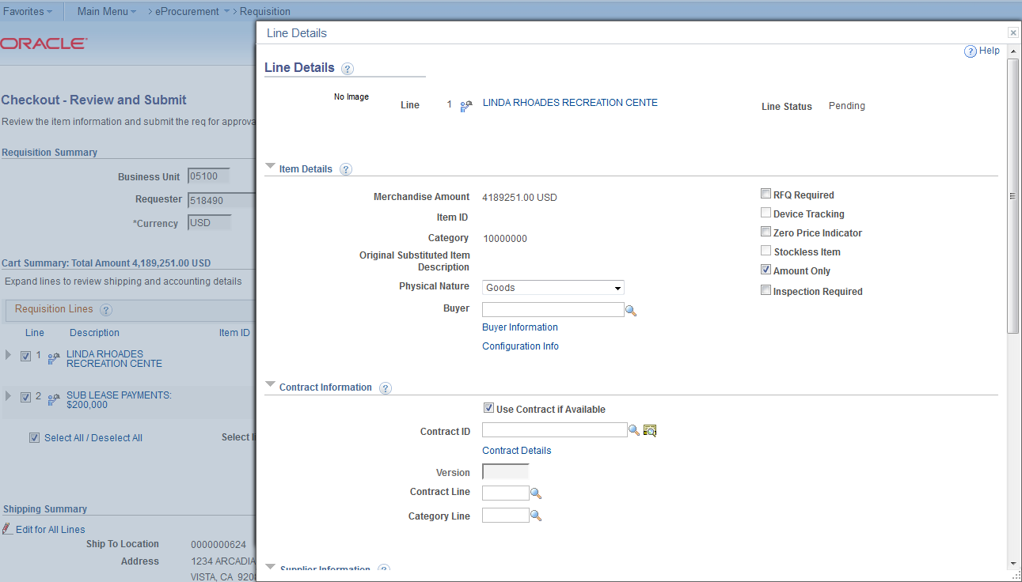
14. On Checkout - Review and Submit page, click on Details.
15. On Line Details, click on Amount Only. In the bottom of the page, click OK. Message shows up, click Yes. Note that the quantity field gets recessed (quantity set to 1 for amount only PO).
14
15

Slide 7
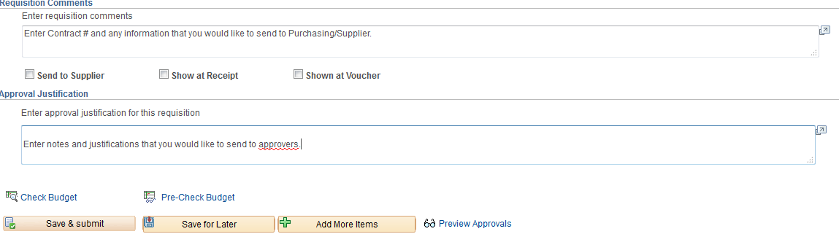
16. Type Requisition Comments and Approval Justification.
Double check amount. When submitted, the system does not allow price change on the requisition.
Click Save and Submit.
16

Slide 8
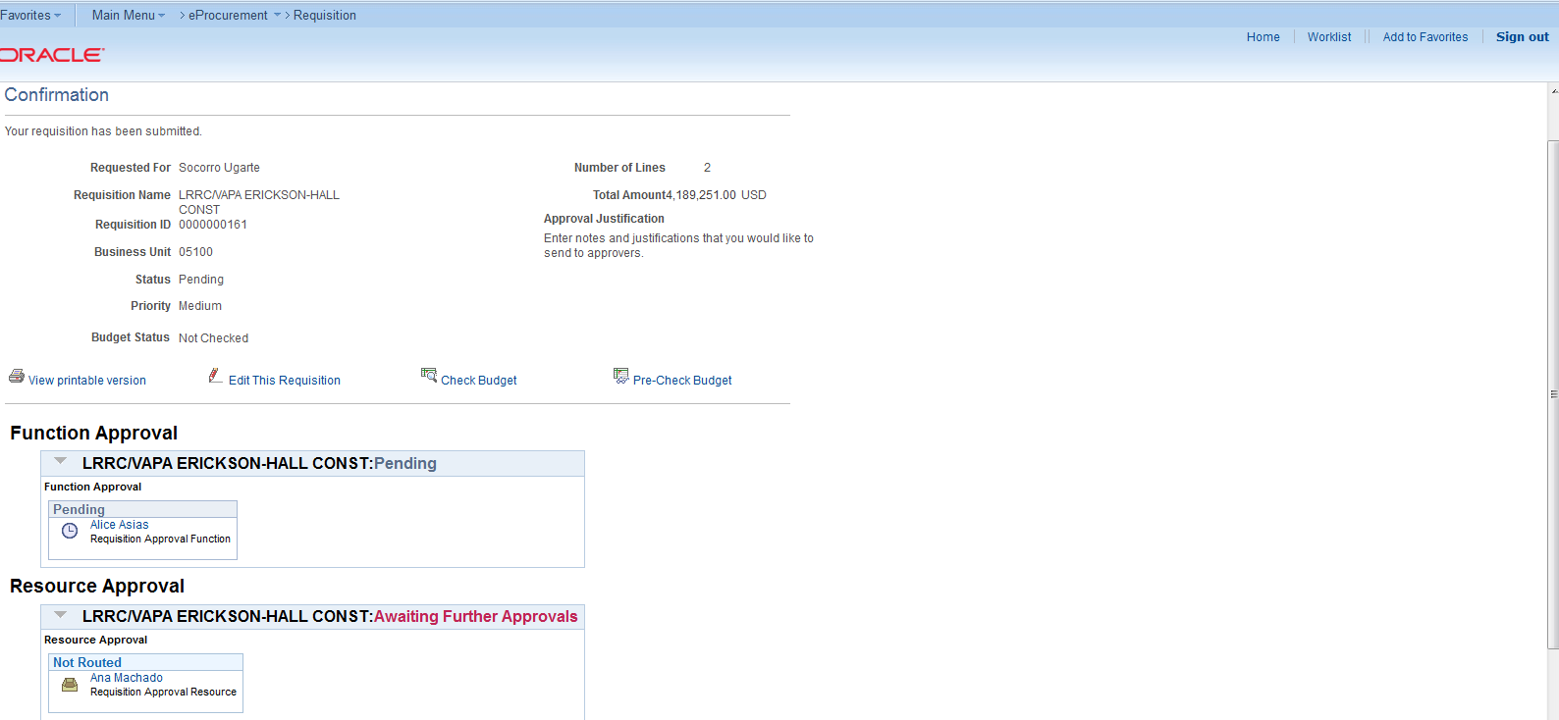
17. On Confirmation Page, system assigns Requisition ID. Budget Status: Not checked. Screen shows workflow.
18. Click on Check Budget. Budget status would change to Valid.
19. Pre-encumbrance will show under total amount.
Pre-encumbrance will show here.
17
18
This will change to Valid after budget check (#18).

