Slide 1
Title IX/Title VII Training
Sexual Harassment

Slide 2
Objectives- attendees should know and be able to
Define sexual harassment under the Final Rule 2020 regulations
  applications under Title VII - Sexual Harassment in the Workplace
Understand what constitutes sexual harassment
Discuss DCS grievance policy and process for reporting and/or filing a complaint

Slide 3
Historical Context for the
Title IX Final Regs 2020
Gebser Case
“actual knowledge”
Davis Case
“deliberate indifference”
New Regulations require a higher level of due process at the K-12 level

Slide 4
“Deliberate Indifference”
Having knowledge of incident but took no deliberate action to investigate, remedy, or prevent the incident – “clearly unreasonable in light of the circumstances”
Due Process procedures-
  “Civil rights issues demand more than the bare minimum.” ATIXA position
  Mandatory Reporter/Responsible Employee
  Actual Knowledge- formal complaint
Sharing of evidence- Disclosure responsibilities
  Both parties view all evidence and submit questions
  Law enforcement – schools are required to investigate even if law enforcement is investigating
  Investigators CANNOT be the decision maker.

Slide 5


HARASSMENT IN THE WORKPLACE
Harassment is a form of employment discrimination that violates Title VII of the Civil Rights Act of 1964, the Age Discrimination in Employment Act of 1967, (ADEA), and the Americans with Disabilities Act of 1990, (ADA).
From the U. S. Equal Employment Opportunity Commission website https://www1.eeoc.gov//laws/types/harassment.cfm?renderforprint=1
Notes:
From the U. S. Equal Employment Opportunity Commission website https://www1.eeoc.gov//laws/types/harassment.cfm?renderforprint=1

Slide 6
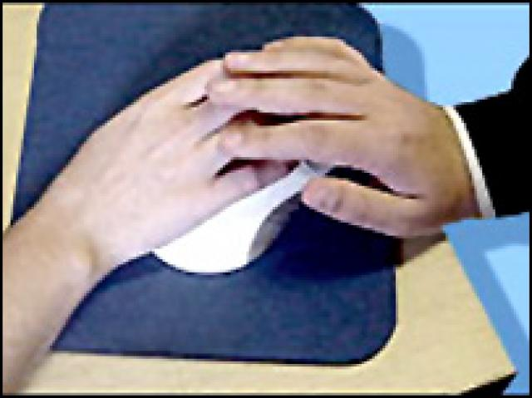

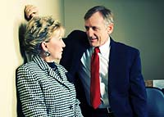

SEXUAL HARASSMENT IS UNWELCOMED SEXUAL CONDUCT
2020 Final Rule- any of the following conduct on the basis of sex constitutes sexual harassment:
A school employee conditioning an educational benefit or service upon a person’s participation in unwelcome sexual conduct (often called “quid pro quo” harassment
Unwelcome conduct determined by a reasonable person to be so severe, pervasive, and objectively offensive that it effectively denies a person equal access to the school’s education program or activity
Sexual assault, dating violence, domestic violence, or stalking (as those offenses are defined in the Clery Act, 20 U.S.C. 1092, and the Violence Against Women Act, 34 U.S.C. 12291(a)).
This Photo by Unknown Author is licensed under CC BY-NC
This Photo by Unknown Author is licensed under CC BY-ND
This Photo by Unknown Author is licensed under CC BY-ND
This Photo by Unknown Author is licensed under CC BY-ND

Slide 7

HARASSMENT
Unlawful when
Enduring the offensive conduct becomes a condition of continued employment
The conduct is severe and pervasive enough to create a work environment that a reasonable person would consider intimidating, hostile, or abusive
Anti-discrimination laws also prohibit harassment against individuals in retaliation for filing a discrimination charge, testifying, or participating in any way in an investigation, proceeding, or lawsuit under these laws, or opposing employment practices that they reasonably believe discriminate against individuals, in violation of these laws.

Slide 8
OFFENSIVE CONDUCT
May include but is not limited to
  Offensive jokes
  Slurs
  Epithets or name calling
  Physical assaults or threats
  Intimidation
  Ridicule or mockery
  Insults or put-downs
  Offensive objects or pictures
  Interference with work performance

Slide 9

SEXUAL HARASSMENT CAN TAKE MANY FORMS
Invading personal space
Sexting
Caressing
Personal remarks
Graffiti and notes of a sexual nature
Mocking
Rude gestures
Unwelcome touching
Sexual violence
Leering
Dirty Jokes
Online Rumors
Requests for sexual favors
Whistling
Innuendo
Staring
Name calling

Slide 10
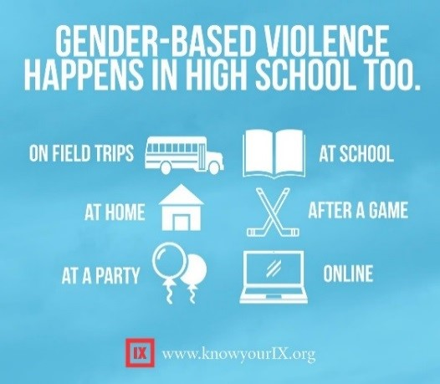


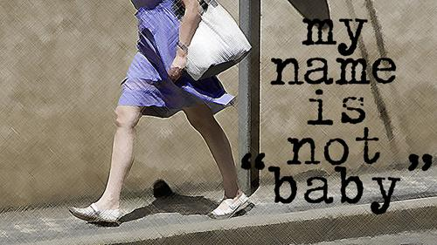
GENDER BASED HARASSMENT
Title IX also covers unwelcome conduct based on an individual’s actual or perceived sex, including harassment based on gender identity or nonconformity with sex stereotypes.

Slide 11
WHO CAN BE A VICTIM OR HARASSER-
The harasser can be
A supervisor or supervisor in another area
An agent of the employer
A co-worker
A non-employee
The victim does not have to be the person harassed, but can be anyone affected by the offensive conduct.
Both victim and the harasser can be either a woman or a man, and the victim and harasser can be the same sex.

Slide 12
TITLE IX AND CASE LAW REQUIRE:
STOP -- Bring an end to the discriminatory conduct.
PREVENT -- Take steps reasonably calculated to prevent the future reoccurrence of the discriminatory conduct.
REMEDY -- Restore the reporting party as best you can to their pre deprivation status.

Slide 13
PREVENTION
Clearly communicate that unwelcome harassing conduct will not be tolerated
See Grievance procedures Dothan City Schools website – Operations and Human Resource tab
Provide anti-harassment training to managers and employees
Take immediate and appropriate action when an employee complains
Strive to create an environment in which employees feel free to raise concerns and are confident that those concerns will be addressed
Employees are encouraged to inform the harasser directly that the conduct is unwelcome and must stop and should report harassment to management at an early stage to prevent its escalation.

Slide 14
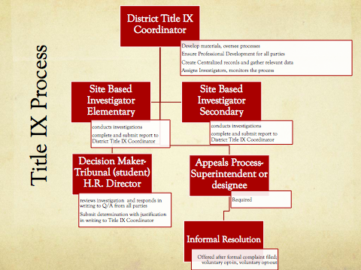

Slide 15
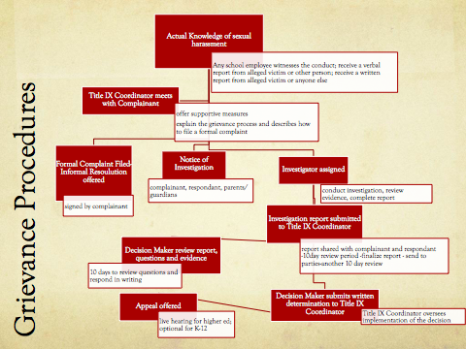

Slide 16
Investigations -Title IX 2020 Final Regulations
Formal complaint filed – Reviewed by Title IX Coordinator – Investigator Assigned
Written notice of allegation – provided to both parties
  Schools must notify parties of additional allegations that may arise during the investigation
  Must include information regarding the right to an advisor of their choice, who may be an attorney
  Must include information noted in District policy/code of conduct regarding false statements
Burden of fact gathering is on the side of the school, not the parties
Parties can gather and submit evidence and cannot be bound by “gag orders”
Parties must be given equal opportunity to present relevant evidence
From OCR webinar: Both parties guaranteed the right to advance notice, in writing, whenever they are invited or expected to participate in an interview, meeting, or hearing

Slide 17
EMPLOYER LIABILITY FOR HARASSMENT - Title VII
If the harassment results in a hostile work environment, the employer should provide and show proof of training i.e.
  It reasonably tried to prevent and promptly correct the harassing behavior
  The employee unreasonably failed to take advantage of any preventive or corrective opportunities provided by the employer.
An employer does have jurisdiction over non-supervisory employees or non-employees on the premises.
  These individuals are expected to follow all applicable district, state, and federal policies.

Slide 18
RETALIATION
Retaliation against an individual
for an allegation,
for supporting a reporting party, or
for assisting in providing information relevant to an allegation
is a serious violation of Dothan City School Board policy as well as Title IX and Title VII laws.

Slide 19
DCS BOARD POLICY
5.14 Sexual Harassment
The Board strictly prohibits unlawful discrimination in all of its programs, offices, departments and facilities.
Sexual harassment, as defined by law, is a form of unlawful discrimination and will not be tolerated from employees or other persons associated with the Board.

Slide 20
EXAMPLES OF PROHIBITED CONDUCT – DCS POLICY
5.14.2 Examples of Prohibited Conduct – The following are examples of conduct that may constitute sexual harassment, depending on individual circumstances:
  Verbal harassment or abuse of a sexual nature, including graphic or derogatory comments, the display of sexually suggestive objects or pictures, and sexual propositions;
  Repeated unwelcome solicitation of sexual activity or sexual contact;
  Unwelcome, inappropriate sexual touching;
  Demands for sexual favors accompanied by implied or overt promises of preferential treatment or threats with regard to an individual’s employment status.

Slide 21
REMINDERS –
DCS WORK ENVIRONMENT EXPECTATIONS
Strive
Strive to provide an environment of mutual respect in a positive and safe workplace.
Strive
Strive to create an environment in which employees feel free to raise concerns and are confident that those concerns will be addressed.
Show
Show appreciation for each other as we respect different personality types.
Have
Have a positive work-life balance i.e. prompt in attendance, work diligently on assigned tasks as part of a team for the overall good of the school system.
Seek
Seek self improvement through professional development/trainings particularly in a relaxed and productive atmosphere
Have
Have open and honest communication through cooperation, support, and empowerment
Be
Be compassionate, understanding, and a sense of humor that is uplifting.

Slide 22
References
U.S. Equal Employment Opportunity Commission Sexual Harassment | US Equal Employment Opportunity Commission
www.ed.gov/OCR
Association of Title IX Administrators (ATIXA)
https://atixa.org
Dothan City Schools Policy Manual
https://dothan.k12.al.us

Slide 23
Questions?
dewright@dothan.k12.al.us
334-726-2005 cell
Thank you!

