Slide 1
The Importance of Compliments
Mrs. Angerson
“There is more hunger for love and appreciation in this world than for bread.” -Mother Teresa

Slide 2
What is a compliment?
a polite expression of praise or admiration.
Some examples of meaningful compliments are:
I would like to compliment you, ____________ because you are such a friendly person. You smile at everyone you see and you make people happy.
I would like to compliment you, ____________ because you are a great soccer player. You make a lot of goals for your team! I wish I could play like that!
I would like to compliment you, ____________ because you are a good friend. You sit with me lunch and you always include me in your games at recess.

Slide 3
How do compliments affect others?
They motivate
They boost self-esteem
They spread joy and love
They inspire positivity
They make others feel good

Slide 4
The Power of Compliments
https://www.youtube.com/watch?v=-OBgdoAmuwI

Slide 5
Why is it Important to give Compliments?
Research shows that “giving compliments is actually a form of leadership and influence.”
If you give sincere compliments, then you will be perceived as a positive person.
People love to be around positive people!
Others will be inspired to be like you and follow your example!

Slide 6
Now it’s Your Turn…
You will be given the name of someone in your class. You will think about that person, (anything and everything you know about that person), and write him or her a meaningful compliment. Be specific!
Mackay Compliment
I would like to compliment _________________________________ because
____________________________________________________________________________
____________________________________________________________________________
____________________________________________________________________________
____________________________________________________________________________
____________________________________________________________________________
Sincerely,
_____________________
Date:______________________

Slide 7
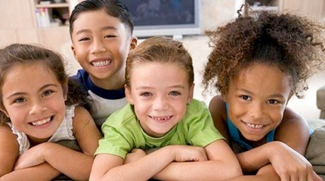
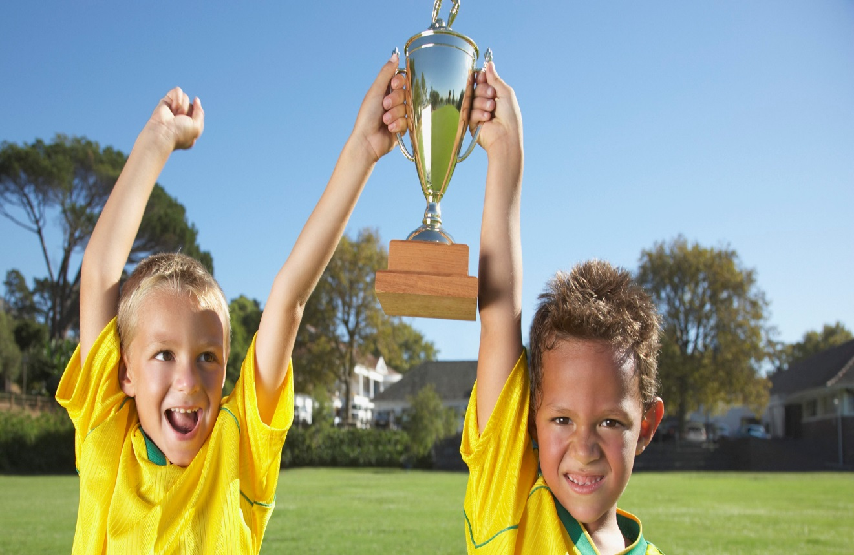
How Did it Feel?
What did it feel like to GIVE a compliment?
What did it feel like to GET a compliment?

Slide 8
The Best Thing About Compliments is:
THEY ARE FREE!!!!!

