Slide 1
The Importance of Compliments
Mrs. Angerson
“There is more hunger for love and appreciation in this world than for bread.” -Mother Teresa

Slide 2
What is a compliment?
a polite expression of praise or admiration.
Some examples of meaningful compliments are:
______, I would like to compliment you for being such a positive person! Every time I see you, you are smiling! You say hi to each person you pass in the hall. It’s so nice how you do that! You have a knack for making people feel special.
______, I would like to compliment you for being a good sport. I know what a competitive athlete you are, but at recess I notice how you always include everybody to play never leaving anyone out. You often encourage your classmates and teammates by saying “Good Job” and “Nice try” even if you’re team didn’t win.
______, I would like to compliment you for being a loyal friend. I know that I can tell you anything and that you will never judge me. You are always there for me and it makes me feel so lucky to have you in my life.

Slide 3
How do compliments affect others?
They motivate
They boost self-esteem
They spread joy and love
They inspire positivity
They make others feel good

Slide 4
The Power of Compliments
https://www.youtube.com/watch?v=-OBgdoAmuwI

Slide 5
Why is it Important to give Compliments?
Research shows that “giving compliments is actually a form of leadership and influence.”
If you give sincere compliments, then you will be perceived as a positive person.
People love to be around positive people!
Others will be inspired to be like you and follow your example!

Slide 6
Now it’s Your Turn…
You will be given the name of someone in your class. You will think about that person, (anything and everything you know about that person), and write him or her a meaningful compliment. Be specific!
Mackay Compliment
I would like to compliment _________________________________ because
____________________________________________________________________________
____________________________________________________________________________
____________________________________________________________________________
____________________________________________________________________________
____________________________________________________________________________
Sincerely,
_____________________
Date:______________________

Slide 7
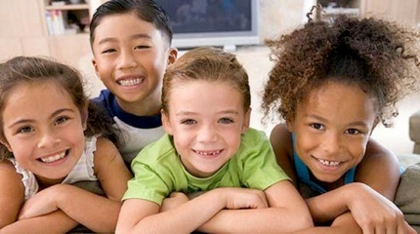
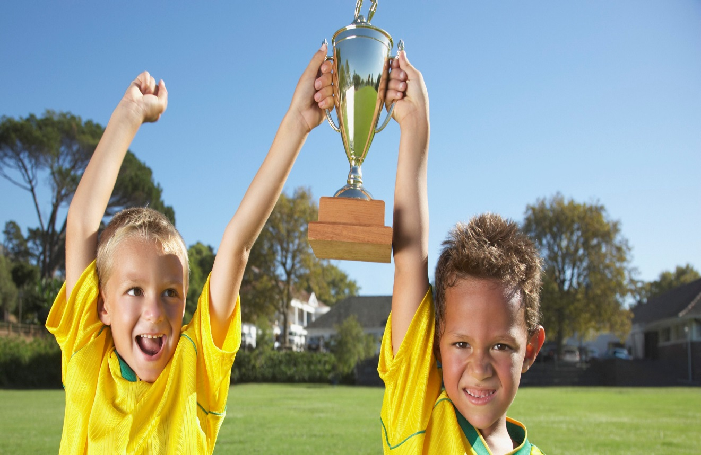
How Did it Feel?
What did it feel like to GIVE a compliment?
What did it feel like to GET a compliment?

Slide 8
The Best Thing About Compliments is:
THEY ARE FREE!!!!!

