Slide 1

Filling a Bucket
Mrs. Angerson

Slide 2
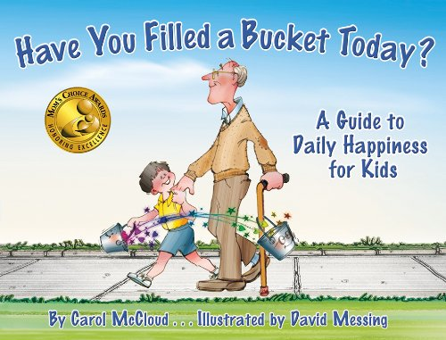
Learning how to fill a bucket
Let’s read the story!

Slide 3
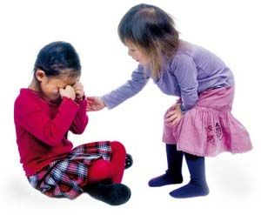
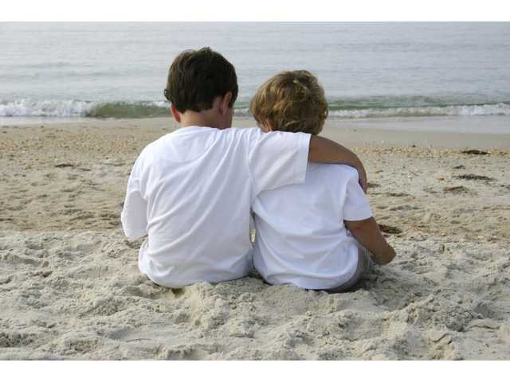
Why is it important to be nice?
When you say nice things to people and when you do nice things for people you are showing them that you care about them.
Are you okay?
How can I help you feel better?

Slide 4
What happens when we are nice to others?
It feels good!
It boosts self-esteem!
It makes people happy!
It makes people feel special!
It fills people’s buckets!

Slide 5
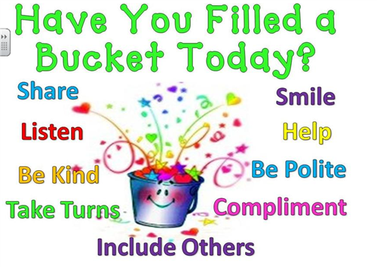
Ways we can be bucket fillers

Slide 6


