Slide 1

Filling a Bucket
Mrs. Angerson

Slide 2

Learning how to fill a bucket
Let’s read the story!
http://www.youtube.com/watch?v=A5R6-2m_qHk

Slide 3
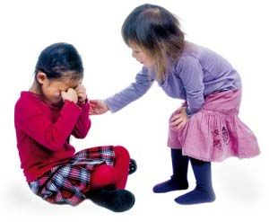
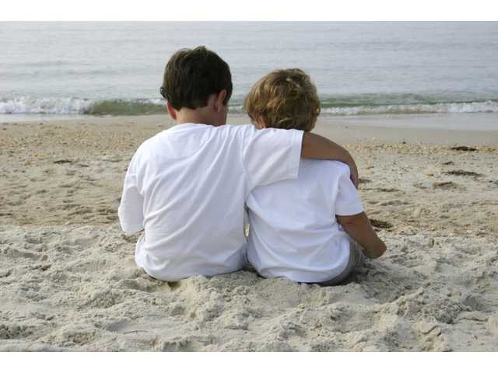
Why is it important to be nice?
When you say nice things to people and when you do nice things for people you are showing them that you care about them.
Are you okay?
How can I help you feel better?

Slide 4
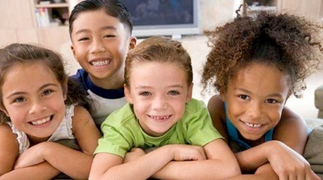
What happens when we are nice to others?
It feels good!
It boosts self-esteem!
It makes people happy!
It makes people feel special!
It fills people’s buckets!

Slide 5
Compliments are nice things we say to others
Some examples of meaningful compliments are:
I would like to compliment you, Charlie, because you are such a friendly person and you are always smiling.
I would like to compliment you, Sally, because you are a great soccer player. You make a lot of goals for your team!
I would like to compliment you, Annie, because you are such a good friend. You always play with me at recess.

Slide 6
Let’s fill someone’s bucket!
Mackay Compliment
I would like to compliment ________________________________________________ because ________________________________________________________________________________________________________________________________________________________________
________________________________________________________________________________________________________________________________________________________________ ________________________________________________________________________________
Sincerely,
                ____________________________
Date:_______________________

Slide 7
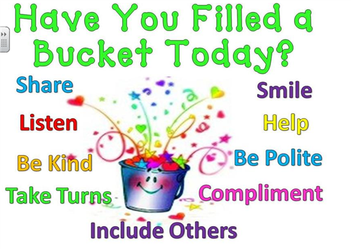
Ways we can be bucket fillers

Slide 8
