Slide 1

Sumner High School Project Review Task Force
Public Meeting
Superintendent: Laurie Dent, Ph.D.
Facilitator: Penny Mabie, EnviroIssues
Hainline: Matt Guilanians, Chuck Hartung
May 28 and 29, 2019

Slide 2

WELCOME!
We’re glad you’re here!
May 28 and 29, 2019

Slide 3

Sumner High School Est. 1891
Creating
Our
Legacy

Slide 4
2016 Bond Projects
Feb. 2016 voters passed a $145.6 million bond
Nine school projects, including Sumner High School
Eight are underway or completed
Let’s take a look at our progress!
May 28 and 29, 2019

Slide 5
Project | Information | Completed
Tehaleh Heights Elementary | New school – 9th elementary | Completed Sept 2018
Bonney Lake High School | New covered seating | Completed Aug 2018
Performing Arts Center | New 550-seat facility @ BLHS | Est. completion Summer 2019
Emerald Hills Elementary | Replacement school | Opens September 3, 2019
Sumner Early Learning Center | New building for Valley P-K students | Opens September 3, 2019
Sumner MS Track & Field | New synthetic track & field | Completed Sept 2018
Lakeridge MS Track & Field | New synthetic track and field | Completed Winter 2018
Mountain View MS Classroom Expansion Track & Field | Classroom Addition and Track/Field Project in planning phase | Classroom Completion TBD Track and Field Anticipated Opening Fall 2020
May 28 and 29, 2019

Slide 6
Sumner High School Project
2016 Bond goals include:
  Additional classrooms New Commons/Cafeteria
  New Library (Learning Resource Center) New Restrooms
  Additional gym seating Technology/security improvements
As bid design– approx. $14 million over budget
  Board rejected only bid received
Board directed Superintendent to form a Task Force to review,
study and evaluate options, for modernization and expansion of
Sumner High School in light of state and local circumstances
May 28 and 29, 2019

Slide 7
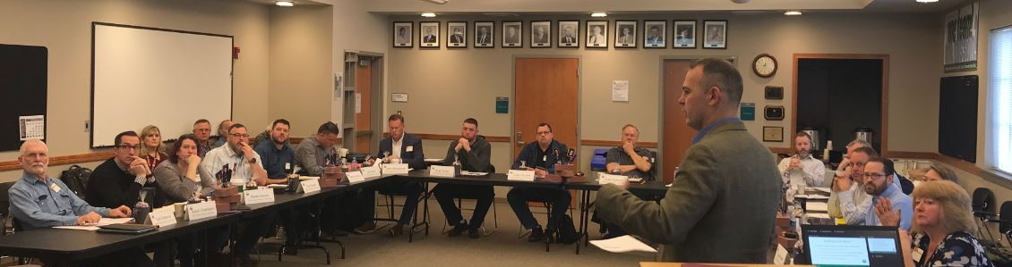
Task Force Members
Met four times over two months, and reviewed dozens of concepts
Adam Chambers
Tyson Cornett
Kyle Hardtke
Karen Harris
Rick Hendricks
Pete Hochstatter
Matthew Kastberg
Barbara Kiliz
Kassie Meath
Scott Nall
Deb Norris
Jason Olson
Tom Osborne
Dana Powers
Troy Powers
Brad Sayre
Seth Sherwood
Paul Smith
Grant Sulham
Ryan Turley
May 28 and 29, 2019

Slide 8
Current Circumstances
Current state and local circumstances considered, include:
  Overheated construction environment
  City parking and regulatory requirements
  Complexity and associated expense of demolition and remodeling or expanding existing structures
  Previously unanticipated impacts to utilities and building systems
  District acquired several properties adjacent to the Sumner
  High School campus
May 28 and 29, 2019

Slide 9
Two-Phased Approach
  Initial Phase Approach (Build now with 2016 Bond Proceeds)
    Build new, priority, core facilities (2016 Bond goals)
    Retain most or all of existing buildings
    Limit remodeling
    Initial Phase Elements
    New Classrooms
    New Commons / Cafeteria
    New Kitchen
    New Library (LRC)
    Improved Circulation
    Restrooms/Security/Technology
May 28 and 29, 2019

Slide 10
Two-Phased Approach
  Master Plan Approach
    Complete new facilities buildout
    Demolish remainder of existing building
    Complete parking and site work
    Master Plan Elements
    Additional classrooms
    CTE and FFA
    Arts, Music and Drama
    Athletic Facilities
    Administration and Student Services
    Support Services
May 28 and 29, 2019

Slide 11
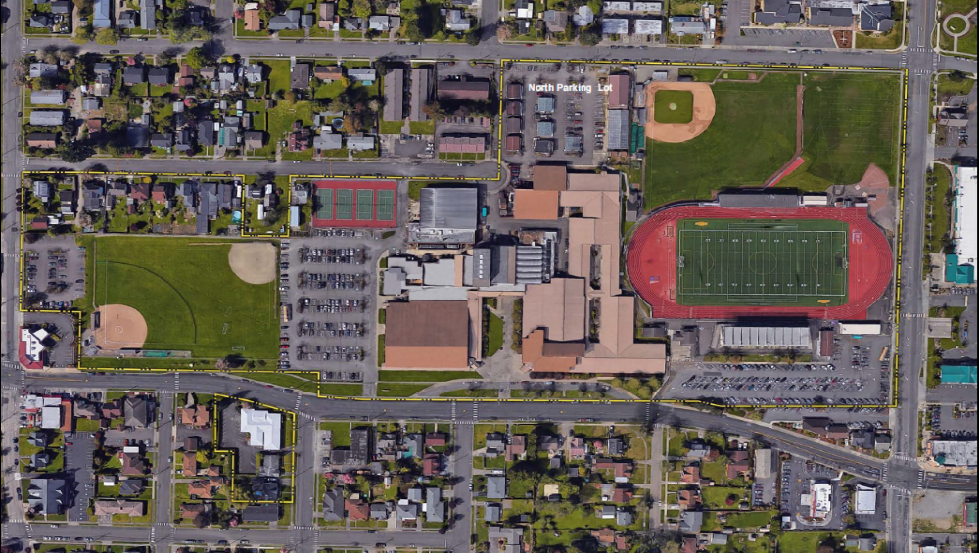
Existing Site
11

Slide 12
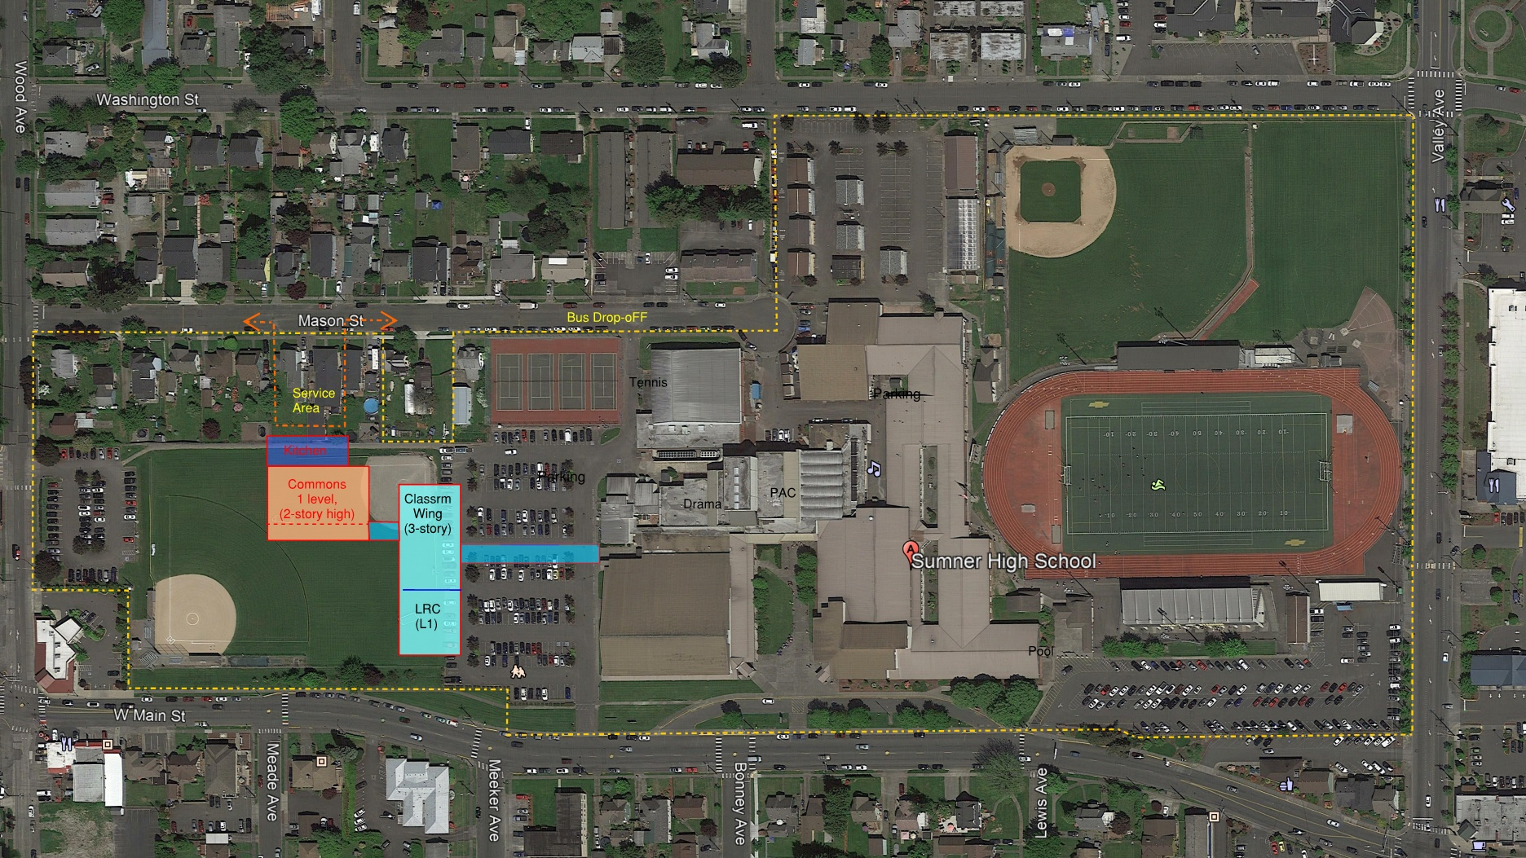

Initial Phase Concept
Initial Phase Concept
May 28 and 29, 2019
12

Slide 13
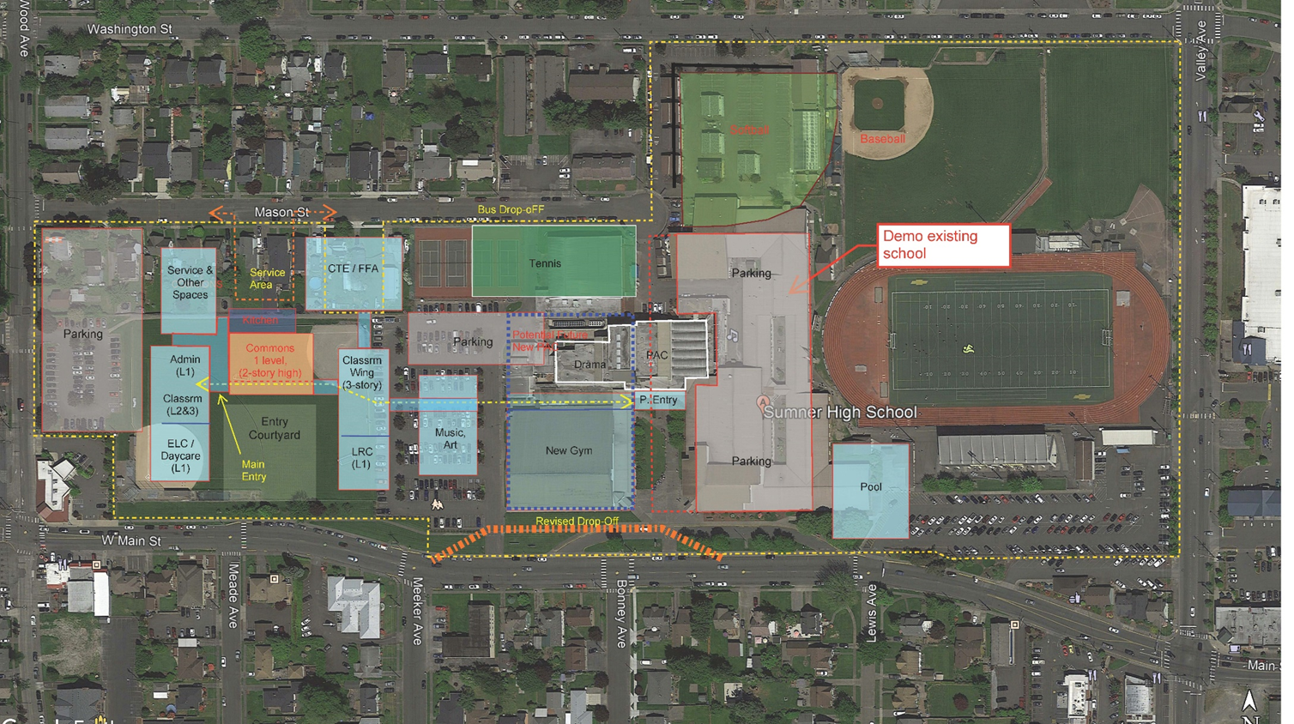
Initial Phase Concept
Initial Phase Concept
Master Plan Concept
May 28 and 29, 2019
13

Slide 14
Recommendations Assumptions
Configuration of buildings in Initial Phase and full build-out under a Master Plan could, and will, likely change during schematic design phase, arising from:
Program considerations ADA access requirements Parking and site development requirements State match funding | Physical constraints Building code requirements Remaining parcel on Mason St. in negotiations for acquisition Bond planning
May 28 and 29, 2019

Slide 15

Task Force Recommendations
Building new construction to the west on campus
Construct Initial Phase facilities westerly
Adopt a Master Plan for future build-out
Minimize remodeling to extent reasonably possible
May 28 and 29, 2019

Slide 16
Task Force Recommendations
Build core facilities in Initial Phase (2016 Bond goals)*
  New classrooms (target 16 – 20)
  New commons/cafeteria
  New kitchen
  New library (Learning Resource Center)
  Improved circulation
  *Facilities will include restrooms/security features/technology
Request bond funding for future build-out of Master Plan as soon as reasonably possible
May 28 and 29, 2019

Slide 17
Next Steps
              Provide input on the recommendations through a survey (located at the comment table or online)
              Superintendent will present her recommendation, informed by the Task Force’s recommendations and a summary of public input, to the School Board on June 18, 2019
              School Board will adopt, or modify the Superintendent’s recommendation in light of current state and local circumstances
              Next steps will be identified to implement the School Board’s action
              to modernize and expand Sumner High School as soon as reasonably
              possible
May 28 and 29, 2019

Slide 18
QUESTIONS?
May 28 and 29, 2019

