Slide 1

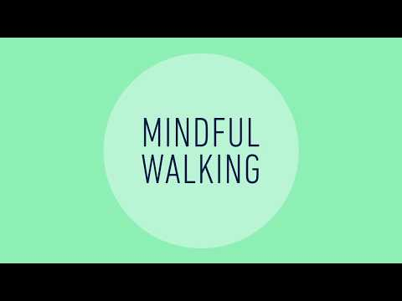
Mindful Walking
Choose one of these videos about taking a “Mindful Walk”.
(You can watch a little bit of each and see which one you like - or try both!)
Then, try a Mindful Walk yourself!
It can be done indoors or outdoors.
You can use this worksheet as a guide: Color/Feelings Walk
Enjoy!

