Slide 1
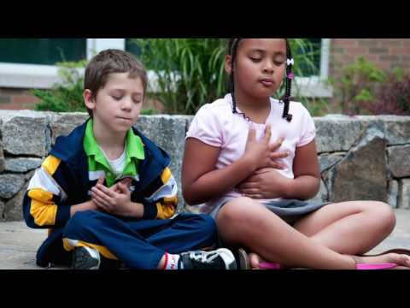
Loving Kindness - “Heartfulness” 💗
Try this video to learn a way to send kind thoughts to others
and also about the importance of sending kindness to yourself!

