Slide 1

WELCOME!
Jean Logan, Early College Administrator

Slide 2

What is the role of the
Early College Administrator?
Support students, parents, and district staff.
Monitor student success in Early College.
Provide interventions and assistance for Early College students.
Help students transition to college.
Guide students in their college and career pathways.

Slide 3

What is JCEC?
Jackson County Early College (JCEC) provides high school students a rigorous opportunity to receive a high school diploma in addition to one of the following:
An occupational certificate (see handout);
An Associate's degree;
Or up to 60 credits toward a Bachelor’s degree.

Slide 4

Little to no cost college classes for students*
Available for grades 9 through 13
Simultaneous high school and college courses
GOAL = Associate Degree, Certificate, Credits toward degree
*Families may incur costs that go beyond the state allowance. This could include credits, fees, and textbooks. Courses with labs may also cost more.

Slide 5

Students enrolled in JCEC attend an additional “13th year” to complete both high school and college program requirements.
They are required to take a math/math-related course their last year.
Students receive their high school diplomas upon exiting Early College.
Notes:
A math class can be taken at the College, that meets their high school requirements. This is a paradigm shift in traditional thinking about how students graduate.

Slide 6

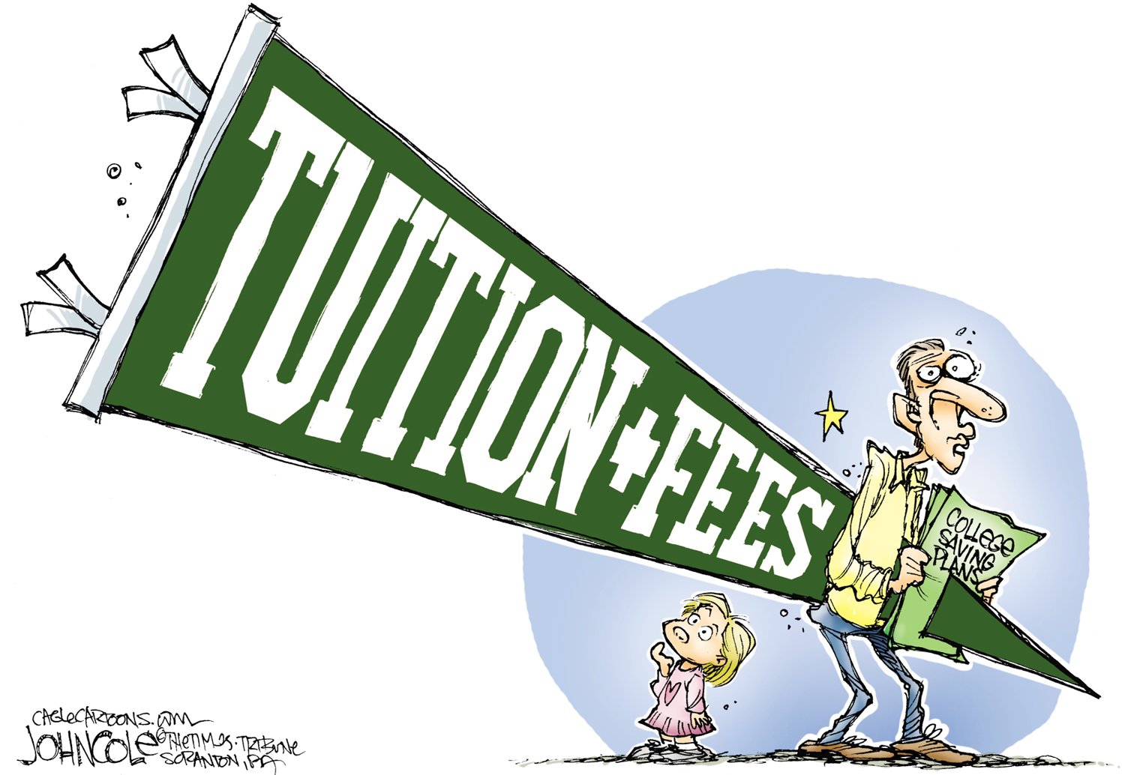
SO…HOW DOES THIS
WORK FINANCIALLY?

Slide 7

JCEC Partner
Reduced tuition for Early College students.
Reduced associated fees for Early College students.
Provides several options for textbooks – Textbook Zero, Cengage, Rental & Purchase.
Your child can attend Jackson County Early College at little to no cost. Families may incur some costs related to credits, fees, and textbooks.

Slide 8

Course Fees & Billing Hours
Lab Classes
On-Line Courses
Science Classes
Example:
5-credit chemistry class
2-hour lab
This class will be billed as 7 credits.
Four-credit on-line course: additional fee of $196
Three-credit on-line course: additional fee of $158

Slide 9
ACADEMICS

Slide 10

Career Pathway
Navigators and counselors, in consultation with the student, determine the best courses to fulfill graduation requirements (both high school and college).
The student’s Educational Development Plan (EDP) will focus on MTA courses and career pathway.
Student success data from local, state, and national assessments will help determine course placement.
Participation in College & Career Readiness activities is a requirement of the program.
Course selection is determined by the student’s career pathway AND the Michigan Transfer Agreement (MTA).

Slide 11
Successful Course Completion
Students who earn a 2.0 in their college courses have successfully earned college credit.
If a student earns less than a 2.0, the family may be billed for the cost of the course. Contact your district administration for their expectations.
Students must take a math course their 13th year – either in the district or at the college.

Slide 12

What is an Educational Development Plan?
Outlines a student’s education and career goals;
Maps the path to achieve those goals;
Is not simply a schedule of classes.

Slide 13

JCEC may not be suitable for:
Student-athletes who will play at the collegiate level.
Students who have received substantial scholarships for college.
Students who struggle with independence and expectations.
Students who struggle with consistent attendance.

Slide 14
Who may be great candidates for JCEC?

Slide 15
JCEC may be just right for your student.
A student who wants to attend college.
A student with a 2.0 or better.
A student with good attendance, a positive attitude, and determination.
A student who wants affordable college.
A student who wants to attend college but is not sure what career pathway.
A student who ALREADY plans to attend Jackson College.
Districts retain the right to develop their own guidelines for eligibility to enroll in JCEC.

Slide 16
Application and Registration Process
2020-2021
All paperwork is submitted to the high school counselor.
Before a student will be considered a JCEC student, all paperwork must be completed.
The JCEC college application will not be processed until enrollment in the program has been approved by the district and paperwork is complete.
Please do not complete a traditional Jackson College application.
Registration for Fall 2020 classes will begin in April for new students.
Notes:
2. Students complete the course placement evaluation and/or submit ACT or SAT scores to the Glen Oaks Admission Office. The COMPASS test may be waived if students meet GOCC college readiness requirements (ACT Reading 19, Math 23, or English 19; SAT English 450+, Reading 450+, and Math 550+)

Slide 17

IT IS VERY IMPORTANT THAT STUDENTS COMPLETE THE JCEC APPLICATION AND NOT
THE TRADITIONAL JC APPLICATION.

Slide 18
REQUIRED DOCUMENTS
Students must PROVIDE:
  A pre-application;
  A letter of recommendation;
  A 250-word essay about how Early College can benefit them;
  A parent waiver signed by the parents…
AND --
Attend a mandatory Success Camp…
before they will be considered a
Jackson County Early College Student.
Notes:
Students will not be registered for college classes until the orientation has been completed. Interested parties will be notified of the dates and times of the EMC mandatory orientation.

Slide 19

Application & registration process
IMPORTANT
All items
(pre-application, letter of recommendation,
essay, and parent waiver)
MUST BE GIVEN
to your student’s HS counselor.

Slide 20

Where Do We Go From Here?
COMPLETE THE PRE-APPLICATION PROCESS
The Deadline for this year’s sophomores is September 1, 2020.
(earlier if your student wants to register
for classes fall term.)

Slide 21
The importance of orientation

Slide 22
Why is Success Camp required?
As part of the Early College requirements, Success Camp provides:
College & career-readiness activities;
Assistance with registration, student IDs, scheduling problems, and technology;
Familiarity with Jackson College’s campus, services, organizations, and staff.

Slide 23
FYS 110 – LIFE MAPS
The Jackson County Early College (JCEC) program is required to provide curriculum that addresses the College and Career Readiness standards established by the Michigan Department of Education. These standards have been developed to prepare students for the challenges of post-secondary education and training. FYS 110 is designed to address those standards and include:
Career Exploration
Contextualized Academics
Career Preparation
Out-of-School Time/Family Engagement
Career Interest Inventories and Activities
Career Planning
Educational Development Plan (EDP)
Talent Portfolio

Slide 24

Questions?
Contact Your District Guidance Counselor,
High School Principal, OR
Jean Logan, Early College Administrator
info@jxncec.org
www.jxncec.org
517-581-2003
Facebook: Jackson County Early College

