Slide 1
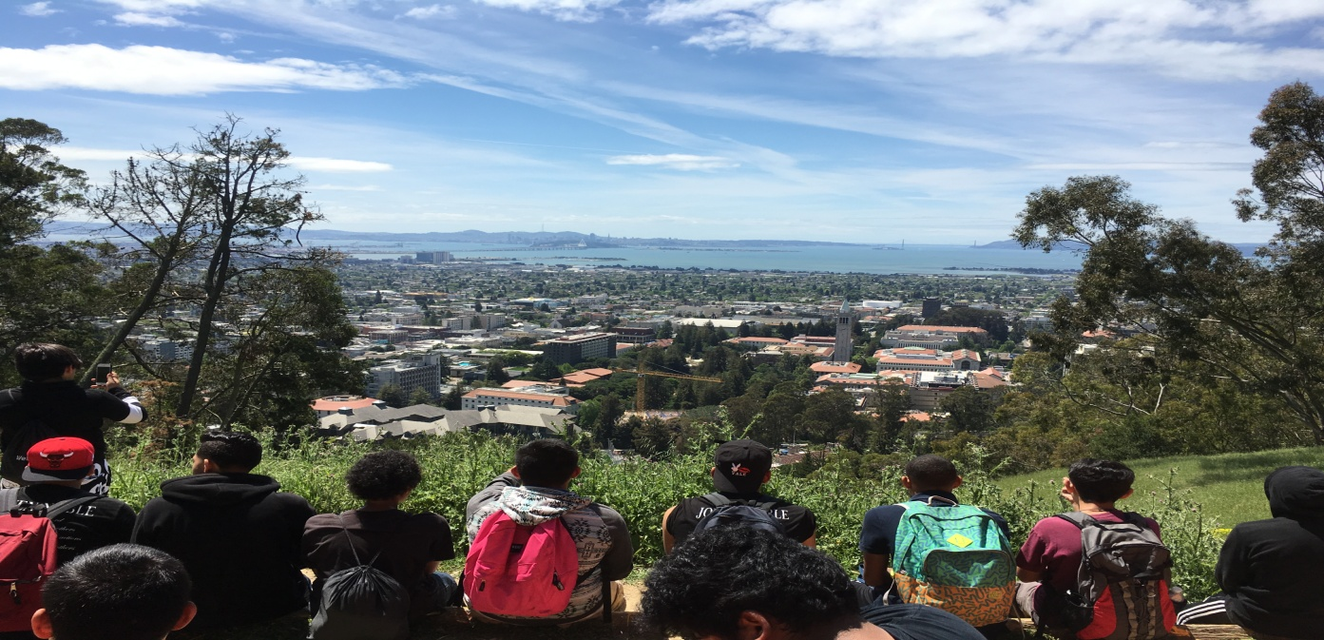

LATINO MEN & BOYS PROGRAM

Slide 2
Overview
The Latino Men and Boys program (LMB) is a school-based, comprehensive and culturally rooted program for Latino male youth in the Oakland.
Our focus is to increase academic achievement, improve social and behavioral tendencies.

Slide 3











LMB in OUSD
We are currently in 10 schools sites (6 middle and 4 High Schools)
We are serving approx. 225 boys. Ages range from 12-24
Participants are mostly Latino but we have African American, Asian, Pacific Islander and Middle Eastern participants

Slide 4
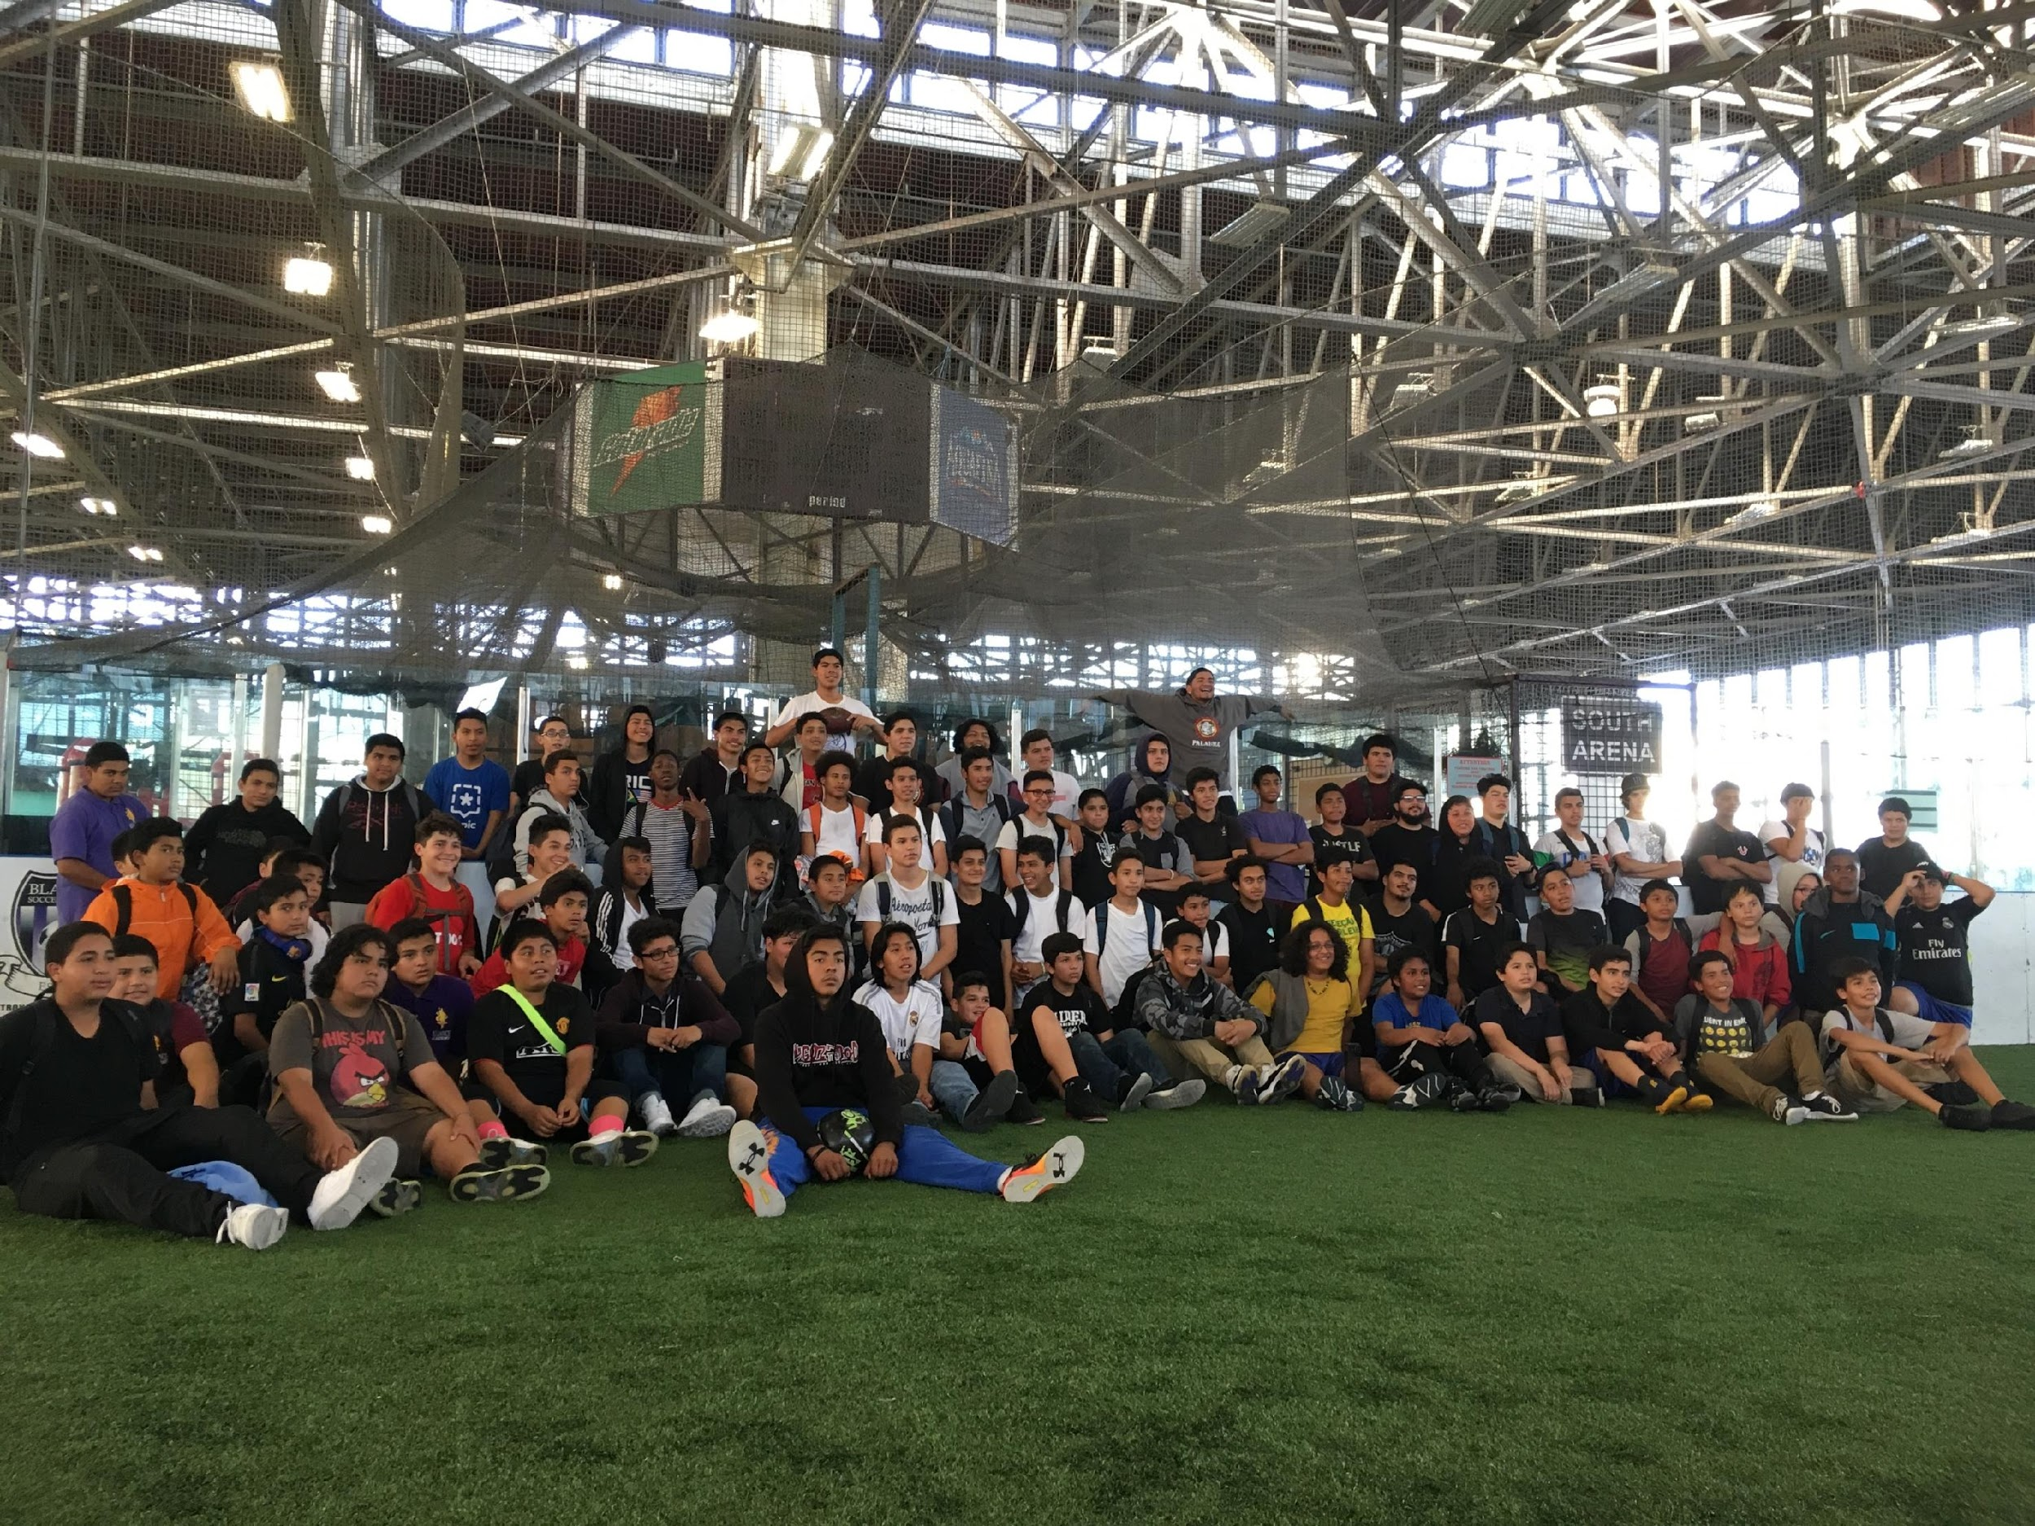
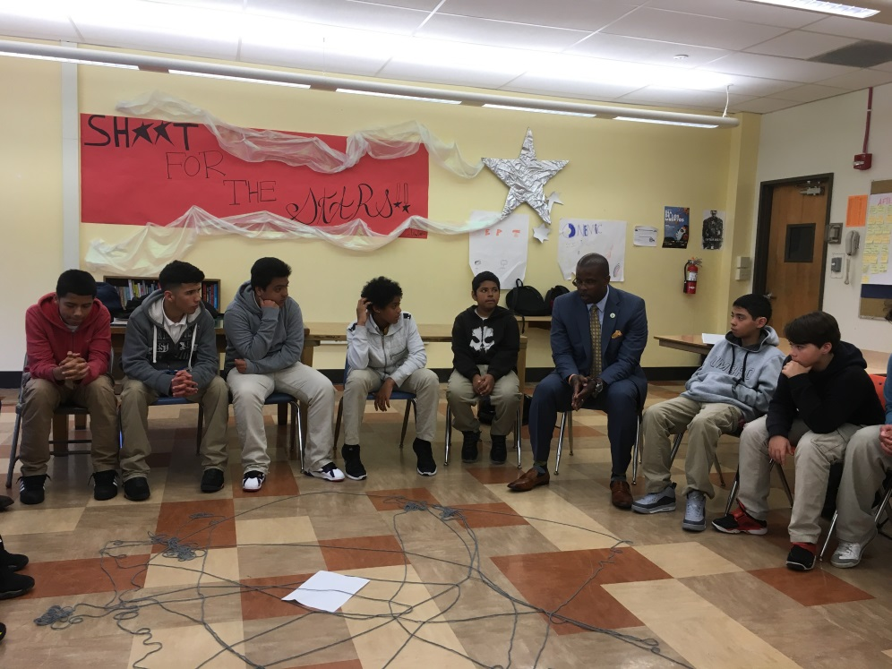
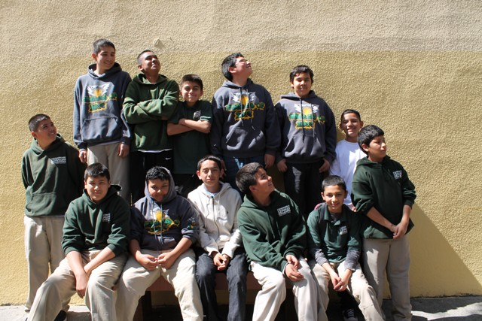
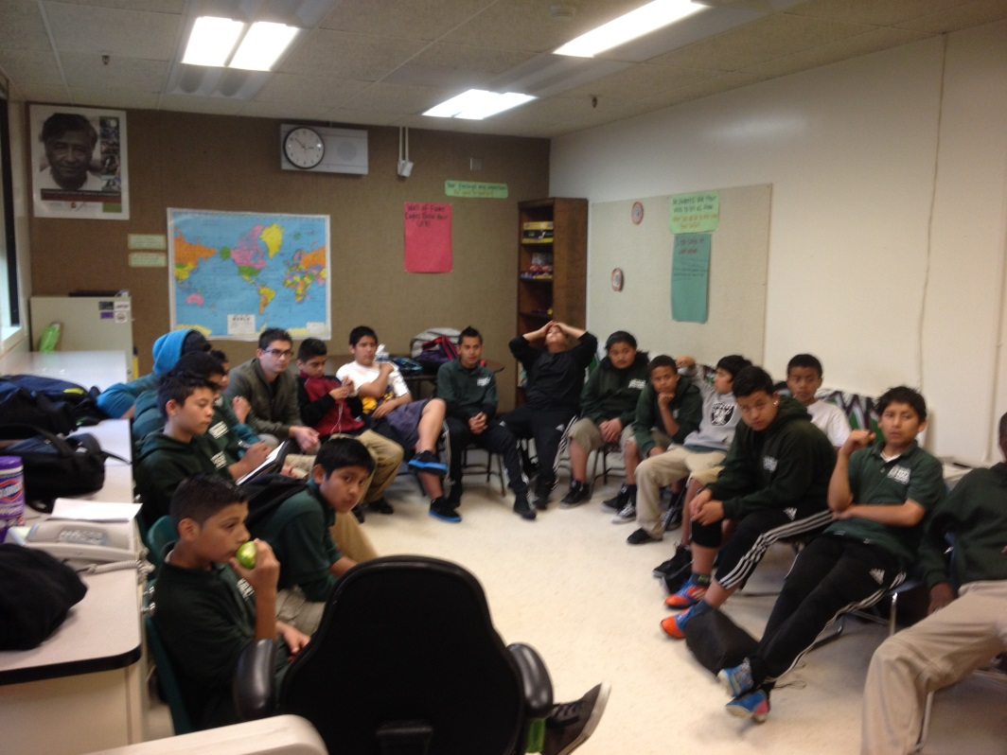

Slide 5
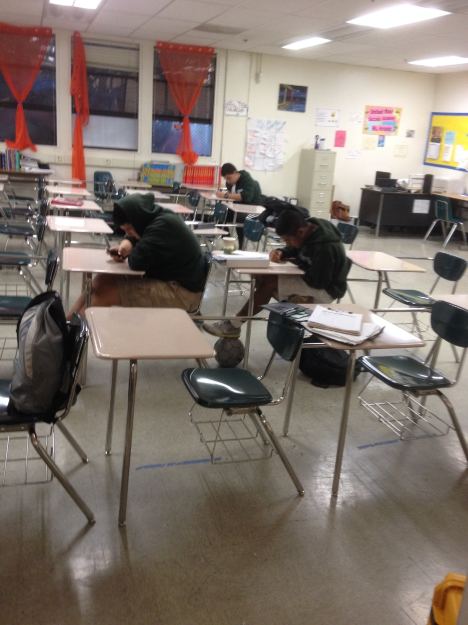
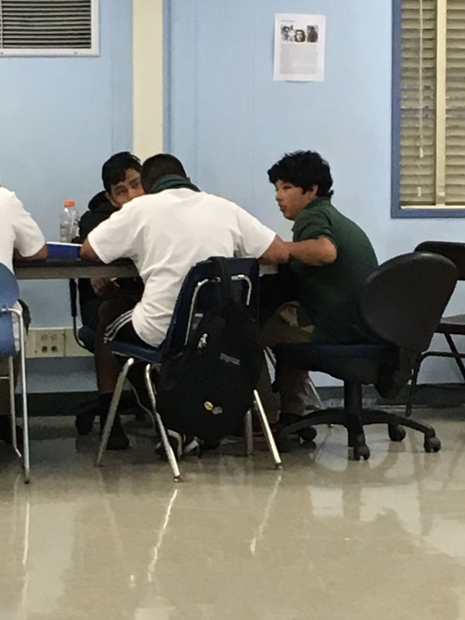
Academic Achievement
Push-in classes help with classwork
After school Tutoring
Student Learning Plan/Parent participation

Slide 6
2015-16 stats
Participants maintained 97% school attendance (compared to 95% district average)
35% increase in participant GPA
66% decrease in referrals/suspensions
90% high school graduation rate for LMB seniors (compared to 48% graduation rate for Latino males in OUSD)

Slide 7
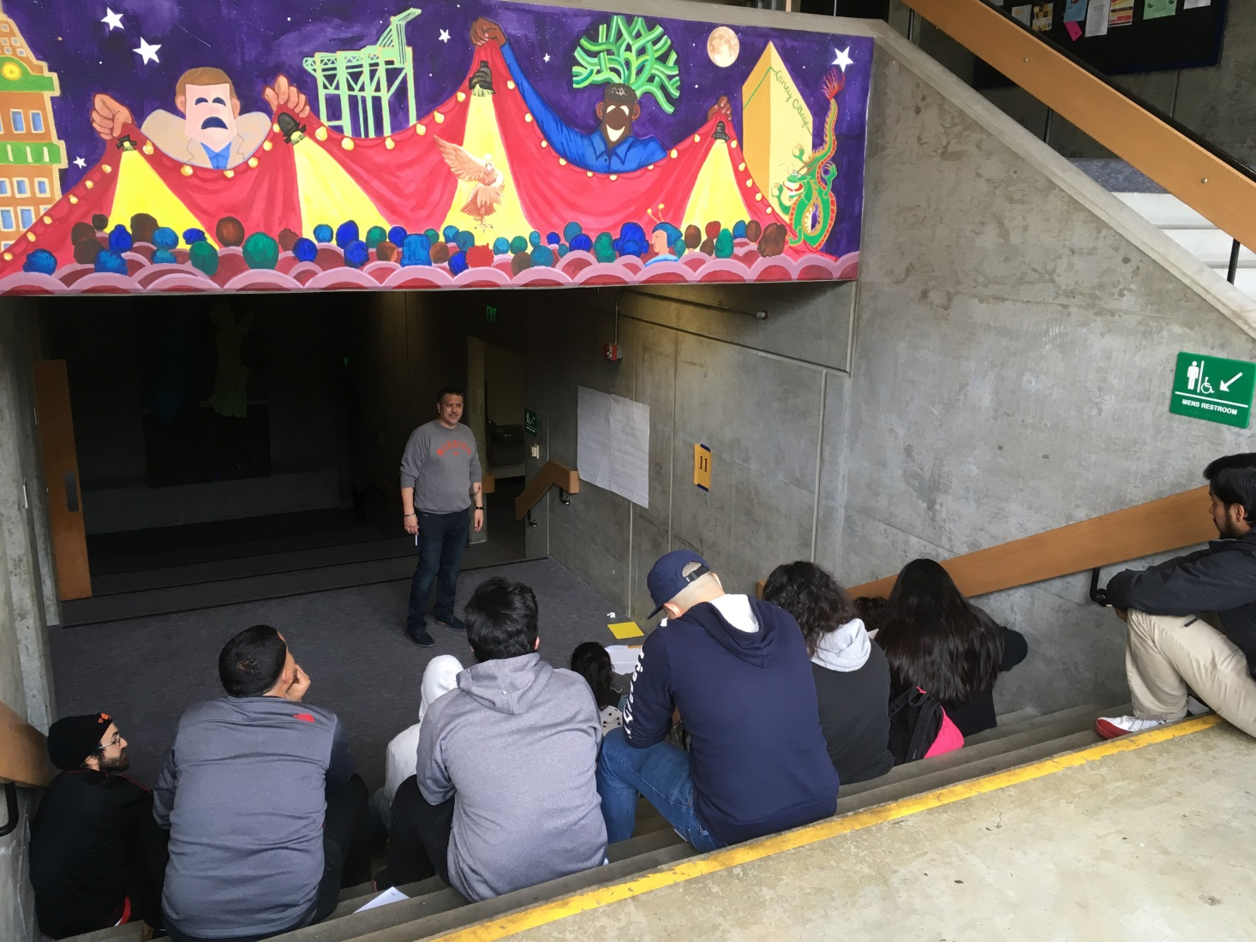
Social Improvement

Slide 8
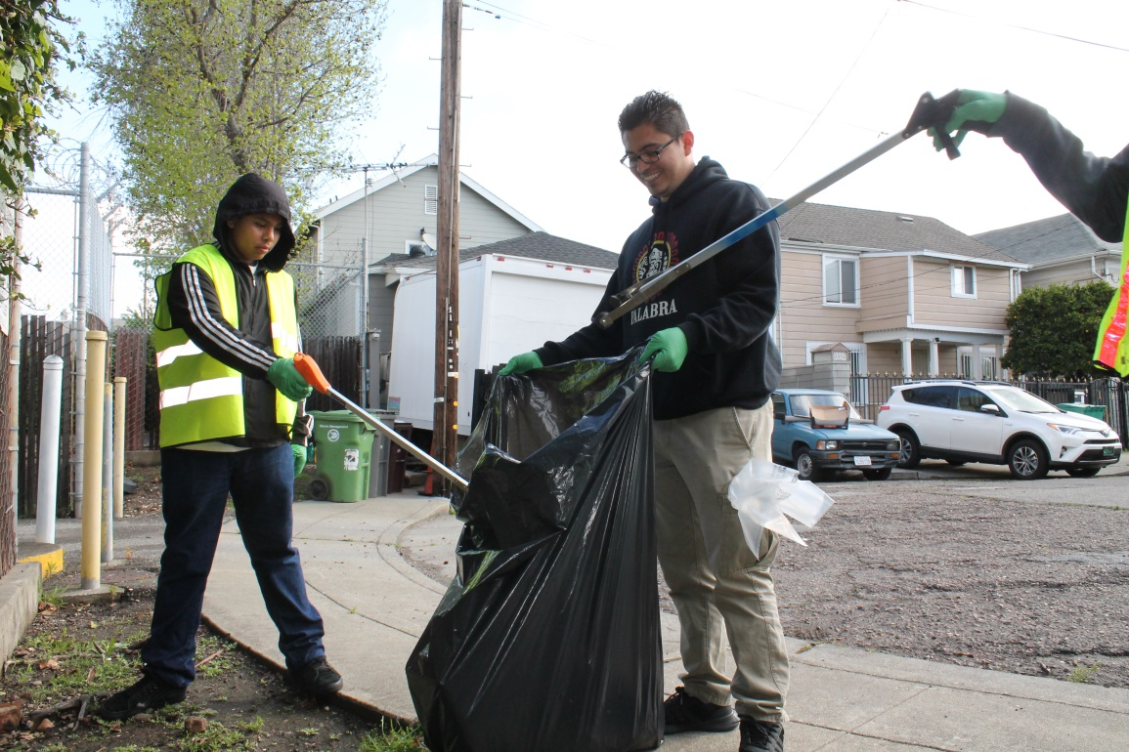
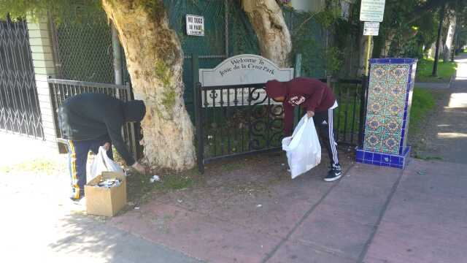
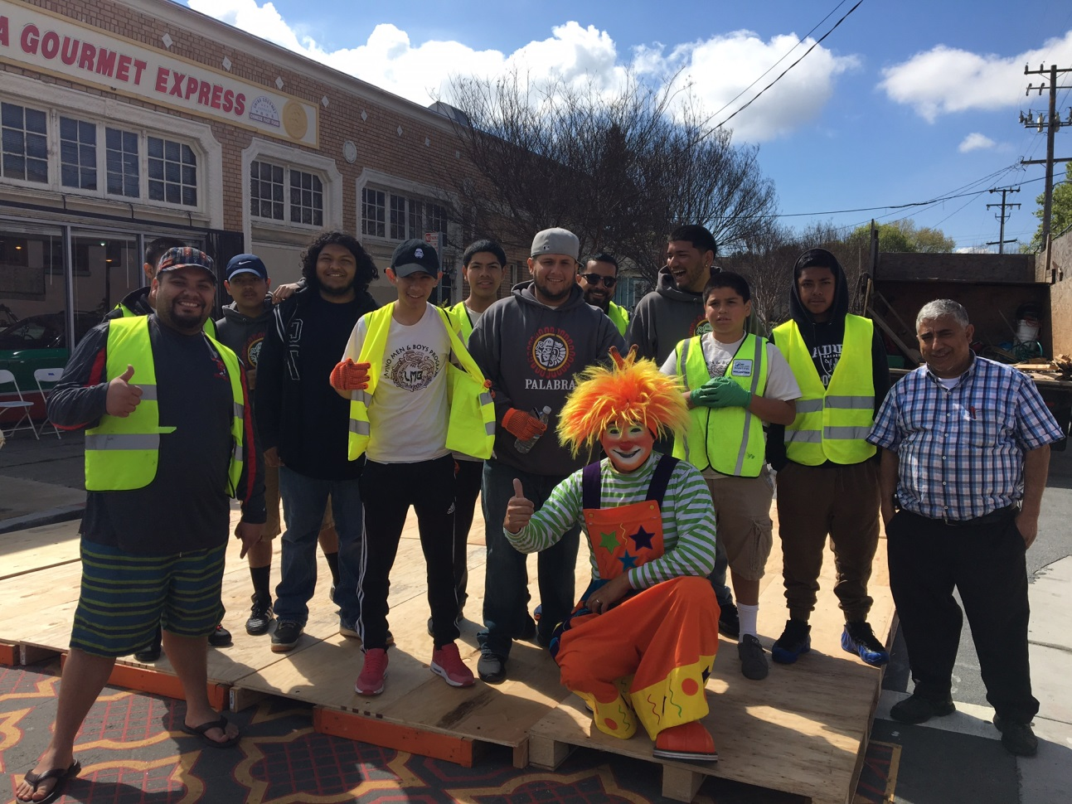
Community Service

Slide 9
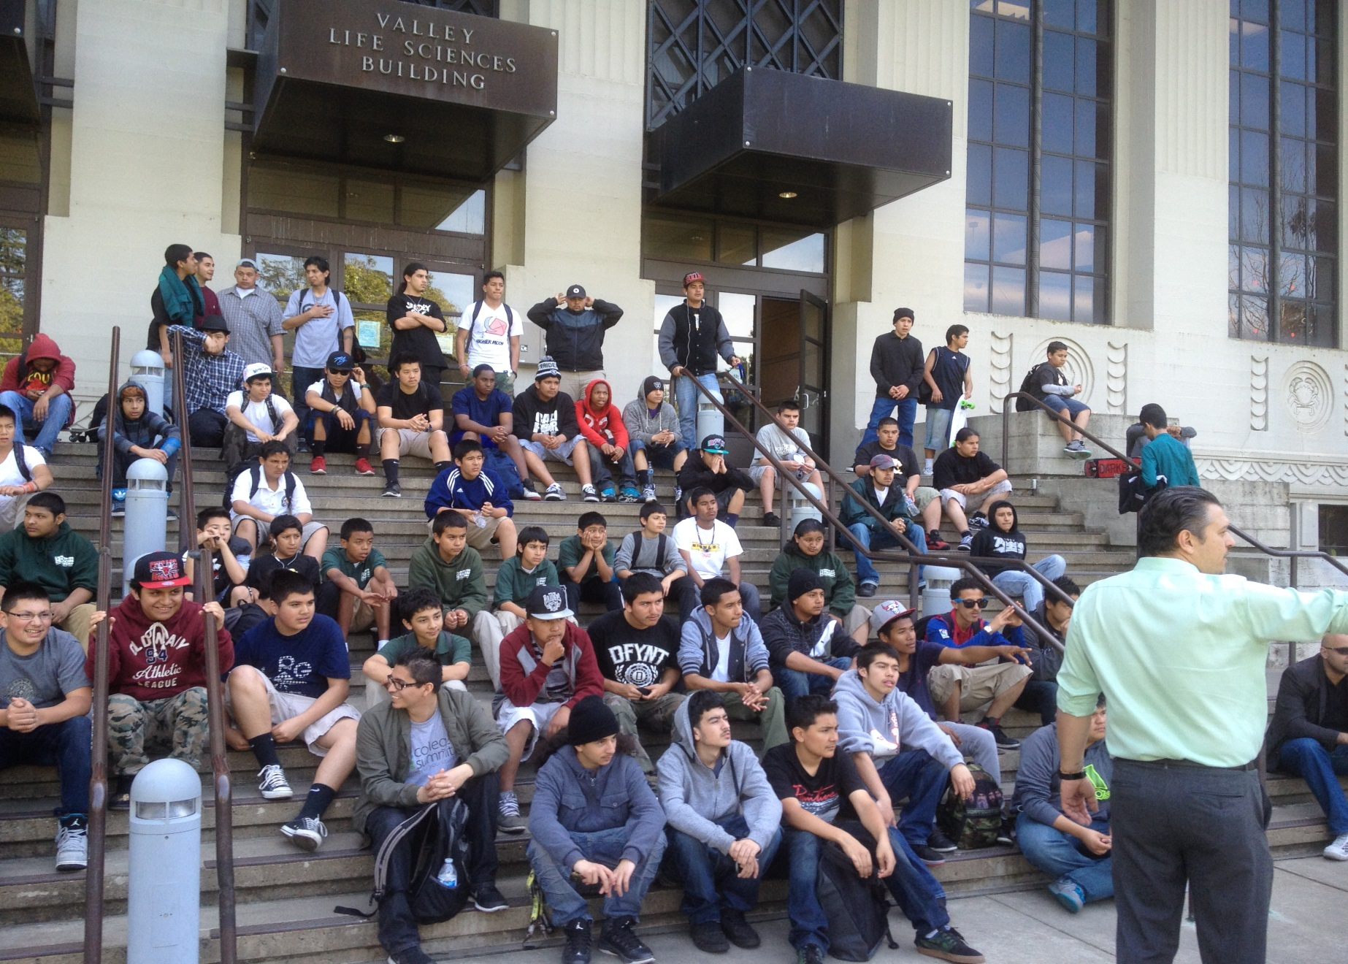
College Tours

Slide 10
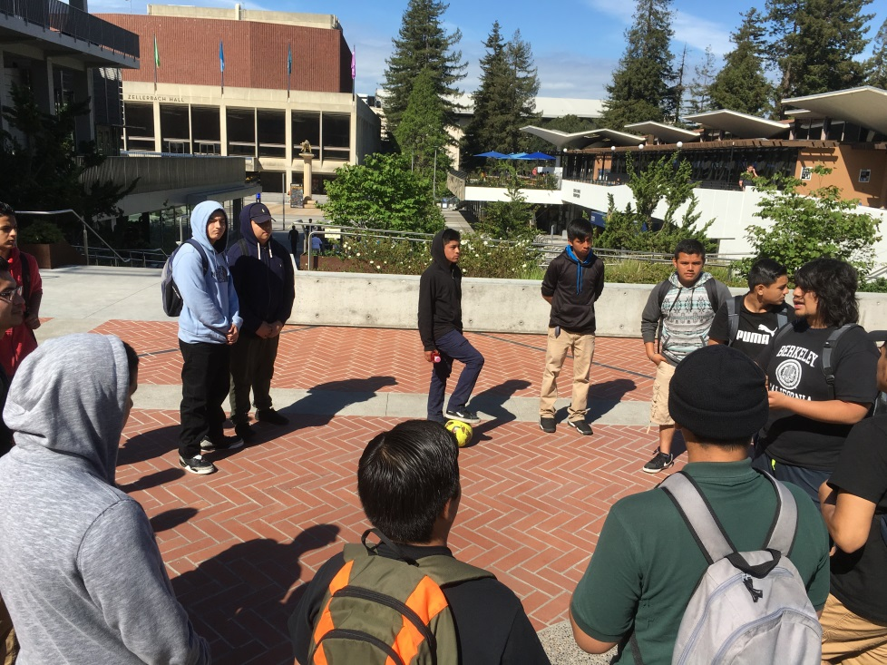
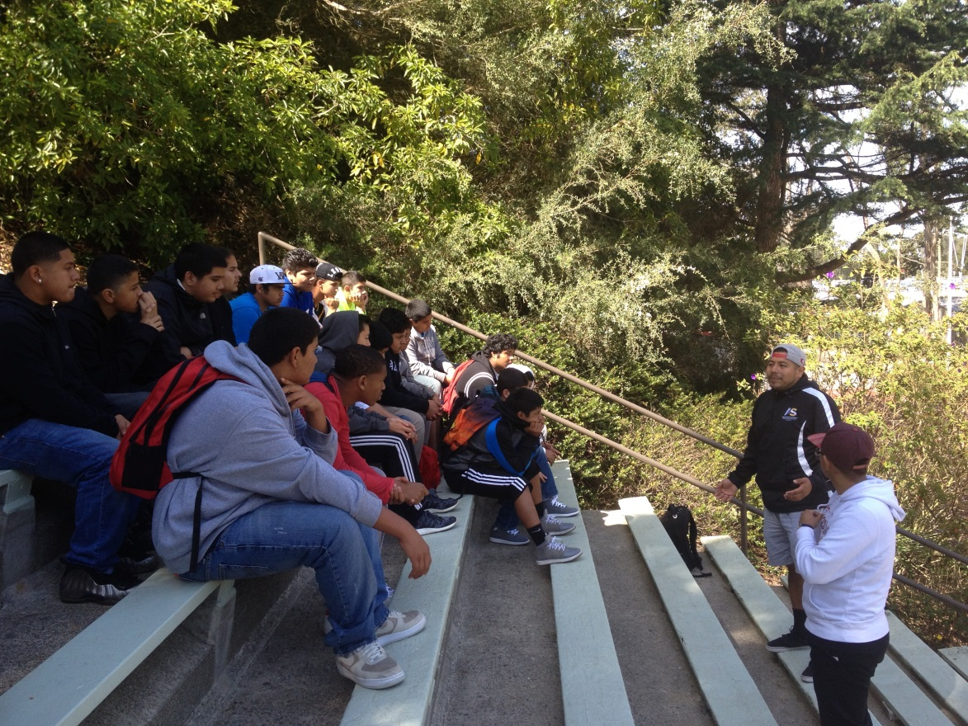

Slide 11
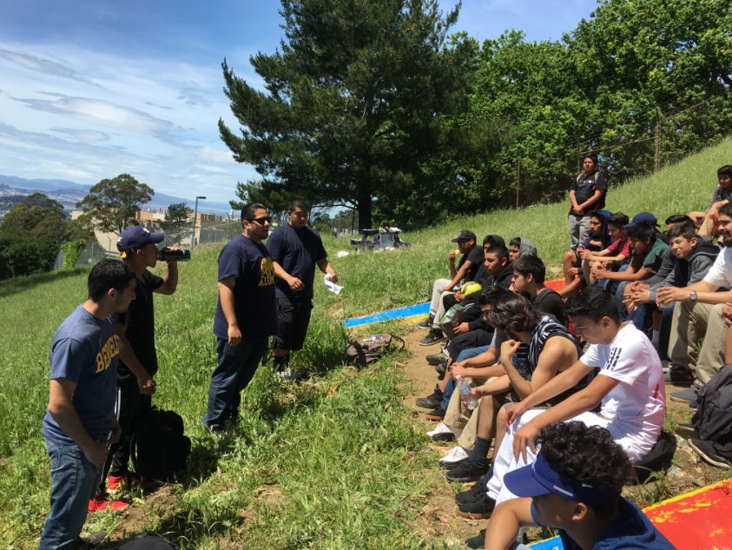
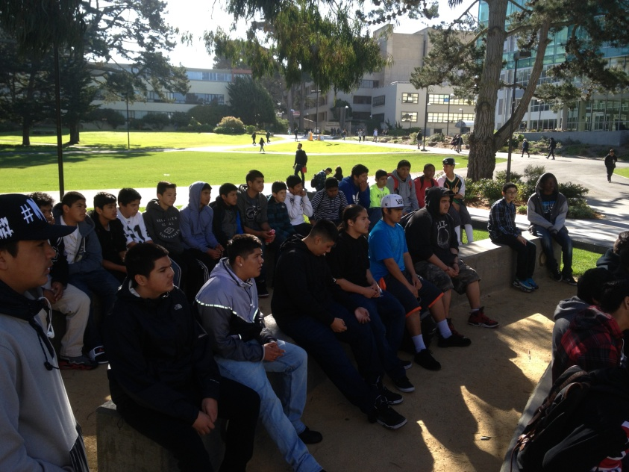
Hermanos Unidos
We are creating a mentorship pipeline with current Latino students various UC and CSU campuses who continue to promote cultura and brotherhood.
Our college visits are hosted by Hermanos Unidos where our college tours and workshops about college life, financial aid, academic achievements and personal stories are shared. Several of our mentors are part of Hermanos Unidos.

Slide 12


Slide 13
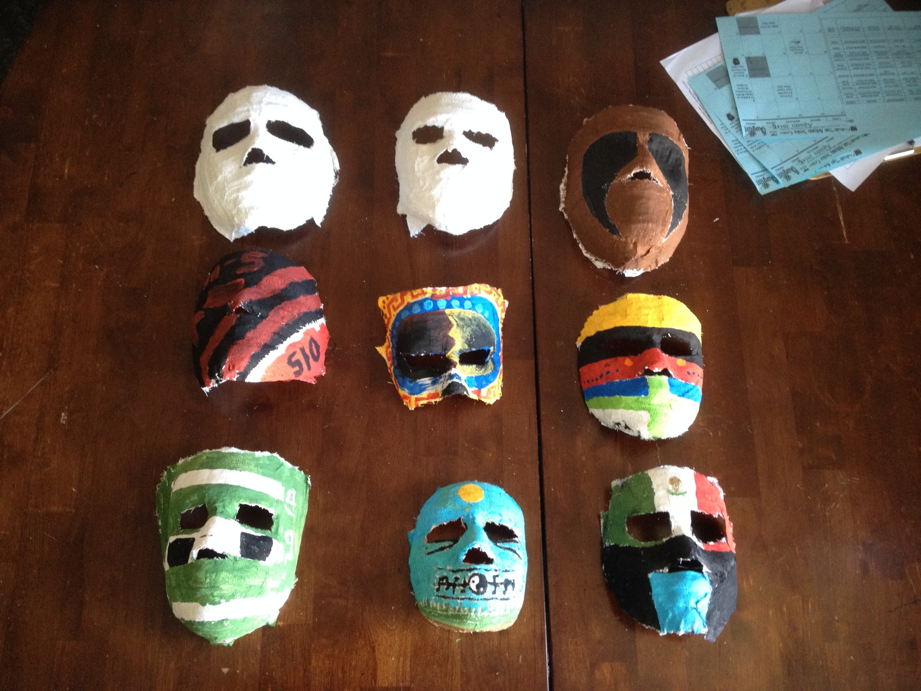
Joven Noble
The Joven Noble Curriculum written by Jerry Tello. It’s a story based curriculum where mentors utilize personal experiences and knowledge to explain the purpose of the teachings in the curriculum.
  Que Dicen- Stereotypes
  Man vs Male- Sex-Ed
  Hombres sin Palabra- Trauma/Abuse

Slide 14
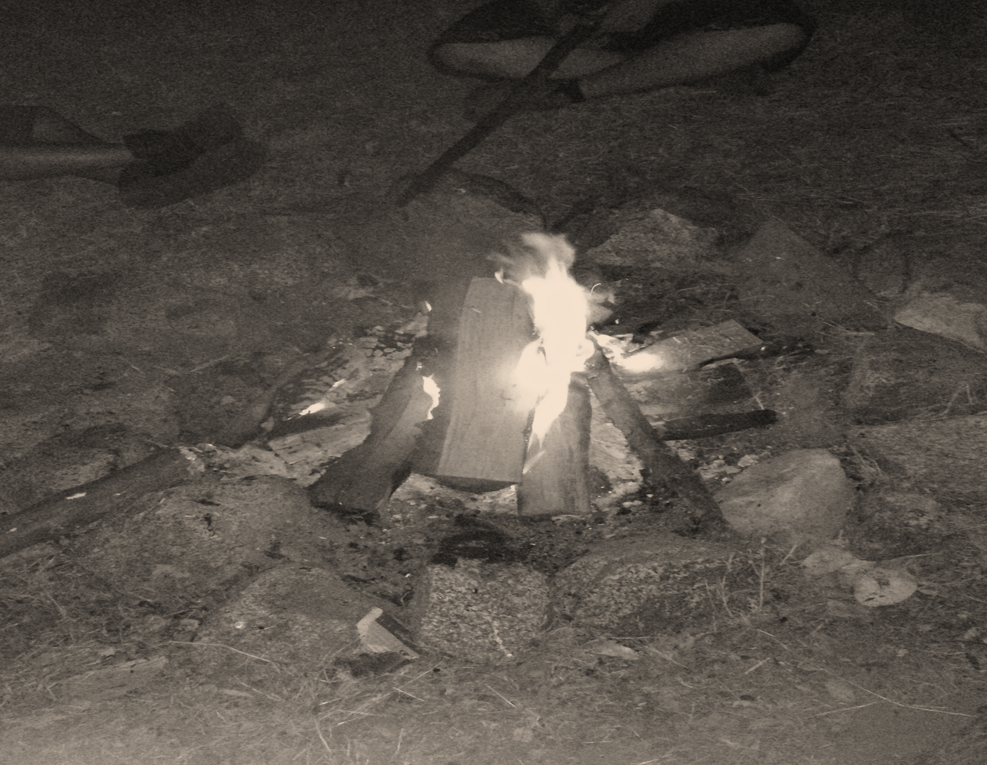
Hombres Con Palabra
VALORES
Keep your Word
Don’t Bring Harm to others
Take responsibility for your actions
Be a positive example

Slide 15
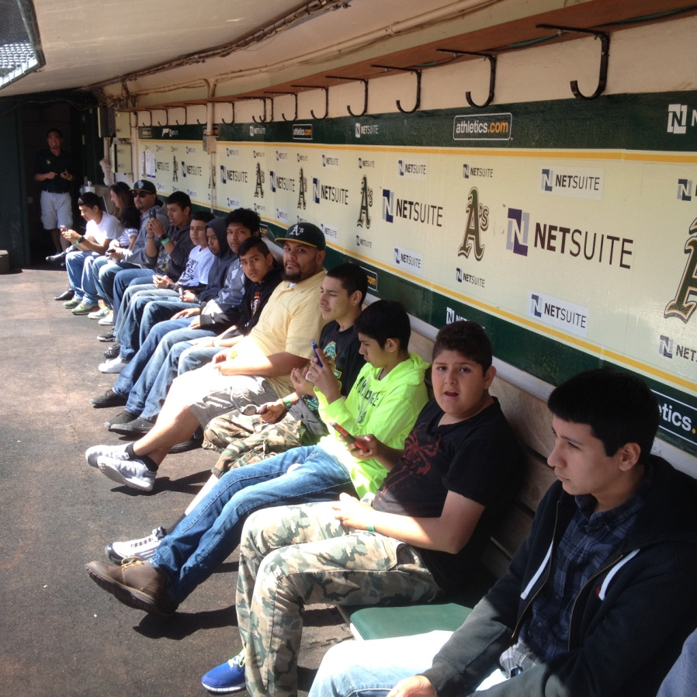
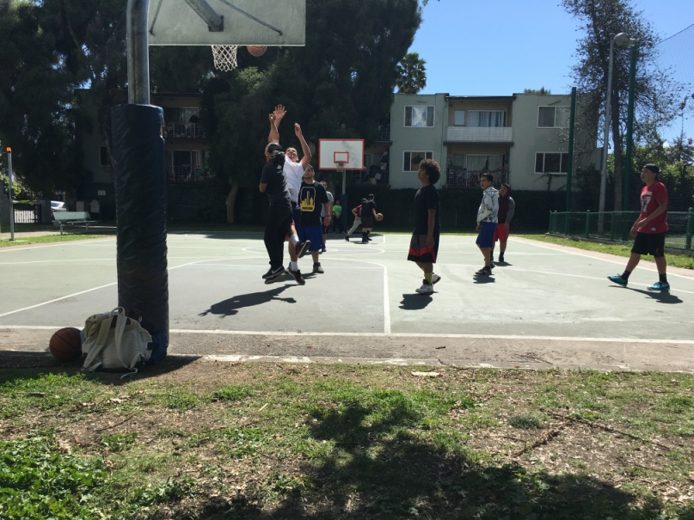
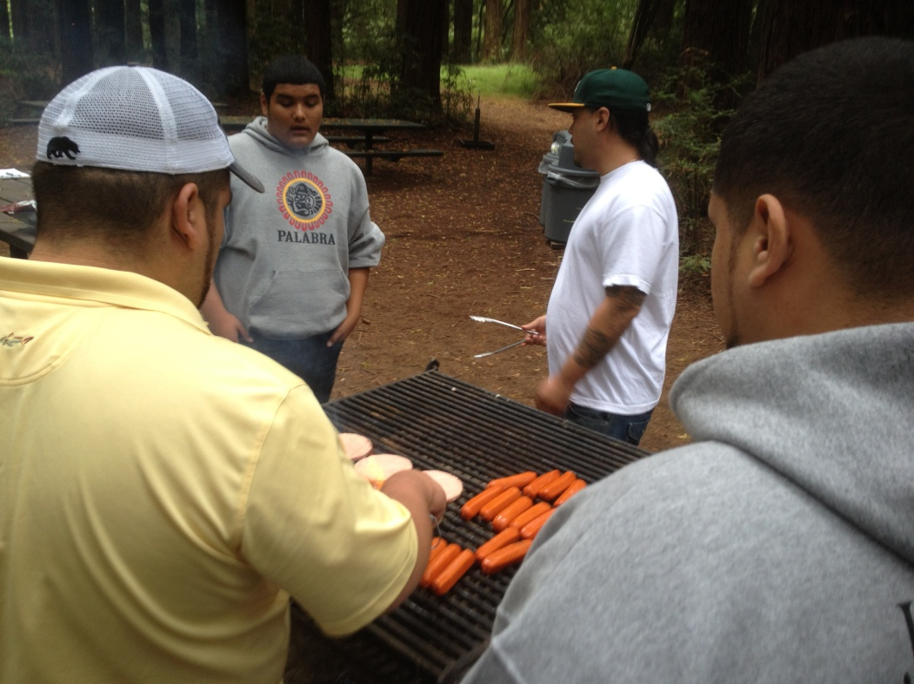
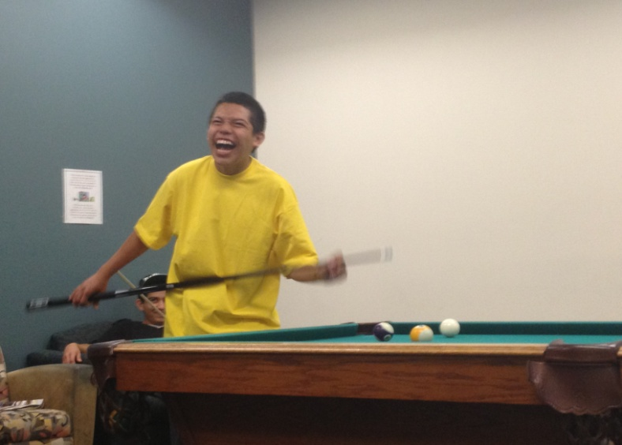

Slide 16


