Slide 1
East Bay Consortium
Program Coordinator: Nikki Yu

Slide 2
What type of support does EBC provide?
College Application Support
  University of California (UC), California State University (CSU), Private Schools, Community College
Financial Aid Application Support
FAFSA/Dream Act Application
Financial Aid Award Break Down
Major and Career Exploration
Supporting students through surveys, researching with students, resume building
1-1 Check-ins
Presentations on different topics
  A-G requirements, different college systems, SAT/ACT updates, etc

Slide 3
College Application Timeline
August 1st
  UC Application opens
October 1st
  CSU Application opens
  Financial Aid Applications
November 30th
  Deadline for BOTH UC & CSU APP
March 2nd
  Deadline for Financial Aid Applications
Private School deadlines vary but are open NOW
Community College is in the spring
Scholarships are ongoing through the whole year

Slide 4
Contact
Nikki Yu, Program Coordinator
Email: nikki@eastbayconsortium.org
Phone Number: ‪(925) 391-0644
1st best method of communication: Texting
2nd best method of communication: Email

Slide 5
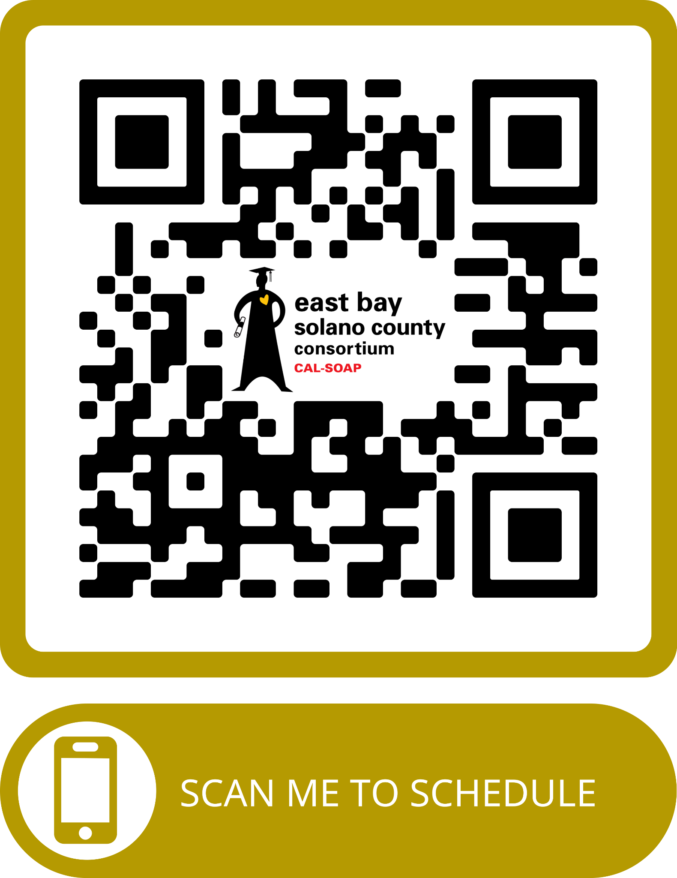
Make an Appointment

