Slide 1




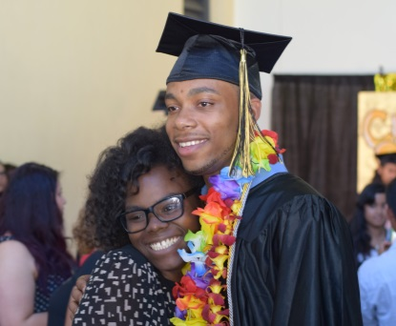
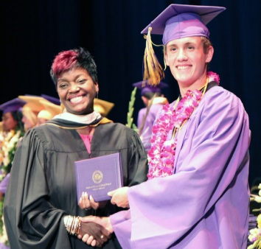

Aeries Registration
(Data Confirmation)
How to complete registration online in Aeries Parent Portal
Created by the OUSD Student Welcome Center May 2020

Slide 2
Aeries Data Confirmation: parent.ousd.org
In Aeries, registration is called Data Confirmation.
Parents can access Aeries Data Confirmation at the following website: parent.ousd.org. This also gives you the option to download the Aeries app, if you prefer.
Aeries Data Confirmation is available in mid-July through August for all students enrolling in an OUSD school.
We encourage families to complete Data Confirmation (Registration) in Aeries before the first day of school (August 10), but it is not required.
The video here can help you get started.

Slide 3
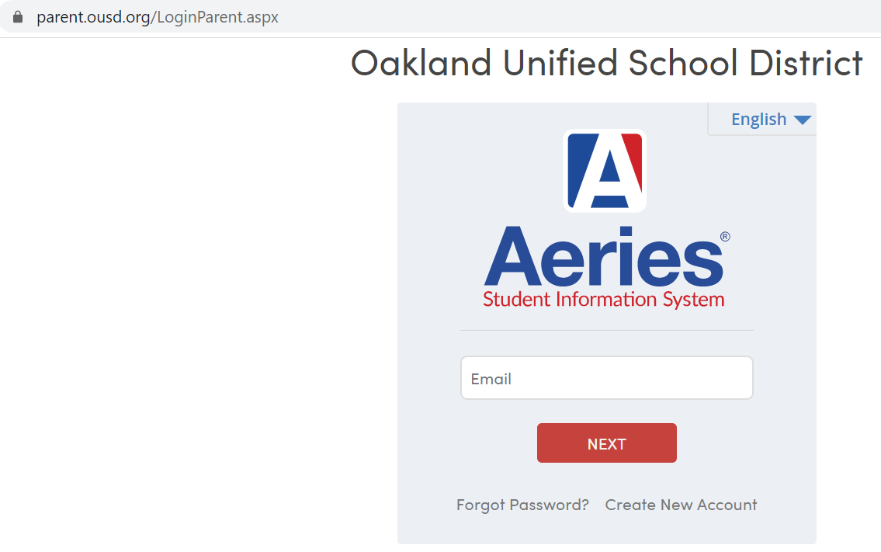

Aeries Login: parent.ousd.org
Parents will login to their Aeries Parent Portal at parent.ousd.org
If you do not know your Aeries Parent Portal email or don’t have one, reach out to the Student Welcome Center (510-879-4600, enroll@ousd.org).
You can also choose to complete registration in another language by clicking the English dropdown (circled in red).
Then click

Slide 4
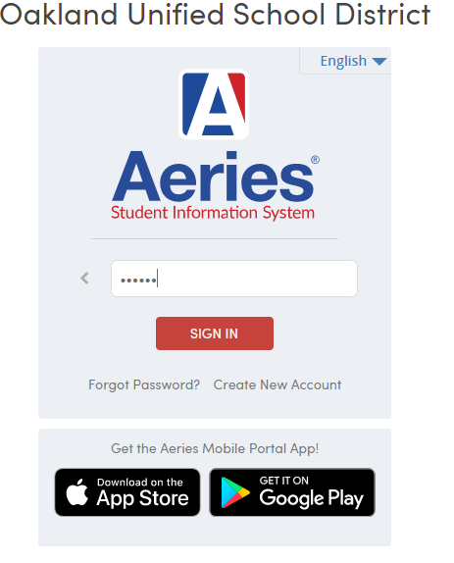

Enter Password
Parents will be asked for their password.
If you do not know your password, click
Forgot Password?
After entering the password, click

Slide 5
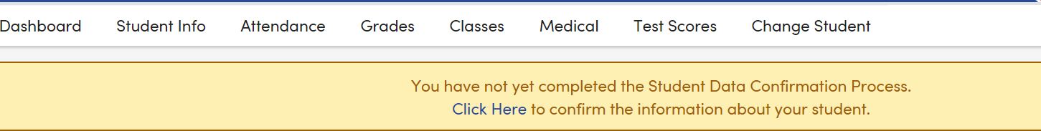
Click to enter Data Confirmation/Registration
You will see a yellow bar at the top.
Click on “Click Here” (circled in red above) to begin registration.

Slide 6
To complete registration for a different child
Once logged in, you can change which child you complete registration for by clicking “Change Student” at the top (circled in red above).
If you do not see your other child under “Change Student”, please reach out to the Student Welcome Center for support (510-879-4600 or enroll@ousd.org)

Slide 7
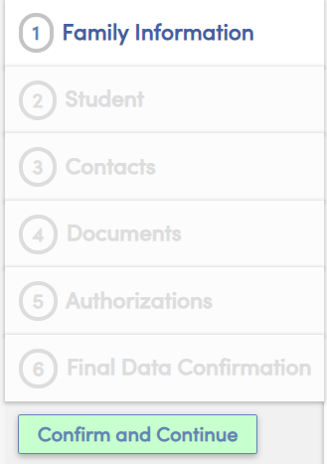

Begin Data Confirmation/Registration
On the left side, you will see the 6 sections of
Data Confirmation/Registration.
After you complete each section, click and then a check mark will appear next to the section name.

Slide 8
1. Family Information
There are two parts to this section - active military service and residence survey.
Click on the box that reflects your status in each section.
When you are done with the section, click
on the left side to move onto the next section

Slide 9

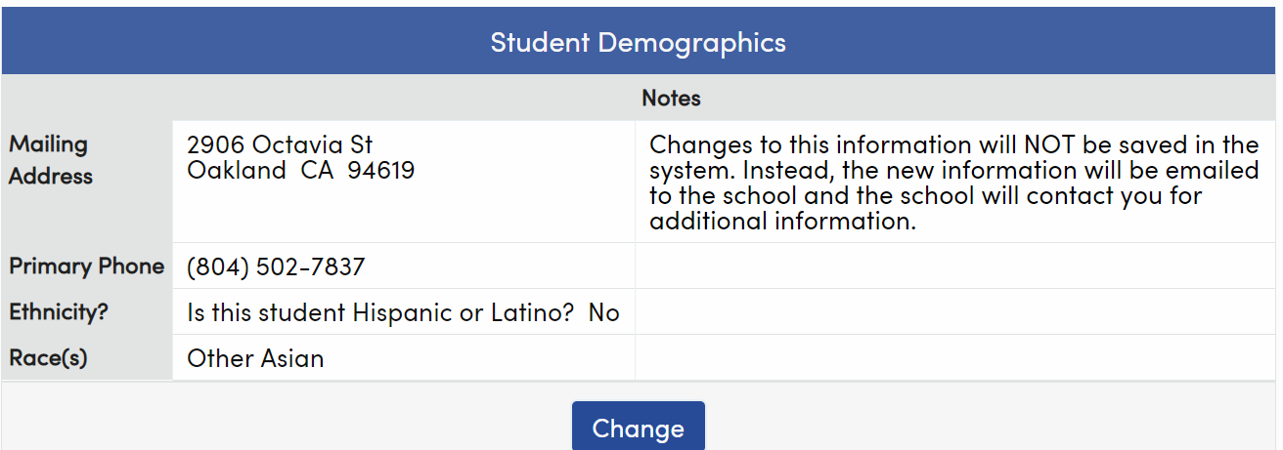
2. Student
To make any changes to this section, click at the bottom of the screen.
In this section, you can update your child’s phone number, ethnicity, and race.
Changes to mailing address will need to be reviewed by school staff.

Slide 10
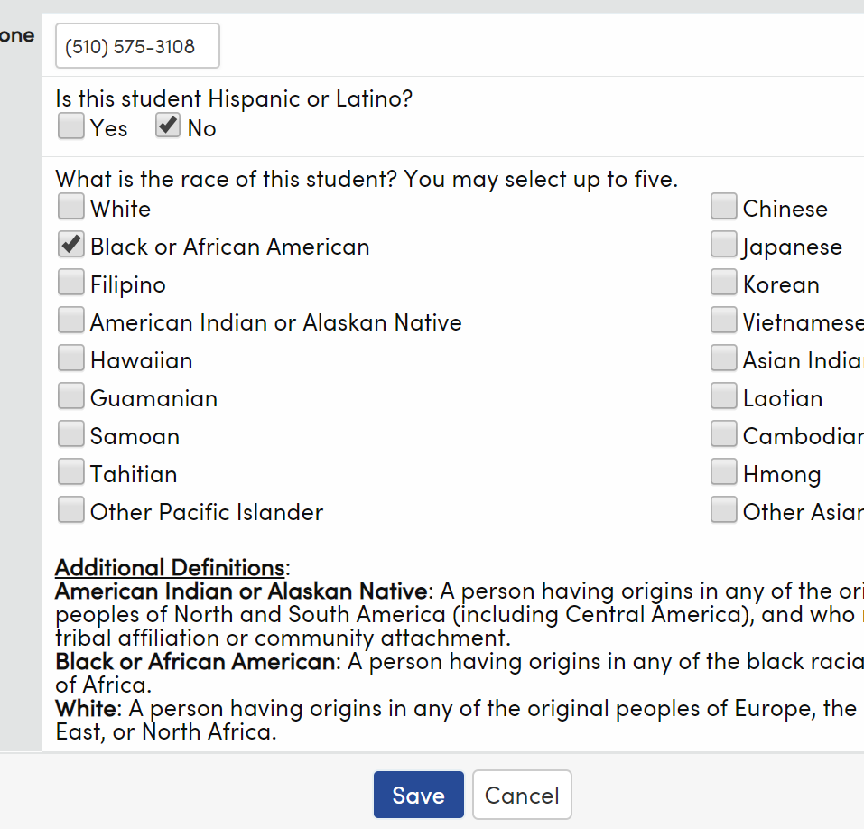

2. Student (Continued)
If you clicked Change, you can update your child’s phone number, ethnicity, and race.
After making any edits, click at the bottom of the screen.
Then, click on the left side.

Slide 11

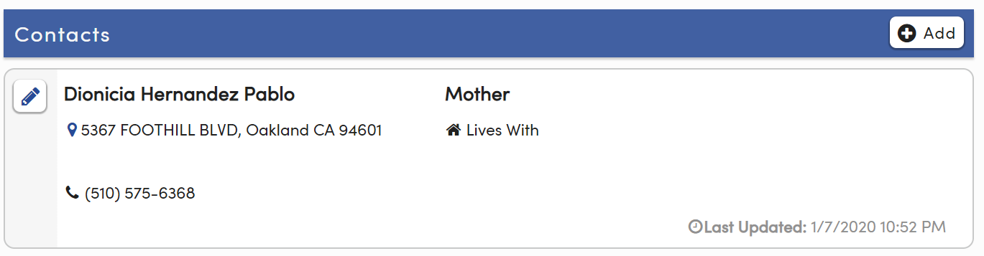
3. Contacts
Under Contacts, you can update an existing contact by clicking the pencil button in the upper left corner of each contact (circled in red below).
If you choose to make edits, you can update the name, address, relationship, phone number, and email address for each contact.
Click at the bottom to save the updated information.

Slide 12

3. Contacts (Continued)
To Add a new contact, click the button in the blue bar (circled in red below).
Fill in last name, first name, relationship, phone number, and email address.
When done adding a contact, click at the bottom.
When done with Contacts, click on the left side.

Slide 13
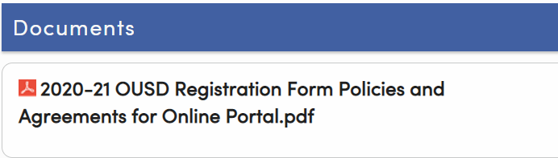
4. Documents
Under Documents, click where it says 2020-21 OUSD Registration Form Policies and Agreements to review the document.
The next section (Authorizations) will ask you questions about the policies described in this document.
After you have reviewed the document, click on the left side.

Slide 14
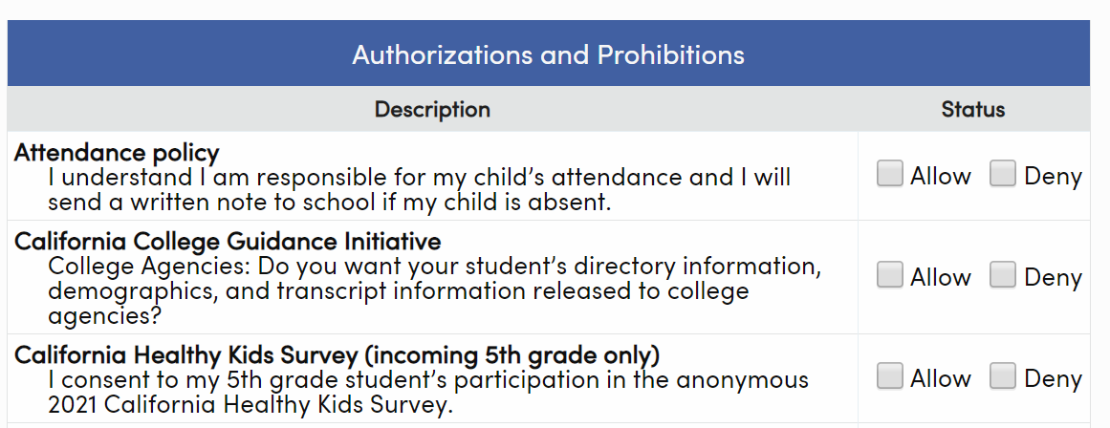
5. Authorizations
Under Authorizations, click Allow or Deny for each item.
Information about each item is in the document you reviewed in the previous section.
After making a choice for all items, click
When done with Authorizations, click on the left side.

Slide 15
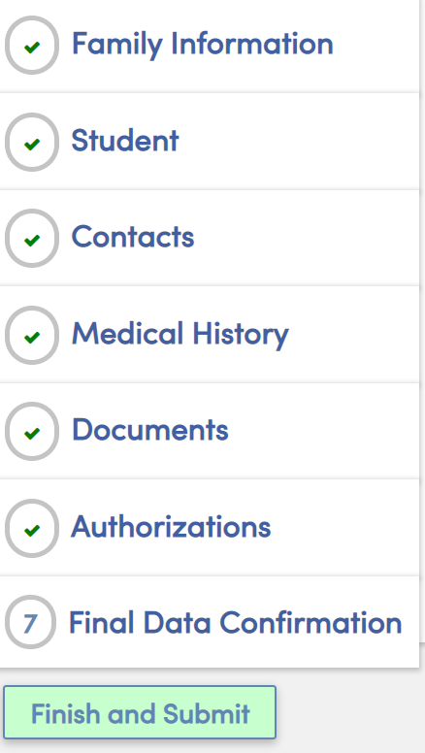
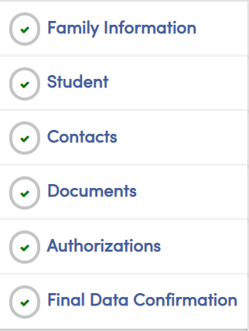

6. Final Data Confirmation
Click
All sections will have a green check.
You are done with online registration - thank you!

Slide 16
For School Staff

Slide 17
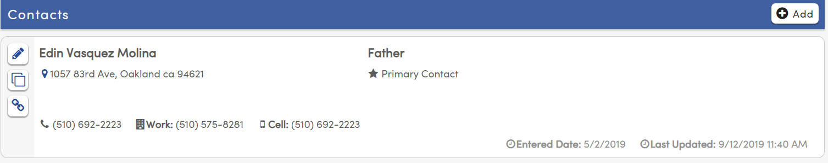
Creating a Parent Portal Account (Step 1)
You can quickly create a parent portal account for a family
Go to the “Contacts” section in Aeries for the student
Find the name of the parent/guardian for whom you want to associate the parent portal account (or you can add a new contact).
Click the pencil icon next to the name to edit the contact (circled in red below)

Slide 18
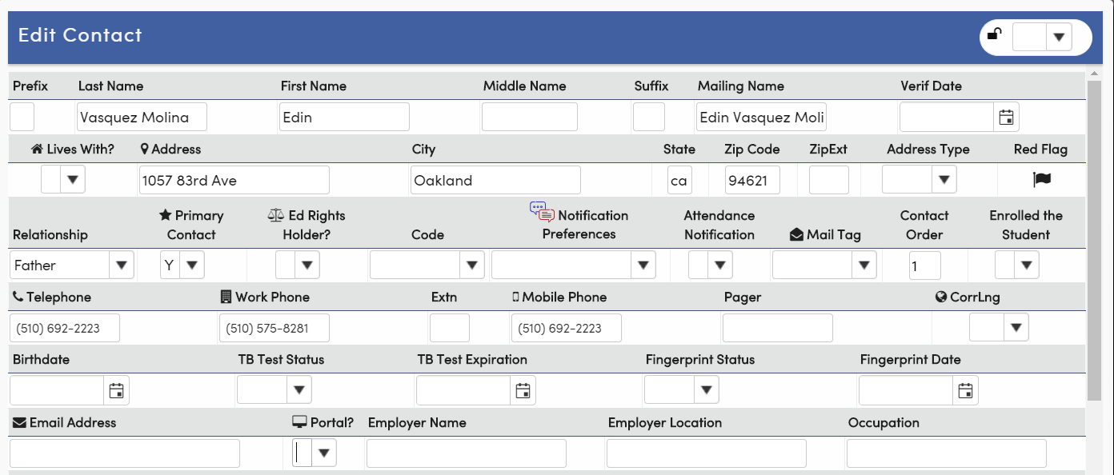
Creating a Parent Portal Account (Step 2)
Under “Email Address” (circled in red below), either input the email address that the parent/guardian wants to use or confirm it’s correct
Then, next to the email address, under “Portal?”, click “Y”.
Then, click at the bottom. The parent will automatically get an email with their account log-in and password.

Slide 19
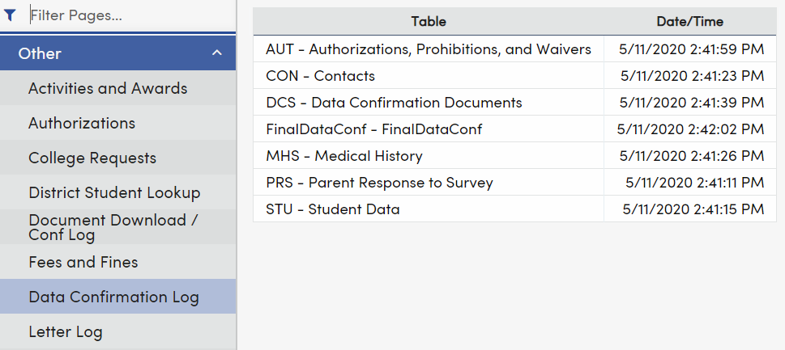
How to Check if Data Confirmation is Complete
To check if an individual student has completed data confirmation, you can look this up in the student’s Aeries profile under Student Data-> Other -> Data Confirmation Log.
In the screenshot below, this student has completed data confirmation on 5/11. Otherwise, the screen would be blank.

Slide 20
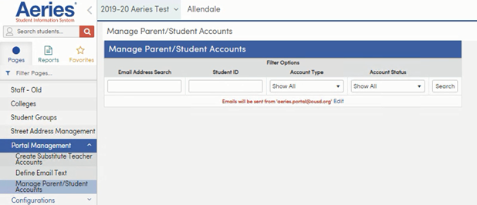
Parent Portal Account Administration
Clerical staff are designated Parent Portal Admins for their schools. You can support families under School Info -> Portal Management -> Manage Parent/Student Accounts (circled in red below)

Slide 21
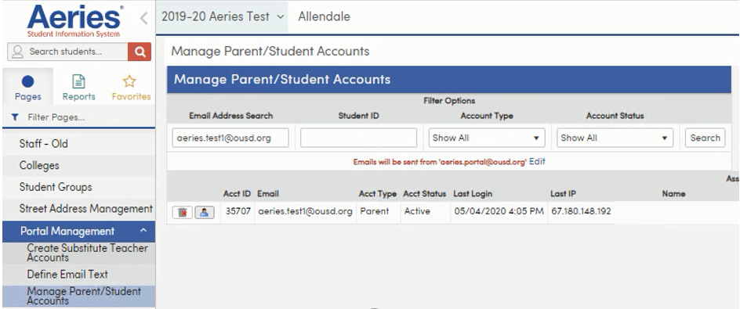
Parent Portal Account Search/Emulation
You can search for a parent portal account by parent email address or student ID When you click on the button in red below, you will be in the parent’s account.

Slide 22
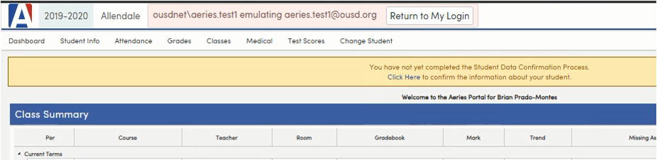
Beginning Data Confirmation/Registration
If the parent has not yet started Data Confirmation/Registration, you’ll see the below screen with a yellow bar at the top. Click the “Click Here” link (circled in red below) to begin Data Confirmation. Please only do this if the student is continuing at your school for 2020-21.

Slide 23
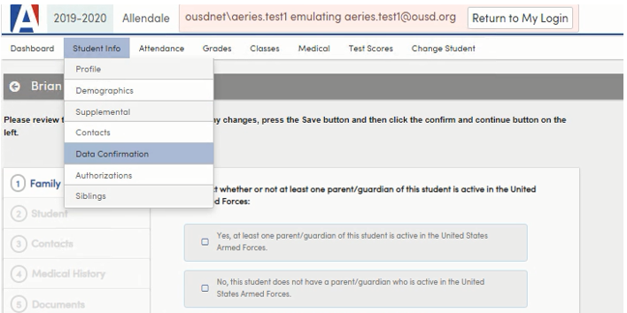
Finishing Data Confirmation/Registration
If the parent has started but not yet completed Data Confirmation/Registration, you can support the parent to complete Data Confirmation by going to Student Info->Data Confirmation (circled in red below).

