Slide 1

Permenter Library orientation
2019-2020

Slide 2

Meet Your Librarian: Ms.Wilson
4th year at Permenter
21st year in Cedar Hill
Loves sports
Goals this year:
  meet every student on campus
  make the library a safe place for all
  share my love of reading with students and staff

Slide 3
Library Hours of Operation
Monday-Friday
7:30 am - 3:00 pm
(Times are subject to change)

Slide 4

AFTER SCHOOL LIBRARY PROCEDURES
No food or drink (unless water)
You can do the following:
  check in & out books
  play games
  read
  color
  relax
  study
  use the computer (for school work only!)
COMING SOON!

Slide 5

Class time Library Visit Procedures
You will visit the library during your ELA class for check in/out
Classes will come every 2 weeks
------------------------------------------
If a teacher sends you to use the computer, finish an assignment, take a test or check-in/out books--YOU MUST HAVE A GREEN LIBRARY PASS WITH YOUR NAME ON IT FROM THE TEACHER!

Slide 6
A few things to know about book check out
Students are allowed THREE book checkouts at one time
Books are checked out for TWO WEEKS
Students with overdue books and/or fines will NOT be allowed to checkout additional books until their account is clear.
**This includes books that were checked out last year and not returned!**

Slide 7

What the library has to offer
book check out (OF COURSE!)
book recommendations
reading
magazines
LEGOs, SnapCircuits, Bloxels, etc.
coloring, crafts, etc.
board games, card games, chess, & checkers
weekly CREATION CORNER (Makerspace) activities
a quiet place to relax
computers
research/random question help

Slide 8
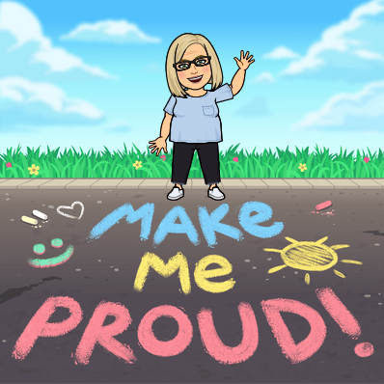
CREATION CORNER (Makerspace)
Every week, Ms. Wilson will list different activities that are available
  For example: origami, snap circuits, duct tape, etc.
The activities will have instructions to support you.
Feel free to alter the instructions as you are creating your product.

Slide 9

Love Ebooks?
We have some resources for Ebooks:
  TexQuest
  Hoopla (Zula B. Wiley Library)

Slide 10

Databases Available For research
Looking for an article about llamas? Or dogs? Or Apollo 11?
Use the Permenter Library Databases
Go to the Permenter Library webpage
Click on Online Resources
Choose one of the databases
  Ask Ms. Wilson or your teacher for the username/
  password

Slide 11
Library Behavior expectations
Enter in a quiet and calm manner
No backpacks (if you have them, put them on the wall)
NO FOOD OR DRINKS
All students MUST SIGN IN AND OUT!

Slide 12
Library Behavior expectations
How will we treat the library resources?
Treat library materials with respect and return them promptly.
You are expected to clean up after yourself!
If you move any chairs/seats/furniture--put it back where you got it from before leaving!

Slide 13

Any questions?
Ms. Melissa Wilson
Permenter Library Media Specialist
melissa.wilson@chisd.net
972-291-5270 ext. 8032

