Slide 1
Our Houses are on POINTE’!
High Pointe’ Elementary Point System

Slide 2
Purpose of the House System
Develop social and leadership skills inside and outside of the classroom.

Slide 3
Our Houses
Red (House of Love)
Orange (House of Excellence)
Yellow (House of Friendship)
Blue (House of Loyalty)
Green (House of Courage)
Purple (House of Honor)

Slide 4


Slide 5


Slide 6


Slide 7
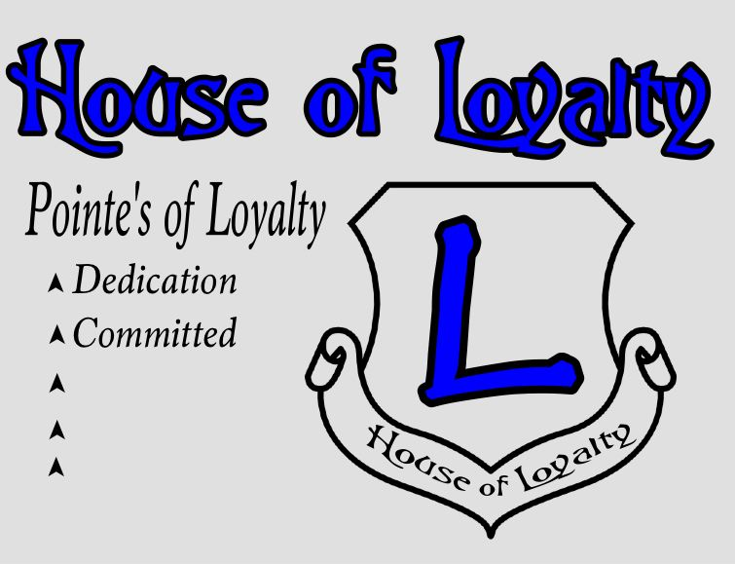

Slide 8


Slide 9


Slide 10
House Rules
Attend House Meetings and Jamborees
Earn Points
Participate in Community Service Project
Display Longhorn Essentials

Slide 11
House Leaders
President
Vice President
Secretary
House Spirit Leaders (Captain & Co-Captain)

Slide 12
House President
Qualifications | Job Duties
5th Grader | Lead House Meetings
Pass All Classes (> 75) | Serve on House Council
Good Behavior (< 1 referral) | Assist House Advisors
Good Attendance (< 2 unexcused absences or tardies per Marking Period) | Display Good Character
Notes:
Character Traits of a Good President
Confident
Dedicated
Good Communicator
Good Decision Maker

Slide 13
House Vice President
Qualifications | Job Duties
4th Grader | Lead Meetings if President absent
Pass All Classes (> 75) | Plan House Celebrations
Good Behavior (< 1 referral) | Assist President
Good Attendance (< 2 unexcused absences or tardies per Marking Period) | Display Good Character
Notes:
Character Traits of a Vice President
Organized
Dependable
Good Communicator
Honest

Slide 14
House Secretary
Qualifications | Job Duties
4th or 5th Grader | Take notes during meetings
Pass All Classes (> 75) | Oversee Service Projects
Good Behavior (< 1 referral) | Assist President and Vice President
Good Attendance (< 2 unexcused absences or tardies per Marking Period) | Display Good Character
Notes:
Character Traits of a Good Secretary
Good Listener
Good Writer
Good Communicator
Detail Oriented

Slide 15
House Spirit Master & Co-Spirit Master
Qualifications | Job Duties
4th or 5th Grader | Create and Lead Chants & Cheers
Pass All Classes (> 75) | Oversee House Morale & Identity
Good Behavior (< 1 referral) | Collaborate with House Leaders
Good Attendance (< 2 unexcused absences or tardies per Marking Period) | Display Good Character
Notes:
Character Traits of a Good Secretary
Good Listener
Good Writer
Good Communicator
Detail Oriented

Slide 16
Pointe’ System
Displaying any Longhorn Essentials - 2pts
Servant Leadership - 2pts
Perfect Attendance - 5pts
“A/B” Honor Roll - 4pts
“A” Honor Roll - 5pts
Community Service - 3pts
Attend Campus Events with an Adult - 4pts
3 Determined by House Council
Pop up points - 3pts

Slide 17
Meeting Locations
Red - Gym
Orange - Music Room
Green - Cafeteria
Purple - Library
Yellow - Room 302
Blue - Room 306

Slide 18
The End

