Slide 1

Collegiate High School Counseling Department Mid-Year Review
December 2021

Slide 2
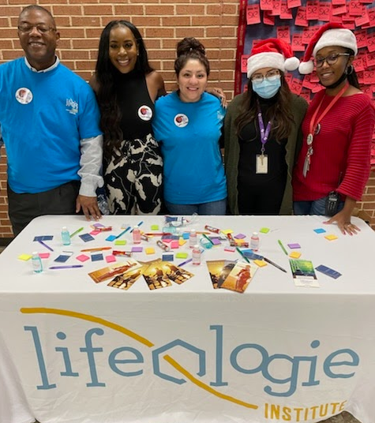
Who We Are
Mission: To develop resilient scholars who excel academically and are empowered to serve
Vision: Unlocking every Longhorn's potential
Motto: Educate. Empower. Inspire.

Slide 3
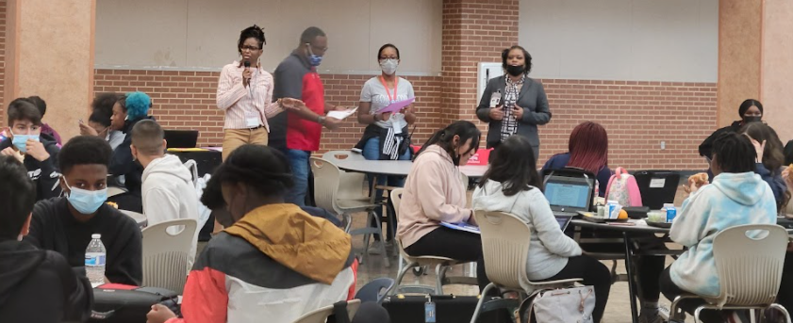
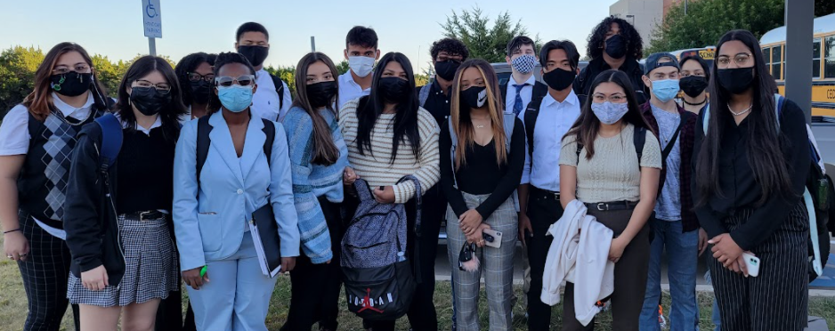
What We Do
ACADEMIC and/or SCHOOL SUPPORT
Repeated absences/tardies
Academic changes
Behavior in Classroom
Learning Difficulties
EMOTIONAL AND BEHAVIORAL
Self-esteem/ Identity
Signs of Depression/Anxiety
Grief/Loss
Attention Concerns
SOCIAL
Peer conflict/bullying
Parent/Family Concerns
Relationships Concerns
HEALTH/BASIC NEEDS
Shortage of basic needs
Eating concerns
Health concerns
Substance Abuse

Slide 4

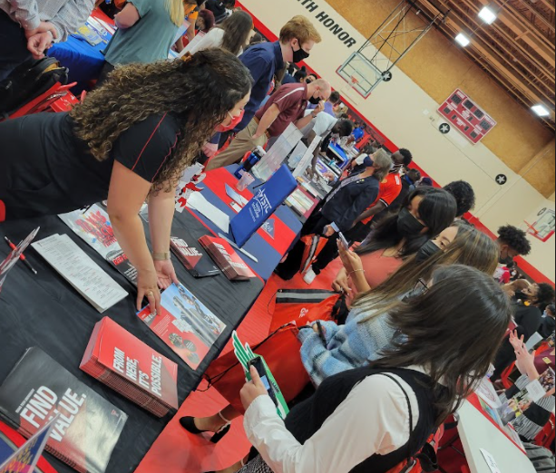


Fall Needs Assessment Data
Personal & Social Development
Improve Communication
Build Healthy Relationships
Positive Self-Esteem
Academic
Time Management
Academic Motivation
Study Skills
College, Career, & Military Readiness
Career Exploration
Academic Goal/Potential
Scholarships

Slide 5
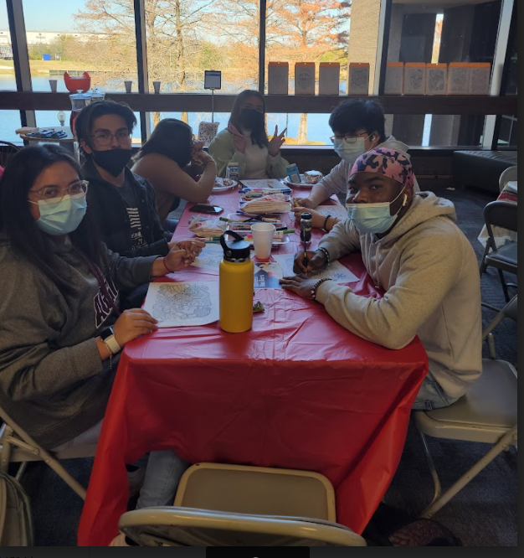
Program Goals
Goal 1: 100% Graduation rate with Associates degree
Goal 2: Motivational Speakers
Goal 3: Build relationships with each scholar

Slide 6
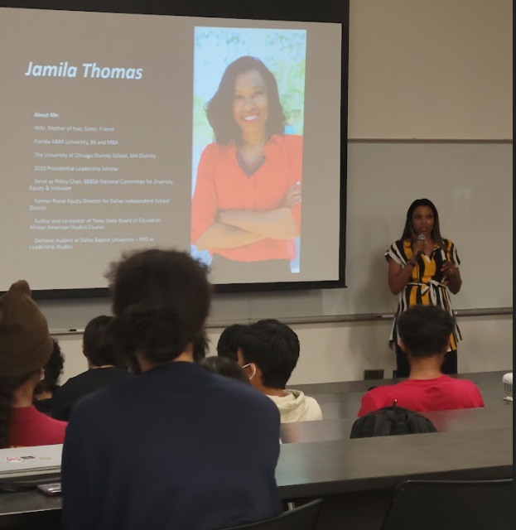
Fall Events
Orientation and Needs Assessment
College Go Get it Week September
1-1 Academic Meeting Sept. - Oct.
Red Ribbon Week October
Kindness (Anti-bullying) Week November
Mental Health Week December
Fall Goal Setting (6 weeks review)
Motivational Speaker
College Representatives

Slide 7
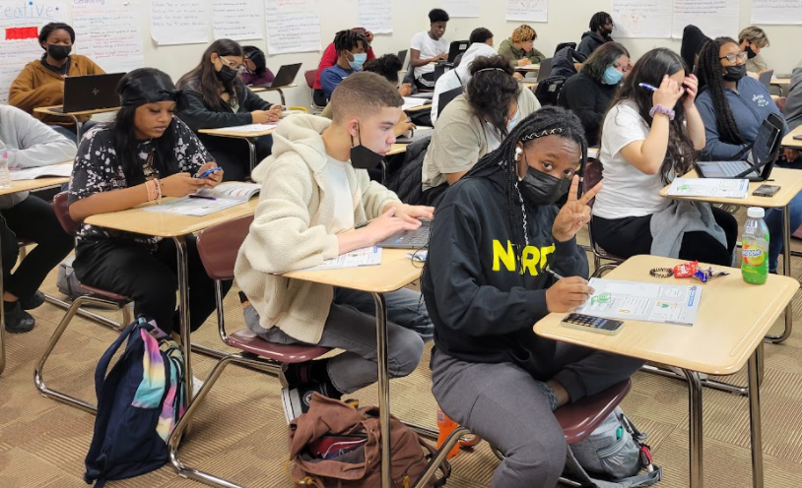
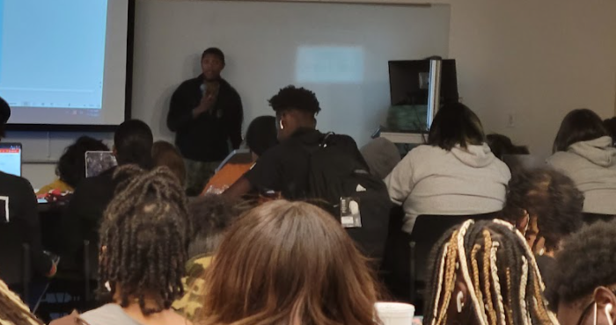
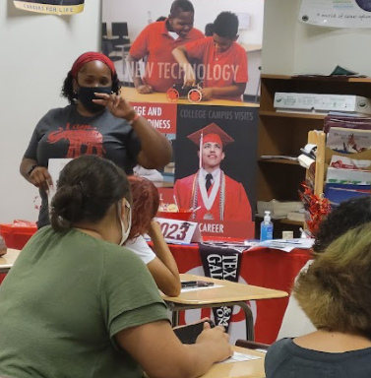
Spring Events
Speakers for Career Day
22-23 Course Selections/1-1 Academic Meetings
Continued Academic Success/Goal Setting
Mental Health Supports (Therapy dogs and speakers)
College and Career Exploration
SAT School Day for Juniors
End of Year Needs Assessment
Class of 2022 Graduation & FAFSA Completion

Slide 8
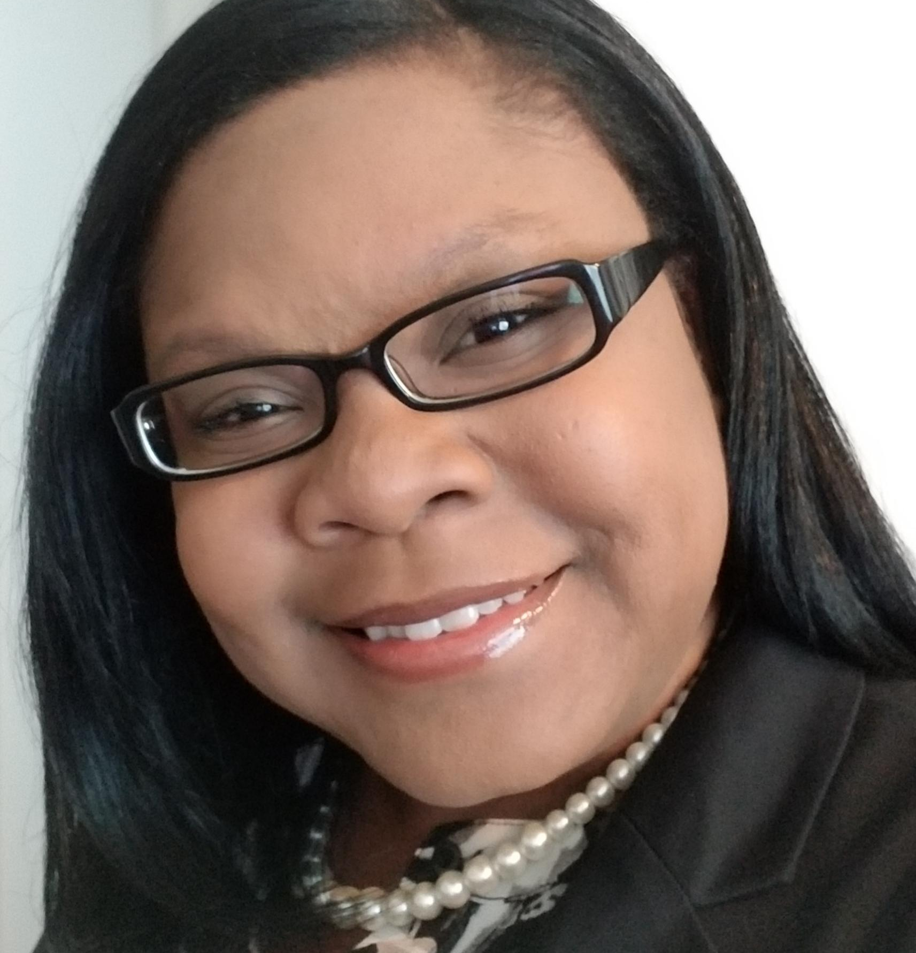
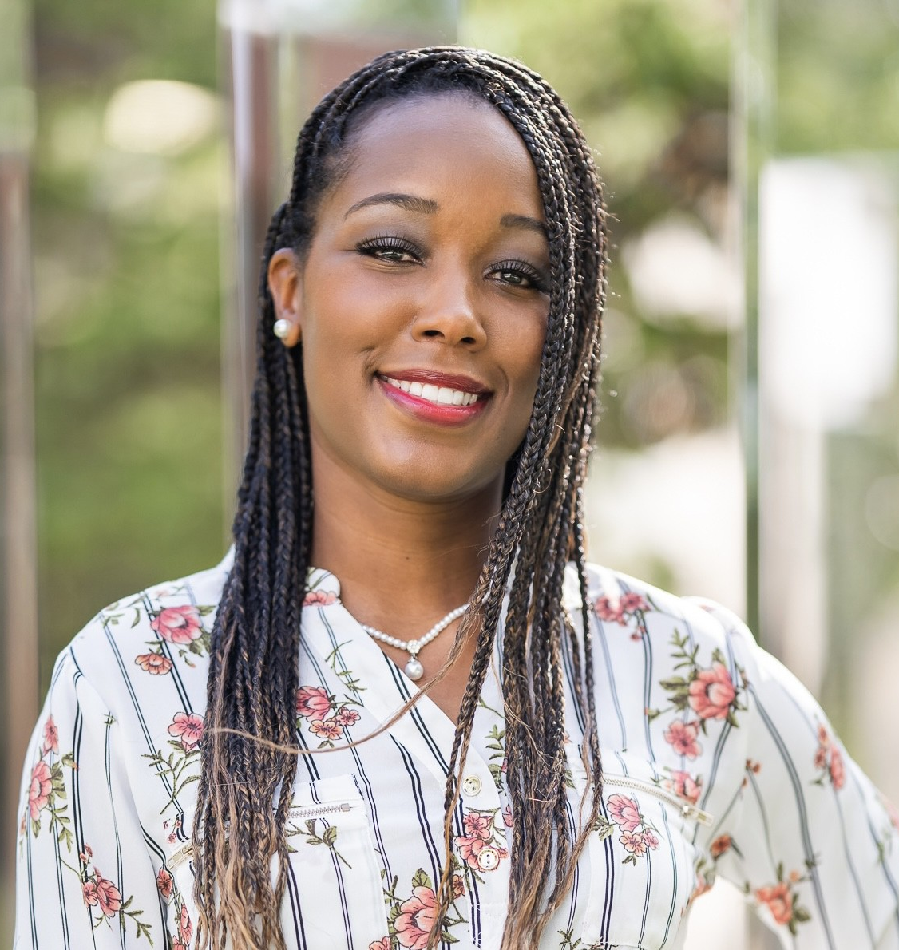
How to Refer to the Counselor
Contact your scholars Counselor
Collegiate High Counselor
Ms. McDaniel
salillian.mcdaniel@chisd.net
469-272-2021 ext. 7805
Collegiate Academy Counselor
Ms. Minor-Chism
candace.minor-chism@chisd.net
469-272-2021 ext 7803

Slide 9

Communities In Schools
Services Provided include:
Tutoring/Grades Monitoring
Mentoring
High School/College Readiness
Goal Setting
Community Service Opportunities
Basic Needs
Steps to receive recommendation form and parent consent form:
Cisdallas.org
‘What we do’
Parent forms
Contact Information
viviana.martinez@chisd.net
(469) 272-2021 ext 7731
Office Hours
Monday - Thursday
8am - 4pm
Viviana Martinez
Site Coordinator

Slide 10
Questions and Feedback

