Slide 1
Improvement Journey
AdvancED/SACS and Strategic Planning
Update
Presented on behalf of:
Dr. Morcease Beasley, Superintendent
Presenter: Dr. Monika M. Wiley

Slide 2
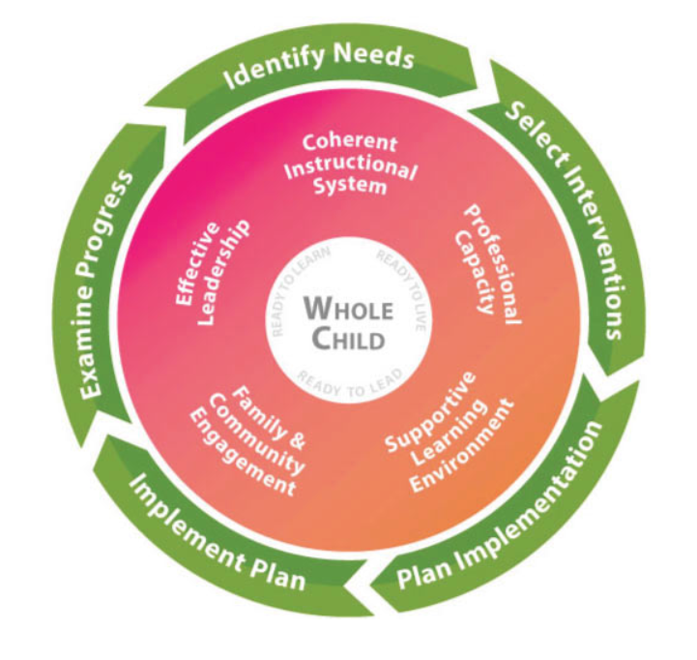
Georgia’s Systems of Continuous Improvement
Clayton County Public Schools
~Strategic Improvement Plan
~Comprehensive Needs Assessment
~AdvancED/SACS
Notes:
Coherent Instructional System – The major system of the complex school organization that articulates and guides the what and how of instruction.
Professional Capacity – A major system of complex school organization that develops a quality staff to reduce the variance of quality in instruction throughout the school.
Supportive Learning Environment – A major system of the complex school organization that ensures students’ school participation and willingness to expend major effort on classroom learning.
Family & Community Engagement – A major system of the complex school organization that develops quality links between local school professionals and the parents and community the school is intended to serve.
Effective Leadership – A major system of the complex school organization that sets the direction for the school, ensures that the school’s staff is capable of meeting that direction, and makes sure the organization functions according to its mission.

Slide 3
Identifying Needs
Mission and Vision
Goals and Core Beliefs
Comprehensive Needs Assessment
AdvancED Surveys
eleot Observations
Notes:
At various times of the year, we will discuss the different improvement components. Today we are going to discuss where we are with identifying our needs. Consult many different sources to determine the needs of the schools.

Slide 4
Committees:
1. Comprehensive Needs Assessment Committee (District)
2. Improvement Journey Committee (Accreditation and Strategic Improvement Plan)
a. Board Members (2)
b. Assistant Principals
c. Teachers
d. Comprehensive Needs Assessment Committee (System Quality Factors)

Slide 5
Strategic Improvement Plan

Slide 6
Community/Staff Meeting:
Input and engagement with the Strategic Improvement Plan and AdvancED. Participants will develop the “new” Mission/Vision, Strategic Goals, and Core Beliefs.
Board of Education Input
The BOE will have the opportunity to give input on the proposed Mission/Vision, Strategic Goals, and Core Beliefs.
Strategic Improvement Plan Survey
All stakeholders will have the opportunity to review the work of the community.
Superintendent’s Recommendation – November 6, 2017

Slide 7


Slide 8
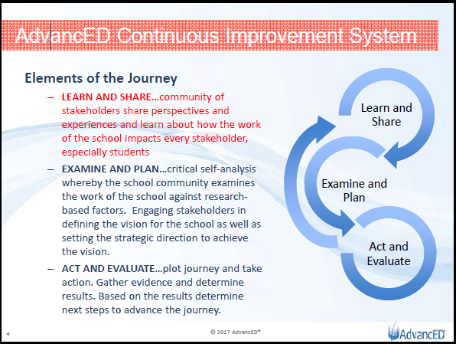
Notes:
Functions independently but its results impact the other elements. The whole is greater than the sum of its parts.

Slide 9
Currently | Moving Forward
Institutions are REQUIRED to conduct an Internal Review process in the year proceeding their External Review. As part of that process they MUST use the following: AdvancED Parent, Student, & Staff Surveys Stakeholder Feedback Diagnostic Student Performance Diagnostic Self Assessment Executive Summary | Institutions are EXPECTED to engage in a process of continuous improvement that: is authentic and inclusive considers that beliefs, perspectives and experiences of all stakeholder groups Addresses research-based factors of school quality and diagnoses areas in need of improvement supports the attainment of clearly defined goals and measurable objectives
Institutions are REQUIRED to submit an AdvancED Prescribed Internal Review Report at least 6-8 weeks prior to their scheduled External Review. The report MUST include the following: Stakeholder Feedback Diagnostic Student Performance Diagnostic Self Assessment Executive Summary Assurances | AdvancED highly RECOMMENDS institutions leverage the suite of research-based tools and resources provided as part of their improvement journey: Surveys (beliefs/perspectives) Inventories (Experiences) Observations – eleot School Quality Factors Diagnostic
AdvancED WILL NOT conduct the External Review until the institution submits their Internal Review Report. | Institutions are ENCOURAGED to provide the Engagement Review Team with evidence and information 3-4 weeks prior to the Engagement Review that demonstrates their commitment to continuous improvement.
 | Institutions are REQUIRED to demonstrate adherence with Accreditation policies/procedures through completion of AdvancED Assurances.
 | The Engagement Review Team will leverage any evidence and information provided by the institution to prepare for the Engagement Review.

Slide 10
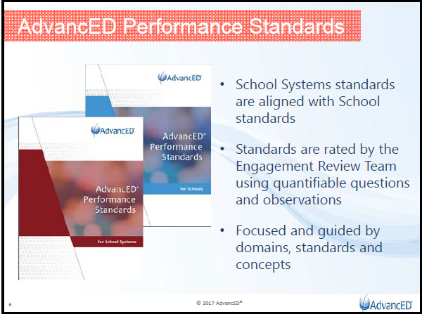
Notes:
Schools/School Systems will not rate themselves on the Standards. Standards used only by the Engagement Review Team.

Slide 11
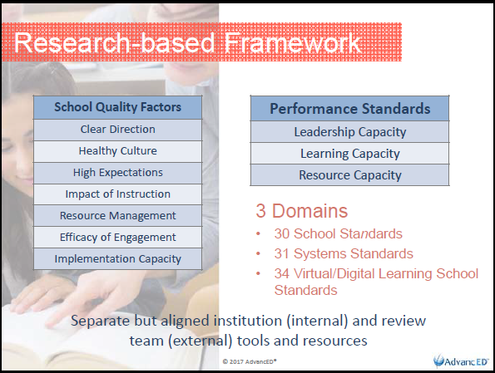
Notes:
Will explain each component during training.
~Separate but aligned institution (internal) and review team (external) tools and resources
~Comprehensive but more easily digestible
~This is where districts/schools upload evidence/artifacts
~Need two Board members to serve on a committee

Slide 12

Surveys
Culture/Climate (new)
Student Engagement (new)
Purpose
Capture the overall culture of the institution through the lens of eight important areas
Taken by
- Students (Grades 3-12)
- Teachers
- Staff
- Parents
Notes:
No longer percentage requirements
District/Schools

Slide 13
Experiences
Inventories
Purpose
Provide opportunity to voice relevant experiences
Indicate frequency of experiences
Types of Inventories
Elementary | Middle School
High School | Teacher

Slide 14

Conduct meaningful classroom observations focused on student engagement.
Equitable Learning Environment
High Expectations Environment
Supportive Learning Environment
Active Learning Environment
Progress Monitoring and Feedback Environment
Well-Managed Learning Environment
Digital Learning Environment
4 – Very Evident | 3 – Evident
2 – Somewhat Evident | 1 – Not Observed

Slide 15
AdvancED System Assurances
AdvancED Policies and Procedures
Substantive Changes
Security and Crisis Management Plan
Financial Transactions
Improvement Plan
AdvancED Standards for Schools
Notes:
Required

Slide 16
Effective Board Governance Observation Items
Physical Setting
Meeting Protocol
Learning
Resources
Rating Guide:
Very Evident – 4 Evident – 3
Somewhat Evident – 2 Not Observed - 1
Notes:
Draft Form – Will conduct observations for at least one hour within three months of our review.

Slide 17
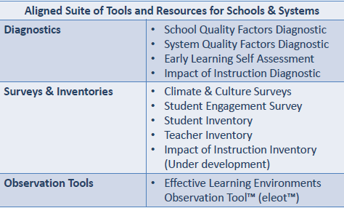
Improvement Journey Components

Slide 18
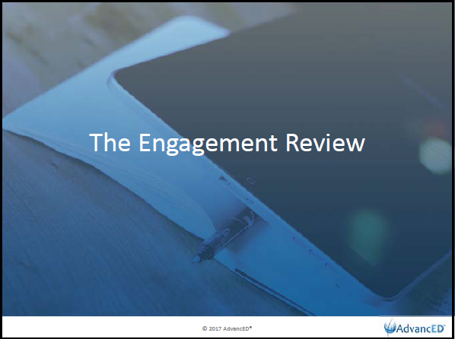

Slide 19
Engagement Review
Align Suite of Tools and Resources for Engagement Review Teams
Diagnostics | Standards Diagnostic(s)
Interview Polls* | Student Interview Teacher/Staff Interview Parent Interview Leader Interview
Observation Tools | Effective Learning Environments Observation Tool (eleot)
Board Observations | At least one hour The team may conduct more than one within three months
*Whole group interviews are not required for the new Engagement Review. The Lead Evaluator will determine if the whole group interviews are needed.

Slide 20
Improvement Journey Timeline

Slide 21
July 19, 2017 | Improvement Journey Committee Meeting (Initial)
July 31, 2017 | Board Presentation – Information regarding new Accreditation process and Strategic Improvement Plan
August 7-25, 2017 | AdvancED Surveys (Parents, Students, Teachers/Staff)
August 15, 2017 | Principals’ Meeting – Information regarding new Accreditation process
August 16, 2017 | Assistant Principals’ Meeting – Information regarding new Accreditation process
August 17, 2017 | Principals’ designee training on eleot and new website portal
August 22, 2017 | CFT – Standards training and rating (District)
August 28, 2017 | Board Presentation – Update (AdvancED Surveys and Training)
September 1-15, 2017 | AdvancED Inventories (Teachers and students)
September 1-30, 2017 | eleot observations (School and district personnel)
September 12, 2017 | Principals’ Meeting – Standards review & rating
September 13, 2017 | Assistant Principals’ Meeting – Standards review and rating

Slide 22
September 19, 2017 | CFT – Analysis of Surveys/Inventories
September 21, 2017 | School/District Quality Factors leadership meeting and training
September 25, 2017 | Board Presentation – Update (AdvancED Inventories)
September 30, 2017 | Community Staff/Meeting – Input and Engagement with Strategic Plan and AdvancED (participants will development “new” mission/vision, Strategic goals, core believes, etc.) – 9:00AM-4:00PM
October 2-31, 2017 | School/District Quality Factors individual team meetings
October 10, 2017 | CFT – Analysis of eleot observations
October 17, 2017 (week of) | Board input on proposed mission/vision, goals, and beliefs (multiple meeting sessions at BOE)
October 23-November 3, 2017 | Strategic Plan survey – Mission/Vision, Beliefs, and Goals
October 30, 2017 | Board Presentation – Update (AdvancED eleot and Community Meeting)
November 6, 2017 | District SQF Report due to Dr. Monika Wiley from leadership team
November 7, 2017 | CFT Meeting to discuss proposed mission/vision, beliefs and goals

Slide 23
November 13, 2017 | Cabinet Meeting to discuss proposed mission/vision, beliefs and goals.
November 27, 2017 | Board Presentation – Update (District SQF Report) Board Presentation – Recommendation for Mission/Vision, Beliefs and Goals
December 4, 2017 | Board Vote – Mission/Vision, Beliefs and Goals
December 15, 2017 | Electronic artifacts due to Dr. Monika Wiley
December 15, 2017 | Schools’ SQF Due in eProve
January 1-31, 2018 | eleot observations (School and district personnel)
January – April 2018 | Strategic Plan – District Committees (Performance Objections, Initiatives, and Action Steps)
January 2018 | Board Presentation (Work Session) – Update on AdvancED submissions
February 1-18, 2018 | Submit AdvancED Documents
February 20, 2018 | CFT – Analysis of eleot observations
March 18-21, 2018 | District’s Engagement Review
April 2018, 2018 | Board Presentation (Work Session) – Update on completed Strategic Plan

Slide 24
Superintendent’s Recommendation
The Superintendent recommends that the BOE nominate and vote upon persons to serve on the District’s AdvancED/Strategic Improvement Plan Committee.

Slide 25
Questions

