Slide 1

postsecondary
CONNECTIONS

Slide 2
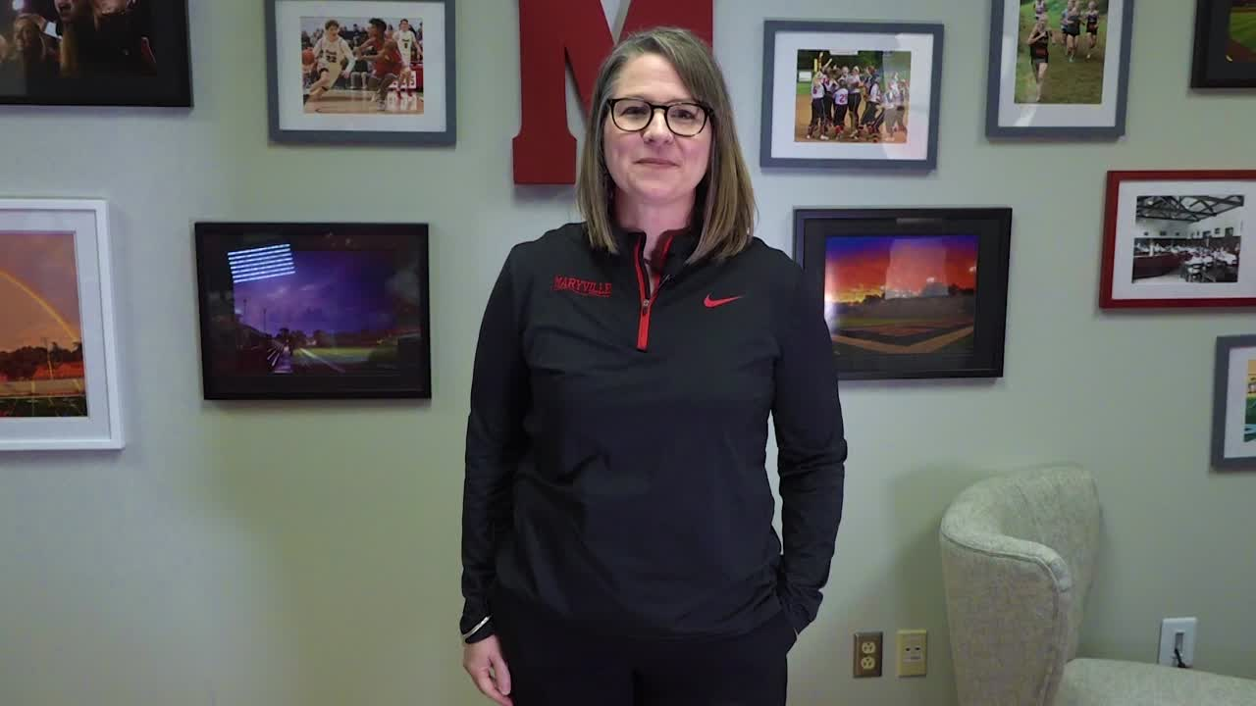


Slide 3
Dear MCS Families,
How many times have we asked kids, " What do you want to be when you grow up"? Who really knew? Such a daunting question as a little kid, but no less confusing as a 17 year old. There are so many options for students, with many career opportunities in the future that have not yet been created. As a school, we want to prepare our students for a bright future, regardless of their interests. We hope to bring awareness to the experiences available within Maryville City Schools and coursework that students can begin now to set them on their future trajectory.

Slide 4
Whether a student knows exactly how they want to impact the world or is still thinking through their post-high school options, this guide will help support conversations by sharing key experiences students need for their future. Regardless of where a student is headed after high school, there are a series of critical skills needed for success:
grit
communication skills
collaboration skills
critical thinking skills
problem solving skills
Rigorous academic courses paired with the development of these critical skills will prepare our students to navigate the next steps in their journey.

Slide 5
We recognize that families and students are asking more critical questions these days, including how to make the most cost conscious decisions when it comes to postsecondary options.
  Is it necessary to attend a four-year college to excel in a particular field?
  Would a two-year college program provide a more appropriate technical degree?
  Perhaps an apprenticeship leading to certification and employment with a local company fits the bill?

Slide 6
College and career are not mutually exclusive.

Slide 7
We are proud to offer our students a rigorous and high quality education that can lead to a variety of postsecondary experiences.
Postsecondary Academic Experiences- a collection of courses and training/education opportunities that are common across several related Career Areas to prepare students for a given career/area of interest. The experience spans from high school to post-high school education including on-the-job training, certificates, and two and four year college. Each experience aligns with the skills and education needed that have been identified by business, industry, and higher education.

Slide 8
This guide is designed to clarify the postsecondary experiences that will allow each student to personalize their high school experience, incorporate classes that will lead to their future employment, certification, training programs, college major, career, and ultimately their own success. Along with general information about each experience, the guide shares what education, training, and skills are needed to succeed.
We want our students to have a competitive advantage regardless of their dreams after high school.

Slide 9
So, as you move forward with considering life after Maryville City Schools, perhaps the questions to discuss next are:
What impact do you want to have on the world?
What lifestyle do you hope to have?
What interests do you have?
How can those interests be crafted into a future career?
What do you see yourself doing "right now"?

Slide 10
The forever decision is not necessary right now, unless you know exactly what's next for you. Let's just take the next best step together toward your future. Let's discover your interests and strengths and pair them with the experiences available in Maryville City Schools before heavy decisions and costly investments accumulate in postsecondary experiences.
We are grateful to be the launching site for your incredible journey.
Sincerely,
MCS Faculty and Staff

Slide 11
table of
CONTENTS
Each item below is a hyperlink to additional information.
  Earning Postsecondary Credit in High School
  Work-Based Learning Experiences
  Apprenticeship Opportunities
  Industry 4.0 Diploma Distinction
  Career and Technical Education Experiences
  Glossary of Terms

Slide 12
Ways to earn Postsecondary Credit
Early postsecondary opportunities (EPSOs) include a course and/or exam that give students a chance to obtain postsecondary credit while still in high school.
Early postsecondary opportunities allow students to:
  Earn postsecondary credits while in high school.
  Become familiar with postsecondary rigor and expectations.
  Develop confidence and skills for success in postsecondary learning.
  Make informed postsecondary and career decisions.
  Decrease the time and cost of completing a certificate or degree.

Slide 13







Maryville High School is proud to offer a variety of EPSO earning opportunities for students:

Slide 14

High school students are encouraged to focus their elective credits on robust, career-aligned learning experiences.
Industry certifications (IC) are earned through secondary and postsecondary career and technical education programs and courses. Industry certifications are work-related credentials, certifications or licenses that verify qualifications of competence in a specific skill set relates to a particular industry or occupation
Industry Certifications are accepted by employers as a recognized credential.
Certification Options
Level I Siemens Certified Mechatronic Systems Assistant
NCCER Core Curriculum
Adobe Certified Associate: Photoshop
Adobe Certified Associate: Illustrator
Certified Nursing Assistant Certification
OSHA 10
Emergency Medical Responder Certification
Personal Trainer Certification
Physical Therapist Aide Certification
ServSafe
CompTIA IT Fundamentals +
Comp TIA A+
Comp TIA Network
FAA Remote Pilot Certification
Hootsuite Platform and/or Social Certifications
Microsoft Office Specialist Certifications
Certified Solidworks Associate - Academic Autodesk Inventor Certified User

Slide 15
Course Options
Statewide dual credit (SDC) classes are college-level courses taught at the high school level by trained high-school teachers.
All students enrolled in a statewide dual credit course take the online challenge exam, which is used to assess mastery of the postsecondary-level learning objectives.
Students which meet or exceed the exam ‘cut score’ receive college credit that can be applied to any Tennessee public postsecondary institution.
SDC Pre-Calculus
SDC Pre-Calculus Honors
SDC Intro to Probability and Statistics
SDC Psychology
SDC World History
SDC US History H
SDC US History
SDC Intro to Communication
SDC Introduction to Business
SDC Criminal Justice 2

Slide 16
Course Options
Local dual credit (LDC)is a high school course aligned to a local postsecondary institution’s course and exam.
Students who pass the exam earn credits that are accepted and/or recognized by the local postsecondary institution. Courses are taught by licensed high school teachers or certified college instructors approved by the school system and the postsecondary institution. Maryville HS works with Pellissippi State Community College to offer LDC opportunities to our students.
LDC Studio Art/Digital Photo
LDC Theatre 2: Intermediate
LDC Web Design Foundations
LDC Web Site Development
LDC Computer Systems
LDC Advanced Computer Apps
LDC Marketing 1
LDC Marketing 2
LDC Culinary 2
LDC Culinary 3
LDC A/V Production 1
LDC A/V Production 2
LDC Digital Electronics

Slide 17



Eligible students must have completed at least the sophomore year of high school with a minimum cumulative grade-point average of 2.5 on a 4.0 scale. In order to apply for dual enrollment, be sure to select “Dual Enrollment HS Students Only” on your application for admission. Also submit a completed application form authorized by TSAC regarding Dual Enrollment and a written recommendation from the high school principal, teacher, or counselor.
Dual enrollment (DE) is a postsecondary course, taught either at the postsecondary institution,at the high school, or online, by postsecondary faculty or credentialed adjunct faculty. Students are enrolled at the postsecondary institution and earn postsecondary credit upon completion of the course.
Students who meet the qualifications will be eligible for five (5) $540.00 scholarships during their final two years of high school. This scholarship is provided through the Lottery Corporation.
MHS students who have ACT subscores of 19 or higher (an 18 in English, or a 19 in Reading, or a 19 or higher for math or science course), along with an unweighted 3.0 G.P.A., have the privilege of earning college credit through Pellissippi State. Students wishing to pursue college credit must meet several criteria. Successful completion of a dual enrollment course results in an EPSO.
Courses will be taught on the Maryville College campus. Students who have ACT subscores of 21 or higher, along with a 3.0 G.P.A., have the privilege of earning college credit for these courses. For students who are approved for the dual enrollment grant, the only cost will be the cost of a textbook. This is a 3-hour college course that is transferable. Successful completion of a dual enrollment course results in an EPSO.

Slide 18
Ruth and Steve West Workforce Development Center
located on the Pellissippi Blount County Campus
High School students should begin in the programming at MHS and then move into these programs for Dual Enrollment or for their postsecondary experience.
The workforce development center will include four Pellissippi State programs:
  Computer Information Technology, Cyber Defense, and Networking concentrations
  Culinary Arts, including its new Baking and Pastry Arts option
  Business Management and Hospitality Management concentrations
  Electrical Engineering Technology
The workforce development center will also include three TCAT Knoxville programs:
  Industrial Maintenance/Mechatronics
  Machine Tool Technology
  Welding Technology

Slide 19
Early College Experience
The Early College Experience is a dual enrollment pathway allowing students to earn 30 hours of college credit during their junior and senior years while remaining connected to Maryville High School. The classes for this program are predetermined between MHS and Pellissippi State to provide an experience where students take general education requirements that are reciprocated with state colleges and apply to most majors.
This opportunity takes advantage of the Dual Enrollment Grant and a scholarship offered by Pellissippi State to cover tuition for all students who are accepted into the program. Student candidates must meet GPA requirements, teacher recommendation, ACT/Pre-ACT/SAT/PSAT/Accuplacer scores to be eligible. A student who is accepted into the program will follow the course sequence on the next page.
Students who wish to enroll in differing coursework would do so under the traditional dual enrollment format. They would not be a part of this program and thus not eligible for the Pellissippi State scholarship associated with the Early College Experience.

Slide 20
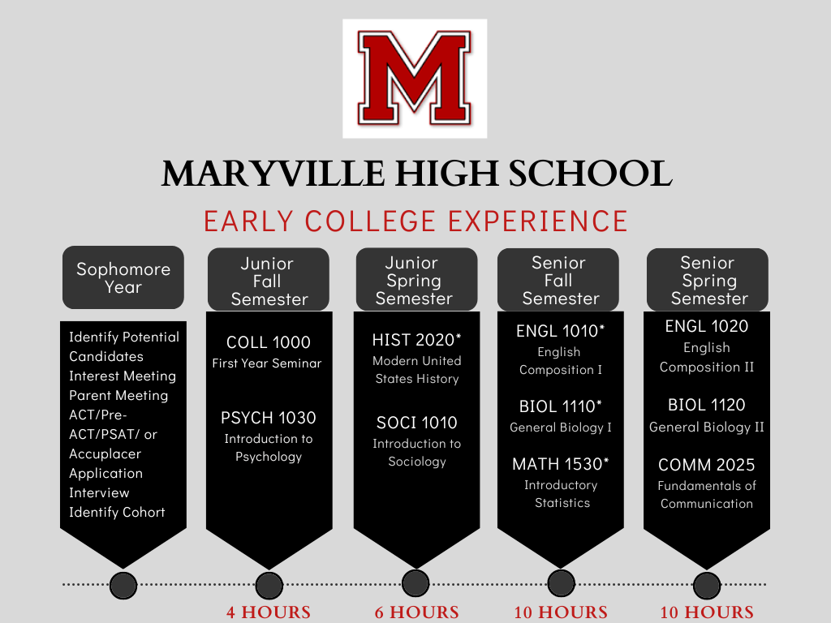

Slide 21
Advanced Placement (AP) is designed to provide students with an opportunity to receive college credit for introductory college courses and move directly to more interesting and challenging courses. All courses are taught according to the College Board Advanced Placement guidelines and students will use college level texts. To qualify for college credit, Advanced Placement exams must be taken on a specific date and hour during the second or third week of May. Each test is designed and will be scored by the Educational Testing Service. Students who choose to take AP course work are expected to take the AP exam and will be responsible for its cost. Students who perform well can receive course credit and/or advanced standing at thousands of colleges and universities worldwide.
Course Options:
https://apstudents.collegeboard.org/getting-credit-placement/search-policies
AP Art History
AP Biology
AP English 3
AP English 4
AP Calculus AB
AP Calculus BC
AP Computer Science
AP Chemistry
AP Economics
AP Environmental Science
AP French
AP Government
AP Human Geography (MJHS & MHS)
AP European History
AP Latin
AP Music Theory
AP Physics 1
AP Physics 2
AP Psychology
AP Research
AP Seminar
AP Spanish
AP Statistics
AP Studio Art Drawing, Studio Art 3D, Studio Art 2D
AP United States History
AP World History

Slide 22
College Level Examination Program
Developed by the College Board, College Level Examination Program (CLEP) exams can be taken by students to earn postsecondary credit. CLEP offers 34 exams that cover introductory level college course material. With a passing score on one CLEP exam, you could earn three or more college credits at 2,900 U.S. colleges and universities. Students can earn credit for postsecondary coursework in a specific subject. Maryville High School is a testing center for CLEP exams.
Click below to learn more about CLEP exams.
Please see https://clep.collegeboard.org/clep-college-credit-policy-search so students can access the CLEP policy of their desired college.

Slide 23
Work-Based Learning Opportunities
Work-Based Learning (WBL) experiences are activities at the high school level that involve actual work experience or connect classroom learning to work. Students have the opportunity to earn course credit while learning how to apply classroom concepts and theories in the workplace through paid or unpaid placements.
WBL experiences can be a capstone course for all Career and Technical Education programs of study.
WBL is open to 11th and 12th grade students who have earned a minimum of 2 credits in a CTE program of study.

Slide 24
Apprenticeship.......
is an opportunity for junior or senior level students who have completed a career experience at MHS. It is an employer driven model that combines structured on-the-job training with job-related instruction at a school or training program tied to the attainment of industry-recognized skills standards and leading into an industry credential.
Youth apprenticeship graduates have skills for a successful career in a specialized field and can continue with adult apprenticeship, be hired full time with business, or continue their education and training for more advanced credentials or degrees.
Current participating programs include Culinary, Construction, Health Science, Manufacturing, and Information Technology
Complete two or more courses in one CTE Experience Area
Current Job Postings:
https://tvyaworks.org/

Slide 25
Industry 4.0 Distinction
Students who are interested in pursuing a career in a high-need, high skill industry after graduation may earn this distinction.
For a student to receive this distinction, the students must participate in monthly career counseling and enroll in work-based learning or dual enrollment coursework in their 11th and 12th grade year.
Before the end of the student's 10th grade year, the student and parent must submit documentation stating the student's intent to pursue an Industry 4.0 Distinction.

Slide 26
Career and Technical Education
EXPERIENCES
  Advanced Manufacturing/Mechatronics
  Architecture and Construction
  Audio/Visual Production
  Digital Arts and Design
  Health Science: Certified Nursing Assistant
  Health Science: Emergency Medical Service
  Health Science: Exercise Science
  Hospitality and Tourism: Culinary Arts
  Information Technology: Web Design
  Information Technology: Networking Systems
  Law Enforcement Services
  Maryville Business Academy
  STEM: Engineering
  STEM: Technology
  Teaching as a Profession
MCS offers a variety of
experiences.
Click on the program name to learn more.

Slide 27
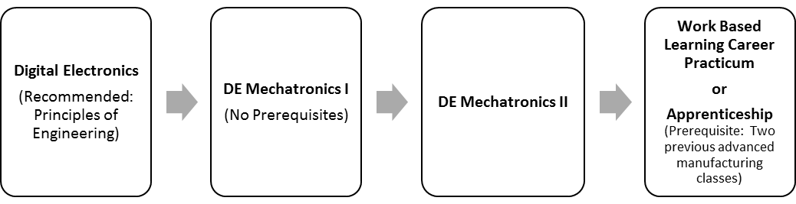
Advanced Manufacturing / Mechatronics Experience
ABOUT THE PROGRAM OF STUDY
The Mechatronics program of study is designed for students interested in becoming a mechatronics technician, electrical technician, mechanical engineering technician, robotics technician, or mechatronics engineer. Course content focuses on the components of manufacturing systems, collection and analysis of quality data, electronics, mechanics, fluid power systems, computers and control systems, and technical documentation and troubleshooting. Upon completion of this program of study, proficient students will be prepared to pursue industry certification at a technology college or more advanced coursework at a two-year or four-year postsecondary institution.
Industry Certifications options include:
Level I Siemens Certified Mechatronic Systems Assistant
LDC Digital Fundamentals
Course Sequence

Slide 28
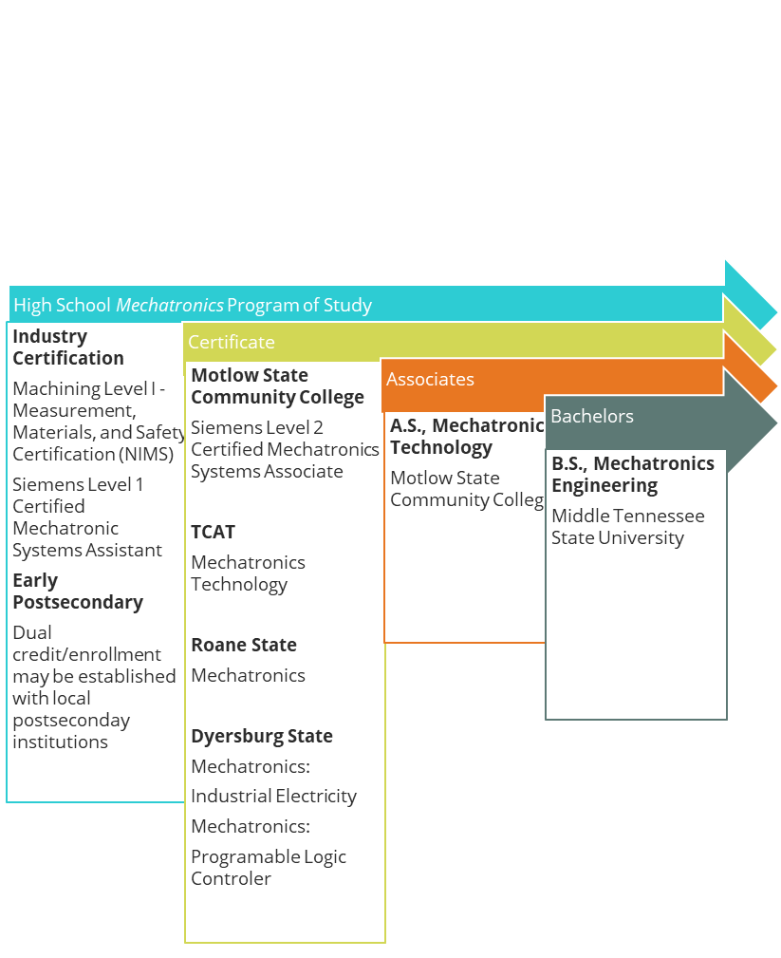
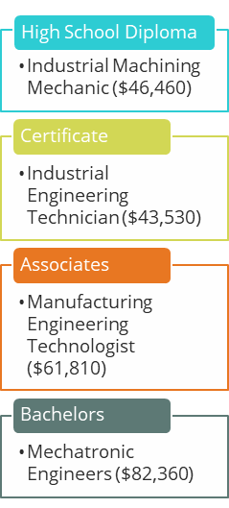


Slide 29
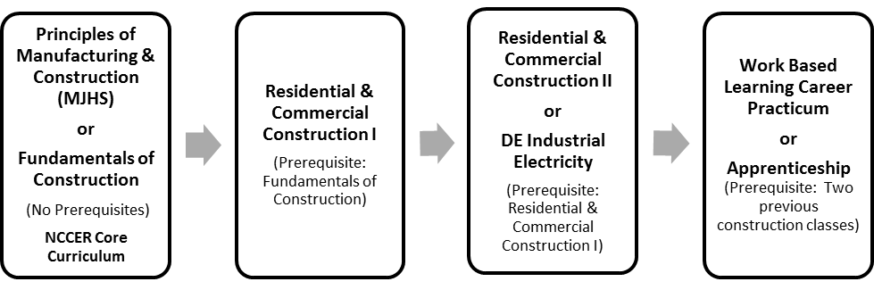
Architecture and Construction Experience
ABOUT THE PROGRAM OF STUDY
The Residential & Commercial Construction program of study prepares students for the various disciplines of construction, providing students with the opportunity to develop a holistic understanding of the building systems and components required for a construction project. Students will be able to interpret construction drawings, perform basic math skills, demonstrate the construction crafts required for each phase of a construction project, and safely use and maintain appropriate tools, equipment, and resources to accomplish construction project goals. Course content covers industry specific business concepts, project management, and career opportunities.
Industry certification options include:
• NCCER Core Curriculum
Course Sequence

Slide 30
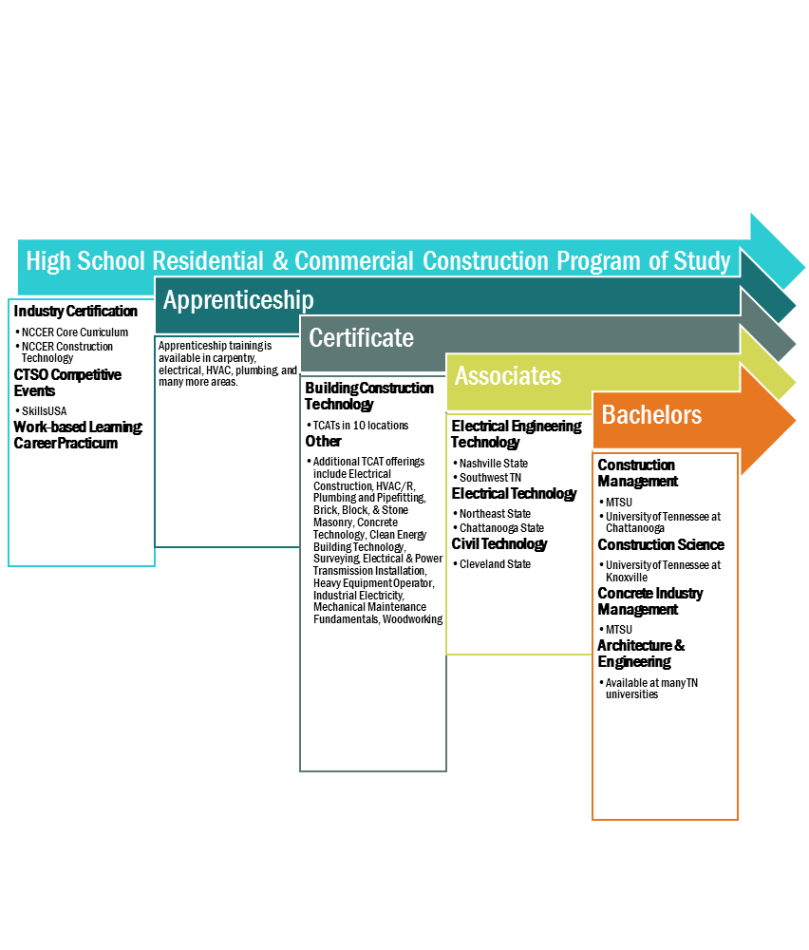
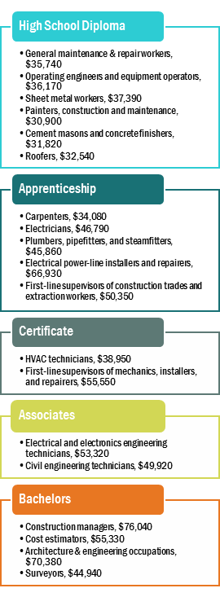

Slide 31
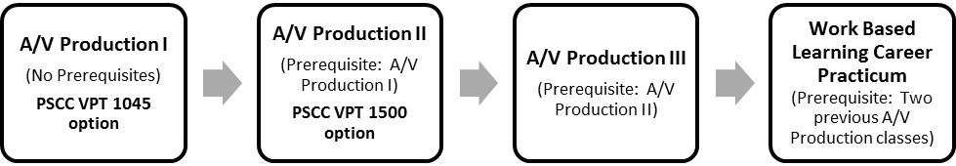
Arts, Audio/Visual Technology and Communications Experience :
Audio/Visual Production
ABOUT THE PROGRAM OF STUDY
The A/V Production program of study is designed for students interested in a range of entertainment and news media fields. Course content centers on production of various television, cinema, radio, and other audio and video products, including commercials, music, news, interactive programming, and film. Students complete all phases of the production process including planning, coordinating, capturing, editing, and distributing productions. Topics include, but are not limited to, concept creation, scripting, interviewing, budgeting, scheduling, set design, engineering, field and studio production, and editing, as well as operating production equipment such as cameras, lights, and audio equipment.
Dual credit/ dual enrollment options include:
Technical Video Production and Campus Broadcast II with Pellissippi
Course Sequence

Slide 32
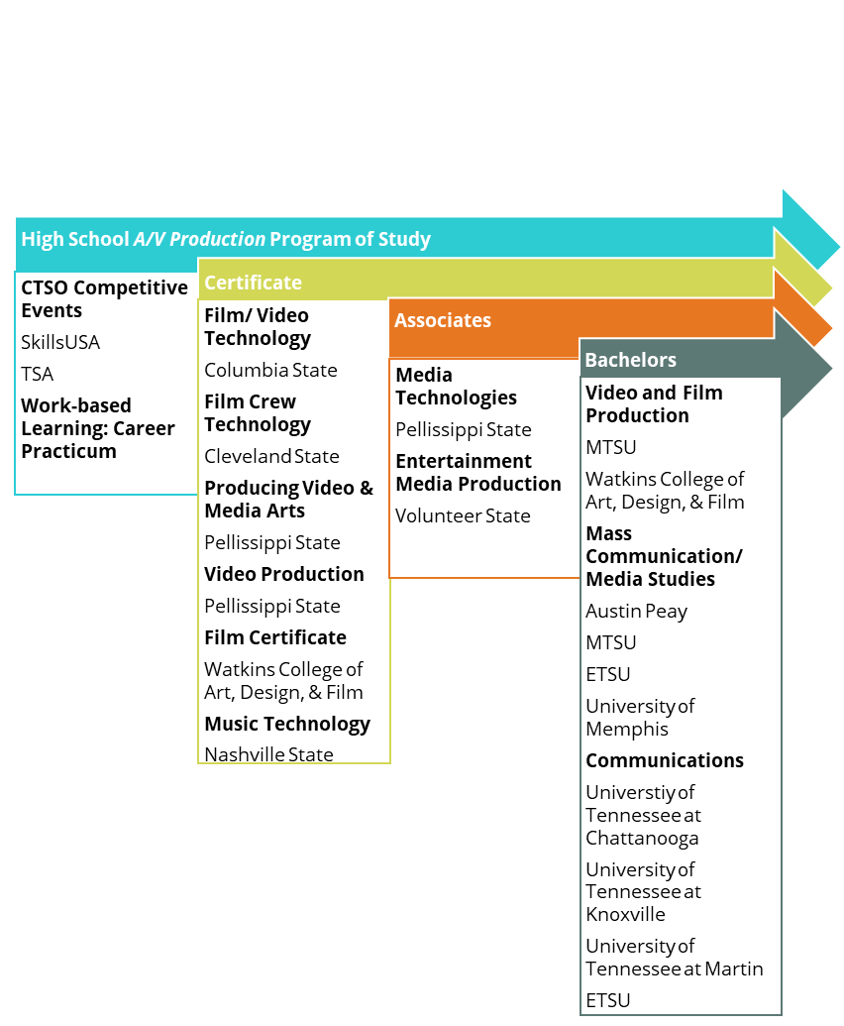
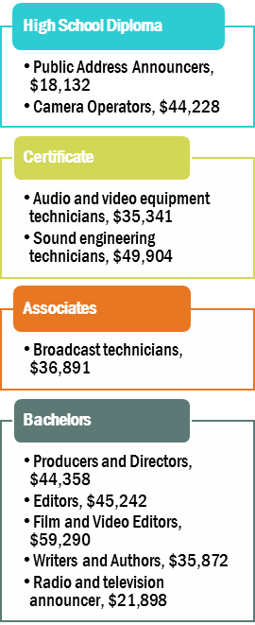

Slide 33
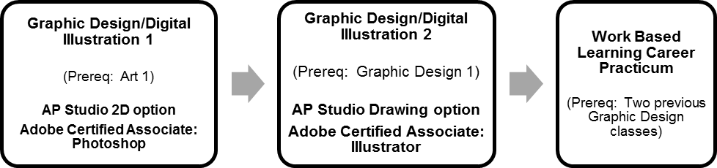
Arts, Audio/Visual Technology and Communications Experience :
Digital Arts and Design
ABOUT THE PROGRAM OF STUDY
The Digital Arts & Design program of study is for students interested in pursuing careers as multimedia artists, animators, graphic designers, and communications specialists. Course content is designed to develop strong knowledge in communications technologies, animation and software applications, digital graphics, motion graphics, and more for a broad range of business and industry applications. Students will leverage digital tools to gather, evaluate, and use information, and apply design skills in the communication of materials as they would for an organization or company. Upon completion of the program of study, students will be prepared to pursue advanced study in graphic design or communications, or seek entry level employment with such organizations.
Industry Certification options include:
Adobe Certified Associate: Photoshop and Illustrator
Course Sequence

Slide 34
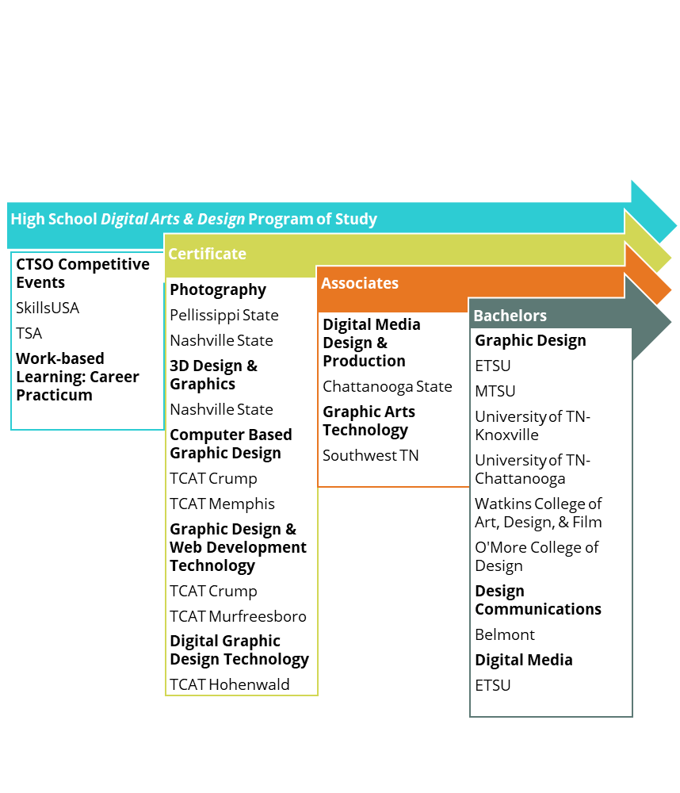
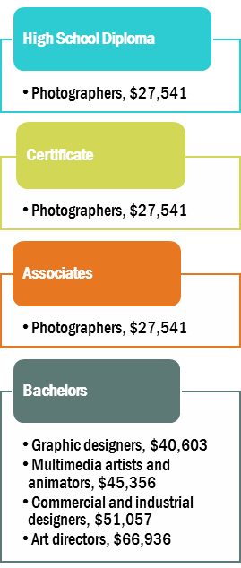

Slide 35
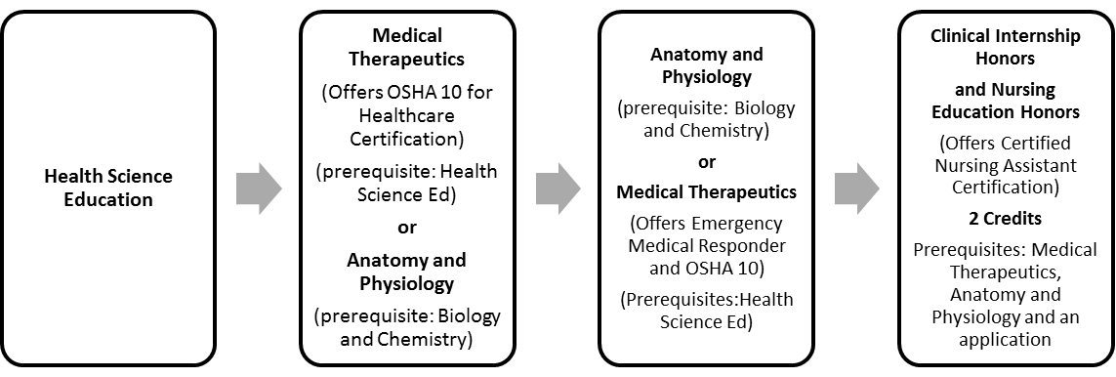
Health Science Experience :
Certified Nursing Assistant
ABOUT THI PROGRAM OF STUDY
Therapeutic Nursing Services is designed to prepare students to pursue careers in the field of nursing. Upon completion of this program, a proficient student will be able to implement communication and interpersonal skills, maintain residents’ rights and independence, provide care safely, prevent emergency situations, prevent infection through infection control, and perform the skills required of a nursing assistant. Students will log forty hours of site-based clinical work with at least 24 of those hours spent in a long-term care facility as part of the Level 4 course.
Course Sequence
Industry Certifications options include:
Certified Nursing Assistant Certification and OSHA 10

Slide 36
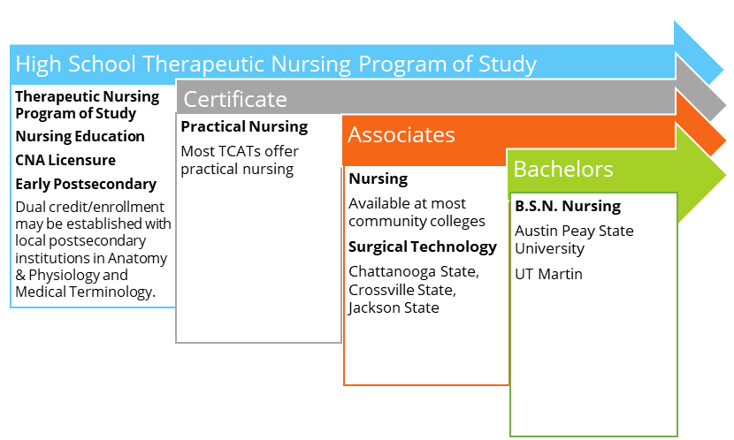
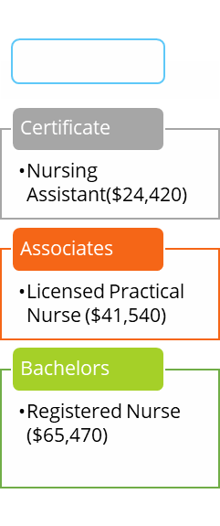

Slide 37
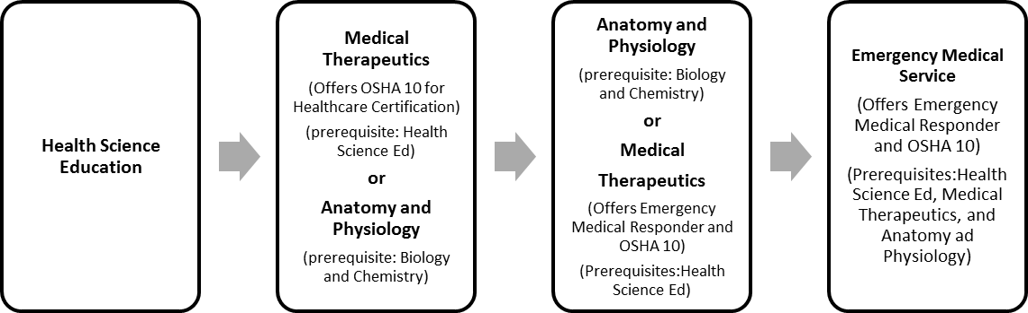
Health Science Experience :
Emergency Medical Service
ABOUT THE PROGRAM OF STUDY
The Emergency Services program of study is designed to prepare students to pursue careers in the fields of emergency medicine. Upon completion, proficient students will be able to identify careers and features of the EMS system; define the importance of workforce safety and wellness; maintain legal and ethical guidelines; correlate anatomy and physiology concepts to the patient with a medical or traumatic injury; and perform EMS skills with a high level of proficiency. This course is taught with an EMT instructor, and students will be given the opportunity to sit for the National Emergency Medical Responder certification.
Industry Certifications options include:
Emergency Medical Responder Certification and OSHA 10
Course Sequence

Slide 38
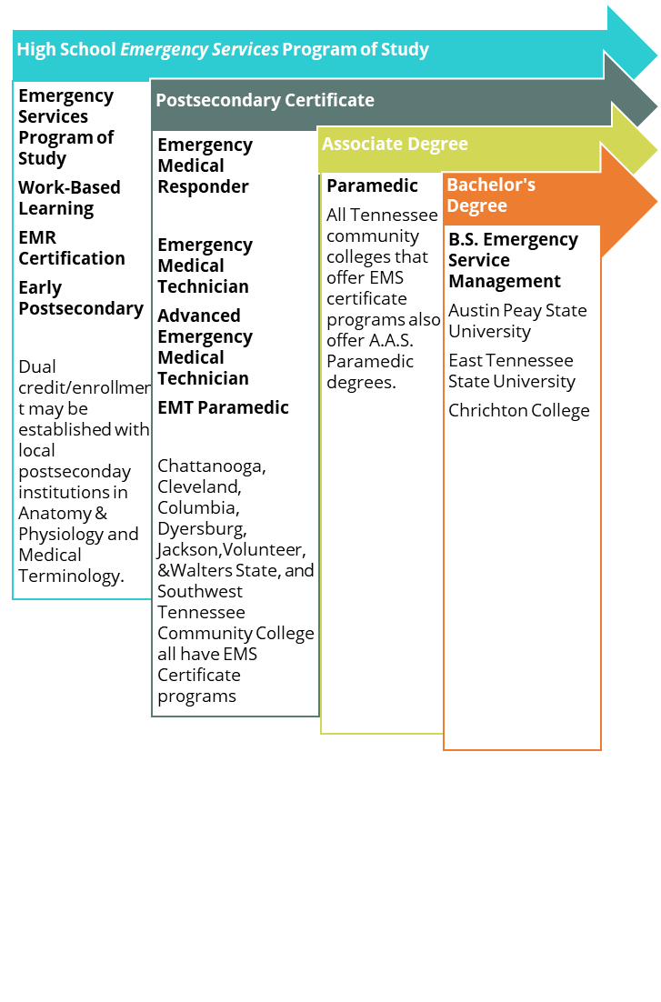
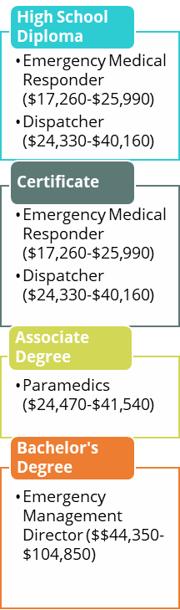

Slide 39
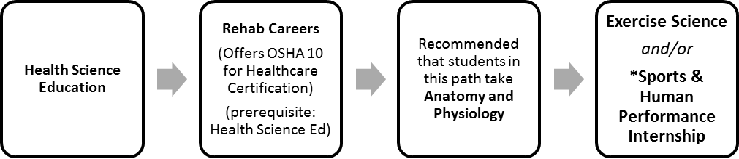
Health Science Experience :
Exercise Science
ABOUT THE PROGRAM OF STUDY
Exercise Physiology is designed to prepare students to pursue careers in kinesiology and exercise physiology services. Upon completion, proficient students will be able to apply concepts of anatomy and physiology, physics, chemistry, bioenergetics, and kinesiology to specific exercise science contexts. Through these connections students will understand the importance that exercise, nutrition, and rehabilitation play in athletes or patients with debilitating or acute metabolic, orthopedic, neurological, psychological, and cardiovascular disorders.
Industry Certification Options Include:
OSHA 10, Personal Trainer Certification or Physical Therapist Aide Certification
Course Sequence

Slide 40
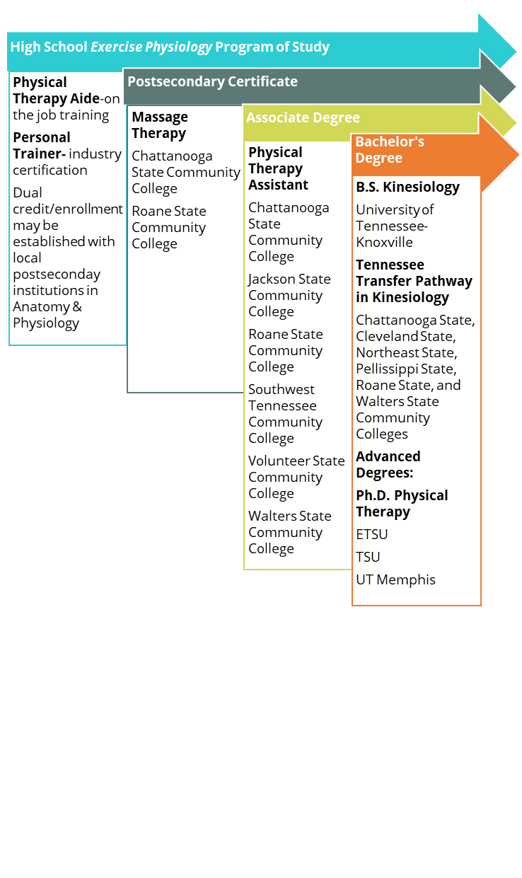
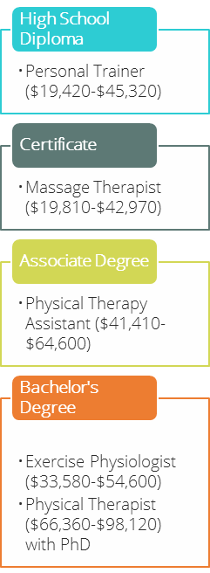

Slide 41
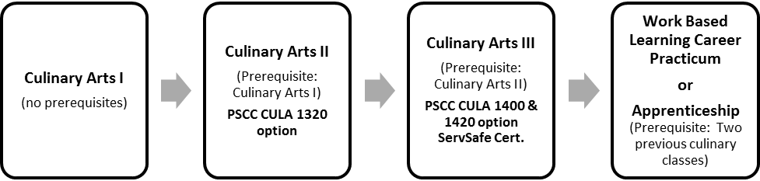
Hospitality and Tourism Experience:
Culinary Arts
ABOUT THE PROGRAM OF STUDY
Culinary Arts equips students with the foundational skills necessary to pursue careers in the culinary field as a banquet chef, caterer, executive chef, and food and beverage manager. Courses cover topics that range from kitchen safety and sanitation, history of the foodservices industry, careers, nutrition, recipe basics, proper kitchen tools and equipment, and kitchen staples, to food presentation, advanced cooking principles, bakeshop preparation skills, professionalism, and business opportunities.
Dual Enrollment/Industry Certification Options Include:
ServSafe Certification
LDC Culinary 1 , LDC Sanitation and Food Safety, LDC Nutrition for Culinary
Course Sequence

Slide 42
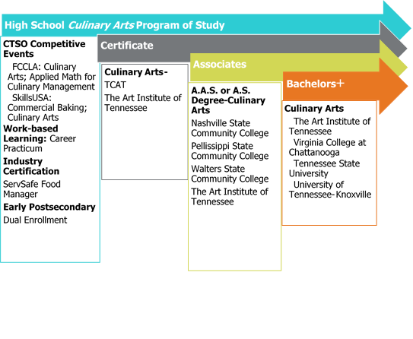
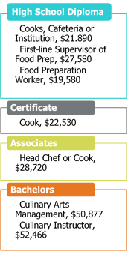

Slide 43

Information Technology Experience:
Web Design
ABOUT THE PROGRAM OF STUDY
The Web Design program of study is designed for students interested in designing and creating websites. Students will develop fundamental skills in both theory and practical application of the basic web design and development process, project management and teamwork, troubleshooting and problem solving, and interpersonal skill development. Emphasis is also placed on applying the design process toward projects of increasing sophistication, culminating in the production of a functional, static website. As students work toward this goal, they will acquire key skills in coding, project management, basic troubleshooting and validation, and content development and analysis.
Dual Enrollment/Industry Certifications options include:
CompTIA IT Fundamentals +
LDC Design Basics for Web and Print and LDC Web Design
Course Sequence

Slide 44
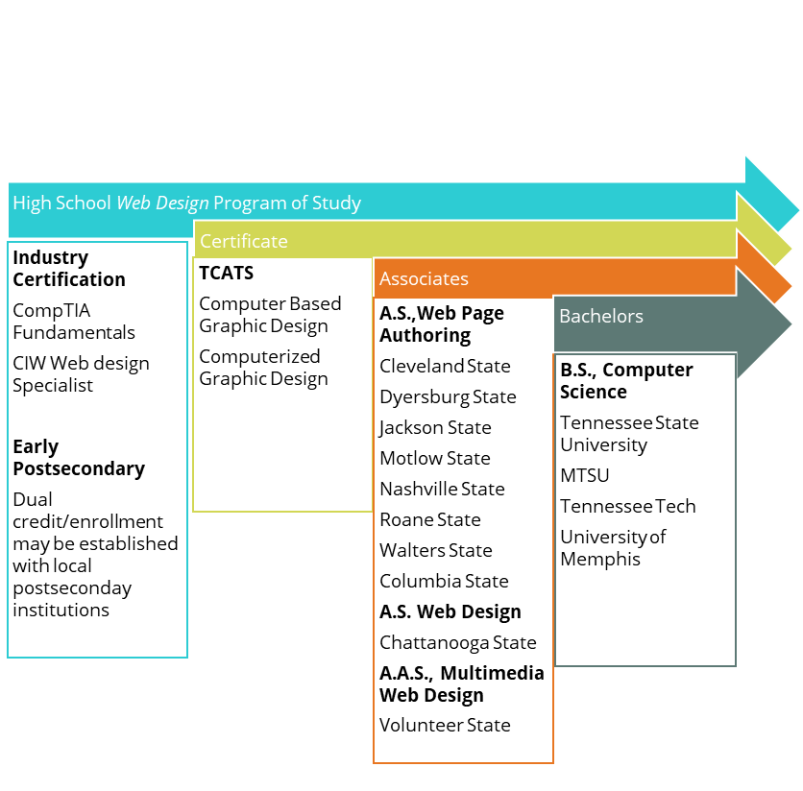
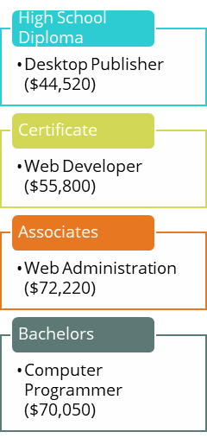

Slide 45
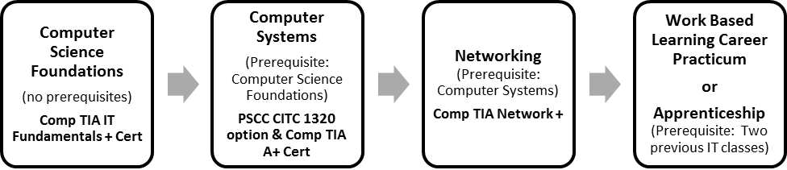
Information Technology Experience:
Networking Systems
ABOUT THIS COURSE OF STUDY
The Networking Systems program of study is designed for students interested in occupations including: computer support specialists, network and computer systems administrators, computer hardware engineers, computer network architects, and information security analysts. This program of study provides students the opportunity to acquire knowledge in both theory and practical applications pertaining to hardware, operating systems, safe mode, command prompt, security, networking, printers, peripheral devices, laptops, mobile devices, troubleshooting, and customer service management.
Industry Certifications options include:
CompTIA IT Fundamentals +, Comp TIA A+, Comp TIA Network +
LDC A+ Hardware & Software
Course Sequence

Slide 46
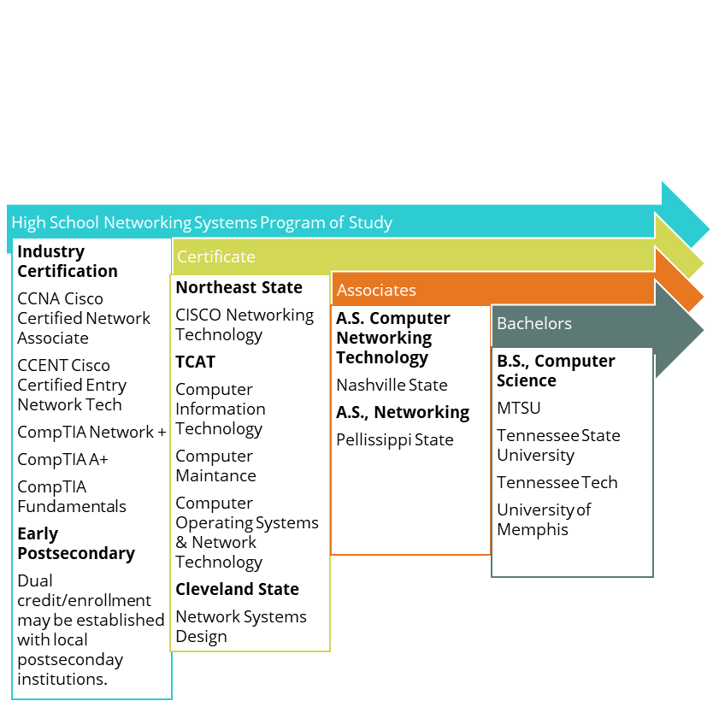
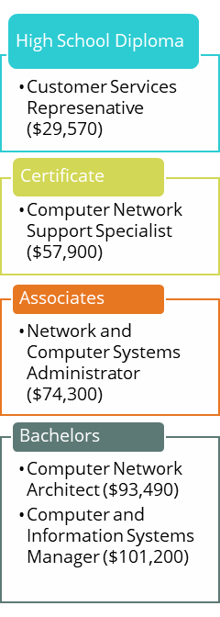

Slide 47
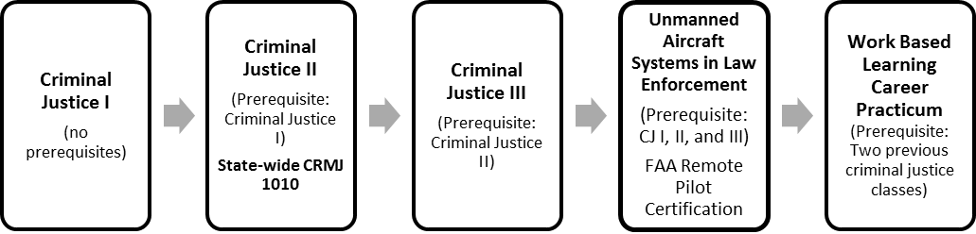
Law Enforcement Experience
ABOUT THE PROGRAM OF STUDY
Criminal Justice and Correction Services prepares students for a range of careers in law enforcement, crime scene analysis, corrections, public safety, and criminal justice. Course content emphasizes procedures and laws governing the application of justice in the United States, from constitutional rights to crisis scenario management to the elements of criminal investigations. Upon completion of this experience, students will be equipped with strong knowledge and skill preparation for postsecondary or career opportunities in many law- and justice-related fields.
Dual Credit/Industry Certifications options include:
Statewide Dual Credit (CJ 2) and FAA Remote Pilot Certification
Course Sequence

Slide 48
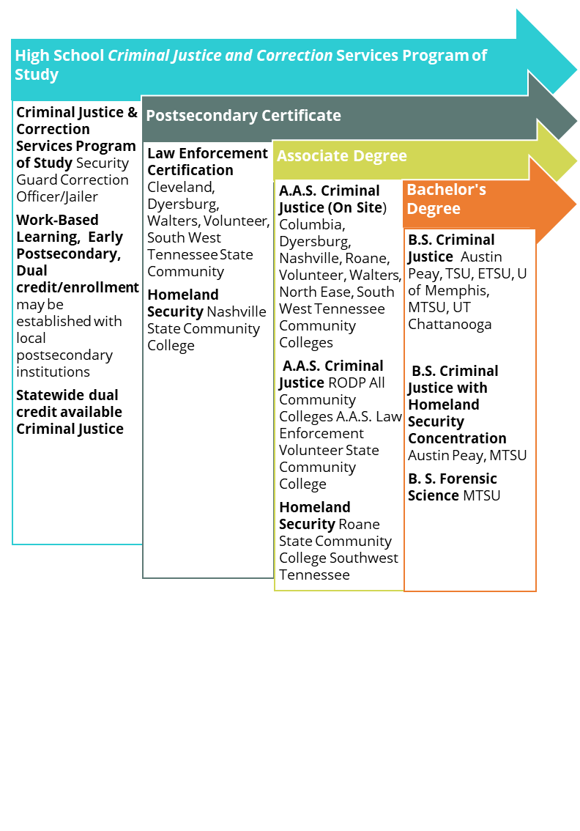
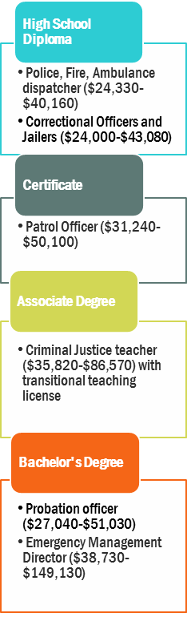

Slide 49
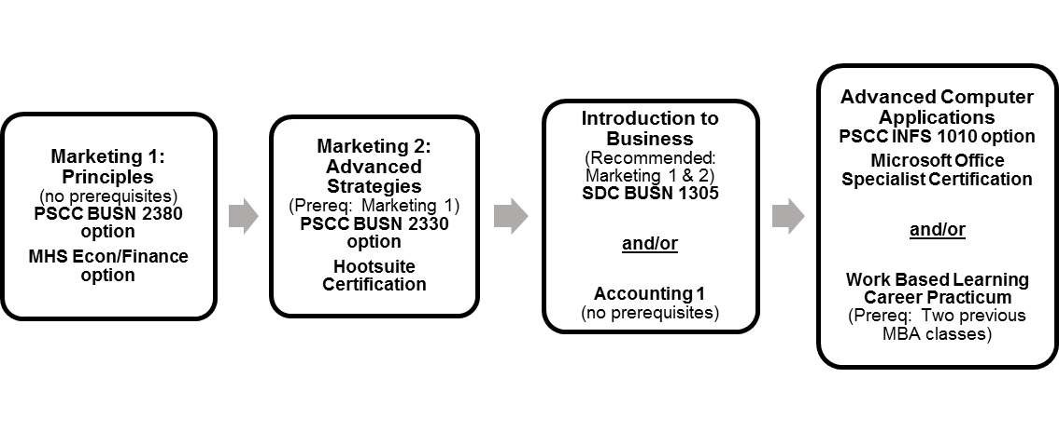
Maryville Business Academy Experience
ABOUT THE PROGRAM OF STUDY
The Maryville Business Academy (MBA) program of studies prepares students with a broad overview of all business disciplines and prepares students by developing a range of skills. In our local area, there is a significant presence of small businesses requiring employees are required to be able to “wear many hats.” The combination of the MBA courses prepare student for additional duties within the business and marketing career clusters, leading to great career options in Tennessee or nationwide. Business and marketing career opportunities are a part of ANY profession, so if you want to sharpen your skills regardless of your final career pathway, this is the program of study for you!
Dual Credit/Industry Certifications options include:
PSCC BUSN 2380 Principles of Marketing, PSCC BUSN 2330 Principles of Management, CLEP Examination – Principles of Management, Hootsuite Platform and/or Social Certifications, BUSN 1305 Introduction to Business, PSCC INFS 1010 Computer Applications, Microsoft Office Specialist Certifications
Course Sequence

Slide 50
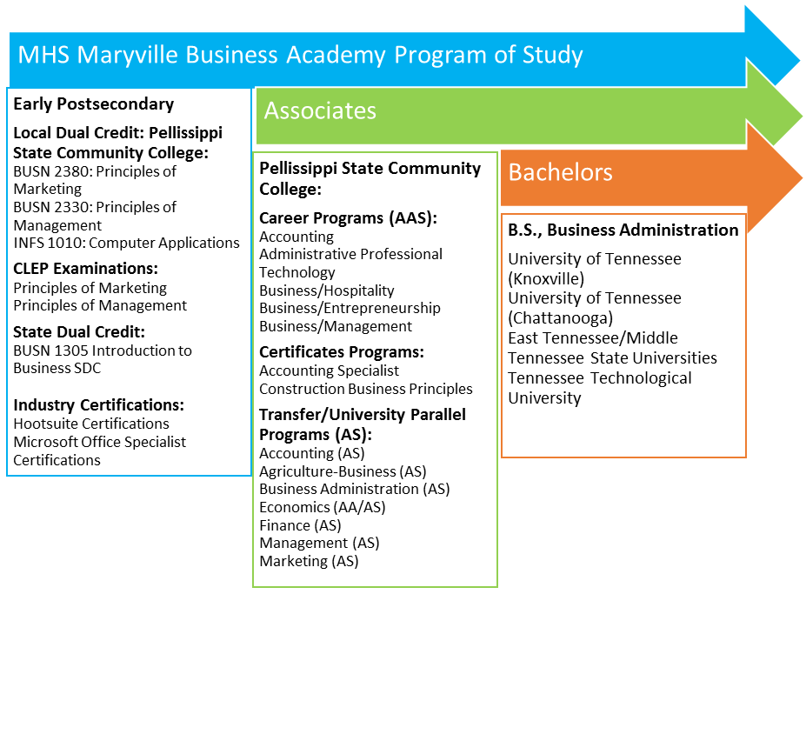
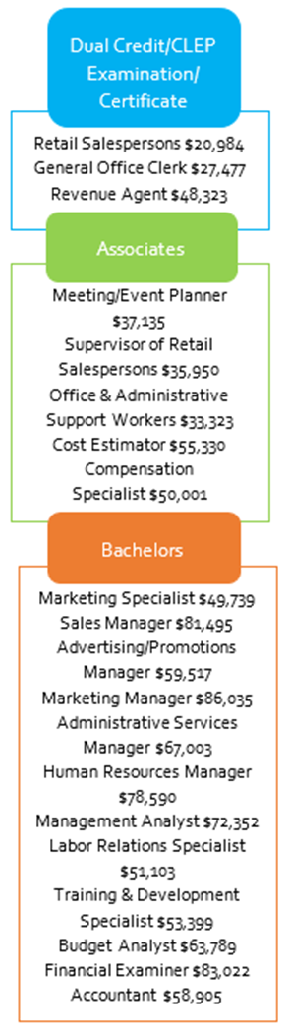

Slide 51
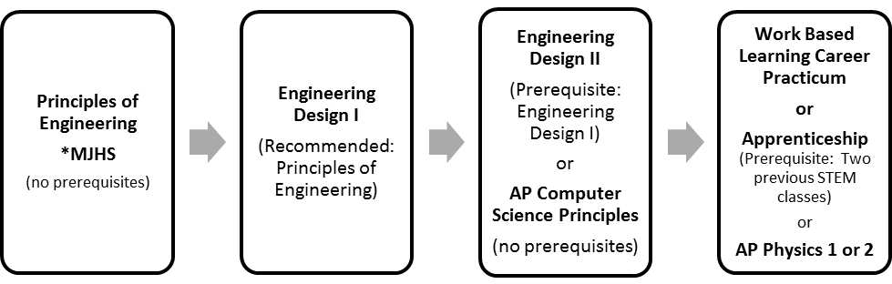
STEM Experience:
Engineering
ABOUT THE PROGRAM OF STUDY
The Engineering program of study designed for students interested in the various disciplines of engineering and engineering technology. Course content is arranged around four sequenced, progressive courses that provide students with the opportunity to develop critical thinking skills and understanding of engineering concepts. Students then apply these skills in conjunction with the multi-step engineering design process to solve real-world problems.
Industry Certifications options include:
Certified Solidworks Associate - Academic Autodesk Inventor Certified User
Course Sequence

Slide 52
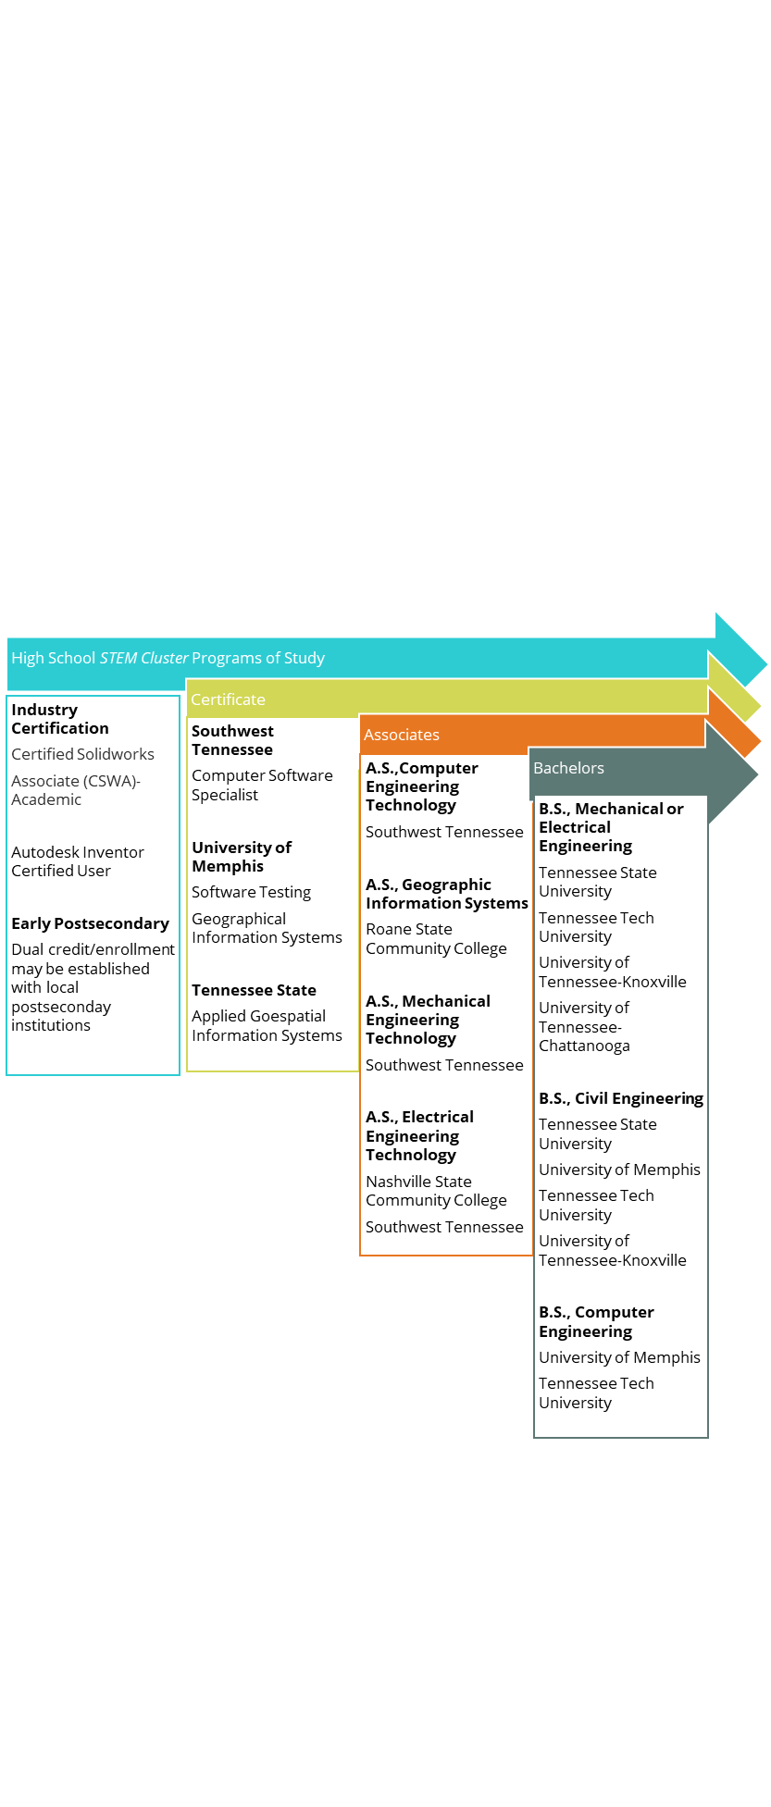
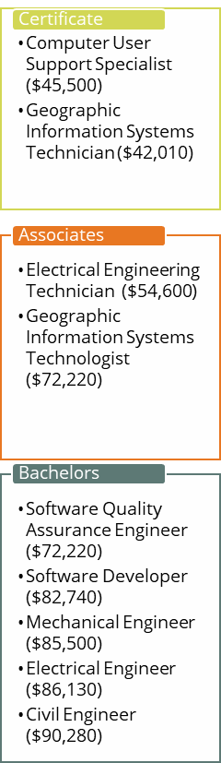

Slide 53
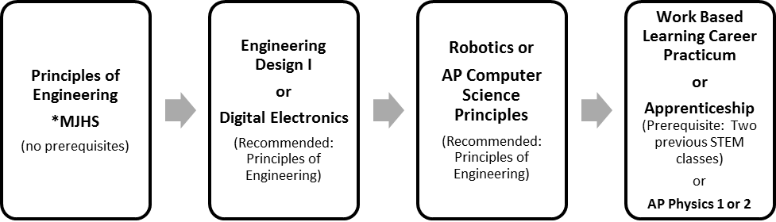
STEM Experience:
Technology
ABOUT THE PROGRAM OF STUDY
The Engineering program of study designed for students interested in the various disciplines of engineering and engineering technology. Course content is arranged around four sequenced, progressive courses that provide students with the opportunity to develop critical thinking skills and understanding of engineering concepts. Students then apply these skills in conjunction with the multi-step engineering design process to solve real-world problems.
Course Sequence

Slide 55
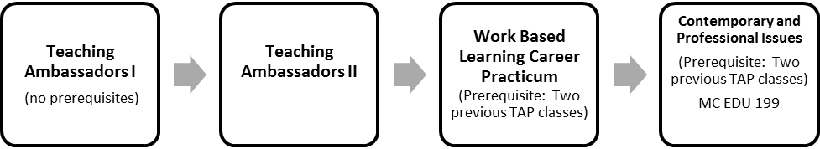
Teaching as a Profession Experience
ABOUT THE PROGRAM OF STUDY
Teaching as a Profession is designed for students interested in becoming a teacher, school counselor, librarian, or speech-language pathologist. While in this program of study, students will learn teaching and classroom management strategies, lesson planning, special populations, how to use educational technology, and how to become a professional. Upon completion of this program of study, students will have participated in an internship and built a professional portfolio that can be used for advanced training as future educators at the postsecondary level.
Dual credit/ dual enrollment options include:
SDC Intro to Education and DE Contemporary & Professional Issues
Course Sequence

Slide 56
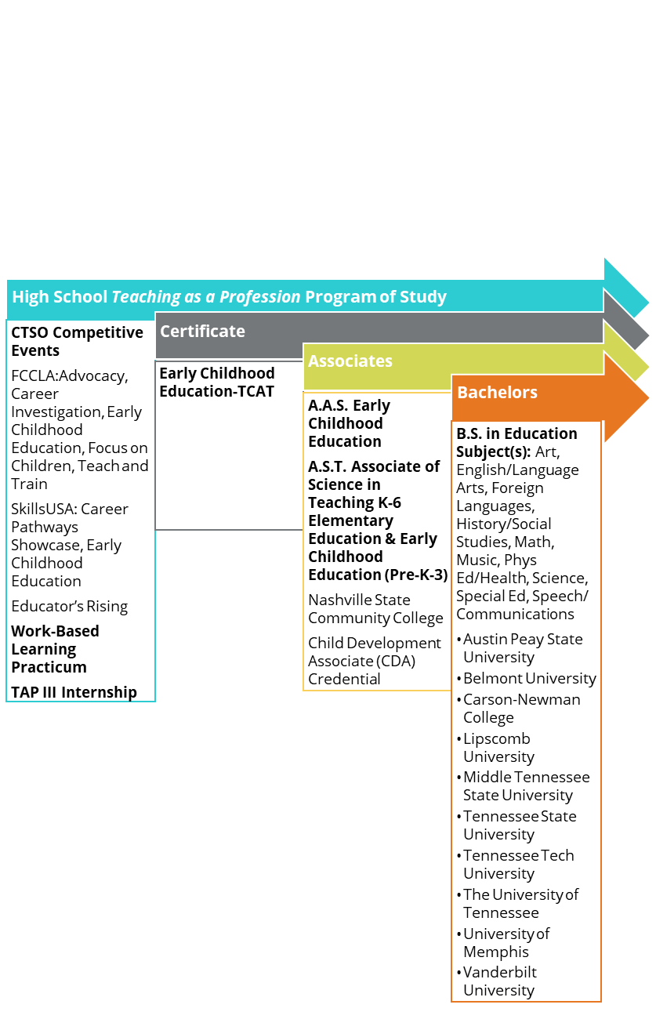
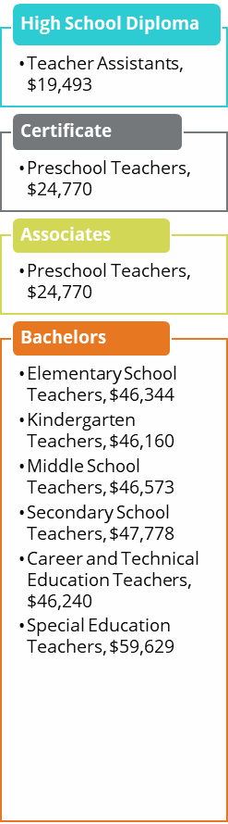

Slide 57
What are your
NEXT STEPS?

Slide 58
Glossary of Important Terms
Early postsecondary opportunities (EPSOs) include a course and/or exam that give students a chance to obtain postsecondary credit while still in high school.
Advanced Placement (AP) is designed to provide students with an opportunity to receive college credit for introductory college courses and move directly to more interesting and challenging courses. All courses are taught according to the College Board Advanced Placement guidelines and students will use college level texts. To qualify for college credit, Advanced Placement exams must be taken on a specific date and hour during the second or third week of May.
Developed by the College Board, College Level Examination Program (CLEP) exams can be taken by students and adults to assess mastery of postsecondary-level material acquired in a variety of ways, including through general academic instructions, significant independent study or extracurricular work. Students can earn credit for postsecondary coursework in a specific subject. Examinations are currently offered in 34 subjects at test centers across the state. Maryville High School is a testing center.
High school students are encouraged to focus their elective credits on robust, career-aligned learning experiences. Industry certifications (IC) are earned through secondary and postsecondary career and technical education programs and courses. Industry certifications are work-related credentials, certifications or licenses that verify qualifications of competence in a specific skill set relates to a particular industry or occupation.
Statewide dual credit (SDC) classes are college-level courses taught at the high school level by trained high-school teachers. All students enrolled in a statewide dual credit course take the online challenge exam, which is used to assess mastery of the postsecondary-level learning objectives.
Local dual credit (LDC) is a high school course aligned to a local postsecondary institution’s course and exam.
Students who pass the exam earn credits that are accepted and/or recognized by the local postsecondary institution. Courses are taught by licensed high school teachers or certified college instructors approved by the school system and the postsecondary institution. Maryville HS works with Pellissippi State Community College to offer LDC opportunities to our students.
Dual enrollment (DE) is a postsecondary course, taught either at the postsecondary institution,at the high school, or online, by postsecondary faculty or credentialed adjunct faculty. Students are enrolled at the postsecondary institution and earn postsecondary credit upon completion of the course. Students who meet the qualifications will be eligible for five (5) $540.00 scholarships during their final two years of high school. This scholarship is provided through the Lottery Corporation.

