Slide 1

Maryville Junior High School

Slide 2
Agenda
1
Welcome to high school!
  2
  Courses and Registration Process
  3
  Frequently Asked Questions
  4
  Volunteer Opportunities
  5
  Athletics
  6
  Things to Know

Slide 3
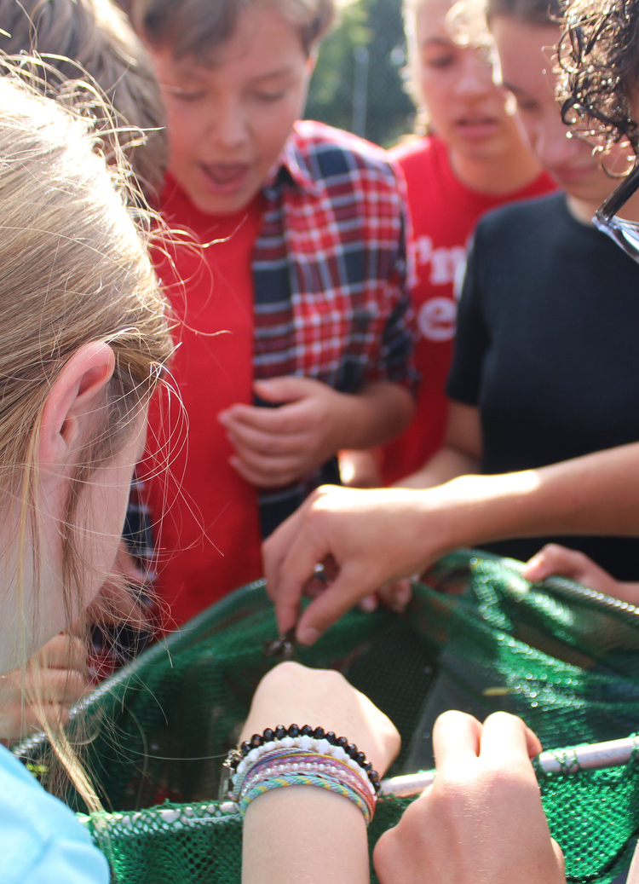


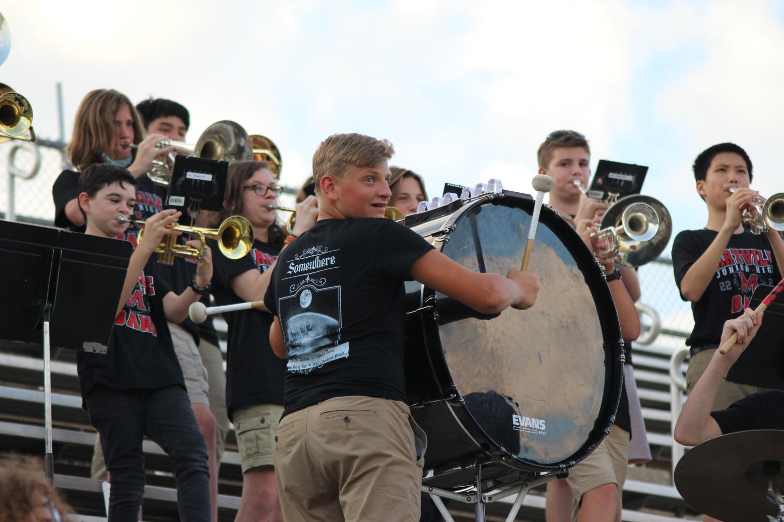
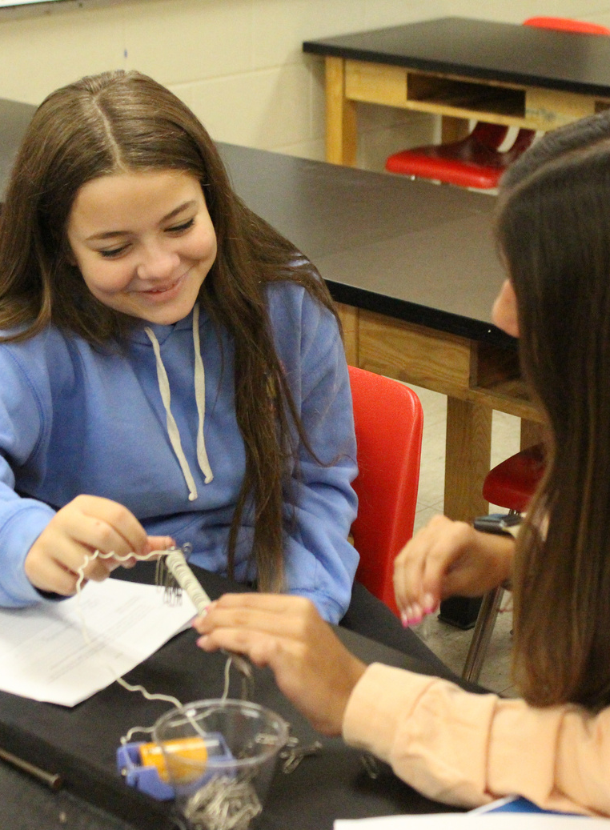
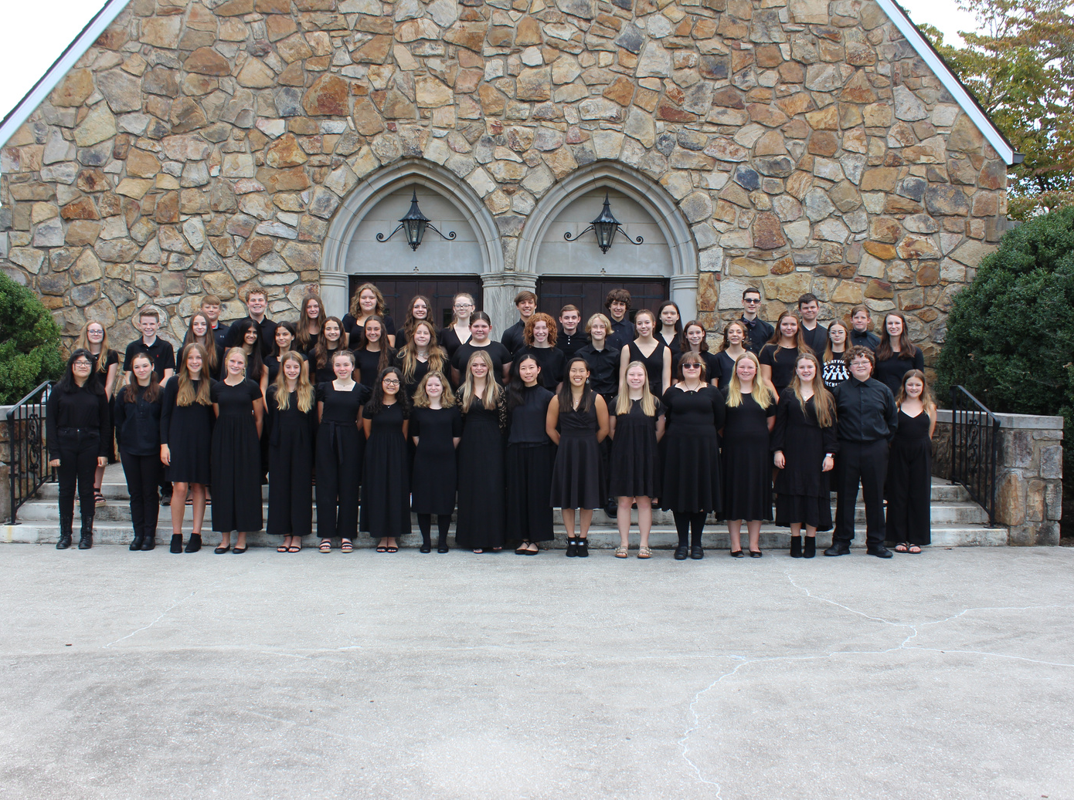
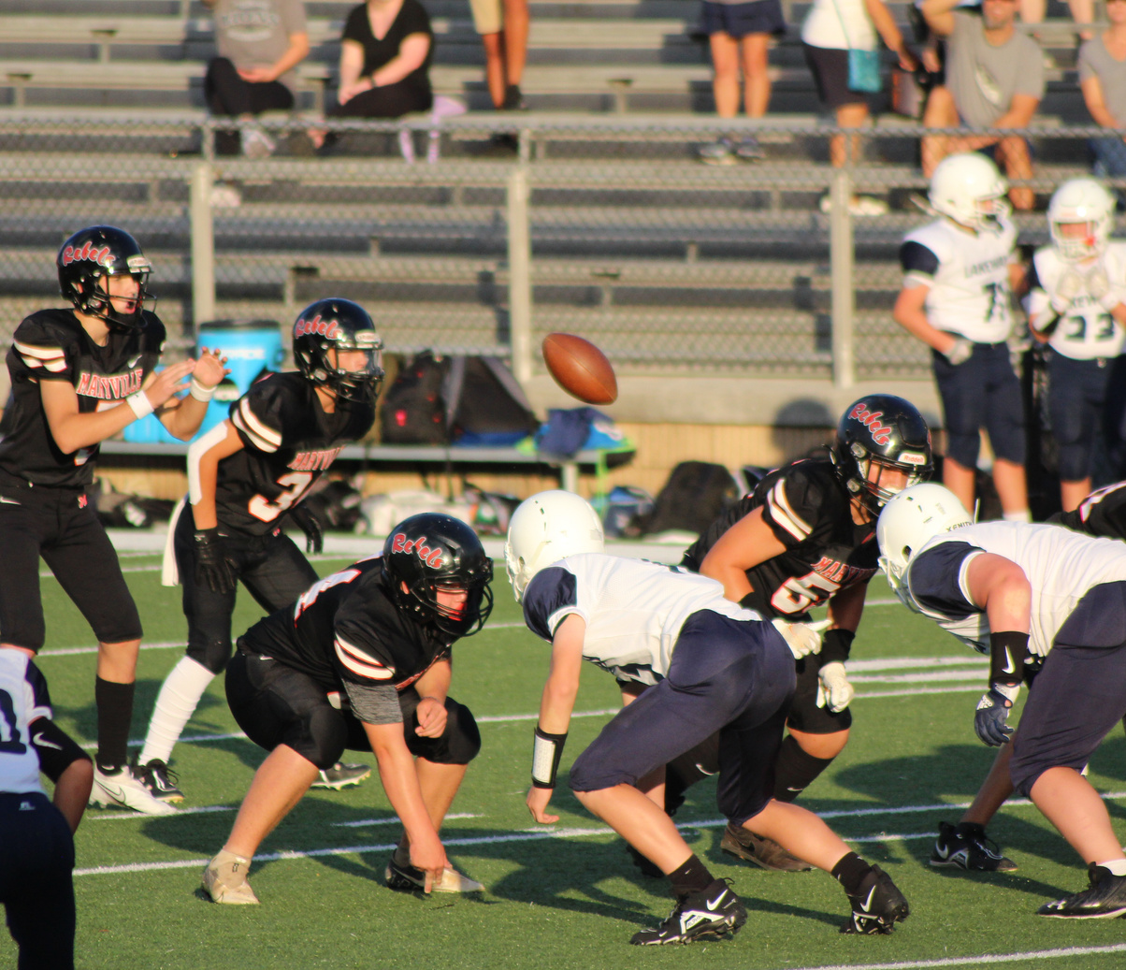
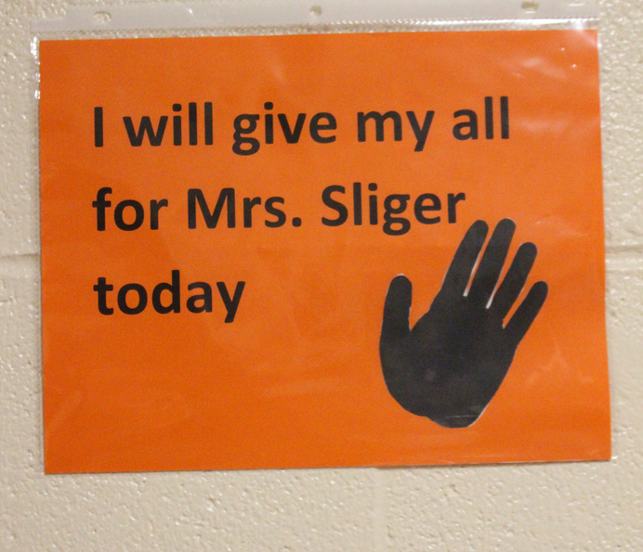
Who are we?

Slide 4
Overview
  This year is the beginning of your student's high school journey where we will begin to create the High School and Beyond plan.
  There are so many opportunities that exist for your student within Maryville City Schools.
  Tonight, we will explore those, and we will provide resources for you to learn more.
  Class of 2027, here we go!.
Overview

Slide 5
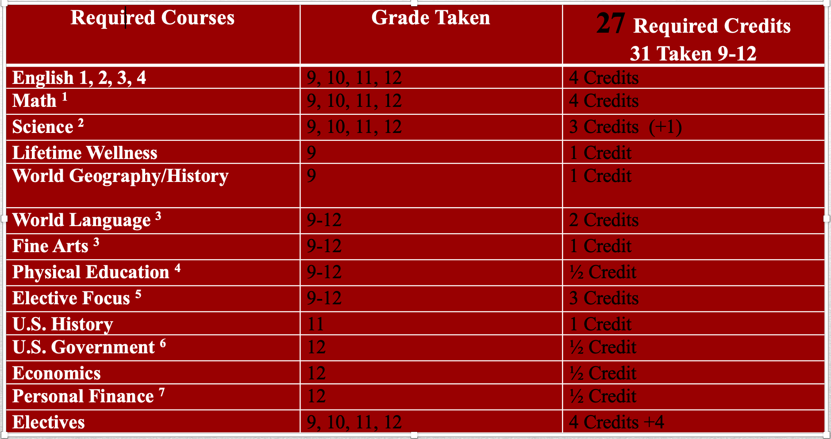
Minimum Graduation Requirements

Slide 6
Required Freshmen Courses
English:
  Honors
  CP
Math:
  Honors Geometry
  CP Geometry
  Algebra 1 CP
  Algebra 1A
Science:
  Honors Biology
  CP Biology
  Env. Science
Social Studies:
  AP Human Geography
  CP World History & World Geography
In addition to the courses listed above, all 9th graders take Wellness.

Slide 7
Elective Focus Experiences
  All Tennessee students are required to successfully complete an elective focus experience of 3 or more credits IN ADDITION TO graduation requirements.
  The focus experience students choose do not track them into a required college major or career.

Slide 8
Elective Focus Experiences
  Available Focus Experiences in MCS include:
    Fine Arts, Humanities, Math and Science, Advanced Placement and Dual Enrollment
    CTE Experience Areas: Advanced Manufacturing, Architecture and Construction, Arts and A/V Communication, Business Management & Administration, Health Science, Information Technology, Law Enforcement, Marketing Management, STEM, Hospitality and Tourism, and Teaching as a Profession.
    9th grade students have access to courses in a variety of the Focus Experiences, but some of the Focus Experiences begin in the 10th grade.

Slide 9
College and career are not mutually exclusive.

Slide 10
Elective Courses Available to Freshmen
Foreign Language | Fine Arts | Application Based
Spanish 1 Spanish 2 | General Band 1 Instrumental Music Orchestra/Strings Chorus | Leadworthy
French 1 French 2 | Theater 1(Drama) Theater Arts Intermediate | Peer Tutoring
American Sign Language | Visual Art 1 | Student Assistant-Library, Help Desk, Main Office, Classroom

Slide 11
ElectiveCourses Available to Freshmen-CTE
Architecture and Construction Experience | Health Sciences Experience | Hospitality and Tourism Experience | Information Technology | Law Enforcement | STEM
Principles of Manufacturing and Construction (Shop) | Health Science | Culinary Arts 1 | Computer Science Foundations | Criminal Justice 1 | Principles of Engineering and Tech
What courses come next?

Slide 12
What if my student wants to take an elective that requires an application?
  If your student wants to take an elective that requires an application, he/she may select the course during registration.
  Your student must also complete and submit an application to MJHS no later than February 17. The applications are located on the MJHS website – Quick Links - Registration.
Application-Based Electives

Slide 13
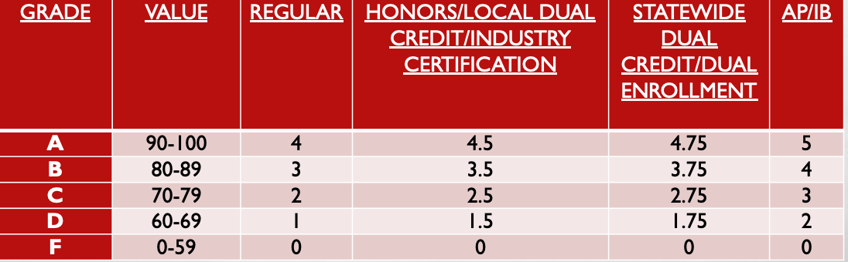
MHS GPA QUALITY POINT TRANSCRIPT CALCULATION FOR COURSES
Assigned quality points above 4.0 are not allowed for determining eligibility for the lottery scholarship. Quality points will be awarded based on successful completion of the course.
Uniform Grading System

Slide 14
Have your student login to PowerSchool
How Does My Student Register?
1
  Click on Navigation --> Registration
  2
  Next to each subject, click the pencil icon
  3
  For core classes, there will only be 1 option
  4
  Choose 2 electives AND 2 alternates
  5

Slide 15
  How is the Master Schedule created?
    The schedule is created based on course recommendations and requests during registration.
  Why do we need to select alternate electives?
    When unavoidable scheduling conflicts occur, students are placed in their selected alternate request.
  How can I express concern about my students academic course recommendation?
    You may complete a Review of Placement form, and the school counselors will reach out to you.
  Can my student take a foreign language in the 8th grade?
    Yes, if he or she is recommended for a foreign language by his or her 7th grade teacher.
  Where can I find an application for elective courses?
    You can find this by clicking Quick Links and then clicking Registration on the MJHS website.
Frequently Asked Questions

Slide 16
Deadlines
Complete Online Registration:
Window to make elective changes:
Window for academic placement review:
No elective changes after:
2/3-2/17
3/20-3/27
3/30-4/6
8/15

Slide 17

Parent Volunteer Opportunities
  Classroom
  Career Fair
  Appreciation
  Library
  Book Fair
  Art
  Stem/Engineering
  Open House
  Field Day/ Field Trips
  Field Trips
  Fundraising
  East TN Band Tryouts
  Music Booster
  Technology
  Theater
  Cafeteria
  Guest Speaker

Slide 18
Athletics
  Baseball
  Basketball
  Bowling
  Cheerleading
  Cross Country
  Football
  Golf
  Dance
  Volleyball
  Marching Band
  Softball
  Swim/Dive
  Tennis
  Track and Field
  Volleyball
  Wrestling
  Climbing
These sports satisfy the 1/2 credit P.E. requirement for graduation.

Slide 19
  The building opens at 7:30 am.
  The building closes at 3:35 pm.
  The school phone number Is 983-2070.
  Daily Announcements are emailed each day. Please check these to stay up to date on MJHS happenings.
  If you have not already done so, please set up a PowerSchool account AND a Canvas account. PowerSchool allows you to see your student's grades, and Canvas allows you to have specific class information (calendars, assignment due dates, etc.).
  Please keep your contact information current with the school office to receive automated calls and emails.
  The MJHS website is a wealth of information!
  Follow us on Facebook, Twitter, and Instagram!
Things to Know...

Slide 20
Class of 2027...
HERE WE GO!

Slide 21
Resources to Review

