Slide 1

Maryville Junior High School

Slide 2
Goals for tonight
1
Meet our team
  2
  Learn about our course offerings
  3
  Preview the registration process
  4
  Explore Elective options

Slide 3
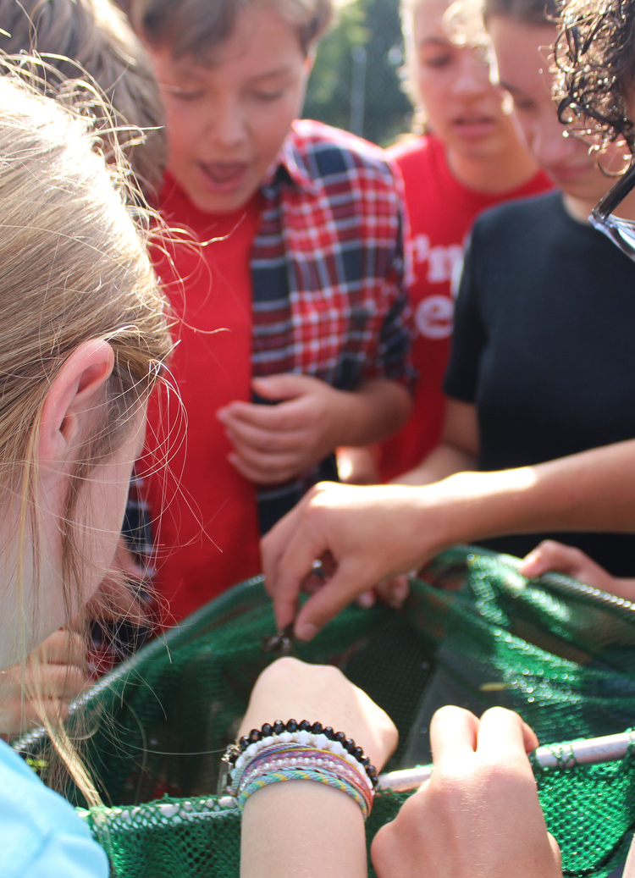
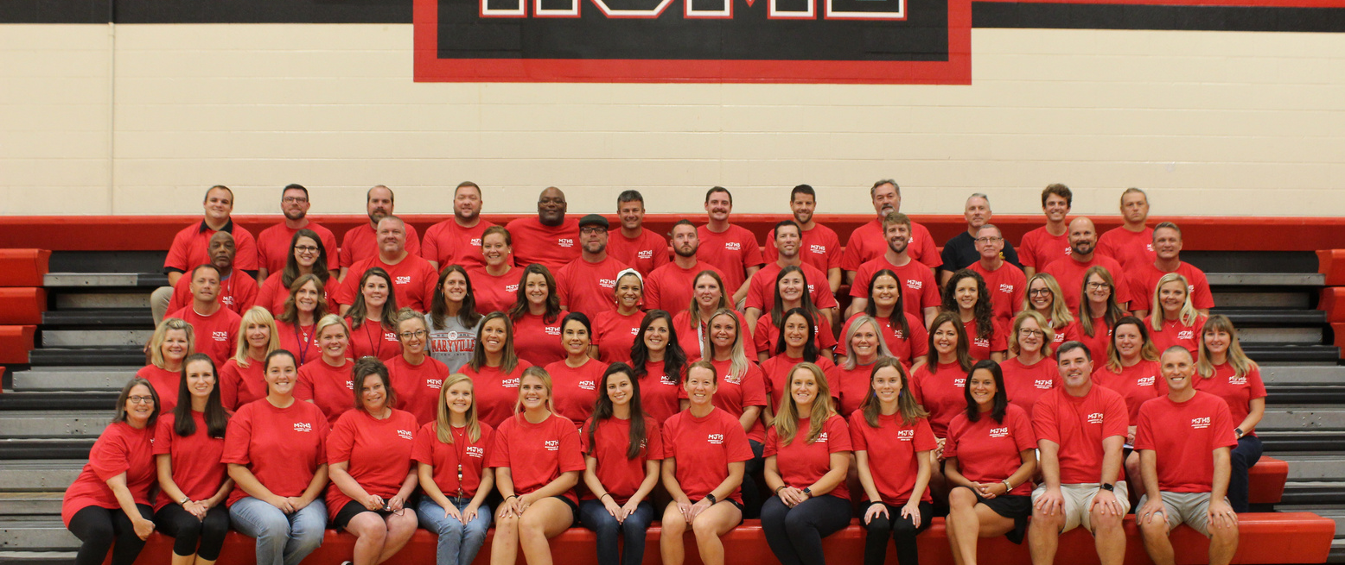

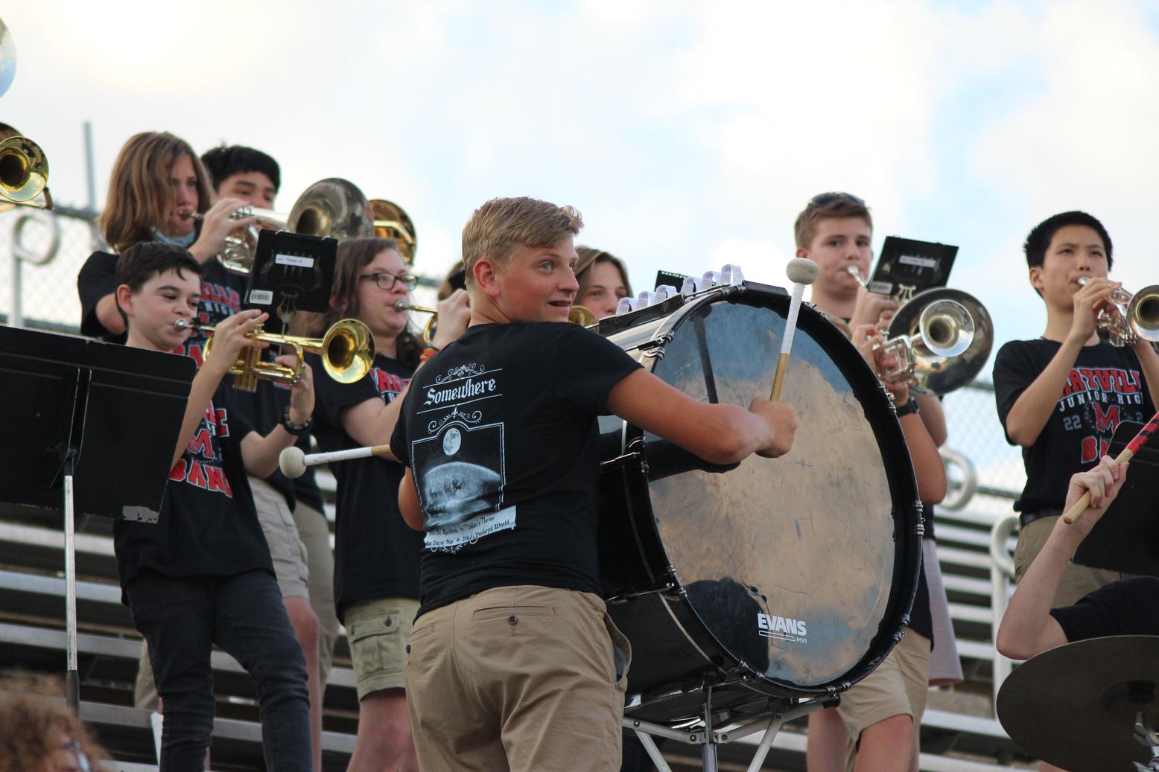
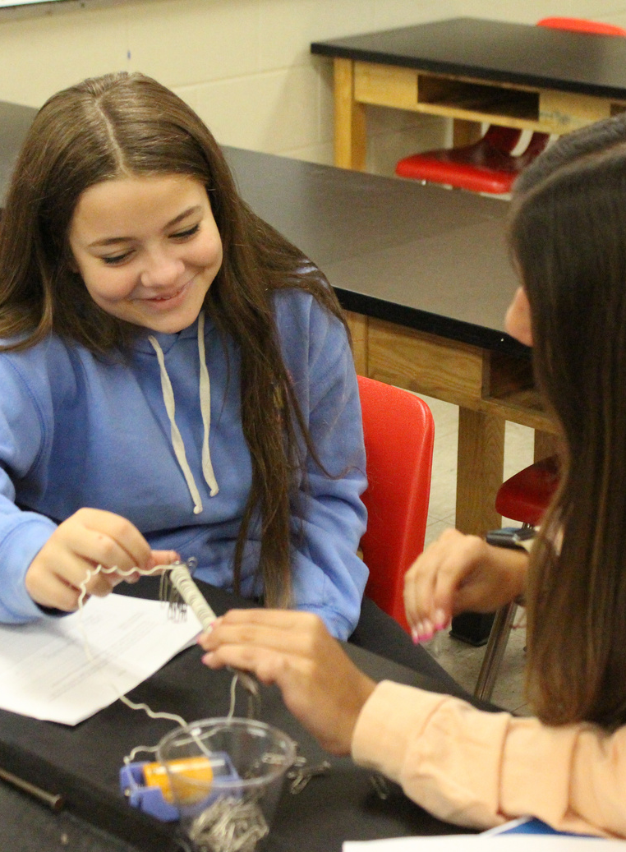
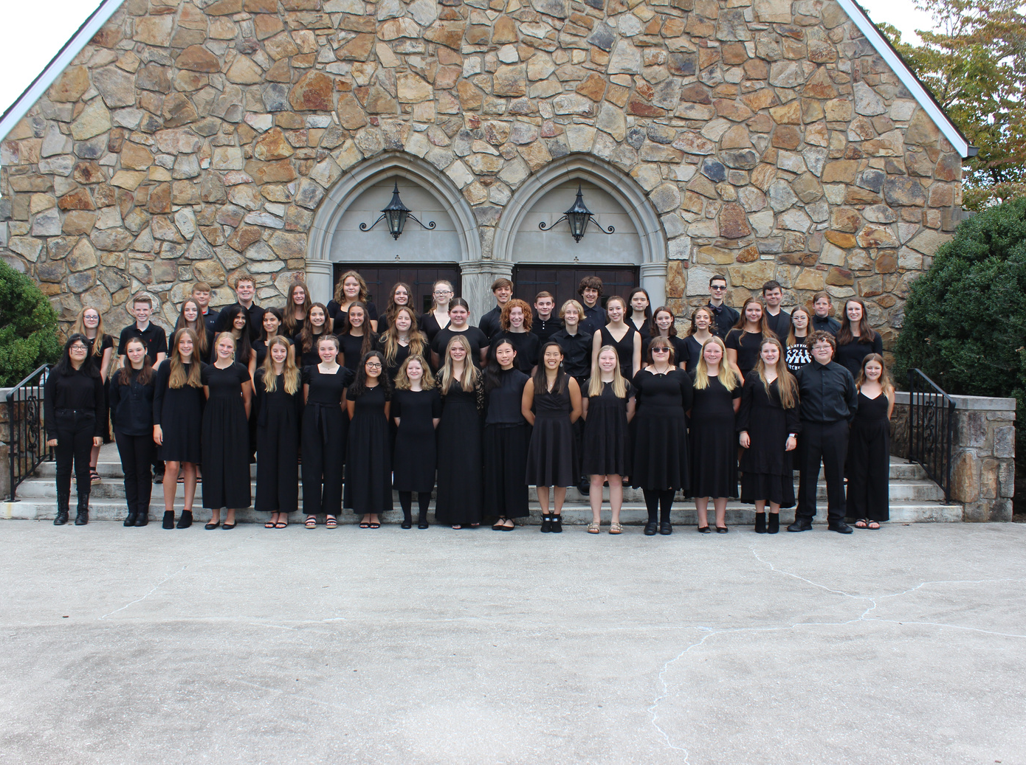
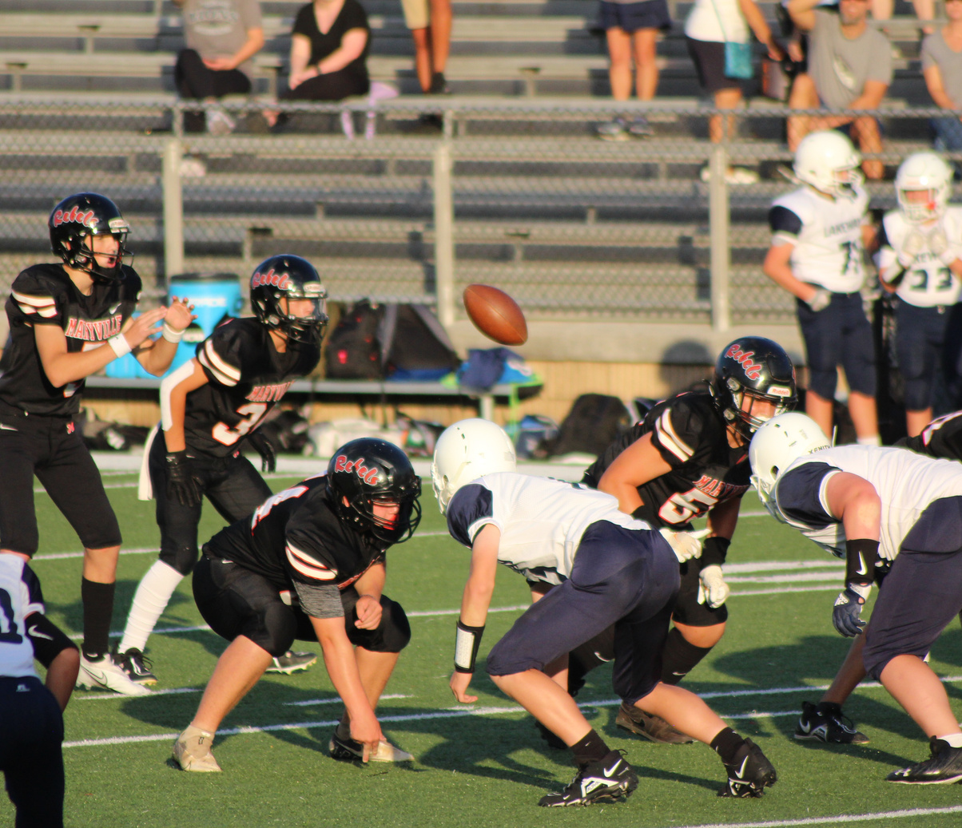
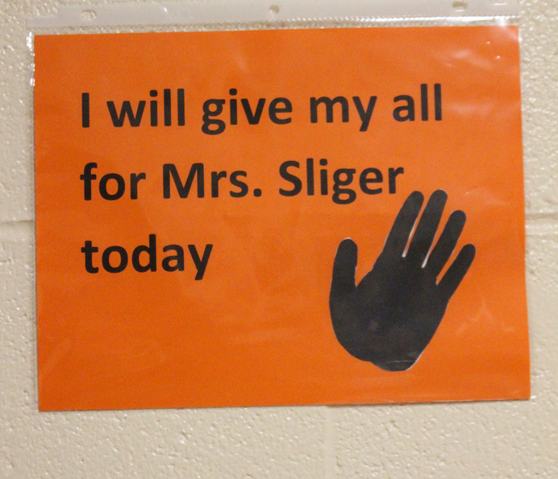
Who are we?

Slide 4
Overview
Required Courses
  8th grade is the beginning of the secondary journey!
  A/B Schedule
  7 year-long courses
  English
  Math-Alg 1 or 8th grade Math
  Science
  Social Studies
  Wellness
Overview

Slide 5
  1
  2
For each required subject, your student has been recommended for a specific level by his or her current teacher.
If you disagree with the recommendation, continue registration, then follow up with the School Counseling office to request a review of placement.

Slide 6
8th Grade Elective Categories
Foreign Language
Career and Technical
Application Based
Fine Arts

Slide 7
Foreign Language | Career and Technical | Fine Arts | Application Based
Spanish 1 | Career Advising Teen Living | Instrumental Music Band Instrumental Music Orchestra Vocal Music | Leadworthy
French 1 | Gateway to Technology (STEM) | Theater 8 (Drama) | Peer Tutoring
 | Shop | Visual Art 8 | Student Assistant-Library, Help Desk, Main Office, Classroom

Slide 8
What if my student wants to take an elective that requires an application?
  If your student wants to take an elective that requires an application, he/she may select the course during registration.
  Your student must also complete and submit an application to MJHS no later than February 17. The applications are located on the MJHS website – Quick Links - Registration.
Application-Based Electives

Slide 9
Have your student login to PowerSchool
How Does My Student Register?
1
  Click on Navigation --> Registration
  2
  Next to each subject, click the pencil icon
  3
  For core classes, there will only be 1 option
  4
  Choose 2 electives AND 2 alternates
  5
Click Here for Step by Step Video Instructions

Slide 10
  How is the Master Schedule created?
    The schedule is created based on course recommendations and requests during registration.
  Why do we need to select alternate electives?
    When unavoidable scheduling conflicts occur, students are placed in their selected alternate request.
  How can I express concern about my students academic course recommendation?
    You may complete a Review of Placement form, and the school counselors will reach out to you.
  Can my student take a foreign language in the 8th grade?
    Yes, if he or she is recommended for a foreign language by his or her 7th grade teacher.
  Where can I find an application for elective courses?
    You can find this by clicking Quick Links and then clicking Registration on the MJHS website.
Frequently Asked Questions

Slide 11
Deadlines
Complete Online Registration:
Window to make elective changes:
Window for academic placement review:
No elective changes after:
2/3-2/17
3/20-3/27
3/30-4/6
8/15

Slide 12

Parent Volunteer Opportunities
  Classroom
  Career Fair
  Appreciation
  Library
  Book Fair
  Art
  Stem/Engineering
  Open House
  Field Day/ Field Trips
  Field Trips
  Fundraising
  East TN Band Tryouts
  Music Booster
  Technology
  Theater
  Cafeteria
  Guest Speaker

Slide 13
8th Grade Athletics
  Baseball
  Basketball
  Cheerleading
  Cross Country
  Football
  Golf
  Softball
  Swimming
  Tennis
  Track and Field
  Volleyball
  Wrestling

Slide 14
  The building opens at 7:30 am.
  The building closes at 3:35 pm.
  The school phone number Is 983-2070.
  Daily Announcements are emailed each day. Please check these to stay up to date on MJHS happenings.
  As your student transitions to MJHS, please set up a PowerSchool account AND a Canvas account. PowerSchool allows you to see your student's grades, and Canvas allows you to have specific class information (calendars, assignment due dates, etc.).
  Please keep your contact information current with the school office to receive automated calls and emails.
  The MJHS website is a wealth of information!
  Follow us on Facebook, Twitter, and Instagram!
Things to Know...

Slide 15
Be:
  Involved-join a club, sport, or school organization
  Present-be at school
  Academic-turn in work all the time
  Connected-form a relationship with at least one adult in the building
  Engaged-participate in classes and demonstrate a high work ethic
How to be a successful 8th grade student...

Slide 16
Class of 2028...
WELCOME TO MJHS!

Slide 17
Resources to Review

