Slide 1

Student Orientation
8th Grade
PHARR-SAN JUAN-ALAMO INDEPENDENT SCHOOL DISTRICT
Class of 2019 and Beyond
12-18-20

Slide 2
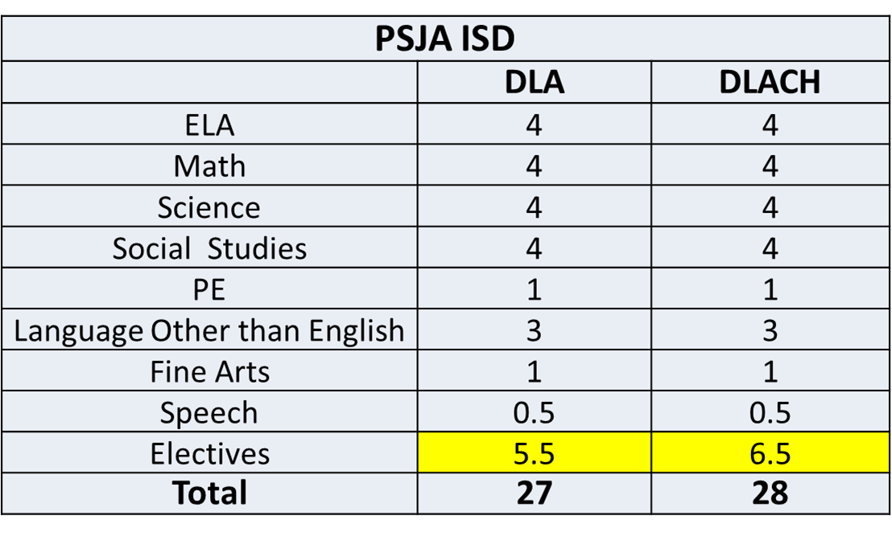
High School Course Requirements

Slide 3
Side by Side Graduation Program
Graduation Plans | ** Distinguished Level Achievement (DLA) 27 credits | Distinguished Level of Achievement with Collegiate Honors 28 credits (Replaces Distinguished Achievement Program (DAP)
FAFSA/TASFA♦ | Required ♦ | Required ♦
College Applications | Two completed by December of senior year | Three completed by December of senior year (one will be State college application)***
Transition plan | A transition plan leading to a post-secondary career goal completed by the end of the 5th Six Weeks | A transition plan leading to a post-secondary career goal completed by the end of the 5th Six Weeks
Post -Secondary work | Option 1- Core Complete (42 hours) Option 2- Completion of college certificate Option 3- Completion of 12 college hours with a transition plan leading to a higher education career goal Option 4- Endorsement only with principal approval (Associate degree preferred) Option 5 – Completion of Industry Certification | Must be core complete (minimum 42 hours) and/or an associate degree To compete for the top 10%: Option 1-Associate complete by December of senior year and/or -Enrolled in final courses leading to an associate by January 31 of senior year. (Dropping any of those courses will disqualify student) Option 2- Core complete by December of senior year

Slide 4
Side by Side Graduation Program
Scholarship application | Two required, completed by January of senior year | Two (Five for top 10%, two of which must be Ford, Dell, Hispanic, Coca-Cola, Gates Millennium or other of similar prestige) completed by January of Senior Year
CAPSTONE project | Required, complete by the end of the 5th Six Weeks | Required, complete by the end of the 5th Six weeks
Texas Success Initiative (TSI) | Attempt all 3 sections by December of Senior year | TSI complete or TSI exempt by December of senior year
Community Service | Recommended, complete by the end of January of Senior year | Option 1-Complete community service project (20+ hours by end of January of Senior Year) Option 2- Attend a college access program or tour by end of January of Senior Year Option 3-Enroll in an internship (minimum 10 hours) related to the chosen degree plan and/or career by end of January of senior year (complete 2 out of 3 options)
Performance acknowledgments | One recommended | One required
Total HS Credits | 27 | 28
*Foundation HSP – PSJA ISD Minimum Graduation Plan
**Waiver from the DLA HSP can only happen their senior year, must have a student, parent, counselor, administrator conference and a parent signature.
***Signed contract with the military
♦students may apply for a waiver due to philosophical reasons. Principal approval required

Slide 5
Assessments
College Preparatory & State Exams​
8th | 9th​ | 10th ​ | 11th​ | 12th​
ELA Science Math Soc. Studies PSAT 8 AP Exams (Spanish ) | TSI​ ​ English 1 EOC​ ​ Biology EOC​ ​ Algebra 1 EOC​ PSAT 9 (2022) AP Exams | TSI​ ​ English 2 EOC​ ​ ACT Aspire​ ​ PSAT/ NMSQT AP Exams | TSI​ ​ US History EOC​ ​ PSAT/NMSQT (Fall)​ ​ ACT & SAT (Saturdays)​ ​ SAT School Day (Spring) AP Exams​ | TSI​ ​ ACT & SAT (Fall)​ ​ AP Exams​
Performance Acknowledgments​
Advance Placement Exams​ PSAT , ACT Aspire , SAT or ACT Exams ​

Slide 6

Dual Language Enrichment Program Distinction
8 Dual Language Credits in Total
Spanish Language Arts
four (4) DL HS credits in Spanish Language Arts (Language and Literature)
Content Subjects
three (3) DL HS credits in content areas: History, Math, and Science. (taught In Spanish)
Electives
one (1) DL credit in Spanish (Art, Folkloric, Dance)
OR all 4 DL credits from content areas.

Slide 7
High School Endorsement Selection
PHARR-SAN JUAN-ALAMO INDEPENDENT SCHOOL DISTRICT

Slide 8
What’s an Endorsement?
An endorsement is a program of study.
An endorsement is earned when a student completes core curriculum requirements and a sequence of courses in a concentrated area of study.
Students must have their endorsement selection in writing before entering 9th grade.

Slide 9





Endorsement Options (Select one)
Business & Industry
Public Service
STEM
Arts & Humanities
Multi-disciplinary
https://vimeo.com/489918383

Slide 10
Endorsement: Business & Industry
Career Pathways | Programs of Study | PSJA Academies: Leads to a college certificate and/or Associates
Agriculture, Food, & Natural Resources | Agribusiness Environmental And Natural Resources
Architecture & Construction | Carpentry HVAC | *Heating, Ventilation, Air Conditioning & Refrigeration Technology Academy
Arts, AV Technology & Communications | Digital Communications Design & Multimedia Arts | *Graphics Arts Academy
Business, Marketing & Finance | Accounting & Financial Services Business Management Entrepreneurship Marketing & Sales | *Business Administration Academy
Hospitality & Tourism | Culinary Arts | *Culinary Arts Academy
Manufacturing | Welding | *Welding Technology Academy
Transportation, Distribution & Logistics | Automotive | *Automotive Technology Academy *Automotive Maintenance & Light Repair Technology Academy

Slide 11
Endorsement: Public Service
Career Pathways | Programs of Study | PSJA Academies: Leads to a college certificate and/or Associates
Education & Training | Teaching and Training | *Education Academy
Law, Public Safety, Corrections & Security | Law Enforcement Emergency Services | *Criminal Justice Academy
Human Services | Cosmetology & Personal Care Services *Cosmetology Operator license available Senior year (must meet pre-requisites)

Slide 12
Endorsement: STEM
Must have successfully completed Alg 2 , Chemistry & Physics
Career Pathways | Programs of Study | PSJA Academies: Leads to a college certificate and/or Associates
Science, Technology, Engineering & Mathematics (STEM) | Cybersecurity Engineering | *Biology Academy *Mathematics Academy *Computer Science Academy
Agriculture, Food, & Natural Resources | Animal Science Plant Science Applied Agri. Engineering
Architecture & Construction | Electrical Architectural Design | *Electrician Assistant Technology Academy
Health Science | Healthcare Diagnostics Nursing Science *CNA, EKG, and Phlebotomy certifications available Senior year (must meet pre-requisites) | *Emergency Medical Technology (EMT) Academy
Information Technology | Information Technology Support & Services
Manufacturing | Advanced Manufacturing & Machinery Mechanics | *Advanced Manufacturing Technology Academy

Slide 13
Endorsement: Arts & Humanities
(Non-CTE)
Area of Focus | Courses related to this career pathway: | PSJA Academies: Leads to a college certificate and/or Associates
Performing Arts of Music Theatre Visual Arts Advertising & Publication | Drama Band Choir Political Science English Literature History World Languages | Associates of Arts/ Science : -Graphic Arts Academy

Slide 14
What are the PSJA ISD Academies?
The PSJA ISD Academies provide additional hands-on learning.
Leads to an associate degree or college certificate from South Texas College.
Students sign up in 10th grade.
Students travel to the Dr. Daniel P. King PSJA College & University Center in San Juan for designated hours and academy coursework.
Home Page - PSJA Academies (psjaisd.us)

Slide 15
psjaisd.us facebook.com/psjaisd twitter.com/psjaisd
PHARR-SAN JUAN-ALAMO INDEPENDENT SCHOOL DISTRICT
All materials, content and forms contained in this presentation are the intellectual property of PSJA ISD
and may not be copied, reproduced, distributed or displayed without PSJA ISD’s express written permission.
If written permission is granted, information may be used accompanied
by an acknowledgement that PSJA ISD is the source.

