Slide 1

Little Elm
Independent
School
District
2Q22
Demographic Report

Slide 2
Local Economic Conditions

Slide 3
DFW Remains the Most Active New Home Market Nationally
Rank | Market | Annual Starts | Annual Change | %
1 | Dallas/Ft.Worth | 54,281 | 4,413 | 8.8%
2 | Houston | 42,567 | 77 | 0.2%
3 | Central Florida | 41,208 | 5,574 | 15.6%
4 | Phoenix/Tucson | 33,600 | 1,286 | 4.0%
5 | Atlanta | 26,578 | -5,177 | -16.3%
6 | Austin | 23,146 | -43 | -0.2%
7 | Denver/Colorado Springs | 23,165 | 2845 | 14.0%
8 | Southern California | 19,926 | -2195 | -9.9%
9 | San Antonio | 23,787 | 4,828 | 25.5%
10 | Salt Lake City | 19,268 | 1,602 | 9.1%
11 | Tampa | 14,959 | -1,629 | -9.8%
12 | Raleigh/Durham | 15,030 | -972 | -6.1%
13 | Northern California | 15,722 | 11 | 0.1%
14 | Charlotte | 14,113 | -1,241 | -8.1%
15 | Philadelphia Region | 12,894 | -1,326 | -9.3%
16 | Central California | 12,649 | -1,873 | -12.9%
17 | Las Vegas | 13,835 | -64 | -0.5%
18 | Jacksonville | 13,828 | 1,406 | 11.3%
19 | Suburban Maryland | 10,229 | -2,136 | -17.3%
20 | South Florida | 12,328 | 66 | 0.5%
21 | Nashville | 10,932 | -651 | -5.6%
22 | Sarasota | 13,145 | 2,319 | 21.4%
23 | Seattle | 9,478 | -762 | -7.4%
24 | Twin Cities | 10,141 | -304 | -2.9%
25 | Northern Virginia | 9,181 | -505 | -5.2%
4
Texas Markets in the national Top 10 rankings
1st
DFW’s national rank in terms of starts volume
14 of the top 25
Highest volume new home markets have seen annual starts decline YOY
Notes:
At 54,300 starts, DFW is the most active new home market in the nation again
Houston is #2, Austin is #6, and San Antonio is #9.
When combined, Central Texas is the 2nd most active region nationally.

Slide 4
Interest Rates – Monthly Payment Comparison
Since January 2022
Mortgage Rates up ~66%
Base Prices up 7%
Monthly
Payment
up $529
(~28%)
January Monthly Payment
3.5% Interest Rate and $343,221 Median Base Price: $1,905
June Monthly Payment
5.8% Interest Rate and $365,700 Median Base Price: $2,434

Slide 5
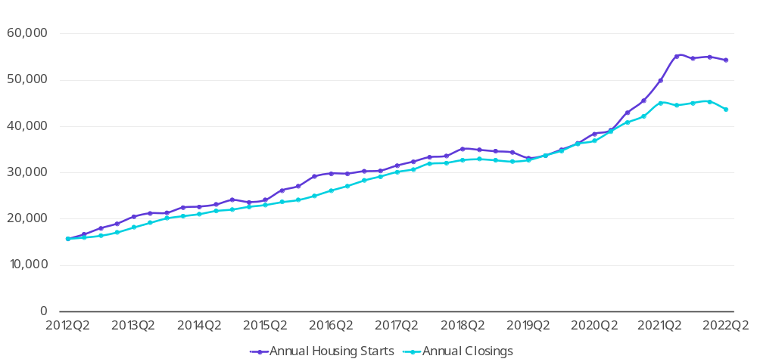
DFW New Home Starts & Closings are Flattening Out
Key Trends
Starts: +9% YOY / -1% QOQ
Closings: -3% YOY / -4% QOQ
Starts Exceed Closings by 10,600 Homes!
54,300
43,700
Source: Zonda
Notes:
New home starts are up 9% YOY, but are down 1% QOQ.
This flattening out was expected given sales caps that were in place, lot supply constraints, and cycle times.
Starts and closings are typically well aligned.
With elongated build times, the gap between starts and closings is the widest on record.

Slide 6
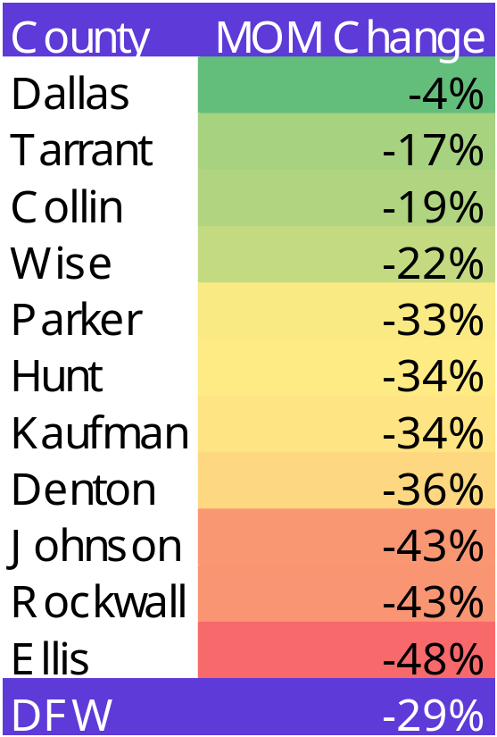
Monthly New Home Sales Contracts Dropped 29% in June
Source: Zonda
Notes:
We saw a sharp decline in contract sales in June.
Overall contract sales dropped 29% MOM in DFW.
Looking across the market, nearly every county had double digit declines.
Start watching activity in tertiary / edge locations where value was a driver.
Kaufman County, Rockwall County, Chisholm Trail Parkway, etc.

Slide 7
DFW Housing Market Trends
YOY Housing Trends
Jan.-June 2021
Jan.-June 2022
Sales
52,934
50,475
Avg. Price
$409,289
$484,658
Median Price
$327,372
$405,500
Median home prices remains near record highs across the state
Home inventory is increasing as sales begin to slow down throughout the state
In the month of May, total monthly home sales are down slightly from the historically high 2021 levels in Austin (-7.3%), DFW (-1.5%), Houston (-1.7%) and San Antonio (-1.0%)
Historically low interest rates and pent up demand have resulted in a fast recovery for the housing market, but these interest rates are on the rise
Total Listings
59,361
57,328
Months Inv.
0.7
1.8

Slide 8
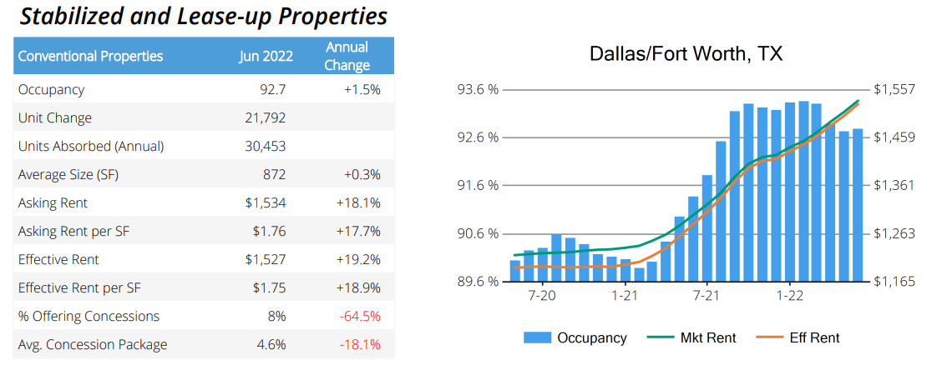
Housing Market Trends:
Multi-family Market

Slide 9
1 Year Change in District Housing
 | 2Q21 | 2Q22 | Difference
Annual Starts | 745 | 773 | +28
Quarterly Starts | 158 | 157 | -1
Annual Closings | 772 | 640 | -132
Quarterly Closings | 191 | 202 | +11
Under Construction | 303 | 492 | +189
Inventory | 393 | 544 | +151
VDL | 777 | 364 | -413
Futures | 1,368 | 2,078 | +710

Slide 10
District New Home Starts and Closings
Starts | 2016 | 2017 | 2018 | 2019 | 2020 | 2021 | 2022 |  | Closings | 2016 | 2017 | 2018 | 2019 | 2020 | 2021 | 2022
1Q | 381 | 237 | 330 | 219 | 183 | 158 | 158 |  | 1Q | 256 | 194 | 349 | 213 | 226 | 127 | 146
2Q | 242 | 435 | 319 | 240 | 201 | 158 | 157 |  | 2Q | 262 | 282 | 366 | 374 | 235 | 176 | 202
3Q | 163 | 489 | 391 | 216 | 179 | 221 |  |  | 3Q | 378 | 323 | 283 | 452 | 244 | 144
4Q | 301 | 310 | 336 | 262 | 250 | 228 |  |  | 4Q | 203 | 459 | 422 | 233 | 214 | 139
Total | 1,087 | 1,471 | 1,376 | 937 | 813 | 765 | 315 |  | Total | 1,099 | 1,258 | 1,420 | 1,272 | 919 | 586 | 348

Slide 11
District Housing Overview by Elementary Zone
Elementary | Annual Starts | Quarterly Starts | Annual Closings | Quarterly Closings | Under Const. | Inventory | Vacant Dev. Lots | Future
BRENT | 0 | 0 | 0 | 0 | 0 | 0 | 9 | 0
CHAVEZ | 3 | 0 | 2 | 1 | 3 | 3 | 1 | 0
HACKBERRY | 36 | 7 | 55 | 10 | 20 | 21 | 12 | 274
LAKEVIEW | 101 | 6 | 82 | 31 | 66 | 71 | 4 | 588
OAK POINT | 461 | 70 | 366 | 116 | 303 | 343 | 246 | 960
PRESTWICK | 172 | 74 | 135 | 44 | 100 | 106 | 92 | 256
TOTALS | 773 | 157 | 640 | 202 | 492 | 544 | 364 | 2,078
 | Highest activity in the category
 | Second highest activity in the category
 | Third highest activity in the category

Slide 12
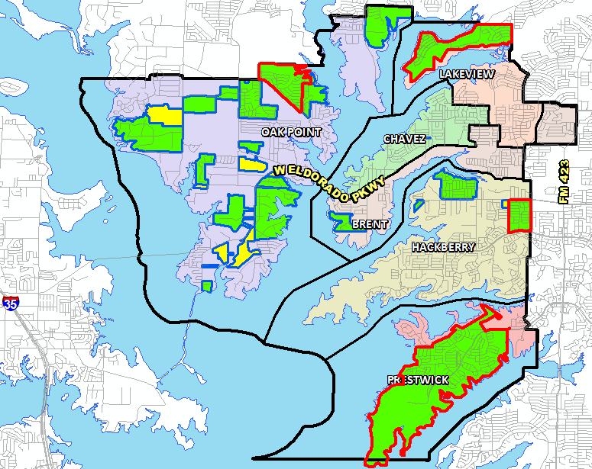
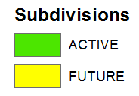

District Housing Overview
The district has 22 actively building subdivisions
Within Little Elm ISD there are 9 future subdivisions
Groundwork is underway on approximately 1,000 lots within 4 subdivisions

Slide 13
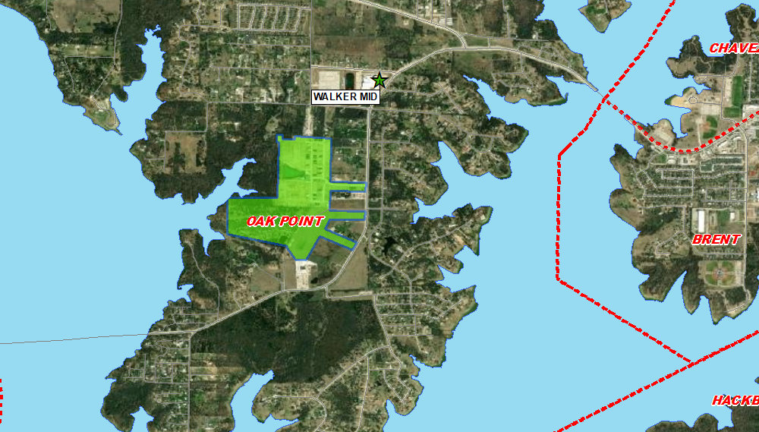
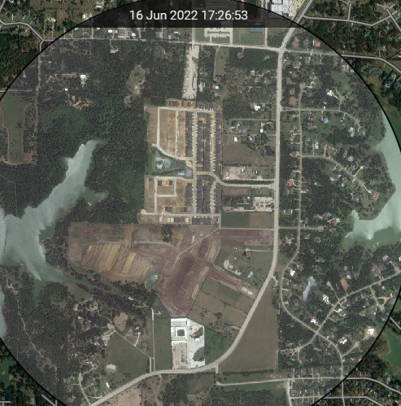
Residential Activity
South Oak
517 total lots
281 future lots
78 vacant developed lots
88 homes under construction
70 homes occupied

Slide 14
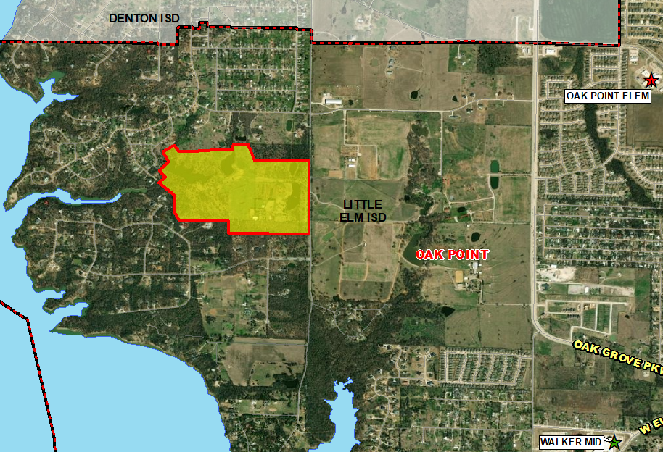
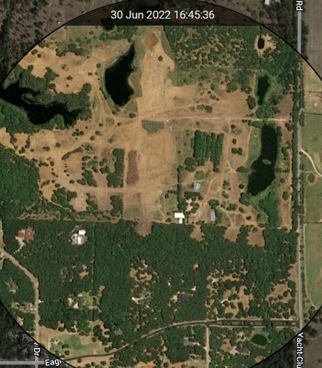
Residential Activity
Estates at Windsor Springs
65 total lots
65 future lots
Groundwork underway

Slide 15
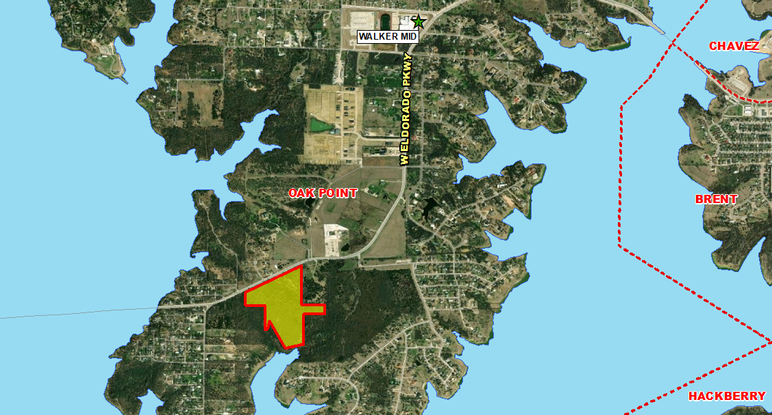
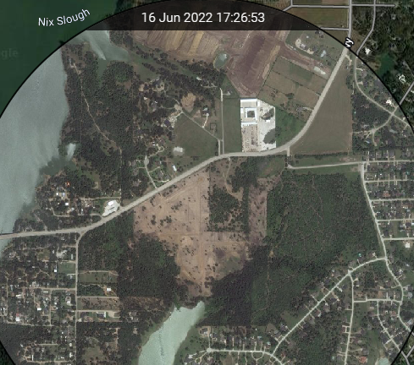
Residential Activity
Northshore at Lakewood Village
80 total lots
80 future lots
Groundwork underway

Slide 16
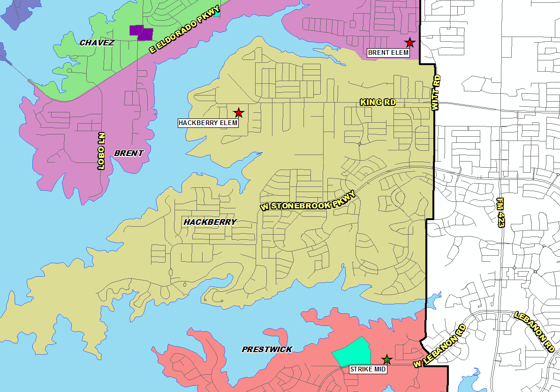
District Multi-Family Overview
There are 324 multi-family units under construction within the district
There are an additional 204 future multi-family units in the planning stages, including 159 single-family rental units
Multi-Family Developments
Future Development
Under Construction

Slide 17
Ten Year Forecast by Grade Level
Year (Oct.) | EE | PK | K | 1st | 2nd | 3rd | 4th | 5th | 6th | 7th | 8th | 9th | 10th | 11th | 12th | Total | Total Growth | % Growth
2017/18 | 33 | 187 | 566 | 563 | 593 | 602 | 609 | 618 | 606 | 542 | 516 | 593 | 519 | 504 | 475 | 7,526
2018/19 | 39 | 179 | 593 | 591 | 576 | 608 | 606 | 634 | 599 | 623 | 575 | 593 | 563 | 529 | 479 | 7,787 | 261 | 3.5%
2019/20 | 45 | 180 | 600 | 623 | 611 | 605 | 620 | 616 | 639 | 629 | 630 | 659 | 570 | 556 | 482 | 8,065 | 278 | 3.6%
2020/21 | 42 | 154 | 579 | 611 | 626 | 588 | 577 | 601 | 622 | 650 | 645 | 687 | 621 | 561 | 544 | 8,108 | 43 | 0.5%
2021/22 | 41 | 152 | 607 | 585 | 624 | 615 | 611 | 581 | 629 | 669 | 678 | 790 | 633 | 554 | 525 | 8,294 | 186 | 2.3%
2022/23 | 41 | 152 | 668 | 674 | 623 | 645 | 647 | 642 | 585 | 655 | 700 | 776 | 743 | 620 | 518 | 8,689 | 395 | 4.8%
2023/24 | 80 | 320 | 702 | 719 | 704 | 639 | 671 | 671 | 635 | 606 | 683 | 802 | 730 | 726 | 580 | 9,268 | 579 | 6.7%
2024/25 | 100 | 350 | 722 | 746 | 730 | 718 | 657 | 690 | 664 | 658 | 631 | 782 | 754 | 716 | 679 | 9,597 | 329 | 3.5%
2025/26 | 100 | 450 | 724 | 768 | 755 | 749 | 734 | 681 | 682 | 681 | 682 | 722 | 736 | 739 | 669 | 9,872 | 275 | 2.9%
2026/27 | 100 | 490 | 733 | 782 | 782 | 778 | 772 | 760 | 685 | 707 | 710 | 781 | 679 | 720 | 691 | 10,170 | 298 | 3.0%
2027/28 | 100 | 490 | 735 | 781 | 794 | 799 | 795 | 800 | 752 | 711 | 729 | 813 | 735 | 665 | 673 | 10,372 | 202 | 2.0%
2028/29 | 100 | 490 | 740 | 786 | 792 | 815 | 816 | 823 | 792 | 763 | 730 | 835 | 765 | 720 | 622 | 10,589 | 217 | 2.1%
2029/30 | 100 | 490 | 762 | 791 | 798 | 811 | 833 | 846 | 816 | 804 | 783 | 836 | 785 | 750 | 673 | 10,878 | 289 | 2.7%
2030/31 | 100 | 490 | 765 | 814 | 803 | 818 | 826 | 865 | 839 | 828 | 825 | 897 | 786 | 769 | 701 | 11,126 | 248 | 2.3%
2031/32 | 100 | 490 | 775 | 817 | 826 | 823 | 835 | 858 | 858 | 852 | 850 | 945 | 844 | 770 | 719 | 11,362 | 236 | 2.1%
Yellow box = largest grade per year
Green box = second largest grade per year

Slide 18
Ten Year Forecast by Campus
 | Maximum | Functional |  | Fall | Projections
Campus | Capacity | Capacity | 2020/21 | 2021/22 | 2022/23 | 2023/24 | 2024/25 | 2025/26 | 2026/27 | 2027/28 | 2028/29 | 2029/30 | 2030/31 | 2031/32
Zellars Early Childhood Center | 600 | 600 | 0 | 0 | 0 | 400 | 450 | 550 | 590 | 590 | 590 | 590 | 590 | 590
Brent Elementary | 914 | 777 | 706 | 702 | 728 | 697 | 691 | 683 | 696 | 713 | 719 | 726 | 730 | 722
Chavez Elementary | 914 | 777 | 543 | 499 | 522 | 489 | 500 | 520 | 534 | 548 | 565 | 575 | 569 | 571
Hackberry Elementary | 914 | 777 | 680 | 711 | 753 | 722 | 747 | 768 | 810 | 816 | 824 | 828 | 834 | 843
Lakeview Elementary | 914 | 777 | 611 | 582 | 622 | 684 | 706 | 727 | 740 | 731 | 731 | 738 | 746 | 763
Oak Point Elementary | 1,070 | 910 | 827 | 856 | 960 | 993 | 1,066 | 1,144 | 1,236 | 1,301 | 1,334 | 1,369 | 1,401 | 1,414
Prestwick Elementary | 834 | 665 | 411 | 466 | 507 | 521 | 553 | 569 | 591 | 595 | 599 | 605 | 611 | 621
ELEMENTARY SCHOOL TOTAL | 4,726 | 4,017 | 3,778 | 3,816 | 4,092 | 4,506 | 4,713 | 4,961 | 5,197 | 5,294 | 5,362 | 5,431 | 5,481 | 5,524
Elementary Absolute Growth |  |  | -122 | 38 | 276 | 414 | 207 | 248 | 236 | 97 | 68 | 69 | 50 | 43
Elementary Percent Growth |  |  | -3.13% | 1.01% | 7.23% | 10.12% | 4.59% | 5.26% | 4.76% | 1.87% | 1.28% | 1.29% | 0.92% | 0.78%
Strike Middle School | 1,200 | 1,020 | 968 | 1,016 | 1,023 | 1,021 | 1,018 | 1,083 | 1,092 | 1,138 | 1,167 | 1,241 | 1,261 | 1,278
Walker Middle School | 1,200 | 1,020 | 949 | 960 | 917 | 903 | 935 | 962 | 1,010 | 1,054 | 1,118 | 1,162 | 1,231 | 1,282
MIDDLE SCHOOL TOTAL |  |  | 1,917 | 1,976 | 1,940 | 1,924 | 1,953 | 2,045 | 2,102 | 2,192 | 2,285 | 2,403 | 2,492 | 2,560
Middle School Absolute Growth |  |  | 20 | 59 | -36 | -16 | 29 | 92 | 57 | 90 | 93 | 118 | 89 | 68
Middle School Percent Growth |  |  | 1.05% | 3.08% | -1.82% | -0.82% | 1.51% | 4.71% | 2.79% | 4.28% | 4.24% | 5.16% | 3.70% | 2.73%
Little Elm High School | 2,500 | 2,125 | 2,413 | 2,502 | 2,657 | 2,838 | 2,931 | 2,866 | 2,871 | 2,886 | 2,942 | 3,044 | 3,153 | 3,278
Denton County JJ AEP |  |  | 0 | 0 | 0 | 0 | 0 | 0 | 0 | 0 | 0 | 0 | 0 | 0
HIGH SCHOOL TOTAL |  |  | 2,413 | 2,502 | 2,657 | 2,838 | 2,931 | 2,866 | 2,871 | 2,886 | 2,942 | 3,044 | 3,153 | 3,278
High School Absolute Growth |  |  | 145 | 89 | 155 | 181 | 93 | -65 | 5 | 15 | 56 | 102 | 109 | 125
High School Percent Growth |  |  | 6.39% | 3.69% | 6.20% | 6.81% | 3.28% | -2.22% | 0.17% | 0.52% | 1.94% | 3.47% | 3.58% | 3.96%
DISTRICT TOTAL |  |  | 8,108 | 8,294 | 8,689 | 9,268 | 9,597 | 9,872 | 10,170 | 10,372 | 10,589 | 10,878 | 11,126 | 11,362
District Absolute Growth |  |  | 43 | 186 | 395 | 579 | 329 | 275 | 298 | 202 | 217 | 289 | 248 | 236
District Percent Growth |  |  | 0.53% | 2.29% | 4.76% | 6.66% | 3.55% | 2.87% | 3.02% | 1.99% | 2.09% | 2.73% | 2.28% | 2.12%
Green = exceeds functional capacity
Yellow = exceeds maximum capacity

Slide 19
Key Takeaways
Little Elm ISD continues to see good home sales activity, rising 5% over 2020 totals
Interest rates and inflation are impacting the new home activity
The district has 22 actively building subdivisions and 9 future subdivisions
Groundwork is underway on roughly 1,000 lots within 4 subdivisions
LEISD may enroll nearly 10,200 students by 2026/27 and over 11,350 students by 2031/32

