Slide 1


Testing Tips
Mission: To educate, challenge, and inspire all students to become life long learners
Tips for your child during this Testing Period

Slide 2
Testing Dates
3rd and 4th Grade
LEAP
Monday May 1st- (Paper and Pencil)
Tuesday May 2nd- (Paper and Pencil)
Wednesday May 3rd- (Paper and Pencil)
Thursday May 4th- (Paper and Pencil)
Friday Math 5th- Science (Paper and Pencil)

Slide 3
Testing Dates
5th Grade
LEAP
Thursday April 6th -ELA & Math Day 1 (Online)
Friday April 7th-ELA & Math Day 2 (Online)
Monday April 10th- ELA & Math Day 3 (Online)
Tuesday April 11th- SS Day 1 (Online)
Wednesday April 12th- SS Day 2 (Online)

Slide 4

Tip#1
Make sure your child has a full night of rest, and a good breakfast before taking the test

Slide 5

Tip #2
Get your child to school on time the day of the test.

Slide 6

Tip #3
Try to make the morning of the test a pleasant one.

Slide 7

Tip #4
Reassure your child that he or she does not have to answer all of the questions correctly to pass. It is not expected that students answer every question correctly.

Slide 8

Tip #5
Tell your child to attempt to answer all of the questions and not leave any blanks. There is no penalty for guessing, and students can get partial credit for open-ended questions.

Slide 9

Tip #6
Remind your child that this test is important!

Slide 10

Tip #7
Remind your child to listen carefully to the instructions from the teacher and to read the directions to each question carefully.

Slide 11

Tip #8
Encourage your child to stay focused on the test, even if other students finish early.

Slide 12

Tip #9
Remind your child that it is okay to mark in the test booklet.
i.e. underlining important words.

Slide 13

Tip#10
Explain to your child the importance of using time wisely. If your child gets stuck on a question, encourage him or her to make the best guess or place a mark in the test booklet by that item and go back to it after finishing that section of the test.

Slide 14
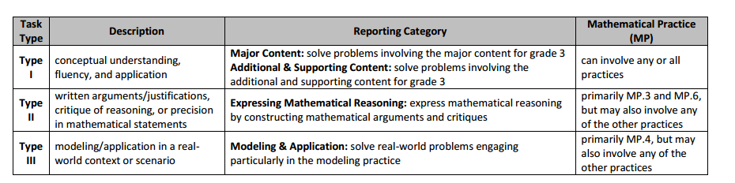
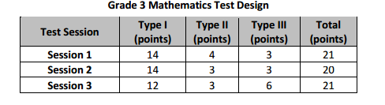
3rd Grade Math Test Structure

Slide 15
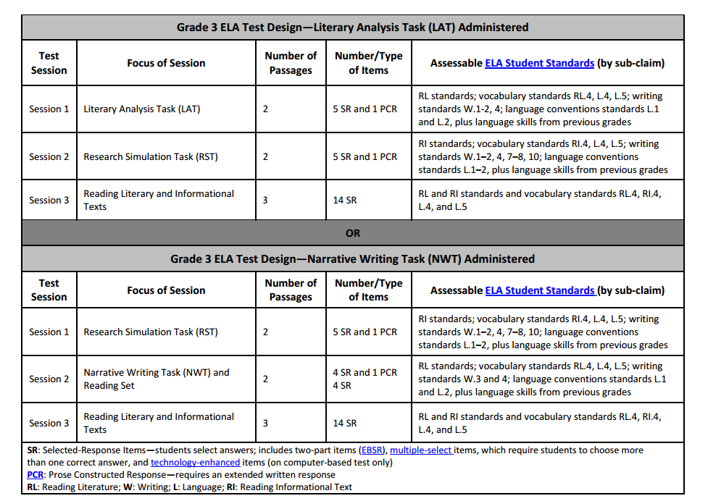
3rd Grade ELA Test Structure

Slide 16
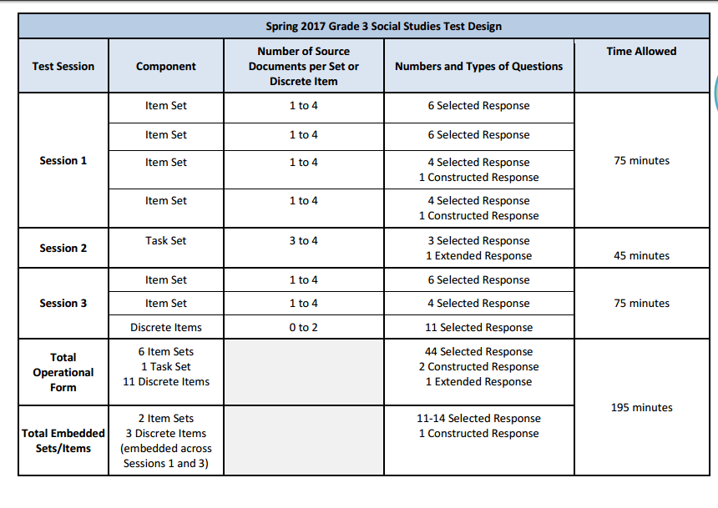
3rd Grade SS Test Structure

Slide 17
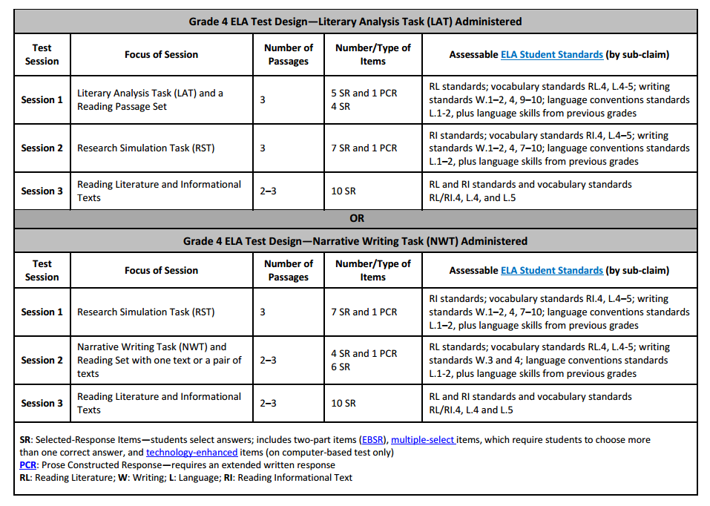
4th/ 5 th Grade ELA Test Structure

Slide 18
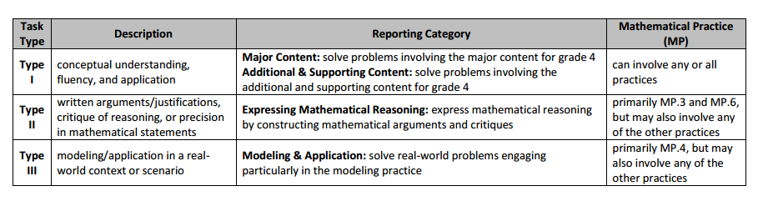
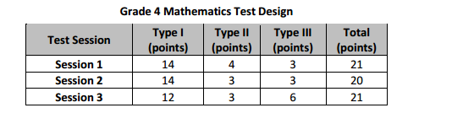
4th/5th Grade Math Test Structure

Slide 19
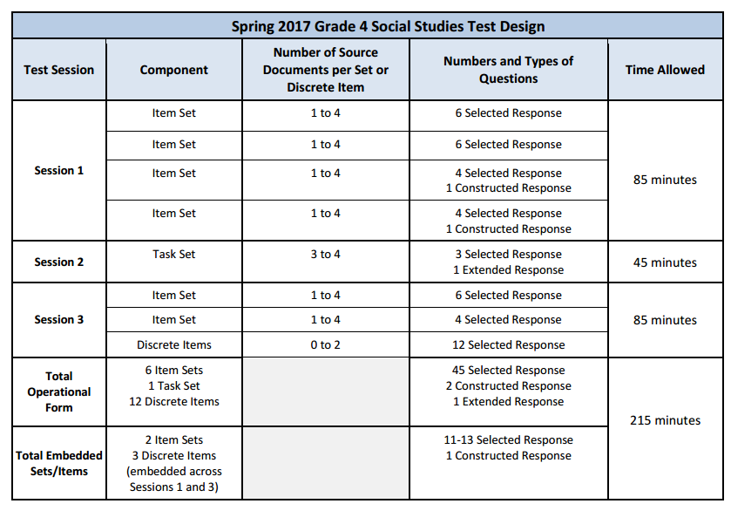
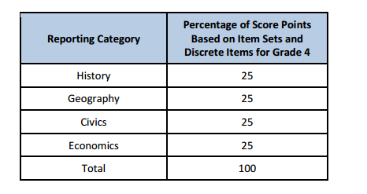
4th Grade SS Test Structure

Slide 20
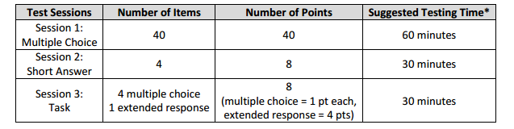
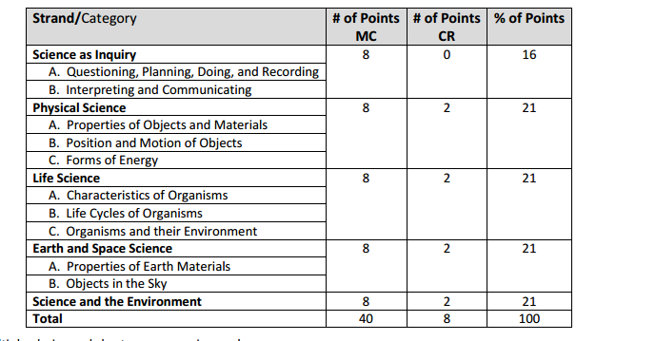
4th Grade Science Test Structure

Slide 21
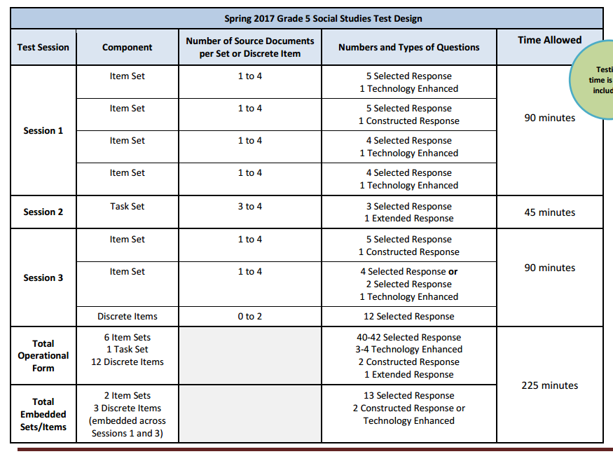
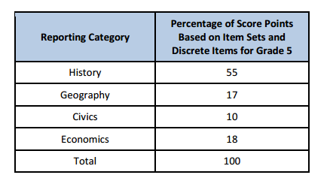
5th Grade Social Studies
Test Structure

Slide 22
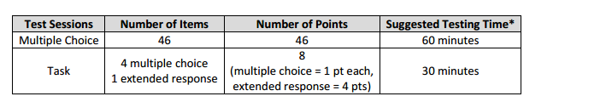
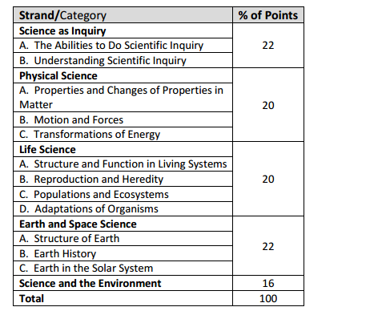
5th Grade Science Test Structure

Slide 23

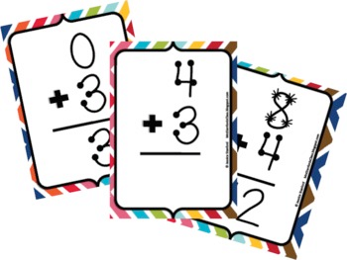
What Can You Do?
Read, Read, Read!
  MYON Reading
  20 minutes daily
Math facts
  Flashcards
  Repetition

Slide 24

Louisiana Believes Parent Resources
http://www.louisianabelieves.com

Slide 25


