Slide 1

Sumner High School Project Superintendent Recommendation
Board Meeting June 18, 2019
Superintendent: Laurie Dent, Ph.D.
June 18, 2019

Slide 2

Sumner High School Est. 1891
Creating
Our
Legacy

Slide 3

Sumner High School Project
2016 Bond goals include:
  Additional classrooms New Commons/Cafeteria
  New Library (Learning Resource Center) New Restrooms
  Additional gym seating Technology/security improvements
As bid design– approx. $14 million over budget
  Board rejected only bid received
Board directed Superintendent to form a Task Force to review,
study and evaluate options, for modernization and expansion of
Sumner High School in light of state and local circumstances
June 18, 2019

Slide 4
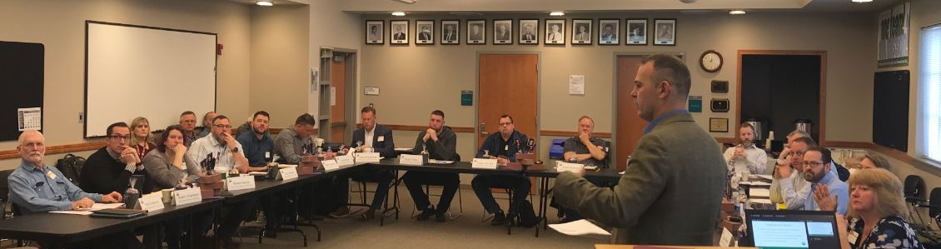
Task Force Members
Met four times over two months, and reviewed dozens of concepts
Adam Chambers
Tyson Cornett
Kyle Hardtke
Karen Harris
Rick Hendricks
Pete Hochstatter
Matthew Kastberg
Barbara Kiliz
Kassie Meath
Scott Nall
Deb Norris
Jason Olson
Tom Osborne
Dana Powers
Troy Powers
Brad Sayre
Seth Sherwood
Paul Smith
Grant Sulham
Ryan Turley
June 18, 2019

Slide 5
Current Circumstances
Current circumstances considered, include:
  Overheated construction environment
  City parking and regulatory requirements
  Complexity and associated expense of demolition and remodeling or expanding existing structures
  Previously unanticipated impacts to utilities and building systems
  District acquired several properties adjacent to the Sumner
  High School campus
June 18, 2019

Slide 6
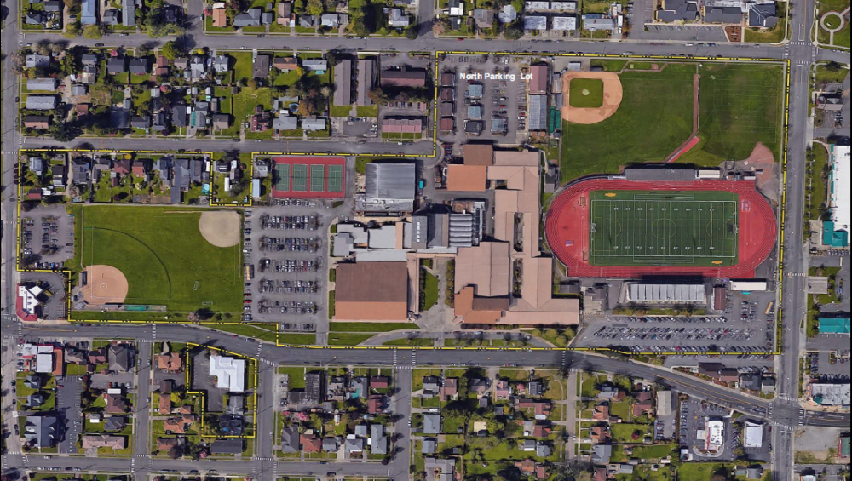
Existing Site
------ Campus Boundaries
8

Slide 7
Phased Approach
  Initial Phase Approach (Build now with 2016 Bond Proceeds)
    Build new, priority, core facilities (2016 Bond goals)
    Retain most or all of existing buildings
    Limit remodeling
    Initial Phase Elements
    New Classrooms
    New Commons / Cafeteria
    New Kitchen
    New Library (LRC)
    Improved Circulation
    Restrooms/Security/Technology
June 18, 2019

Slide 8
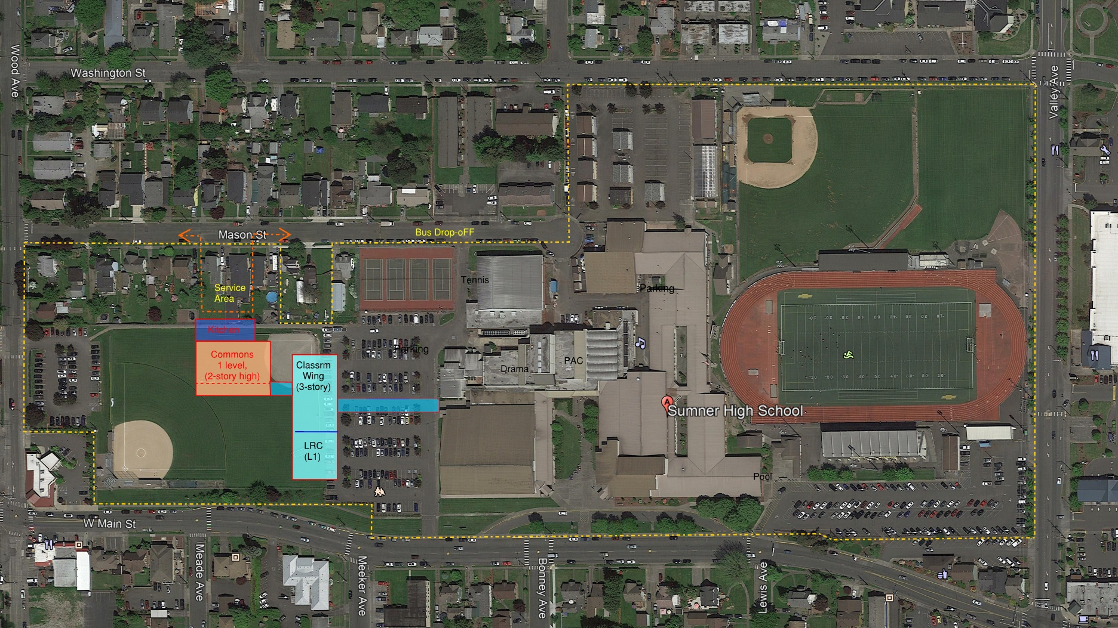

Initial Phase Concept
Initial Phase Concept
June 18, 2019
------ Campus Boundaries
9

Slide 9
Phased Approach
  Master Plan Approach
    Complete new facilities buildout
    Demolish remainder of existing building
    Complete parking and site work
    Master Plan Elements
    Additional classrooms
    CTE and FFA
    Arts, Music and Drama
    Athletic Facilities
    Administration and Student Services
    Support Services
June 18, 2019

Slide 10
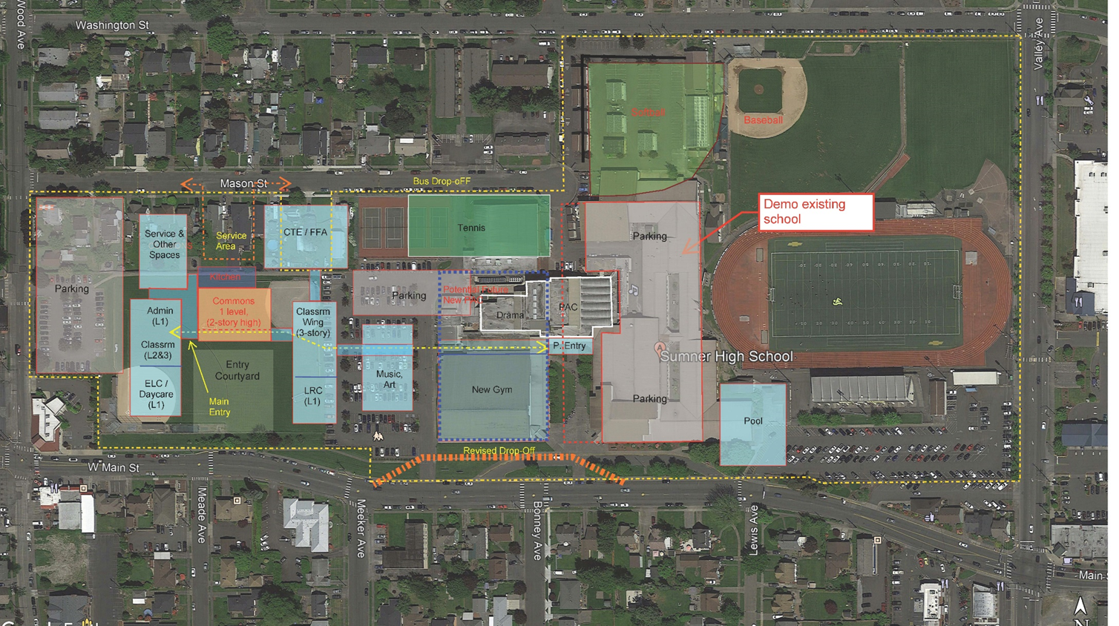
Initial Phase Concept
Initial Phase Concept
Master Plan Concept
*
------ Campus Boundaries
* Parcel acquisition in negotiations
June 18, 2019
10

Slide 11
Recommendations Assumptions
Configuration of buildings in Initial Phase and full build-out under a Master Plan could, and will, likely change during schematic design phase, arising from:
Program considerations ADA access requirements Parking and site development requirements State match funding | Physical constraints Building code requirements Remaining parcel on Mason St. in negotiations for acquisition Bond planning
June 18, 2019

Slide 12
Task Force Recommendations
Building new construction to the west on campus
Construct Initial Phase facilities westerly
Adopt a Master Plan for future build-out
Minimize remodeling to extent reasonably possible
June 18, 2019

Slide 13
Task Force Recommendations
Build core facilities in Initial Phase (2016 Bond goals)*
  New classrooms (target 16 – 20)
  New commons/cafeteria
  New kitchen
  New library (Learning Resource Center)
  Improved circulation
  *Facilities will include restrooms/security features/technology
Request bond funding for future build-out of Master Plan as soon as reasonably possible
June 18, 2019

Slide 14
Community Input
In-person and Online
June 18, 2019
14

Slide 15
Community Outreach
Two in-person public meetings
  May 28, Sumner
  May 29, Bonney Lake
Online survey
  Open from May 28 – June 5
    13 Respondents
June 18, 2019
15

Slide 16
Survey Themes - Benefits
Initial Phase
Limits major disruptions to academics
Shows the community that work is being completed and there is momentum to complete the project
Is a good use of the limited bond budget
Master Plan
Something the community can be proud of
Shows that there is strong support for the schools’ athletics
Is a better use of resources than remodeling existing structures
Layout makes sense for the community’s needs
June 18, 2019
16

Slide 17
Survey Themes - Challenges
Initial Phase
Current and future costs of construction are major concerns to completing the project
There are concerns with keeping the project phases on-schedule
Master Plan
Concerns about funding for future phases
Gathering support from the community for additional bonds may be challenging
Concerns about the safety and wellbeing of students during construction
June 18, 2019
17

Slide 18
Proud of the thoughtful, committed, and focused work of the Task Force together with the community participation and input to provide a path forward for the SHS project to ensure the High School’s legacy as the heart of the community continues!
THANK YOU!
June 18, 2019

Slide 19
THOUGHTS?
COMMENTS?
QUESTIONS?
June 18, 2019

