Slide 1

Sumner High School Project Review Task Force
Final Meeting, May 14, 2019
Superintendent: Laurie Dent, Ph.D.
Facilitator: Penny Mabie, EnviroIssues
Hainline: Matt Guilanians, Chuck Hartung
May 14, 2019

Slide 2

WELCOME BACK!
May 14, 2019

Slide 3


Slide 4


Slide 5

 Task Force Process Expectations: Check In
“Find solutions that allow the Sumner District to deliver on its promise to taxpayers and the Community.”
“Make sure we get the best value for the taxpayers, students and faculty.”
“Thoughtful plans with realistic goals and objectives.”
“Providing Sumner SD with a range of viable options.”
“Long-term plan for the SHS Campus.”
“Contract and construction oversight.”
May 14, 2019
5

Slide 6

Context for Concept(s) Recommendations
    Began with an overview of SHS Project
    State and local circumstances
    Changed circumstances
    Presented broad locations and concepts
    Task Force prioritized new construction to the west
    Considered three western concepts
    Task Force indicated preference for proximal concept
    Presentation of refined proximal/westerly concepts

Slide 7
Programming Considerations
Initial Phase: Priority Core Elements (2016 Bond Goals)
    Classrooms
    Commons
    Kitchen
    Library (Learning Resource Center)
    Circulation

Slide 8
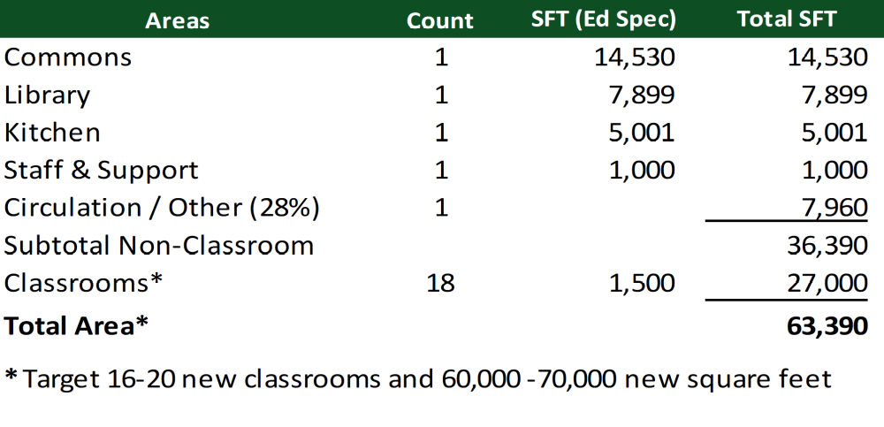
Initial Phase Programming

Slide 9
Master Plan Elements
Additional Classrooms
CTE and FFA
Arts, Music, and Drama
Administration and Student Services
Support Services
Athletic Facilities

Slide 10
Review of Prior Concepts and Concepts Evolution
    Proximal 1: Initial Phase and Master Plan
    The Proximal Concept from Task Force meeting #3 has evolved into the Proximal 2 and 3 Initial Phase and Master Plan Concepts presented here.
    Distal 1: Initial Phase and Master Plan
  The Distal Concept from the Task Force meeting #3 has evolved into the Distal 2 Initial Phase and Master Plan Concept presented here.

Slide 11
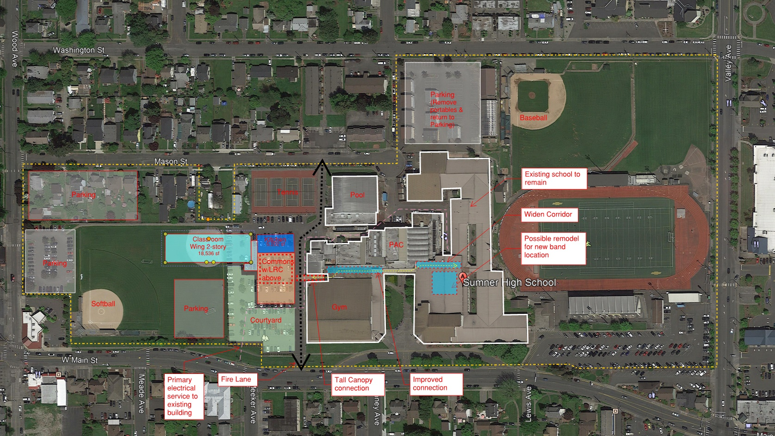
Proximal 1: Initial Phase
April 30, 2019 (TF #3)
11

Slide 12
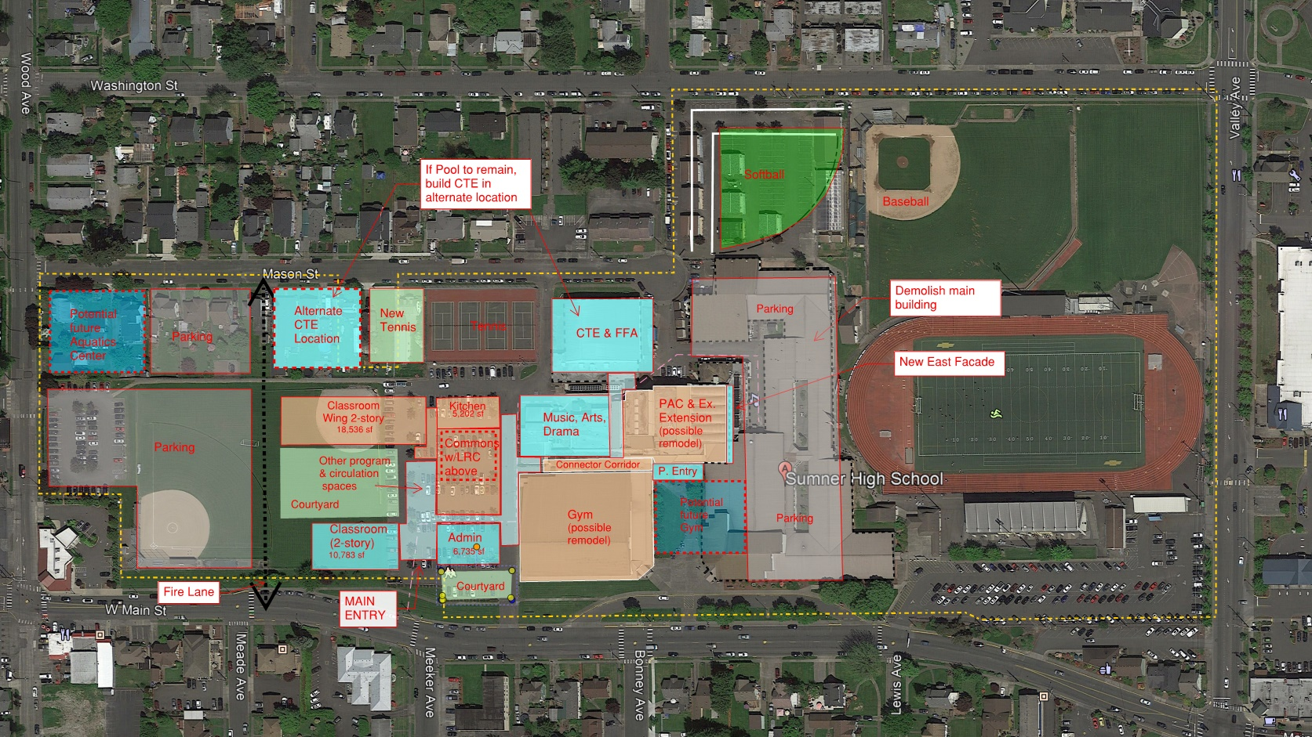
Proximal 1: Master Plan
April 30, 2019 (TF #3)
12

Slide 13
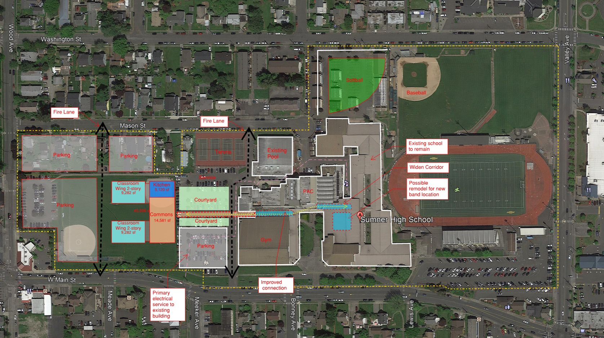
Distal 1: Initial Phase
April 30, 2019 (TF #3)
13

Slide 14
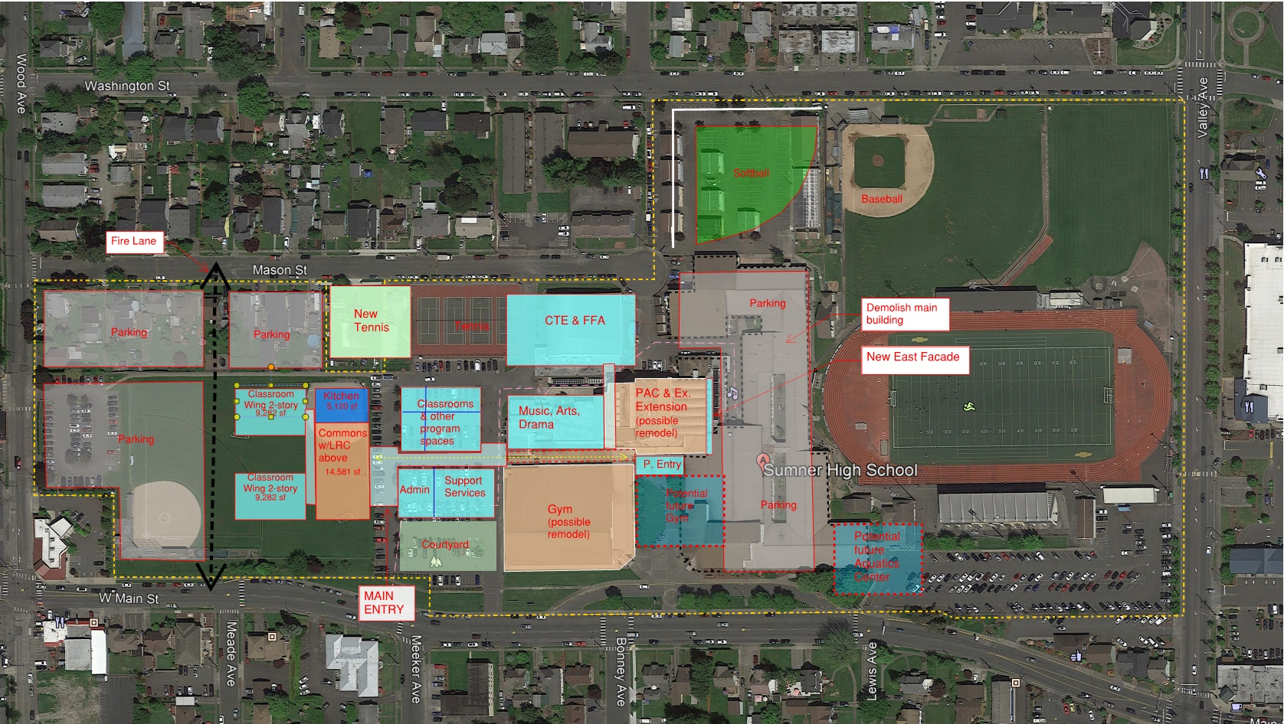
Distal 1: Master Plan
April 30, 2019 (TF #3)
14

Slide 15
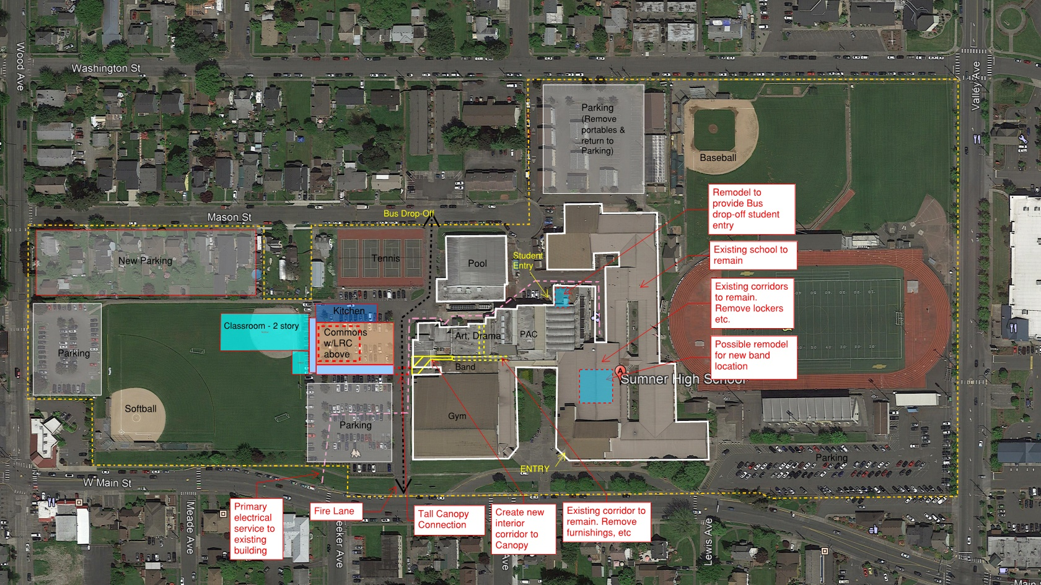
Proximal 2: Initial Phase
May 14, 2019
15

Slide 16
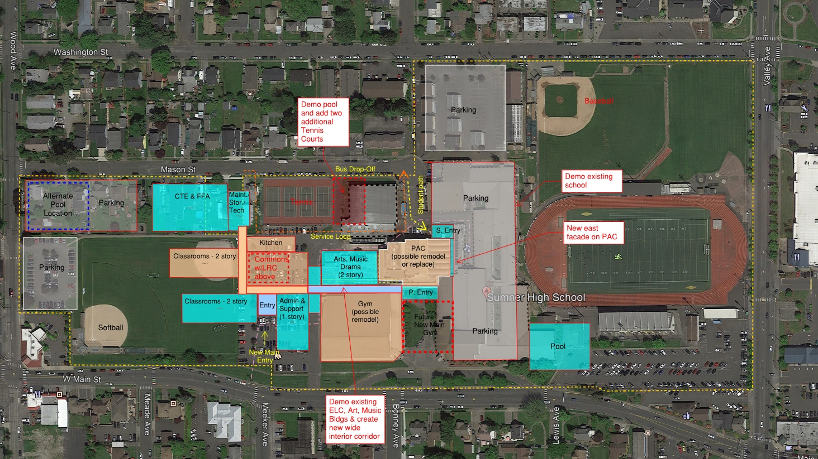
Proximal 2: Master Plan A
May 14, 2019
16

Slide 17
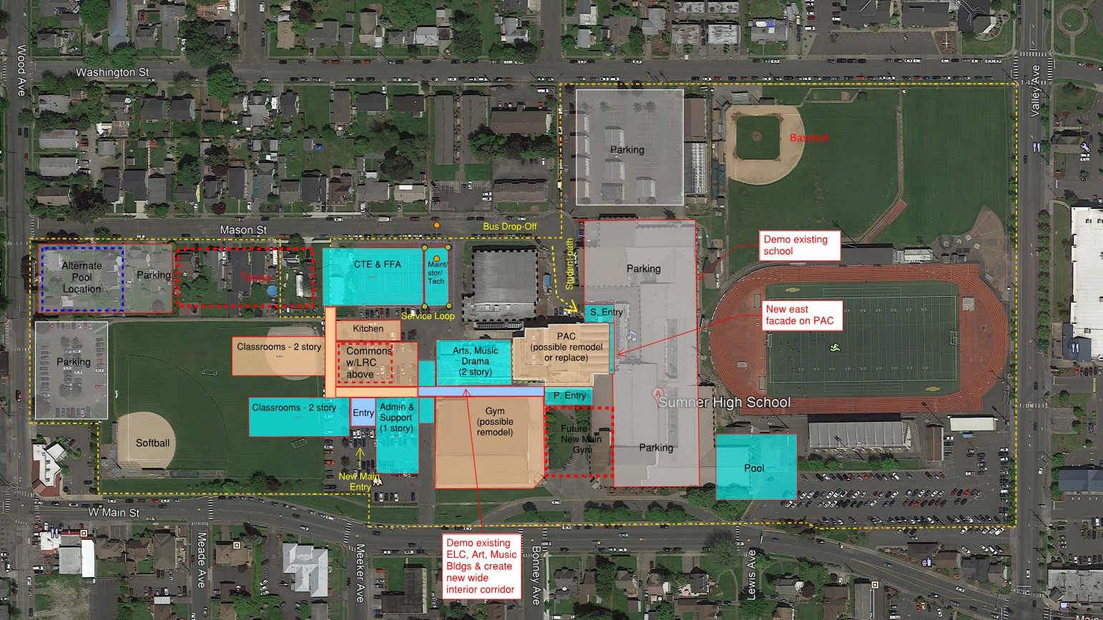
Proximal 2: Master Plan B
May 14, 2019
17

Slide 18
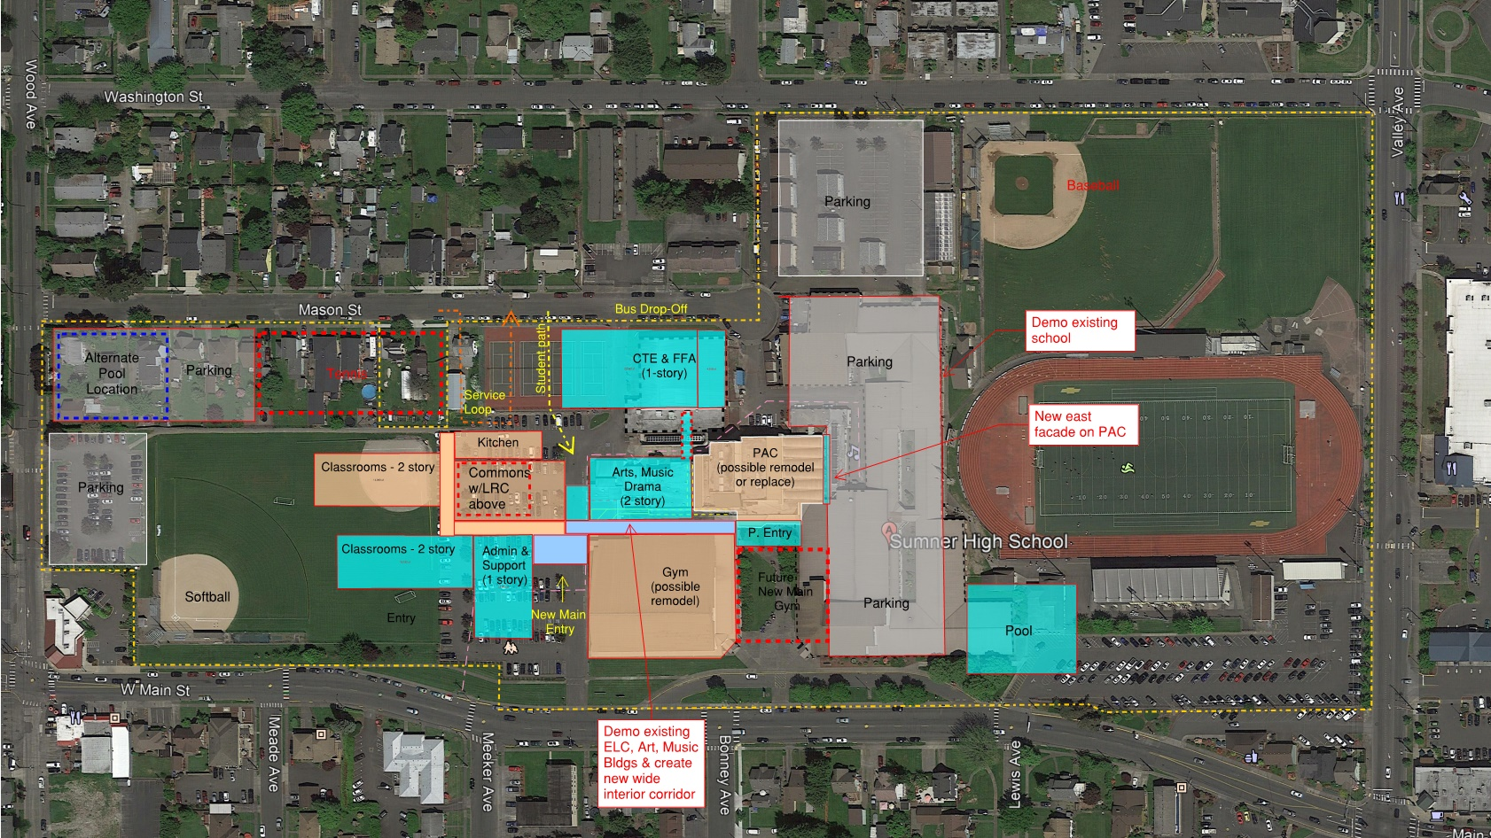
Proximal 2: Master Plan C
May 14, 2019
18

Slide 19
Proximal 2: Considerations
  Creates a visible “new school building” in the Initial Phase
  Retains visitors parking in Initial Phase
  Provides adjacency to existing school in Initial Phase
  Leaves softball field and some green space in the west
  Commits to existing location of PAC and Gym whether remodeled or new
  Bifurcates site athletic facilities and locates school in center of site
  Commons façade constructed in Initial Phase will require modification in
  Master Plan build out
  Proximity to existing school causes complexity in construction in
  Initial Phase
  Proximity to existing school will disturb daycare

Slide 20
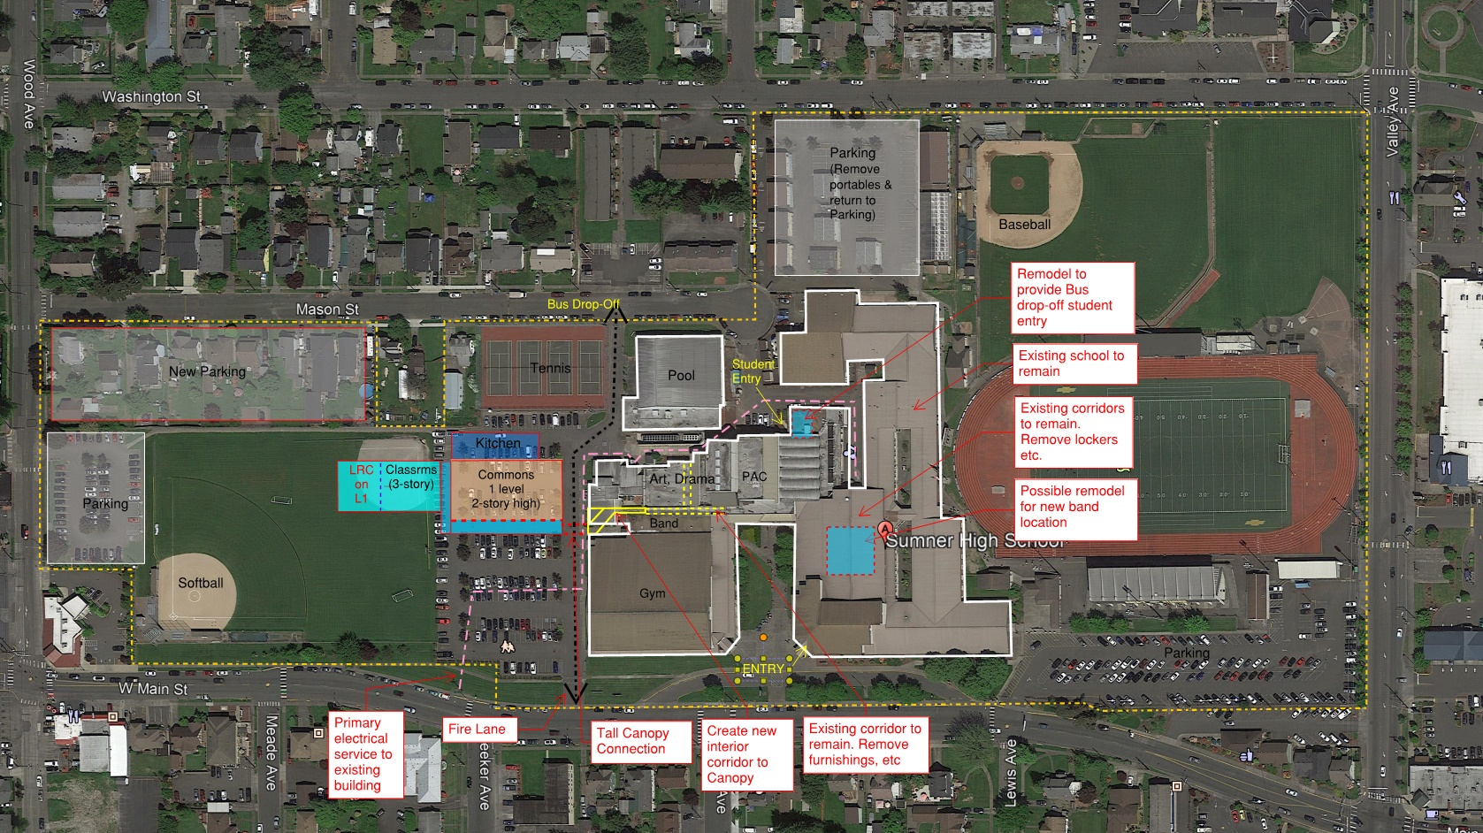
Proximal 3: Initial Phase
May 14, 2019
20

Slide 21
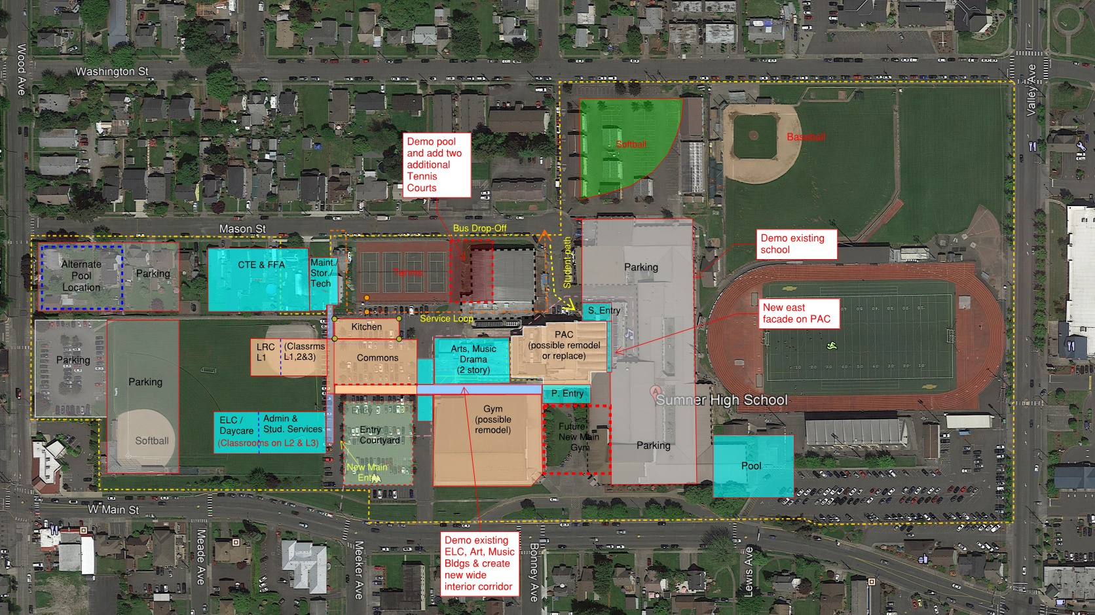
Proximal 3: Master Plan
May 14, 2019
21

Slide 22
Proximal 3: Considerations
  Considerations are similar to Proximal 2, except:
  Three (3) story vs. two (2) story classroom wings
  Administration is located in classroom wing to the west in
  Master Plan build out
  Commons façade does not require removal in Master Plan build out
  Softball field is moved to northeast and west parking expanded

Slide 23
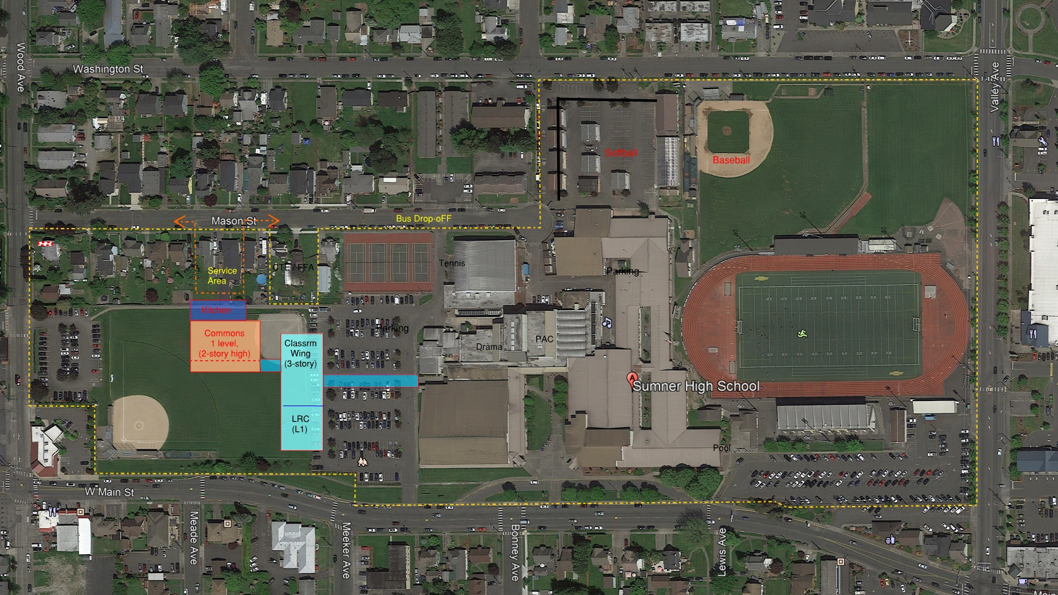
Distal 2: Initial Phase
May 14, 2019
23

Slide 24
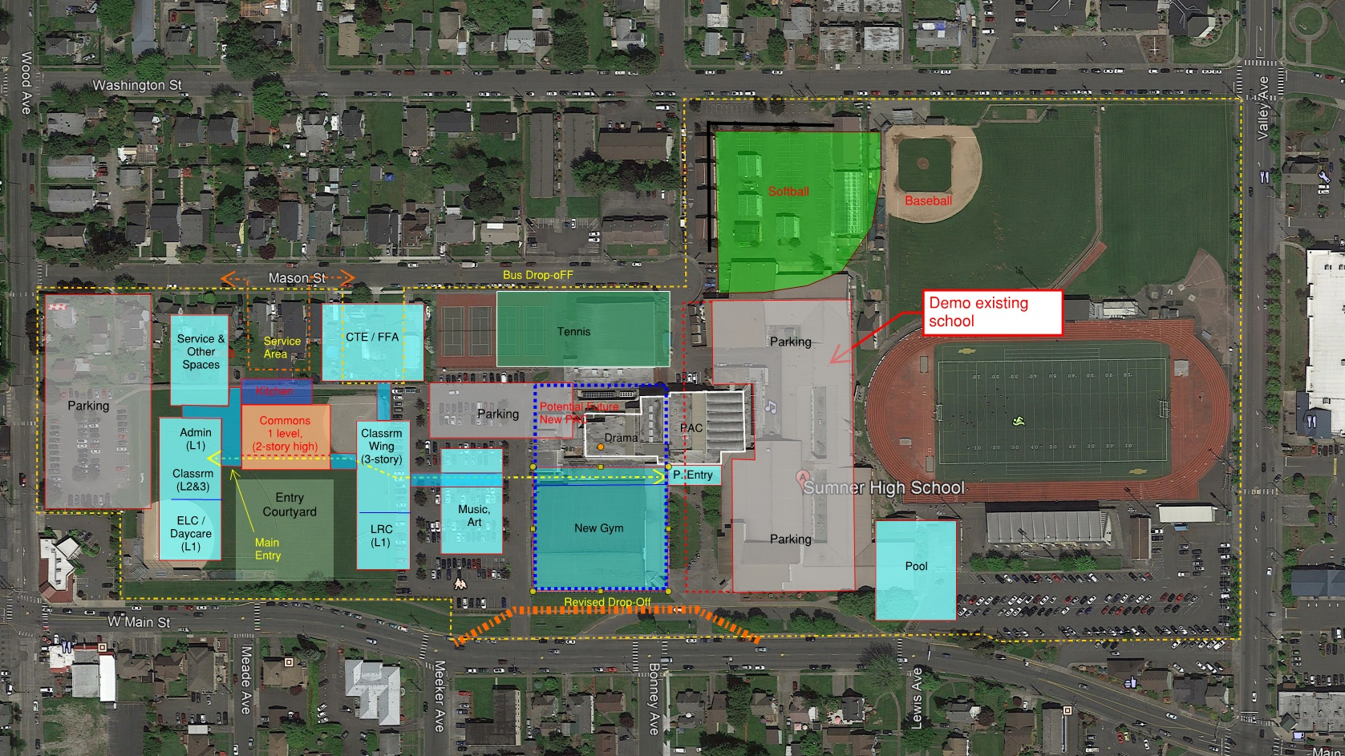
Distal 2: Master Plan
May 14, 2019
24

Slide 25
Distal 2: Considerations
  Allows new school to be prominent and not obscured by Gym
  Clean visual break from existing school
  Better flexibility of site usage in Master Plan build out
  Potential for relocation of PAC and Gym, if determined to relocate
  Entry courtyard provides green space in front of Commons
  Further west location means less disturbance to ongoing education
  during construction
  Simpler construction staging

Slide 26
Distal 2: Considerations (cont’d)
Commons is more remote to existing school in the Initial Phase
Retains parking west of Gym in Initial Phase, but is bifurcated
Moves school mass west, creating an academic section and an
athletic section
Student drop-off further from main entry (in front of Gym)
Drop-off for administration and daycare likely from west (Wood Avenue) parking lot
Minimally increases travel time from existing school in Initial Phase

Slide 27
Pathway Recommendations Assumptions
Bond planning numbers are a rule of thumb
District used a preliminary, hypothetical number to calculate sample bond tax rate
The Master Plan is a guide for future development
Run another bond to fund components of the Master Plan based upon future bond planning
The full build out of the Master Plan is not budgeted - future discussions and refinements will have to be made

Slide 28
Pathway Recommendations Assumptions
Configuration of buildings in Initial Phase and full build out under a Master Plan could and will likely change during schematic design phase, arising from:
Program considerations ADA access requirements Parking requirements Site development requirements State match funding | Physical constraints Remaining parcel not in District ownership Building code requirements Bond planning
May 14, 2019
28

Slide 29

Task Force Recommendations - Draft
Building new construction to the west on campus
Construct Initial Phase facilities westerly (represented by Concept)
Adopt a Master Plan for future build out (represented by Concept)
Minimize remodeling to extent reasonably possible
Build core facilities in Initial Phase (2016 Bond goals)
  New classrooms (target 16 – 20)
  New commons
  New kitchen
  New library (Learning Resource Center)
  Improve circulation
Request bond funding for future build out of Master Plan as soon as reasonably possible
May 14, 2019
29

Slide 30

Task Force Recommendations - Draft
Design location of buildings to be constructed in the Initial Phase to avoid where practical having to relocate, modify or interrupt existing utilities serving the existing building
Consider using alternate delivery methods where beneficial for project
In the design of the Initial Phase, consider modifications that may be necessary to build out the Master Plan
Master Plan
  Build new Gym
  Remodel or build new Performing Arts Center, depending upon budget considerations
  Include Aquatic facility (pool)
  Consider three story structures where feasible, cost effective, and functionally acceptable to District
  Other recommendations?

Slide 31
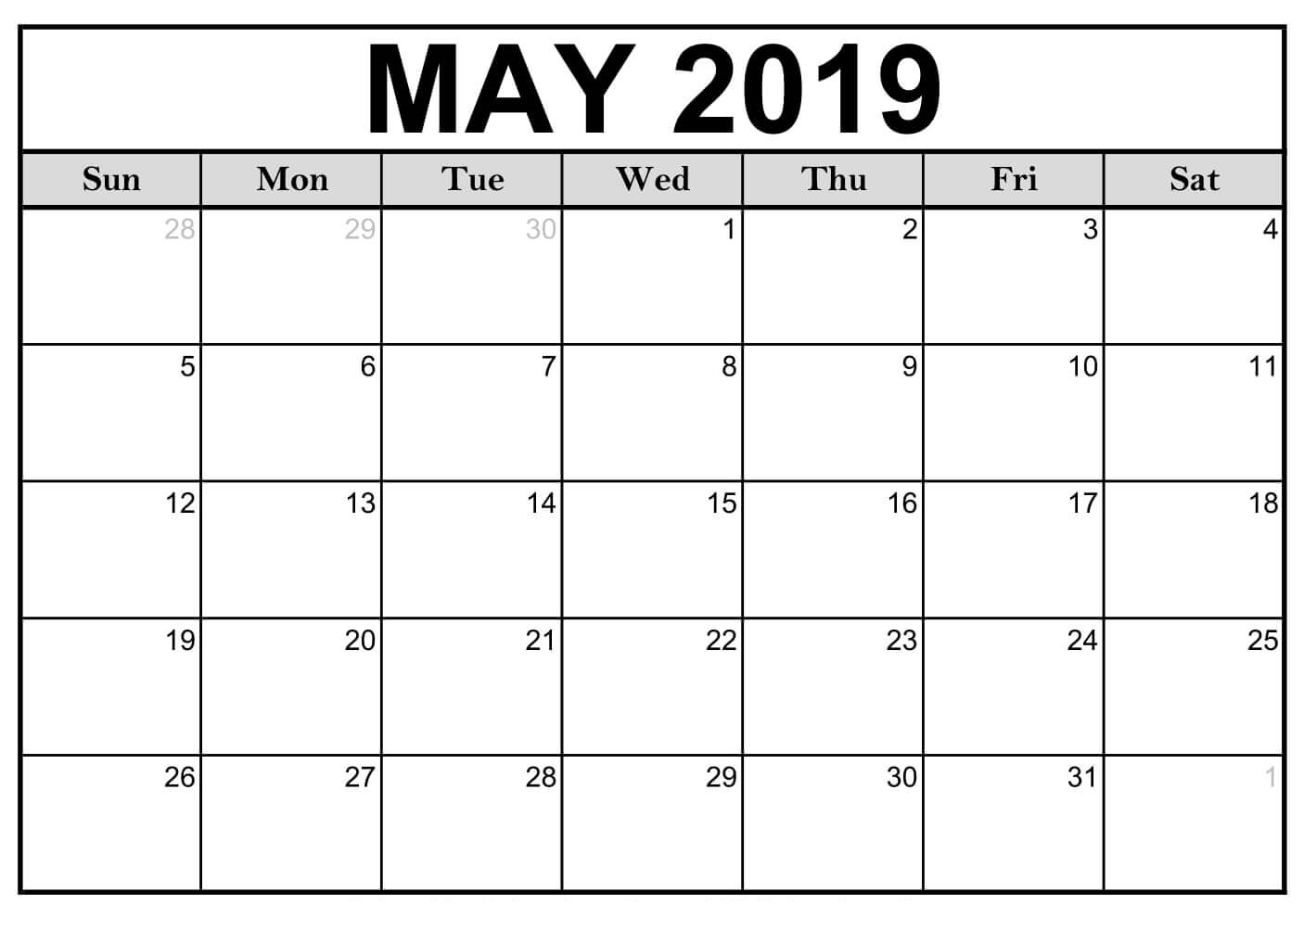

Public Meetings Information
May 28th @ Lakeridge Middle School
May 29th @ Sumner Middle School
Time: 6:00PM – 7:30PM

Slide 32
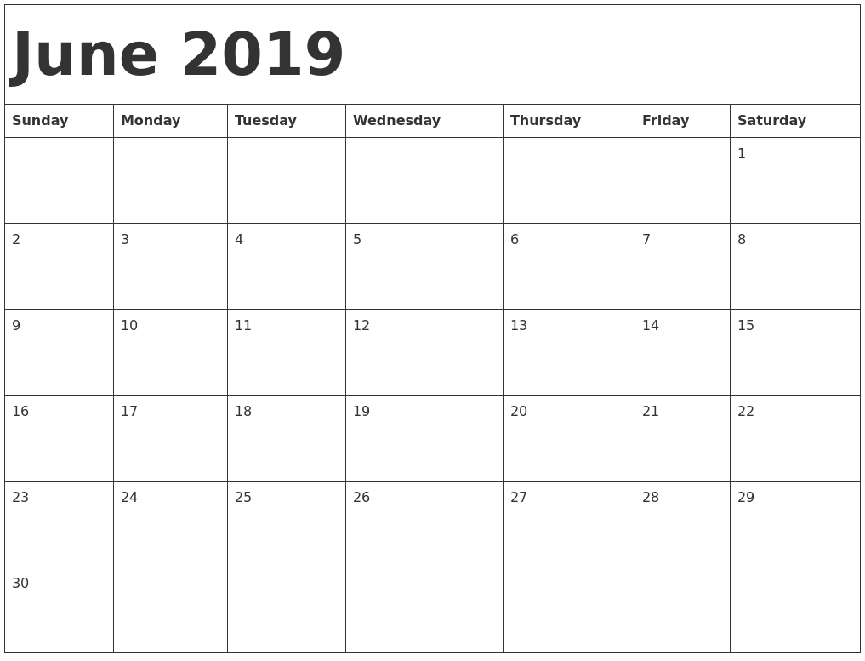
Board Meeting: Recommendations Delivered
Tuesday June 18th
@ Maple Lawn
Elementary School
Time: 6:00PM

Slide 33

May 14, 2019

