Slide 1

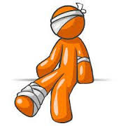

Hazards
Fire
Safety
Security
Integrated Pest Management
Key Control

Slide 2
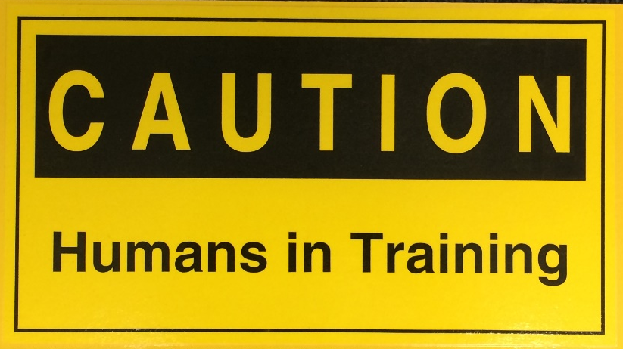

Slide 3
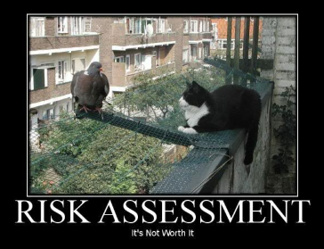
Risk Management
Step 1: Identify hazards.
Step 2: Assess hazards to determine risks.
Step 3: Develop controls (Mitigation measures) and make risk decisions.
Step 4: Implement controls.
Step 5: Supervise and evaluate.
Is the risk worth it?

Slide 4

Familiarization with common hazards in the school environment.
See First – Understand First – Act First.
We must train ourselves to see what others overlook.
Generate discussion and develop situational awareness.
Learn about the common hazards in our work environment.

Slide 5

“We” All Have A Responsibility In This
Poor organizations have no accountability.
Mediocre organizations have accountability driven by leaders only.
High performing organizations have teams that hold themselves and each other accountable to the standards and expectations.

Slide 6
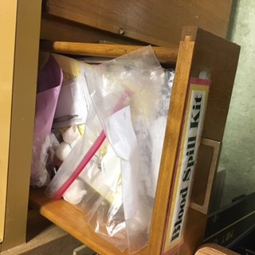
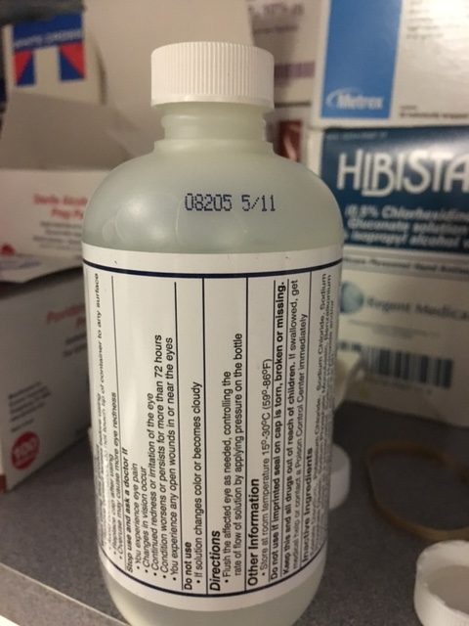
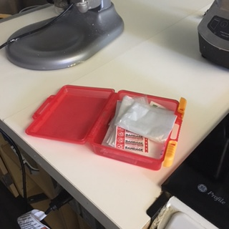
Blood spill kits and first aid kits not organized or fully stocked and/or unable to locate them. Kits should be inspected monthly, check expiration dates, and restocked as necessary.

Slide 7
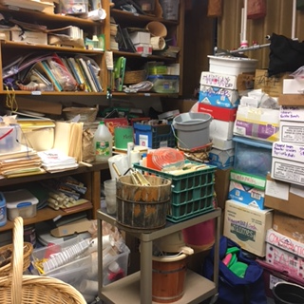
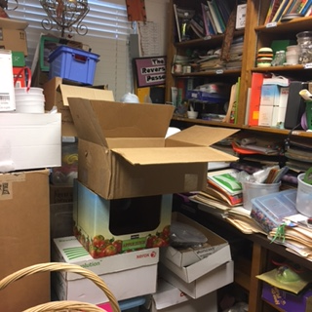
Disorganized clutter. Storage spaces should be organized, purged when possible and used efficiently. They should not have falling hazards or become pest habitats. Clear paths of ingress and egress must be maintained.

Slide 8
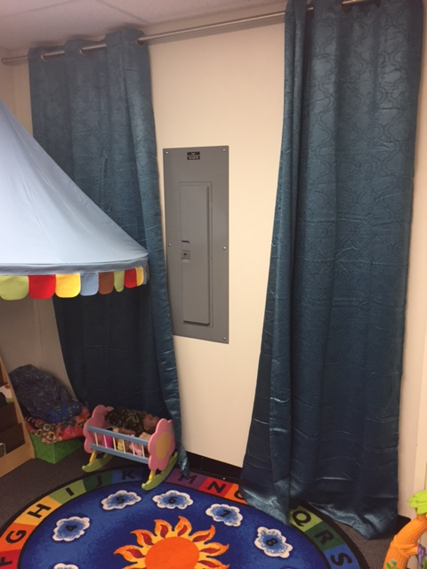
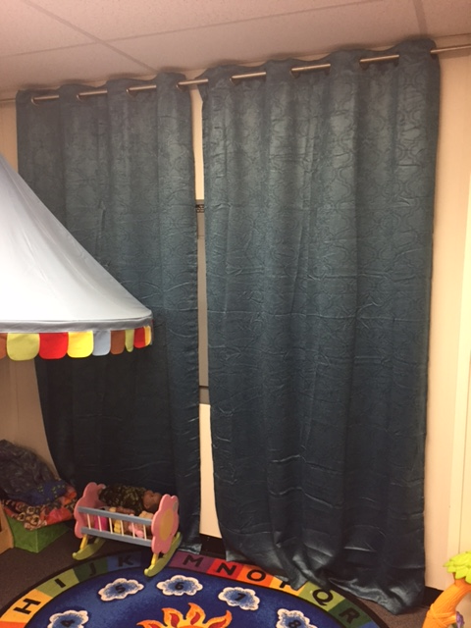
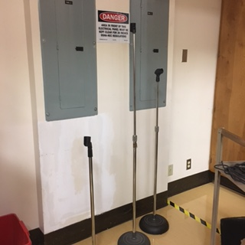
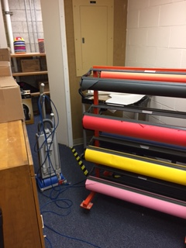
Electrical panels cannot be blocked in any way, shape or form. Electrical rooms and mechanical rooms cannot be utilized for storage. There must be a clear space in front of them for at least 36”.

Slide 9
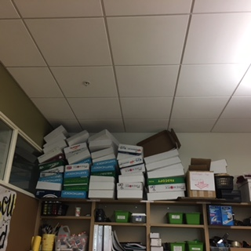
Nothing can be within 24 inches of the ceiling. This keeps combustibles away from the ceiling and prevents any obstruction to existing fire sprinklers. Items can be suspended from the ceiling, but they must hang at least 24” below. Items can be hung on the wall up to the ceiling, but they must be flat against the wall. For example, you could hang an alphabet flat against the wall up to the ceiling. It cannot be an item that protrudes out away from the wall such as the boxes stacked below.

Slide 10
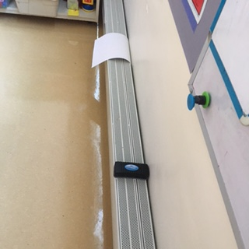

Items should not be stored on heaters. This is a fire hazard.
Heater

Slide 11
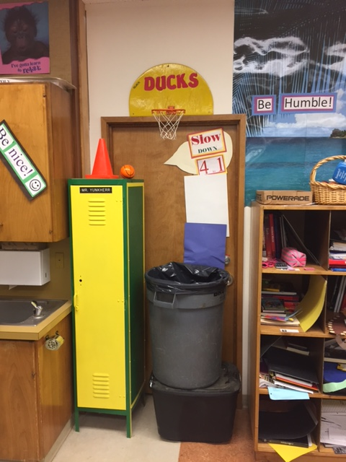
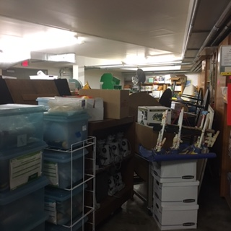
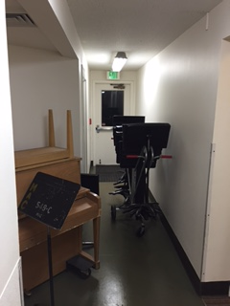
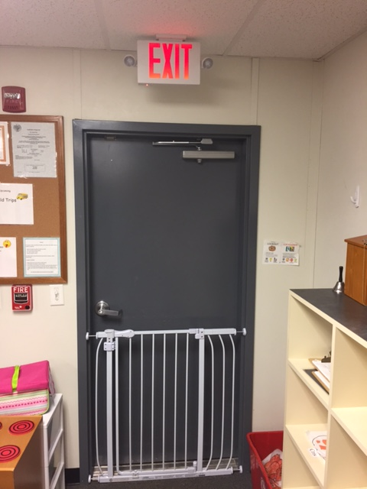
Disorganized clutter. Storage spaces should be organized, purged when possible and used efficiently. They should not have falling hazards or become pest habitats. Clear paths of ingress and egress must be maintained. Exits/doors cannot be blocked.

Slide 12
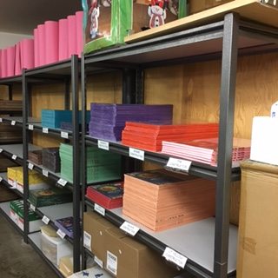
Storage racks should be anchored to the wall to avoid tipping over during earthquakes or if someone attempts to climb them. OSHA 1926.250 (a)(1). Heavy items should not be stacked above the shoulder level to prevent injury when moving the item.

Slide 13
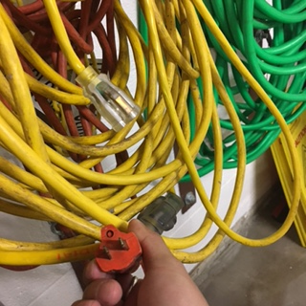
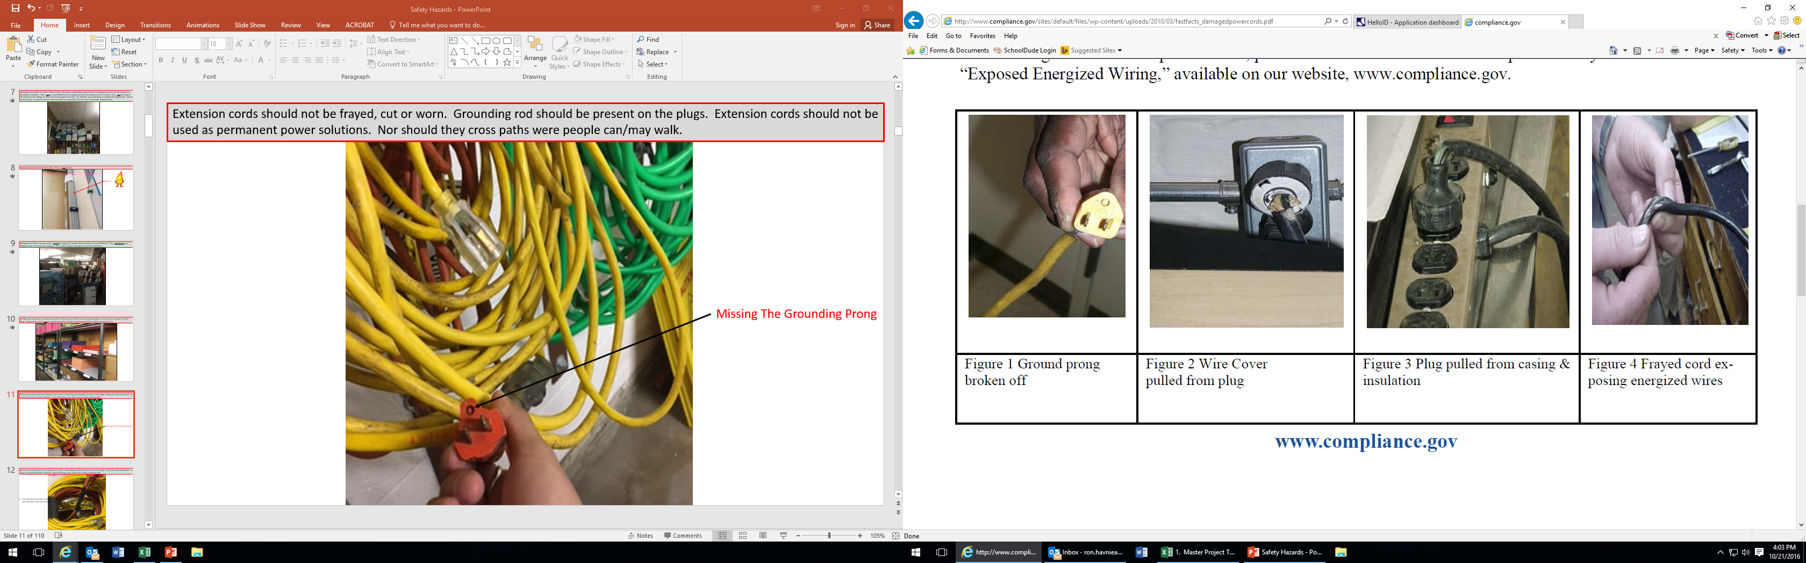
Damaged and ungrounded power cords pose serious hazards to users of the appliance including lethal levels of electrical shock and risk of fire. Extension cords should not be frayed, cut or worn. Grounding prongs should be present on the plugs. Extension cords should not be used as permanent power solutions. They should be put away on a daily basis. They should not cross paths as trip hazards where people can/may walk. Power strips should not be daisy chained or plugged in series.
Missing The Grounding Prong

Slide 14
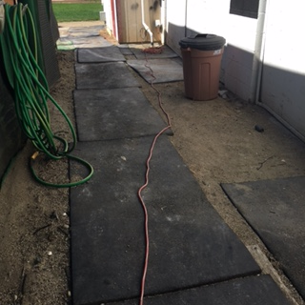
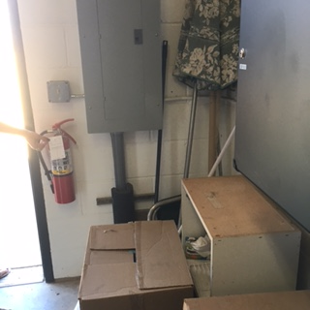
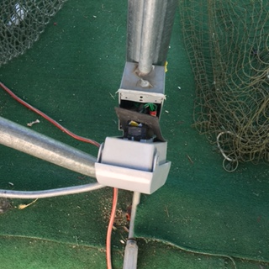
Damaged and exposed power poses a serious hazard to the user including lethal levels of electrical shock and risk of fire. Extension cords should not be used as permanent power solutions. Nor should they cross paths as trip hazards were people can/may walk. Electrical panels should never be blocked. They must remain accessible at all times.
Exposed electrical Hazard
Blocked Electrical Panel
Extension Cord Trip Hazard

Slide 15
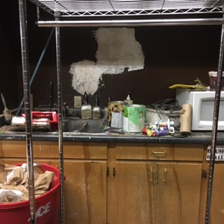
Clutter and extremely poor housekeeping. Paint disposal in the sink. Improper paint storage. Graffiti on the walls. Unauthorized microwave. Unsecured shelving.
"Housekeeping." Storage areas shall be kept free from accumulation of materials that constitute hazards from tripping, fire, explosion, or pest harborage. OSHA 1926.250(c)
Appliances must be preapproved by the facilities manager. We have thousands of appliances throughout the district. The energy cost is significant over the course of a year. Consolidated staff rooms are set up for this purpose.

Slide 16
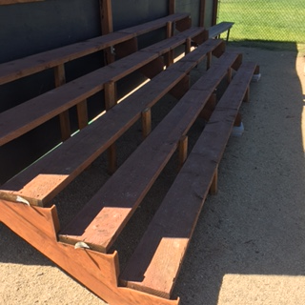

Home Made Bleachers
These bleachers built without any coordination with facilities. The pressure treated wood utilized for the seats is a known carcinogen that should not be utilized where skin contact is likely. Coordination and communication with the facilities department can help avoid mistakes of this nature. Pressure treated wood should not be used in this situation.
What Do You Think?

Slide 17
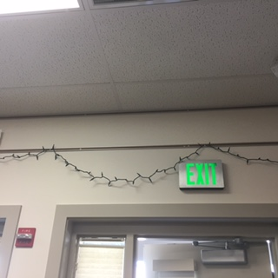
Christmas lights should not be hung up in July. Temporary lighting cannot be used as permanent lighting solutions; otherwise, they become subject to code for permanent lighting solutions. We have seen Christmas trees still set up at the end of January. Holiday decorations should be down before departing for winter break.

Slide 18
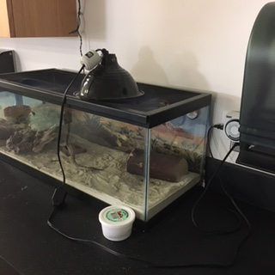
Heat lamps are the source of many fires. From a fire and energy conservation perspective, they should be avoided. We have made a few exceptions for heat lamps for education purposes; however, adequate precautions should be taken.
Things To Consider:
Use UL-listed heat lamps and follow manufacturer’s instructions.
Heat lamps with guards may provide some protection if the lamp falls into combustible bedding.
Ensure heat lamps are installed in locations where they are far enough from any combustibles to preclude ignition. Remember that wooden construction elements will eventually dry out and ignite from a heat lamp too.
Ensure the installation is secure and the light cannot be knocked down.
Run cords in locations where animals/children cannot reach them.
Make sure electrical circuits are not overloaded. Heat lamps use more amperage than regular lights.
Keep all combustibles away from heat lamps and ensure kids doing chores are aware of the hazards.
Check the lamp and mounting periodically to ensure it is secure.

Slide 19
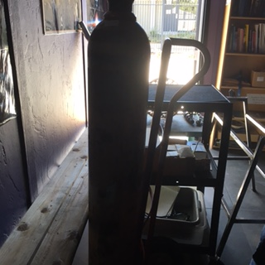
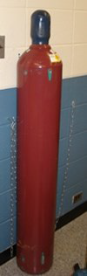
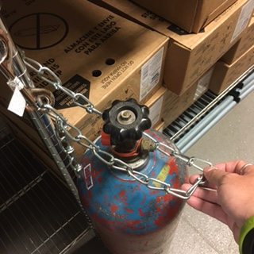
Gas cylinders unsecured create a dangerous hazard.
No Chain
(MAJOR) – Gas cylinders need to be safeguarded against falling and damage. Secure cylinders with chains or straps to a secure and stable structure.
Chain Not
Utilized
OR-OSHA 437-002-0293
Chain Too Loose

Slide 20
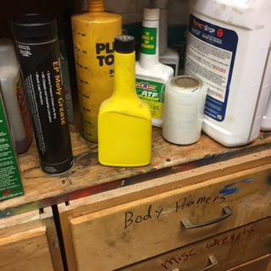
Unlabeled liquid. Containers should be labeled to identify the chemical and appropriate hazard warning. The hazard label must be legible and displayed in English. OSHA 1910.1200(f)(1)

Slide 21
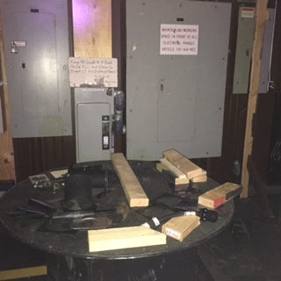
Electrical panels cannot be blocked. They must have direct access available and at a minimum 36” of clear space in front of them OSHA 1910/303(g)(1)(i) and (ii).

Slide 22
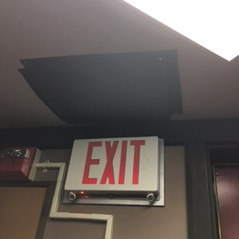
Dark construction paper attached to the wall to fold down and bock exit sign lighting. Exit signs cannot be blocked to dim the light.
Construction paper thumb tacked to the ceiling

Slide 23
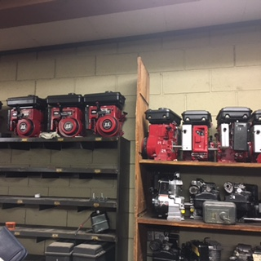
Shelves should be secured to the wall and heavy items should be stored on middle shelving to prevent back strains (Not stored at heights). Any shelf 42” or taller should be secured to the wall.

Slide 24
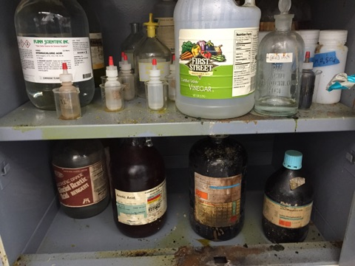
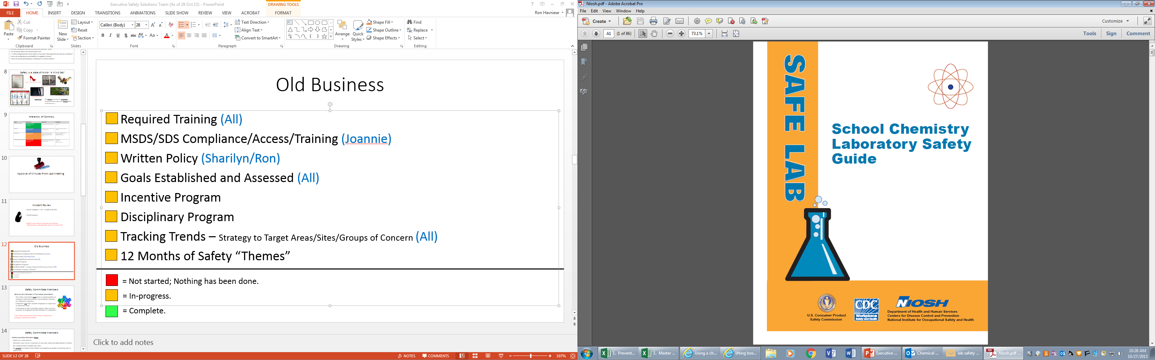
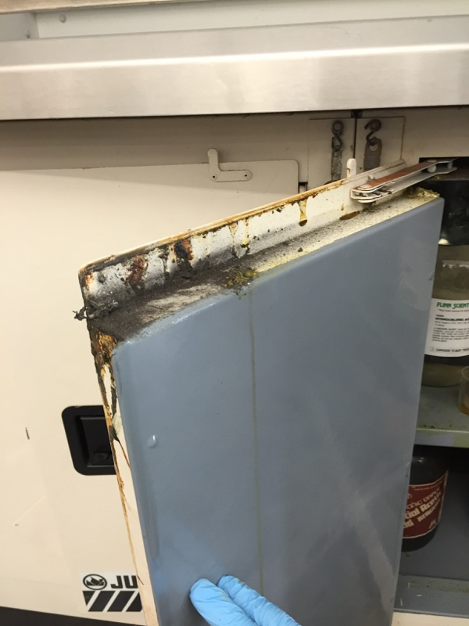
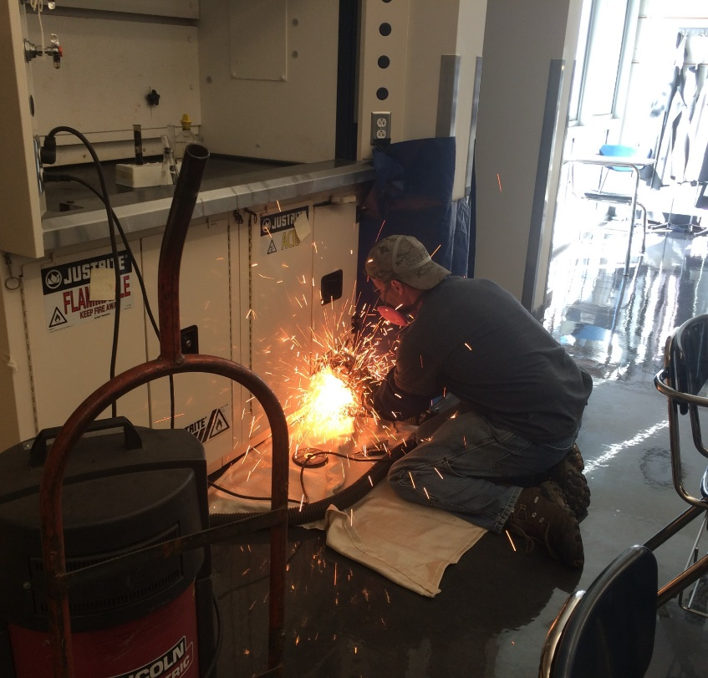
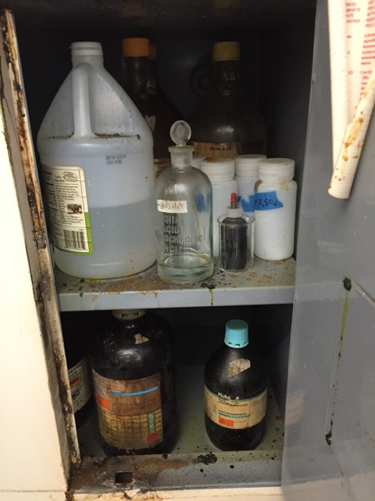
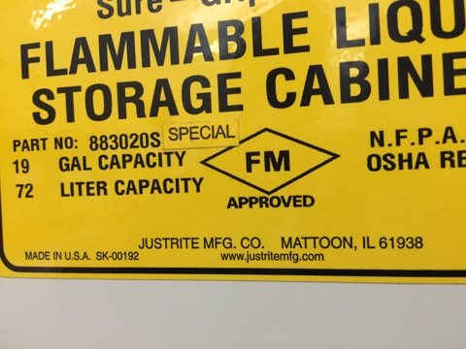
Inadequate storage and hygiene of science chemicals. We have had numerous science chemical incidents that have put students, staff and maintenance personnel at risk in addition to being very costly. Inventories should be maintained, minimum quantities should be kept on hand, and serious hazards should be separated and isolated. Chemicals should be cleaned up, re-sealed, grouped properly and in appropriate containers. “Chemicals in any form can be safely stored, handled, or used if the physical, chemical, and hazardous properties are fully understood and the necessary precautions including the use of proper safeguards and personal protective equipment, are observed”. Flinn Scientific Catalog/Reference Manuel or the NIOSH School Chemistry Laboratory Safety Guide are excellent resources. All chemicals in the schools should have Safety Data Sheets (SDS) available.
$16,000 To Fix One Locker
Exceeding the limits for secondary containment.

Slide 25
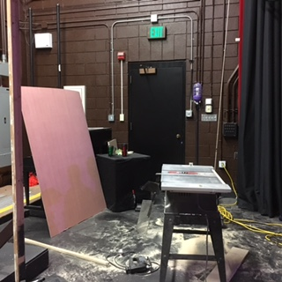
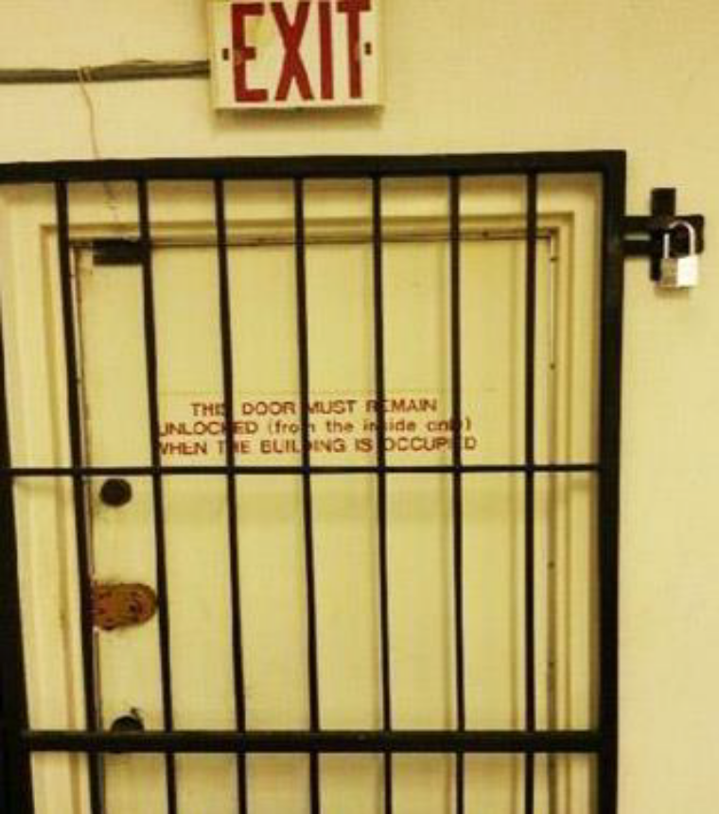
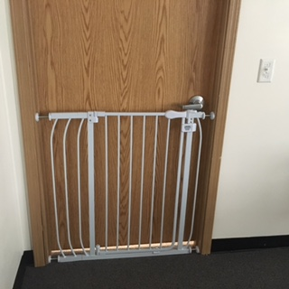
Exits need to be maintained to provide unobstructed egress. Keep paths clear in case of an emergency evacuation. Always make sure aisles and exits remain clear of desks, chairs, boxes or any items obstructing a clear path. OSHA 1926.34(a).

Slide 26
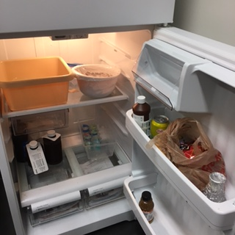
Lunches should not be stored with science chemicals and or supplies. Refrigerators should be monitored for cleanliness and temperature. Food should be stored a 40 degrees or less.

Slide 27
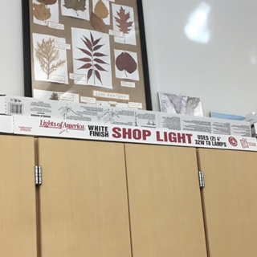
Fluorescent Lights should be kept at ground level in a designated storage area away from other stored items . Used and new lights should be kept in a protective container/box to prevent accidental breakage.

Slide 28
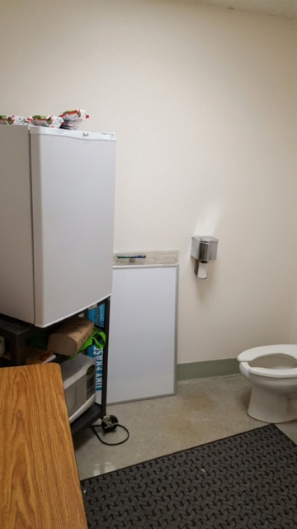
Refrigerators, microwaves and appliances in general do not belong in the bathrooms. This is not sanitary. Appliances must be approved by the facilities manager and placed on your sites “approved” appliance list.
Refrigerator
Bathroom
Toilet
Microwave

Slide 29
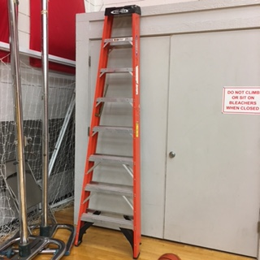
Ladders should be locked and secured while in storage to prevent ladder from falling and/or being used to access unsafe areas. We recommend this ladder be relocated to a safer location.

Slide 30
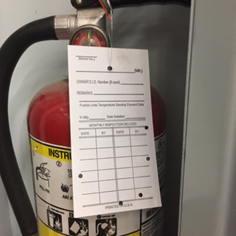
Fire Extinguishers must be serviced and tagged annually. They must also be visually inspected monthly. OSHA 437-007-0410(6).
Operation-think “PASS” (Pull pin, Aim Nozzle, Squeeze trigger, Sweep toward base of fire).
Check fire extinguishers in your area to ensure they are fully charged and ready for use.
A contract service inspects every fire extinguisher on an annual basis, because pressure can be lost even if a
fire extinguisher has not been used.
Immediately notify maintenance if fire extinguishers are not properly charged or are missing.
This should not be blank
and inspections should
not be skipped.

Slide 31

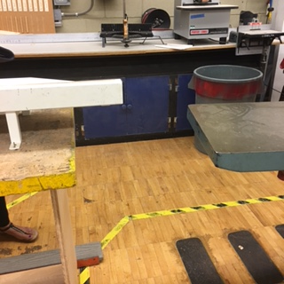

Aisles and walkways need to be maintained at 22 inches or wider. OR-OSHA 437-002-0022(3)

Slide 32

American National Standard requires that a “qualified lift inspector” inspect every lift at least annually.
There is no record of this lift
having been inspected.

Slide 33


Housekeeping." Storage areas shall be kept free from accumulation of materials that constitute hazards from tripping, fire, explosion, or pest harborage. OSHA 1926.250(c)

Slide 34



All windows should remain closed. As good stewards of public resources, we cannot afford to heat and cool the entire earth. Open windows and doors with HVAC systems running is not something most individuals would deem acceptable in their own homes when “we” are paying the bills. The Medford School District spends ~ $2,000,000 annually on utility costs. It adds up quickly and even small steps make a big difference. It also overwhelms and stresses equipment and makes it difficult for it to ever catch back up. Fresh air is brought into the HVAC systems constantly.
If you believe your space is outside the acceptable limits as outlined in the District’s Energy Conservation Policy (Heated between 68 and 70 degrees and cooled between 74 and 76 degrees) then contact your custodian who will take the temperature and submit a work order if necessary. If you have a medical condition, then work with Human Resources. Please dress appropriately for the seasons. Layers that allow you to dress up or down work best.

Slide 35


The distance between the wheel periphery and the adjustable tongue or the end of the peripheral member at the top shall never exceed one-fourth inch. OSHA 1910.215(b)(9).
Work rests shall be kept adjusted closely to the wheel to prevent the work from being jammed between the wheel and the rest.

Slide 36



All windows should remain closed. In addition, ground floor windows are a significant security concern. Open and/or unattended windows place staff and students at risk to injury from malicious individuals and make our buildings vulnerable to theft. You can get in the building through open windows in seconds, and you do not need to even enter to cause harm through an open window. We have also had situations where access was provided through 2nd floor windows that were left open and accessible via roof access and covered walk ways. These specific windows allowed access to an individual who was easily able to step in and wander the school unopposed.
6:30 a.m.
- Unoccupied classroom.

Slide 37




Orange cones were stored on top of a heater in a ball room. Over the next several hours, the cones heated up, melted and dripped down into the wall heater. Fortunately, this was discovered before igniting and turning into a fire.

Slide 38

Spills should be cleaned up immediately and thoroughly. Improper footwear: There are many, many slip, trip, and fall hazards ranging from expansion joints in concrete to curbs and drain grates. Wearing proper footwear and situational awareness are your first line of defense for hazards of this nature. These injuries have been significant.

Slide 39


Make sure your event does not exceed the maximum capacity of the space. We have had this situation more than once.

Slide 40





Inadequate supervision - One individual was trying to watch multiple spaces and in doing so was gone for certain periods of time. Long enough for students to put themselves and others at risk and to do significant damage.
Total Cost of Damage: $16,000
Several students climbed the wall in the gym and
then threw balls and objects into the ceiling. They broke the
majority of the light fixtures and embedded glass into the
mats below in a short amount of time.

Slide 41

Classroom and hallway doors must be clear of all displays, decorations, or artwork. This is a fire hazard enforced by the fire marshal. We do not want our emergency exits on fire in the event of an emergency. Doors should not be propped open blocking hallways. This also helps to prevent a fire from spreading.

Slide 42

Bleachers cannot be utilized safely unless they are fully extended. The bleacher’s are designed so that each bleacher row’s strength is dependent upon the others. They are not fully structurally supported unless fully deployed. Do not use bleachers or allow people to climb on them unless they are used in accordance with the manufacture’s guidance – fully extended.
Bleachers:
– Not fully extended
Hi,
Thanks for calling this morning and discussing your bleachers with me.
I want to recap our discussion and verify with you that the bleachers must to be fully opened before anyone sits on them or walks on the aisles. When the bleachers are closed, or in the partially opened position, there is no vertical support and when weight is put on the bleachers it will bend the cantilevers which will affect the operation and safety of the entire stand.
- Bleacher Manufacturer

Slide 43


An “A” for effort, but windows need to remain closed unless there is a confirmed HVAC issue that maintenance cannot remedy in a timely manner. Desks should not be used as ladders or step stools.
A+

Slide 44

Slip, Trip, and Fall hazard in a parking lot. Proper footwear and situational awareness can help mitigate the risk associated with a hazard of this nature. A work order should be submitted for repair.

Slide 45

This inspection was the result of a mice infestation report right before winter break. Upon inspection we found several sources of candy left out, a sealed zip lock bag with candy in a desk that had ants swarming on it, clutter and years worth of “stuff” that provided the perfect pest habitat, and more than two dozen open plastic bottles that still had remnant amounts of soda in the containers. Conditions like this are a pest magnet.

Slide 46

No office should ever look like this….especially after the summer closeout and shutdown inspections. This is how this office was left for the summer. Schools should have a thorough and adequate closeout procedure in place before summer release.
Housekeeping." Storage areas shall be kept free from accumulation of materials that constitute hazards from tripping, fire, explosion, or pest harborage. OSHA 1926.250(c)

Slide 47


Servers need to remain free and clear of obstacles. This is improper storage and access.

Slide 48



Asbestos is a naturally occurring material with many advantageous properties that led to its wide scale use as an additive to many construction, industry, automotive and consumer products. In an airborne state, the small fibers are hazardous to your health. The Medford School District has done large scale abatement in all facilities; however, asbestos does still exist in several schools. Remaining asbestos is either in a non-friable state, meaning that it cannot be crushed or pulverized by hand creating airborne fibers, or it has been contained or encapsulated. For more information on asbestos in the schools, please contact the facilities department. If you see signs, like below, steer clear of those areas. No work should be done on any facility until the site Asbestos Management Plan (AMP) has been checked.

Slide 49
Response Actions To A Fiber Release
“If asbestos containing material is disturbed (broken, sanded, abraded, drilled through, punched through, etc.) then this is called an asbestos fiber release event”.
Remove yourself and others from the area.
Report it to the Facilities Department and the site leadership.
Isolate the area. Seal it off. Tape off air gaps.
Turn off HVAC servicing the area.
Label the area with a sign / Post monitors.
Facilities will call in licensed asbestos professionals to assess the situation, abate it, and conduct air clearance testing before opening the area back up.
*Do not attempt to clean it up.

Slide 50





Hopefully, no one considers themselves above the law. Regardless, parking in no parking areas, in designated emergency lanes, blocking access gates, parking in handicap parking spots repeatedly when not qualified to do so, and parking on and in the athletic facilities are all daily occurrences in the Medford School District. This is a security issue, a safety issue, it blocks first responders when they arrive to incidents, and causes significant amounts of damage to areas that are not meant to be driven on or parked in. Please use the parking lots and walk to your destination. “To compound the disaster, the ability of emergency responders to reach the scene is often severely compromised by individuals parking in fire access lanes in front of buildings.

Slide 51



This individual was found living in one of the school district’s athletic outbuildings on school grounds. He had been living there for several weeks and was told that it was ok to do so by a former student. If you have outbuildings on your campus, it may be wise to stick your head in once and awhile and see what’s going on.
The correct way to secure
a lock when not in use.
During this incident, it was discovered that non-district locks were being utilized on the site. Facilities personnel must have access to all locks at all locations for emergency purposes. No non-school district locks are authorized. When you do open a gate lock, best practice is to lock that lock to the fence to prevent it from walking away. Replacement locks can run ~$100.

Slide 52

When we treat sites with pesticides and/or herbicides, we post these warning signs. It is in your best interest to heed their warning. We have had numerous incidents where individuals have ripped down the signs, climbed fences, and removed gate panels that were wired shut to hold practice, sunbath, and walk their dog. When these signs are posted, we are trying to keep you safe and maintain the high quality facilities of the school district. Please take them seriously and support the groundskeepers who are trying their best to support you.

Slide 53

This is a example of improper key storage. Key control is directly related to security. We all have a responsibility to keep our keys accounted for and to limit access based on need. We have invested millions of dollars into school security. It is all for nothing, if we let keys to our sites fall into the hands of the wrong person looking to do us harm. It only takes once. Please take your keys seriously. They should not be used for communal use. They should not be given to other individuals. They should not be stored in your car or on your bike. They should not be attached to your Medford School District id badge. They should not be stored on a wall in a shed that can easily be broken into, that has no alarm, and that has no camera system coverage.
We have had to re-key 26 schools in the last few years because of lost keys. Some schools more than once. Ten of those schools were from cars/bicycles that were stolen that had the individuals keys and identification badges in the car/on the bicycle, a few hanging on the rear view mirror. Losing your keys puts others at risk and is very costly. Please report your keys lost in a timely manner and make every effort possible to keep positive control of your keys.

Slide 54


This was a ladder being utilized by a contractor. The picture probably speaks for itself. If you see something of this nature, even if it is a non-district employee working on school grounds, please do not let it go. Report it to the appropriate department.

Slide 55

Submit a work order. If it is urgent or unsafe, please follow it up with a phone call to the facilities office (541) 842-3646. This was a light switch broken by an individual who was going to attempt to repair it his/herself. Let facilities do this kind of work.

Slide 56

This is not what locker rooms and/or athletic storage facilities should look like.
Housekeeping." Storage areas shall be kept free from accumulation of materials that constitute hazards from tripping, fire, explosion, or pest harborage. OSHA 1926.250(c)
Exits need to be maintained to provide unobstructed egress. Keep paths clear in case of an emergency evacuation. Always make sure aisles and exits remain clear of desks, chairs, boxes or any items obstructing a clear path. OSHA 1926.34(a).

Slide 57






There are several hazards in this picture. This photo on the left was part of a hazard identification lane that was set up for training purposes. The significant one to highlight was the improper footwear: There are many, many slip, trip, and fall hazards throughout the district. Wearing proper footwear and situational awareness are your first line of defense for hazards of this nature. We have had several significant injuries where improper footwear was a contributing factor. Excessively high heels, flip flops, and certain types of sandals are not stable. We have even seen individuals who walk around barefoot in the classrooms.

Slide 58
Light fixtures should have their covers on them. Some times they are missing, some times they are damaged or become loose and dangle at height. If you see a light that should have a cover, please report it.

Slide 59

On July 1, 2012, under ORS 634.700-634.750, schools became subject to Integrated Pest Management (IPM) laws. This law was put into place as part of an effort to reduce the amount of hazardous substances that children are exposed to. It also outlines a graduated response type approach where other steps are taken to eliminate and control pests before utilizing an application. For instance, before spraying for ants, we would clean up thoroughly, block access points, remove food sources, and eliminate any potential harborage. As part of this process, only certified applicators can apply pesticides (herbicides and fungicides fall under pesticides). Below is an example of a raid can that an individual tried to hide by wrapping it in blue painters tape. Unless you are a certified applicator working for the district, you cannot utilize any of these application for pest or on grass. Report the concern and we will do our best to address it. Please do not attempt to sneak it. Improper and uncoordinated application is a significant issue and potential liability.
Disguised Raid can spraying of fields

Slide 60

Bees in a box, on top of a ladder, balanced with a glove, stacked on top of four pallets – At a school. ~5% of the population is allergic to a bee sting to some extent. Some are minor reactions, yet some can be extreme and potentially life threatening (anaphylaxis).

Slide 61



It happens all the time. We get in a hurry, we take a short cut, and we have had significant injuries from individuals utilizing chairs as ladders. Sometimes we even use chairs with wheels and chairs stacked on top of tables to achieve height. Chairs as ladders, chairs with broken wheels, chairs with only four wheels, and chairs at heights are not a good idea. We do not want to rush to failure. If you need a ladder or a step stool, please take the time to get the proper tool and use it correctly. If you do not feel comfortable doing so, please ask for help. It may seem insignificant, but it is not worth the risk and it has caused more than one significant injury.

Slide 62

We see these injuries frequently. They seem to spike at the beginning of the school year and at the end of the school year as we move in and out of buildings. Some departments, have done extensive training on the proper lifting procedures; however, we tend to hurry and not utilize the techniques outlined below. These simple movements can cause painful and lingering injuries. Please take advantage of the proper techniques and save yourself the pain! What safety training does your site conduct?

Slide 63



Paper cutters should never be left in the open position and the guards should be used when the blade is not in use.
Safety latch not used
Left open and latch not used
No safety latch

Slide 64

Electrical appliances should be unplugged when not in use even if they are equipped with a ground fault circuit interrupter (GFCI). This eliminates the risk of an electrical hazard and saves energy via elimination of any phantom loads. A phantom load is a device that consumes electricity when turned off but still plugged into an outlet.

Slide 65

Overloading plugs and circuits is a serious fire hazard. Just because there is space to plug in additional items does not mean that it is safe to do so. Overloading can cause overheating which leads to a meltdown/sparks and a fire.
Check Regularly For The Following Danger Signs:
- A smell of hot plastic or burning near an appliance or socket.
- Sparks or smoke coming from a plug or appliance.
- Blackness or scorch marks around a socket or plug, or on an appliance.
- Damaged or frayed leads.
- Colored wire inside leads showing at the plug or anywhere else.
- Melted plastic on appliance casings or leads.
- Fuses that blow or circuit-breakers that operate for no obvious reason.
- Cords or wall plates are warm to the touch or discolored.
- Crackling, sizzling or buzzing is heard from outlets.

Slide 66

There is congestion at drop off and pick up at all schools. We have had incidents when children are attempting to cross the street. We have had doors knocked off of cars. This is a dangerous time of day. Please make sure your plan is sound for personnel coverage during these times. The facilities department cannot paint curbs/crosswalks or add signage on streets . This is the City’s domain. The City no longer paints curbs and very rarely will approve a crosswalk that is not staffed or controlled by a signal. Statistics show that more injuries occur “in crosswalks” not covered by signals due to a the false sense of security. If you would like signs or would like to change existing signs on the streets then it needs to be requested through the City Traffic Coordination Committee (TCC). Once they give you a date, it is beneficial to show up and advocate for your request. It is difficult to change existing signage in front of your neighbor’s houses. Lastly, the signs are only as good as the enforcement that follows. This is usually best executed as a combined effort between the school staff and when necessary an SRO.

Slide 67



Creosote soaked railroad ties can cause skin allergies and rashes. Facilities does not use these for any new construction and when the opportunity arises we remove them.

Slide 68



Doors should not be propped open with wedges, kick downs, etc. For interior doors, this is fire hazard. In the event of a fire, open doors will allow fire to travel quickly throughout the building. Doors can only be held open when a magnetic door hold is used. This will allow the door to close automatically when the fire alarm is triggered and help to contain the fire. Open exterior doors, are a security hazard. In addition, we have seen many doors damaged when placing wedges near the hinges to keep doors open.
Any open door is an energy conservation issue. HVAC systems are designed to heat/cool a specific space. Not all hallways are heated and cooled. When a door is left open and the system attempts to heat/cool the additional hallway space it overwhelms the system, stresses the equipment, and makes it difficult for it to ever catch up. It can also provide false temperature readings to the thermostat. Doors need to remain closed in order for the system to work properly and efficiently.

Slide 69

Walking backwards is not safe. This occurs daily in the schools. If you have to turn around and talk, please stop. More than one individual has been injured while walking backwards and falling over something. Some campuses at the college level have outlawed their tour guides from walking backwards due to the frequency of injuries.

Slide 70

The computerized name tag system is not a security system. Human interaction and screening are still required at the front offices. As you can see below, you can write whatever you want on your name tag and enter into the school. The individual below was a contractor who signed into the “Cocktail Lounge” and caused concern with parents when he then left his sticker at the desk upon leaving. We have also had an individual who signed into the school, pretended to be enrolling a student, then exited into the school. He then proceeded to walk around the school and out to the playground where he then stole a student’s bike and walked out the playground gate via the panic bars. We have had more than one individual who has entered schools to steal, to try and eat in the cafeteria, to hide in a girls bathroom, and to take a sink bath in a restroom. Often, we see staff in the schools who do not even look up when individuals enter the schools and at times walk right past the front office. Complacency kills. Please do not let this system become a false sense of security.
Contractor

Slide 71

Tripping Hazard – even as little as ¼” of difference between two surfaces can cause a slip, trip, or fall. Proper footwear does help to mitigate this hazard, but carpets folded up like below are a common occurrence at our entrances/exits to be aware of and fixed.

Slide 72

Some individuals believe that it is a good idea to load up their horses in a trailer, drive down to the schools, and ride them on the fields. This is a safety issue when other people are present using the fields and in the damage that it causes to the fields. The sports fields are not for riding horses. If you see people riding horses on the fields, please let them know that it is not allowed and/or report it. This is a horseshoe that we pulled out of a soccer field.

Slide 73


Frequently, we find items like you see below on the school campuses too include items like syringes, condoms, blow torches, drug paraphilia, people sleeping on the playgrounds – in bushes – in sheds on the school grounds, excrement, campfires, etc. Please make sure that you are checking the grounds on a daily basis to identify and remove items of this nature before school starts. The weapons below were found on school playgrounds.
Bolts
Hand Grip

Slide 74

School roofs are easy to access. We have had individuals injured while messing around on roofs. We have seen people fighting on roofs, drinking on roofs, jumping, riding bikes, growing marijuana “gardens”, etc. A significant amount of damage is done to the roofs and the HVAC systems from these individuals and this type of activity. We cannot completely remove the ability for people to get on the roofs; however, the most effective method has been to catch them and hold them accountable. If you see people on the schools roofs who are not facilities personnel, please report it, call the police, stop them. Even a date and time can help us to find them on the camera systems and help to identify them.

Slide 75



We cannot stop every snake, tick, rodent, or animal from visiting the school grounds. Awareness is key here. Please stay away from them and do not handle them. Report any concerns to facilities.

Slide 76

Ergonomic issues are preventable. Knowing the ergonomic considerations of a work space is the first step in remedying these type of issues. If you are experiencing pain due to a potential ergonomic issue, we can help in getting the situation evaluated. Please contact Human Resources if you are experiencing ergonomic type pain.

Slide 77



“The Grapes of Wrath” – We have had significant injuries occur when staff have slipped on grapes and other items that commonly end up on school floors. Please beware of the risk associated with even things small and seemingly insignificant.
“Slipped on an orange peel”
- Actual incident
“Slipped in peaches on cafeteria floor”
- Actual incident

Slide 78






Think twice before you partake in any food that has been left sitting out. This apple was eaten by a rat while sitting on a desk in a school. We have killed rats/mice that were full of jelly beans and seen rat/mice foot tracks on cake frosting that was left out over night. The bottom of the door and the corner of the shelf were chewed on by rats/mice. The most important consideration in preventing an outbreak is to limit access, remove all food sources, and avoid harborage.
Rats
Rats

Slide 79




Rats/mice can and will chew through bags and containers and squeeze through access points of less than ¼”. The schools have a tremendous amount of candy, soda, lunches, and pest friendly habitat. Not having it, is the best approach; however, if/when it is necessary it should be stored properly and consumed in isolated areas. This is one reason we encourage people to utilize staff rooms and lunch rooms to eat in. We do not have the staffing to deep clean every room, every night. Limiting the areas where food particles are left behind is important in avoiding an outbreak. The most effective storage containers are items that snap shut and seal air tight.
A Rat Chewed This Hole

Slide 80

Displays, decorations or artwork can only cover up to 20% of a hallway wall area. Ceilings cannot be covered with flammable materials. This is the fire code enforced by the fire marshal. Please do not make your whole hallway a bulletin board.

Slide 81



Couches/bean bag chairs are not easily cleaned nor cleaned on a regular basis. They can be incubators of filth. They increase the possibility of indoor air quality problems, allergies, and overall hygiene concern. Couches also provide harborage for pests and lice. To date, many of these items remain in the schools. If you intend to keep them on site, then it important to establish a cleaning plan for these types of items.

Slide 82

Situational awareness is key to identifying hazards. With today’s ever present technology, it is extremely easy to be completely unaware of what is going on around you. We have had people trip, fall, and run into cars while walking and looking at their mobile devices. Please avoid the temptation and stay alert. It may save your life.

Slide 83

Improper personal protective equipment (PPE) or lack of PPE. Depending on the nature of the work/task proper PPE should be utilized whether it be in the classroom or on a job site. The individual below is missing eye and ear protection.

Slide 84

Individuals injured while doing staff/student type sports games or activities. Unless you are 20 years old, please be aware that you are no longer 20 years old☺ Please know your ability level and what you can and cannot/should not partake in.

Slide 85




Items from home and donated items: Please leave your home items at home. When items are brought in from home, we inherit the liability of that item being used. Below is an example of some of the types of quality items that have been brought in from home and/or offered up for donation. Most people are not giving away their best items. We do not want to accept substandard items and then bear the liability of it and/or the disposal cost for it shortly after it fails. When items are “donated” to the school, it is a deliberate and specific approval process. Once it is donated, it needs to go on the books as school district property. For example, we had an instance where an individual “donated” weight equipment to the school district while he/she was employed at the school district. Once he/she was no longer employed with the school district, the individual believed that it was ok to rent a U-Haul truck and pay a teacher and a student to remove the equipment from the school weight room. That is not how it works. Wen items are donated, they become school property.
Donated Appliances
Item brought In From Home

Slide 86




Personal appliances need to be approved by the facilities manager for the purpose of consistency and in accordance with the district’s Energy Conservation Policy. Personal appliances can pose a fire hazard, potentially a safety hazard, and consume energy. We have staff rooms designated for this purpose. They should not be in every other classroom. We cannot be myopic on this issue. At times, we have had significant number of unauthorized appliances in the schools. The energy and the cost add up quickly. For instance, one space heater can add in upwards of $18 per month. If your appliance is not on your school’s approved list then it should not be there and should go home. If you believe that you have a genuine need for it in your space, then please submit your request to the facilities manager for approval. If approved, we will add it to the “approved” list. Your site supervisors can assist with this process.

Slide 87


Materials suspended from the ceiling must hang at least 24 inches below the ceiling and cannot interfere with exiting.

Slide 88



Power strips are not always the answer and should be used properly and with discretion. We should only use underwriter laboratory (UL ) approved power strips with circuit breakers. Power strips should be plugged directly into a wall outlet and never into another power strip. Improper cord management is not only unsightly, it is also a safety and fire hazard.

Slide 89


To the left is an ice pack that was taped to a thermostat and to the right is a wet paper towel that was wrapped around a thermostat. Do not do this. Do not override thermostats, break locks, or disassemble them. First make sure you are aware of what the acceptable temperature range is in accordance with the Energy Conservation Policy. Second, if you believe there is an issue, have your custodian verify the actual temperature and submit a work order. Facilities will address it if it is outside the acceptable temperature range. If necessary, we will place a data logger in the space to monitor actual temperatures over time to see what may be contributing to the issue.

Slide 90

When looking into a gym issue, we came across data that showed that the gym lights were frequently on from ~10:00 p.m. - 2:00 a.m. Upon further investigation, we found that kids were letting themselves in with a key and turning off the alarm with a security code (Given To Them By A Coach) and playing basketball in the gym until the wee hours of the morning. No one should be sharing security codes or keys or allowing kids to be in the facilities unsupervised. This is a significant security, safety, and liability issue.

Slide 91




Space heaters are the cause of many, many fires. They are dangerous, and they consume a lot of energy. Space heaters are not allowed in the schools unless approved by the facilities manager for a specific purpose or through Human Resources because of a medical issue. If the HVAC system is maintaining room temperature within the acceptable temperature ranges, we will not authorize an additional heat source. We encourage individuals to dress up or down as necessary. If there is a HVAC issue or a design flaw of some sort, a heat source may be temporarily authorized; however, facilities will issue it so that it has the required safety features (turns it off if it tips over). Combustible material cannot be near the space heater at all and it should never be on during unoccupied times. If you have a space heater, it should be on the approved list for your site. If not, it needs to go home.

Slide 92

Fire alarm pull stations cannot be covered, blocked or hidden. They must remain visible and accessible at all times. The same goes for all thermostats and electrical plugs.

Slide 93

As the seasons turn and the leaves start falling, the sidewalks can become very slippery. Facilities teams will do their best to keep them cleared, but it is not possible 24/7. Please be aware of the hazard and wear appropriate footwear,

Slide 94


Dogs and other animals are not unconditionally allowed inside the schools. The two exceptions are legitimate service dogs and, when approved, for educational purposes. They should not be brought in as class mascots, or to be hanging out in classrooms or gyms unless the previous guidelines have been met. This applies 365 days a year 24/7. They should not be brought in over breaks. We have seen them stored in “time out rooms”, we have had them eat the rat poison, and we have had parent complaints about their kids being bitten, lunches being eaten, and back packs being urinated on. Please leave your animals at home unless they are in for an approved purpose. If you or a member of the public has their dog out on the campus fields, first - it should not be during school hours, second – they are required to be on a leash and picked up after. The fenced in playground areas are not public dog parks. We have had custodians who have had to spend more than an hour each day cleaning up dog feces in the mornings. Please address these situations when you see them.

Slide 95



Diffusers are not allowed in schools. They introduce a foreign substance and scent into the air supply similar to an indoor air pollutant that some staff and students may be sensitive to at varying levels, potentially even as a trigger for an asthmatic type reaction. The HVAC system return air for one room may also make a diffuser affect several rooms as it is redistributed throughout the building. This is not something that every staff member, student, and parent approve of or want and it is a potential liability issue as well. See OAR 581-021-0037 and OAR 855-043-002.

Slide 96


We see this frequently as people bypass the door locks/gates to let people in who do not have key access. This is a security issue. Please do not do this, and when you see it please remove it and address/educate the person responsible for the security lapse.

Slide 97


Do not store your keys in your car and/or attached to your security badge. This is an invitation to theft and a road map straight to a school. It only takes one key in the hands of a deranged individual wanting to do harm to have a life changing event. We have had more than 10 cars stolen and one “bicycle” that had the keys stored in the car or on the bicycle and several with them hanging on the rear view mirror. Even when the cars have been recovered, the keys have never been present. We cannot count how many times, people in the community have asked for their own personal keys to be able to access the school facilities at will. School district keys are a prized and sought after possession that we see abused on a regular basis. It is negligent to store your keys in a car. They are broken into on a nightly basis. This is a security issue, please store them in a safe place.

Slide 98

Smoking is not allowed on school grounds anywhere. This is a state law. It is not optional. We have found staff, community members, students, and contractors smoking on the school grounds. If you see this, please inform the individual of the requirement. If they are noncompliant, please report it to school leadership, your SRO, or facilities.

Slide 99


Ants are very resourceful scavengers and predators. The can bite and they can walk all over your food. Most ants establish their colonies outside and have their search parties raid the plentiful food supplies left behind in schools. Once the scouts locate a food source their friends will soon follow. It does not take much. An ant can feast on a countertop that to the naked eye may appear clean. The key to ants or lack of ants is cleanliness and the elimination of a food source.

Slide 100

The main hazard here is the individuals not wearing sun screen while exposing themselves to the harmful effects of ultraviolet rays.
Just Kidding….
This is primarily for comic relief to reward the individuals who have made it this far in the brief. As you can see, there are quite a few hazards in the photo to include the water and electricity mixed with alcohol. This is the one photo that is not specific to the schools, but has several noteworthy hazards!

Slide 101


During the summer months, the facilities crews re-finish the gym floors. The fumes are not healthy to breathe. During the application, the crews wear respirators. Until the off-gassing is complete, it is not safe to be in the space. We have had several instances where coaches have disregarded this hazard and continued to hold workouts inside, typically in the weight rooms. This is not something that can be “toughed out” nor should it be ignored. Please find an alternative location for your workout or event during this process.

Slide 102
Hierarchy of Controls
It is important to be familiar with the hierarchy of controls. Though it is best to eliminate or engineer out a hazard, it is not always feasible. Some issues are behavioral issues that can be addressed through messaging, awareness, and proper training. Please understand that a work order is not the answer to every problem.
Control | Effectiveness | Description | Constraints
Elimination / Substitution | 100% Reduction of Risk Total Hazard Elimination Most Effective | Removes Hazard from Workplace, Process Redesign, Substitute with Less Hazardous | Process Dependence, Out of Service is not Elimination
Engineering | 75% Reduction of Risk Isolation or Control | Controlling the Hazard Through Guarding, Barrier, Ventilation etc. | Usually the Costliest and Hardest to Implement
Administration | 50% Reduction of Risk Hazard Awareness | Lessen Impact of Hazard through Administrative Controls such as Job Rotation, Training, Signs or Safety Procedures | Requires Close Management and Dependent on People Ongoing Updates Necessary
Personal Protective Equipment (PPE) | 25% Reduction of Risk Barrier Around Worker Least Effective | Protects Workers from Hazard by Placing Barrier Around Them Through Personal Protective Equipment | Least Effective Hazard Remains PPE Fails Ongoing Enforcement

Slide 103

Whether it be on a construction site or in a classroom, we are not immune or insulated from this hazard. It take a courageous person to report alcohol or drug usage in the workplace. If you suspect that there is an issue of this nature, please do not overlook it and let it go. If you do, you most likely are passing the problem on to someone else where there may be a more catastrophic effect during the next incident. Report concerns to leadership and human resources at any time of day.

Slide 104
Many injuries come from student teacher interactions. These are all real examples that have occurred recently.
Student stepped on my foot.
Twisted knee at practice.
Fell trying to stop one boy from attacking another.
MAPS student shoved me and kicked me in the leg.
Ran into a player playing basketball and hurt my nose.
Hit by a line drive during a baseball game.
Hit head on brick wall while playing wall ball.
Hit by a ball flying through the air.
Running student collided with employee.
Checking students mouth for injury when he coughed and spit blood on me.
Hit in the face by ball – kicked by a student.
Hit with a ball from behind.
Bodily fluid got on my hand.
Stepped in a gopher hole.
Attacked by a student.
Student bit me.
Hit head on uneven bars when picking up clothing on the playground.
Student jumped and landed on my foot.
Student grabbed my arm and pulled me to the floor injuring my knee
Ball hit hand during kick ball and jammed my finger.
Jumped to untangle tetherball and tweaked my knee.
Broke finger/jammed during wrestling practice.
Student ran into me from behind.
Was hit by student in face when trying to do a high five.
Hit with a chair thrown by a student.
Student jumped off a play structure and landed on my neck and face.
Injured thumb on wrestling partners leg.
Snapped on the hand by a water soaked rubber toy.
Student spat in my eye.
Tripped over a child’s foot.
During CPI restrain a student spat in my face and kicked me.
Hit in face with a ball while playing dodgeball.
Jammed finger playing catch with a football.
Student knocked my glasses off.
Pulled muscle running to assist a student.
Hurt back playing tug of war with students.
During CPI restrain a student spat in my face and kicked me in the ribs and knee.

Slide 105

Safety Data Sheets (SDS) are required to be on-hand. They are very useful documents that can tell you a variety of information. Please take the time to read them and familiarize yourself with the hazardous products that you may be in contact with.
Where are yours?

Slide 106




Before transporting students, please familiarize yourself with what is required pending your preferred mode of transportation. If you are driving a district activity van you must be approved through human resources before you are cleared to transport students. This entails checking your driving history, taking a test, paperwork submitted to ODE, and a current first aid course. Once cleared, the van must be inspected and it must have a fire extinguisher, a first aid kit, and an accident form on board. Please check the district’s Administrative Regulations (AR) EEAE-AR for specific guidance regarding transporting student in personally owned vehicles.
The Bus
What needs to happen before they are transported?
The District Activity Vans
Your Personal Vehicle

Slide 107



This eyewash station is missing an inspection tag. They should be inspected monthly and flushed weekly.
[OR-OSHA 437-004-1305]

Slide 108

This eyewash station, located on the sink fixture, has been disassembled by the site. If the sink is labeled as an eye was station then it needs have an eye wash fixture present. Sites should not disassemble eye wash fixtures and/or should submit a work order if it becomes broken. If this is no longer going to be an eye wash station, then the fixture and sign need to be removed.
Sign
Eye Wash

Slide 109




Holiday Decorations:
Doors - The doors cannot be decorated or wrapped. This is a fire marshal directive. In the event of an emergency, we do not want our exits to be on fire.
Lights - If we allow lights to be hung up, they must have a fuse in them, and we encourage LED lights that reduce the energy load and have minimal heat output. Lights can only be on when someone is present. They must be taken down no later than winter break close out. We see them stay up year round at times. Several were still up in July of this year. They are considered temporary lighting. Once temporary lighting is used permanently, then it becomes subject to permanent lighting code.
Some other considerations:
- No candles.
- No fake snow sprayed on windows.
- Do not hang decorations from light fixtures, sprinkler heads, or HVAC vents.
- Do not block/cover exits, fire alarms, or emergency signs.
- Decorate safely. Do not climb on desks or chairs to do so.
- Minimize the amount of combustible material added to the space.
- Christmas trees cannot not block exits, they must be watered, monitored for dryness, and removed when signs of dryness appear.

Slide 110


While tempting, no they cannot be used for storage or occupied as a working space. Pretend these spaces do not exist. This is not something that can continue to be ignored or justified with space limitations. Do not put people at risk unnecessarily.
“We cannot allow those spaces to be used for any other purpose. It is a life safety risk for people with offices in those spaces, and a fire hazard to have additional fuel load near the typical ignition sources within mechanical/electrical spaces” – Fire Marshal
Can boiler rooms, electrical rooms or mechanical spaces be used for storage or as office spaces?

Slide 111

Real Christmas trees are an extreme hazard when they become dried out. We still had trees in some schools in late January. They should be taken down before winter break.
Do you know what started this fire?
Christmas Tree.

Slide 112

Weight Rooms: Tears in equipment upholstery should be patched/repaired to avoid spread of MRSA, staph, etc.

Slide 113

Nails need to be removed from lumber before stacking or storing. [OSHA 1926.250(b)(8)(i)]

Slide 114


Windows should remain uncovered unless there is a security lock down. All classrooms need to maintain visual access as a preventative measure to misconduct and boundary invasion issues. The red and green covers are no longer required during lockdowns.

Slide 115

Combustibles cannot be stored on/or near stoves or heaters.

Slide 116

What three training classes must your safety committee conduct?
Accident and Incident Investigation
Hazard Identification
Safety Committees/Safety Meeting Rules

Slide 117


Slide 118


Slide 119


For Your Culinary Arts Classes: We had an individual get electrocuted due to a situation like below. When pulling the burners out to clean them it is important to make sure that the metal spacer clip is not loose. In this incident, the clip was pulled forward over the insulation material and on to the metal containing electric current. Beware of the possible hazards in your environment and train your staff and students to be able to identify them. Report any concerns to facilities immediately.
Resistance Wire “Inside”
Insulation
Steel Alloy Sheath (Outer Layer)
Metal Spacer Clip

Slide 120
Questions To Ask Ourselves
What hazards exist at your site?
How can they be mitigated?
How do you report a hazard at your site? Does everyone know?
Does your site have a fully functioning Safety Solutions Team?
Do you have adequate representation?
Is the team trained? What is required? What is needed?
When and who does your safety inspections? Does your whole team participate?
Are your minutes timely, accurate, and complete? Do you have the last three years worth?
Does incident analysis occur?
Do you have a genuine safety culture? What are the indicators?
How do you monitor safety trends at your site?
Do you prepare for our safety meetings?
What can we do better?
How can we get more people involved? How do we show people the value of our program?
What other questions should we be asking ourselves?
What other hazards should we add to this training?

Slide 121




A “Genuine” Safety Culture
If you have other good examples, please
send them to the facilities department
or your safety solution team so that
we can share the lesson learned
and help to prevent the next mishap.
We can make a difference.

Slide 122
Supporting Slides

Slide 123

References
Oregon OSHA’s Quick Guide To Safety Committees and Safety Meetings for General Industry and Construction Employers

Slide 124
“Our” Charter
Mission:
The Executive Safety Solutions Team will establish and foster an effective and consistent safety culture throughout the Medford School District in order to provide the District with a safe and healthy working environment for the education process to flourish.
Intent: (What we have to do to achieve success)
- Establish a written policy that codifies and clearly articulates the District’s safety priorities and procedures.
- Communicate and disseminate the plan so that all 19 school sites can implement it successfully.
- Streamline the process and empower every employee so that they feel comfortable and know how to address safety concerns.
- Inform leaders with knowledge that they can leverage in their organizations to establish a safety culture and continually improve safety performance.
- Track performance trends by site/organization with metrics that drive action to improve performance across the District.
-Cross-pollinate best practices and lessons learned throughout the Medford School District so that we are continually learning from mistakes, proactively addressing concerns, and anticipating needs.
Notes:
Do we agree upon this mission statement?

Slide 125

Safety Solution Team
Who Can Be A Member of The Safety Solution Team?
The safety solutions team must have an equal number of employer selected members and employee elected (or volunteer) members.
Employees can elect another employee or supervisor to represent them.
If everyone on the team agrees, there can be a majority of employee elected members or volunteers.
*The Safety Solutions Team cannot have a majority of employer selected members.

Slide 126

Safety Solution Team
Safety Solution Team Members Must:
Agree on a chair person.
Members must serve a minimum of one year, when possible (Good to rotate).
Be compensated at regular pay rates.
Be trained in Accident and incident Investigation principles and know how to apply them.
Be trained in Hazard Identification
Be trained in Safety Committees – Safety Meeting Rules
Receive Safety Committee minutes.
Represent the major activities of the company.
Must hold a monthly meeting.
Must be at a time when all members of the organization can attend.
Must take and maintain minutes for 3 years.
Once per quarter a safety inspection must occur.
Notes:
Do we agree on the chair person?
Has anyone already been on here more than a year that would be beneficial for us to rotate out with a new perspective?
Do we need to schedule hazard, and accident and incident investigation training?

Slide 127
Our Current “Safety Net”
Facilities Manager
Executive Safety Solutions Team
(Quarterly Meeting)
Human Resources
Additional Resources
SAIF
PACE
SafeSchools
Facilities Assistant Office Manager
Guidance
Trends
Lessons Learned – Best Practices
School Safety
Meeting Minutes
Incident Reports
Abraham Lincoln
(Monthly Meeting)
Griffin Creek
(Monthly Meeting)
Hoover
(Monthly Meeting)
Howard
(Monthly Meeting)
Jackson
(Monthly Meeting)
Facilities/Warehouse/
NTS/IMC/Publications
(Monthly Meeting)
Jacksonville
(Monthly Meeting)
Jefferson
(Monthly Meeting)
Kennedy
(Monthly Meeting)
Lone Pine
(Monthly Meeting)
Oak Grove
(Monthly Meeting)
Roosevelt
(Monthly Meeting)
Ruch
(Monthly Meeting)
Washington
(Monthly Meeting)
Wilson
(Monthly Meeting)
Hedrick
(Monthly Meeting)
McLoughlin
(Monthly Meeting)
Central
(Monthly Meeting)
North
(Monthly Meeting)
South
(Monthly Meeting)
*Safety Meetings do not need to occur during a month when quarterly work place inspections occur (Mar – June – Sept – Dec).
Notes:
We need to establish a standard for the safety minutes and a due date for them to be turned in.
Any additional resources?

Slide 128

Records
The Safety Solution Team Must Keep A Record Of Each Meeting For 3 Years. It must include:
Meeting Date
Attendees’ names
Safety and health issues discussed; include hazards involving tools, equipment, the work environment, and work practices.
Recommendations for correcting hazards and reasonable deadlines for management to respond.
Name of the person who will follow up on the recommendations.
All other committee reports, evaluations, and recommendations.

Slide 129
Keys To Success Safety Culture
Taking corrective action and accountability when necessary
Target problem area trends
Integrated into our daily operation – “Tool box Talks”- Not an after thought
Proactive approach versus reactive
No one is exempt – Lead by example
Eliminate – “This is how I do it at my house”
Eliminate – “This is how we have always done it”
Eliminate – “We don’t have time for this”
Don’t rush to failure
Resist the short cut
Identify the hazards (Employee participation)
Mitigate the hazards
Do not feel obligated to make something up. If there are no safety concerns at the time of the meeting then that is fine.
Incentive program
Disciplinary policies
Do not exaggerate safety concerns

Slide 130

How To Report
Any employee can report a safety issue at any time.
No one has to wait until a Safety Meeting.
Discuss at the Safety Meeting as a lesson learned.
If it is a facility related issue submit a work order.
If it is an imminent danger safety issue, call it in to the Facilities Office.
If it is a behavior modification issue report it to the leadership and leadership will address verbally and/or in writing.
Afford the local level leadership an opportunity to address the issue and establish accountability. If nothing is done and there has been no follow through or communication then take it to the next level.

