Slide 1
BoT Strategic Planning Update
May 4th, 2023

Slide 2
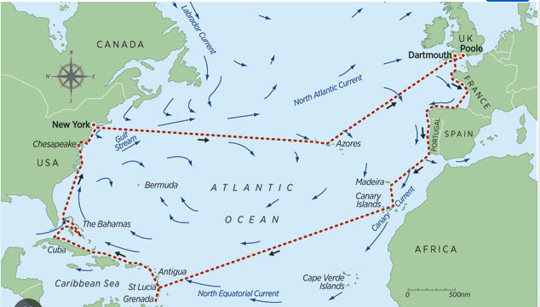
Boards Govern ~ CEOs Manage
Governance is the responsibility to fulfill your charter promises. The Board sets direction, purpose, goals, and deadlines.
Management is responsible for “getting us there”, determines “how” we are going to get it done, and what resources we need to get to our destination

Slide 3
Governance
Management
Oversight
Accountability
Contract Approval
Resource Allocation
Policies
CEO Support & Evaluation
Mission & Vision
Goal-setting
Stakeholders
Advocacy
Fundraising
Strategy
Operations & Systems
Curriculum & Instruction
Personnel
Resource Deployment
Programming
Implement Policies

Slide 4
Examples of Goals & Targets
The Mission
why you exist, and what you hope to achieve
We exist to innovate K-12 education in order to prepare every student to lead change, solve problems and succeed in an exponentially changing world.
Goal Example
goal statements are expressed in broad aspirational terms
Develop leadership opportunities for students
Target Example (written as a SMART Goal)
benchmark and metric within a timeframe
By August 15, 2023, have an internship program in place for all
10th-grade students

Slide 5
Gallery Walk
Resources
Celebration of Knowledge
Board Leadership

Slide 6
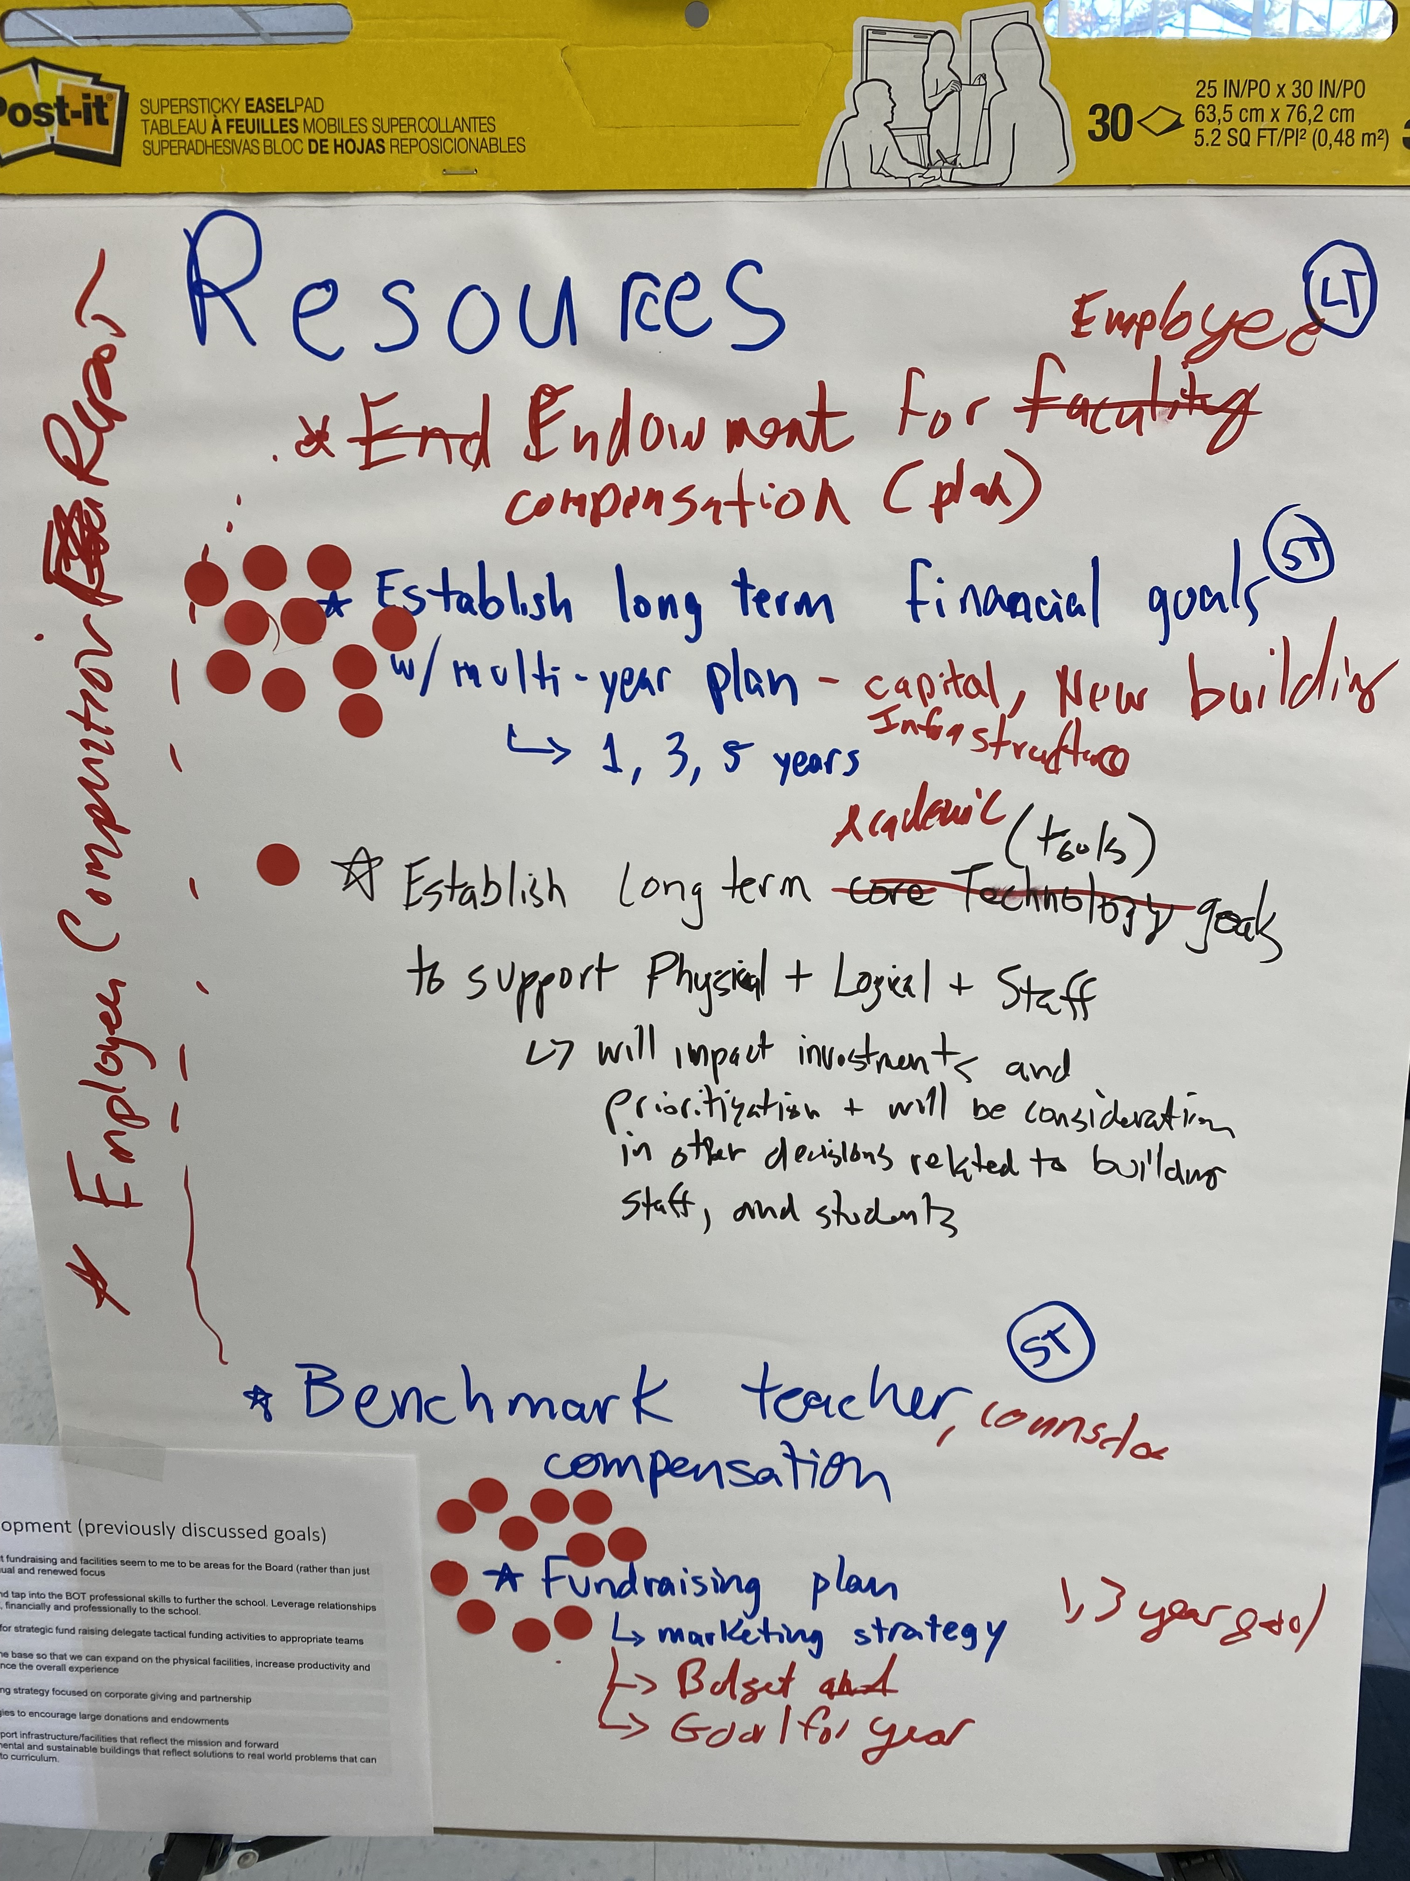
Resources
ST/LT | Goal | Committee Ownership
ST | Establish long term financial goals w/multi-year plan (1, 3, 5 years) | Finance
ST (1-3yr) | Fundraising plan Marketing strategy Fundraising/Campaign budget Fundraising goal for year 1 | Development

Slide 7
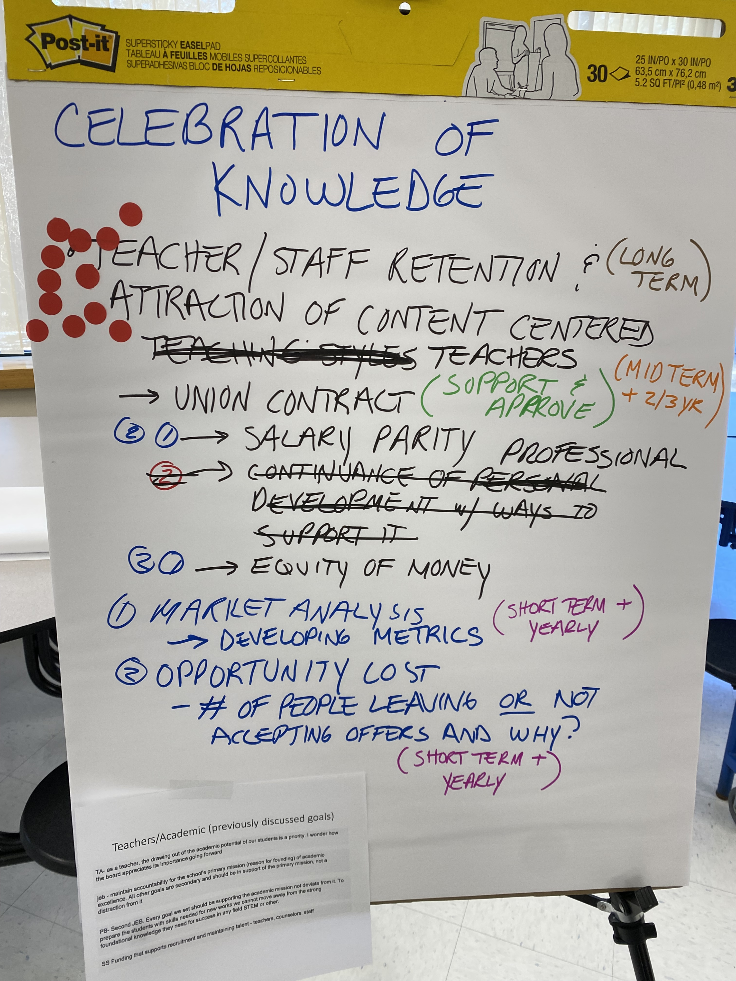
Celebration of Knowledge
ST/LT | Goal | Committee Ownership
Ongoing | Teacher/staff long term retention
MT (2-3yrs) | Develop plan for long term retention and attraction of content-centered teachers | Education?
ST | Support & approve union contract | Union Negotiation Task Force
ST, annual | Research and develop plan for funding salary parity Metric, market analysis Understanding opportunity cost | TBD

Slide 8
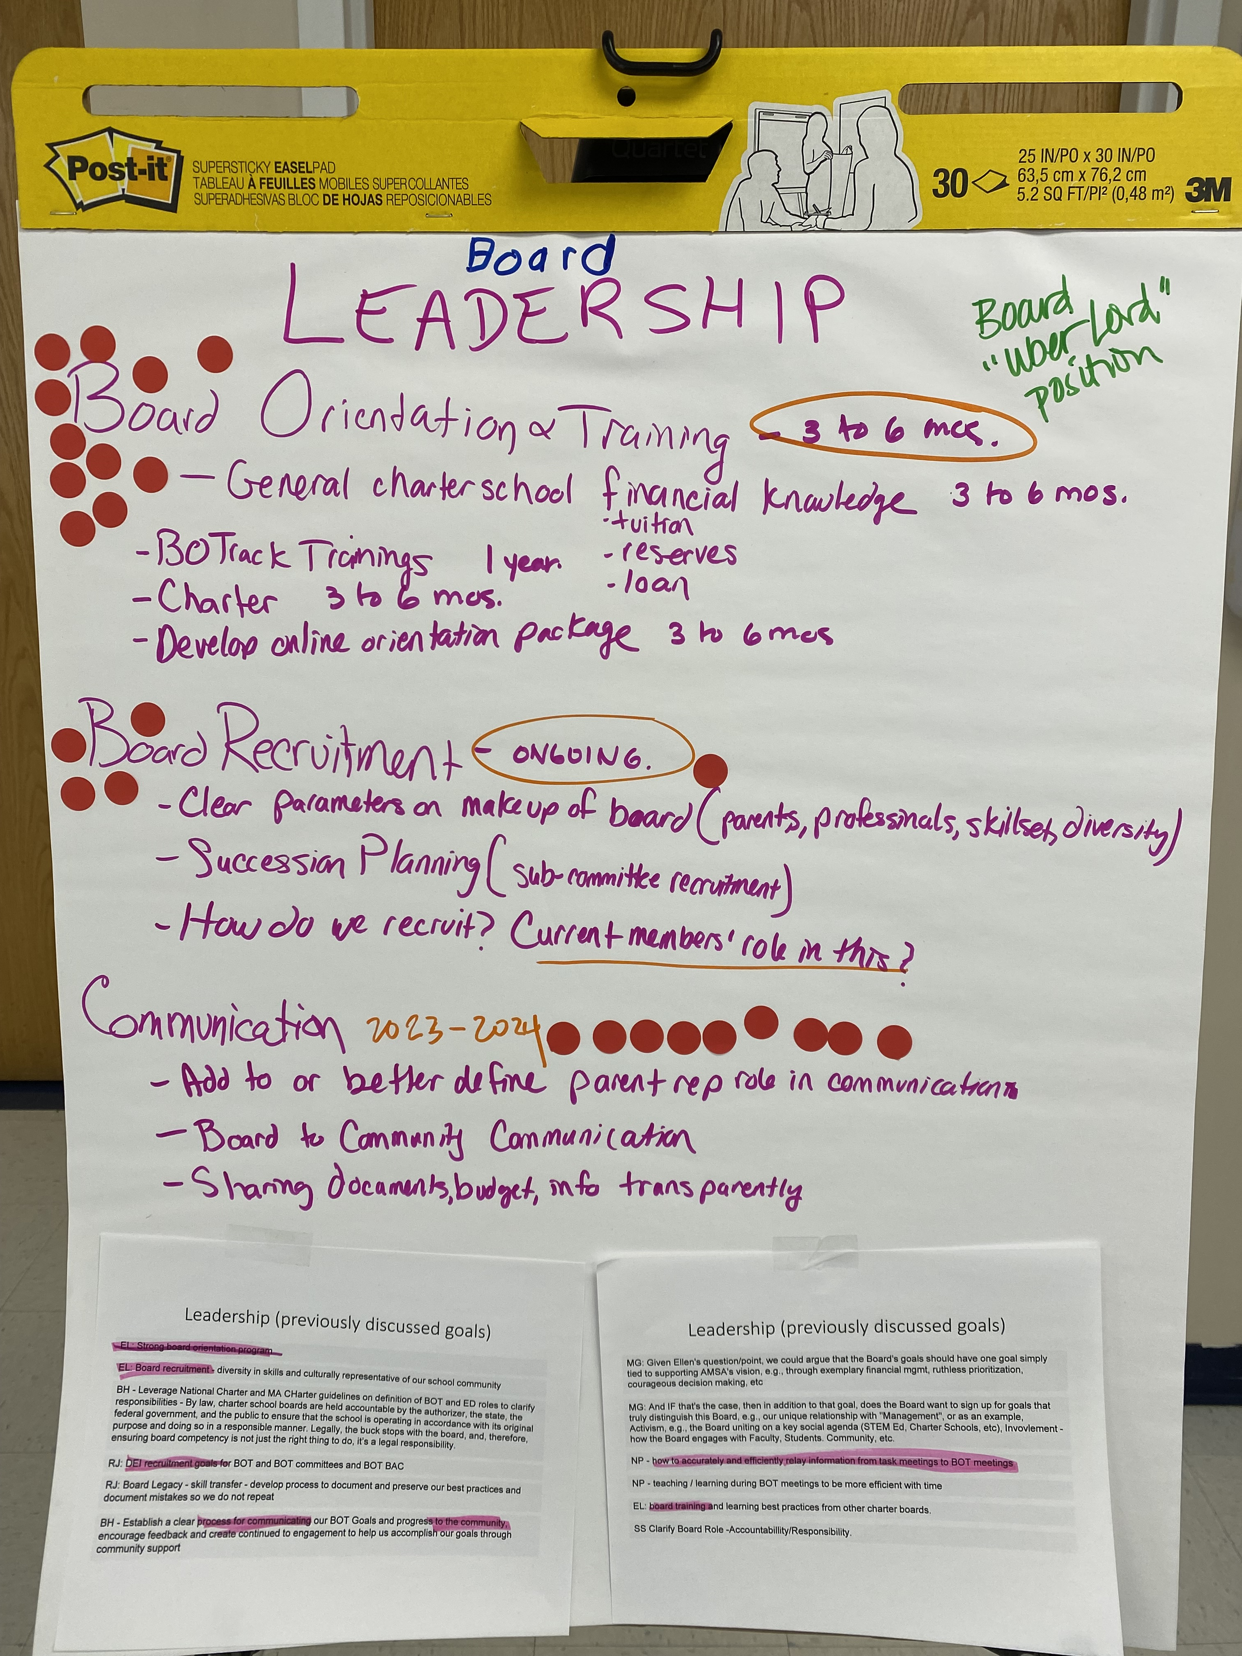
Board Leadership
ST/LT | Goal | Committee Ownership
ST | Board Orientation & Training General charter school governance Familiarity with the AMSA charter Board on Track trainings Develop online orientation package Financial knowledge (tuition, reserves, liabilities) | Governance
ST | Communication Add to or better define parent rep role in communications Board to community communications Transparent document sharing | TBD
Ongoing | Board recruitment Ideal board candidate profile (update) Succession planning (committee recruitment – chairs) How do we recruit? | Governance +ALL

Slide 9

AMSA Strategy on a Page
Foundation
Strategic Objectives and Organization Goals
Key Performance Indicators
Our Mission
Resources
How we measure success
To create an atmosphere of celebration of knowledge where children of all backgrounds and abilities excel in all subjects, especially in math, science and technology, empowering them to succeed in the workplace in our modern high-tech world
1. Establish long term financial goals (1, 3, 5 yrs)
2. Establish fundraising plan
3.
Measure
…
…
Target
…
…
Our Core Values
Celebration of Knowledge
Integrity: adhere to AMSA’s mission, honesty and responsibility, openness to new ideas
Excellence: passion and joy for teaching and learning, high expectations – with results!, innovation, creativity, and collaboration, hard work, commitment and resilience
Community: school spirit and community service, creating an empathic, caring environment for students and staff
1. Develop plan for attraction and long-term retention of content-centered faculty.
2. Research and develop plan for funding salary parity
3.
Vision
What our organization will look like
Children with a wide range of abilities can achieve a world-class education
Acquisition of knowledge is celebrated
Teachers are the fundamental creative force
Students exhibit kindness to one another
Academic rigor complements rich extracurricular life
We depend on strong stakeholder commitment throughout the community
Leadership
1. Formalize board orientation and conduct onboarding training
2. Improve board communication
3. Attract and recruit new board members
Competitive Advantage
What we do best
…
Implementation
How we make strategy a habit
Track
Empower
Coach
Cadence – quarterly review. Next update: October
Organization-Wide Strategies
How we will get there
…

Slide 10
Next STEP
Discuss SY23-24 targets in each committee for
Annual BoT meeting approval

