Slide 1
Mrs. Mallory Foster
Speech - Language Pathologist

Slide 2
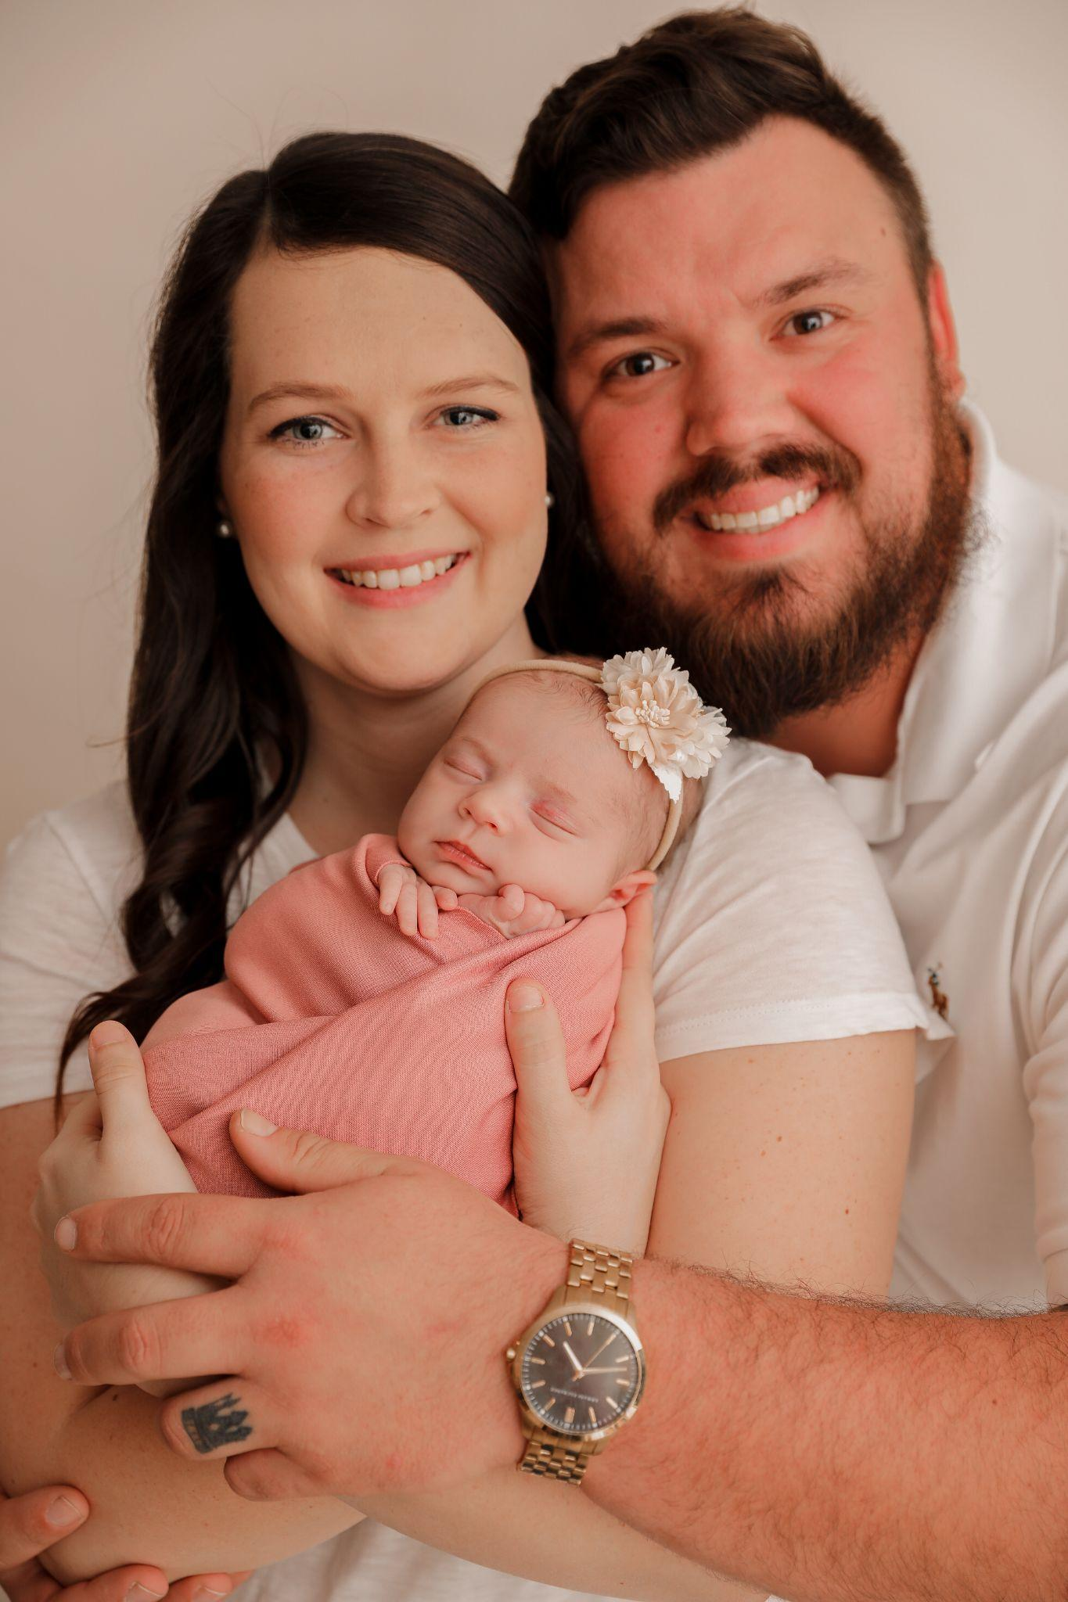
All About Me!
I met my husband in middle school, we got married in 2018. We moved to Enterprise, AL in July of 2020.
We welcomed our first baby girl, Everleigh, in January 2022.
We are also licensed foster parents.
In my free time I enjoy spending time with family and friends, going to the beach, and watching Alabama sports.

Slide 3
Educational History and Licenses
I graduated from the University of Alabama with my Bachelor’s degree in Communicative Sciences and Disorders in 2017.
I graduated from Alabama A&M University with my master’s degree in Speech - Language Pathology in 2020.
I am a member of Speech and Hearing Association of Alabama
I hold Certificate of Clinical Competence in Speech-Language Pathology from the American Speech-Language Hearing Association.

Slide 4
Contact Information
Email: mfoster@enterpriseschools.net
Phone: 334-347-3535 ext. 6705
I will be sending home more information on how to stay “in the loop” with all things speech in the first few days of school.
Please do not hesitate to email me if you have any questions or concerns.

Slide 5
Speech Therapy Fun
It is my goal to create a fun, safe, nurturing environment for students to learn and grow. In speech we will use games, activities, and evidence based best practices to meet goals and have fun learning new skills. We will work in small groups or one on one settings. We will use crafts, technology, hands on activities, and sensory items to help engage children and foster speech skills. Each day your child attends speech, their individual speech folder will be marked with a stamp. Homework sheets and extra materials will be sent home throughout the year to reinforce new speech skills at home.

