Slide 1
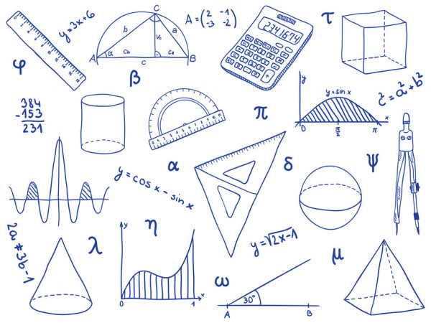
Mrs. McCulloch

Slide 2
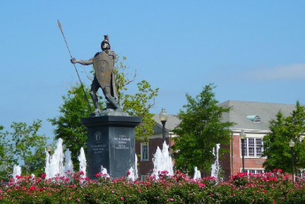
Where did I go to School?
I graduated from Opp High School in 2016.
I graduated from Troy University with a Mathematics Education degree in Spring 2020

Slide 3
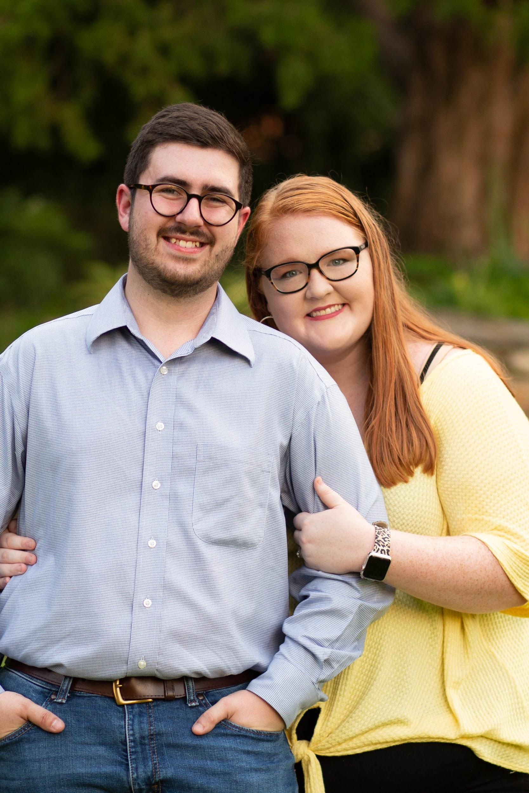
Do I have a family ?
My husbands name is Matthew McCulloch. He is a cost accountant for Wayne Farms. We have been married since June 2018 and have been together since January 2015.
We do not currently have kids, but are in the process of pursuing adoption. We can’t wait to add to our family.
We also have a year and half old lab/gsp mix named Baylor.

Slide 4
What do I do for fun?
One of my favorite things to do in the evenings is to go home and have dinner with my husband and play with our dog, Baylor. In addition to hanging out with them I also love spending time with family and friends, traveling for long weekends or vacations, and volunteering in the children's department at church.

Slide 5
Why do I teach math?
I teach because I have a desire to be a positive influence on all my students lives. I believe that teaching is more than a job, but it a lifelong commitment to support your students inside and outside of the classroom. I believe with the right amount of love and support all students can succeed in life. I chose to teach math because I believe that it is a useful subject that will be used and applied throughout everyday life.

