Slide 1
DJHS
Open House
Mrs. Cooper
8th Grade Math

Slide 2



Three Critical Concepts
Construct and reason about expressions and equations.
Describe the concept of a function and use functions to interpret relationships.
Analyze two- and three-dimensional figures and use the Pythagorean Theorem.

Slide 3


INFORMATION
For assignments, notes, class announcements, etc.
May be updated daily
For grades
Will be posted and updated weekly

Slide 4
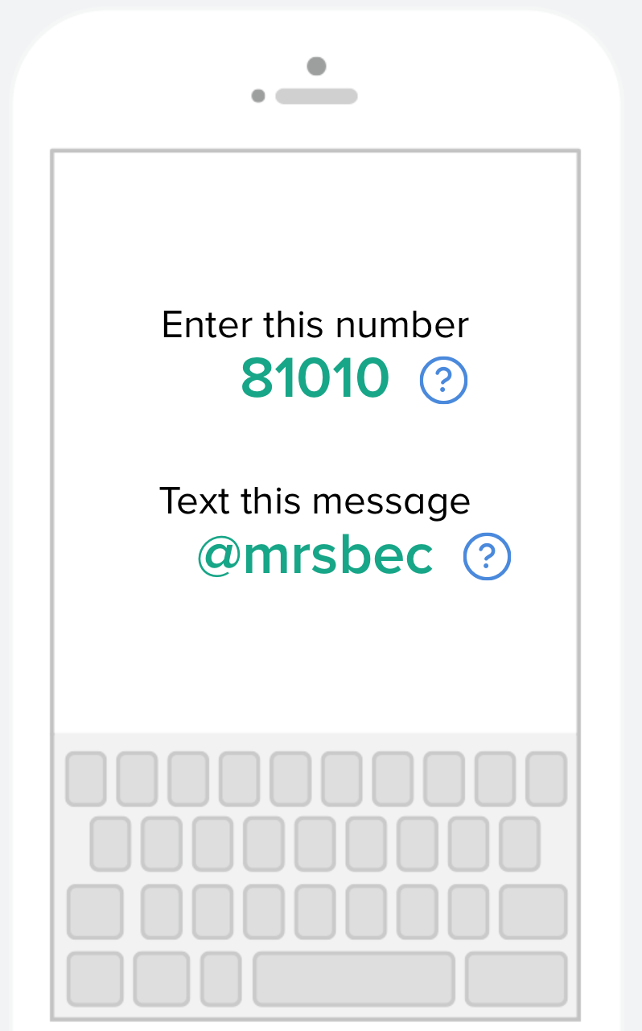
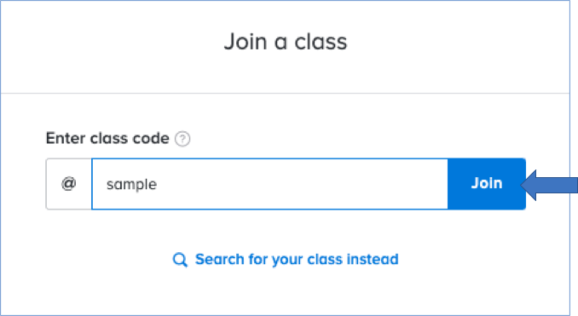

communication
remind
Faster and easier than email
Allows two-way communication
81010
MATH 8
@coopm8
or
@coopm8a
ACCELERATED
MATH 8

Slide 5
Assignments &
Grading Policy
Applications – 40%
Assessments – 60%
Majority of graded assignments; 1-2 per week
Students will be given time in class to complete but may be allowed to finish applications at home.
Intended to assess understanding of specific individual concepts.
Students are generally assessed 2 times each unit.
Intended to assess student understanding of entire unit.
Includes a cumulative exam at the end of every nine weeks.

Slide 6
Homework
Students will not receive traditional homework assignments.
Notes, practice problems, answers keys and explanations for every lesson will be available for the student to access in Schoology.
Students are expected to use provided resources to adequately prepare for graded assignments, and are strongly encouraged to ask for help whenever needed.

Slide 7



Student Supplies
one composition notebook
3-ring binder for handouts
lined and graph paper
pencils
dry erase markers
colored pencils

Slide 8

Meet the Teacher
B.S. from UF
M.Ed from UWF
Started teaching in 2007
ARMY spouse since 2009
6th year with Enterprise City Schools
Previously taught math at CJHS and worked as the math specialist for HCES
2nd year at DJHS

Slide 9


