Slide 2
Facilities for Learning
Community Engagement Meeting
May 17, 2022
Notes:
2

Slide 3
Welcome
Introduce yourself to others at your table
Put on a name tag
Complete the information on the sign-in sheet
Bienvenidos. Gracias por venir esta noche. Hay una mesa designada si hablan espanol y necesitan ayuda si prefieren.
Notes:
[Selected Community Chair at podium]
Good evening and welcome to tonight’s Vision Forward community engagement session. Last month we learned more about improving student achievement for our middle and high schools and tonight we will look at how facilities play an important role in learning and academic success for all students.
Thank you for joining us tonight. Over the past few months we’ve had really good participation and it’s really nice to see so many of you here tonight. This is the last Vision Forward session until next fall, but the work will continue over the summer with the development of our Action Plan.
As we’ve done for past sessions, we wanted everyone to have an opportunity to share ideas with as many people as possible, so tonight we have both the in-person and the virtual sessions again. We welcome those of you who are joining us virtually via Zoom and look forward to hearing your ideas and comments. If you’re joining us virtually tonight, be sure to check your Welcome page that has links to all you’ll need tonight – including the sign in sheet, the presentation and the work activity.
My name is Bob Miller and I’m one of four co-chairs of our program.
3

Slide 4

QR Code to Tonight’s Presentation
Look for the QR code on the agenda on your table.
Scan the code with the camera on your phone.
This will take you to a link of tonight’s presentation.
Notes:
[Selected Community Chair at podium]
We want everyone to be able to see the information on our screen, but some of you may not have an easy view of the screen. We don’t want you to miss anything so if you don’t have a clear view please grab your phone, open your camera and do a quick scan of the QR code on the printed agenda at your table. This will pull up a link to the presentation so you can easily view it.
4

Slide 5
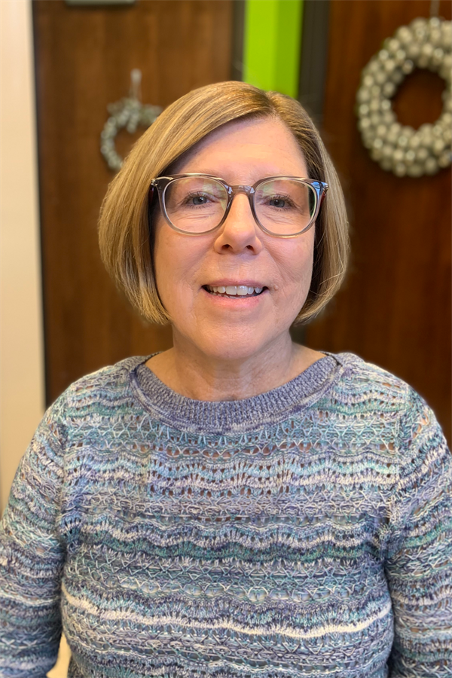
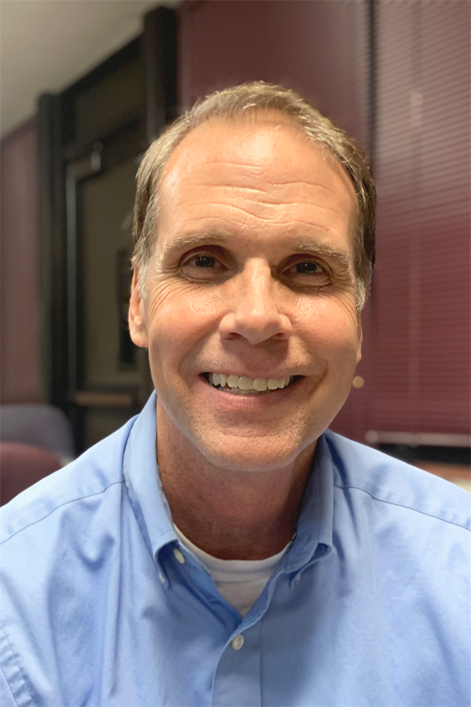
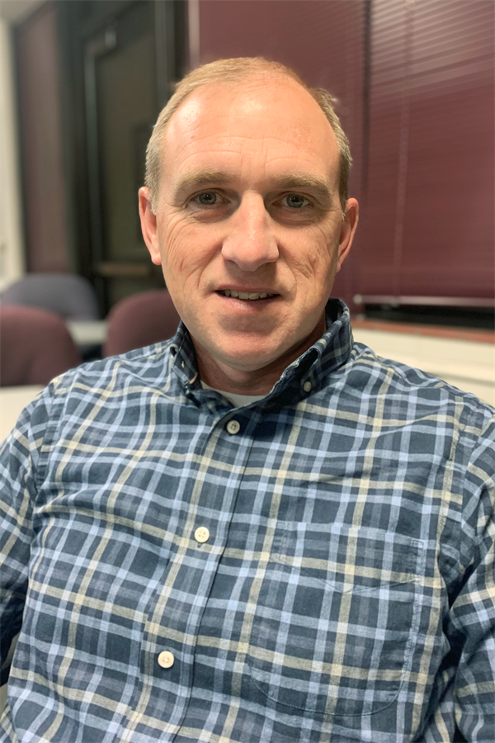
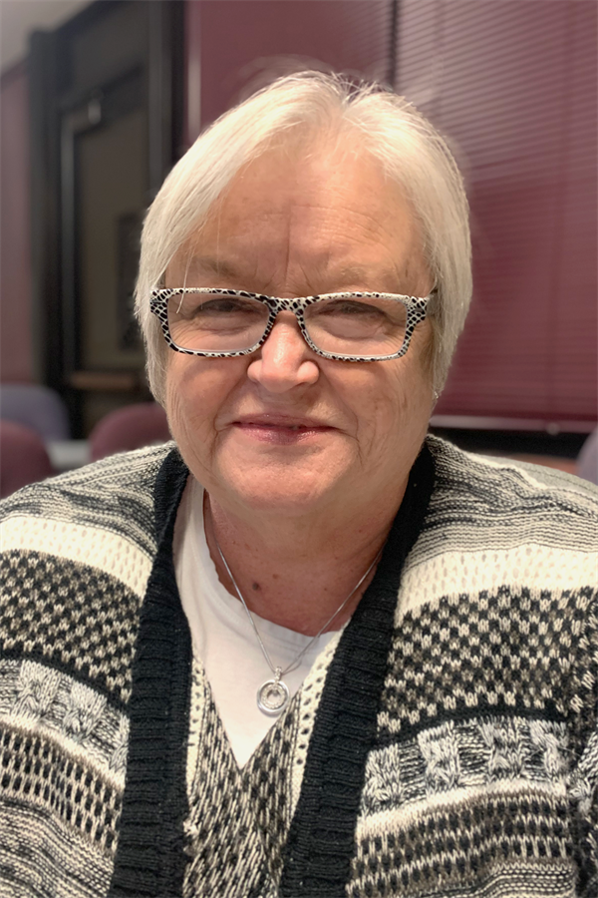
Community Engagement Team Co-Chairs
Linda Bahrke
David Hinde
Bob Miller
Teresa Simmons
Notes:
So let’s get started. It is my pleasure to introduce our other co-chairs — Linda Bahrke, Teresa Simmons and Dave Hinde.
Chair ? is going to kick-off our program —
[Selected Community Chair at podium]
5

Slide 6
Community Engagement Sessions (CES)
Notes:
6

Slide 7
Vison Forward Is a Partnership
We Need You!
  Vision Forward is the result of a sincere desire to improve the educational opportunities for our children. We review information that reflects the community’s priorities to improve SJSD and will present recommendations to the St. Joseph Board of Education by December 2022.
  All of Us Working Together
  Residents, Business and Community Leaders, Parents and Educators
  A Strong Partnership That Will Make a Difference
Notes:
[Selected Community Chair at podium]
The Vision Forward program is really about listening and sharing ideas to improve our school district and our community. The input we heard from you resulted in selecting the topic for tonight’s meeting.
Vision Forward is the result of a real, sincere desire to work with the St. Joseph community and our school district to improve the educational opportunities for our children.
All of us working together – residents, business and community leaders, parents and educators – we are a strong partnership that will make a difference.
7

Slide 8
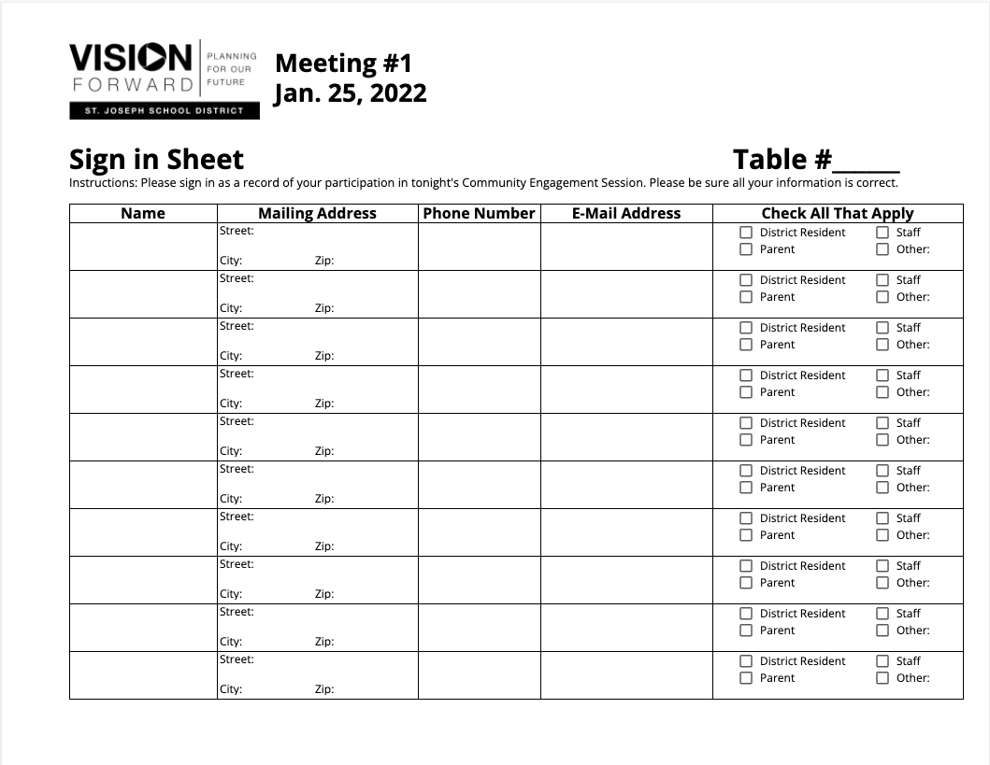
Sign-in Sheet
Notes:
So, a couple more things before we get started tonight.
Please make sure everyone at the table or online has signed in. This is our way of taking attendance and getting your contact information so we can keep you informed about our program. We’ll gather these sheets during the small group work time later in the session.
8

Slide 9
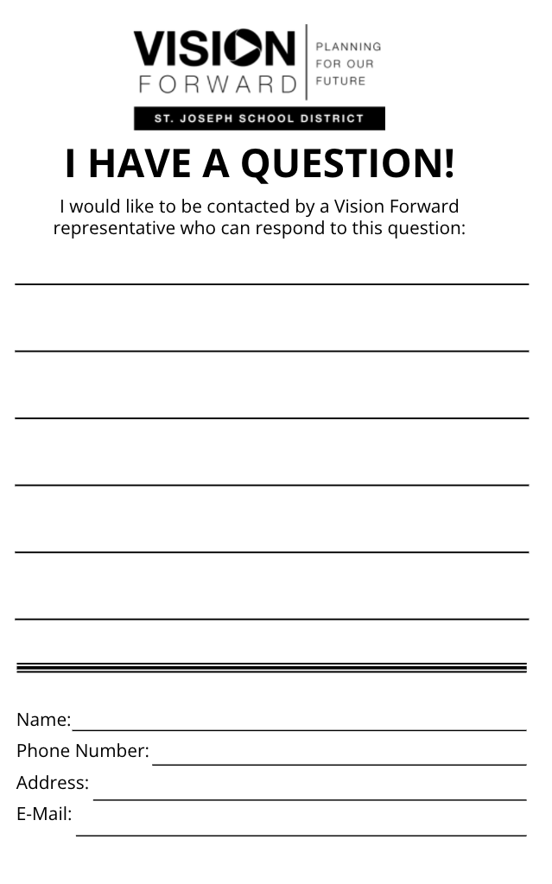
Questions/Comments
Fill out “I Have a Question/Comment” form
Email communications@sjsd.k12.mo.us
Ask Questions during Small Group Time
Notes:
And just a couple more things -
Our agenda is tight. As such, it’s important to not interrupt the presenter with questions so we have plenty of time to work. During the work session, the presenters and Community Engagement Team members will visit the tables to answer questions you might have. If you’re joining us virtually, you can also ask a question in the chat area and we will respond as quickly as possible.
Also, there are “I Have A Question/Comment” forms on each table. If you have a question or comment, and we are not able to respond during small group time, please fill out a form and turn it in to us at the end of the session. You can also call or send us an email.
And lastly, for those here in the room, please feel free to grab some water we have in the back of the room or visit bathrooms during our meeting.
Now, I’d like to turn it over to [Selected Community Chair at podium] to introduce tonight’s speaker.
9

Slide 10
Shaping the Vision
A Recap of What We’ve Learned
Presenter: Dr. Doug Van Zyl, Superintendent
Notes:
[Bob at the podium]
Thanks Chair Name?
At our first session, we heard about the State of the District and then asked participants to list a few of the topics they wanted to learn more about.
Your suggestions identified the next presentations. At our second meeting, we addressed the issue of recruiting and retaining quality staff — getting good people in the school building.
At the past two sessions we explored improving student performance. Tonight, Dr. Van Zyl will help us review what we’ve learned and what you’ve shared with us and then we’ll jump into hearing about Facilities for Learning.
After the presentation you will have a chance to ask questions and work at your table discussing what you’ve heard.
10

Slide 11
Community Engagement #1
The State of the District
“An Overview of the St. Joseph School District”

Slide 12
District Mission and Vision
District Mission
Preparing students for success in a complex and changing world.
District Vision
Creating a climate of achievement in
partnership with an engaged community.

Slide 13
Programs
New Hillyard Technical Center
  Pathways to the Teaching Profession
  Industrial Equipment Repair & Maintenance
North Central MO College TRIO Talent Search Grant
  Focuses on first-generation, low-income, disabled, or disadvantaged students whose post-secondary education enrollment and graduation rates are measurably lower than those of their peers
Apprenticeship Program
  Provides technical instruction, on the job training and earning money while students learn
  Twenty-two local business partners
Career Exploration Opportunities
  Breakfast with the Experts
  Lunch & Learn
  Manufacturing Day
  Missouri Connections

Slide 14
Programs (continued)
Project Lead the Way
  Exploration of Engineering and Biomedical Science programs for students in Grades 9-12
Grow Your Own Program
  Recruits, develops and retrains teachers already in the community
  Targets current high school students, college students majoring in education and employees who have an interest in teaching
State required courses are offered at all schools.
Special Education Services, ESOL, McKinney Vento Program, and the Homebound Program

Slide 15
SJSD Attendance by Grade Level*
Grade | Sum of MSIP Prop Attendance (attending 90% or more)
K | 69.22%
1 | 72.08%
2 | 77.41%
3 | 77.17%
4 | 77.90%
5 | 78.89%
6 | 74.56%
7 | 69.90%
8 | 66.98%
9 | 73.49%
10 | 69.12%
11 | 71.58%
12 | 75.46%
173 Student Days of School
Attendance Rate
St. Joseph School District
75.10%
State of Missouri
82.3%
2020-21
*Attendance Aug. 23, 2021 to March 31, 2022

Slide 16
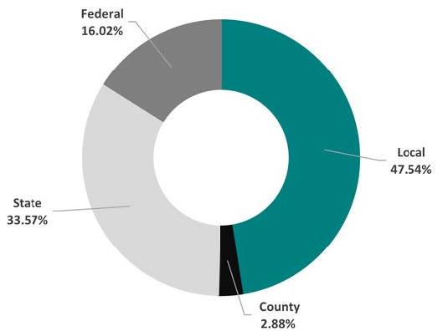
Sources of Revenue
Additional Breakdown
Local Property Taxes 34.8%
Basic Formula 26.6%
Prop. C 8.51%
Gaming 3.01%
COVID-19 Relief 8.19%

Slide 17
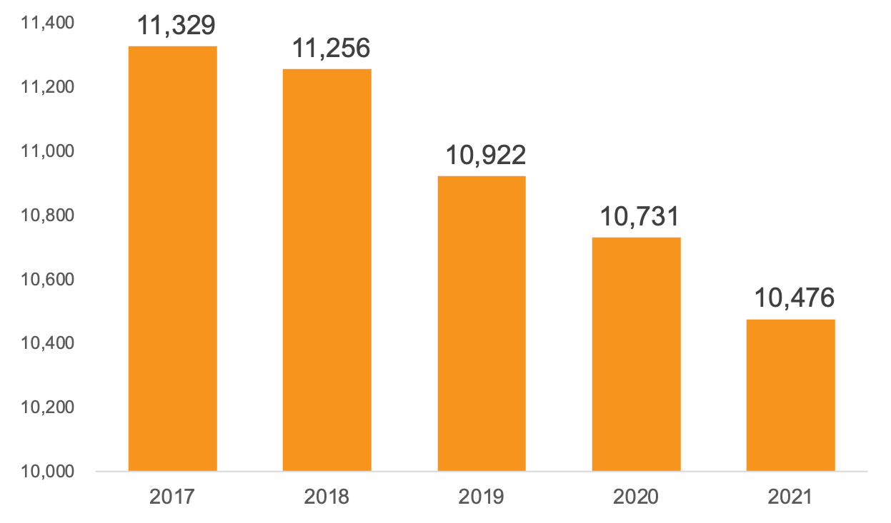
Total Student Enrollment
Five Year Loss:
-953 Students

Slide 18
School Capacity Overview
All Schools
Optimum Capacity: 12,004
Current Seated Enrollment: 9,503
Empty Seats: 2,501
High School
Optimum Capacity: 3,996
Current Seated Enrollment: 2,642
Empty Seats: 1,354
Middle School
Optimum Capacity: 1,940
Current Seated Enrollment: 1,777
Empty Seats: 163
Elementary School
Optimum Capacity: 6,068
Current Seated Enrollment: 5,084
Empty Seats: 984
Seated Enrollment Excludes Virtual Academy Students

Slide 19
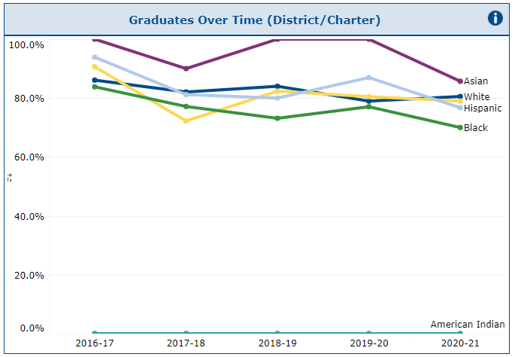
Graduation Rates
Total Graduation Rate
St. Joseph
School District
79.6%
State of Missouri
89.2%
2020-21

Slide 20

Our Schools
Pre-School: 1
Elementary Schools: 14
Middle Schools: 4
High Schools: 3
Alternative School (Webster): 1
Technical School (Hillyard): 1
Virtual Academy: 1
Total Number of Schools
25

Slide 21
Challenges
Academic Achievement
Enrollment Decline and Impact
Facilities
Funding
Attendance
Staffing

Slide 22
Community Engagement #2
What Matters Most
High-Quality Staff in Every Classroom

Slide 23
Turnover Rates
Employee Category | Employees in 20-21 | Leaving in 20-21 | Retired | Resigned | Released | Turnover Rate
Adult Basic Ed. | 24 | 4 | 1 | 3 | 0 | 16.67%
Accompanists | 3 | 2 | 1 | 1 | 0 | 66.67%
Administrators | 63 | 8 | 5 | 2 | 1 | 12.70%
Campus Supervisors | 10 | 3 | 0 | 2 | 1 | 30.00%
Career Development Spec | 3 | 0 | 0 | 0 | 0 | 0.00%
Counselors | 37 | 2 | 1 | 1 | 0 | 5.41%
ESOL | 4 | 0 | 0 | 0 | 0 | 0.00%
Family Involvement Coord. | 7 | 0 | 0 | 0 | 0 | 0.00%
Full-time Substitutes | 9 | 3 | 0 | 3 | 0 | 33.33%
Interpreters | 3 | 0 | 0 | 2 | 0 | 0.00%
ISS | 7 | 1 | 0 | 1 | 0 | 14.29%
Library Facilitators | 14 | 2 | 0 | 1 | 1 | 14.29%
Maintenance | 147 | 23 | 6 | 6 | 11 | 15.65%
Nurses | 33 | 2 | 0 | 2 | 0 | 6.06%
Nutrition Services | 122 | 13 | 9 | 4 | 0 | 10.66%
OT's and PT's | 4 | 2 | 1 | 1 | 0 | 50.00%
Paras | 99 | 28 | 1 | 25 | 2 | 28.28%
Parent Educators | 10 | 1 | 0 | 1 | 0 | 10.00%
Secretaries | 85 | 9 | 4 | 5 | 0 | 10.59%
Social Workers | 12 | 0 | 0 | 0 | 0 | 0.00%
Teachers | 813 | 116 | 21 | 92 | 3 | 14.27%
TMC | 34 | 9 | 2 | 3 | 4 | 26.47%
Total | 1543 | 228 | 52 | 155 | 23 | 14.78%
Notes:
Turnover % for next year
Talk about early incentive programs
23

Slide 24
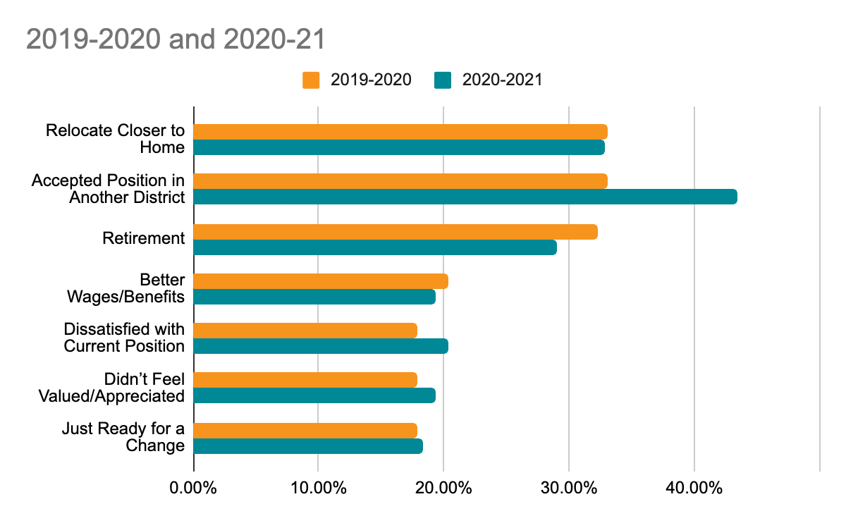
Exit Surveys - Why Staff Are Leaving
Exit surveys provide insight to why employees are leaving St. Joseph School District

Slide 25

Staff Recruitment Efforts
Teacher Career Fairs
Job Postings
Individual Contacts with All Missouri Teacher Preparation Institutions
Grow Your Own Program
Pathways to the Teaching Profession

Slide 26

Staff Retention Efforts
Increasing/Adjusting Teacher Salary Schedules
Early Notification of Intent to Return Incentive
Hiring Additional Support Staff
Closing the Gap Initiative
Maintaining a Robust Health Insurance Program

Slide 27
Challenges to Recruitment & Retention
State and National Teacher Shortage
Living Close to a Metropolitan Area
Many of Our Competitors Pay More
Economic Levels & Different Needs of Students
Our State Department of Education
Overall Teacher Pay in Missouri
Reputation of the District
Negative Narrative in District and Community
Teaching Is Very Hard Work

Slide 28
Community Engagement #3
Improving Student Performance
PreK and Elementary

Slide 29
Special Education Services
Provide services to students ages 3-21 who qualify
Services are offered at all schools
1130 students K-12 receive special education services
  174 Early Childhood Special Education (ECSE)
Staff totals: 146 Certified Staff and 78 Non-Certified Staff
Current challenge is our staffing shortage
  17 Teacher openings and 7 Para openings for the 22-23 school year

Slide 30


Early Childhood Education

Slide 31
Parents As Teachers
Frequently Asked Questions
                How many Parent Educators are there?
                8 Full-Time Parent Educators
                1 Part-Time Parent Educator
Who qualifies (or what qualifies a family) for home visitation?
  Any family within the SJSD who has a child(ren) aged prenatal-Kindergarten entry
What is the frequency of home visitation?
  Either once or twice monthly

Slide 32

ESL- English as a Second Language
839 K-12 Students are receiving ESL services. We have had 50 Newcomers move into our district this school year. 13 of those students are designated as SLIFE. Students exit our program when they earn a 4.7 on the ACCESS test which is administered once a year or through a portfolio exit.

Slide 33
ESL Staffing and Services
We offer ESL services at all schools K-12
We have 32 full time staff members and 1 part-time staff member
  2 ESL Family Advocates
  1 Part-Time ESL Interpreter/Translator (Spanish)
  24 ESL Teachers
  1 ESL Assessment Specialist
  1 ESL Instructional Specialist

Slide 34
Highly Effective Staff
Teachers, Principals and Support Personnel
Impact School Improvement the Most
#1 is the quality of the teacher
#2 is highly effective school leaders
#3 is support personnel (interventionist and specialized program personnel)

Slide 35
Community Engagement #4
Improving Student Performance
Secondary Level – Grades 6-12

Slide 36
Our Secondary Schools
Middle Schools:
  Bode (7, 8)
  Robidoux* (6, 7, 8)
  Spring Garden (6, 7, 8)
  Truman* (7, 8)
High Schools:
  Benton
  Central
  Lafayette* (open enrollment as a freshman)
Alternative School:
  Webster
Technical School:
  Hillyard
Virtual Academy
*Title I Secondary Schools Lafayette, Robidoux, Truman
  Family Involvement Coordinator, Behavior Interventionist, Teacher Interventionists (ELA or math), tutoring funds, para support

Slide 37
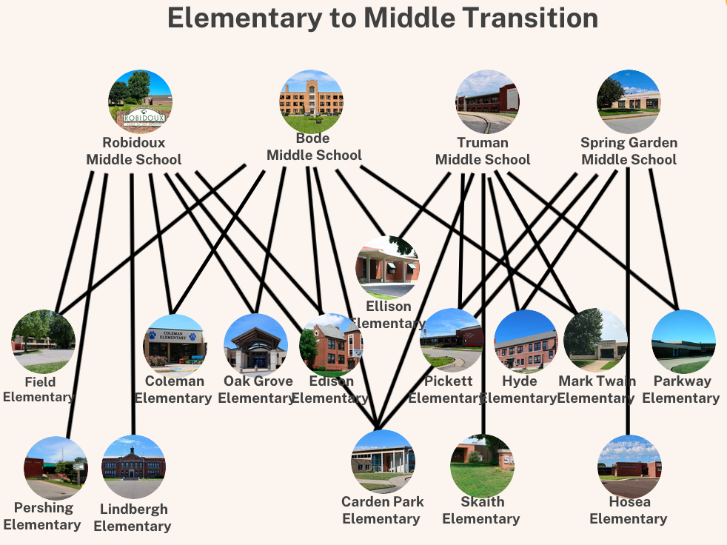
Notes:
Infographic from Bethany Clark, Director of Elementary Education
Pershing, Lindbergh, Skaith, and Hosea are the only elementary schools that send all their students to one middle school as a cohort.
Hyde is a K-5 building that transitions students to Spring Garden, but also Truman (a 7-8 building). There are a few 6th graders that transfer to a different elementary for 6th grade then transfer again for 7th grade to Truman, or they can request a transfer to Spring Garden. If they are granted a transfer, they do not have any district transportation.

Slide 38
Middle Level Feeder Pattern
Bode Middle School – Ellison, Coleman, Field, Oak Grove, Edison
Robidoux Middle School – Lindbergh (K-5), Pershing, Carden Park
Spring Garden Middle School – Hosea (K-5), Hyde (K-5), Carden Park
Truman Middle School – Skaith, Pickett, Parkway, Mark Twain, Carden Park
*All elementary schools are K-6 unless noted otherwise.
7th grade = 259 | 8th grade = 258
6th grade = 78 | 7th grade = 139 | 8th grade = 178
6th grade = 157 | 7th grade = 160 | 8th grade = 169
7th grade = 242 | 8th grade = 215
Notes:
*Challenges:
Robidoux - Transitioning partial grade level cohorts from their feeder schools. (Pershing 6th grade to RMS 7th, Lindbergh 5th to RMS 6th)
*Carden Park – Majority attend Truman, but typically 8 to 10 live in the SGMS boundaries and will enroll for 7th grade.
*SGMS – Pocket of Hyde 6th grade live in Truman’s attendance area. Could require student to attend Hyde K-5 SGMS 6, Truman 7/8 and then open enrollment.

Slide 39
School Capacity Breakdown
School | Max Capacity | Optimum Capacity | Current Enrollment | Current Enrollment as a Percentage of Optimum Capacity
Benton | 999 | 884 | 596 | 67%
Central | 1937 | 1732 | 1553 | 90%
Lafayette | 1611 | 1380 | 640 | 46%
Bode | 510 | 460 | 523 | 114%
Robidoux | 540 | 500 | 396 | 79%
Spring Garden | 556 | 496 | 486 | 98%
Truman | 515 | 484 | 459 | 95%

Slide 40
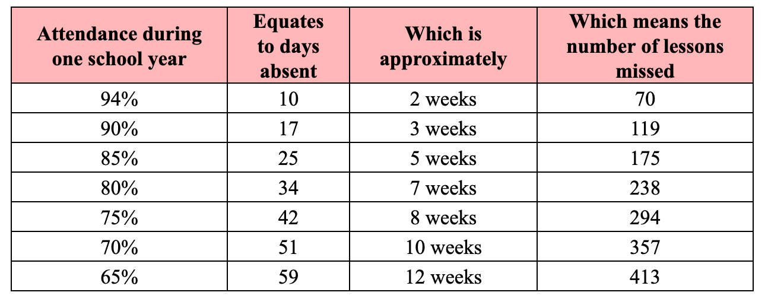
Impact of Attendance

Slide 41
Behavior/Discipline Data – Number of Referrals for 2021-2022 school year
 | Benton | Central | Lafayette | Bode | Robidoux | Spring Garden | Truman
Alcohol | 0 | 3 | 1 | 1 | 0 | 4 | 0
Assault | 11 | 21 | 6 | 3 | 5 | 8 | 14
Bullying | 1 | 8 | 0 | 0 | 0 | 2 | 0
Cell Phone Misuse | 61 | 64 | 263 | 46 | 55 | 115 | 46
Defiance | 118 | 134 | 404 | 41 | 105 | 305 | 97
Disrespect | 177 | 174 | 289 | 118 | 151 | 281 | 103
Disruptive | 96 | 263 | 450 | 261 | 230 | 595 | 180
Drugs | 14 | 15 | 14 | 1 | 6 | 0 | 8
Fighting | 25 | 38 | 15 | 48 | 38 | 52 | 43
Tobacco/E-cig | 77 | 121 | 50 | 46 | 21 | 40 | 25
Vandalism | 6 | 8 | 9 | 18 | 13 | 15 | 10
Notes:
Data as of 4/18/22
Why is Lafayette higher?

Slide 42
SJSD Facilities Review
Presenters: Mr. Mickey Gill, Director of Operations
Mr. Casey Housman
Coordinator of Maintenance and Warehousing
Notes:
[Bob at the podium]
Thank you Dr. Van Zyl.
Strategies to improve student achievement was another a high priority for the majority of the participants and we’ve looked at some of the many factors that impact the overall success of our students. Another important piece for successful students, are the actual schools. How do school buildings impact learning? We’re happy to have several people tonight to share information about our schools and what they believe our schools need to improve the educational programs for our students.
First we will hear from Mr. Mickey Gill, Director of Operations and Mr. Casey Housman, Coordinator of Maintenance and Warehousing. Then we also have a few video presentations so we can hear from teachers and students, too.
After the presentation you will have a chance to ask questions and work at your table discussing what you’ve heard.
42

Slide 43
Summary for All 31 Locations
1.8 million
sq. ft.
Total Square Footage
1.3 million sq. ft. (27.72 acres)
Total Roofing
$1.6 million
2021-22
Capital Improvement Projects (CIP) Budget
302
Total Acreage
$2,060,962
2021-22
Maintenance Budget
$2.6 million
2021-22
Utilities Budget
2020-22 Maintenance Cost For All Buildings: $2,164,324

Slide 44
3 High Schools / 1 Tech School / 1 Alternative School
School (Enrollment/Max. Capacity) | Square Footage | Year Built | Addition(s) | Average Annual Cost
Benton High School (577 / 999) | 122,109 | 1939 | 1963, 1964, 1968,1990, 2002 | $116,725
Central High School (1474 / 1937) | 238,109 | 1930 | 1961,1968, 2002, 2013 | $162,712
Lafayette High School (591 / 1611) | 156,641 | 1916 | 1938, 1960, 1968, 1990, 2002 | $134,120
Hillyard Tech School (412 / 506) | 119,500 | 1984 | 2008, 2016 | $56,875
Webster (174 / 567) | 37,060 | 1931 | 2002 | $33,394

Slide 45
4 Middle Schools
School (Enrollment/Max. Capacity) | Square Footage | Year Built | Addition(s) | Average Annual Cost
Bode Middle School (503 / 510) | 66,606 | 1926 | 1966, 2002 | $80,871
Robidoux Middle School (393 / 540) | 54,602 | 1974 | 2001 | $39,704
Spring Garden Middle School (473 / 556) | 59,752 | 1967 | 1972, 2001 | $52,355
Truman Middle School (408 / 515) | 63,100 | 1956 | 1972, 2002 | $69,510

Slide 46
14 Grade Schools
School (Enrollment/Max. Capacity) | Square Footage | Year Built | Addition(s) | Average Annual Cost
Carden Park (523 / 699) | 75,844 | 2014 |  | $45,533
Coleman (306 / 537) | 44,264 | 1966 | 1990, 2001 | $55,799
Edison (308 / 458) | 44,442 | 1930 | 1955, 2002 | $38,192
Ellison (357 / 378) | 44,264 | 1954 | 1966, 2002 | $71,941
Eugene Field (269 / 428) | 35,663 | 1918 | 1954, 1974, 1987, 2002 | $81,905

Slide 47
14 Grade Schools
School (Enrollment/Max. Capacity) | Square Footage | Year Built | Addition(s) | Annual Cost
Hosea (455 / 516) | 42,341 | 1961 | 2001 | $56,246
Hyde (328 / 477) | 40,224 | 1901 | 1972, 2001 | $44,851
Lindbergh (497 / 553) | 58,021 | 1931 | 1966, 2002 | $75,981
Mark Twain (292 / 453) | 36,107 | 1954 | 2001 | $52,323

Slide 48
14 Grade Schools
School (Enrollment/Max. Capacity) | Square Footage | Year Built | Addition(s) | Annual Cost
Oak Grove (453 / 790) | 80,969 | 2014 |  | $46,306
Parkway (365/ 507) | 43,118 | 1972 | 2002 | $37,599
Pershing (274 / 378) | 35,055 | 1952 | 1963, 2002 | $72,342
Pickett (208 / 378) | 34,097 | 1955 | 2001 | $44,310
Skaith (369 / 537) | 41,641 | 1965 | 1966, 1971, 2002 | $42,621

Slide 49
1 Preschool
School (Enrollment/Max. Capacity) | Square Footage | Year Built | Addition(s) | Annual Cost
Early Learning Center / Lake (392/ 452) | 37,035 | 1961 | 1966, 2001 | $100,045

Slide 50
Non-School Settings
School | Square Footage | Year Built | Addition(s) | Annual Cost
Former Admin. Offices 925 Felix | 17,562 | 1902 |  | $43,383
Noyes Administration Offices | 30,991 | 1939 | 1967, 2002 | $308,359
Maintenance Dept. 1000 S 9th | 60,988 | 1964 |  | $82,292
Maintenance Grounds Dept. 801 S 9th | 25,380 | 1921 |  | $23,497
Keatley Center | 21,216 | 1976 |  | $11,031
Pear St. Warehouse | 33,000 |  |  | $36,321
Troester Media Center | 21,116 | 1925 |  | $47,168

Slide 51
Capital Improvement Projects
2020-21 $2,091,477
2021-22 $1,590,054
New playground equipment
Roofs
HVAC
Concrete; asphalt
Electrical panels
Replace main entrance canopy at Pickett
Refinish cedar siding at Carden Park
New playground equipment
Roofs
HVAC
Concrete; asphalt
Electrical panels
Noyes renovation
Replacement of main backup generator at TMC
Install water softeners for all boilers, cooling towers, and chillers
Emergency fire line repair/replacement at Hillyard Tech
Gravel bus parking lot at Lake

Slide 52

Security Entrances
2020-21 $79,933
Bode | Eugene Field | Mark Twain | 925 Felix
2021-2022 $97,654
Coleman | Parkway | Spring Garden
Lake | Troester Media Center

Slide 53

Security Entrance Costs
Lafayette High School | Central High School Benton High School
2022-2023 $85,000
Security Entrance Costs
for Three High Schools

Slide 54
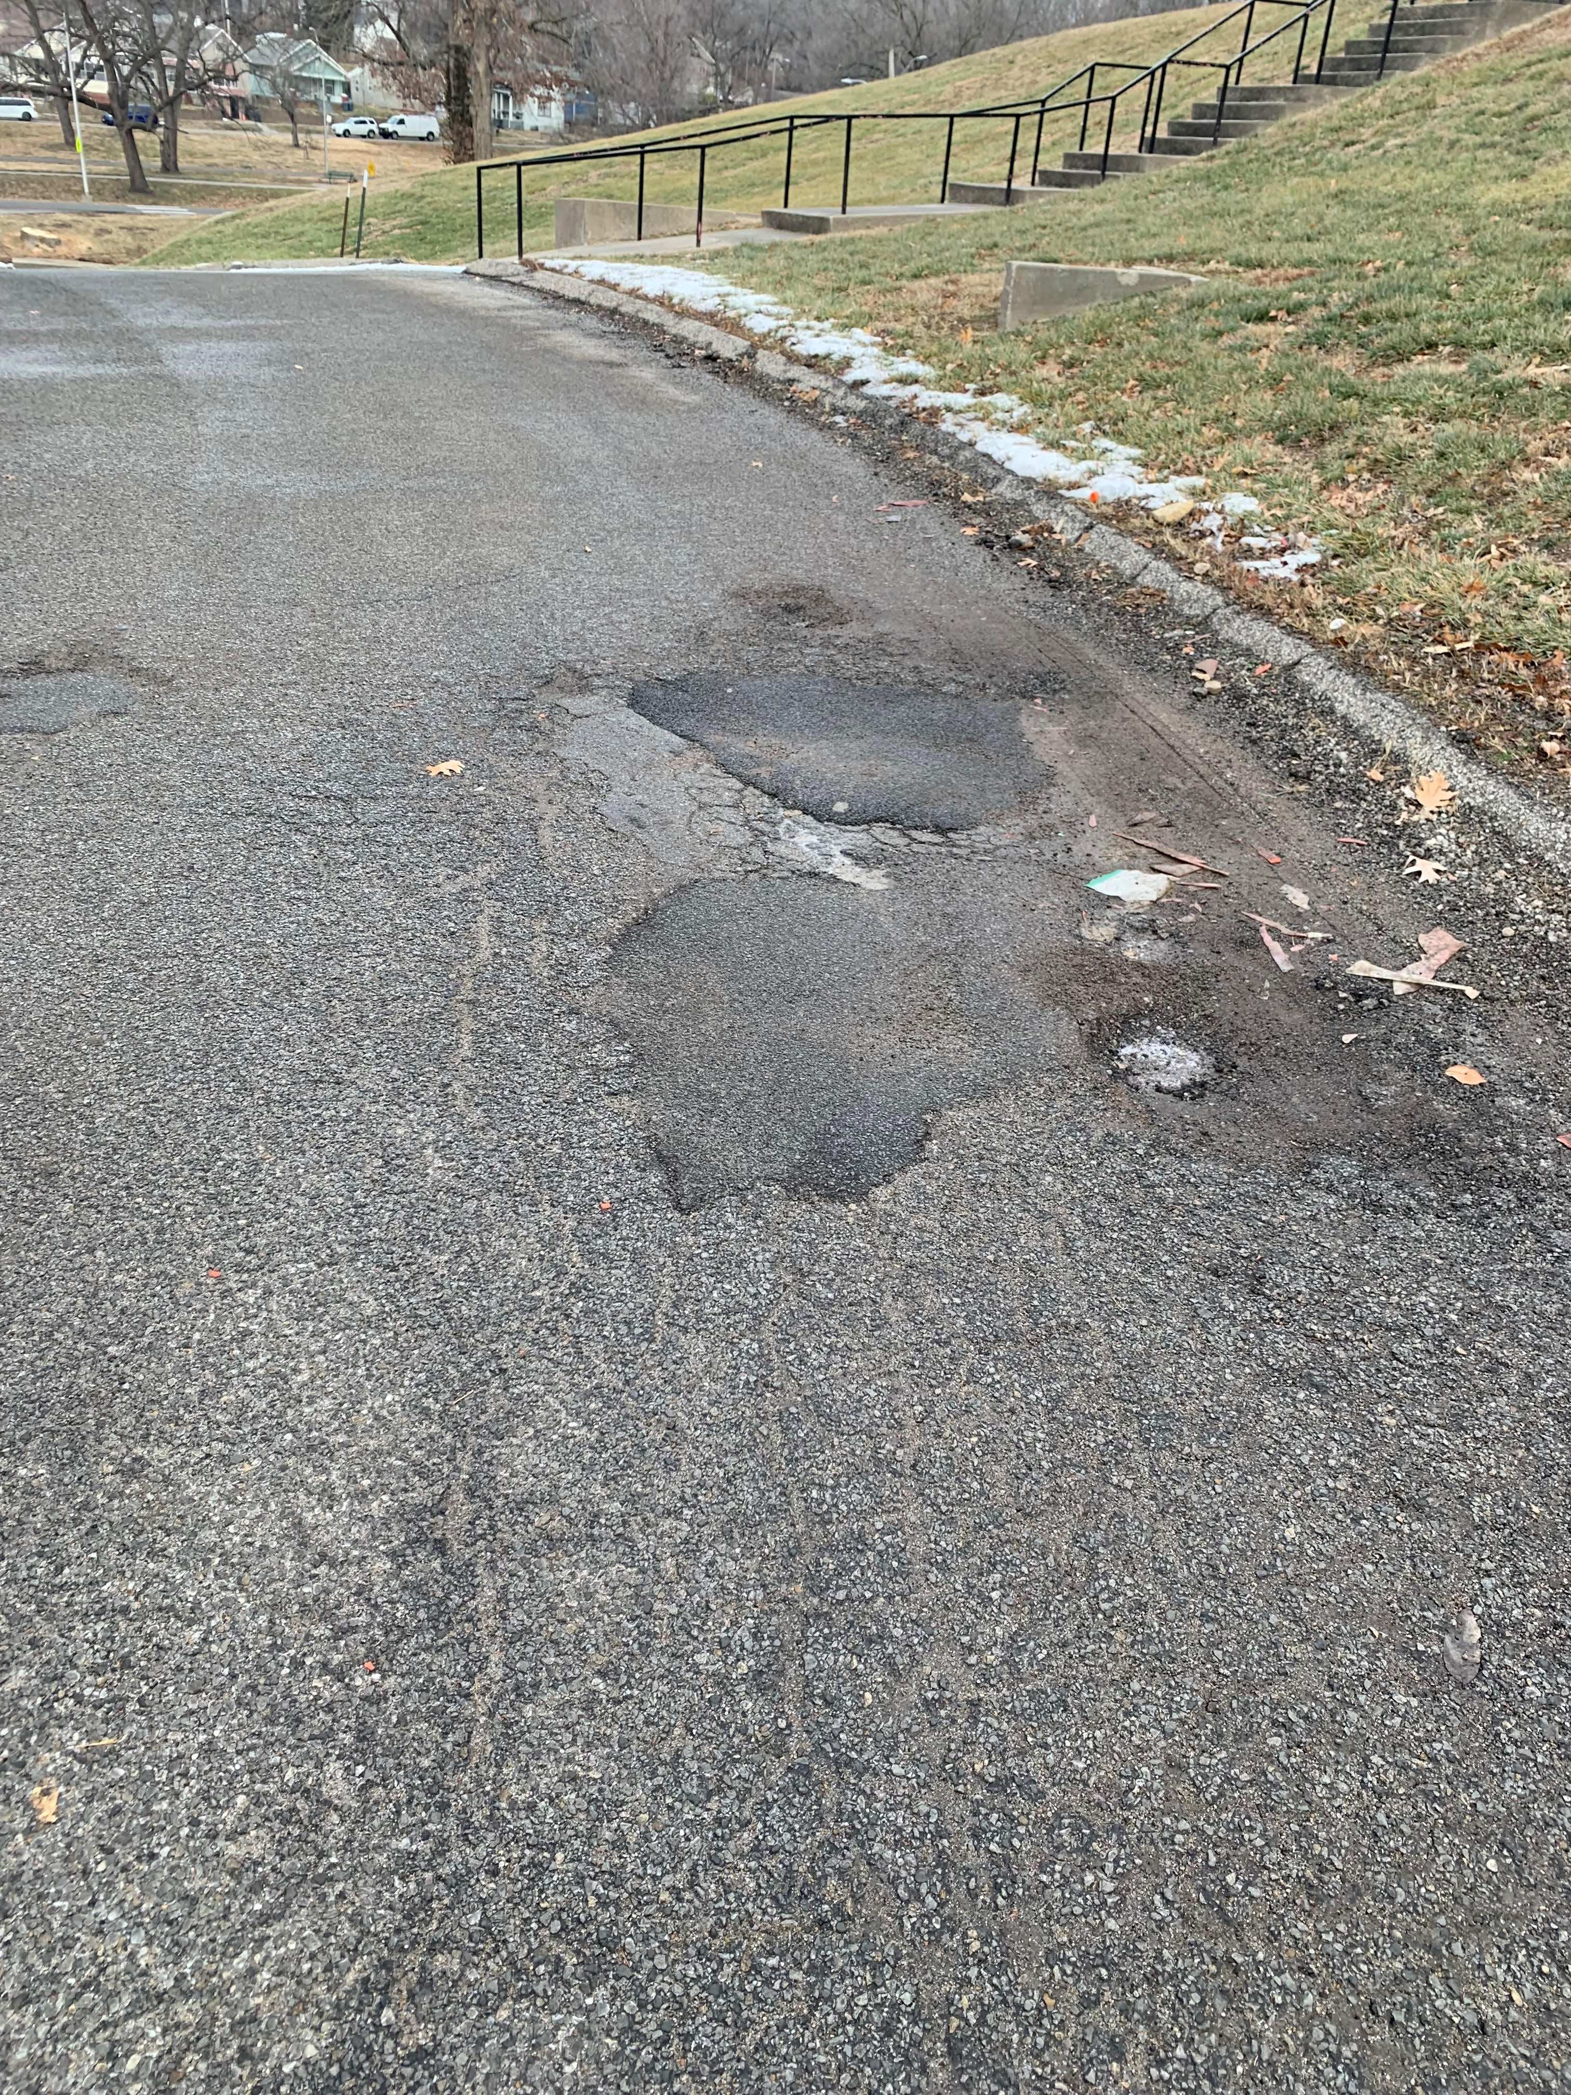
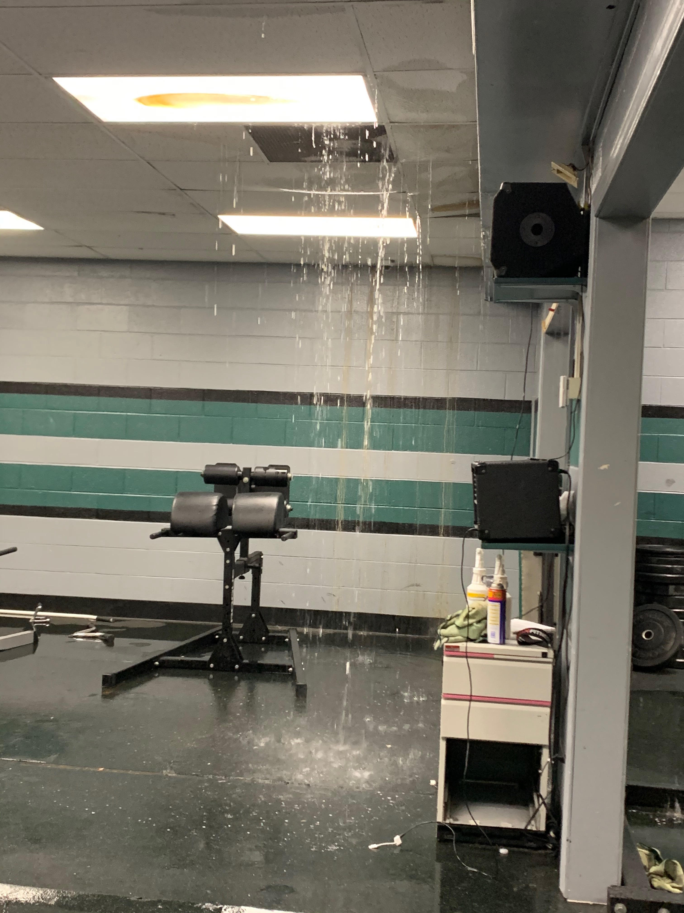
Current Conditions at SJSD Schools
Repairs
and Needs
Exceed
Financial Resources

Slide 55
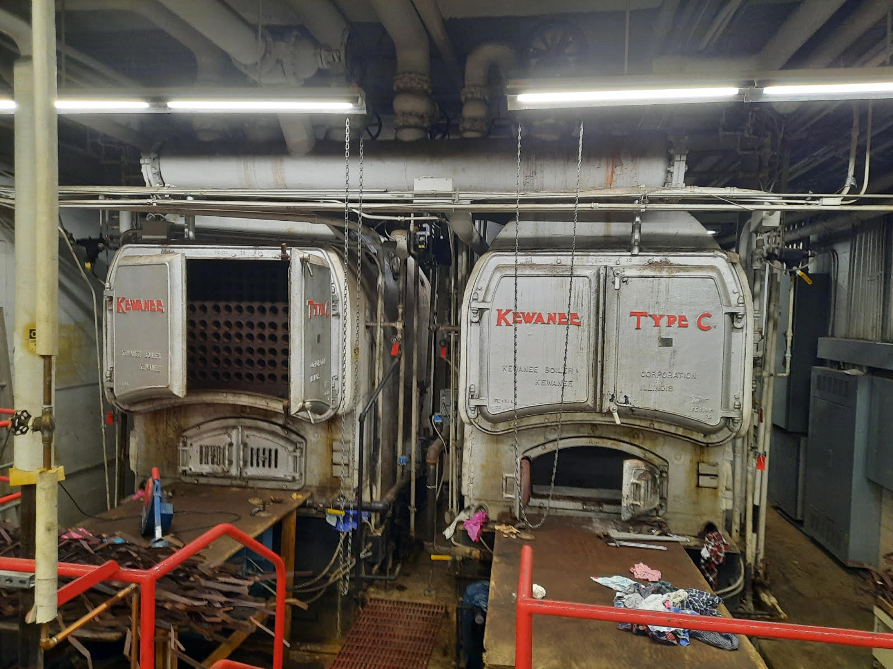
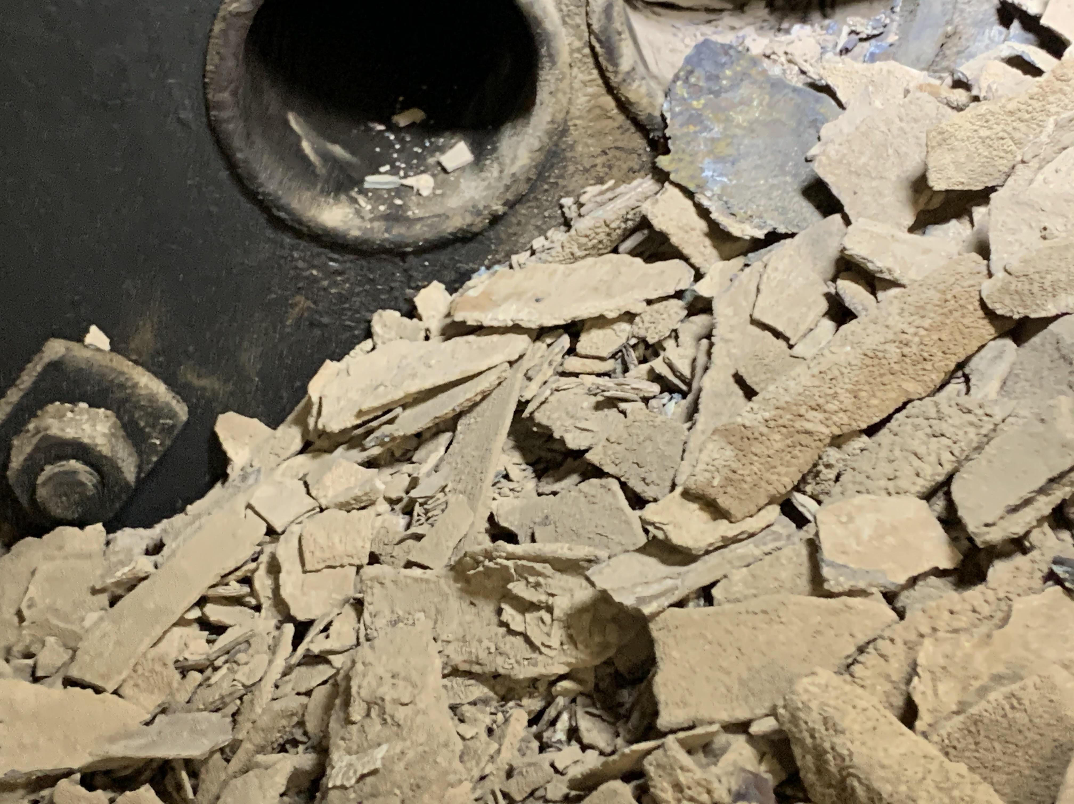
Current Conditions at SJSD Schools

Slide 56
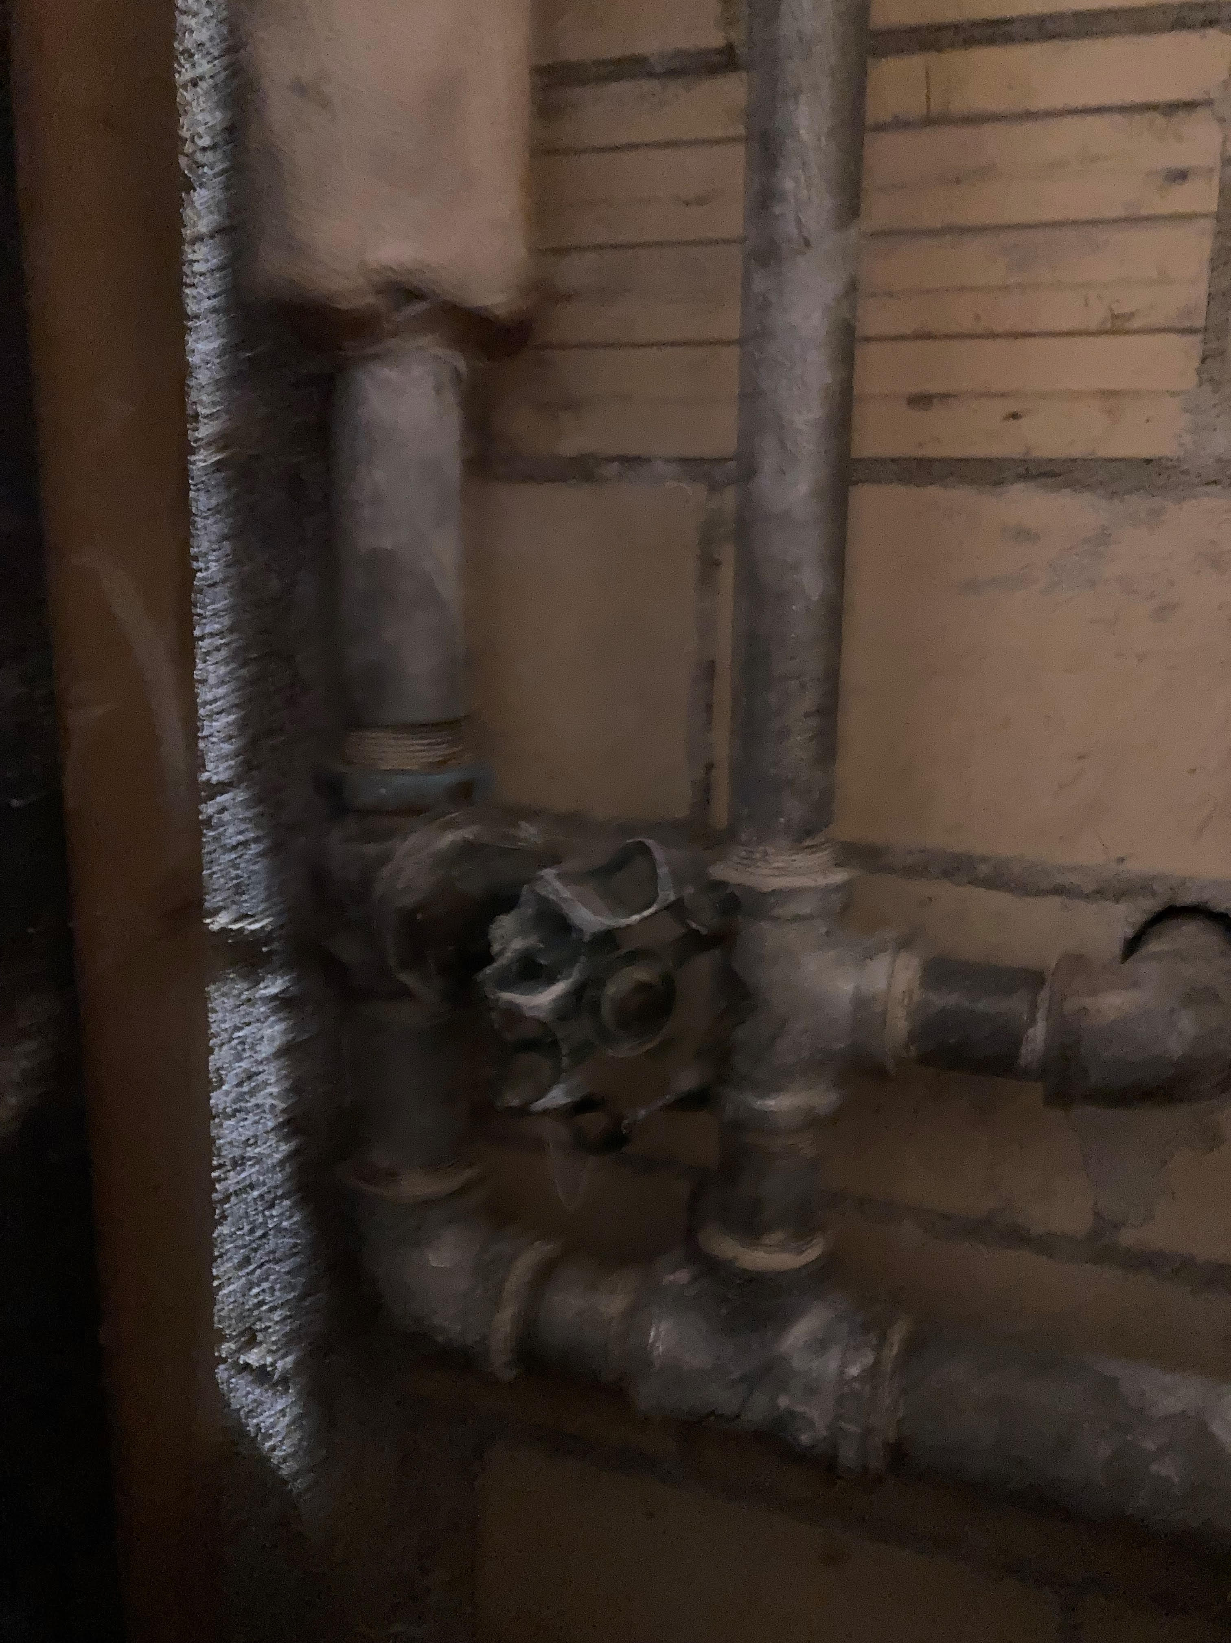
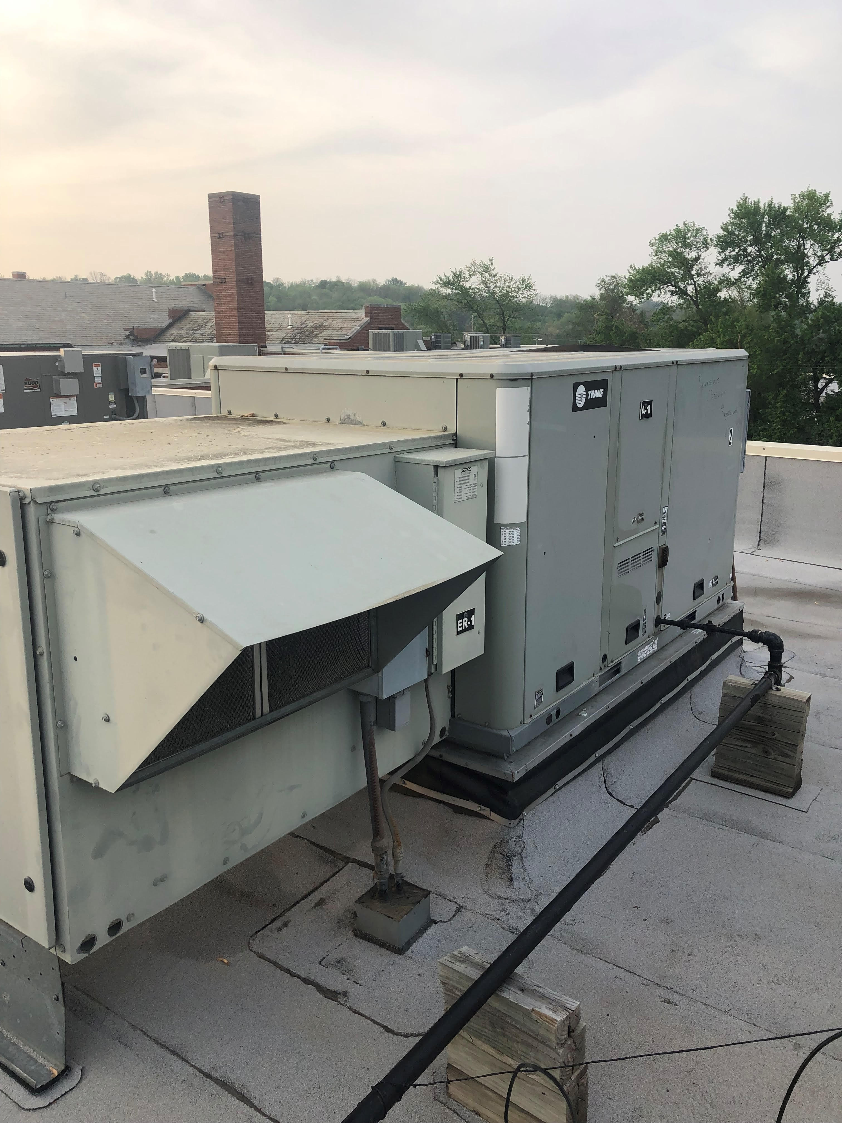
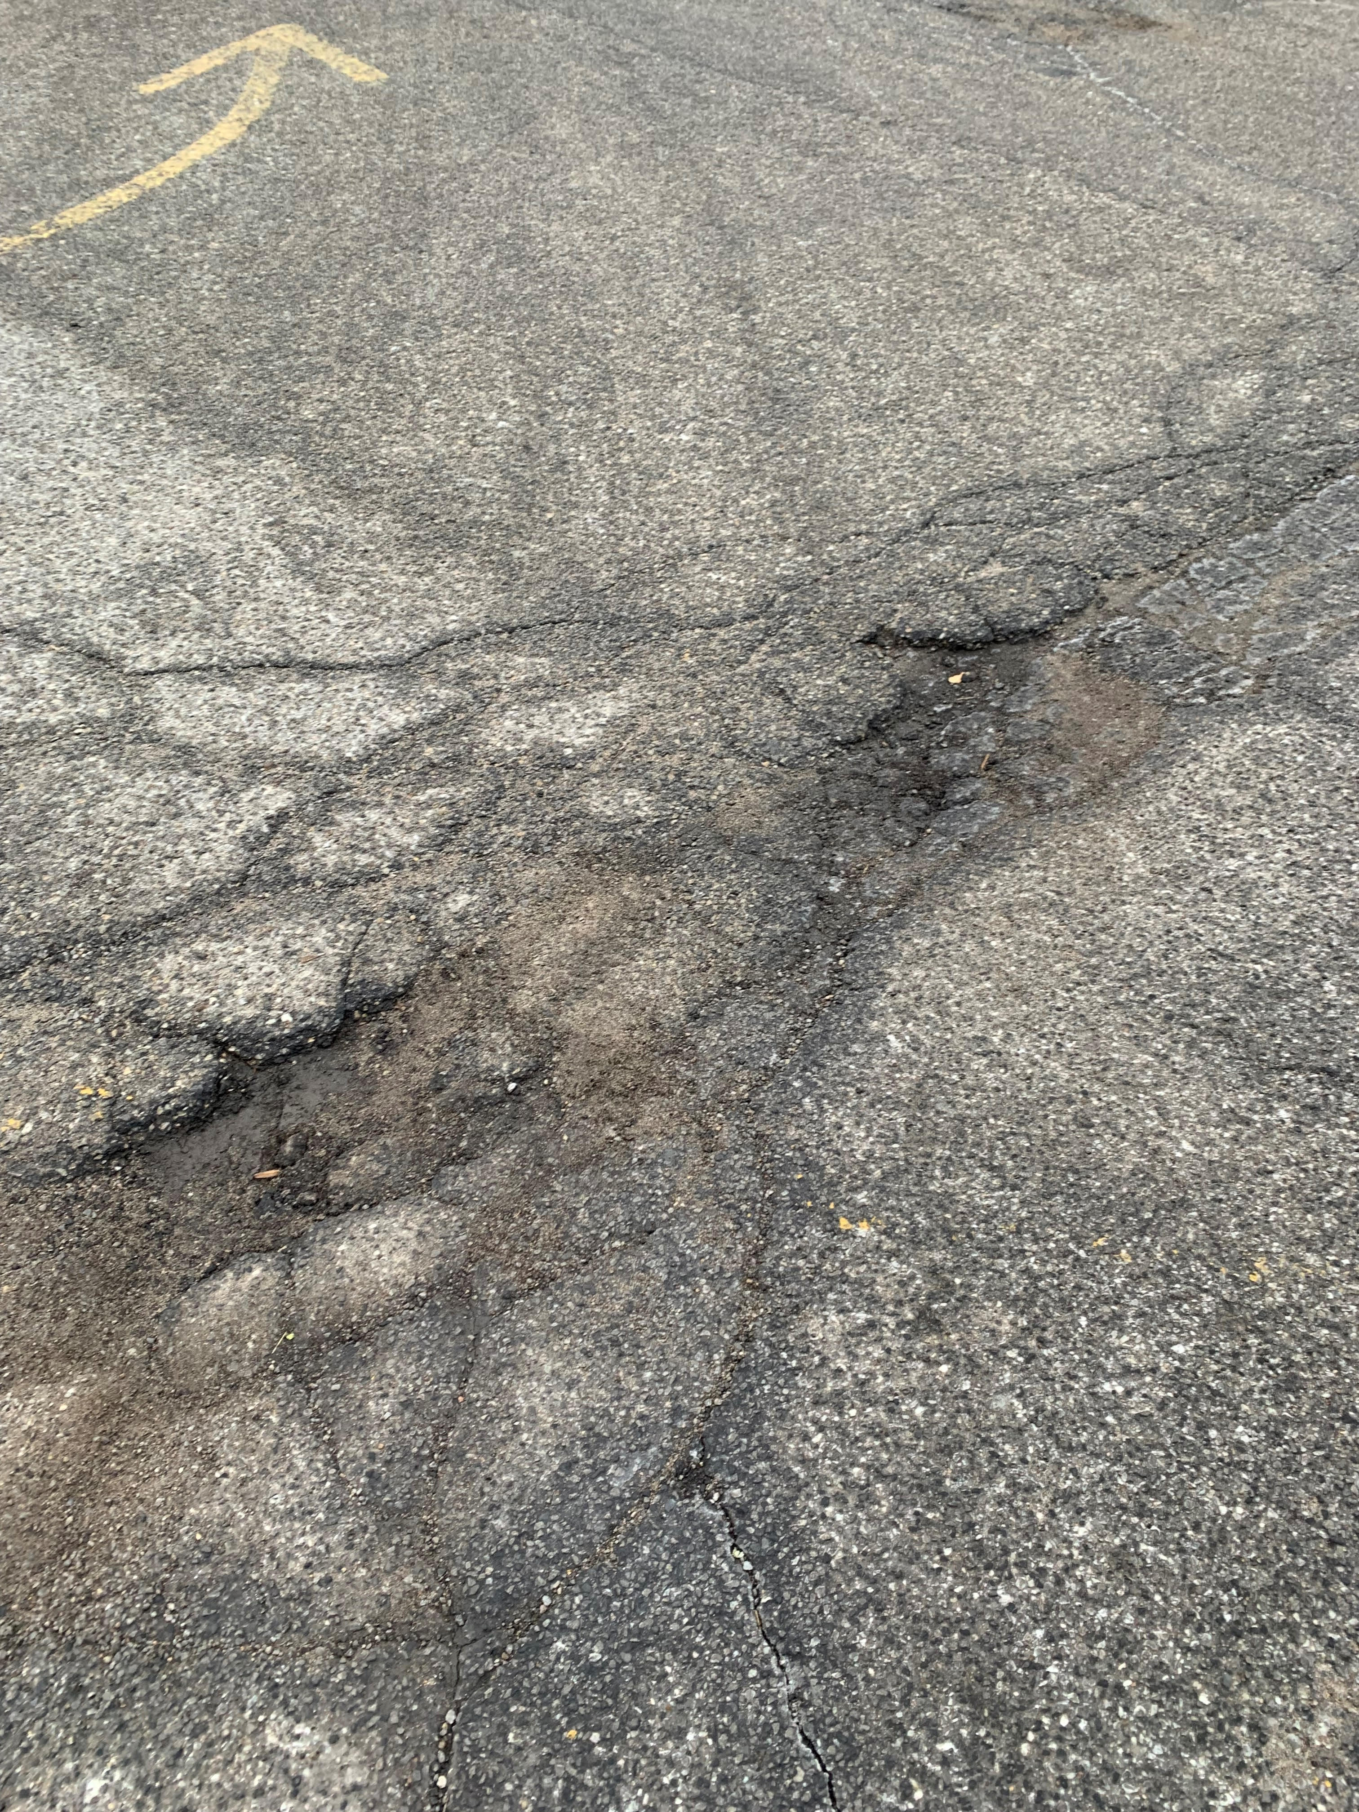
Current Conditions at SJSD Schools

Slide 57
Facility Needs Assessment
Physical
Needs
Functional Needs
Notes:
Introduce Doug here

Slide 58





Physical Condition of Building
What is the Physical Condition of the Building?
Infrastructure/
Systems
Operation and Maintenance Costs
Safety / Security
Interior Environmental Quality
Energy Efficiency
Technology

Slide 59
Functional Needs
Does the Learning Environment Support the Educational Program?
Adequate Space for Instructional Delivery
Capacity and Utilization
Educational Program Delivery
Appropriate Educational Environment
Changing Demographics and Proximity

Slide 60
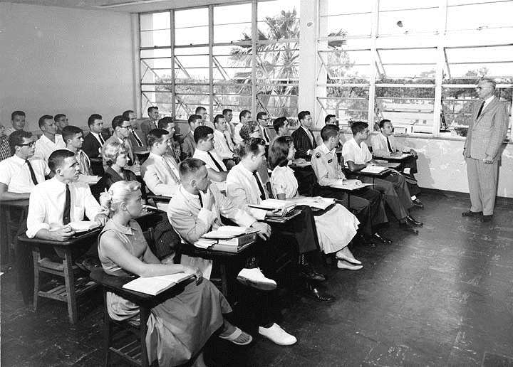

THEN…

Slide 61
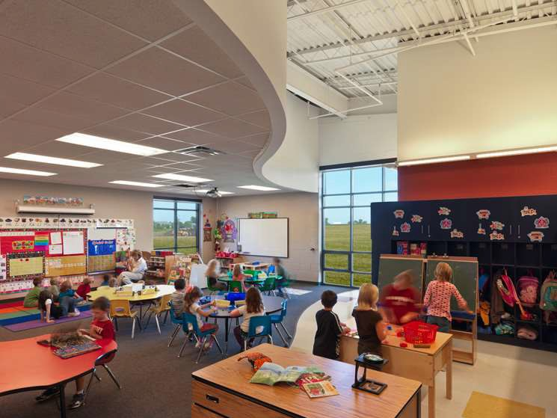

STUDENT-CENTERED
Students are active participants in the learning process.

Slide 62
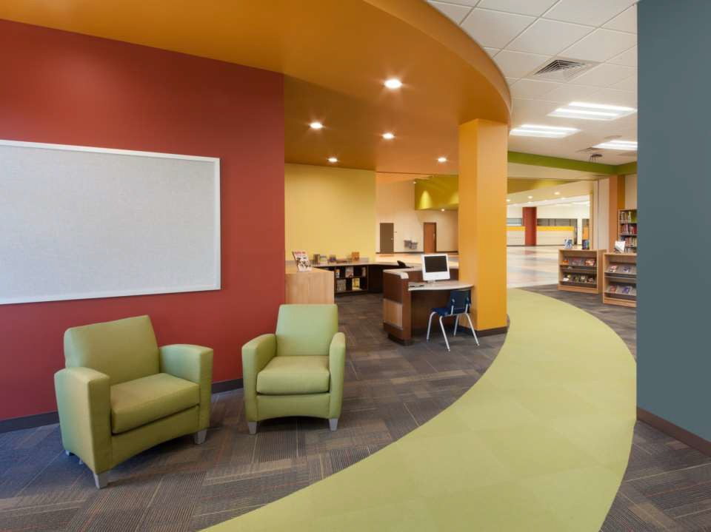
ENGAGING
“If children have interest, education happens.” Arthur C. Clark

Slide 63
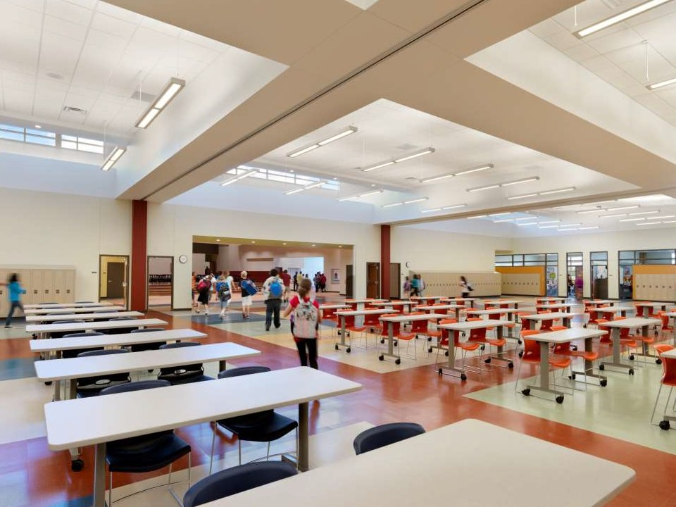
FLUID/FLEXIBLE
Rapidly reconfigurable

Slide 64
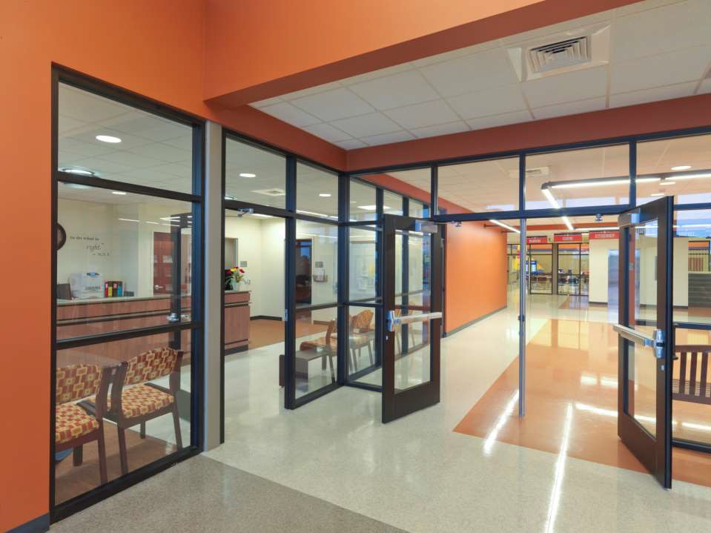
SAFE & SECURE
Transparent environment, easily observed, access controlled, a feeling of home.

Slide 65
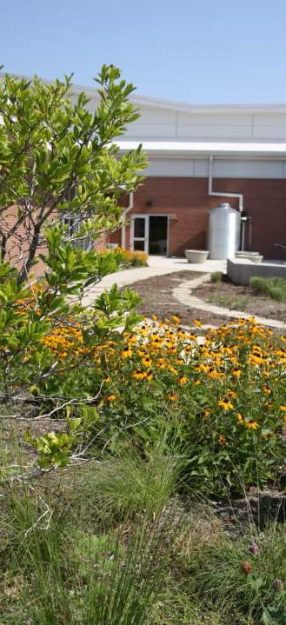
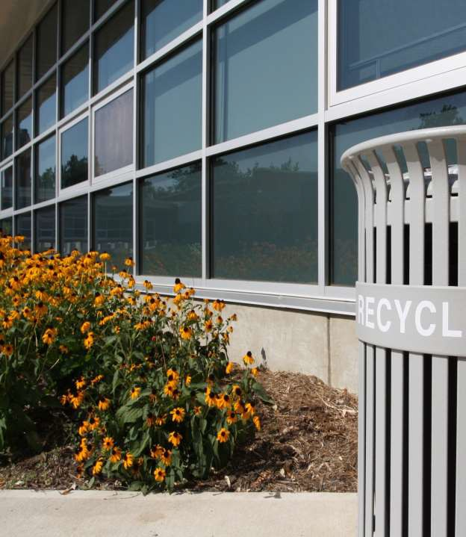
SUSTAINABLE
Development that meets the needs of the present without compromising the ability of future generations to meet their own needs.

Slide 66
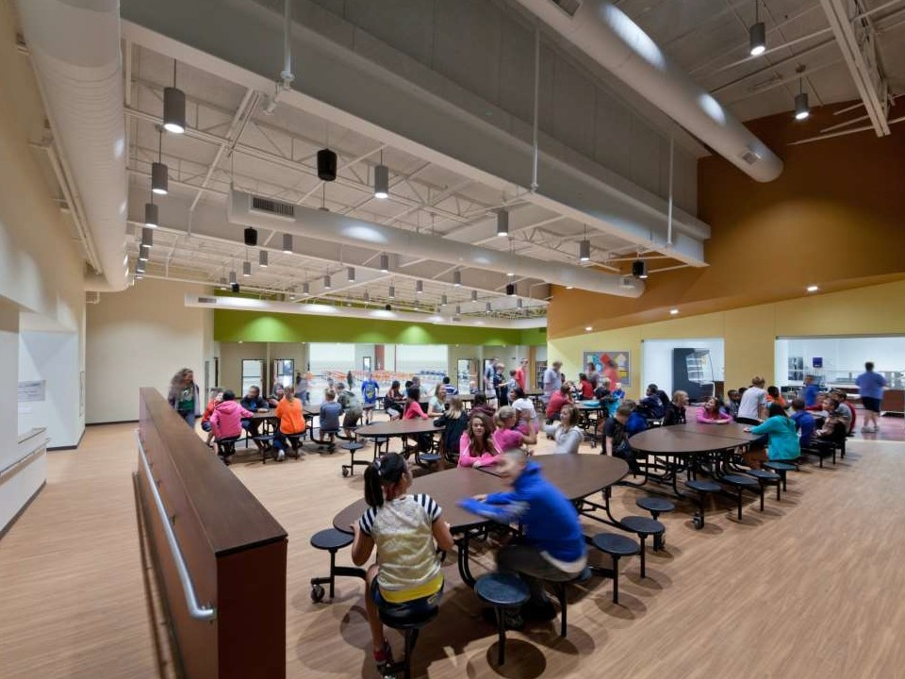
COLLABORATIVE
Allowing students to learn from students.

Slide 67
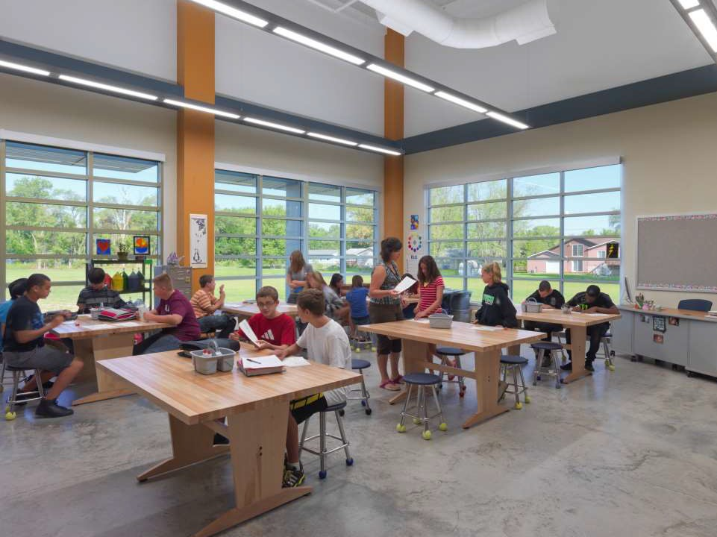
FOSTER CREATIVITY
Supporting creativity and innovation to meet the needs of the generation.

Slide 68
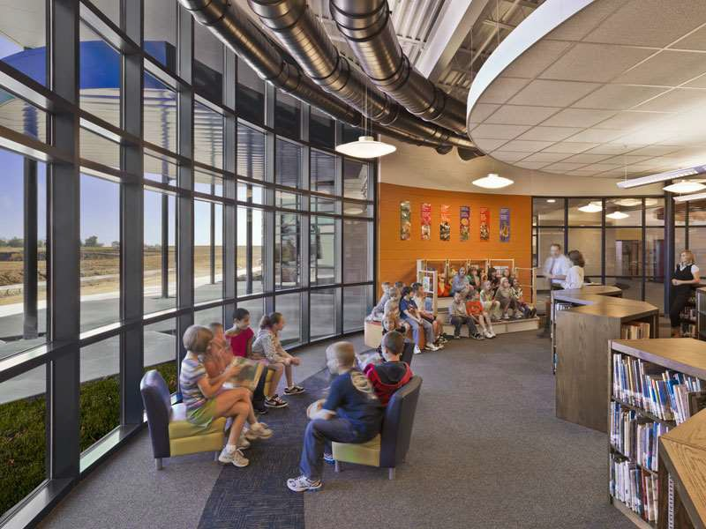
SUPERIOR LIGHTING
Abundant natural light

Slide 69
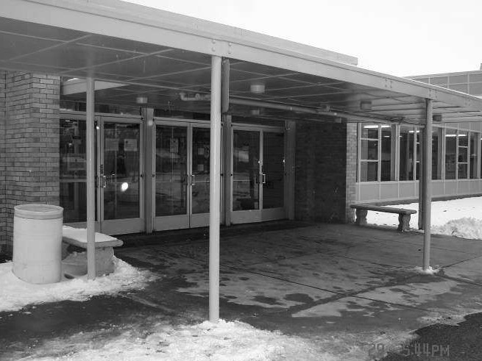

front entry

Slide 70
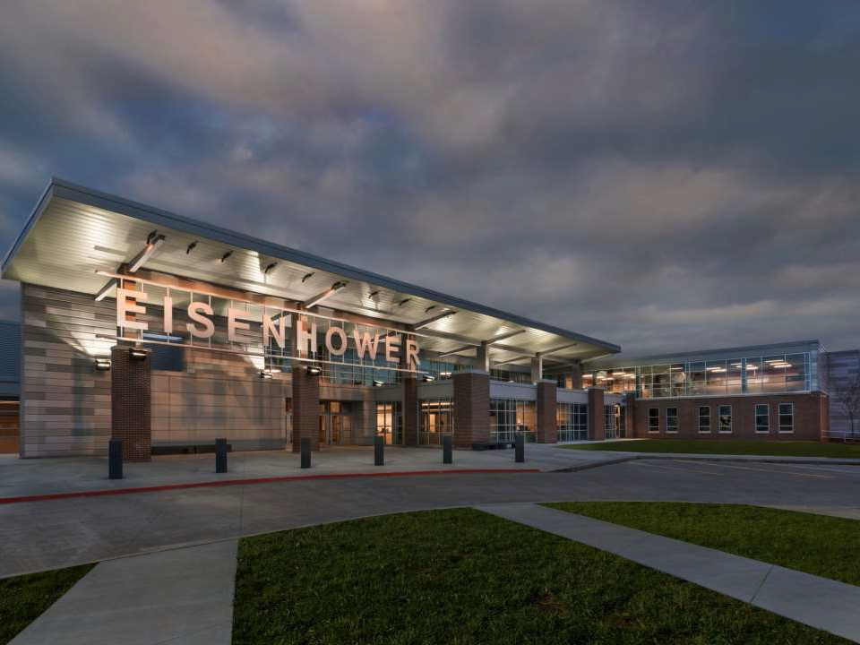
front entry

Slide 71
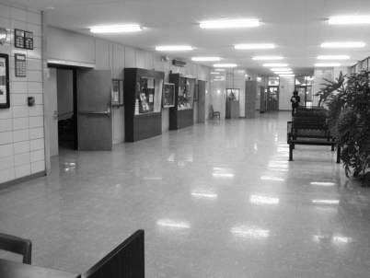
interior entry

Slide 72
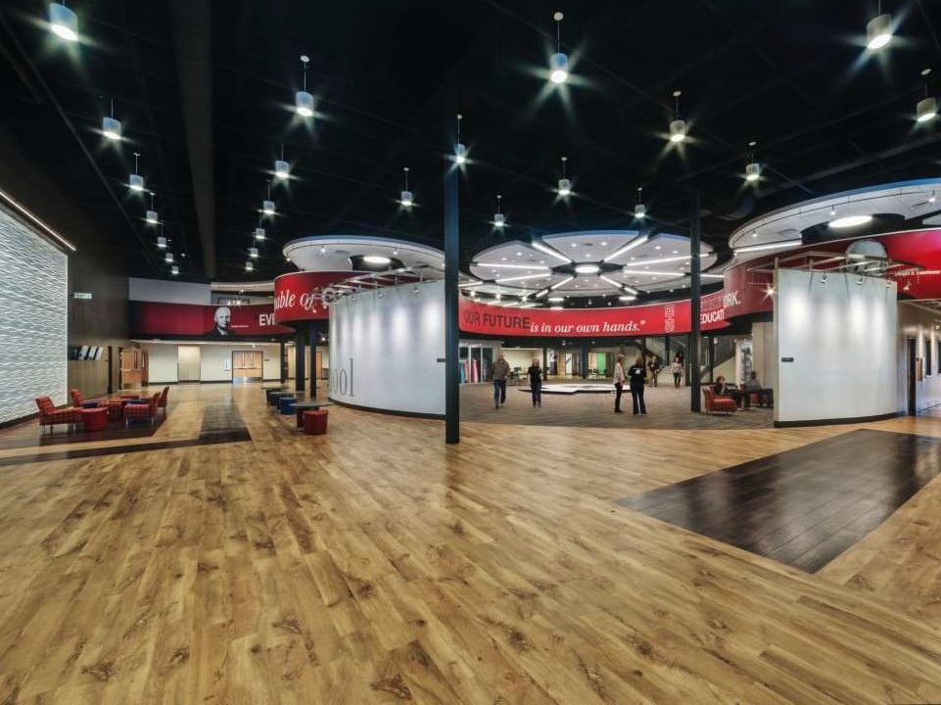
interior entry

Slide 73
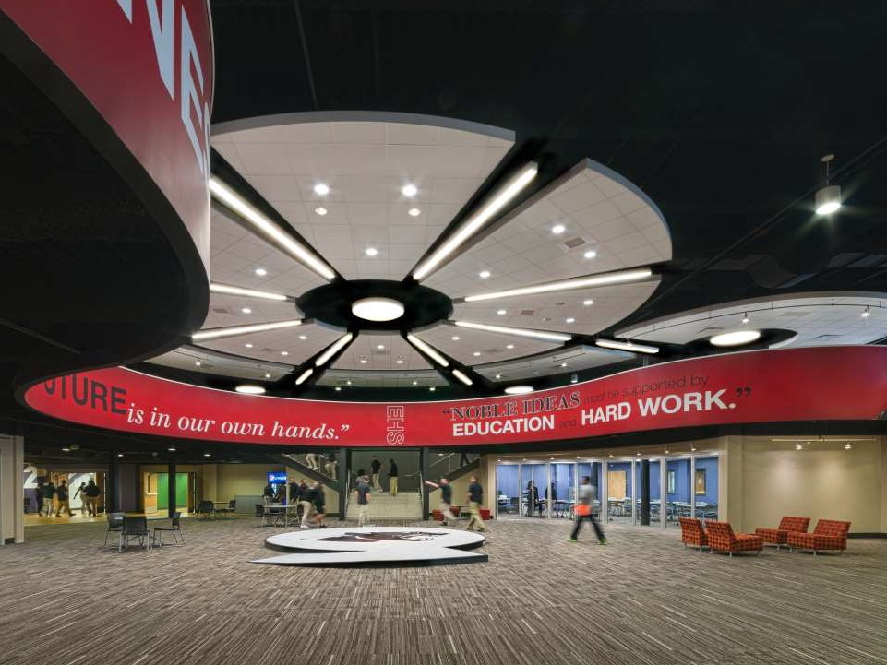
student commons

Slide 74
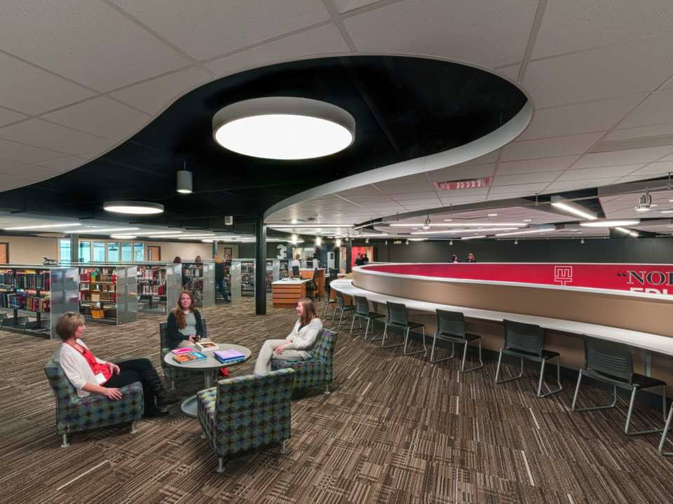
information commons

Slide 75
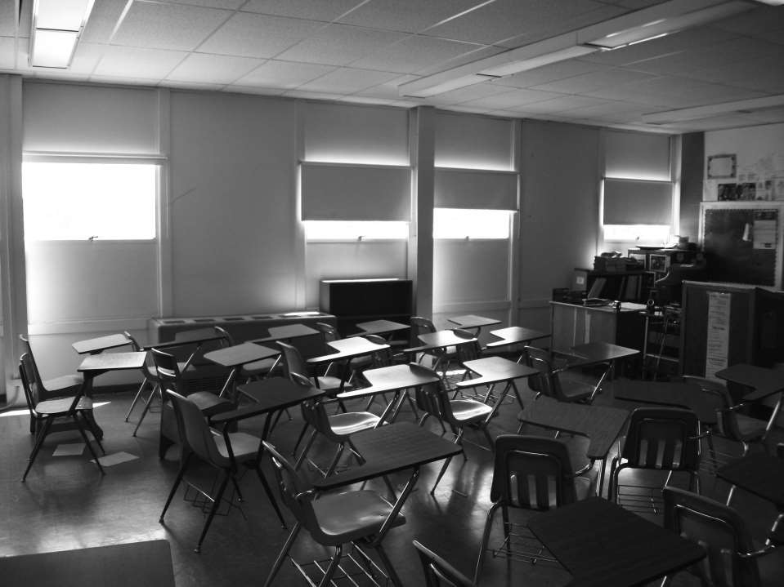
classrooms

Slide 76
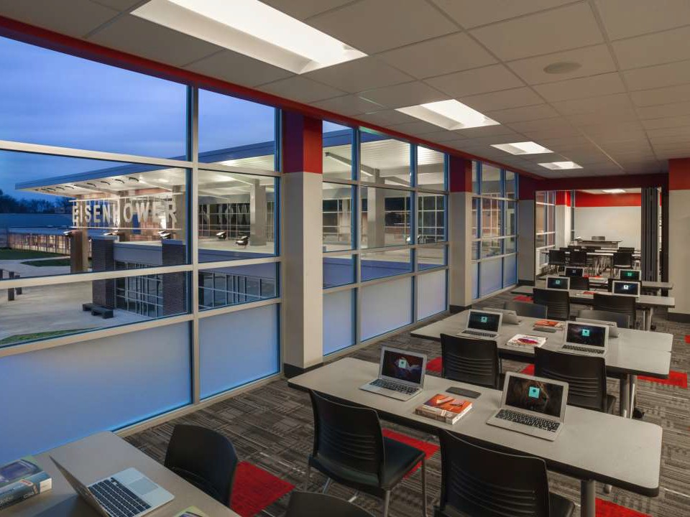
21st century learning environments

Slide 77
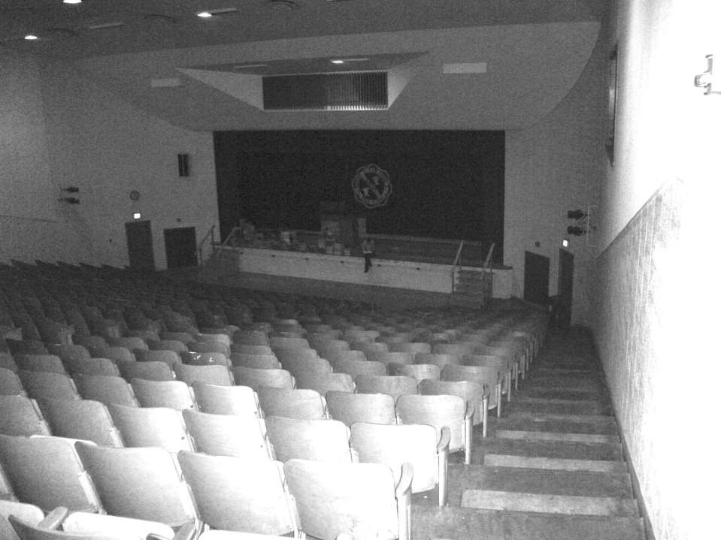
auditorium

Slide 78
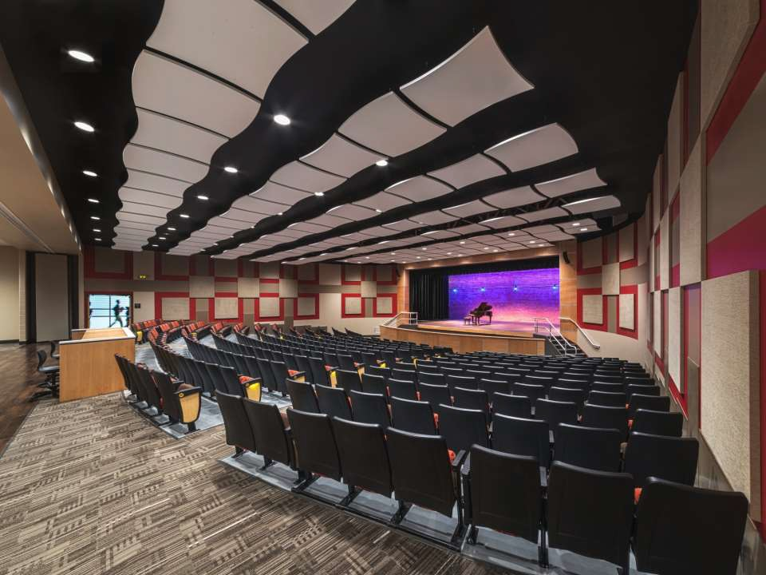
auditorium

Slide 79
Facilities for Learning
A Special Video Presentations
Notes:
[Bob at the podium]
Thank you! We often hear the phrase “boots on the ground” and those are the people in our schools that are here everyday and know first hand the conditions and needs. Let’s hear from a few of them now.
79

Slide 80
Small Group
Work Activity
Notes:
[Chair at podium]
Thank you to all the St. Joe employees and students for sharing their insight about our facilities and how they believe we can improve education in our schools.
Now let’s get to work!
On your table, on INSERT COLOR OF PAPER HERE paper, is tonight’s work activity. This is the official sheet for your recorder to use.
(Hold up a copy of the work activity)
And if you’re here virtually, please check your Welcome Sheet for the link to the work activity.
Let’s go through the instructions to make sure everyone understands the tasks.
80

Slide 81

Small Group Work Activity
Select a Recorder and Spokesperson
Recorder Responsibilities
  Complete the information on the group’s worksheet
Spokesperson Responsibilities
  Facilitate Discussion
  Keep Group Focused/On Task
  Report Group’s Information
Notes:
[Teresa at podium]
At each table, you will select a recorder and spokesperson.
The recorder is responsible for completing the worksheet. Make sure to complete the information in the box in the upper left corner.
The spokesperson should facilitate discussions, keep the group focused so the work is completed on time, and then report table results.
81

Slide 82
Small Group Worksheet
Information on worksheet should reflect consensus/general agreement of group members.
Monitor progress to complete the worksheet in allotted time.
Only group recorder’s worksheet will be collected.
Notes:
Please make sure the information recorded on the group’s worksheet reflects general agreement of everyone at the table, not just the opinion of one or two individuals.
Monitor the time to make sure you get done on time. We’ll start the reporting out at (name a time).
At the end of the session we will only collect the worksheet that has been completed by the recorder.
82

Slide 83
Small Group Discussion Norms
Turn off/silence electronic devices/phones
Give everyone an opportunity to speak
Be positive; focus on being productive
Focus on the collective good, not just individual
Respect the opinions of fellow group members
Stay engaged with the conversation
Notes:
As you begin your group discussion tonight we ask that you please keep these points in mind as you work toward consensus on the activities.
(Read points)
83

Slide 84
Small Group Work Tasks
Task #1
Based on tonight’s presentation, what are two positive things about the St. Joseph School District, its students or staff you could share?
Task #2
What are 3 priorities to align SJSD buildings to improve our facilities for learning? List your top priorities on the chart.
Prioritize your top 3 priorities from 1 to 3 - 1 being the highest and 3 being the lowest priority.
What recommendations does your group have to address these priorities in the next 5 years?
Notes:
We are asking each group to complete two activities.
(Read Tasks)
Take a minute or two to review the tasks and then let’s get work. If you have questions about the work activities, just ask one of the Community Team Members who are walking around the room or send us note in the chat if in a virtual breakout room.
And please, we really need your help on this activity. Please pay special attention to Task #2 – it is very important for your group to rank your top 3 priorities for both the high school level and also for the middle school level. Then, please offer recommendations for each priority. When you list them 1 through 3, it helps us identify the top priorities moving forward for the Action Plan. Remember 1 is the highest and 3 is the lowest.
If you’re joining us virtually tonight, we’re sending you to special breakout rooms where you will complete the group same activity and then rejoin the in-person group to share your ideas.
84

Slide 85
Small Group Work Activity Reporting
Notes:
Now it is time to hear from the tables and from the virtual groups. [Selected Community Chairs] will bring a microphone around to and try to get to as many groups as possible.
Please be brief so we can hear from as many tables as possible. We’ll collect the worksheet at the end of tonight’s session and document everything on our website.
From each table, let’s hear one of the favorite positive things about our district you learned tonight that you can share with a friend.
Then tell us your top 3 priorities to align SJSD buildings to improve our facilities for learning?
Then share any recommendations your group listed to address these priorities in the next 5 years?
Okay, let’s get started!
(Community chairpersons will take microphone from table to table for each group’s spokesperson to report. Be sure to collect the worksheet from the spokesperson as he/she finishes reporting.)
85

Slide 86
Thank You
On Behalf of Everyone with Vision Forward, THANK YOU to everyone who helped us throughout the project!
Dr. Doug Van Zyl, Superintendent
Dr. Brian Kraus
Mrs. Dlo DuVall
Dr. Diane Rutledge
Dr. Ashly McGinnis
Mr. Mickey Gill
Mr. Casey Housman
Word of Life Church
SJSD Facilities and Maintenance Staffs
Lafayette High School Staff
Benton High School Staff
St. Joseph Chamber of Commerce
SJSD Communications Dept.
Ms. Eileen Houston-Stewart,
Mr. John Morris, Ms. Ashley Coats
Notes:
Thank you for your great comments and ideas. These will be added to the information that will be used over the summer as we continue the Vision Forward process. Please stay tuned. We will share information as the work continues. We want to make sure everyone stays informed and up-to-date with the planning work.
Vison Forward began several months ago as a way to bring community and business leaders, residents, parents and school employees together for one goal – improve our schools for improved student success. We’ve listened to each of you. Vision Forward is not quite finished yet, but we are well on our way. We would not have been able to get to this point without the help of so many of you. Thank you to each of you and to the individuals and organizations listed here. It’s been so rewarding to work with so many who put our children and our community first!
Have a great summer and look for our Vison Forward updates!

Slide 87
THANK YOU FOR YOUR PARTICIPATION!
Community Engagement Meeting
May 17, 2022
Notes:
87

Slide 88
Notes:
88

