Slide 2
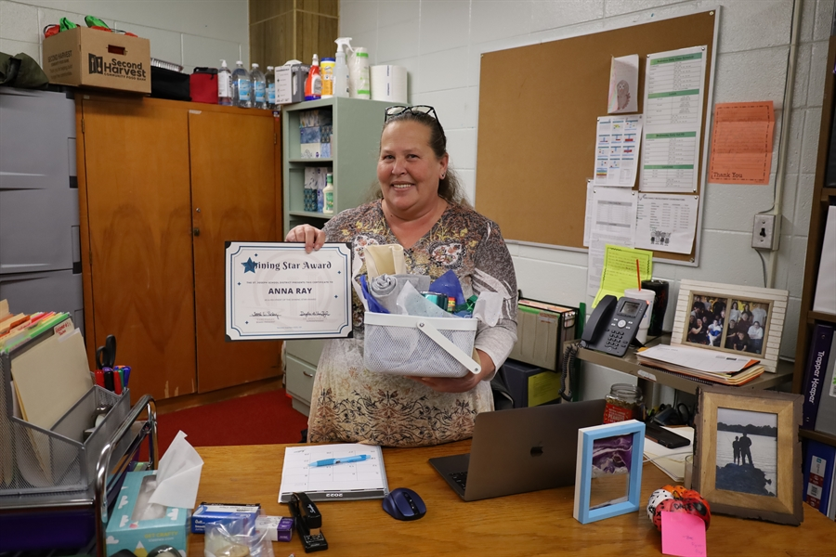

St. Joseph Shining Star
Annie Ray
Family Involvement Coordinator, Robidoux Middle School
Notes:
2

Slide 3
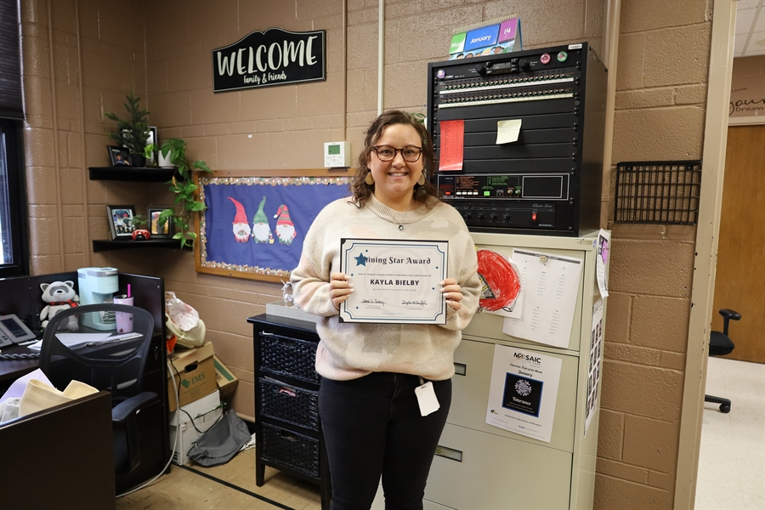
St. Joseph Shining Star
Kayla Bielby
Secretary, Pickett
Notes:
3

Slide 4
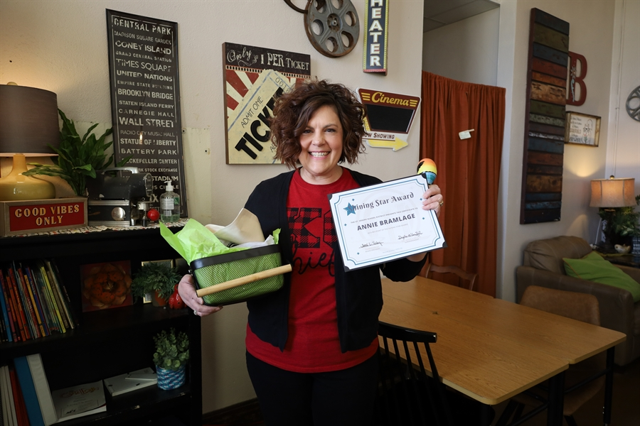
St. Joseph Shining Star
Annie Bramlage
Theater Teacher, Central High School
Notes:
4

Slide 5
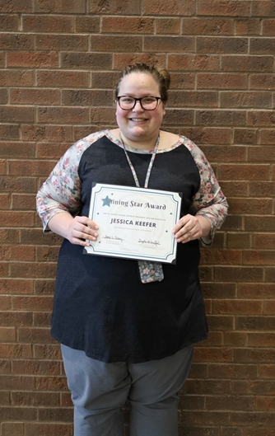
St. Joseph Shining Star
Jessica Keefer
Ag Education, Hillyard/LHS/RMS/VA
Notes:
5

Slide 6
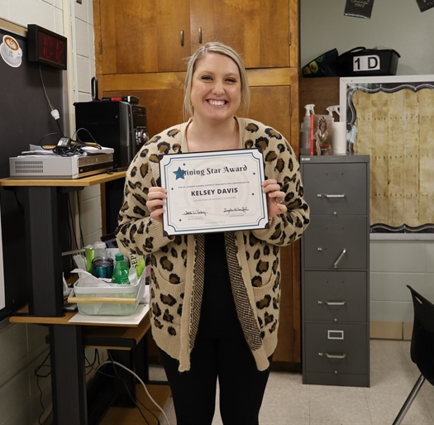
St. Joseph Shining Star
Kelsey Davis
7th grade ELA, Robidoux
Notes:
6

Slide 7
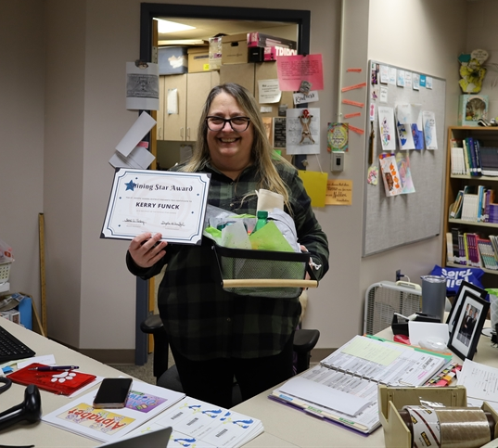
St. Joseph Shining Star
Kerry Funck
Library Facilitator, Skaith Elementary
Notes:
7

Slide 8
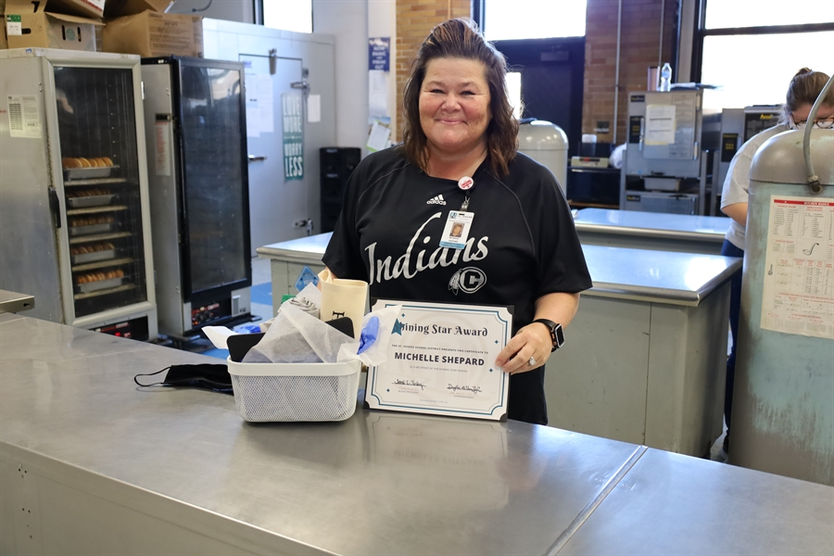
St. Joseph Shining Star
Michelle Shepard
Nutrition Services Manager
Central High School
Notes:
8

Slide 9
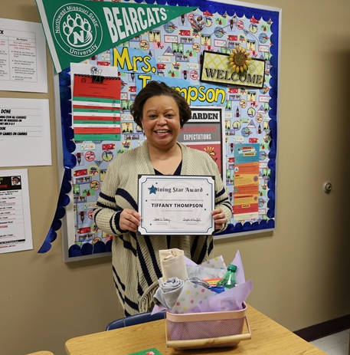
St. Joseph Shining Star
Tiffany Thompson
6th Grade Social Studies
Spring Garden
Notes:
9

Slide 10
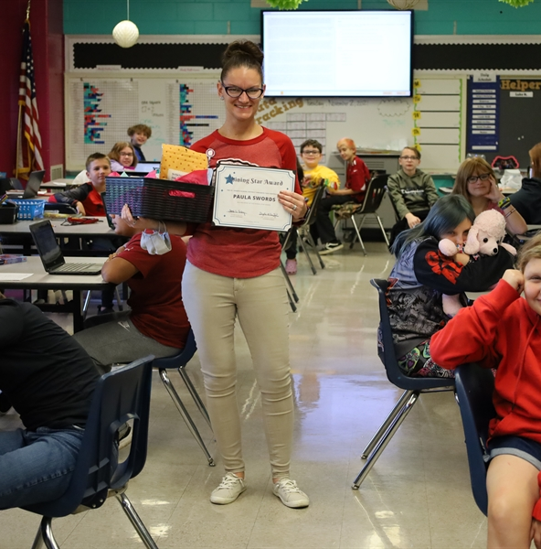
St. Joseph Shining Star
Paula Swords
6th Grade Teacher
Skaith Elementary
Notes:
10

Slide 11
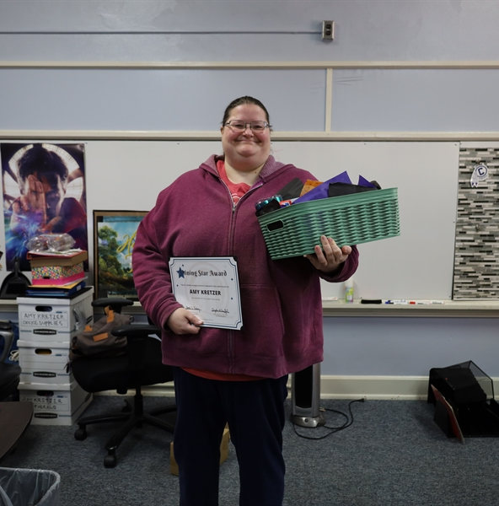
St. Joseph Shining Star
Amy Kretzer
PowerSchool Technician
TMC
Notes:
11

Slide 12
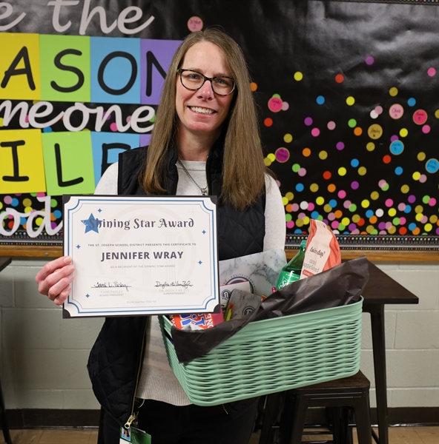
St. Joseph Shining Star
Jennifer Wray
SPED Para
Pershing Elementary
Notes:
12

Slide 13
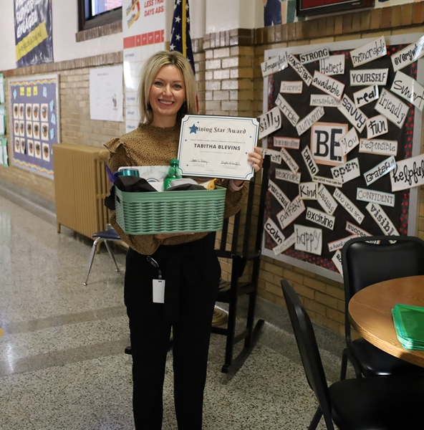
St. Joseph Shining Star
Tabitha Blevins
Principal
Edison Elementary
Notes:
13

Slide 14
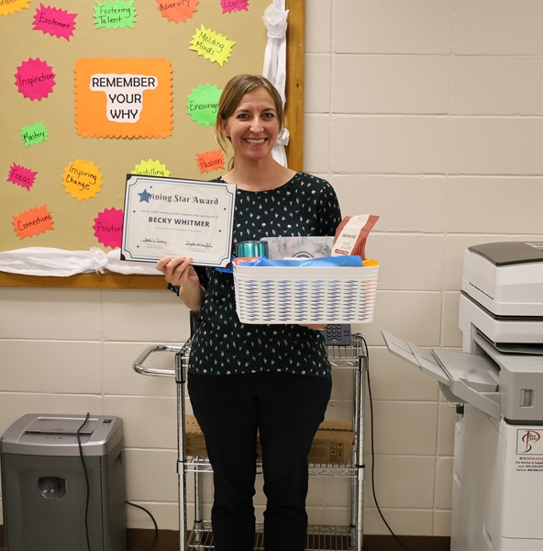
St. Joseph Shining Star
Becky Whitmer
Counselor
Hillyard Technical Center
Notes:
14

Slide 15
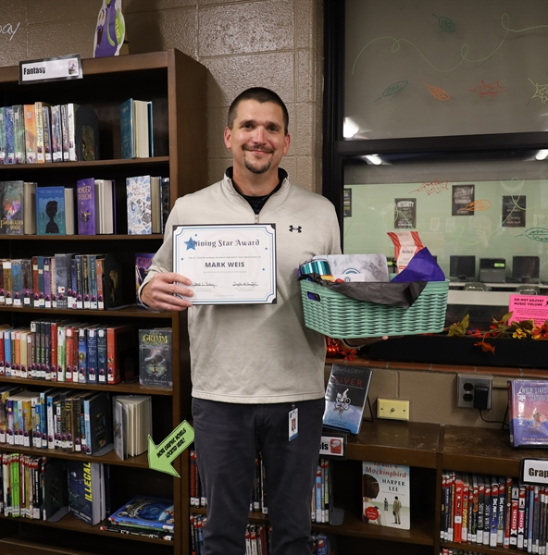
St. Joseph Shining Star
Mark Weis
Principal
Robidoux
Notes:
15

Slide 16
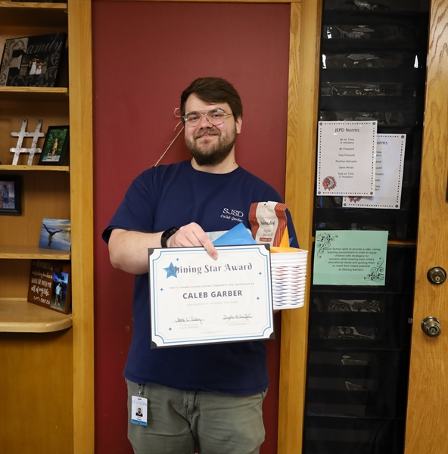
St. Joseph Shining Star
Caleb Garber
Building Computer Technician
District
Notes:
16

Slide 17
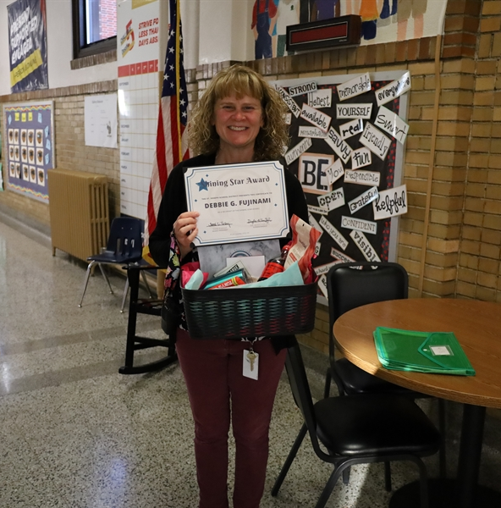
St. Joseph Shining Star
Debbie G. Fujinami
Social Worker
Edison Elementary
Notes:
17

Slide 18

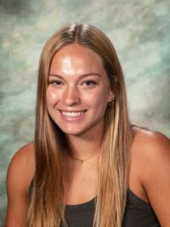
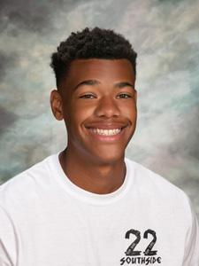
St. Joseph Scholar Athletes
Ella Moody
Central High School
Taten Piepergerdes
Benton High School
Notes:
18

Slide 19
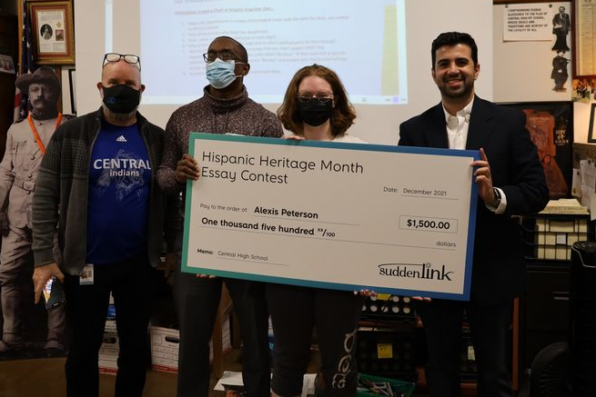
Grand Prize Winner
Congratulations
Alexis Peterson
Grand Prize Winner
Award Winning Essay Hispanic Heritage Month Essay Contest
$1,500 Scholarship
Notes:
19

Slide 20
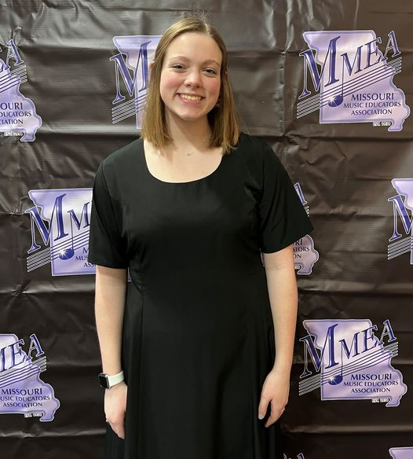
Missouri All-State Band
One of Only 100 Student Musicians Selected
Chloe Crooks
Central High School Junior
Missouri All-State Band
Missouri Music Educators Association Annual Conference
Notes:
20

Slide 21

National SkillsUSA Medalists
Silver Medalists
Kali Justice
and
Marissa Foster
SkillsUSA Emergency Medical Technician Contest
Notes:
21

Slide 22
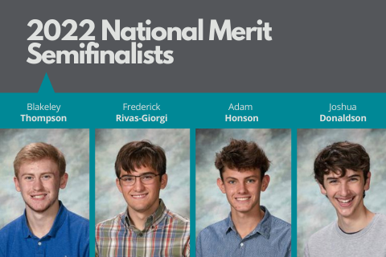
National Merit Semifinalists
Way to go!
Blakeley Thompson
Frederick Rivas-Giorgi
Adam Honson
Joshua Donaldsaon
Notes:
22

Slide 23
Missouri Seal of Biliteracy
Recognition for Proficiency to Two or More Languages!
Grace Tang
Chinese, Central High School
Frederick Rivas-Giorgi
Spanish, Central High School
Isabella Wiebelt-Smith
Spanish, Central High School
Marianna Sanchez
Spanish, Benton High School
Caden Lovelady
French, Central High School
Eli Blair
French, Central High School
Carson Haberyan
French, Central High School
Ian Patterson
French, Central High School
Nicholas Leonardo
French, Central High School
Cowles Anderson
French, Central High School
Connor McPhillips
Latin, Central High School
Notes:
23

Slide 24
Improving Student Performance
Pre-K and Elementary
Community Engagement Meeting
March 29, 2022
Notes:
24

Slide 25
Welcome
Introduce yourself to others at your table
Put on a name tag
Complete the information on the sign-in sheet
Bienvenidos. Gracias por venir esta noche. Hay una mesa designada si hablan espanol y necesitan ayuda si prefieren.
Notes:
[Selected Community Chair at podium]
Good evening and welcome to our third Vision Forward community engagement session. Over the past two months we’ve had really good participation and it’s really nice to see so many of you here tonight.
We wanted everyone to have an opportunity to share ideas with as many people as possible, so tonight we have both the in-person and the virtual sessions again. We welcome those of you who are joining us virtually via Zoom and look forward to hearing your ideas and comments. If you’re joining us virtually tonight, be sure to check your Welcome page that has links to all you’ll need tonight – including the sign in sheet, the presentation and the work activity.
My name is Bob Miller and I’m one of four co-chairs of our program.
(At this point acknowledge any dignitaries in the audience — elected officials such as mayor, city council members, legislators, president of Chamber of Commerce, school board members and others holding positions of community leadership.)
We’ve asked you to help us choose the topics you would like to learn more about as we move forward. Tonight we are going to learn more about strategies to improve our PreK and elementary learning.
25

Slide 26

QR Code to Tonight’s Presentation
Look for the QR code on the agenda on your table.
Scan the code with the camera on your phone.
This will take you to a link of tonight’s presentation.
Notes:
[Selected Community Chair at podium]
We know this is a large room and some of you sitting in the back may not have an easy view of the screen. Some of the charts have lots of information and we don’t want you to miss anything. So grab your phone, open your camera and do a quick scan of the QR code on the printed agenda at your table. This will pull up a link to the presentation so you can easily view it.
26

Slide 27
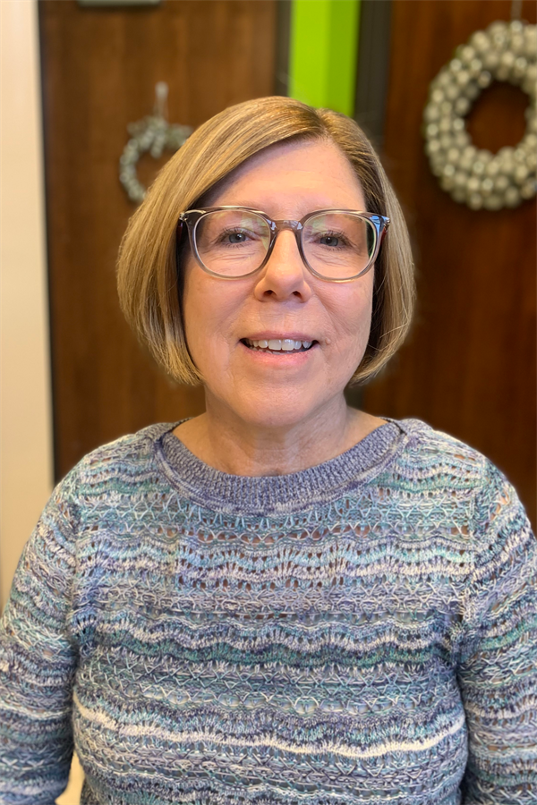
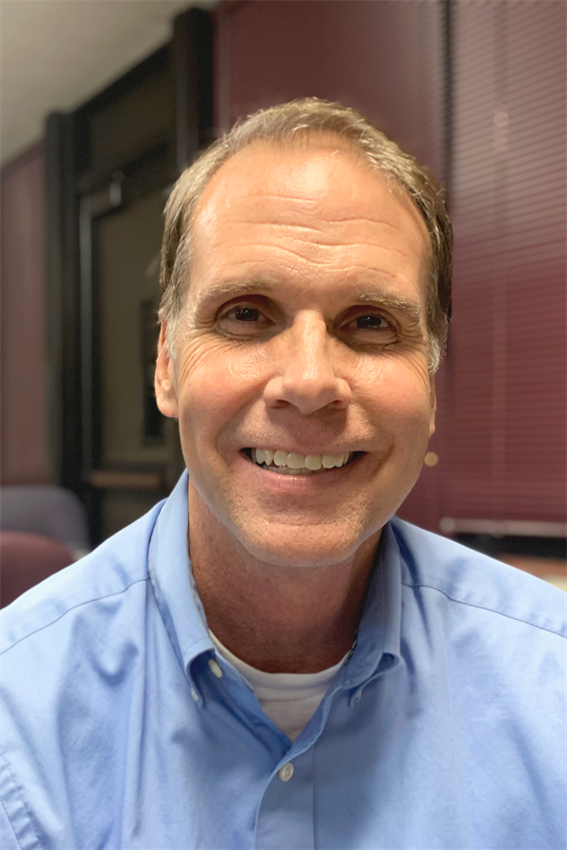
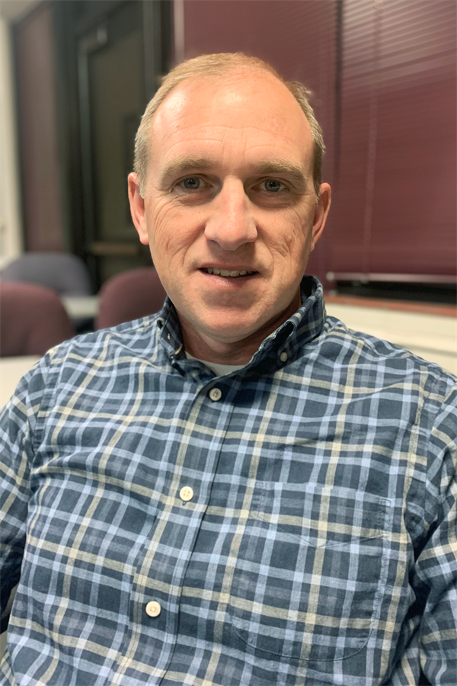
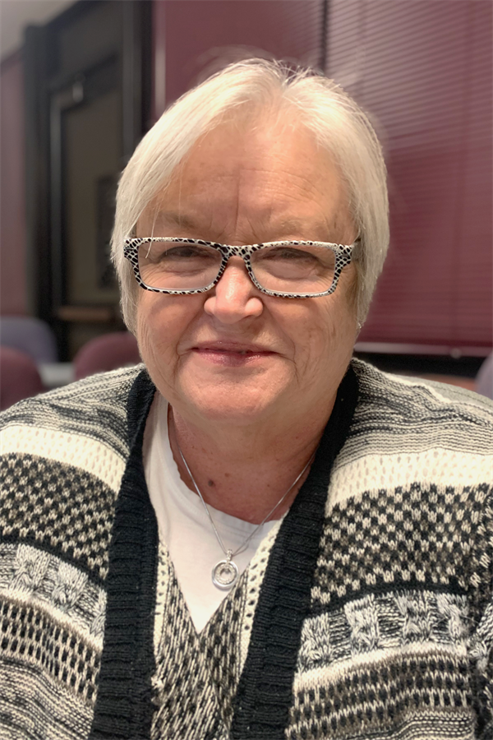
Community Engagement Team Co-Chairs
Linda Bahrke
David Hinde
Bob Miller
Teresa Simmons
Notes:
So let’s get started. It is my pleasure to introduce our other co-chairs — Linda Bahrke, Teresa Simmons and Dave Hinde.
Chair ? is going to kick-off our program —
[Selected Community Chair at podium]
27

Slide 28
Community Engagement Sessions (CES)
Notes:
28

Slide 29
Purpose
Review current and accurate information that reflects the community’s priorities related to the future operations and educational opportunities for students in the St. Joseph Public Schools.
Involve a broad-based group of citizens in dialogue and deliberation.
Recommendations made to the St. Joseph Board of Education by December 2022.
Notes:
Let’s talk about why we’re here. The goal of Vision Forward is to develop a long range Action Plan, that is created by and supported by our community that will improve the St. Joseph School District.
This group, all of us here tonight and hopefully even more residents who join in the future, has the responsibility of developing and administering Vision Forward. I want to emphasize that this program is truly a community program.
We want to thank the district for its efforts in helping us implement our program and for trusting the process. This is truly a community led and driven engagement program we believe will make a difference for our schools, our children and our community.
The Action Plan is to be developed with extensive community participation. That why we are here. So far we’ve learned more about the school district and ways to help recruit and retain staff and tonight we focus on student achievement for our young learners.
29

Slide 30
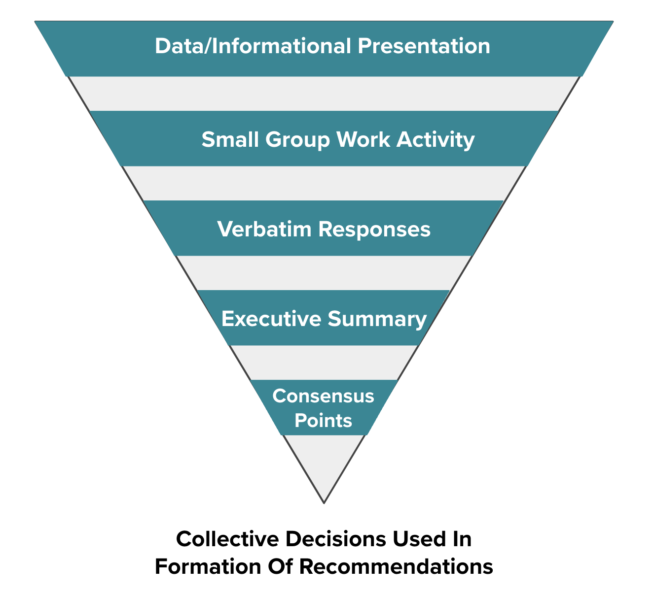
Session Documentation
Notes:
Info from previous sessions on website
We are documenting everything and making all information available on our website.
Just like with the previous sessions, tonight’s presentation will be posted on our website along with work group responses. We’ll also produce an executive summary with consensus points. Those consensus points will be the building blocks for our final Action Plan.
30

Slide 31
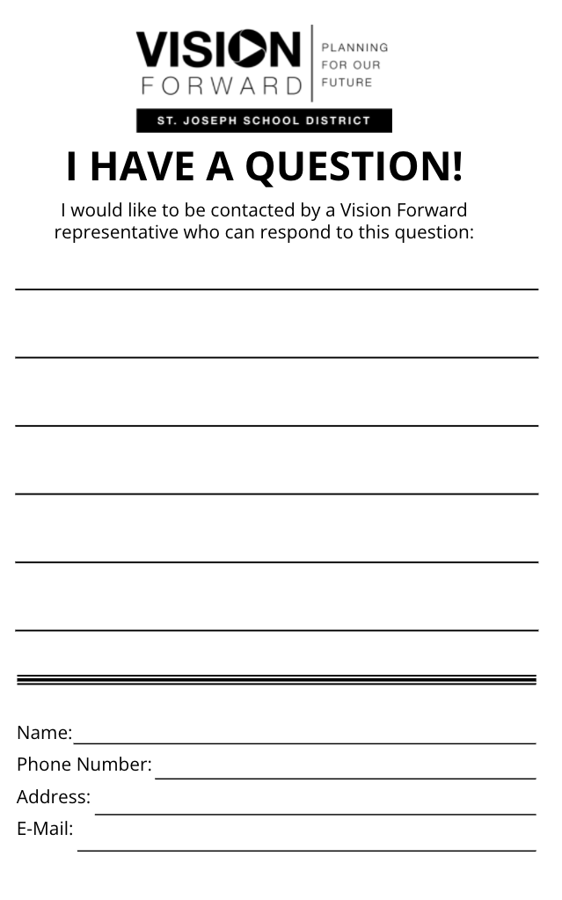
Questions/Comments
Fill out “I Have a Question/Comment” form
Email communications@sjsd.k12.mo.us
Ask Questions during Small Group Time
Notes:
A couple more things.
Our agenda is tight. As such, it’s important to not interrupt the presenter with questions so we have plenty of time to work. During the work session, the presenters and Community Engagement Team members will visit the tables to answer questions you might have. If you’re joining us virtually, you can also ask a question in the chat area and we will respond as quickly as possible.
Also, there are “I Have A Question/Comment” forms on each table. If you have a question or comment, and we are not able to respond during small group time, please fill out a form and turn it in to us at the end of the session. You can also call or send us an email.
And lastly, for those here in the room, please feel free to grab some water we have in the back of the room or visit bathrooms during our meeting.
Now, I’d like to turn it over to Bob to introduce tonight’s speakers.
31

Slide 32
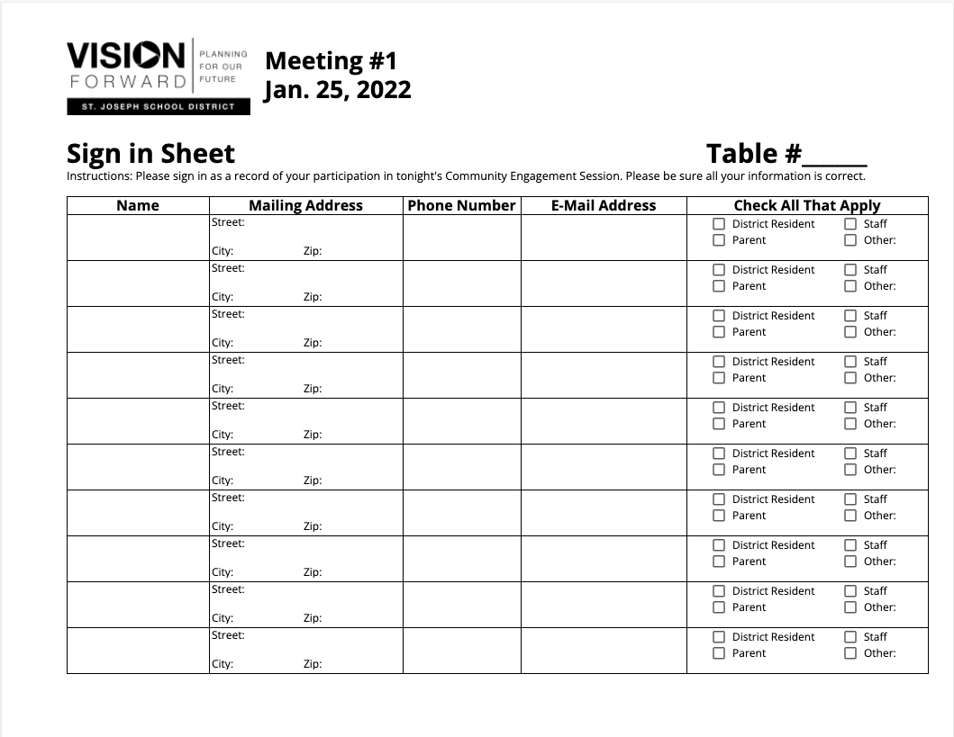
Sign-in Sheet
Notes:
Please make sure everyone at the table or online has signed in. This is our way of taking attendance and getting your contact information so we can keep you informed about our program. We’ll gather these sheets during the small group work time later in the session.
Now, I’d like to turn it over to [Selected Community Chair at podium] to introduce tonight’s speaker.
32

Slide 33
We Are Listening – We Hear You
Vision Forward Community Engagement Session #2
Top Identified Priority to Improve Recruiting and Retention of Staff
  Salaries
  Retaining and recruiting high quality employees
  Teacher support (support by administration, resources)
  Facilities
  Reputation of St. Joseph School District and community
Notes:
[Selected Community Chair at podium]
The Vision Forward program is really about listening and sharing ideas to improve our school district and our community. The input we heard from you resulted in selecting the topic for tonight’s meeting.
At our first session, after listening to the State of the District presentation by Superintendent Dr. Van Zyl, we then asked participants to list a few of the topics they wanted to learn more about.
At our second meeting, we addressed the issue of recruiting and retaining quality staff — getting good people in the school building.
Tonight we explore improving student performance. We learn more about the various factors that impact learning and ways to create an educational environment enabling students to perform better.
33

Slide 34
Vison Forward Is a Partnership
We Need You!
  Vision Forward is the result of a sincere desire to work with the St. Joseph community and our school district to improve the educational opportunities for our children.
  All of Us Working Together
  Residents, Business and Community Leaders, Parents and Educators
  A Strong Partnership That Will Make a Difference
Notes:
[Selected Community Chair at podium]
Vision Forward is the result of a real, sincere desire to work with the St. Joseph community and our school district to improve the educational opportunities for our children.
All of us working together – residents, business and community leaders, parents and educators – we are a strong partnership that will make a difference.
34

Slide 35
Improving Student Performance
PreK and Elementary
Presenters: Mrs. Dlo DuVall, Assistant Director of Special Programs and
Dr. Diane Rutledge, District Leadership Solutions
Notes:
[Bob at the podium]
Thanks Chair Name? Strategies to improve student achievement was another a high priority for the majority of the participants. First we’re going to hear from Mrs. Dlo DuVall, who is Assistant Director of Special Programs, about our youngest learners. Then, we will turn our attention to grades 1-5. Dr. Diane Rutledge, a highly successful educational leader who is with District Leadership Solutions will share proven practices that improve teaching and learning in elementary schools.
After the presentation you will have a chance to ask questions and work at your table discussing what you’ve heard.
35

Slide 36
Special Programs Overview
Dlo DuVall
Assistant Director of Special Programs

Slide 37
Special Education Services
Provide services to students ages 3-21 who qualify
Services are offered at all schools
1130 students K-12 receive special education services
  174 Early Childhood Special Education (ECSE)
Staff totals: 146 Certified Staff and 78 Non-Certified Staff
Current challenge is our staffing shortage
  17 Teacher openings and 7 Para openings for the 22-23 school year

Slide 38


Early Childhood Education
Notes:
ADD COMMENT ABOUT WHY THIS PROGRAM EXIST
RESEARCH SHOWS KIDS COME TO SCHOOL BEHIND AND THESE PROGRAMS HELP CHILDREN WHO ARE BEHIND

Slide 39
Parents As Teachers
Frequently Asked Questions
                How many Parent Educators are there?
                8 Full-Time Parent Educators
                1 Part-Time Parent Educator
Who qualifies (or what qualifies a family) for home visitation?
  Any family within the SJSD who has a child(ren) aged prenatal-Kindergarten entry
What is the frequency of home visitation?
  Either once or twice monthly

Slide 40
Parents As Teachers
What is the overarching goal for families receiving home visitation?
  School readiness, connection to other families with young children, accessibility to community resources, reduce child abuse and neglect.
How many are enrolled and being served currently?
  393 families, 607 children
What other things does Parents as Teachers offer?
  Annual health and developmental screenings for all participating children, connection to community resources, twice monthly play groups, infant massage, group connections, Early Childhood screening events, and we help families set and work toward goals that are important to them.

Slide 41
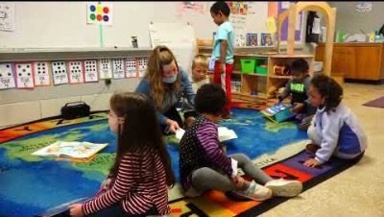
SJSD
Early Learning Center Preschool
New Location!

Slide 42
The Preschool Boost
Recent studies estimate that public schools
save $3 to $7 dollars for every $1 spent
on preschool
Long-term social benefits of preschool
transcend academic benefits
Quality Preschool benefits students with identified
needs as well as typically developing children
Yoshikawa, H., Weiland, C., Brooks-Gunn, J., Burchinal, M., Espinosa, L., Gormley, W., . . . Zaslow, M. (October 2013). Education and outreach: Investing in our future. Society for Research in Child Development. doi:10.22541/au.158456657.76257442

Slide 43
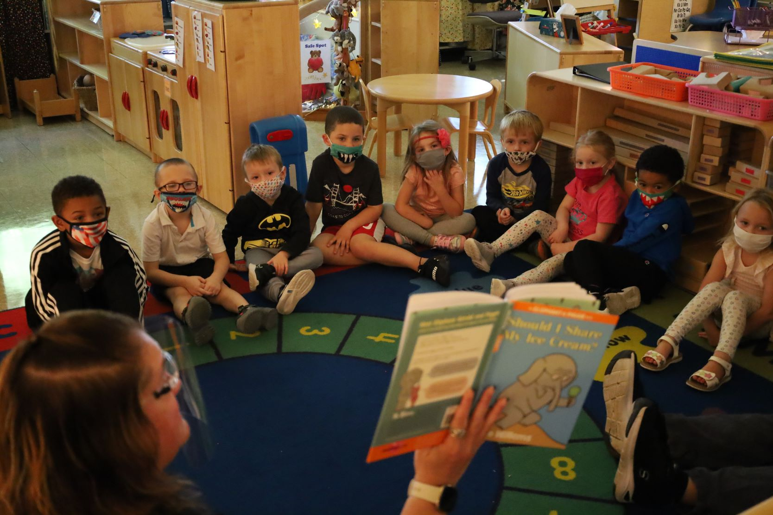
Early Learning Center Enrollment
Enrollment as of 3/11/22 is 390 students. 174 of those students have an Individual Education Plan and receive Special Education services.
Title funded spots and ECSE (Early Childhood Special Education) spots are available for those who qualify.
  5 Title Classrooms
  10 Integrated (ECSE and Peer) Classrooms
  4 Low-Incidence ECSE Classrooms
ELC capacity based on best practice ratios is 452:
  Title 18:1, ECSE Integrated 12:1, and ECSE Low Incidence 4:1
ELC Staffing
  1 Coordinator, 1 Admin. Assistant, 1 Nurse, 2 Social Workers, 2 Process Consultants, 2 SLPs, 1 SLP-A, 1 Occupational Therapist, 1 Physical Therapist,
  26.5 Paraprofessionals and 17 teachers
Notes:
Does this mean you have room for 62 more students?

Slide 44
Preschool Acceptance Criteria
    Health Screening provided by the school district
      (including vision, hearing and a dental screening)
    Developmental Screening
      (including motor, language, thinking skills, and social emotional)
    Title funded and monitored placements are offered to those students with the greatest need first
    Evaluation of Special Education services throughout the entire
    school year
    Any remaining Title and Peer spots are offered to families who participated in the screening
Notes:
All students must participate in the Health and Developmental Screening provided by the school district.
We offer Title funded and monitored positions to those students with the greatest need according to the Parent report, the health, and the developmental screening.
We also evaluate students for Special Education services throughout the entire school year. All students ages 3-5 that have an IEP are serviced through our Early Learning Center.
Any remaining title and peer spots are offered to families that have participated in the screening. However, busing is offered between AM and PM depending on where a family lives in town. We are never “full” for students that have qualified for Special Education services. We always need to leave space to service a student ages 3-5 with an IEP.

Slide 45

Community Partnerships

Slide 46

ESL- English as a Second Language
839 K-12 Students are receiving ESL services. We have had 50 Newcomers move into our district this school year. 13 of those students are designated as SLIFE. Students exit our program when they earn a 4.7 on the ACCESS test which is administered once a year or through a portfolio exit.
Notes:
IN THE PREK PROGAM – DOES THIS HELP STUDENTS PREPARE FOR ELEMENTARY? WHY IS ELS TALKED ABOUT HERE? HELP CONNECT THE DOTS – WHY IS THIS IMPORTANT TO PREK? NOT SEEING HOW THIS FITS IN PREK PROGRAM.

Slide 47
ESL Staffing and Services
We offer ESL services at all schools K-12
We have 32 full time staff members and 1 part-time staff member
  2 ESL Family Advocates
  1 Part-Time ESL Interpreter/Translator (Spanish)
  24 ESL Teachers
  1 ESL Assessment Specialist
  1 ESL Instructional Specialist

Slide 48
Home School Partnerships
Parents are a child’s first teacher, and the home is a child’s first classroom. As key resources for learning and growth, parents help to shape a child’s social, emotional and physical development so that he/she can thrive in school and beyond.
Supporting student success starts with a shared agreement among families, schools and the community to work together and it involves committed actions to make it happen.
“How to Support Student Learning at Home.” CAPTA Toolkit, http://toolkit.capta.org/programs/family-engagement/how-to-support-student-learning-at-home/.

Slide 49
Expanded Program Will Help Students
    Expanded program offers additional placements to children
    A longer day with before and after school childcare.
    More openings would allow additional “peer” spots which would change the qualification matrix.
Notes:
How would the district like to see the programs grow or improve? Or what initiatives would we like to see in SJSD?
We would like to see our Early Childhood program offerings expand to be able to offer additional placements to children in our district. Which could include a longer day and before and after school childcare. By being able to offer more “spots” we could offer additional “peer” spots which would change our qualification matrix.
Our ELL program is constantly growing and by offering a Center School Model at the secondary level, we could meet those students needs better by offering more classes specifically for newcomers and/or students with limited or interrupted education.

Slide 50
What Would Benefit Our Students Most
    More Special Education and ESOL Teachers and Paraprofessionals
    A Chuukese speaking translator/interpreter/family advocate.
    More time with SPED and ESOL staff for professional development and planning/collaboration.
    Additional Sites to Expand Program for More Children
Notes:
A large Early Learning Center in the middle of town or second site on the North side of town to be able to expand our program to meet the needs of more children in our community.

Slide 51
What Matters Most
Several factors have a positive impact on PreK education. These include:
Significant enrollment of community’s youngest learners
Community Partnerships
Fully staffed teachers and support personnel
Home School Partnerships

Slide 52
Improving Student Performance
Grades PreK-5
Dr. Diane Rutledge
District Leadership Solutions

Slide 53
PreK – Grade 5
What’s Possible?

Slide 54
Characteristics of Improved School Districts

Slide 55
Successful Strategies That Impact Achievement
Research identifies key factors that impact a school district’s ability to improve student achievement. These factors include:
Districts are fully staffed with high quality teachers and principals
High level of additional support services available for students
  Coaches for teachers and principals, interventionists, reading and math specialists
Schools function at optimal capacity
School buildings accommodate all educational programs
21st Century Learning; Challenging Curriculum
Family Engagement

Slide 56
Teachers, Principals and Staff

Slide 57
Highly Effective Staff
Teachers and Principals Are Keys to Improvement
The number one most impactful strategy for school improvement for those factors we can control for inside the school building is the quality of the teacher.
The second most impactful strategy is highly effective school leaders.
Wallace Foundation

Slide 58
Highly Qualified Teachers
Recruitment & Development
Develop teachers from within
Partner with teacher preparation programs
Provide opportunities for paraprofessionals
Remove barriers
Professional Development
Supports by mentors and coaches
Highly Qualified Principals
Working Conditions

Slide 59
Highly Qualified Principals
No successful school without successful principal
Create the conditions for success
Attract and develop effective teachers
Impact entire school; not just classroom
Engage in instructional focus
Build productive culture and environment
Facilitate collaboration
Manage personnel and resources
Promote equity

Slide 60
Develop Principals
Identify early and provide opportunities
Partner with principal preparation programs / application opportunities during coursework
Offer year-long residencies
Mentors and Coaches
Effective leadership is stable and sustains improvement strategies long enough to become institutionalized.

Slide 61
Principal Role in School Improvement
Effective use of Time focused on School Improvement
Effective use of Leadership Framework i.e. those factors that principals have control, including use of Instructional Leadership Team
Aligned School Improvement Strategy that identifies both student learning problems and instructional problems of practice
Supported by ongoing professional development and coaching

Slide 62
Support Personnel Available
Intervention Supports Needed
  Academic and behavioral
  Reading and Math specialists
Specialized programming
  Gifted
  Special Education
  ESOL
  504
  Trauma informed (NME)
Notes:
Instructional design: small groups
DISTRICT DATA NEEDED
What is an interventionist?
Number of Interventionist in SJSD
How many are needed

Slide 63
Schools for Learning

Slide 64
Facilities Role in School Improvement
1. Impact on both teacher and student outcomes
Teachers: recruitment, retention, commitment & effort
Students: health, behavior, engagement, & achievement
2. Aging school buildings tend to lack 21st century physical spaces, technology, laboratories, and safety features
Center for the Evaluation and Education Policy Analysis/Penn State University

Slide 65
School Facilities Facets
Acoustics and Noise
Air Quality
Lighting
Temperature Control
Classroom Size and Space
Twenty-First Century Learning
Equitable Opportunities
Security and Safety
Notes:
These aspects impact student achievement and many of these items are currently being addressed. More in-depth conversation in another presentation in the future.

Slide 66
Curriculum
State Standards • Challenging Curriculum • Quality Lesson Planning

Slide 67
Curriculum
People are the #1 important strategy for school improvement, but content is also important.
Alignment of curriculum AND assessment to state standards is required.
Resources (time, money, and expertise) for professional development, teacher collaboration, and monitoring are a part of the curriculum conversation.
Regular review process of curriculum.

Slide 68
Curriculum in Classrooms
The issue is not the curriculum, but more about how teachers and principals implement the curriculum.
SJSD coordinates with the state mandated assessment program in all its classrooms.
This is a requirement of all Missouri schools and can not be changed. Schools can control the effectiveness of the instruction.
Notes:
refer to handouts on tables with quick comment about curriculum that is in place
SJSD USES ITEMS CURRENTLY REQUIRED OR IN PLACE NOW; MEETING STATE STANDARDS, AND CHALLENGING CURRICULUM IN PLACE NOW

Slide 69
Families and District
Working Together

Slide 70
Family Engagement and Impact on Learning
Students are more likely to graduate
Students earn higher grades
Students improve their attendance
Students go to college or trade skill training
Notes:
When families are stakeholders in students' education, there's a positive impact on student success. When families get involved and engaged in their child's education, students are more likely to graduate, earn higher grades, improve their attendance, and go to college or trade school training.

Slide 71
Family Engagement Role in School Improvement
Partner with the School
  Verbalize and Demonstrate Relationship
Ensure to best of ability, sleep and nutrition
Ask about school and provide space and time for home study
Read to elementary children at least 15 minutes daily

Slide 72
Partners in Students’ Success
Working Together for Academic Success
Parents and School Staff Are Equal Partners
All parents have dreams for their children and want the best for them
All parents have the capacity to support their children’s learning
Responsibility for building partnerships between school and home rests primarily with school staff, especially school leaders
'Beyond the Bake Sale' by Anne T. Henderson, Karen L. Mapp, Vivian R. Johnson

Slide 73
Family Support Is Important
“No matter their income or background, students with involved parents are more likely to have higher grades and test scores, attend school regularly, have better social skills, show improved behavior and adapt well to school.”
National Coalition for Parent Involvement in Education Nov 18, 2019
When parents are involved at school, the performance of all the children at school, not just their own, tends to improve. The more comprehensive and well planned the partnership between school and home, the higher the student achievement.
Henderson, A.T., and Nancy Berla. 1995. A New Generation of Evidence: The Family Is Critical to Student Achievement. Washington, DC: Center for Law and Education, 14–16.

Slide 74
School Improvement – Two Way Street
Improvement is Possible
Key Factors
That Result in
Quality Classroom
Instruction &
Increased Student Achievement
High expectations and accountability for adults – Adult Data
Coordinated and aligned curriculum and assessment – Student Data
Effective use of meaningful data (infrastructure, training, time, and application of data to instruction)
Coordinated and embedded professional development
Shannon & Bylsma

Slide 75
The District’s Role in School Improvement
High Expectations, Belief System, Shared Vision, Monitoring Performance
Instruction-focused / Monitoring curriculum, instructional practice, and both student and adult data
Alignment of District and School Goals based on Data
Target Professional Development based on Data – embed through the use of instructional coaches

Slide 76
District’s Role continued
Develop and utilize school-based Instructional Leadership Teams in order to distribute leadership
Adopt a continuous school improvement model
Stay the Course
Strategically allocate resources based on data and needs
Identify District Leadership roles to support school efforts
Partner with Parents, Business, and Community
Notes:
Add comment that most of these key items do not cost a lot of money – but successful implementation of key factors know to impact achievement

Slide 77
Academic Success is Possible
Improved Student Achievement is Complex
Focus cannot only be on students
Families, Teachers, Principals, Support Staff, Central Office, Facilities, and Community all play a role
Data
Strategic Resources – time, people, dollars, facilities
Communication and Relationships
Values, Long-term Commitment

Slide 78
Closing
With Your Help,
St. Joseph Students Can Have a Brighter Future
The most valuable asset a community
has is its public school system.
Communities embrace, support, and communicate the value of their system.
No reason it cannot happen for St. Joseph! Already part way there
by embracing this process.

Slide 79
Small Group
Work Activity
Notes:
[Teresa at podium]
Let’s give a round of applause to Dr. Rutledge for an excellent presentation. Thank you Dr. Rutledge.
Now let’s get to work!
On your table, on INSERT COLOR OF PAPER HERE paper, is tonight’s work activity. This is the official sheet for your recorder to use.
(Hold up a copy of the work activity)
And if you’re here virtually, please check your Welcome Sheet for the link to the work activity.
Let’s go through the instructions to make sure everyone understands the tasks.
79

Slide 80

Small Group Work Activity
Select a Recorder and Spokesperson
Recorder Responsibilities
  Complete the information on the group’s worksheet
Spokesperson Responsibilities
  Facilitate Discussion
  Keep Group Focused/On Task
  Report Group’s Information
Notes:
[Teresa at podium]
At each table, you will select a recorder and spokesperson.
The recorder is responsible for completing the worksheet. Make sure to complete the information in the box in the upper left corner.
The spokesperson should facilitate discussions, keep the group focused so the work is completed on time, and then report table results.
80

Slide 81
Small Group Worksheet
Information on worksheet should reflect consensus/general agreement of group members.
Monitor progress to complete the worksheet in allotted time.
Only group recorder’s worksheet will be collected.
Notes:
Please make sure the information recorded on the group’s worksheet reflects general agreement of everyone at the table, not just the opinion of one or two individuals.
Monitor the time to make sure you get done on time. We’ll start the reporting out at (name a time).
At the end of the session we will only collect the worksheet that has been completed by the recorder.
81

Slide 82
Small Group Discussion Norms
Turn off/silence electronic devices/phones
Give everyone an opportunity to speak
Be positive; focus on being productive
Focus on the collective good, not just individual
Respect the opinions of fellow group members
Stay engaged with the conversation
Notes:
As you begin your group discussion tonight we ask that you please keep these points in mind as you work toward consensus on the activities.
(Read points)
82

Slide 83
Small Group Work Tasks
Task #1
If you were sharing information with a friend, what are two positive things about the St. Joseph School District, its students or staff you could share?
Task #2
What are 3 priorities to be addressed in the area of improving PreK and Elementary academic achievement?
Prioritize your top 3 priorities from 1 to 3 - 1 being the highest and 3 being the lowest.
What recommendations does your group have to address these priorities in the next 5 years?
Notes:
We are asking each group to complete two activities.
(Read Tasks)
Take a minute or two to review the tasks and then let’s get work. If you have questions about the work activities, just ask one of the Community Team Members who are walking around the room or send us note in the chat if in a virtual breakout room.
And please, we really need your help on this activity. Please pay special attention to Task #2 – it is very important for your group to rank your top 3 priorities and then offer any recommendations about each one. When you list them 1 through 3, it helps us identify the top priorities moving forward for the Action Plan. Remember 1 is the highest and 3 is the lowest.
If you’re joining us virtually tonight, we’re sending you to special breakout rooms where you will complete the group same activity and then rejoin the in-person group to share your ideas.
83

Slide 84
Small Group Work Activity Reporting
Notes:
Now it is time to hear from the tables and from the virtual groups. [Selected Community Chairs] will bring a microphone around to and try to get to as many groups as possible.
Please be brief so we can hear from as many tables as possible. We’ll collect the worksheet at the end of tonight’s session and document everything on our website.
From each table, let’s hear one of the favorite positive things about our district, students or staff that you can share with a friend. Then tell us your top 3 priorities for improving PreK and Elementary academic achievement.
Okay, let’s get started!
(Community chairpersons will take microphone from table to table for each group’s spokesperson to report. Be sure to collect the worksheet from the spokesperson as he/she finishes reporting.)
84

Slide 85
Upcoming Community Engagement Sessions
Session 4
Improving Student Performance – High School
Tuesday, April 26, 2022 Lafayette High School
Session 5
Facilities for Learning
Tuesday, May 17, 2022 Benton High School
Notes:
[Selected Community Chair at podium]
Thanks for your hard work. I hope you enjoyed this meeting — it sounds like there were great discussions at the tables.
We want as many people as possible attending these sessions. So please help us to spread the word! And we hope to see each and every one of you at our next meeting. Let me see a show of hands – how many of you can we count on attending our next meeting?
Don’t worry about picking up anything. And make sure and leave any Question/Comment forms on your table.
Thanks for coming — see you in April!
85

Slide 86
THANK YOU FOR YOUR PARTICIPATION!
Community Engagement Meeting
March 29, 2022
Notes:
86

Slide 87
Notes:
87

