Slide 2
Improving Student Performance
Secondary Level
Community Engagement Meeting
April 26, 2022
Notes:
2

Slide 3
Welcome
Introduce yourself to others at your table
Put on a name tag
Complete the information on the sign-in sheet
Bienvenidos. Gracias por venir esta noche. Hay una mesa designada si hablan espanol y necesitan ayuda si prefieren.
Notes:
[Selected Community Chair at podium]
Good evening and welcome to tonight’s Vision Forward community engagement session. Last month we learned more about improving student achievement for our youngest learners in Pre-Kindergarten and in elementary school. Tonight we look at our middle and high schools.
Thank you for joining us tonight. Over the past few months we’ve had really good participation and it’s really nice to see so many of you here tonight.
We wanted everyone to have an opportunity to share ideas with as many people as possible, so tonight we have both the in-person and the virtual sessions again. We welcome those of you who are joining us virtually via Zoom and look forward to hearing your ideas and comments. If you’re joining us virtually tonight, be sure to check your Welcome page that has links to all you’ll need tonight – including the sign in sheet, the presentation and the work activity.
My name is Bob Miller and I’m one of four co-chairs of our program.
3

Slide 4
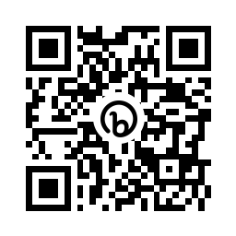
QR Code to Tonight’s Presentation
Look for the QR code on the agenda on your table.
Scan the code with the camera on your phone.
This will take you to a link of tonight’s presentation.
Notes:
[Selected Community Chair at podium]
We want everyone to be able to see the information on our screen, but some of you may not have an easy view of the screen. We don’t want you to miss anything so if you don’t have a clear view please grab your phone, open your camera and do a quick scan of the QR code on the printed agenda at your table. This will pull up a link to the presentation so you can easily view it.
4

Slide 5
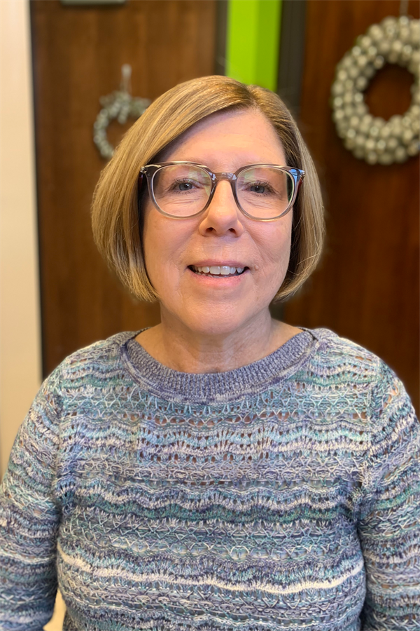
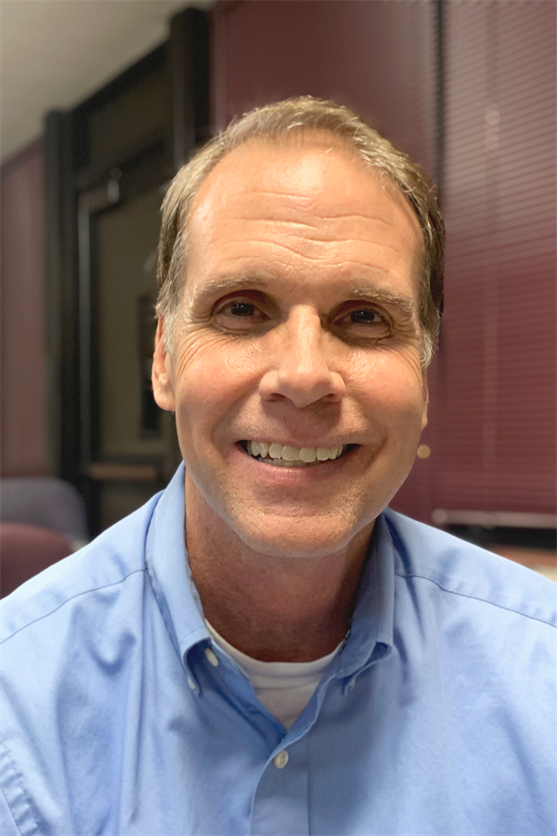
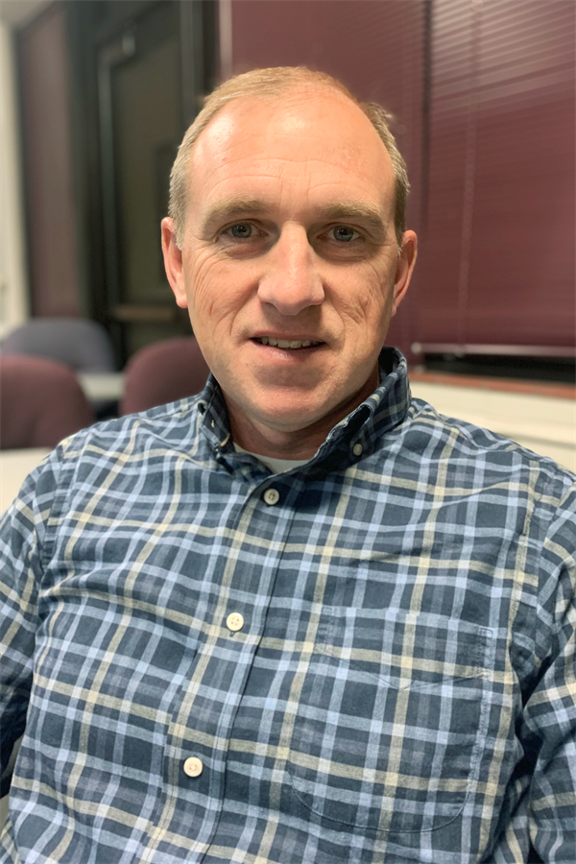
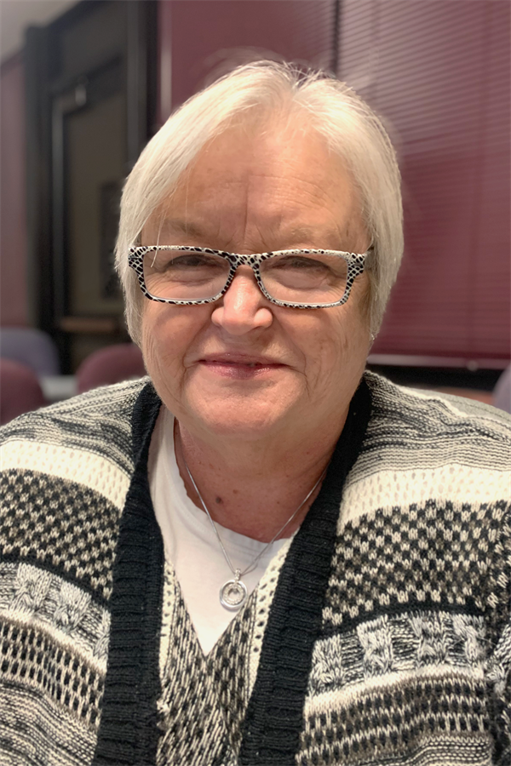
Community Engagement Team Co-Chairs
Linda Bahrke
David Hinde
Bob Miller
Teresa Simmons
Notes:
So let’s get started. It is my pleasure to introduce our other co-chairs — Linda Bahrke, Teresa Simmons and Dave Hinde.
Chair ? is going to kick-off our program —
[Selected Community Chair at podium]
5

Slide 6
Community Engagement Sessions (CES)
Notes:
6

Slide 7
Vison Forward Is a Partnership
We Need You!
  Vision Forward is the result of a sincere desire to improve the educational opportunities for our children. We review information that reflects the community’s priorities to improve SJSD and will present recommendations to the St. Joseph Board of Education by December 2022.
  All of Us Working Together
  Residents, Business and Community Leaders, Parents and Educators
  A Strong Partnership That Will Make a Difference
Notes:
[Selected Community Chair at podium]
The Vision Forward program is really about listening and sharing ideas to improve our school district and our community. The input we heard from you resulted in selecting the topic for tonight’s meeting.
At our first session, we heard about the State of the District and then asked participants to list a few of the topics they wanted to learn more about.
Your suggestions identified the next presentations. At our second meeting, we addressed the issue of recruiting and retaining quality staff — getting good people in the school building.
Last month we explored improving student performance at the PreK-Grade 5 levels. Tonight we’ll learn more about the various factors that impact learning at the secondary level.
Vision Forward is the result of a real, sincere desire to work with the St. Joseph community and our school district to improve the educational opportunities for our children.
All of us working together – residents, business and community leaders, parents and educators – we are a strong partnership that will make a difference.
7

Slide 8
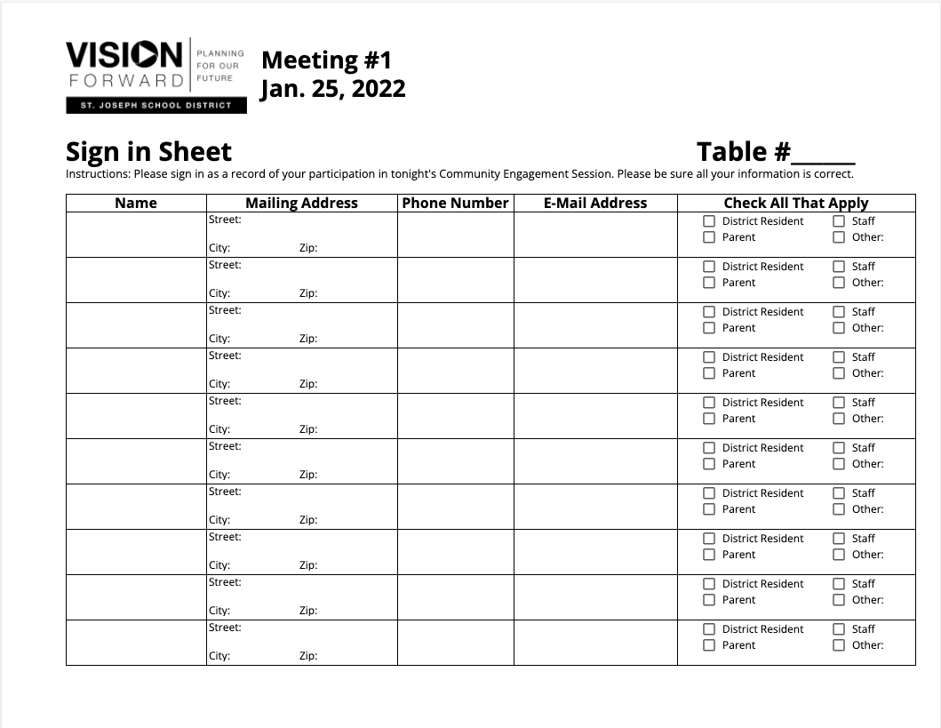
Sign-in Sheet
Notes:
So, a couple more things before we get started tonight.
Please make sure everyone at the table or online has signed in. This is our way of taking attendance and getting your contact information so we can keep you informed about our program. We’ll gather these sheets during the small group work time later in the session.
8

Slide 9
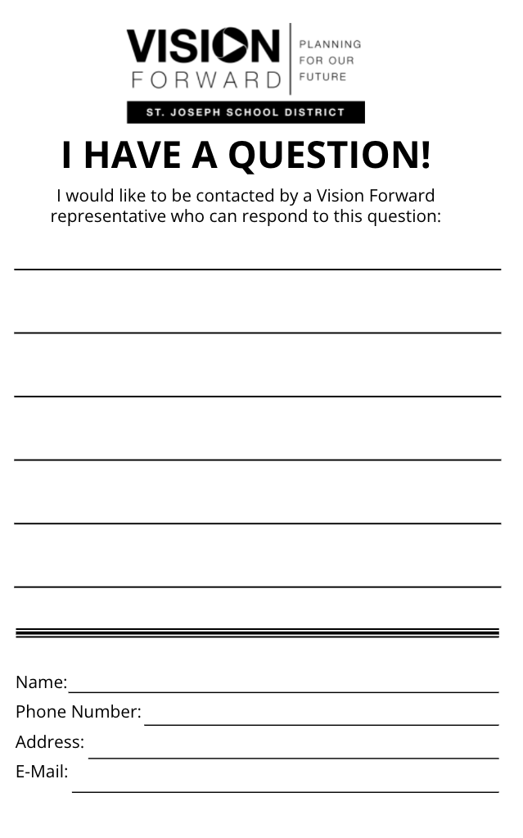
Questions/Comments
Fill out “I Have a Question/Comment” form
Email communications@sjsd.k12.mo.us
Ask Questions during Small Group Time
Notes:
And just a couple more things -
Our agenda is tight. As such, it’s important to not interrupt the presenter with questions so we have plenty of time to work. During the work session, the presenters and Community Engagement Team members will visit the tables to answer questions you might have. If you’re joining us virtually, you can also ask a question in the chat area and we will respond as quickly as possible.
Also, there are “I Have A Question/Comment” forms on each table. If you have a question or comment, and we are not able to respond during small group time, please fill out a form and turn it in to us at the end of the session. You can also call or send us an email.
And lastly, for those here in the room, please feel free to grab some water we have in the back of the room or visit bathrooms during our meeting.
Now, I’d like to turn it over to [Selected Community Chair at podium] to introduce tonight’s speaker.
9

Slide 10
Improving Student Performance
Secondary Level –High School & Middle School
Presenter: Dr. Ashly McGinnis, Principal, Lafayette High School and
Notes:
[Bob at the podium]
Thanks Chair Name?
Strategies to improve student achievement was another a high priority for the majority of the participants. First we’re going to hear from Dr. Ashly McGinnis, who is the principal at Lafayette High School who will provide an overview of our secondary schools.
After the presentation you will have a chance to ask questions and work at your table discussing what you’ve heard.
10

Slide 11
Secondary Education
Dr. Ashly McGinnis, Principal
Lafayette High School

Slide 12
Our Secondary Schools
Middle Schools:
  Bode (7, 8)
  Robidoux (6, 7, 8)
  Spring Garden (6, 7, 8)
  Truman (7, 8)
High Schools: Benton, Central, Lafayette (open enrollment as a freshman)
Alternative School: Webster
Technical School: Hillyard
Virtual Academy
*Title I Secondary Schools – Lafayette, Robidoux, Truman
  Family Involvement Coordinator, Behavior Interventionist, Teacher Interventionists (ELA or math), tutoring funds, para support

Slide 13
Middle Level Feeder Pattern
Bode Middle School – Ellison, Coleman, Field, Oak Grove, Edison
Robidoux Middle School – Lindbergh (K-5), Pershing, Carden Park
Spring Garden Middle School – Hosea (K-5), Hyde (K-5), Carden Park
Truman Middle School – Skaith, Pickett, Parkway, Mark Twain, Carden Park
*All elementary schools are K-6 unless noted otherwise.
7th grade = 259 | 8th grade = 258
6th grade = 78 | 7th grade = 139 | 8th grade = 178
6th grade = 157 | 7th grade = 160 | 8th grade = 169
7th grade = 242 | 8th grade = 215
Notes:
*Challenges:
Robidoux - Transitioning partial grade level cohorts from their feeder schools. (Pershing 6th grade to RMS 7th, Lindbergh 5th to RMS 6th)
*Carden Park – Majority attend Truman, but typically 8 to 10 live in the SGMS boundaries and will enroll for 7th grade.
*SGMS – Pocket of Hyde 6th grade live in Truman’s attendance area. Could require student to attend Hyde K-5 SGMS 6, Truman 7/8 and then open enrollment.

Slide 14
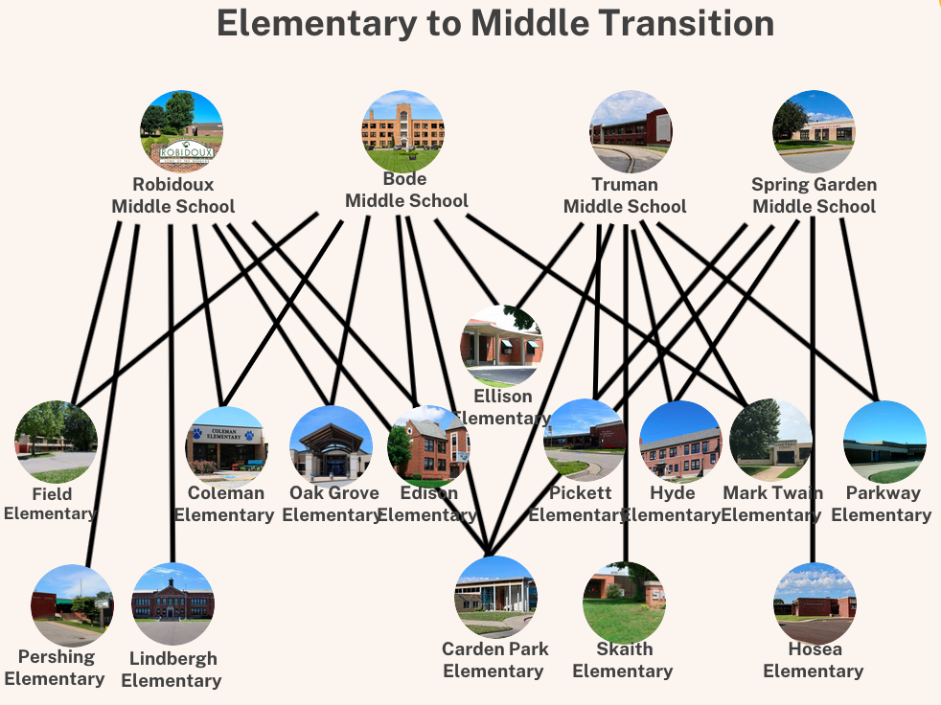
Notes:
Infographic from Bethany Clark, Director of Elementary Education
Pershing, Lindbergh, Skaith, and Hosea are the only elementary schools that send all their students to one middle school as a cohort.
Hyde is a K-5 building that transitions students to Spring Garden, but also Truman (a 7-8 building). There are a few 6th graders that transfer to a different elementary for 6th grade then transfer again for 7th grade to Truman, or they can request a transfer to Spring Garden. If they are granted a transfer, they do not have any district transportation.

Slide 15
Middle School vs. Junior High
Grade Configuration 6-8
More exploratory/elective opportunities
Flexible Scheduling - Interdisciplinary Curriculum
Student – Focused
Classrooms arranged by grade level teams
Grade Configuration 7-9
Core content with fewer electives
Traditional 6, 7, or 8 period day
Content - Oriented
Classrooms arranged by content
Notes:
*6th grade @ SGMS and RMS - Spanish, computer applications, PLTW, Digital Publications – in addition to art, music, PE, orchestra, band

Slide 16
SJSD Middle Level Structures
Bode Middle School
organized by grade level / common department plan time
Robidoux Middle School
  organized by grade level / common department plan time
Truman Middle School
  organized by team / common team plan time
Spring Garden Middle School
  organized by department / common department plan time
Notes:
*Truman moving to like department plan time for 22-23.

Slide 17
NASSP Breaking Ranks
At the Middle Level….
At no other time in the life cycle are the changes of finding one’s self and losing one’s self so closely aligned.
~Erik Erikson
NASSP - National Association of Secondary School Principals
Notes:
Middle school is a critical time for our students.

Slide 18
School Capacity Breakdown
School | Max Capacity | Optimum Capacity | Current Enrollment | Current Enrollment as a Percentage of Optimum Capacity
Benton | 999 | 884 | 596 | 67%
Central | 1937 | 1732 | 1553 | 90%
Lafayette | 1611 | 1380 | 640 | 46%
Bode | 510 | 460 | 523 | 114%
Robidoux | 540 | 500 | 396 | 79%
Spring Garden | 556 | 496 | 486 | 98%
Truman | 515 | 484 | 459 | 95%

Slide 19
Webster
Grades 6-8 students are enrolled in the following programs:
  Public Day School (IEP) – 3 students
  Long-Term Placement (Suspension) – 14 students
  Buchanan County Academy (BCA) – 3 students
  Juvenile Detention (at BCA) – 2 students
High school students are enrolled in the following programs:
  Mo Options – 105 students enrolled
  ASPIRE (credit deficient sophomores and juniors) – 100 students
  Public Day School (IEP) – 10 students
  Long-Term Placement (Suspension) – 27 students
  Buchanan County Academy – 11 students
  Juvenile Detention (at BCA) – 1
  Academic Reassignment (numbers vary)

Slide 20
Hillyard Technical Center
Current Enrollment = 427 in 2-year programs. Agriculture has 30 students who attend one class a day.
17 sending schools outside SJSD:
Cameron = 16 students | North Platte = 16 students
DeKalb = 7 students | Osborn = 3 students
East Buchanan = 19 students | Plattsburg = 24 students
Home School = 5 students | Savannah = 31 students
King City = 13 students | St. Joe Christian = 4 students
LeBlond = 9 students | South Holt = 13 students
Maysville = 20 students | Stewartsville = 6 students
Mid Buchanan = 21 students | Union Star = 5 students
North Andrew = 11 student | TOTAL = 223 students
Benton = 59 students
Central = 88 students
Lafayette = 51 students
Webster = 6 students
TOTAL = 204 students

Slide 21
Hillyard Technical Center
Most popular programs – Health Services Assistant and Welding Technology
For 22-23, students strongly requested – Automotive, Carpentry, Collision Repair and Refinish, Computer Science, Electronics, and HVAC (in addition to Health Service and Welding).
Additional Programs
Career Pathways to Teaching | Emergency Medical Tech
Plant Science | Computer Aid Drafting
Animal Sciences | Industrial Equipment and Repair
Veterinary Science | Precision Machine Technology

Slide 22
Virtual Academy
 | Total Enrollment | Full-Time Virtual | Percentage of Total Enrollment | Blended Virtual | Percentage of Total Enrollment
Benton | 596 | 38 | 6% | 46 | 8%
Central | 1553 | 116 | 7% | 82 | 5%
Lafayette | 640 | 45 | 7% | 46 | 7%
Bode | 523 | 39 | 6% | 5 | <1%
Robidoux | 396 | 43 | 11% | 1 | <1%
Spring Garden | 486 | 38 | 8% | 3 | <1%
Truman | 459 | 51 | 11% | 0 | 0%

Slide 23
Academic Achievement, Attendance, Behavior

Slide 24
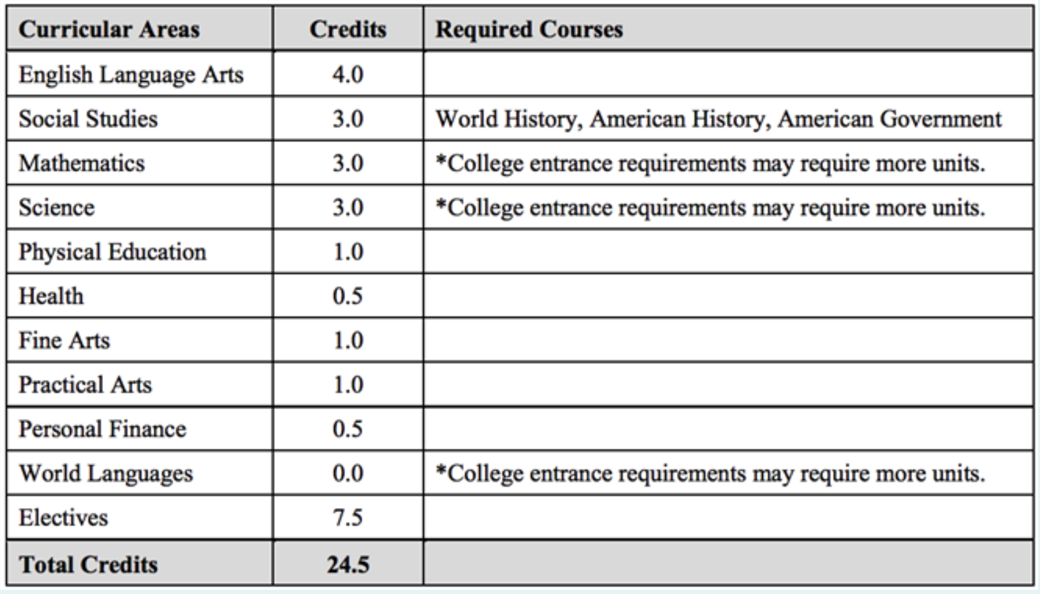
Graduation Requirements
In January 2017, the Board of dEucation approved the increase of required graduation credits from 25 out of a possible 32 (78.1%) to 28 out of a possible 32 (87.5%) on a block schedule.
In March 2018, the Board of Education approved the revision of board policy IKF. Their action reduced graduation requirements from 28 under a block schedule to 24.5 under a 7-period schedule. This revision maintains the required percentage of 87.5% (24.5 out of 28) that was approved for the class of 2021 in January 2017.

Slide 25
Where Do Our Graduates Go?
Benton = 49% workforce, 46% college, less than 5% military
Central = 65% college, 29% workforce, 6% military
Lafayette = 51% workforce, 45% college, less than 5% military
Notes:
Benton = 49% workforce, 46% college, less than 5% military
Central = 65% college, 29% workforce, 6% military
Lafayette = 51% workforce, 45% college, less than 5% military

Slide 26
In-Person Course Offerings
 | Benton | Central | Lafayette
Accounting I and *Accounting II | No | Yes | No
*AP/DC Calculus | No | Yes | Yes
Aerobics and Dance | Yes | Yes | No
*DC American History | No | No | Yes
*DE Composition 104/108 | No | Yes | Yes
Fashion and Fabrics | Yes | Yes | No
French | No | Yes | No
*Microbiology and *Physics | Yes | Yes | No
*PLTW (Project Lead the Way) Medical Interventions | Yes | No | No
*TAG (Talented & Gifted) Lit/Hum 9, 10, 11, 12 | No | Yes | No
* = honors course DC = dual credit DE = dual enrollment AP = advanced placement
Notes:
Not a comprehensive list, only a sample (one course per content area)

Slide 27
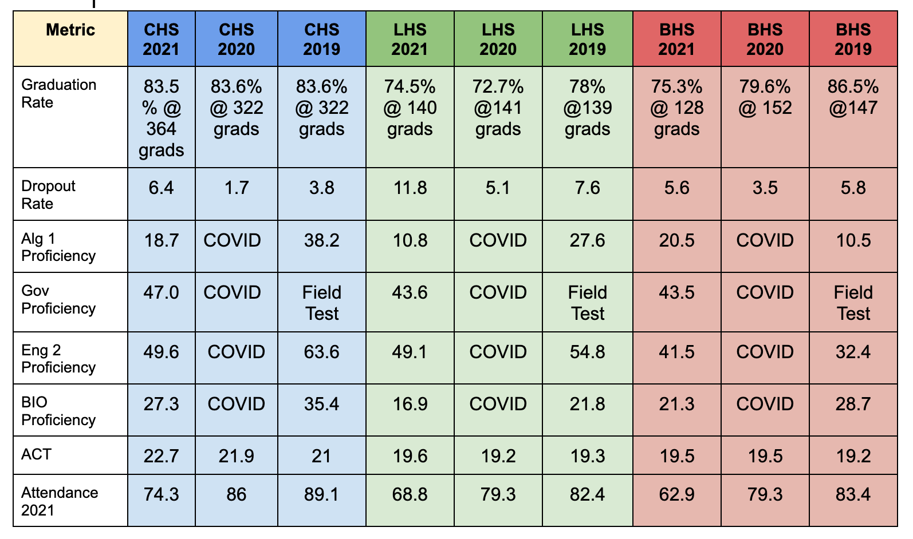
2021 scores were not used to determine funding
High School Data

Slide 28
Graduation Information
Graduation Rate
  How is it calculated? The four-year graduation rate is calculated by dividing the number of students who graduate within four years, including the summer following their fourth year of high school, with a regular high school diploma by the number of students who form the adjusted cohort for that graduating class. Students who drop out of high school remain in the adjusted cohort- that is, the denominator of the cohort graduation rate calculation.
Dropout Rate
  How is it calculated? Dropout rate is calculated for grades 9-12 by taking the number of dropouts divided by the total of September enrollment, plus transfers in, minus transfers out, minus dropouts, added to September enrollment, then divided by two.
Did You Know -
Students who drop out at any time during K-12 are factored into the graduation rate.
Students who transfer out (but never receive a records request), 20-day drops, etc. are factored into the rate.

Slide 29
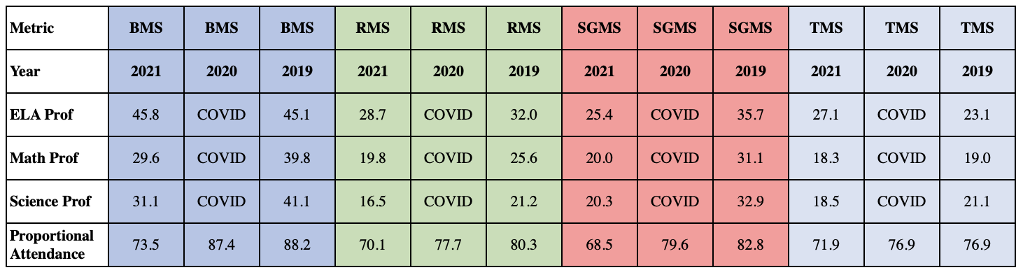
Middle School Data

Slide 30
2021 State Data Takeaways for SJSD Secondary Education
High percentage of students in the SJSD who participated in the tests.
Grades 6 and 7 posted improvements in ELA. Grade 8 posted improvement in math.
Overall, the biggest increase in proficiency rates were in Grade 7 ELA.
The SJSD proficiency rate in Social Studies was 3.9% higher than the state’s proficiency rate with SJSD at 45.9% and the state at 42%.
The largest decreases in SJSD district proficiency rates came in all end-of-course content areas (Algebra 1, Biology, English 2). Algebra 1 decreased the most for both the district and the state.
The district closed its proficiency gap with the state based on 2021 ELA, Math and Science scores.
SJSD attendance has declined from 88% attendance in 2018 to 73.36% attendance in 2022.
Notes:
Slide from Dr. Williams – presented to BOE Dec. 2021

Slide 31
SJSD Attendance by Grade Level*
Grade | Sum of MSIP Prop Attendance (attending 90% or more)
K | 69.22%
1 | 72.08%
2 | 77.41%
3 | 77.17%
4 | 77.90%
5 | 78.89%
6 | 74.56%
7 | 69.90%
8 | 66.98%
9 | 73.49%
10 | 69.12%
11 | 71.58%
12 | 75.46%
173 Student Days of School
Students who come to school less than 90% miss over 17 days of school.
*Attendance Aug. 23, 2021 to March 31, 2022

Slide 32
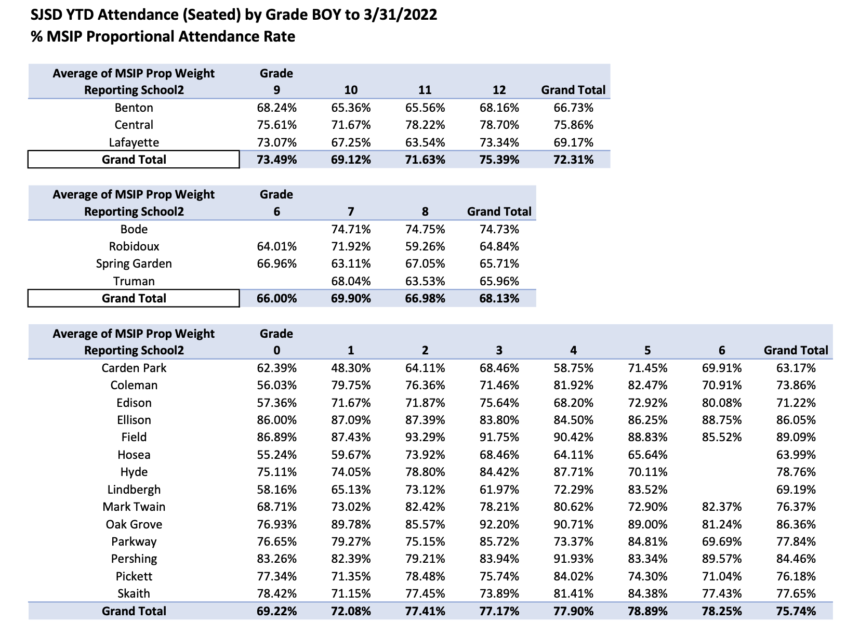
73.36%
SJSD Overall Attendance
Notes:
Middle School norms = pass students to the next grade level
Retention: The student does not meet requirements for promotion, lack of schooling due to poor attendance, and whether the social, emotional, or physical development is such that progress in the next grade is questionable.
Timeline for Promotion & Retention Decisions: Teachers and the principal will review students being considered for retention by March 1. Teachers will inform parents of possible placement or retention before or during the third quarter conference. Written evidence of this contact will be placed in the student’s record. Teachers will submit formal placement or retention recommendations to their principal by May 1. The principal and/or teachers shall confer with parents and review recommendations, grades, test results, and other pertinent data that went into making the decision. Parents shall be given the opportunity to express their opinion concerning the proposed action.
Principals will make the final binding decision before the end of the school year. Before a third retention can be assigned, a principal must obtain prior approval of the Director of Elementary Education. A student passing all but one primary subject, but close to passing the one failed subject, can be promoted upon the successful completion of summer school. Students failing more than one subject cannot be promoted by attending summer school.

Slide 33
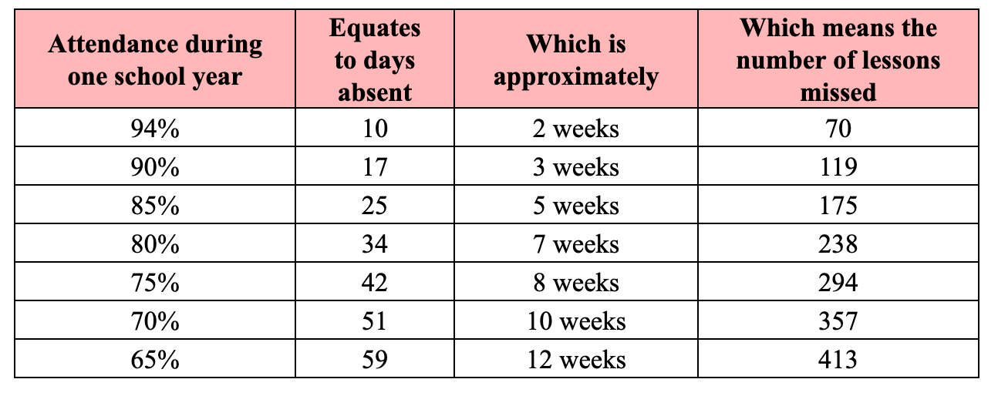
Impact of Attendance

Slide 34
High School Attendance Policy
A high school student shall be allowed no more than 8 absences per semester in any one class (this includes partial absences). Any absence from a class (including partial absences) will count toward the 8-absence maximum. On the 9th absence in any one class, the student will not earn credit for that class and an informational letter will be mailed home to parents.
  Exceptions: hospitalizations, death in the family, documented doctor’s appointment, court, COVID quarantines, and counselor’s appointment.
  No exceptions for: vacations, going out of town, no ride to school, missing the bus, personal business, needed at home, car trouble, and oversleeping.
Students with 9 absences in a semester may complete an attendance appeal to gain credit.
  Grace given during COVID-19 pandemic - credit given if passing the class

Slide 35
Strategies to Improve Attendance
Low Impact | Middle Impact | High Impact
Celebrations | P/T Conferences | Positive School Climate
Generic School Letters | Back to School Night | Goal Setting
Fundraisers | Parent Training Events | Positive Phone Calls (1st line of action)
Potlucks |  | Home Visits
Performances and Showcases |  | Supports/Resources
Generic School Newsletters |  | Regular, personalized communication
 |  | Parent help on learning projects
Notes:
*Information from Attendance Works

Slide 36
Behavior/Discipline Data – Number of Referrals for 2021-2022 school year
 | Benton | Central | Lafayette | Bode | Robidoux | Spring Garden | Truman
Alcohol | 0 | 3 | 1 | 1 | 0 | 4 | 0
Assault | 11 | 21 | 6 | 3 | 5 | 8 | 14
Bullying | 1 | 8 | 0 | 0 | 0 | 2 | 0
Cell Phone Misuse | 61 | 64 | 263 | 46 | 55 | 115 | 46
Defiance | 118 | 134 | 404 | 41 | 105 | 305 | 97
Disrespect | 177 | 174 | 289 | 118 | 151 | 281 | 103
Disruptive | 96 | 263 | 450 | 261 | 230 | 595 | 180
Drugs | 14 | 15 | 14 | 1 | 6 | 0 | 8
Fighting | 25 | 38 | 15 | 48 | 38 | 52 | 43
Tobacco/E-cig | 77 | 121 | 50 | 46 | 21 | 40 | 25
Vandalism | 6 | 8 | 9 | 18 | 13 | 15 | 10
Notes:
Data as of 4/18/22

Slide 37
Curriculum
State Standards • Challenging Curriculum • Quality Lesson Planning

Slide 38
Curriculum
Alignment of curriculum AND assessment to state standards is required. This is a requirement of all Missouri schools and can not be changed. Schools can control the effectiveness of the instruction.
Regular review process of curriculum.
People are the #1 important strategy for school improvement, but content is also important. The issue is not the curriculum, but more about how teachers and principals implement the curriculum.
SJSD coordinates with the state mandated assessment program in all its classrooms. SJSD curriculum is accessible on the district website.

Slide 39
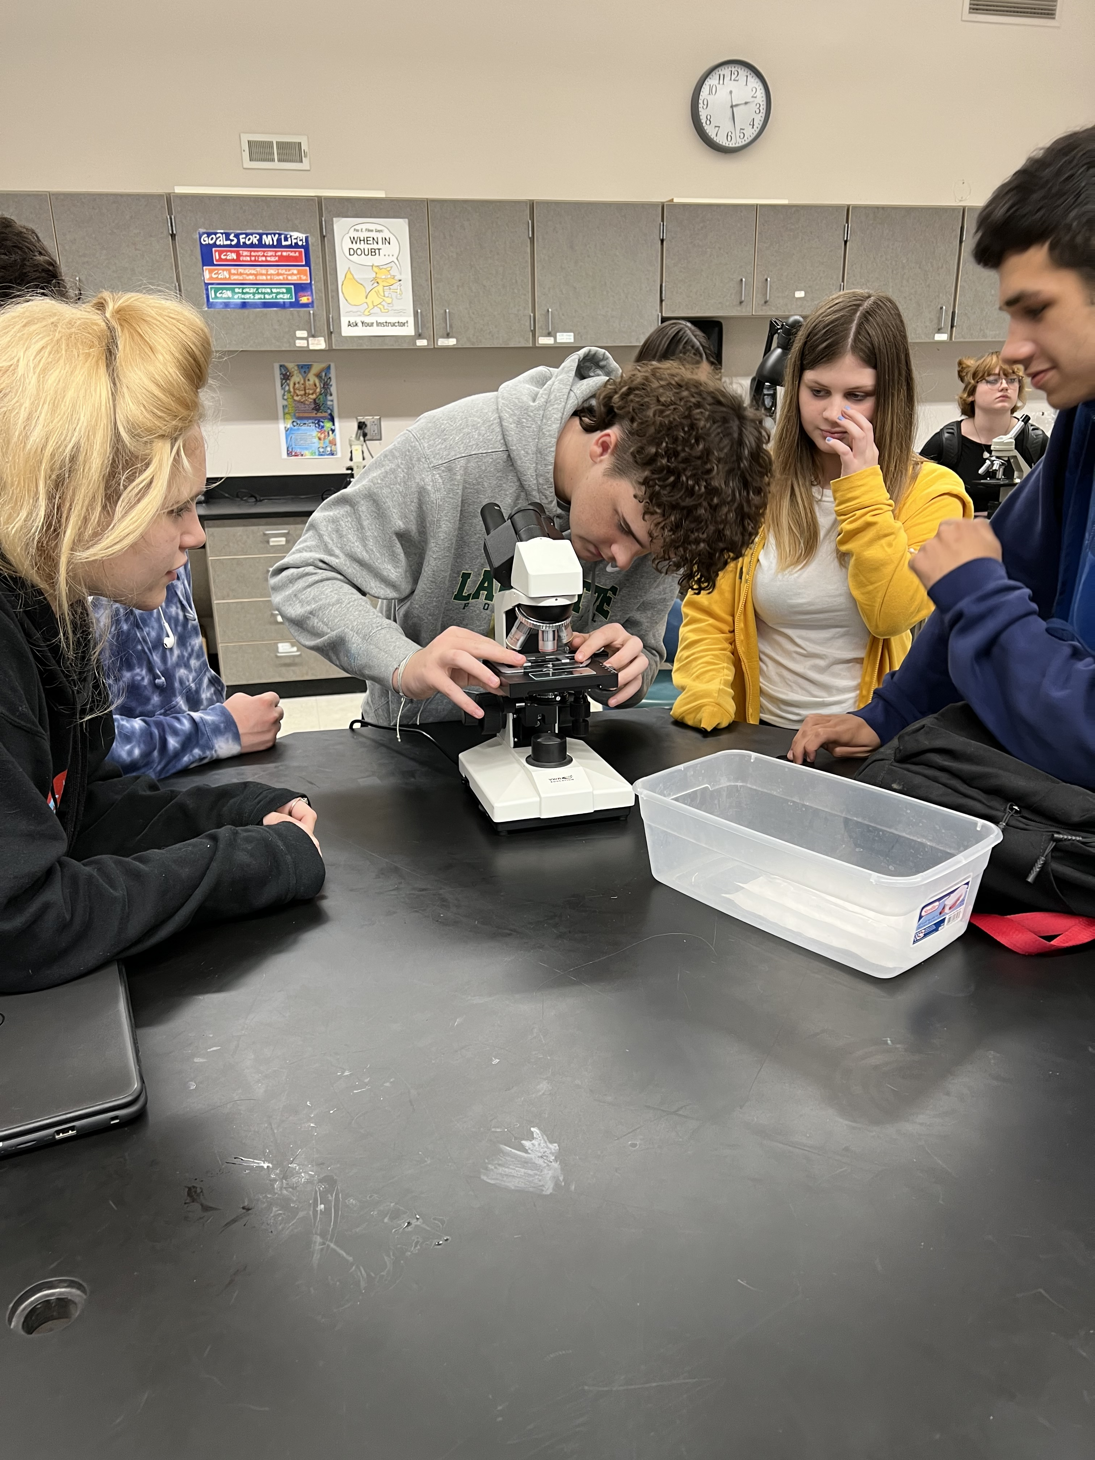
Strengths in Learning within SJSD
Virtual Academy courses have allowed more opportunities for high school students.
Opportunities for college coursework, classes at Hillyard, internships, apprenticeships, etc.
People – High-quality educators who are invested
Real-world, relevant, innovative instruction: sports marketing, PLTW, business programs.
Relationships
Business Partners

Slide 40
Barriers that Impact Learning
Lack of student motivation or goals
Returning to normal after pandemic
Discipline issues (cell phones)
Elimination of course offerings due to low student requests
Multiple classes within a period (Foundations of Art and Advanced 2D)
Mental health
Lack of ADA accessible environments
Lack of parent engagement and support
Poverty – Basic Needs
Lack of high-quality staff applying for open positions within SJSD.
Notes:
Feedback from secondary principals and teachers

Slide 41
What does the research state?
Research indicates the ideal school start time for middle school and high school is 8:30am.
  Improved grades and attendance
Community Engagement Matters in School Improvement
Research conducted by the National Center for Education Statistics found that participation in extracurricular activities have a positive correlation to the students' attendance, GPA, engagement, test scores, and expected educational goals.
Research shows retention in middle school increases drop out rates in high schools.
Middle Schools - There is not a single grade span configuration that will serve all purposes. There is not an agreed on ‘best model’.

Slide 42
St. Joseph School District Professional Development Initiatives

Slide 43
Our Response Through Professional Development
Clarity for Learning (students understand “the why” behind learning)
3D Coaching - Building Relationships
Math Curriculum PD, focus on Algebra I instructional strategies
ACT Focus on Learning
Blended Learning PD
PBIS (Positive Behavioral Interventions and Supports)
Canvas and Instructional Technology Strategies
Building ENGAGE
PDC Building Funds – Choose Your Own PD

Slide 44
Additional Supports
Attendance Interventionists
Attendance intervention plans at each building
Additional social workers in schools
Returning to volunteers in schools
Free breakfast and lunch for all students this school year

Slide 45
Small Group
Work Activity
Notes:
[Chair at podium]
Let’s give a round of applause to Dr. McGinnis her excellent presentation. Thank you Dr. McGinnis..
Now let’s get to work!
On your table, on INSERT COLOR OF PAPER HERE paper, is tonight’s work activity. This is the official sheet for your recorder to use.
(Hold up a copy of the work activity)
And if you’re here virtually, please check your Welcome Sheet for the link to the work activity.
Let’s go through the instructions to make sure everyone understands the tasks.
45

Slide 46

Small Group Work Activity
Select a Recorder and Spokesperson
Recorder Responsibilities
  Complete the information on the group’s worksheet
Spokesperson Responsibilities
  Facilitate Discussion
  Keep Group Focused/On Task
  Report Group’s Information
Notes:
[Teresa at podium]
At each table, you will select a recorder and spokesperson.
The recorder is responsible for completing the worksheet. Make sure to complete the information in the box in the upper left corner.
The spokesperson should facilitate discussions, keep the group focused so the work is completed on time, and then report table results.
46

Slide 47
Small Group Worksheet
Information on worksheet should reflect consensus/general agreement of group members.
Monitor progress to complete the worksheet in allotted time.
Only group recorder’s worksheet will be collected.
Notes:
Please make sure the information recorded on the group’s worksheet reflects general agreement of everyone at the table, not just the opinion of one or two individuals.
Monitor the time to make sure you get done on time. We’ll start the reporting out at (name a time).
At the end of the session we will only collect the worksheet that has been completed by the recorder.
47

Slide 48
Small Group Discussion Norms
Turn off/silence electronic devices/phones
Give everyone an opportunity to speak
Be positive; focus on being productive
Focus on the collective good, not just individual
Respect the opinions of fellow group members
Stay engaged with the conversation
Notes:
As you begin your group discussion tonight we ask that you please keep these points in mind as you work toward consensus on the activities.
(Read points)
48

Slide 49
Small Group Work Tasks
Task #1
Based on tonight’s presentation, what are two positive things about the St. Joseph School District, its students or staff you could share?
Task #2
What are 3 priorities to be addressed in the area of improving high school academic achievement? List your top priorities on the chart. Prioritize your top 3 priorities from 1 to 3 - 1 being the highest and 3 being the lowest priority.
What are 3 priorities to be addressed in the area of improving junior high/middle school academic achievement? List your top priorities on the chart. Prioritize your top 3 priorities from 1 to 3 - 1 being the highest and 3 being the lowest priority.
What recommendations does your group have to address these priorities in the next 5 years?
Notes:
We are asking each group to complete two activities.
(Read Tasks)
Take a minute or two to review the tasks and then let’s get work. If you have questions about the work activities, just ask one of the Community Team Members who are walking around the room or send us note in the chat if in a virtual breakout room.
And please, we really need your help on this activity. Please pay special attention to Task #2 – it is very important for your group to rank your top 3 priorities for both the high school level and also for the middle school level. Then, please offer recommendations for each priority. When you list them 1 through 3, it helps us identify the top priorities moving forward for the Action Plan. Remember 1 is the highest and 3 is the lowest.
If you’re joining us virtually tonight, we’re sending you to special breakout rooms where you will complete the group same activity and then rejoin the in-person group to share your ideas.
49

Slide 50
Small Group Work Activity Reporting
Notes:
Now it is time to hear from the tables and from the virtual groups. [Selected Community Chairs] will bring a microphone around to and try to get to as many groups as possible.
Please be brief so we can hear from as many tables as possible. We’ll collect the worksheet at the end of tonight’s session and document everything on our website.
From each table, let’s hear one of the favorite positive things about our district you learned tonight that you can share with a friend. Then tell us your top 3 priorities for improving high school academic achievement and then your top 3 for the middle school level.
Okay, let’s get started!
(Community chairpersons will take microphone from table to table for each group’s spokesperson to report. Be sure to collect the worksheet from the spokesperson as he/she finishes reporting.)
50

Slide 51
Upcoming Community Engagement Sessions
Session 5
Facilities for Learning
Tuesday, May 17, 2022 Benton High School 6-8 p.m.
Notes:
[Selected Community Chair at podium]
Thanks for your hard work. I hope you enjoyed this meeting — it sounds like there were great discussions at the tables.
Next month will be the last scheduled Vision Forward community meeting. On May 17 we will be at Benton High School to learn more about how facilities can play a role in improving student achievement and best meet the needs of our students. Please invite your friends and neighbors to this important session because all ideas and suggestions are important for our work.
Don’t worry about picking up anything. And make sure and leave any Question/Comment forms on your table.
Thanks for coming — see you in May!
51

Slide 52
THANK YOU FOR YOUR PARTICIPATION!
Community Engagement Meeting
April 26, 2022
Notes:
52

Slide 53
Notes:
53

