Slide 2
Action Plan
Community Engagement Meeting
September 20, 2022
Notes:
2

Slide 3
Welcome
Introduce yourself to others at your table
Put on a name tag
Complete the information on the sign-in sheet
Notes:
Good evening. My name is (YOUR FULL NAME) Welcome to tonight’s Vision Forward community engagement session. It’s great to see so many of you’re here. We hope everyone had a great summer.
As we’ve done for past sessions, we wanted everyone to have an opportunity to share ideas with as many people as possible, so tonight we have both the in-person and the virtual sessions again. We welcome those of you who are joining us virtually via Zoom and look forward to hearing your ideas and comments. If you’re joining us virtually tonight, be sure to check your Welcome page that has links to all you’ll need tonight – including the sign in sheet, the presentation and the work activity.
3

Slide 4
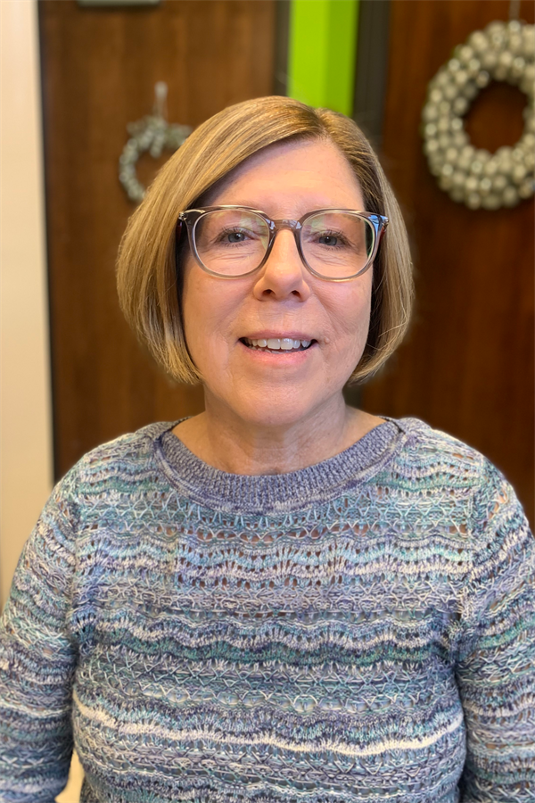
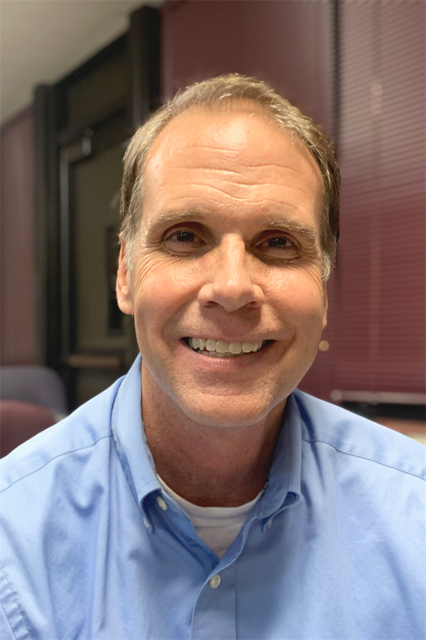
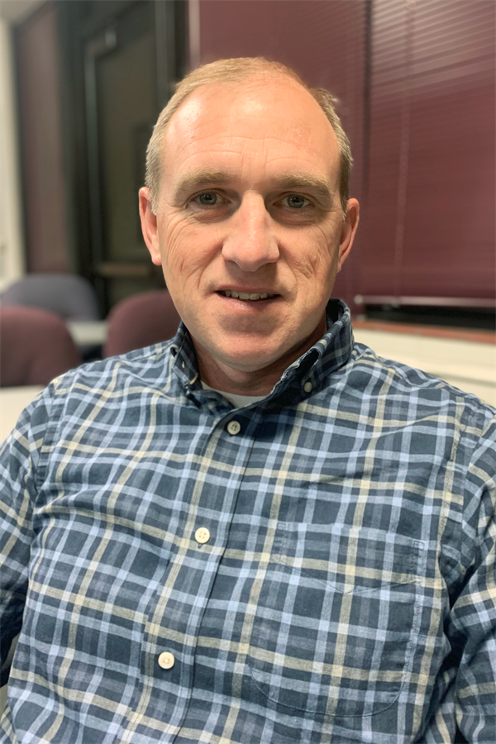
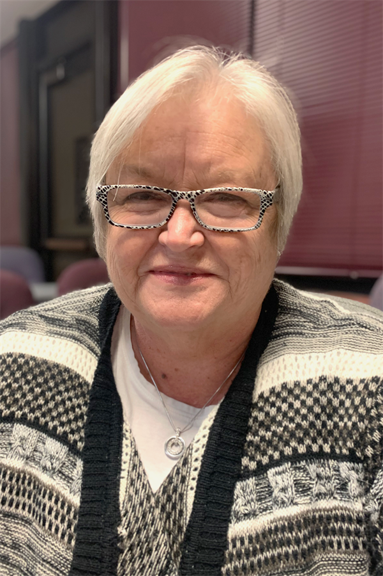
Community Engagement Team Co-Chairs
Linda Bahrke
David Hinde
Bob Miller
Teresa Simmons
Notes:
It is my pleasure to introduce our other co-chairs — (NAME THE OTHER THREE CHAIRS). We’ve had a very busy summer getting ready for tonight’s meeting. So let’s get started.
4

Slide 5
Vison Forward Is a Partnership
We Need You!
  Vision Forward is the result of a sincere desire to improve the educational opportunities for our children. We review information that reflects the community’s priorities to improve SJSD and will present recommendations to the St. Joseph Board of Education by December 2022.
  All of Us Working Together
  Residents, Business and Community Leaders, Parents and Educators
  A Strong Partnership That Will Make a Difference
Notes:
It is hard to believe that our Community Engagement Team has now been working nearly a year. We’ve only two more community engagement sessions left — tonight and then on October 18. Our job — all of our jobs — not just our Team but everyone who has been attending our sessions — is to develop an Action Plan for improving our district. We are going to review the first draft of that plan this evening.
5

Slide 6
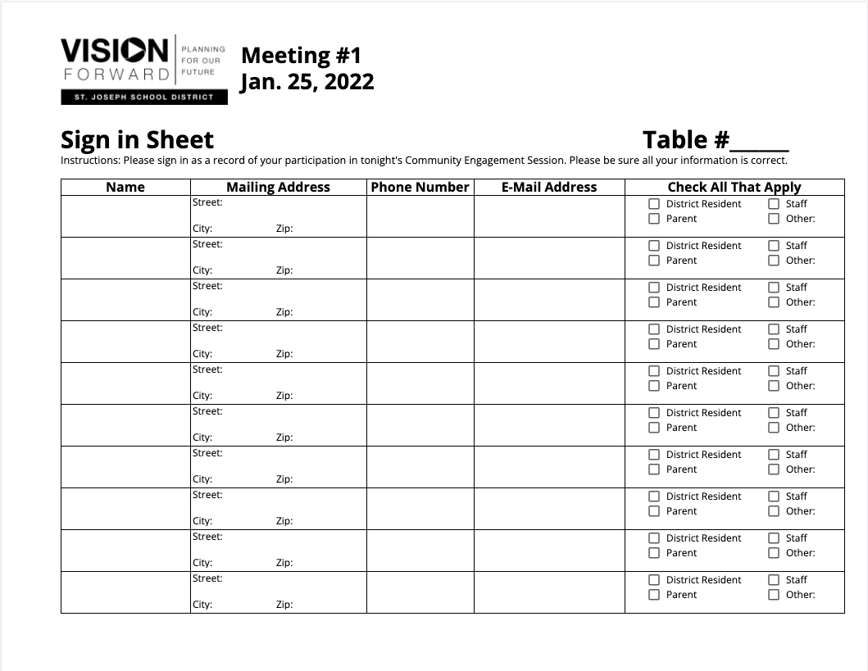
Sign-in Sheet
Notes:
Before we get started, please make sure everyone at the table or online has signed in. This is our way of taking attendance and getting your contact information so we can keep you informed about our program. We’ll gather these sheets during the small group work time later in the session.
6

Slide 7
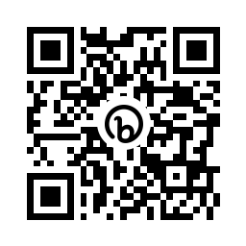
QR Code to Tonight’s Presentation
Look for the QR code on the agenda on your table.
Scan the code with the camera on your phone.
This will take you to a link of tonight’s presentation.
Notes:
Another reminder — we want everyone to be able to see the information on our screen, but some of you may not have an easy view. We don’t want you to miss anything so if you don’t have a clear view, please grab your phone, open your camera and do a quick scan of the QR code on the printed agenda at your table. This will pull up a link to the presentation so you can easily view it.
7

Slide 8
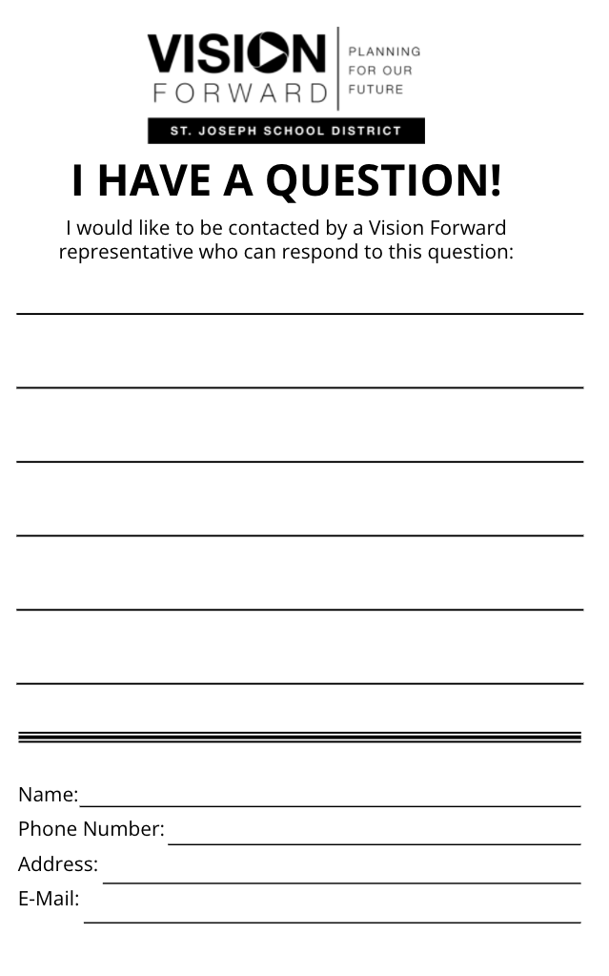
Questions/Comments
Fill out “I Have a Question/Comment” form
Email communications@sjsd.k12.mo.us
Ask Questions during Small Group Time
Notes:
And a couple of more things -
Also, there are “I Have A Question/Comment” forms on each table. If you have a question or comment, and we are not able to respond during small group time, please fill out a form and turn it in to us at the end of the session. You can also call or send us an email.
And lastly, for those here in the room, please feel free to grab some water we have in the back of the room or visit bathrooms during our meeting.
8

Slide 9
A New Day in St. Joseph School District!
Notes:
At our Community Engagement Meeting, many commented about what seems to be a new day here in the St. Joseph School District — how positive things seem compared to just a year ago.

Slide 10
A New Day in St. Joseph School District
District Leadership
Passage of Referendum
Vision Forward
Impact of Global Pandemic
Notes:
In the past year, we have new district leadership. Voters in our district overwhelmingly approved ballot proposal. We could not be happier with the progress of our Vision Forward program — attendance at our last meeting was outstanding. And lastly, if you talk with teachers, administrators — all staff — the mood in our schools has dramatically improved as the global pandemic has winded down. Things are getting back to normal. And for our school district, better than normal.

Slide 11
Action Plan Draft #1
How We Got Here
Notes:
Tonight our job is to review, and make better, the first draft of the Action Plan that we will present to the Board of Education in December. A copy of that draft plan is on your tables.
11

Slide 12
How We Got Here
Five Community Engagement Sessions
Consensus Points from Sessions
Priority Statements Developed by Community Engagement Team
Notes:
Good evening and welcome to tonight’s Vision Forward community engagement session. Last month we learned more about improving student achievement for our middle and high schools and tonight we will look at how facilities play an important role in learning and academic success for all students.
Thank you for joining us tonight. Over the past few months we’ve had really good participation and it’s really nice to see so many of you here tonight. This is the last Vision Forward session until next fall, but the work will continue over the summer with the development of our Action Plan.
As we’ve done for past sessions, we wanted everyone to have an opportunity to share ideas with as many people as possible, so tonight we have both the in-person and the virtual sessions again. We welcome those of you who are joining us virtually via Zoom and look forward to hearing your ideas and comments. If you’re joining us virtually tonight, be sure to check your Welcome page that has links to all you’ll need tonight – including the sign in sheet, the presentation and the work activity.
My name is Bob Miller and I’m one of four co-chairs of our program.
12

Slide 13
Process To Develop Draft 1
Consensus Points from Engagement Session
Priority Statements Developed by Community Engagement Team
All Day Workshop on August 12th Facilitated by District Leadership Solutions
Initial Draft Developed by District Leadership Solutions
Reviewed/Edited by Community Engagement Team on September 13th
Community Engagement Session #6 on September 20th
Notes:
I’d like to spent a minute or two talking about how this draft was put together. Following each of the five community engagement meetings last winter and spring, consensus points were pulled from the work activity. Our Engagement Team took those points and developed Priority Statements. At an all-day workshop session, based on those priority statements, a large group of educators and members of our Team brainstormed Action Plan steps. Professionals from District Leadership Solutions, who had facilitated the all-day work session, then developed an initial draft of the Action Plan. We reviewed and edited that document at our Team meeting on September 13th. That version is what we will present tonight for your review and suggestions. Your job is to make it a better document — a better plan.
13

Slide 14
Priority Statements
Session 1: Work toward enhanced pride and improved community commitment to the importance of public education.
Session 2: Improve staff recruitment and retention including additional staff support and payment of competitive salaries.
Session 3: Expand the availability of quality early childhood education programs citywide.
Session 4: Provide a consistent middle school/junior high model both in configuration and curriculum to improve academic achievement. Address discipline and low attendance challenges.
Session 5: Consolidate, right-size and make more equitable and functional facilities at all levels (elementary, middle school and high school) so that curricula and programs are equivalent and buildings at optimum efficiency.
Notes:
14
On the screen, you will see the five Priority Statements developed by our Community Engagement Team. They are not listed in order of importance — all are equally important. They are listed by how the lined up to the community engagement sessions we had — Please note that two statements were pulled from the consensus points of the 4th session.

Slide 15
Priority #1
DISTRICT CULTURE
Notes:
As noted before, a copy of the first draft of the Action Plan is on your tables. We are going to briefly review that document, then you will get to work to review it, edit it, make it better, and make it right for our district. I’m not going to read all action steps, just briefly cover each priority area. Again, I want to remind you that these are presented in the order of our engagement meetings — they are not in priorities order — the fifth priority is no less important that the first. And the first area is about district culture.

Slide 16
Priority #1
#1
DISTRICT CULTURE
Action Steps
  Communicate a new Vision for District that reflects the new administration and opportunities
  Reflect the Vision within the work of the District
Notes:
There are two categories of Action Steps for District culture. The first involves communicating a new vision for our District that reflects our new leadership, our new opportunities and our Action Plan that we will report to the Board of Education this coming December.

Slide 17
Priority #2
HIGH QUALITY STAFF
Notes:
The second priority area is about High Quality Staff.

Slide 18
Priority #2
#2
HIGH QUALITY STAFF
Action Steps
Prioritize identified compensation
Identify and communicate advantages of SJSD
Evaluate mentoring programs
Evaluate coaching
Staff that reflects District values
Align evaluation of employees to expectations
Align professional development to District goals
Ensure effective principals in every building
Hire support staff as needed
Notes:
Action steps in the high quality staff priority area include statement about compensation, communications to prospective staff, mentoring, coaching, aligning employee evaluations to expectations, professional development, building level leadership and support staff.

Slide 19
Priority #3
STUDENT PERFORMANCE PK-5
Notes:
The third priority area is PK-5 student performance.

Slide 20
Priority #3
#3
STUDENT
PERFORMANCE
PK-5
Action Steps
Identify optimal school size and capacity
Enhance Early Childhood opportunities
Support and improve instructional practices
Create environment for success
Audit current practices
Identify goals, instructional practice, and curriculum
Attendance initiative
Root causes of learning problems/practices
Strategies for improved student behaviors
Notes:
In third third area, action steps cover optimal school size and capacity — how many kids should we optimally have in elementary schools, early childhood, education, improving instructional practices, improving the environment for success, auditing current practices, identifying goals, instructional practice and curriculum, and improving attendance, finding causes of learning problems and strategies for improving student behavior.

Slide 21
Priority #4
IMPROVING STUDENT PERFORMANCE IN SECONDARY SCHOOLS
Notes:
The fourth area is improving student performance in secondary schools.

Slide 22
Priority #4
Action Steps
Implement Middle School model with teaming
Transition to 9-12 High School model to block scheduling
Ensure equity
To Change Grade Structures
Identify optimal school size and capacity
Define philosophy at each level
Identify enrollment goals
Study impact on students and families
Develop financial profile for middle school transition
#4
IMPROVING STUDENT PERFORMANCE IN SECONDARY SCHOOLS
Notes:
The major Action Plan item here is transitioning to middle schools with teaming. Other items deal with high school block scheduling and assuring equity. Five Action steps deal with transitioning to new grade structures both with respect to impact on staff and students and their families.

Slide 23
Priority #5
FACILITIES
Notes:
The fifth and final priority area — again remember that this is just as important as the first — it is just listed fifth — has to do with facilities.

Slide 24
Priority #5
#5
FACILITIES
Action Steps
Analyze existing architectural/demographic studies
Develop comprehensive plan of which
buildings need to be maintained, renovated, retired, converted, or replaced
Consider transportation and feeder
school patterns
Notes:
With previous action steps having to do with grade configuration, and optimal size and capacities of schools, we will need to look at our existing facilities and how to go about improving them to enhance our educational program. In a nutshell, this Priority area deals with development of a comprehensive plan.

Slide 25
Conclusion
Great Start
Need Your Input — Let’s Make it Better
An Action Plan to Improve Our Schools
Supported by Community/Staff/Board of Education
A New Day for St. Joe!!
Notes:
The members of our Community Engagement Team think this is a great start — a week ago we worked hard on putting this together. But we know you can make it better. So we need your input. We need an Action Plan that is supported by the community, our educators, and our Board of Education. That will be our contribution to a New Day for St. Joe.
So let’s get to work.

Slide 26
Small Group
Work Activity
Notes:
On your table, on INSERT COLOR OF PAPER HERE paper, is tonight’s work activity. This is the official sheet for your recorder to use.
(Hold up a copy of the work activity)
And if you’re here virtually, please check your Welcome Sheet for the link to the work activity.
Let’s go through the instructions to make sure everyone understands the tasks.
26

Slide 27

Small Group Work Activity
Select a Recorder and Spokesperson
Recorder Responsibilities
  Complete the information on the group’s worksheet
Spokesperson Responsibilities
  Facilitate Discussion
  Keep Group Focused/On Task
  Report Group’s Information
Notes:
At each table, you will select a recorder and spokesperson.
The recorder is responsible for completing the worksheet. Make sure to complete the information in the box in the upper left corner.
The spokesperson should facilitate discussions, keep the group focused so the work is completed on time, and then report table results.
27

Slide 28
Small Group Worksheet
Information on worksheet should reflect consensus/general agreement of group members.
Monitor progress to complete the worksheet in allotted time.
Only group recorder’s worksheet will be collected.
Notes:
Please make sure the information recorded on the group’s worksheet reflects general agreement of everyone at the table, not just the opinion of one or two individuals.
Monitor the time to make sure you get done on time. We’ll start the reporting out at (name a time).
At the end of the session we will only collect the worksheet that has been completed by the recorder.
28

Slide 29
Small Group Discussion Norms
Turn off/silence electronic devices/phones
Give everyone an opportunity to speak
Be positive; focus on being productive
Focus on the collective good, not just individual
Respect the opinions of fellow group members
Stay engaged with the conversation
Notes:
As you begin your group discussion tonight we ask that you please keep these points in mind as you work toward consensus on the activities.
(Read points)
29

Slide 30
Small Group Work Tasks
Task: Strengthening the Action Plan
Ideas to Add to the Plan
Ideas to Modify, Delete or Change the Action Plan
Notes:
We are asking each group to complete two activities. The first is ideas you would like to add to the plan. Please make it clear under which Priority you would like to add this. The second activity is whatever ideas to you have to modify, delete items or otherwise change the plan. Again, please be specific. And if needed, go ahead and write on the back of the worksheet.
If you’re joining us virtually tonight, we’re sending you to special breakout rooms where you will complete the group same activity and then rejoin the in-person group to share your ideas.
Okay, let’s get to work.
30

Slide 31
Small Group Work Activity Reporting
Notes:
Now it is time to hear from the tables and from the virtual groups. [Selected Community Chairs] will bring a microphone around to and try to get to as many groups as possible.
Please be brief so we can hear from as many tables as possible. We’ll collect the worksheet at the end of tonight’s session and document everything on our website.
For each group, cover two items you like to change, add or change in the draft of the Action Plan.
Okay, let’s get started!
(Community chairpersons will take microphone from table to table for each group’s spokesperson to report. Be sure to collect the worksheet from the spokesperson as he/she finishes reporting.)
31

Slide 32
THANK YOU FOR YOUR PARTICIPATION!
Community Engagement Meeting
October 18, 2022
Notes:
Thanks so much for your hard work tonight. We’re going to take your input, do a second draft of the Action Plan, and bring that to our next meeting. So we’ll have another chance at this. That next meeting is October 18th — please, please attend. It is our last meeting and a very important meeting. Bring family members or friends. We’ll see you then.
Good night.
32

Slide 33
Notes:
33

