Slide 2
Action Plan
Community Engagement Meeting
October 18, 2022
Notes:
2

Slide 3
A New Day in St. Joseph School District!
Dr. Robert Sigrist
Assistant Superintendent of Business and Operations
St. Joseph School District
Notes:
Welcome comments from Dr. Sigrist

Slide 4
THANK YOU!
We Reached the Finish Line
Notes:
Dr. Sigrist - Thank you

Slide 5
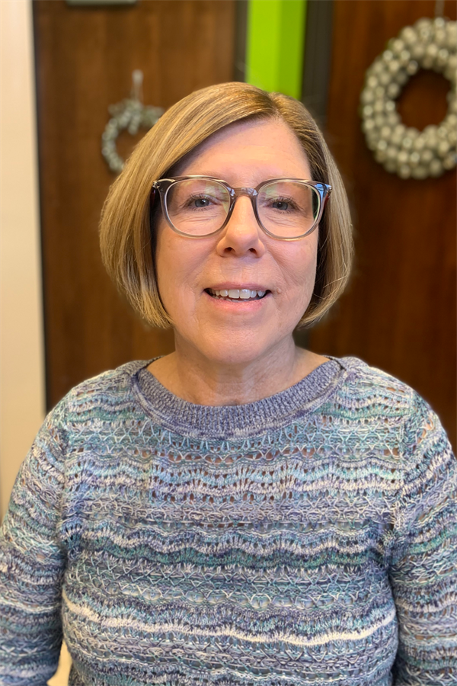
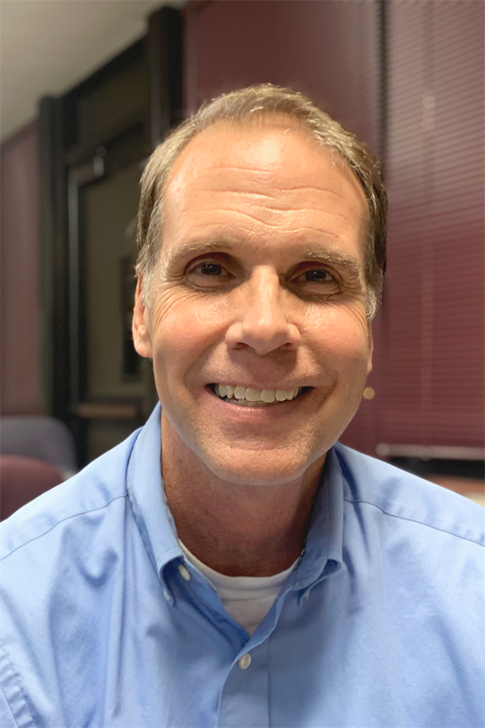
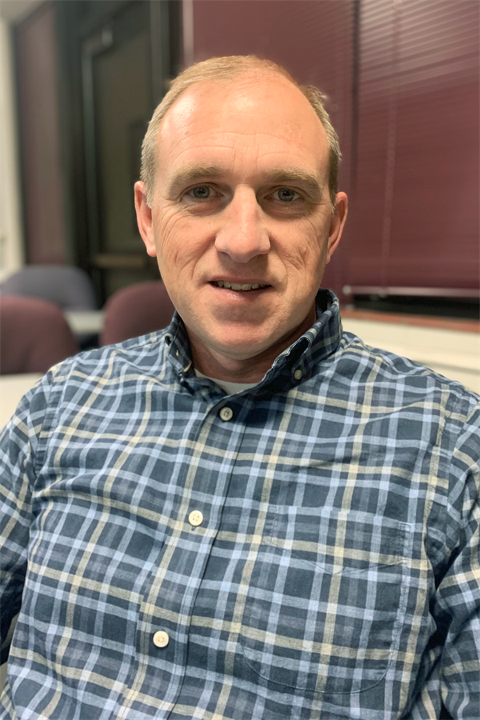
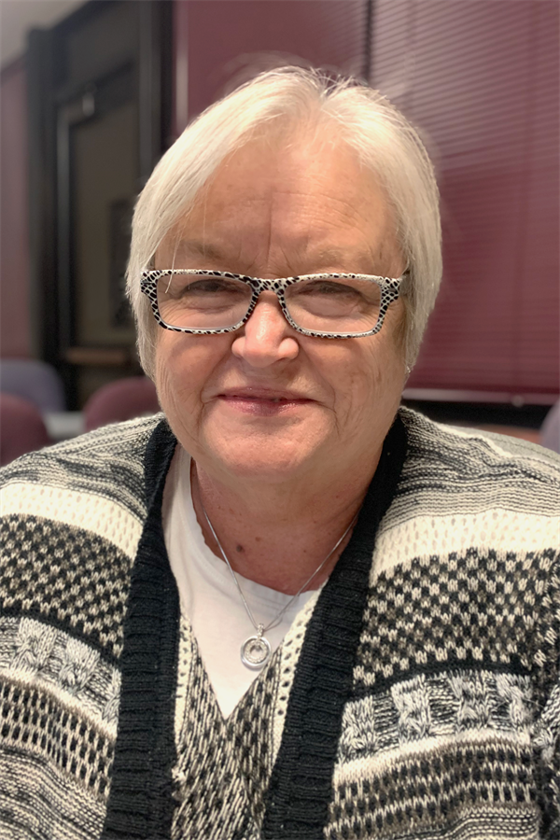
Community Engagement Team Co-Chairs
Linda Bahrke
David Hinde
Bob Miller
Teresa Simmons
Notes:
Dr. Sigrist
Thank you to the Vision Forward co-chairs — Linda Bahrke, David Hinde, Bob Miller and Teresa Simmons.
5

Slide 6
Community Engagement Team Members
Community Members
Reid Barnett
Colette Cox
Don Crabtree
Chad Crooks
Courtney Cruz
Jenny Goss
Chad Higdon
Steve Hofferber
Rebecca Lobina
District Representatives
Dr. Gabe Edgar
Superintendent
Eileen Houston-Stewart
Communications Director
School Board Members
LaTonya Williams
Rick Gilmore
Jacob McMillian
Mia Murry
Mackenzie Norton
Annie Roseberry
Dennis Rosonke
Joanne Snapp
Brenda Steidel
Alex Tomes
Lynnea Wootten
Notes:
Dr. Sigrist - Thank you to the many community members and district employees who served on the Vision Forward team.
IDEAS - Thank for leadership, commitment to school district, hard work, vision, believing in a better St. Joseph School District
Beginning in November, our Community Engagement Team has been working to put this program together. On the screen is a list of members. At this time I would ask the Community Engagement Team members to stand and be recognized. (Applause)
Vision Forward is also very pleased to introduce three individuals from the St. Joseph School District who are also a part of the Community Engagement Team.
District Representatives
Eileen Houston-Stewart – Communications Director
School Board Members
LaTonya Williams
Rick Gilmore
Our thanks to each of them for their support and important assistance they bring to our Vision Forward process.
While this Team is responsible for putting the program together, I want to emphasize that decisions about the Action Plan were made at community engagement sessions just like this one. This team has created the process — the plan was developed by the community.
6

Slide 7
Thank You to Our Vision Forward Partners
St. Joseph Chamber of Commerce
Word of Life Church
Mosaic Life Care
Notes:
Dr. Sigrist
thank you’s
In addition to the many individuals who brought Vision Forward to the finish line, we are fortunate in St. Joseph to also have great partners who support our work everyday. Our thanks the St. Joseph Chamber of Commerce and to the Word of Life Church t for their support and important assistance they brought to our Vision Forward process.
7

Slide 8
A New Day in St. Joseph School District
District Leadership
Passage of Referendum
Vision Forward
Impact of Global Pandemic
Notes:
Dr. Sigrist comments on district highlights

Slide 9
Vision Forward
Our Action Plan for Success
Notes:
Thank you Dr. Sigrist. We appreciate all your support for the Vision Forward program and for your wonderful leadership for our district! Good evening. My name is (YOUR FULL NAME)

Slide 10
Welcome
Introduce yourself to others at your table
Put on a name tag
Complete the information on the sign-in sheet
Notes:
Welcome to tonight’s Vision Forward community engagement session. Vision Forward has reached the finish line! It’s great to see so many of you’re here for our last session.
As we’ve done for past sessions, we wanted everyone to have an opportunity as many people as possible to learn about our final plan and our recommendations we will be taking to the Board of Education in December. So, again tonight we have both the in-person and the virtual sessions. We welcome those of you who are joining us virtually via Zoom. If you’re joining us virtually tonight, be sure to check your Welcome page that has links to all you’ll need tonight – including the sign in sheet, the presentation and the work activity.
10

Slide 11
Vision Forward Is a Partnership
We Need You!
  Vision Forward is the result of a sincere desire to improve the educational opportunities for our children. We review information that reflects the community’s priorities to improve SJSD and will present recommendations to the St. Joseph Board of Education by December 2022.
  All of Us Working Together
  Residents, Business and Community Leaders, Parents and Educators
  A Strong Partnership That Will Make a Difference
Notes:
It is hard to believe that our Community Engagement Team has now been working nearly a year and tonight is our last session. Our job — all of our jobs — not just our Team but everyone who has been attending our sessions — was to develop an Action Plan for improving our district. Last month we presented the first draft of the Action Plan. You shared your ideas and suggestions for the plan and our final plan includes these comments. We are going to review the final draft of that plan this evening.
11

Slide 12
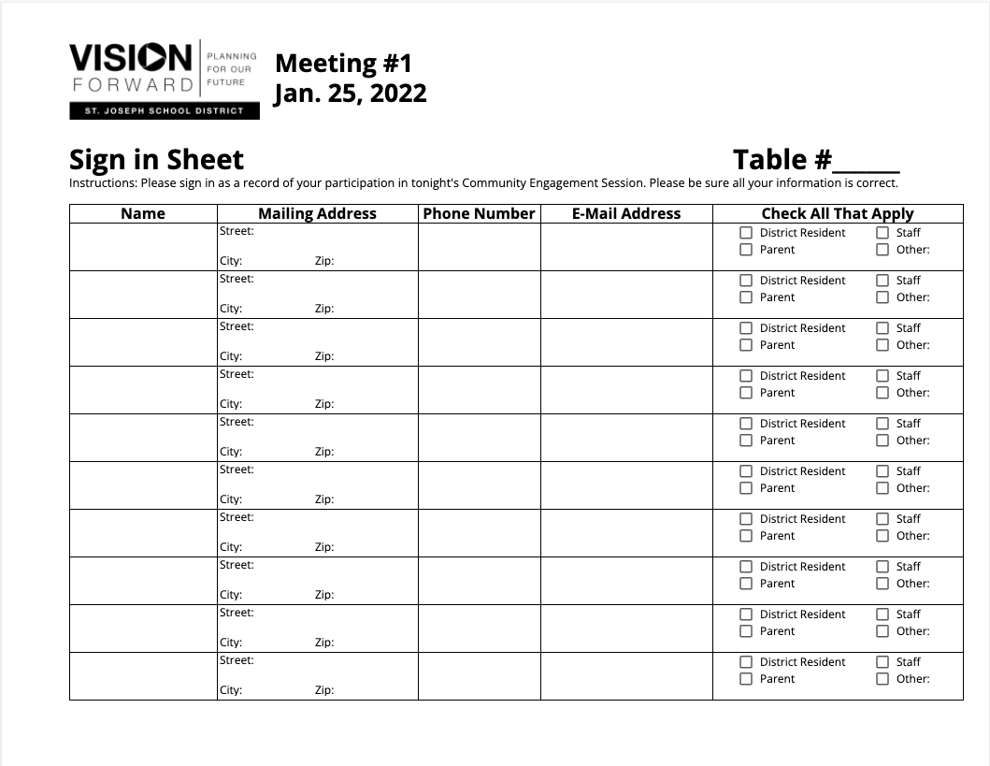
Sign-in Sheet
Notes:
Before we get started, please make sure everyone at the table or online has signed in. This is our way of taking attendance and getting your contact information so we can keep you informed about our program. We’ll gather these sheets during the small group work time later in the session.
12

Slide 13
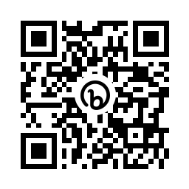
QR Code to Tonight’s Presentation
Look for the QR code on the agenda on your table.
Scan the code with the camera on your phone.
This will take you to a link of tonight’s presentation.
Notes:
Another reminder — we want everyone to be able to see the information on our screen, but some of you may not have an easy view. We don’t want you to miss anything so if you don’t have a clear view, please grab your phone, open your camera and do a quick scan of the QR code on the printed agenda at your table. This will pull up a link to the presentation so you can easily view it.
13

Slide 14
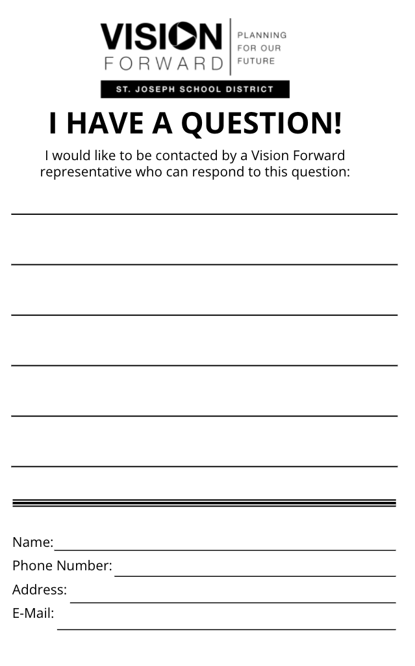
Questions/Comments
Fill out “I Have a Question/Comment” form
Email communications@sjsd.k12.mo.us
Ask Questions during Small Group Time
Notes:
And a couple of more things -
Also, there are “I Have A Question/Comment” forms on each table. If you have a question or comment, and we are not able to respond during small group time, please fill out a form and turn it in to us at the end of the session. You can also call or send us an email.
And lastly, for those here in the room, please feel free to grab some water we have in the back of the room or visit bathrooms during our meeting.
14

Slide 15
Action Plan
How We Got Here & Update
Notes:
Tonight our job is to review the final draft of the Action Plan that we will present to the Board of Education in December. A copy of the Action Plan is on your tables.
15

Slide 16
How We Got Here
Seven Community Engagement Sessions
Consensus Points from Sessions
Priority Statements Developed by Community Engagement Team
Notes:
I’d like to spent a minute or two talking about how the Action Plan was put together. Following each of the seven community engagement meetings last winter and spring, consensus points were pulled from the work activity. Our Engagement Team took those points and developed Priority Statements
16

Slide 17
Process To Develop Action Plan
Consensus Points from Engagement Sessions
Priority Statements Developed by Community Engagement Team
All Day Workshop on August 12th Facilitated by District Leadership Solutions
Initial Draft Developed by District Leadership Solutions
Reviewed/Edited by Community Engagement Team on September 13th
Community Engagement Session #6 on September 20th
Notes:
Then, at an all-day workshop session, based on those priority statements, a large group of educators and members of our Team brainstormed Action Plan steps. Professionals from District Leadership Solutions, who had facilitated the all-day work session, then developed an initial draft of the Action Plan. We reviewed and edited that document at our Team meeting in September. Next we brought the first draft to you last month for your input and ideas. Those suggestions were included in the final Action Plan recommendations and that final plan is what we will present tonight.
17

Slide 18
Priority Statements
Session 1: Work toward enhanced pride and improved community commitment to the importance of public education.
Session 2: Improve staff recruitment and retention including additional staff support and payment of competitive salaries.
Session 3: Expand the availability of quality early childhood education programs citywide.
Session 4: Provide a consistent middle school/junior high model both in configuration and curriculum to improve academic achievement. Address discipline and low attendance challenges.
Session 5: Consolidate, right-size and make more equitable and functional facilities at all levels (elementary, middle school and high school) so that curricula and programs are equivalent and buildings at optimum efficiency.
Notes:
Here are the Priority Statements developed from each of the first five sessions. These statements became the foundation for our recommendations to improve our district.
18
On the screen, you will see the five Priority Statements developed by our Community Engagement Team. They are not listed in order of importance — all are equally important. They are listed by how the lined up to the community engagement sessions we had — Please note that two statements were pulled from the consensus points of the 4th session.

Slide 19
Priority #1
IMPROVING DISTRICT CULTURE
Notes:
As noted before, a copy of the the Action Plan is on your tables. We are going to briefly review that document. I’m not going to read all action steps, just briefly cover each priority area. Again, I want to remind you that these are presented in the order of our engagement meetings — they are not in priorities order — the fifth priority is no less important that the first. And the first area is about district culture.

Slide 20
Priority #1
#1
Action Plan Items
Communicate a new Vision for District that reflects the new administration and opportunities
Reflect the Vision within the work of the District
IMPROVING DISTRICT CULTURE
Notes:
There are two categories of Action Steps for District culture. The first involves communicating a new vision for our District that reflects our new leadership, our new opportunities and our Action Plan that we will report to the Board of Education this coming December.

Slide 21
Priority #1
Action Plan Items
Define the desired culture and vision
Identify branding opportunities to represent the new Vision
Revise and utilize social networking visuals and strategies
Utilize every communication opportunity
Regularly engage and involve the community
#1
IMPROVING DISTRICT CULTURE
Collectively develop and communicate a new Vision for the District that reflects the new administration and opportunities.
Notes:
For each of the two categories, several action steps are recommended to address District culture. The first involves communicating a new vision for our District that reflects our new leadership, our new opportunities and our Action Plan that we will report to the Board of Education this coming December.

Slide 22
Priority #1
Action Plan Items
A. Align standards, curriculum, professional development, assessments, and policies
B. Allocate and reallocate resources
C. Eliminate processes, programs, and mandates that no longer reflect the new direction
D. Monitor growth towards the new Vision and goal attainment
E. Specify to the business community its role and can support district efforts
F. Partner with families with specific strategies for success
G. Assure communication reflects the newly developed communication strategies
#1
IMPROVING DISTRICT CULTURE
Reflect the vision within the work of the District.
Notes:
The second addresses the various areas in the district and the community to foster improved practices and a better understanding of the new vision and climate within the district.

Slide 23
Priority #2
HIGH QUALITY STAFF
Notes:
The second priority area is about High Quality Staff.

Slide 24
Priority #2
Action Plan Items
Prioritize identified compensation
Identify and communicate advantages of SJSD
Evaluate mentoring programs
Evaluate coaching
Staff that reflects District values
Align evaluation of employees to expectations
Align professional development to District goals
Ensure effective principals in every building
Hire support staff as needed
Support student teachers
Evaluate job descriptions at all levels and define workflow
#2
HIGH QUALITY STAFF
Notes:
Action steps in the high quality staff priority area include statement about compensation, communications to prospective staff, mentoring, coaching, aligning employee evaluations to expectations, professional development, building level leadership and support staff.

Slide 25
Priority #3
STUDENT PERFORMANCE &
WELL-BEING PK-5
Notes:
The third priority area is PK-5 student performance.

Slide 26
Priority #3
Action Plan Items
Identify optimal school size and capacity
Expand Early Childhood opportunities
Support and improve instructional practices
Create environment for success
Audit current practices
Identify goals, instructional practice, and curriculum
Attendance initiative
Root causes of learning problems/practices
Strategies for improved student behaviors
Equitable programming options
Alternative instructional plan for K-2
#3
STUDENT
PERFORMANCE
& WELL BEING
PK-5
Notes:
In third third area, action steps cover optimal school size and capacity — how many kids should we optimally have in elementary schools, early childhood, education, improving instructional practices, improving the environment for success, auditing current practices, identifying goals, instructional practice and curriculum, and improving attendance, finding causes of learning problems and strategies for improving student behavior.

Slide 27
Priority #4
STUDENT PERFORMANCE
& WELL-BEING 6-12
Notes:
The fourth area is improving student performance in secondary schools.

Slide 28
Priority #4
Action Plan Items
Implement Middle School model with teaming
Transition to 9-12 High School model to block scheduling
Ensure equity
#4
STUDENT
PERFORMANCE
& WELL-BEING
6-12
Notes:
The major Action Plan item here is transitioning to middle schools with teaming. Other items deal with high school block scheduling and assuring equity. Five Action steps deal with transitioning to new grade structures both with respect to impact on staff and students and their families.

Slide 29
Priority #4
Action Plan Items To Change Grade Structures
Identify optimal school size and capacity
Define philosophy at each level
Identify enrollment goals
Study impact on students and families
Develop financial profile for middle school transition
Identify needs for transition of staffing
Alternative school plan for Grades 3 through 12
Maximize the growth of Hillyard Technical School
Identify facility needs
Develop professional development, curriculum, and instructional needs
Identify extracurricular, athletic, activity, alternative, career and technical, STEM, and fine arts needs
#4
STUDENT
PERFORMANCE
& WELL-BEING
6-12
Notes:
The plan also includes steps to successfully change grade structures including transitioning to middle schools with teaming. Other items deal with enrollment goals, school size and capacity, professional development for staff, high school block scheduling and assuring equity. Five Action steps deal with transitioning to new grade structures both with respect to impact on staff and students and their families.

Slide 30
Priority #5
FACILITIES
Notes:
The fifth and final priority area — again remember that this is just as important as the first — it is just listed fifth — has to do with facilities.

Slide 31
Priority #5
#5
FACILITIES
Action Plan Items
Utilize existing architectural/demographic studies
Develop comprehensive plan of which
buildings need to be maintained, renovated, retired, converted, or replaced
Consider transportation and feeder
school patterns
Notes:
With previous action steps having to do with grade configuration, and optimal size and capacities of schools, we will need to look at our existing facilities and how to go about improving them to enhance our educational program. In a nutshell, this Priority area deals with development of a comprehensive plan.

Slide 32
Conclusion
Help Us Cross the Finish Line
Need Your Input
An Action Plan to Improve Our Schools
Supported by Community/Staff/Board of Education
A New Day for St. Joe!!
Notes:
The members of our Community Engagement Team think this is a great plan. We know the input this past year from so many in our community was critical to the development of critical strategies to improve our schools. At our last session, we received really great suggestions that we added to the plan we have tonight. Thank you for your thoughtful and positive ideas to improve our schools. The Vision Forward program is a success thanks to you and everyone in our community who participated in the sessions.
And now, we believe we have an Action Plan that can be fully supported by the community, our educators, and our Board of Education. That will be our contribution to a New Day for St. Joe.

Slide 33
Small Group
Work Activity
Notes:
On your table, on INSERT COLOR OF PAPER HERE paper, is tonight’s work activity. This is the official sheet for your recorder to use.
(Hold up a copy of the work activity)
And if you’re here virtually, please check your Welcome Sheet for the link to the work activity.
Tonight’s task is really short. It’s one question. However, we still encourage you to talk about the Action Plan at your table and offer your impression of the plan.
33

Slide 34

Small Group Work Activity
Select a Recorder and Spokesperson
Recorder Responsibilities
  Complete the information on the group’s worksheet
Spokesperson Responsibilities
  Facilitate Discussion
  Keep Group Focused/On Task
  Report Group’s Information
Notes:
At each table, you will select a recorder and spokesperson.
The recorder is responsible for completing the worksheet. Make sure to complete the information in the box in the upper left corner.
The spokesperson should facilitate discussions, keep the group focused so the work is completed on time, and then report table results.
34

Slide 35
Small Group Worksheet
Information on worksheet should reflect consensus/general agreement of group members.
Monitor progress to complete the worksheet in allotted time.
Only group recorder’s worksheet will be collected.
Notes:
Please make sure the information recorded on the group’s worksheet reflects general agreement of everyone at the table, not just the opinion of one or two individuals.
Monitor the time to make sure you get done on time. We’ll start the reporting out at (name a time).
At the end of the session we will only collect the worksheet that has been completed by the recorder.
35

Slide 36
Small Group Discussion Norms
Turn off/silence electronic devices/phones
Give everyone an opportunity to speak
Be positive; focus on being productive
Focus on the collective good, not just individual
Respect the opinions of fellow group members
Stay engaged with the conversation
Notes:
As you begin your group discussion tonight we ask that you please keep these points in mind as you work toward consensus on the activities.
(Read points)
36

Slide 37

Small Group Work Tasks
TONIGHT’S
WORK ACTIVITY
One Question
Did we get it right?
Share Your Big Picture Ideas!
Focus on goals - not so much how the plan will be accomplished or implemented.
Notes:
In tonight's presentation you were presented the FINAL DRAFT of the Action Plan. At our last session, when we asked for edits to our Action Plan document, we received a lot of input that was more actual ‘How-to-do-it” steps to be taken to implement the Plan. We did not hear many suggestions about adding, deleting or amending one of the Action Plan items.
All the suggestions were great and we are including those suggestions in our report to the Board of Education for district consideration. So when thinking about this tonight — try to focus on goals or Action Plan items — not so much how that portion of the plan will be accomplished or implemented. I know, sometimes, this can be a subtle difference, but try to keep it in mind.
We realize there are very few things in life that can be labeled "perfect" and that is also true for any final solution that offers improvement strategies for our school district. Tonight, we are asking each group to complete one question - Did we get it right? Or tell us if we almost got it, and then share a couple additional ideas for improving the plan.
If you’re joining us virtually tonight, we’re sending you to special breakout rooms where you will complete the group same activity and then rejoin the in-person group to share your ideas.
With that said, now let’s get to work.
37

Slide 38
Small Group Work Activity Reporting
Notes:
Now it is time to hear from the tables and from the virtual groups. [Selected Community Chairs] will bring a microphone around to and try to get to as many groups as possible.
Please be brief so we can hear from as many tables as possible. We’ll collect the worksheet at the end of tonight’s session and document everything on our website.
For each group, tell us if the table gives the plan a thumbs up and we got it right, or if you have a couple additional ideas for the Action Plan.
Okay, let’s get started!
(Community chairpersons will take microphone from table to table for each group’s spokesperson to report. Be sure to collect the worksheet from the spokesperson as he/she finishes reporting.)
38

Slide 39
Let’s Celebrate
An Exciting Future for SJSD Students, Staff and our Community . . .
Thanks To You!
Notes:
Thanks so much for your hard work tonight and during the past year. We’re going to put the final touches to the Action Plan. Then, the Vision Forward committee will share the Action Plan with the St. Joseph School District Board of Education at its meeting on Dec. 19. We hope you can join us at the meeting! On behalf of the Vision Forward chairs and each of the committee members, thank you! Thank you for believing in a better St. Joseph School District and working to ensure our children have an exciting future ahead.
Good night.

Slide 40
THANK YOU FOR YOUR PARTICIPATION!
Community Engagement Meeting
October 18, 2022
Notes:
Thanks so much for your hard work tonight. We’re going to take your input, do a second draft of the Action Plan, and bring that to our next meeting. So we’ll have another chance at this. That next meeting is October 18th — please, please attend. It is our last meeting and a very important meeting. Bring family members or friends. We’ll see you then.
Good night.
40

Slide 41
Notes:
41

