Slide 1
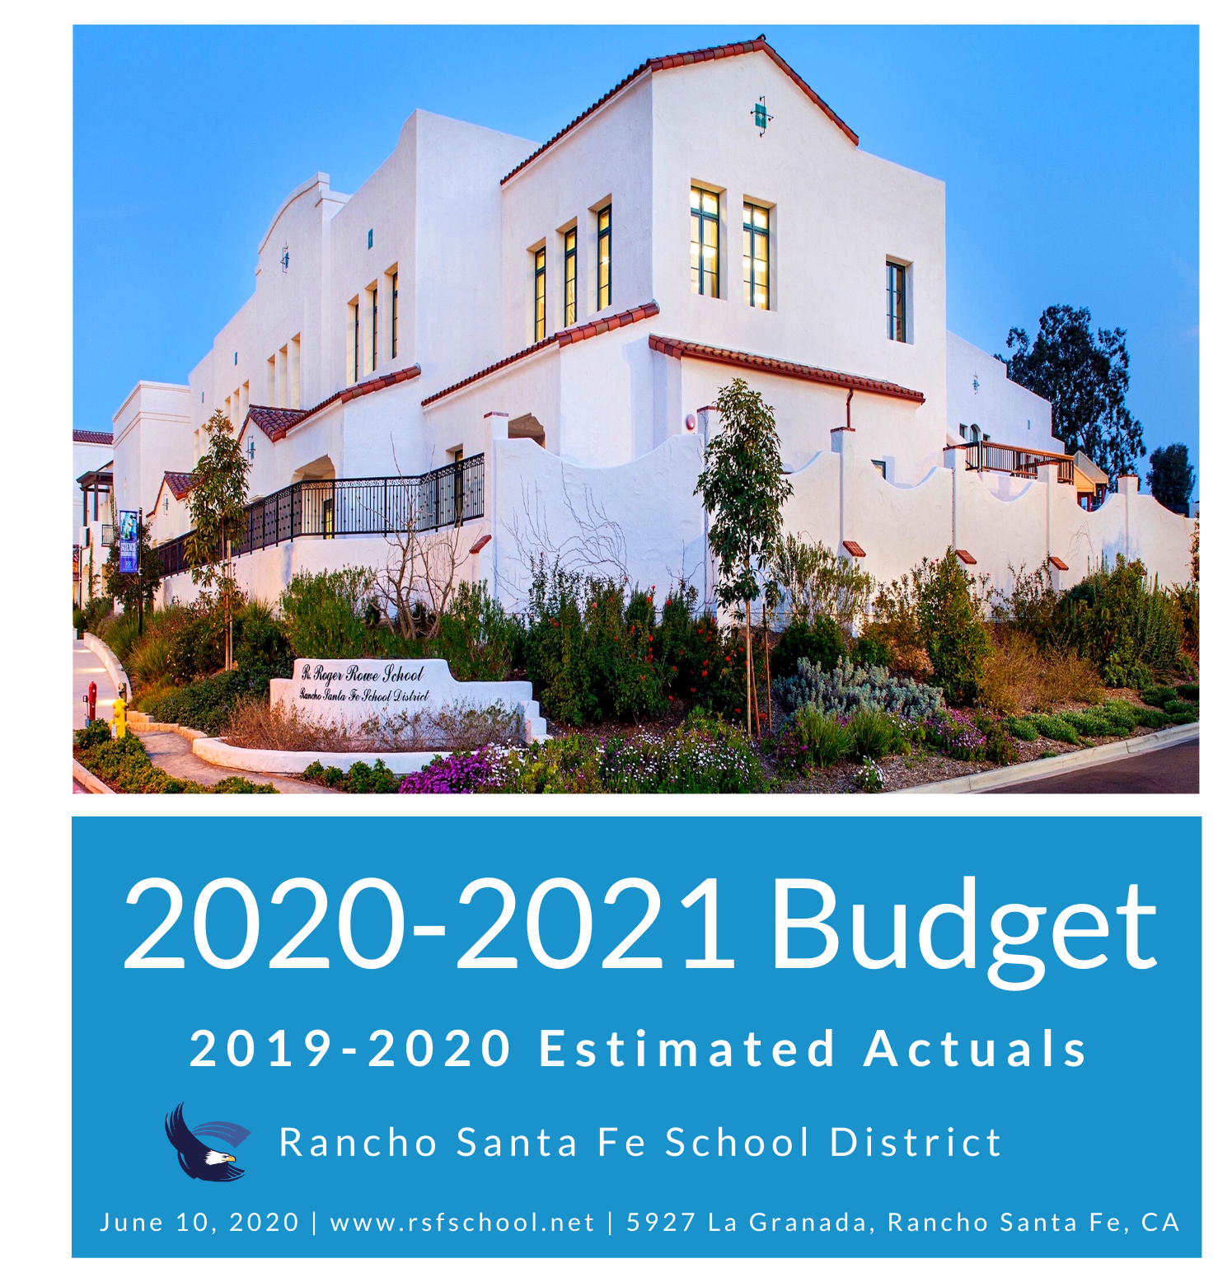

Notes:
02800

Slide 2
Overview
FY19-20 Estimated Actuals
FY20-21 Proposed Budget
  Revenues, Expenditures & Ending Balance
  Proposed Desired Transfer
Enrollment & ADA
Class Size Projections
Staffing Summary FY20-21
Multi-Year Projections/Assumptions
Discussion
Notes:
Brief overview of budget presentation.

Slide 3
FY19-20 – Estimated Actuals
Category | FY19-20 Adopted Budget | FY19-20 1st Interim Budget | FY19-20 2nd Interim Budget | FY19-20 Projected (as of 6.5.20)
Beginning Balance | $843,645 | $981,825 | $981,825 | $981,825
Add: Revenues | $12,069,350 | $12,639,536 | $12,639,536 | $12,635,282
Less: Expenditures | $11,119,373 | $12,051,465 | $12,016,466 | $11,946,875
Ending Balance Before Transfer(s) | $1,793,622 | $1,569,896 | $1,604,895 | $1,670,232
Transfer In/(Out) | $504,628 | $504,628 | $504,628 | $430,923
Ending Balance | $1,288,994 | $1,065,268 | $1,100,267 | $1,239,309
Total (Deficit)/Surplus: | 949,974 | 588,071 | 623,070 | 688,407

Slide 4
FY20-21 Proposed Budget - Revenues
Category | FY19-20 Est. Actuals | FY20-21 Proposed Budget | Variance
LCFF/EPA | $273,113 | $248,717 | (24,396)
Property Taxes | $9,746,630 | $9,747, 591 | $961
Foundation & Endowment | $900,000 | $650,000 | ($250,000)
Other State* | $1,232,914 | $755,185 | ($477,729)
Special Education | $335,124 | $329,034 | ($6,090)
Other Local | $147,501 | $115,000 | ($32,501)
Total: | $12,635,282 | $11,845,527 | ($789,755)
*Includes STRS on Behalf
Notes:
LCFF/EPA down due to ADA & Negative COLA. 0% property tax increase. Foundation and Endowment down due to fewer families and lower “ask” per family. Other state down due to no one-time funding and grants. Special Ed flat. Other Local includes less rental & interest due to COIVD
Other State includes STRS on Behalf, the 20-21 Budget amount will change @1st interim with the audited actuals

Slide 5
FY20-21 Proposed Budget – Expenditures
Category | FY19-20 Est. Actuals | FY20-21 Proposed Budget | Variance
Certificated Salaries | $5,061,122 | $5,187,857 | ($126,735)
Classified Salaries | $1,885,742 | $1,857,482 | $28,260
Benefits | $3,340,112 | $3,065,214* | $274,898
Supplies & Materials | $699,037 | $495,683 | $203,354
Contracts, Utilities, Other | $960,862 | $1,113,663 | ($152,801)
Capital Outlay* | $0 | $52,000* | $52,000*
Total: | $11,946,875 | $11,771,899 | $278,976
*Includes STRS on Behalf
Notes:
All changes in labor reflect updated staffing levels, including step and column and STRS/PERS increases.
Certificated salary includes the additional staff(one additional teacher & one Counselor)
The Benefit amount will increase for 20-21 once the actual STRS on Behalf amount is calculated based on audited actuals@1st Interim
The supplies budget may change drastically once all COVID expenditures requirements are established. COVID expenditure has been set aside as part of statement of excess funds under the reserve Fund
Contract are higher due to special education costs(MOU) & needed consultants.
*Capital Outlay is estimated cost of GYM repair, funds have been assigned under deferred maintenance fund as needed. The final cost will be reflected on 1st Interim reporting

Slide 6
Multi-Year Cost Of CALSTRS & CALPERS
Fiscal Year | CALSTRS Rate for Employer(%) | District Contribution | CALPERS Rate for Employer(%) | District Contribution
2017-18 | 14.43 | $626,911 | 15.53 | $213,834
2018-19 | 16.28 | $812,871 | 18.06 | $247,902
2019-20 | 17.10 | $925,197 | 19.72 | $301,542
2020-21 | 18.48 | $968,299 | 22.68 | $381,703
Notes:
The District contribution rates are set by CALSTRS & CALPERS .
This is a breakdown of the District cost over the last few years and the upcoming budget

Slide 7
FY20-21 Proposed Budget – Ending Balance
Category | FY19-20 Est. Actuals | FY20-21 Proposed Budget
Beginning Balance | $981,828 | $1,164,413
Add: Revenues | $12,635,282 | $11,845,527
Less: Expenditures | $11,946,875 | $11,771,899*
Ending Balance Before Transfer(s) | $1,670,235. | $1,238,041
Transfer In/(Out) | $430,923 | 0
Ending Balance | $1,239,312 | $1,238,041
Total (Deficit)/Surplus: | 688,407 | $73,628
Notes:
The expenditure total reflects the $52,000 proposed GYM repair, reflected @ 1st Interim
STRS on Behalf is also reflected under Expenditures & will change @ 1st Interim

Slide 8
Staffing Summary FY20-21
Category | FTE | Headcount | Salary & Benefits
Teachers (non SPED) | 37.78 | 39 | $4,700,531
Teachers (Intervention) | 4.00 | 4.00 | $522,634
Teacher Support (Paraprofessionals) | 7.00 | *7.50 | $322,757
School Admin/Support* | 5.5 | 6 | $629,858
Special Education Teachers | 3.00 | 3.00 | $317,348
Special Education Admin/Support | 9.5 | 10.00 | $682,801
Notes:
School Admin includes, School Health & Retired principal
Paraprofessional includes 50% Rosie Martinez

Slide 9
Staffing Summary FY20-21
Category | FTE | Headcount | Salary & Benefits
Superintendent inc. Supt/Business Support | 2.00 | 2.00 | $361,643
Business Services | 2.50 | *2.50 | $334,386
Facilities | 5.00 | 5.00 | $599,091
Foundation | 1.00 | 1.00 | $80,913
Technology | 3.75 | 4.00 | $564,916
Total | 81.03 | 84.00 | $9,142,878
Substitutes, Summer Work, Hourly Music, Athletics, Robotics, Stipends, OPEB |  |  | $433,368
Grand Total |  |  | $9,550,246
Notes:
* Business Services Head Count includes purchasing for 50% position

Slide 10
FY20-21 Desired Reserve Wish List
Category | Amount
Technology Reserve | $90,000
Deferred Maintenance | $200,000
OPEB Trust | $73,705
Total Reserve Transfer: | $363,705
Notes:
The desired reserve wish list set aside is included in case of improved economic outlook and excess surplus, which is unknown at this time due to unexpected COVID requirements.

Slide 11
Multi-Year Projections/Assumptions
Enrollment/ADA – Declining over next 10 years per demographic study.
Property Tax Revenues assumes 0% annual increase for FY20-21 and 2% for FY21-22, 2% thereafter.
One-time state revenues no longer forecasted.
Decrease in annual Foundation contribution based on declining enrollment. Staffing structure TBD.
Healthcare costs continue to climb, adding pressure to employee needs.
STRS and PERS continue to increase.
Remaining MYP assumptions listed in budget book.

Slide 12
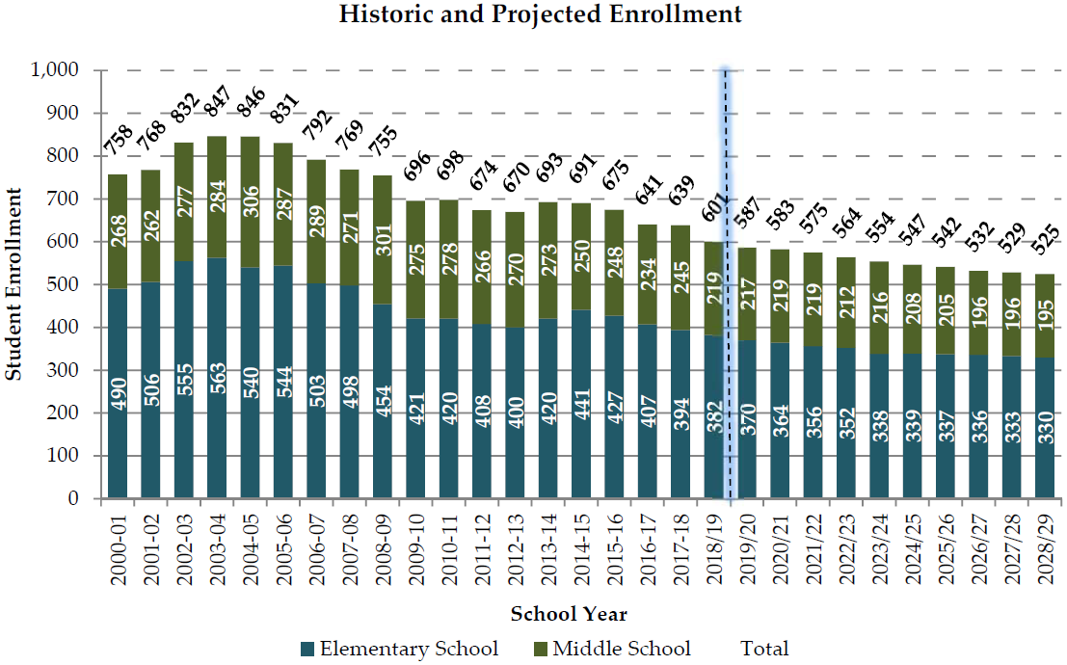
Enrollment & ADA
Study Conducted
Enrollment 19/20 563 vs. 587
Enrollment 20/21 550 (estimated)

Slide 13
Class Size Projections
Grade | FY19-20 Enrollment (6.3.20)* | FY20-21 Enrollment | FY20-21 Packets Out | Total | FY19-20 vs. FY20-21
K | 37 | 17 | 16* | 33 | (4)
1 | 49 | 36 | 4 | 40 | (9)
2 | 57 | 49 | 2 | 51 | (6)
3 | 55 | 56 | 3 | 59 | 4
4 | 65 | 55 | 3 | 58 | (7)
5 | 77 | 64 | 0 | 64 | (13)
SDC | 5 | 4 | 2** | 6 | 1
6 | 79 | 75 | 1 | 76 | (3)
7 | 69 | 75 | 1 | 76 | 7
8 | 74 | 66 | 1 | 67 | (7)
Total: | 567 | 497 | 33 | 530 | (37)
*Packets out, in addition to inquiries.
**Enrollment based on the outcome of IEP meetings.
Notes:
Explain each column.

Slide 14
Average Projected Class Sizes - Elementary
Grade | Expected Enrollment | Total Teachers | Average Class Size
K | 35 | 2 | 17.5
1 | 42 | 2 (3) | 21 (14.00)
2 | 52 | 3 | 17.33
3 | 62 | 3 (4) | 20.66 (15.5)
4 | 61 | 4 | 15.25
5 | 66 | 4 | 16.5
SDC | 4 | 1 | N/A
Total | 322 | 18 (20) 1 SDC teacher | 17.88 (16.1)
Summary does not include Special Education resource teacher (1), Intervention teachers (4), K-3 Engineering teacher (.4), Enrichment teachers (shared with middle school) or Physical Education (1.38 FTE K-8).

Slide 15
Possible COVID Related Projects
Project | Estimated Expenditure
Shade structure extension – Kindergarten area | $20,000+
Shade structure(s) for middle school area(s)
Shade structure for area on upper field | $35,000+
Additional hand washing stations converting water fountains
Additional hand washing stations in front of classrooms
Additional hand washing stations added to restrooms on the asphalt

Slide 16
Discussion
Questions?

