Slide 1






2020-2021
1st Interim Budget
December 8, 2020

Slide 2
Overview
FY20-21 1st Interim Budget
                Revenues
                Expenditures
                Ending Balance
                COVID Revenues
                Multi-Year Projections
                Discussion

Slide 3
Projected Revenues
Category | FY 20-21 45-Day Budget | FY20-21 1st Int. Budget | Variance
LCFF/EPA | $248,717 | $248,717 | $0
Property Taxes (No Special Ed) | $9,712,779 | $10,028,444 | $315,665
Foundation & Endowment | $650,000 | $650,000 | $0
Federal Revenues | $282,880 | $288,932 | $6052
Other State* | $795,350 | $795,350 | $0
Special Education (All) | $269,388 | $314,961 | $45,573
Other Local | $115,000 | $128,575 | $13,575
Total: | $12,074,114 | $12,454,979 | $380,865
Notes:
Property taxes adjusted due to J29 report from the County. The taxes have been adjusted to an approx.3.25% increase.
The Federal funds have been increase due to increased funding
Other State includes STRS on Behalf
Special Education has received more categorical funding
Other local includes a one time donation for COVID & sale of an IPAD

Slide 4
Projected Expenses
Category | FY20-21 45-Day Budget | FY20-21 1st Int. Budget | Variance
Certificated Salaries | $5,268,923 | $5,335,491 | $66,568
Classified Salaries | $1,857,481 | $1,880,518 | $23,037
Benefits* | $3,083,927 | $3,067,926 | ($16,001)
Supplies & Materials | $568,348 | $584,329 | $15,981
Contracts, Utilities, Ins., Other | $1,169,523 | $1,317,083 | $147,560
Capital Outlay* | $0 | $52,000 | $52,000
Total: | $11,948.202 | $12,237,347 | $289,145
Notes:
Certificated salaries have been increased due to additional contract percentage increases. There was an step increase in the assistant principal that was not reflected on the original budget, differential in salary for additional FTE to replace a teacher on leave .
Classified Salaries have been increased due to an additional para professional aide, some overtime. This may be adjusted down in 2nd Interim, depending on the timing on hiring for assistant to the Superintendent & a new
CBO.
Benefits were adjusted due to STRS/PERS deductions. Part of the benefits is also STRS on behalf.
We have had to increase the supplies & materials due to extra demand, however, if conditions improve, these numbers maybe adjusted at a later time.
Contracts and utilities have increased due to increased maintenance needs, additional services for COVID testing has been needed.
These may be adjusted down as conditions improve.
Capital outlay was not originally budgeted, however, it had been discussed and is coming from the set aside

Slide 5
Projected Ending Balance
Category | FY20-21 45-Day Budget | FY20-21 1st Int. Budget | Variance
Beginning Balance* | $1,576,662 | $1,576,662 | $0
Add: Revenues | $12,074,114 | $12,454,979 | $380,865
Less: Expenditures | $11,948,202 | $12,237,347 | $289,145
Transfer In/(Out) | $0 | $0 | $0
Ending Balance: | $1,702,574 | $1,794,294 | $91,720
(Deficit)/Surplus | $125,912 | $217,632 | $91,720
*
Beginning Balance updated during FY19-20 Unaudited Actuals.

Slide 6
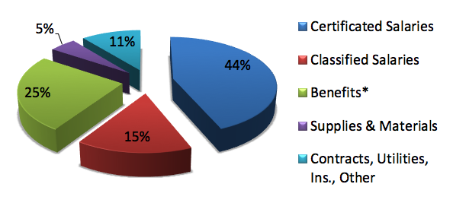
REVENUES
EXPENDITURES

Slide 7
COVID | Federal | State | ^{Donation} ^{One time}
Revenue | CRF Fund $156,830 | GEER Fund $32,201 | $13,375
 | LLMF Fund $40,165 | There has not been any expenditures out of this resource as of 10/31/2020 | There has not been any expenditures out of this resource as of 10/31/2020
Notes:
Federal Fund CRF will need to be spent by 12/31/2020. Federal Fund LLMF will need to be spent by June 20th, 2021.
State Fund GEER can be spent by September 30th,2022. The Federal Funds have all been received. The State Funds are due around January or February, 2021.
The one time donation can be spent at anytime during the fiscal year

Slide 8
Multi-Year Projections
Declining Enrollment will continue for foreseeable future
                Property tax revenues assume an average of 3.25% for
                20-21.The assumption for 21-22 & 22-23 will be @2%
                One-time Federal COVID revenues not anticipated in future years
                Foundation fundraising efforts may be impacted by declining enrollment.
                Step & Column Avgs. – Certificated = 1.75%, Classified 1.25%
                STRS and PERS will continue to increase by 2-3% annually.
                Moderate healthcare costs projected year over year.

Slide 9
HAPPY HOLIDAYS!
QUESTIONS?

