Slide 1


Statewide Required Implementation of Computer Based Testing (CBT)

Slide 2
Plans for Full Implementation of CBT in Grades 3-8
NYSED is planning on districts leveraging the increase in technology infrastructure that has occurred in the last two years
  “Historic infusions of federal and state funding in the form of COVID-response grants and state aid increases have made available critical fiscal resources that can assist districts and charter schools needing to upgrade their infrastructure and devices.” (June 16 CBT Memo)
NYSED will be phasing in required implementation of CBT testing by districts, charters, and BOCES
  “Since the introduction of CBT in the Grades 3-8 ELA and Math testing program, the optional nature of participation in CBT for this program has impacted opportunities to fully harness the benefits of testing on computer.” (June 16 CBT Memo)

Slide 3
Plans for Full Implementation of CBT in Grades 3-8
NYSED is planning on districts leveraging the increase in technology infrastructure that has occurred in the last two years
  “Historic infusions of federal and state funding in the form of COVID-response grants and state aid increases have made available critical fiscal resources that can assist districts and charter schools needing to upgrade their infrastructure and devices.” (June 16 CBT Memo)
NYSED will be phasing in required implementation of CBT testing by districts, charters, and BOCES
  “Since the introduction of CBT in the Grades 3-8 ELA and Math testing program, the optional nature of participation in CBT for this program has impacted opportunities to fully harness the benefits of testing on computer.” (June 16 CBT Memo)

Slide 4
Implementation Schedule of CBT ELA/Math/Science
Spring 2023
  All LEA’s are STRONGLY ENCOURAGED to participate in Stand Alone Field Testing
    LEA’s who have not attempted any CBT in the past should consider this as the minimum level of involvement in 2023
Spring 2024
  All students in grades 5 & 8 will be required to take CBT ELA/Math/Science
  Districts may implement other grades as your ability allows
Spring 2025
  All students in grades 4,5,6 & 8 will be required to take CBT ELA/Math/Science
  Districts may implement other grades as your ability allows
Spring 2026
  Required CBT for all students 3-8

Slide 5
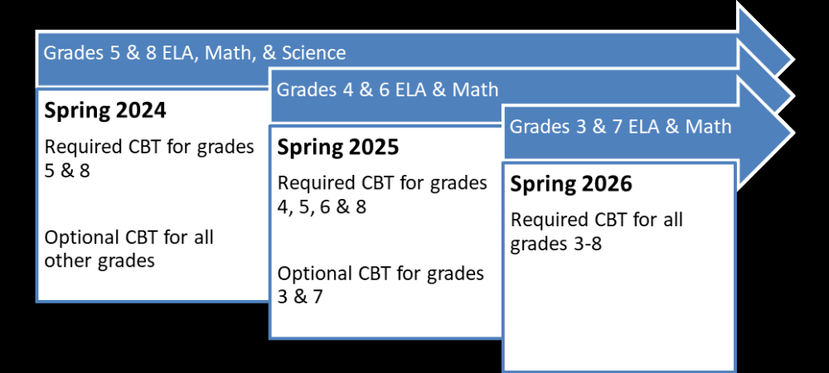
Implementation Schedule of CBT ELA/Math/Science

Slide 6
Implementation Schedule of CBT NYSESLAT & NYSITELL
Spring 2023
  All field testing for the NYSESLAT in Grades 2-12 will move to computer in Spring 2023
  LEAs are Strongly Encouraged to participate in Field Testing “to provide an opportunity for students, teachers, and administrators to become familiar with the testing system prior to full-scale implementation. “(June 16 CBT Memo)
Spring 2024
  NYSESLAT
    All NYSESLAT testing in grades 2-12 will be conducted via CBT
  NYSITELL
    The New York State Identification Test for English Language Learners (NYSITELL) will also be available on computer for Grades 2-12 beginning in Spring 2024

