Slide 1

NYSED Updates
Standards, Instruction, and Educational Technology

Slide 2


Back to School 2022
SED – DOH Joint Guidance and FAQs available
SED supports Multi-Modal Learning
Notes:
- COVID Guidance released August 22. Essentially, follow the most recent CDC guidance.
Continue to leverage multiple modalities to support the needs of students, including virtual and blended learning.
Board presentation in May showcased the wonderful programs the BOCES are offering
NYSED supports the use of technology, including virtual learning, to help schools to continue to meet the needs of students

Slide 3

Digital Access
Each school is required to report information on student access to computing devices and access to internet connectivity in their primary place of residence by June 30.
Notes:
Districts were asked last school year to collect information on student access to devices and broadband in their primary places of residence. We did receive data from many schools, but we need your help with the message that this collection will be an ongoing annual collection.
This data will help districts make instructional decisions; it will give districts a better understanding on what students have at home
At the state level, both NYSED and the Governor’s office are still focused on addressing the digital divide, so this data is critical

Slide 4
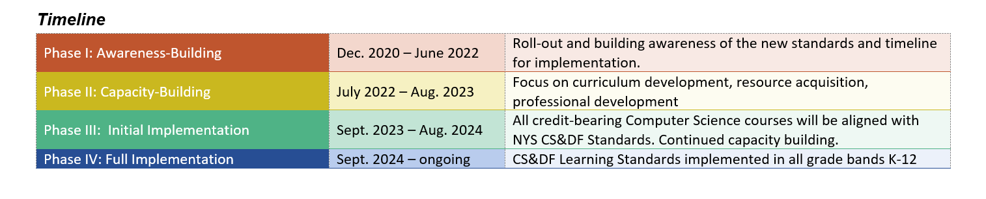
Computer Science and Digital Fluency Standards
Computer Science Certification / SOCE pushed to September 1, 2024
Computer Science considered a CTE subject area
  CDOS Option 1 Diploma Pathway
  Can count towards Middle Level 1.75 units CTE requirement
  Five-unit CTE sequence leading to Regents Diploma with Advanced Designation
Notes:
We know that access to technology isn’t enough – students must know how to use technology safely and effectively. This is where our Digital Fluency Standards come in.
We are currently in the Capacity-Building Phase of the implementation of the new Computer Science and Digital Fluency Standards.
Just to make sure we are all on the same page, Computer Science and Digital Fluency are related but not one content area. Digital Fluency should be incorporated across the subject areas, and our guess is that Model Schools are primarily taking ownership of helping districts plan for and implement the Digital Fluency standards.
As for Computer Science, we do want to make sure everyone knows that the Board is set to approve regulatory and policy change that, as far as NYSED goes, we will consider computer science a CTE subject area. We have received tremendous support on this.

Slide 5
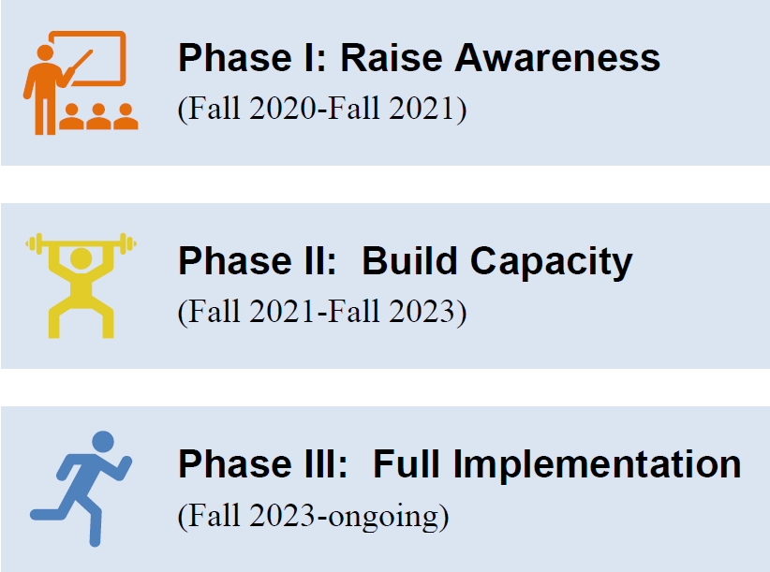

Physical Education Standards
Notes:
The new Phys Ed standards were adopted Fall 2020, and districts should be building moving towards implementation this year.
In addition to what you would expect to see– personal fitness, lifelong fitness, includes wellness, health-enhancing behaviors, social awareness and relationship skills, self- and social awareness, and self-expression and enjoyment.
If you know anyone who wants to move to Albany or Brooklyn and help lead physical education and athletics for State Ed, please encourage them to apply!

Slide 6

ELA, Math, Science Standards
English Language Arts Learning Standards
  Grades PK-8 transition to NGLS
  Spring 2023: First Administration of GR3-8 ELA test aligned to NGLS
Mathematics Learning Standards
  Grades 3-8 transition to NGLS (PK-2 began 2019-20)
  Spring 2023: First Administration of GR3-8 ELA test aligned to NGLS
Science Learning Standards
  Grades 4 and 7 new standards (Pk-3 and 6 began 2019-20)
  Spring 2023: No Grade 4 Science Test, these students will take Grade 5 Science Test in Spring 2024. Last administration of Grade 8 science test aligned to 1996 Standards.
Notes:
For ELA, Math, and Science, this is an important year.

Slide 7
Implementation Timelines
Instruction in New/Revised Standards
2021
2022
2023
2024
2025
September 2021:
PK-3 Science
September 2022:
Science, Grades 4 and 7
PK-8 ELA
PK-8 Math
September 2023:
Science, Grades 5 and 8
Grade 9 ELA
Algebra I*
September 2024:
Biology and Earth & Space Science courses*
Grade 10 ELA
Geometry*
September 2025:
Chemistry and Physics courses*
Grade 11 ELA*
Algebra II*
* Credit-bearing courses aligned to Regents Exams
Notes:
Looking forward, in the 2023-24 school year and beyond, through the 2025-26 school year, additional grades will transition to the new standards.

Slide 8
Computer-Based Testing (CBT)
Grades 5 & 8 ELA, Math, Science
Spring 2024
Grades 4 & 6 ELA and Math
Spring 2025
Grades 3 and 7 ELA and Math
Spring 2026
Required CBT for grades 5 & 8
Optional CBT for all other Grades
Required CBT for grades 4, 5, 6 and 8
Optional CBT for grades 3 and 7
Required CBT for all grades 3-8
Notes:
Speaking of ELA, Math, and Science assessments, I’m sure you saw the June 16, 2022 memo regarding computer-based testing.
Starting in Spring of 2024, schools will begin the transition to CBT.

Slide 9
Graduation Measures Timeline
November 2019 – March 2020:
  Regional meetings held beginning Jan. – Mar. 2020 to gather feedback from across the state.
March 2020: All workshops canceled due to COVID-19 pandemic.
Fall 2021 – Spring 2022: Workshops held in virtual format.
Spring / Summer 2022: Compile Regional Meeting feedback.
Fall 2022:
  Present regional meeting and literature review findings to the Board.
  Establish the Blue Ribbon Commission (BRC) and draft meeting schedule.
Phase I: Information Gathering & Learning
Phase II: Blue Ribbon Commission
Fall 2022 – Winter / Spring 2023:
  Commission’s first meeting – the BRC convenes and defines its scope of work.
  Blue Ribbon Commission second meeting to identify priority areas and a framework for moving forward. Establish sub-groups for priority areas.
Winter 2023 – Spring 2023: Sub-groups meet.
Spring 2023 – Summer 2023: Sub-groups develop proposed recommendations.
Fall 2023 – Winter 2024: Sub-groups advance recommendations to the BRC.
Winter 2024 – Spring 2024: The BRC finalizes recommendations, and a report is prepared.
Spring / Summer 2024: The Blue Ribbon Commission’s final report is presented to the Board of Regents for consideration.
Phase III: Regents Discussion
9
Notes:
The Graduation Measures work continues
The Blue Ribbon Commission will be announced at the September Board of Regents Meeting

Slide 10

Culturally Responsive-Sustaining Webinar Series
Webinar 1: Laying the Groundwork and Planting the Seed
Date and Time: August 23, 2002 at 9:30–10:30 a.m. (ET)
Registration: https://wested.zoom.us/webinar/register/WN_f_u63BFHQOC_kJjZN4Q18g
In this webinar, leaders from Dansville School District and South Huntington will share how they laid the groundwork for their initiatives and activities that brought continued professional learning and rigorous instruction to their schools and districts.
Webinar 2: Cultivating Collaborative Communities
Date and Time: September 22, 2022 at 3:00–4:30 p.m. (ET)
Registration: https://wested.zoom.us/webinar/register/WN_-fNKNlptQ1O3iZjmyJOXHg
In this webinar, leaders from Eastern Suffolk BOCES, Onondaga Nation School, and Buffalo School District will present a range of collaborative approaches to implement components of the CRSE Framework
Webinar 3: Nourishing Student Voice and Growth
Date and Time: October 4, 2022 at 11:00 a.m.–12:00 noon (ET)
Registration: https://wested.zoom.us/webinar/register/WN_Bw8Mv7mUTSylyL0QrzokSg
In this webinar, leaders from West Irondequoit School District and Yonkers School District will share information about initiatives that have supported student growth, highlighted student strengths, and amplified student voices.
Webinar 4: Sustaining Healthy Growing Conditions for Learning
Date and Time: November 2, 2022 at 3:00–4:00 p.m. (ET)
Registration: https://wested.zoom.us/webinar/register/WN__Gx1DxJNTtuTINE4579oiA
In this webinar, leaders from Western Suffolk BOCES and Penfield School District present on how they are sustaining the work related to the CRSE Framework across multiple initiatives and with attention to multiple stakeholders.
10
Notes:
We are really pleased about our CRSE webinar series
The first webinar was held last week, and it was wonderful to hear from colleagues across the state on how they are approaching this work.
We will be publishing the recordings and links to related materials in late Fall.
We continue to be so appreciative of SCDN’s partnership in this work

Slide 11

Office of Standards & Instruction
(518) 474-5922 nysed.gov/curriculum-instruction emscurric@nysed.gov
Office of Educational Design and Technology
(518) 474-5461 nysed.gov/edtech edtech@nysed.gov

