Slide 1

Educational Support Services
(ESS)
Services & Announcements
September – October 2022
Visit our website for more information!
https://www.esboces.org/Page/41
Educational Support Services:
Working Together to Support Excellence in Education

Slide 2


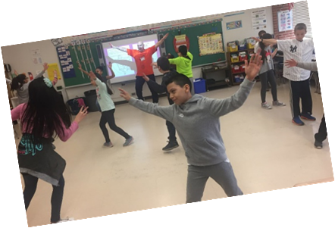
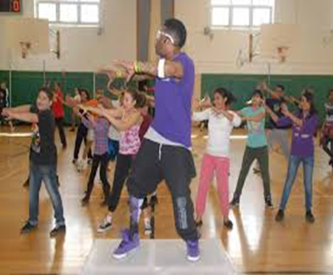

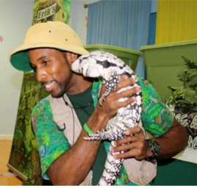


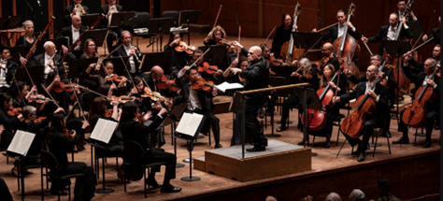

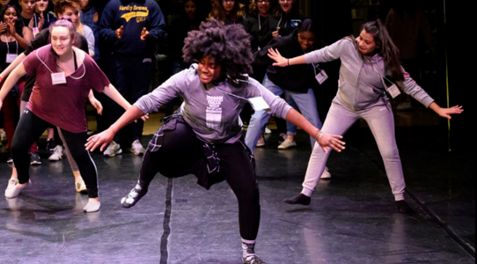
Arts-in-Education/Exploratory Enrichment
http://artsined.esboces.org
In-Person, On-Site, Virtual, Outdoor and Socially Distant Experiences for Students and Teachers
Our online catalog is categorized by program description, various art form, curriculum areas, standards alignment, and grade level suitability.
BROADWAY, THEATRE, DRAMA – Broadway Live/Virtual, Shakespeare, Bilingual Drama, In School Performances
SCHOOL PRODUCTIONS – Live, Virtual, Live Stream
FILM, STORYTELLING, AUTHORS – Film Studies, Dr. Seuss, PARP, Poetry, Puppets
MUSIC, DANCE – Hip Hop, Children’s Story, Traditional, Global Dance, Global Music
VISUAL ARTS, MUSEUMS – Tours, Artifact Loan, Professional Development, Murals, Animation
HISTORY – Indigenous People, Tuskegee Air, Holocaust Survivors, Scavenger Hunt, Global Artifacts
OUTDOOR AND ADVENTURE – Reptiles, Environmental, Cornell Cooperative, Quogue Wildlife, Dogsledding Stories
SCIENCE – Brookhaven Lab, Mad Science, Weather
TOURS and TRIPS – Medieval Times, Boat Trips, Museums
MAGIC, CIRCUS, INTERACTIVE GAME SHOW
CULTURALLY RESPONSIVE – SUSTAINING EDUCATION - programs in every subject area to support DEI, SEL, CIVIC ENGAGEMENT, SOCIAL JUSTICE, and more.
For information contact Loretta Corbisiero-Drakos, lcorbisi@esboces.org, (631) 286-6988

Slide 3


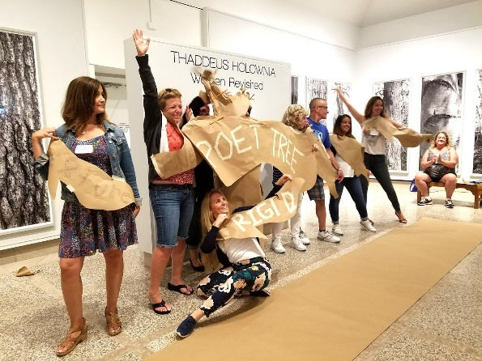
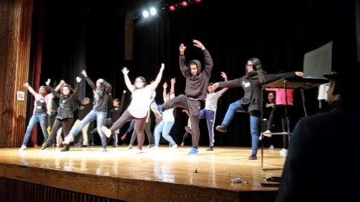
Arts-in-Education/Exploratory Enrichment
PEACE - Partners in Education, Arts, & Community Empowerment
Patchogue Arts Council • Museum of Contemporary Art L.I. awarded a 1.8 million grant
from the US Department of Education for Assistance for Arts Education (AAE)
What is PEACE?
A program that empowers educators in Suffolk County middle and high schools to make more effective use of the arts, ensuring that students have an equitable opportunity to succeed at college, careers, and in their civic lives. This is made possible through a collaboration among cultural partners.
How will PEACE succeed?
Support for Educators: Arts-based professional development for educators and community cultural partners through:
Annual summer institute June 28 & 29
Monthly online community of practice
Monthly gatherings at cultural partner events
CTLE credit and certificate of completion
Critical Community of Practice: Ongoing curriculum support to use arts based partnerships and instruction
Provide Resources: Coordinated resources among schools and cultural partners
Contemporary Relevance: Dissemination of best practices, materials, and methods
What does PEACE include?
Tuition for a limited number of educators to attend the ES BOCES the PEACE Institute
Stipend for attendance
VIP access to cultural partner events
Museum membership
CTLE hours
Teaching artist / arts experience for their classrooms
Participation in Arts Conference
Opportunity for student ambassadors for PEACE
How to get involved?
Complete the application on Patchogue Arts Council’s website – available March 15th

Slide 4

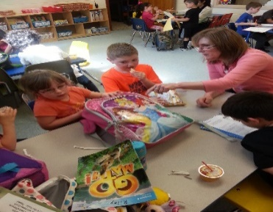
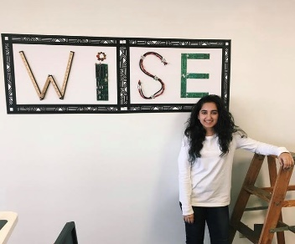
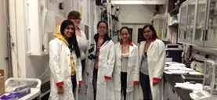
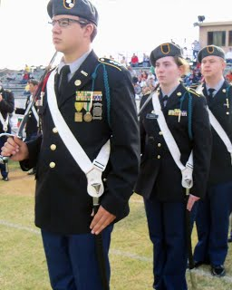
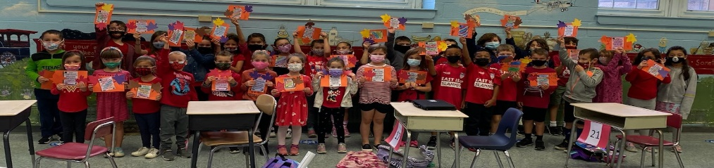
Enrichment Programs
Junior Naval/Air Force ROTC – Patchogue-Medford and William Floyd School Districts – one unit of cadets is ten students. We have openings for our Air Force JROTC program – please contact our office if interested!
Women in Science and Engineering (WISE) at Stony Brook University: WISE aims to encourage young women to pursue STEM by linking Stony Brook University graduate and faculty mentors with high school students. Middle School WISE develops students’ competence and confidence in their math and science abilities by providing an intensive multi-level program that integrates science, technology, engineering, arts, and mathematics (STEAM) with mentoring and application based hands-on activities in lab space provided by the participating district.
School Year Extended Day Student Enrichment: To provide for the needs of their community’s working parents, the district can choose the hours of extended day enrichment to best suit their needs. This Eastern Suffolk BOCES service provides students with the opportunity to enhance their learning during an extended day program to include homework assistance and a variety of enrichment opportunities.
For more information contact School Year Enrichment:
schoolyearenrichment@esboces.org or (631) 244-4250
Check out our website: https://www.esboces.org/Page/626
Notes:
Junior Naval/Air Force ROTC
We are currently operating programs in the Patchogue-Medford and William Floyd High Schools in grades 9-12 for the Navy and Air Force Junior Reserve Officers Training Corps programs. My role is to work with the instructors directly and to assist in providing the staff and students with field trips and leadership professional development. I recently worked with a national presenter to help facilitate a “7 Habits of Highly Effective Teens” leadership workshop with 172 cadets at the Instructional Support Center.
Regional Scoring Services
We are currently offering “Full Service” scoring for ELA, Mathematics, and Science in Grades 3-8 and regional scoring sessions for the NYSESLAT and New York State Alternate assessments. I work directly with a local electronic scoring vendor to assist the districts in getting their students’ assessments scored.
Science Programs
For science enrichment, we coordinate a variety of programs for Eastern, Western and Nassau BOCES component school districts. The Long Island Science and Engineering Fair (LISEF) is a project based competition with 413 students from 26 districts participating across Long Island. We offer the Women in Science and Engineering (WISE) program to 65 young women from 5 component school districts in collaboration with SUNY Stony Brook to encourage them to explore the sciences and entice them to go into STEM careers. I work with each individual provider to coordinate these programs with our districts.
Year Round Enrichment Programs
In addition, we coordinate the Extended-Day Year Round Enrichment program in the Comsewogue School District to provide before and after school enrichment to students in grades K-6. I work in collaboration with a BOCES appointed Director to hire and appoint staff, provide clubs and field trips, order supplies as well as collaborate with the staff to continuously improve the program.

Slide 5



Model Schools
To Register: http://webreg.esboces.org
Model Schools Liaison Meeting
October 6th 9AM-11AM
In-Person at 750 Waverly Avenue, Holtsville, NY
Long Island Technology and Education Summit
October 21st 8:30 AM-2:30 PM
In-Person at the Huntington Hilton, Melville, NY
For information contact Heather Ciccone, hciccone@esboces.org, (631) 288-9568

Slide 6
Model Schools
To Register: http://webreg.esboces.org
Upcoming Workshops
Thursday, September 29, 2022 • 2:30 pm – 4:00 pm • Transform your Classroom with Pear Drive
Tuesday, September 30, 2022 • 2:00 pm – 3:00 pm • Getting Students Organized with Google Drive
Tuesday, October 4, 2022 • 8:30 am – 9:30 am • Chromebook Tips and Tricks
Thursday, October 13, 2022 • 9:00 am – 10:30 am • Nearpod for Novices
Tuesday, October 18, 2022 • 9:00 am – 11:00 am • Digital Citizenship for Classroom Instruction
Wednesday, October 19, 2022 • 8:30 am – 9:30 am • Digital Citizenship for Classroom Instruction
Thursday, October 20, 2022 • 9:00 am – 3:00 pm • 3D Printing – Fall Session (In-Person at ISC @Sequoya)
Monday, October 24, 2022 • 3:00 pm – 4:00 pm • Creating a Classroom Website Using Google Sites (In-Person at ISC @Sequoya)
Tuesday, October 25, 2022 • 2:30 pm – 4:00 pm • Digital Content and Activities with Discovery Education
Friday, October 28, 2022 • 11:30 am – 12:30 pm • Creating Your Own Instructional Videos
For information contact Heather Ciccone, hciccone@esboces.org, (631) 288-9568

Slide 7
Model Schools
To Register: http://webreg.esboces.org
Third Party Assessments
Upcoming Events
Wednesday, September 7, 2022 • Aimsweb Plus – Teacher Essentials Regional Training
Thursday, September 8, 2022 • Aimsweb Plus – Back to School 2022 Updates
Friday, September 9, 2022 • i-Ready New Teacher/Admin. Training
Tuesday, September 13, 2022 • i-Ready New Teacher/Admin. Training
Wednesday, September 14, 2022 • Aimsweb Plus – Back to School 2022 Updates
Thursday, September 15, 2022 • Aimsweb Plus – Teacher Essentials Regional Training
Thursday, September 22, 2022 • LAS Links Online Test Administration Training
Thursday, October 6, 2022 • Right Reason Technologies Fall User Meeting
Thursday, October 6, 2022 • Right Reason Technologies Product Demo
Tuesday, October 11, 2022 • LinkIt! Fall User Meeting
Tuesday, October 11, 2022 • LinkIt! Lunch & Learn Product Demonstration
Monday, October 17, 2022 • Aimsweb Plus Fall User Meeting (2 sessions AM & PM)
Thursday, October 20, 2022 • Aimsweb Plus – Reports and Progress Monitoring Regional Training
Tuesday, October 25, 2022 • LAS Links Fall User Meeting
Wednesday, October 26, 2022 • Renaissance (2 sessions AM & PM)
For information contact Heather Ciccone, hciccone@esboces.org, (631) 288-9568

Slide 8



Professional Development
To Register: http://webreg.esboces.org
For information contact Bernadette Gentile, bgentile@esboces.org, (631) 218-4152

Slide 9
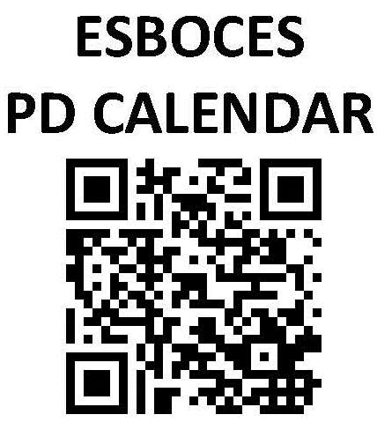
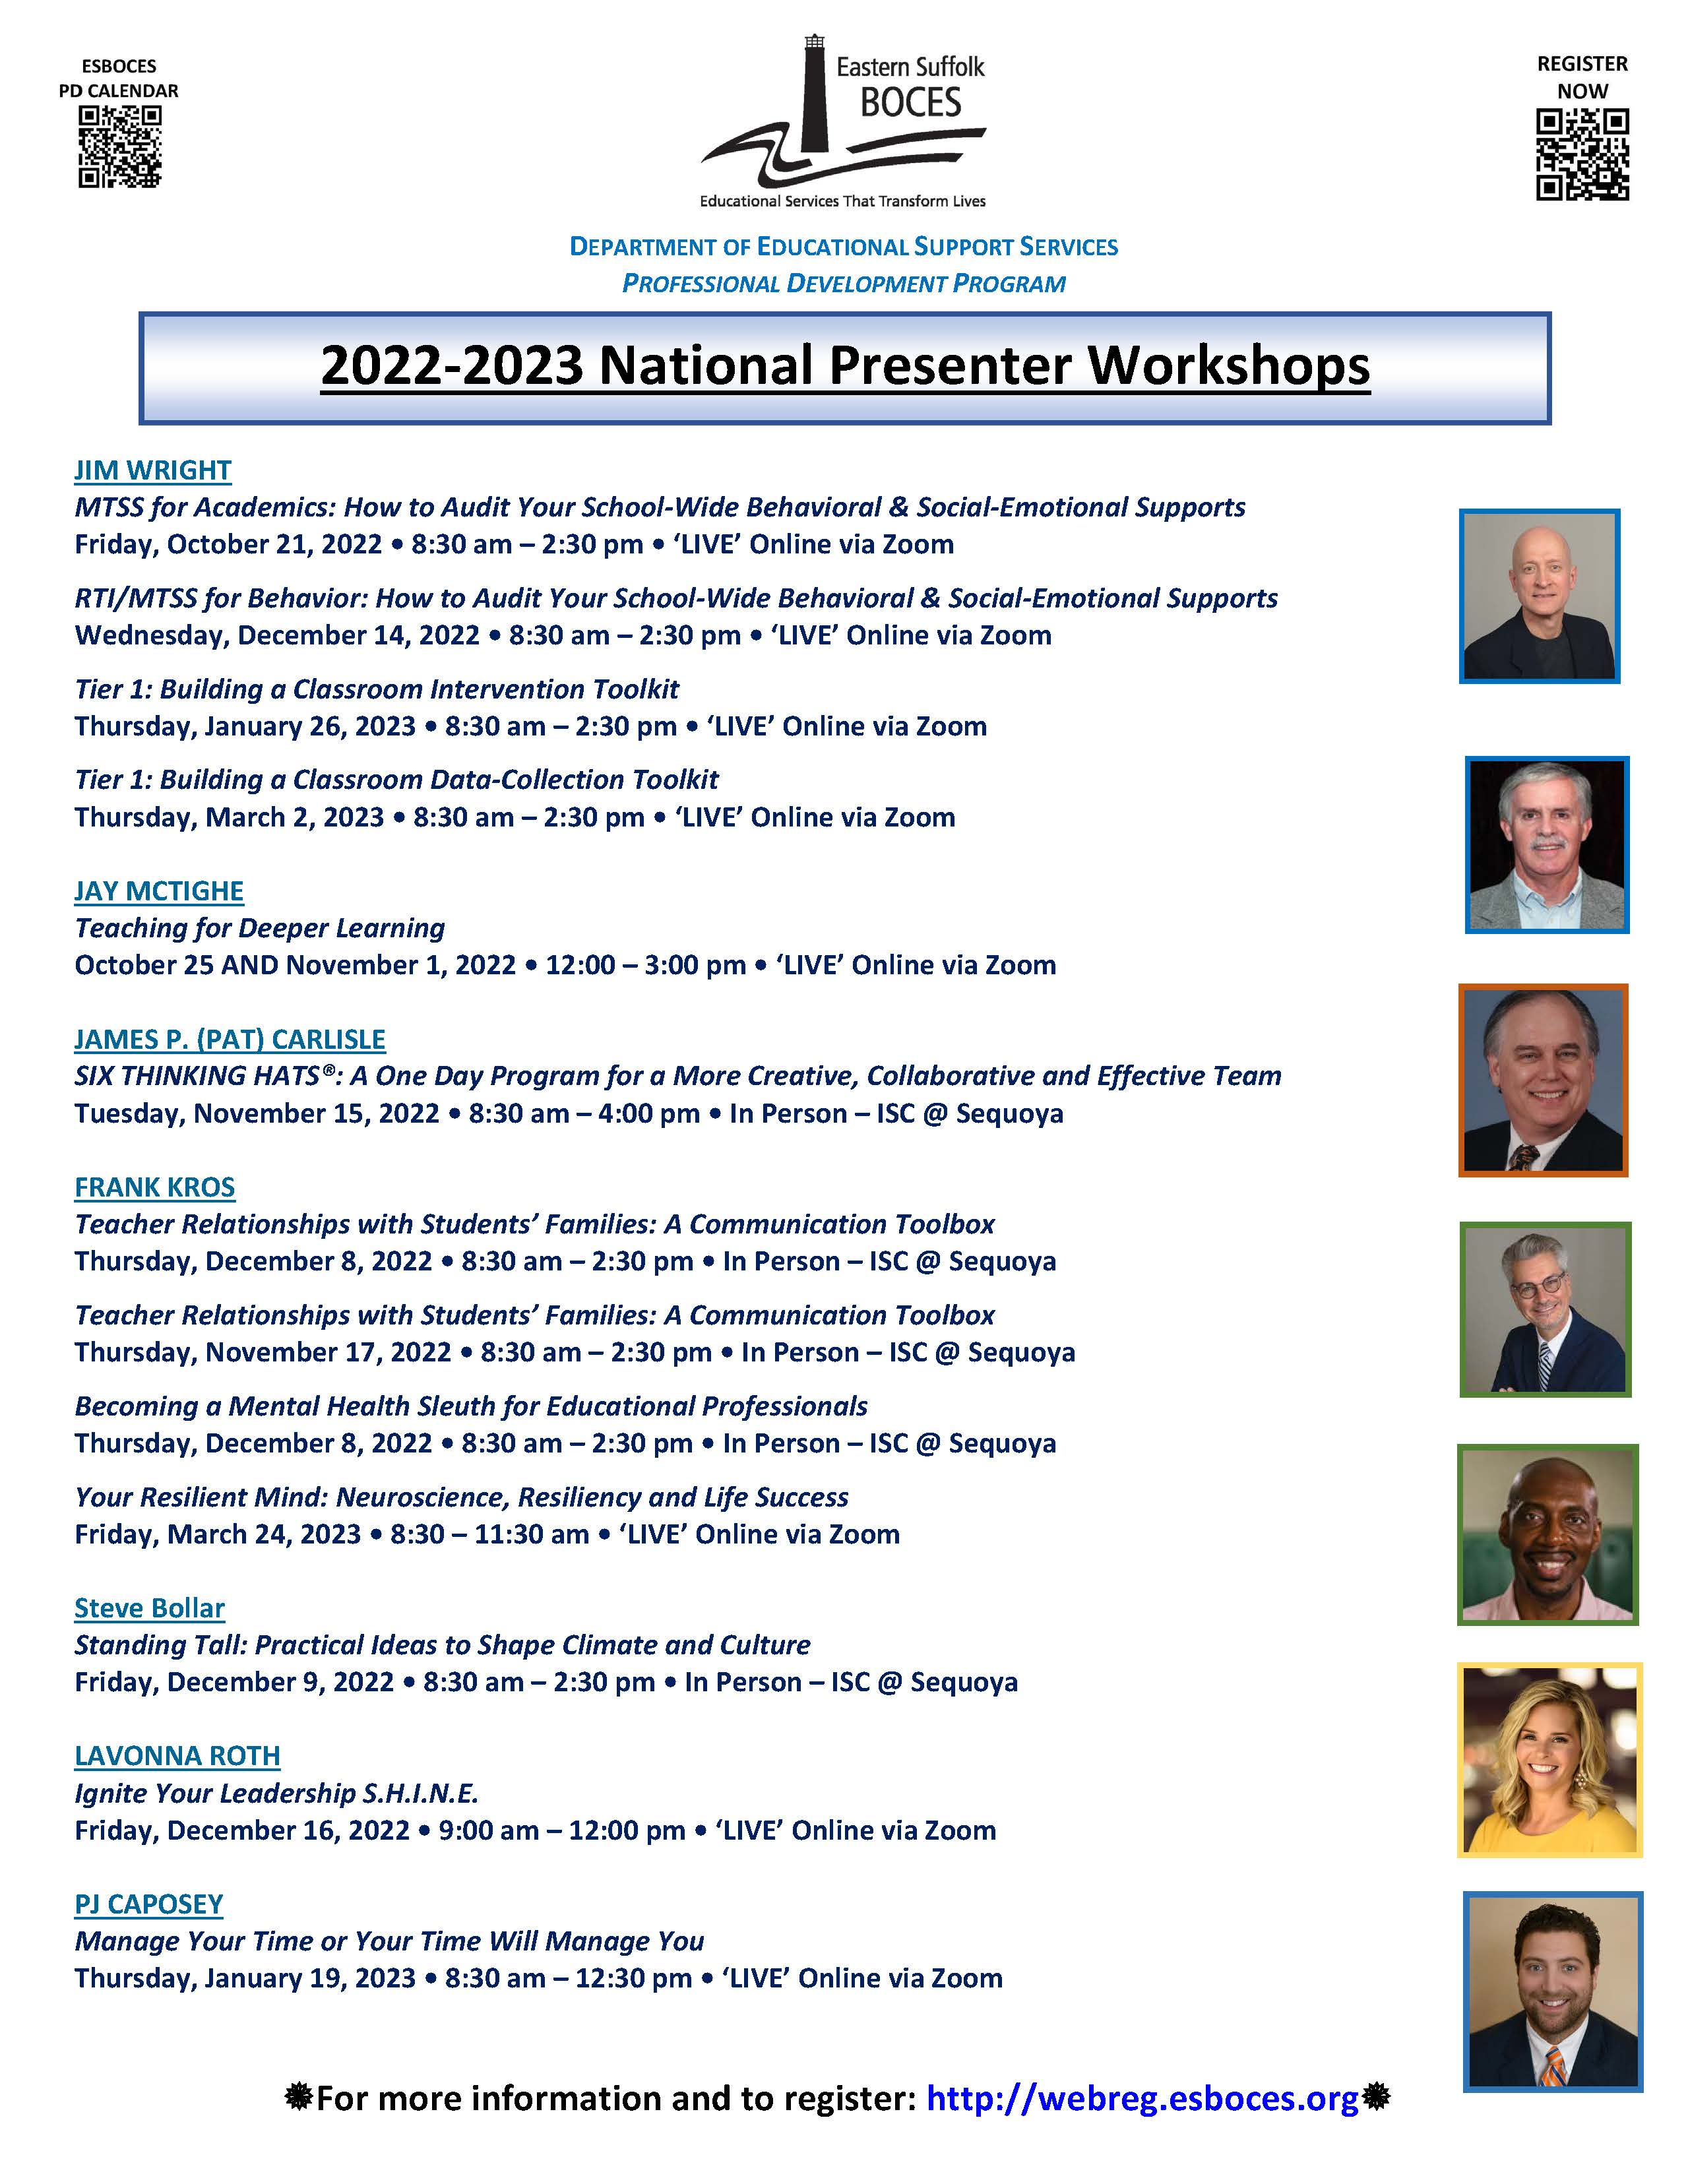
Professional Development
To Register: http://webreg.esboces.org
For information contact Bernadette Gentile, bgentile@esboces.org, (631) 218-4152

Slide 10
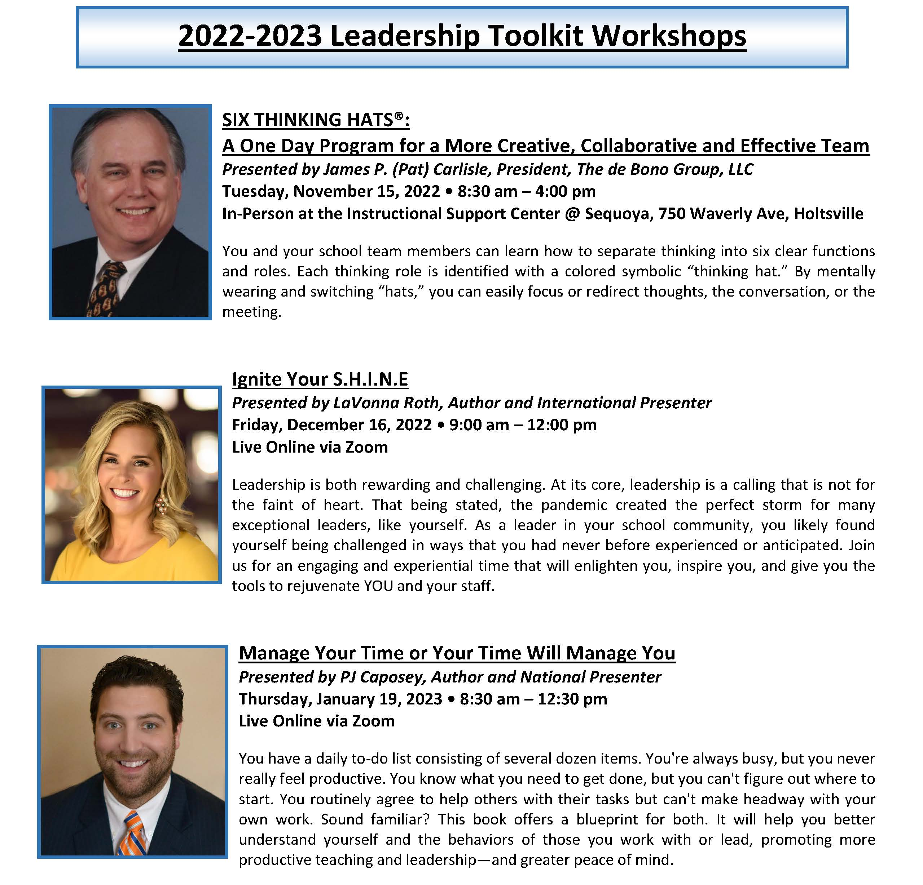

To Register: http://webreg.esboces.org
Professional Development
CIVIC SEAL OF READINESS
WORKSHOPS WITH GREG FREDRICKS
October 20 & November 17, 2022
Civic Seal Two-day Boot Camp for Educators and Leaders 8:30 – 11:30 am ● Zoom
December 1, 2022
Civic Seal for Grades 6-8
8:30 am – 2:30 pm ● Zoom
December 6, 2022
Civic Seal for Grades K-5
8:30 am – 2:30 pm ● Zoom
For information contact Bernadette Gentile, bgentile@esboces.org, (631) 218-4152

Slide 11



Professional Development
To Register: http://webreg.esboces.org
For information contact Bernadette Gentile, bgentile@esboces.org, (631) 218-4152

Slide 12



School Library System
Please contact School Library System
for more information
slshelp@esboces.org
All of our latest workshop offerings can be found here: https://www.esboces.org/Page/1683
Discovery Education Bootcamp
October 12, 2022 ~ 9:00 am – 3:00 pm
Discovery Education continues to empower educators with resources, strategies, and tools for creating quality lessons using multi-modal digital resources. For Back-to-School, we are combining all that teachers and students love about the DE ecosystem with new content to keep all learners curious and engaged. Join us this Fall at Eastern Suffolk BOCES to learn about the best ways to utilize all that Discovery Education has to offer as well as exciting updated features, synchronous and asynchronous activities, assignment templates, background builder lessons, and much more!
RECOMMENDED AUDIENCE:
Technology Integration Specialists, Librarians,
Lead Teachers, Curriculum

Slide 13

School Data Bank Services
Relevant, Timely, and In The Moment
Services & Support We Provide!
Did You Know…
Assessment Services – Full Service Scoring is now a service
Planned, Coordinated and Operated by School Data Bank Services
Annual NYSAA Test Administrator Training [Coming in October & November]
School Data Bank Services provides educators with the opportunity to participate in a facilitator-lead workshop for the administration of the NYS Alternate Assessment for Computer Based Testing. District educators and staff can participate in the following:
Full-Day Workshop – Supports Test Administrators new to the process
Half-Day Refresher Workshop – Supports Test Administrators who participated in the prior years’ administration and training
To learn more about how to register for a workshop, contact Eileen Jaeger at 631-244-4243, SDBS@esboces.org.
For information contact Vanessa Biagioli-Dittrich, vdittric@esboces.org, (631) 419-1688

Slide 14
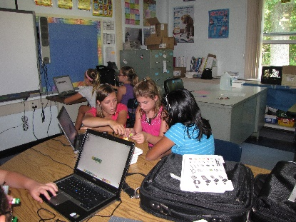
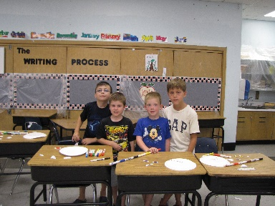
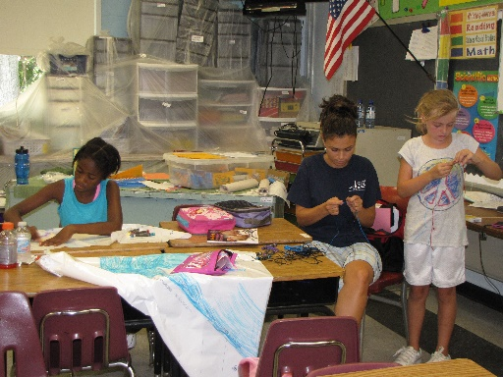
Summer Enrichment
Exciting features of Summer Enrichment:
STEAM activities
Reading instruction
Local field trips
Swimming and outdoor activities
Arts in Education experiences
Who said school cannot be fun and engaging in the summer?
This Eastern Suffolk BOCES service provides students with the opportunity to extend and enhance their learning during a six-week summer enrichment extended day program to include literacy, hands on math, and science along with a variety of enrichment opportunities. Courses include: Robotics, Claymation, Brick Lab, Rocketry, Chef Shop, Reader’s Theater and Oceanography.
For information contact us at
summerenrichment@esboces.org or (631) 244-4293
Check out our website: https://www.esboces.org/Page/625

