Slide 1
Curriculum Council DEI-CRSE Resources:
CR-SE and Math Education
Presented by:
April Francis-Taylor, ESBOCES
Director of DEI
Candace Pinn
DEI Consultant

Slide 2
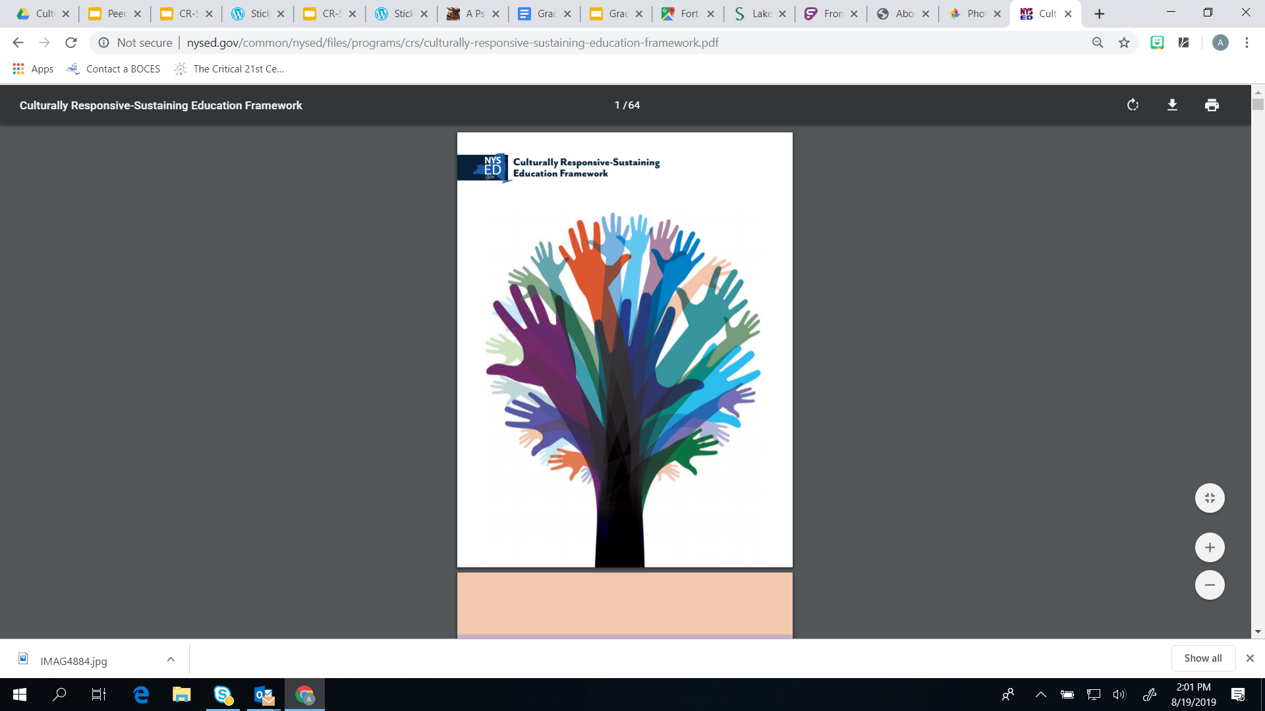
Overarching Themes for DEI/CRSE 22-23 Share
“CR-SE Framework and Curriculum Reviews”
“Equity Walks for Classroom Environments”
“Empowering Student Groups using the CR-SE Framework”

Slide 3
Defining Culturally
Responsive-Sustaining Education
Culturally responsive-sustaining education
is grounded in a cultural view of learning and human development in which multiple expressions of diversity — race, social class, gender, language, sexual orientation, nationality, religion, ability — are recognized and regarded as assets for teaching and learning.

Slide 4
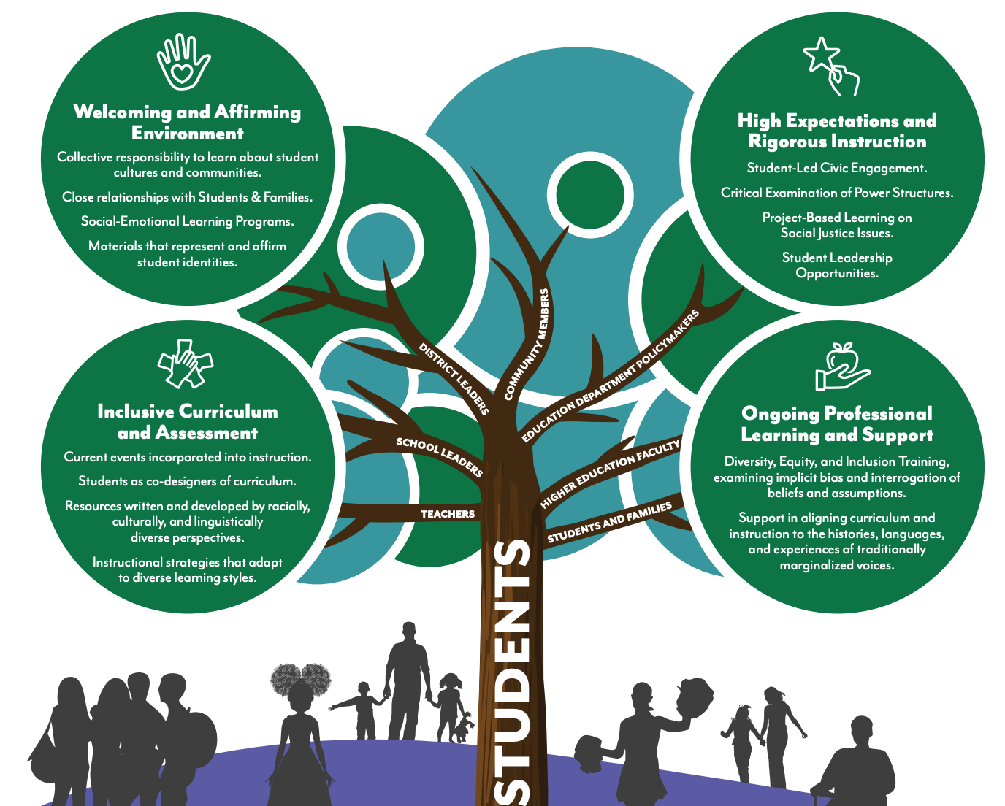

Slide 5
CR-SE and Math Education
Culturally responsive math teaching practices for advancing equity:
Foster students’ math identities as math thinkers and doers
Provide every student with challenges that leverage their strengths while pushing them to grow
Promote meaning-making through discourse and justification
Support students to see each other as capable, valuable learning partners
Connect students’ math learning and doing to their lives through “windows and mirrors”
https://www.edweek.org/teaching-learning/opinion-twelve-ways-to-make-math-more-culturally-responsive/2020/12

Slide 6
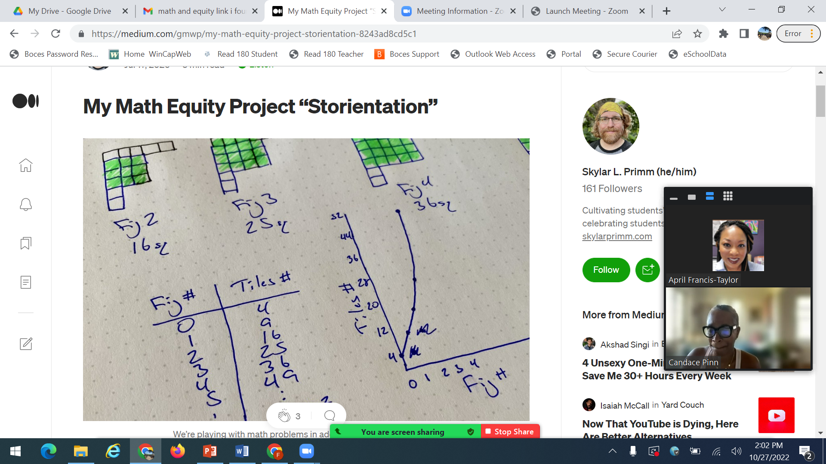
Math “St-orientation”
Your Math story/identity: What is your earliest memory of connecting with math? Was it positive or negative? How has math shaped who you are today? How does it shape how you speak about math to students?
You can write or draw
https://place.education.wisc.edu/k12-programs/math-equity-project/

Slide 7
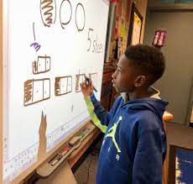
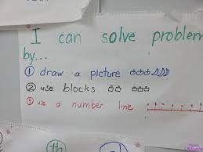
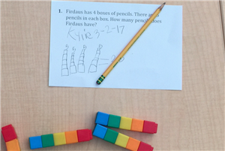
CR-SE in Elementary Math Education
Cognitively Guided Instruction (CGI)- A child centered framework that helps teachers to understand how children's mathematical ideas develop, and provides an opportunity to build on the child's own thinking and understanding.

Slide 8
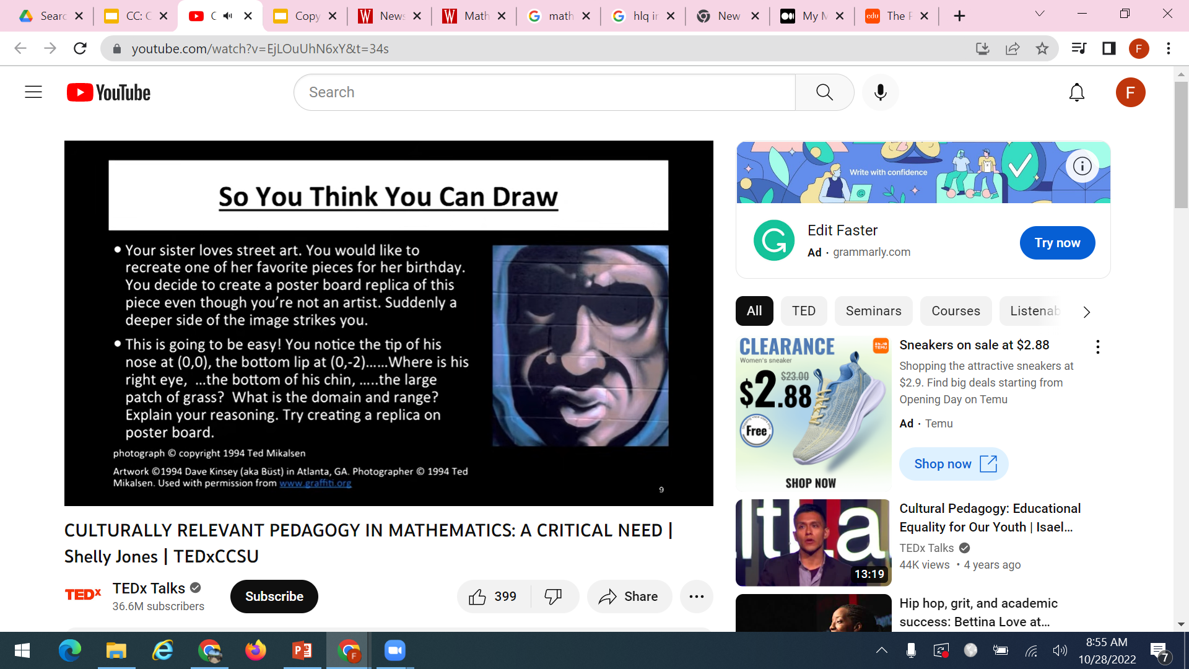
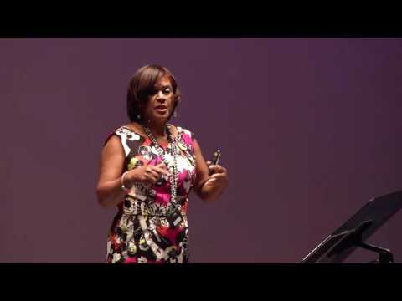
CR-SE in Secondary Math Education

Slide 9
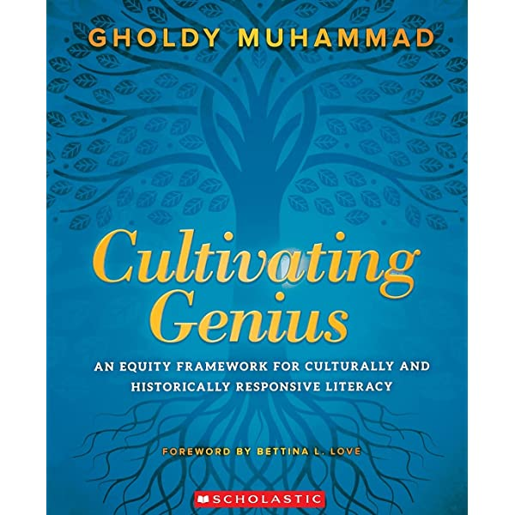
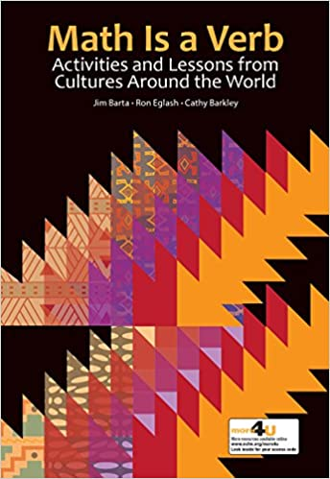
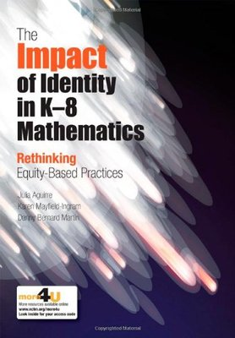
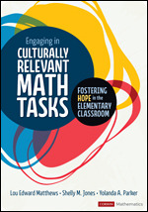
CR-SE and Mathematics Resources

