Slide 1
The Current State of Mental Health in School
Kelly Zinn, DSW, LMSW

Slide 2
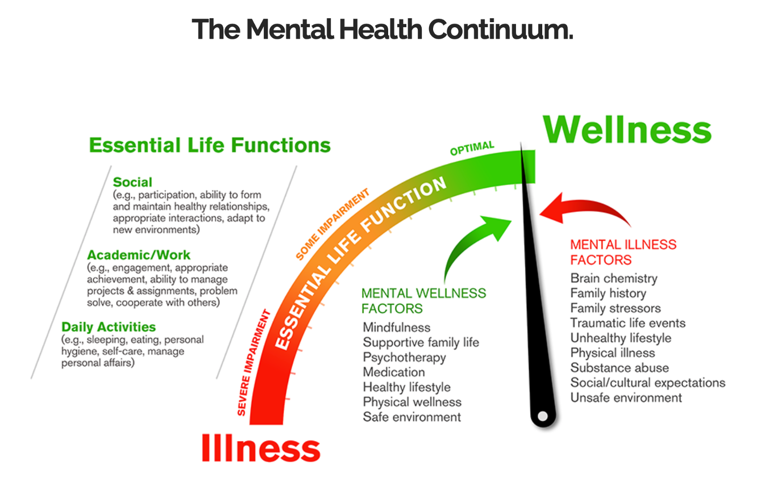
Source: https://ymhproject.org/mental-health/

Slide 3
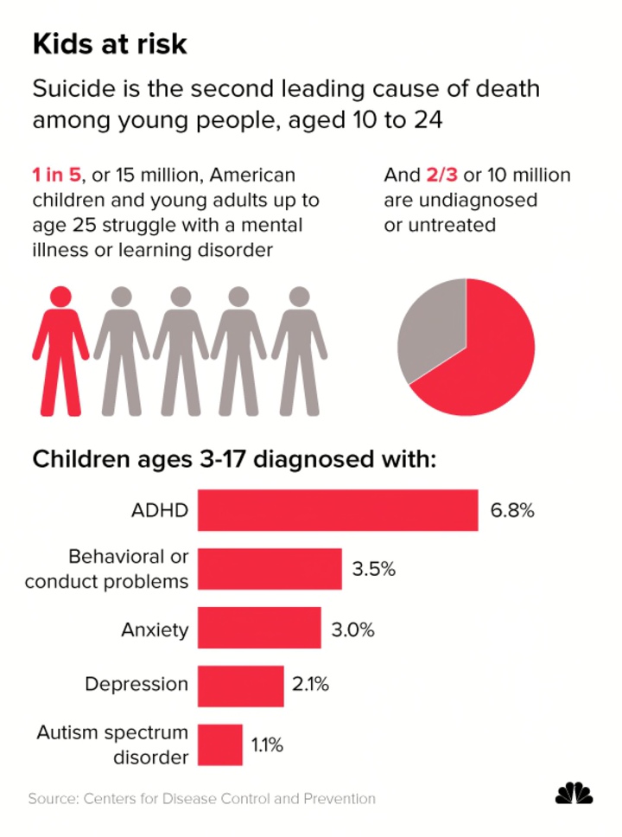
Mental Health Concerns:
Pre-Pandemic
1 in 6 children, aged 2-8, has a mental, behavioral, or developmental disorder (CDC, 2019)

Slide 4
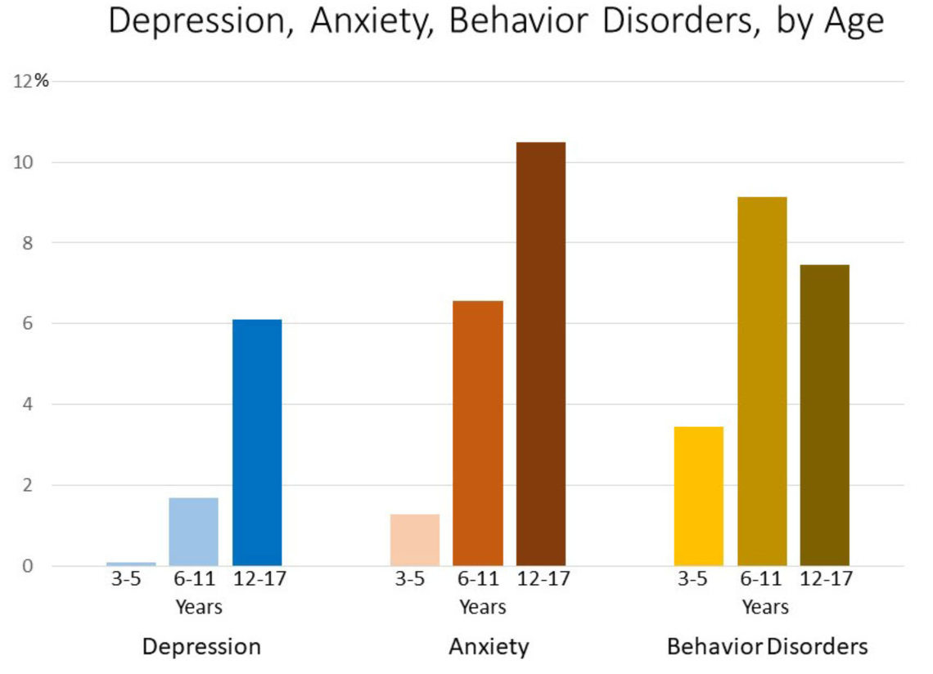
Source: https://www.cdc.gov/childrensmentalhealth/data.html
Notes:
Data is for 2016-2019

Slide 5
Current Mental Health Concerns
A National Emergency in Child & Adolescent Mental Health (AAP–AACAP-CHA, 2021)
Most common concerns: depression, anxiety, suicidal ideation
Anxiety rates in children have doubled since the start of the pandemic (USPSTF, 2022)
USPSTF is recommending pediatricians screen all children ages 8+ for anxiety, 12+ for depression
Less than ⅔ of children experiencing mental health challenges access professional help (Radez et al, 2021)
On average, parents/caregivers wait between 2-8 years from the onset of symptoms before seeking help (Koplewicz, 2021)
Challenging behaviors are often masking underlying mental health conditions

Slide 6
Emotional & Behavioral Challenges
Preschool-aged children:
Disruption to physiologic functions (i.e. sleep, toileting, feeding), increased separation anxiety, regression of skills, irritability, social withdrawal (AAP, 2022)
Elementary school-aged children:
Clinginess, attention seeking, increased dependence on parents (AAP, 2022)
In 2020 children aged 5-11 exhibited a 24% increase in mental health-related ER visits as compared to 2019 (CDC, 2022)
Middle and high school-aged children:
Increased prevalence of eating disorders and tic disorders (particularly in females), as well as depression, anxiety, trauma, stress, and obsessive-compulsive disorders (AAP, 2022)
In 2020 children aged 12-17 exhibited a 31% increase in mental health-related ER visits as compared to 2019 (CDC, 2022)

Slide 7
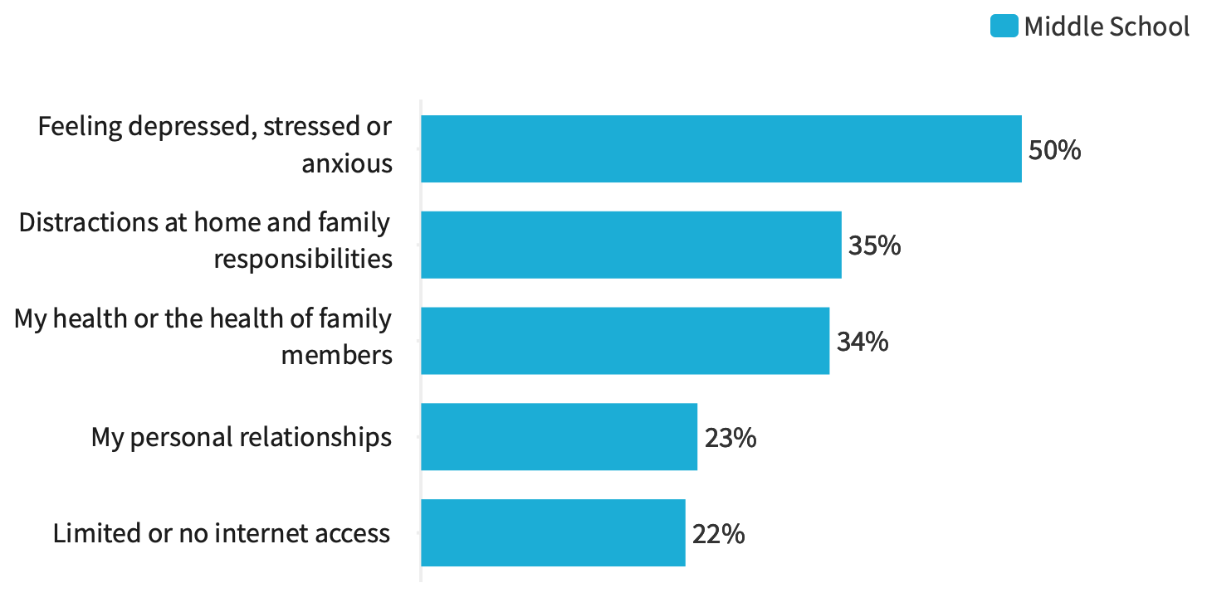
Student-reported obstacles to learning (YouthTruth, 2022)

Slide 8
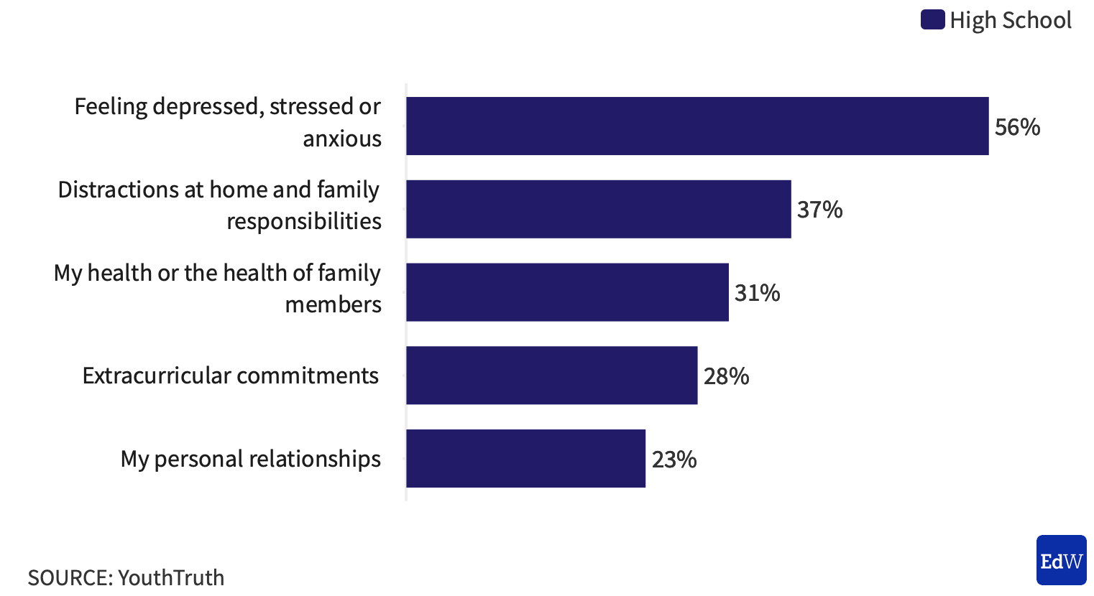

Slide 9
Mental Health Support in Schools
School Based Mental Health Providers | Recommended Ratio | Ratio in New York
School Counselors | 1:250 | 1:350 (ASCA, 20-21)
School Psychologists | 1:500 | 1:638 (NASP, 20-21)
School Social Workers | 1:250 | 1:773 (USDOE, 15-16)

Slide 10
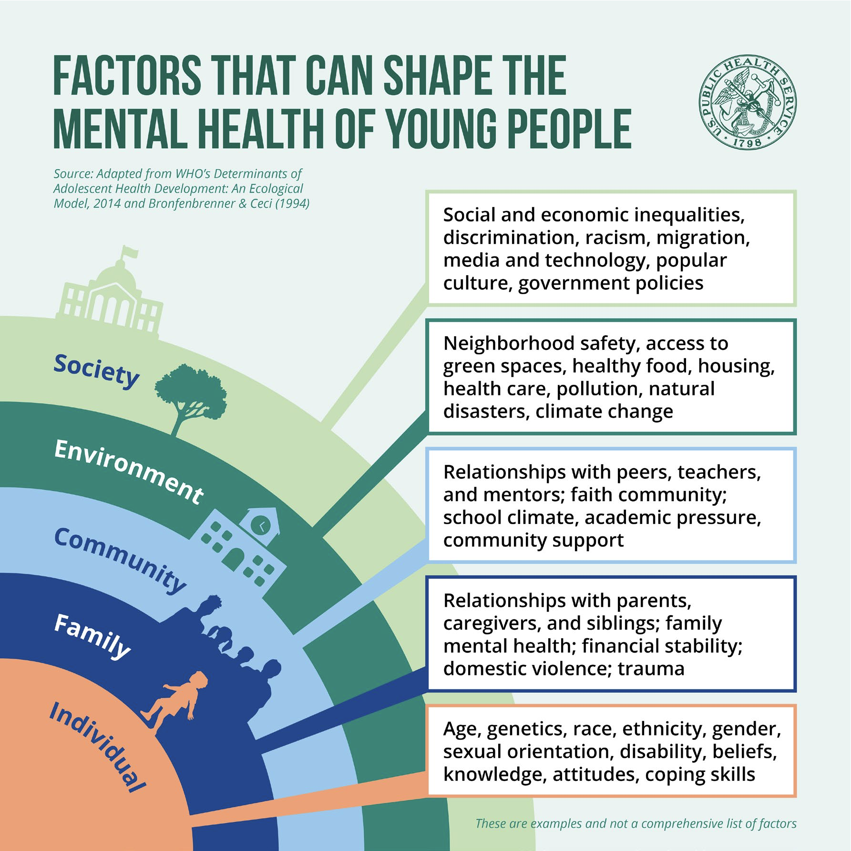
Special Considerations
In the wake of the pandemic, it is important to consider:
The disproportionately negative impact on under resourced populations
Special populations: youth in the LGBTQ+ community, involved in the juvenile justice system, & the child welfare system
The Pair of ACEs: Adverse Childhood Experiences & Adverse Community Environments
Home environment - including parent/caregiver mental health, increase in substance use
Pre-existing mental health, learning, and behavioral challenges may have been exacerbated
Prevalence of risk & protective factors
Individual temperament & ability to self-regulate
Grief & loss

Slide 11

Challenges Can Be Opportunities
Reframe mental health, destigmatize & work towards wellness
Build support into the structure of schools through SEL
Believe in the capacity of the school community to foster resilience through relationship development & growth mindset

