Slide 1

BRC Graduation Measures Update
Presentation For ES & WS BOCES Curriculum Council Meeting – 2/3/2023

Slide 2


Opening Thoughts….
Young People Reimagine Education for the 21st Century

Slide 3

Update
Who is the BRC?
What’s been said and done…
Guiding Questions
Staying Connected to the Work

Slide 4
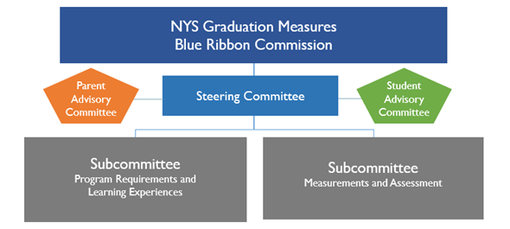
Who is the BRC?
Steering Committee – Liaisons between the subcommittees
Program Requirements and Learning Experiences – courses, experiences and credits
Measurements and Assessments – options

Slide 5

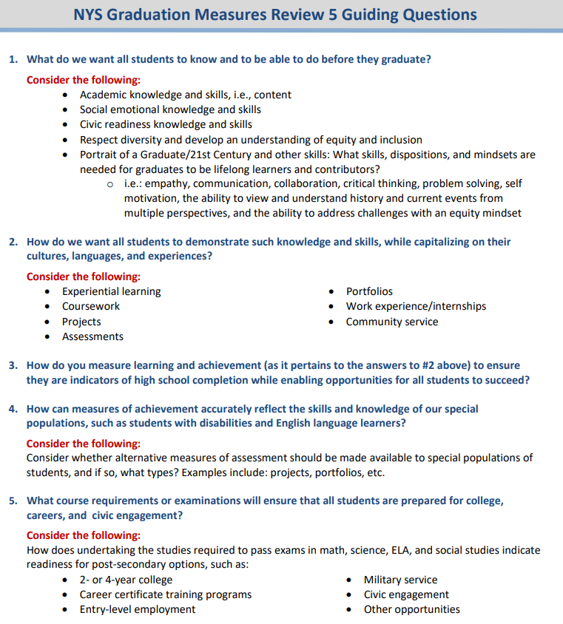
Guiding Questions

Slide 6
What’s been said and done…
Timeline updated
Across three meetings we have established meeting norms, been briefed on and discussed the Graduation Requirements and Measures Comprehensive Report, and reviewed graduation guidelines and documents form other states and nations
There is a focus on articulating the “Portrait of a NYS Graduate”
From the mouth of the members:
  Every student should have a voice in their learning.
  Learning should be hands-on and relevant for all students.
  We need to make sure all students can show their learning.
  We need to reconsider the “why” of education.
  Not every student has the same opportunities for success
  Students are not coming with the skills needed to be a part of the workforce
  We have an opportunity to bring equity to the forefront in a meaningful way.
  Our children have to be prepared for their futures, not ours.
  Must focus on students with disabilities
  Students need to also succeed in areas like CTE pathways.

Slide 7

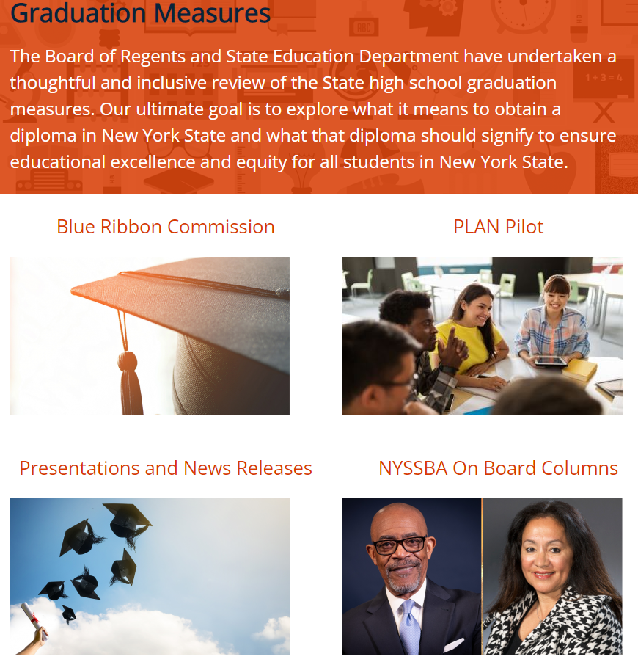
Staying Connected to the Work
Please complete and share broadly thought exchange questions generated by the BRC.
  December Thought Exchange had 1878 Participants, 1831 Thouhgts and 34,274 Rating
  December Question: What are the skills and abilities most needed by NY State graduates to be successful in their chosen post- secondary path?
  January Exchange response window closed yesterday
Visit the NYSED Graduation Measures website.

Slide 8

Thank You!
To contact Chuck: jachanwatkis@rockypoint.k12.ny.us

