Slide 1

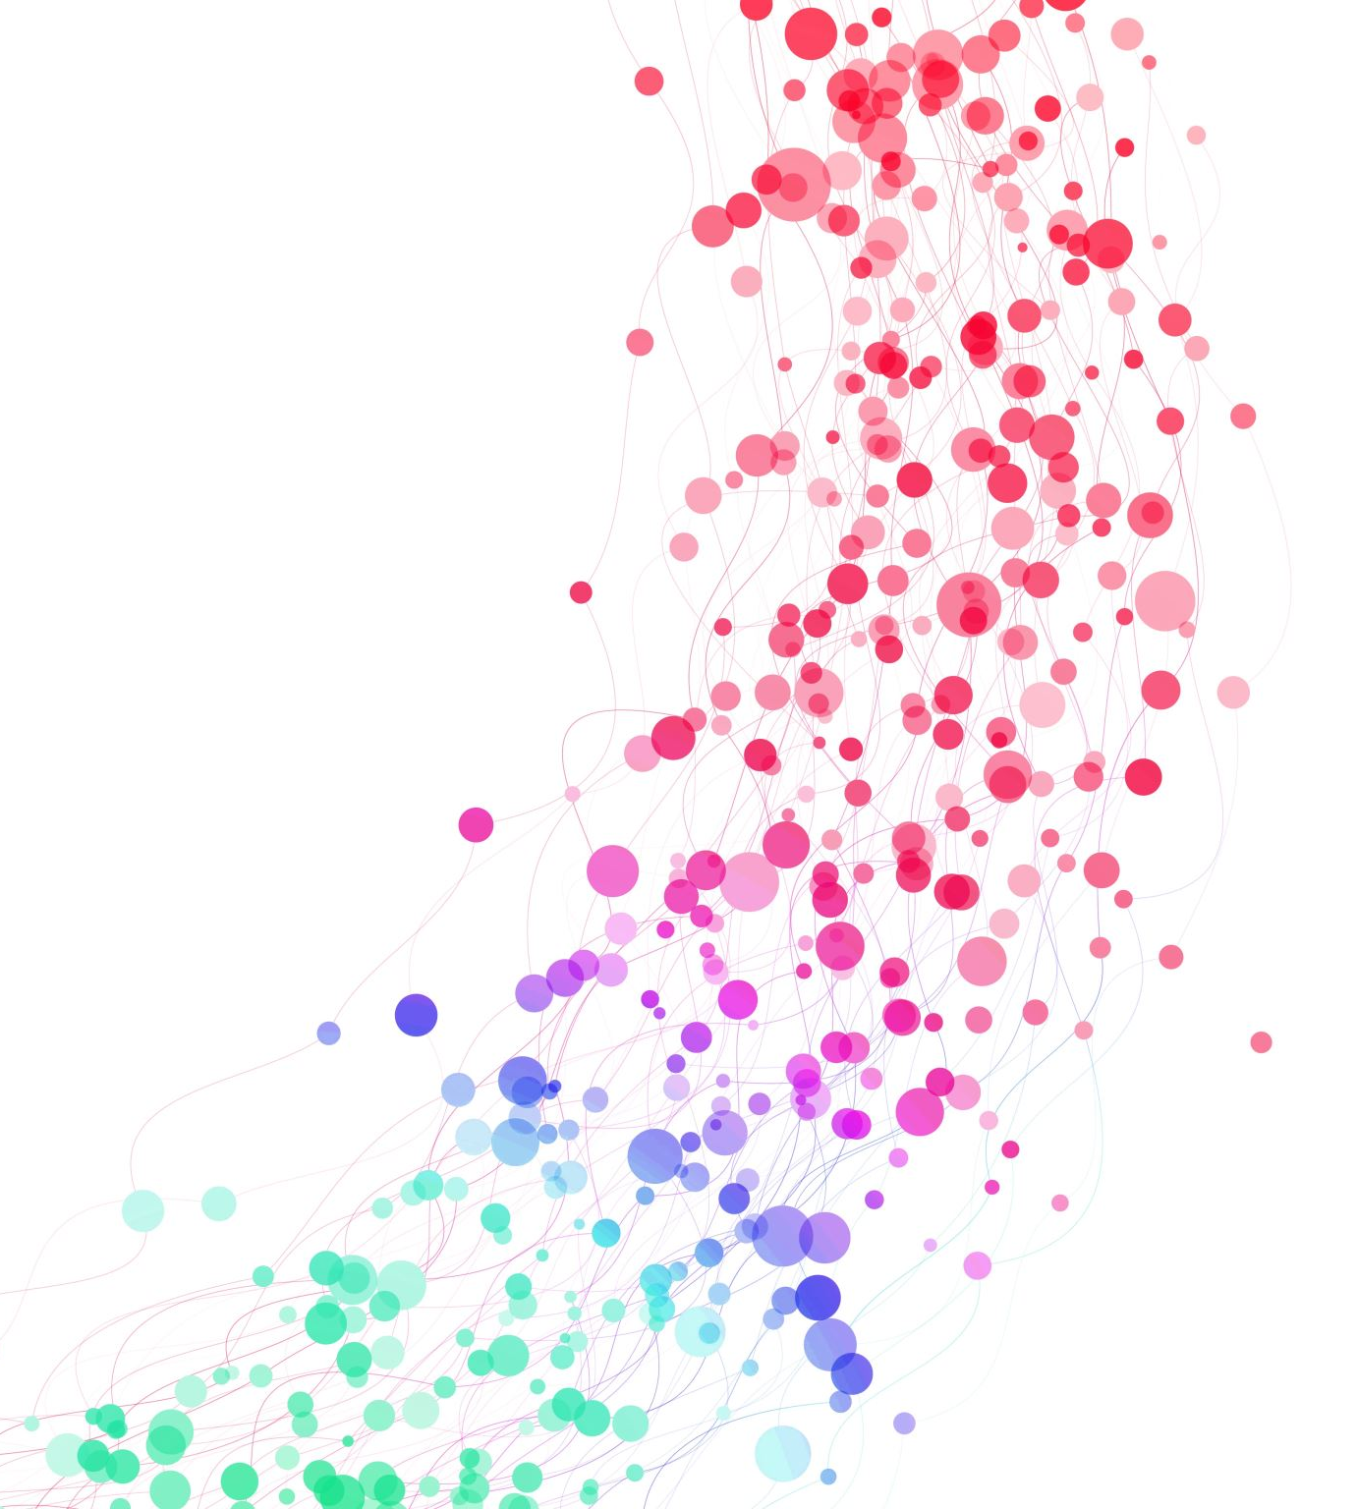
Computer Science
&
Digitial Fluency
Standards
June 9th
Curriculum Council Meeting
Christina Fordham
Educational Technology Coach
Eastern Suffolk BOCES - Model Schools

Slide 2

Agenda
History/Vision of the Computer Science & Digitial Fluency (CS&DF) Standards
Implementation Timeline
NYS Excel Version of Standards with Examples
Resources
Breakout Groups (10 minutes)
Share-Out (5 minutes)

Slide 3
History/Vision of the
CS & DF Standards
The NYS Computer Science and Digital Fluency Standards were adopted by the Board of Regents in 2020.
Every student will know how to live productively and safely in a technology-dominated world

Slide 4
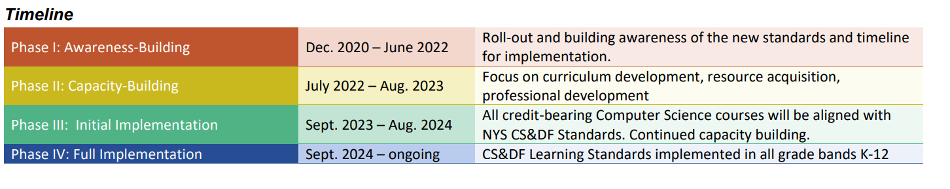
Implementation Timeline

Slide 5
NYSED Excel Version of Standards with Examples

Slide 6
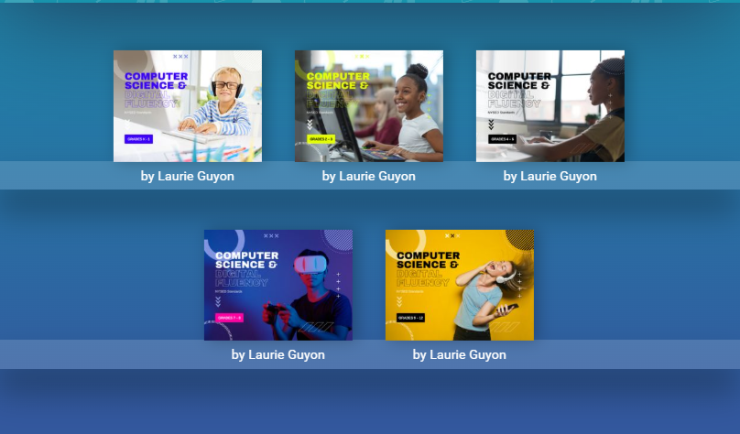
NYSED CS&DF Activities and Examples

Slide 7
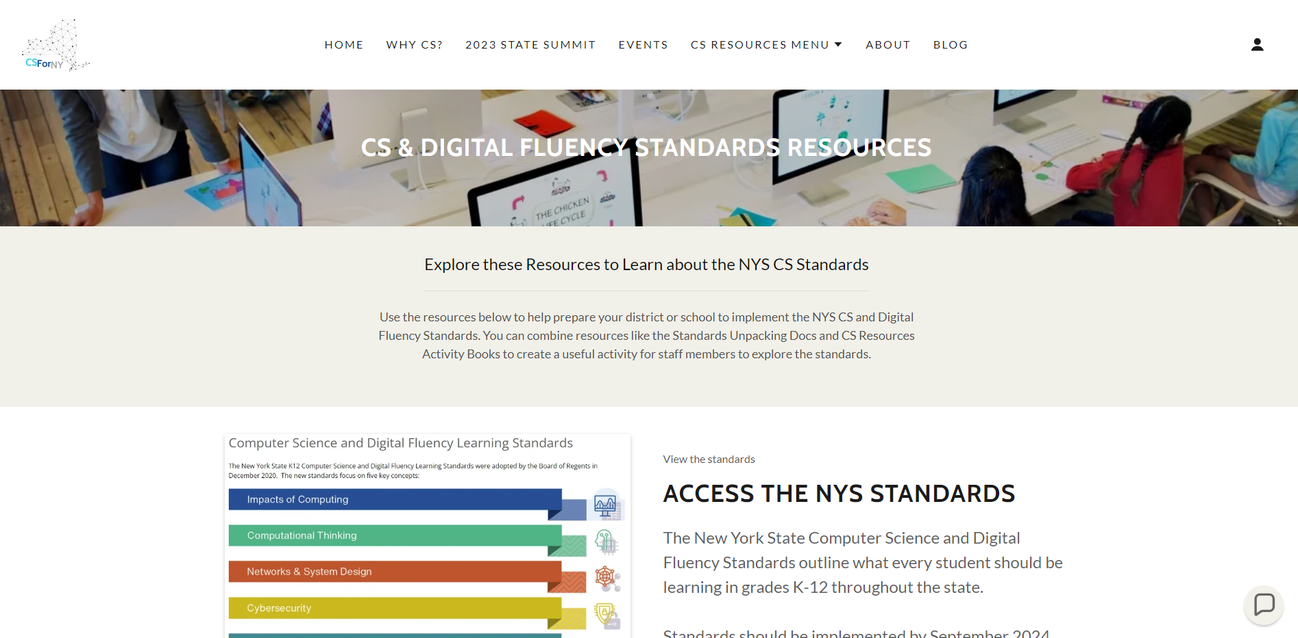
CS for NY

Slide 8
Tips for Getting Started
Start with the NYS Excel Document
Look at the examples and then look at your lessons
Work with your Ed. Tech Coach (Model Schools)
Work with your grade level or content area teachers

Slide 9

Breakout Groups

Slide 10

Guiding Questions
What support does your district need going forward?
What are your district’s plans for implementing CS&DF next school year for computer science and for the following school year for full implementation?

