Slide 1
Curriculum Council DEI-CRSE Resource Summary 22-23
Presented by:
Amanda Chansingh
Administrative Coordinator of Regional
DEI Services

Slide 2
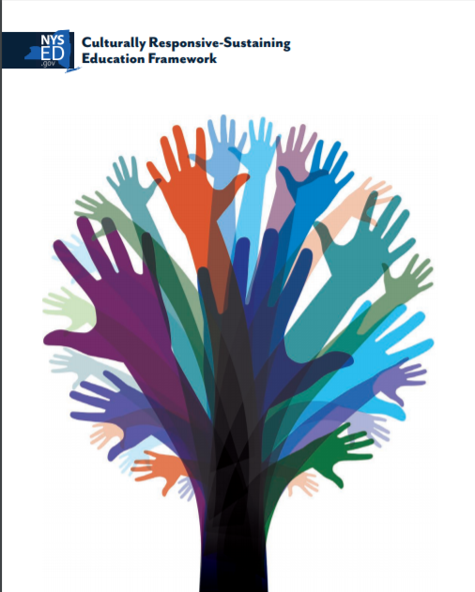
Overarching Themes for DEI/CRSE 22-23 Share
“CR-SE Framework and Curriculum Reviews”

Slide 3
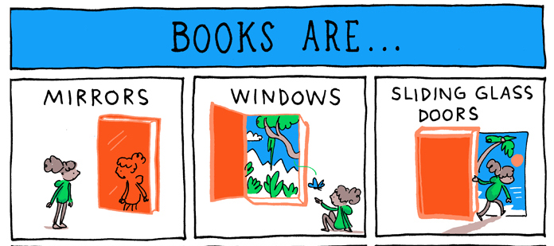
Inclusive Curriculum: Windows, Mirrors, and Sliding Doors
..Culturally responsive education is about teaching the students in front of you...However, culturally responsive education must also be sustaining, that is it must work to encourage cultural pluralism* and not cultural assimilation….

Slide 4
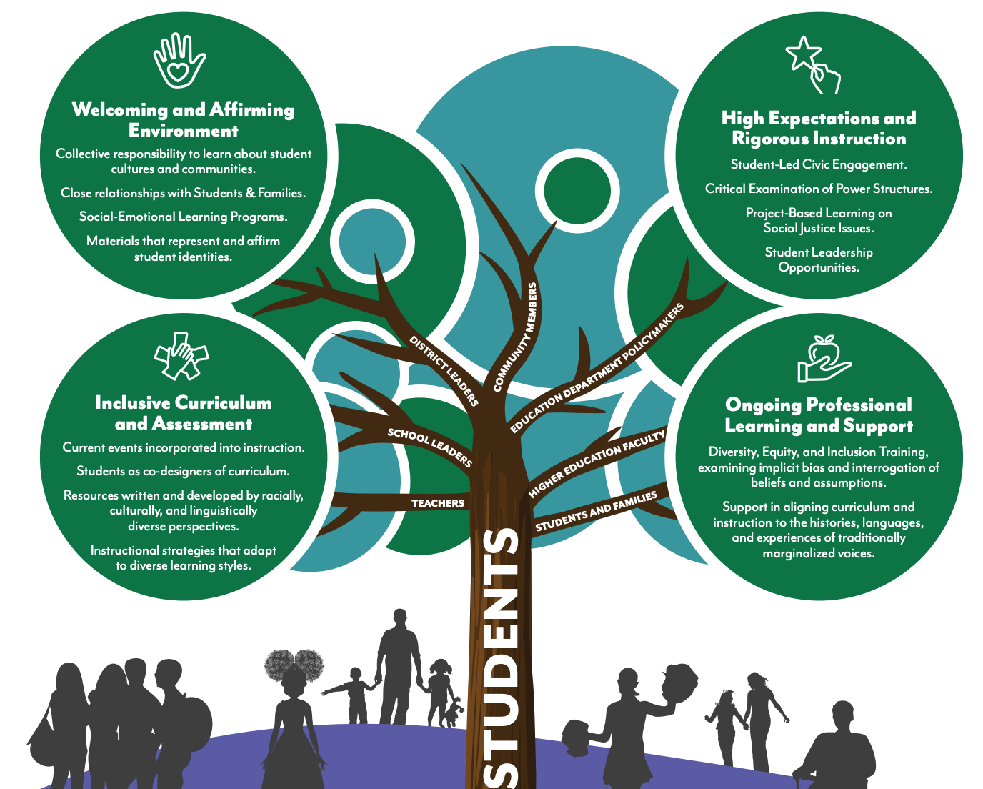

Slide 5
CR-SE Framework: Math and Science Curriculum Review

Slide 6
CR-SE and Math Education
Culturally responsive math teaching practices for advancing equity:
Foster students’ math identities as math thinkers and doers
Provide every student with challenges that leverage their strengths while pushing them to grow
Promote meaning-making through discourse and justification
Support students to see each other as capable, valuable learning partners
Connect students’ math learning and doing to their lives through “windows and mirrors”
https://www.edweek.org/teaching-learning/opinion-twelve-ways-to-make-math-more-culturally-responsive/2020/12

Slide 7
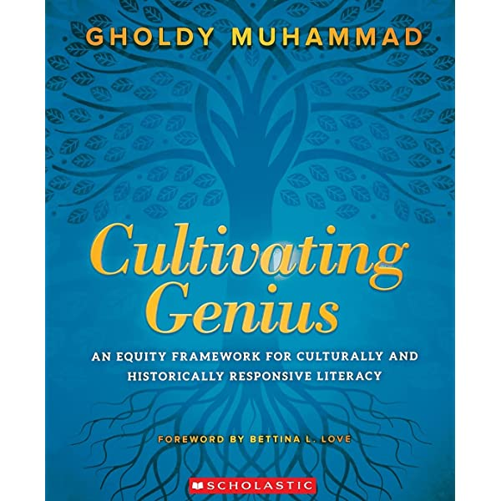



CR-SE and Mathematics Resources

Slide 8

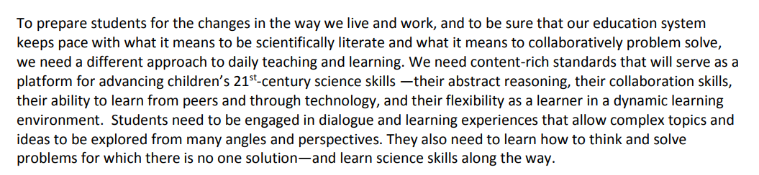
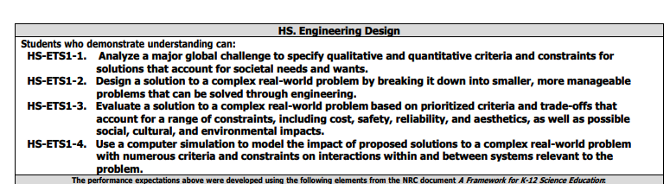
Next Generation Science Standards and NYS SLS
Notes:
Global perspective on NGSS and what it looks like in the classroom
https://www.nextgenscience.org/

Slide 9
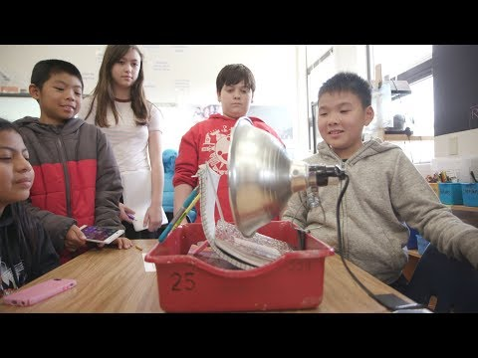
CR-SE in Science Education
Science: Connect to the Community
Classroom research and problem solving in the sciences should focus on culturally relevant elements in the students’ local or broader community.
https://www.edweek.org/teaching-learning/opinion-ten-culturally-responsive-teaching-strategies-for-the-science-classroom/2021/02
Notes:
5 minute example in science https://youtu.be/0s1xl6zIQ9Y

Slide 10
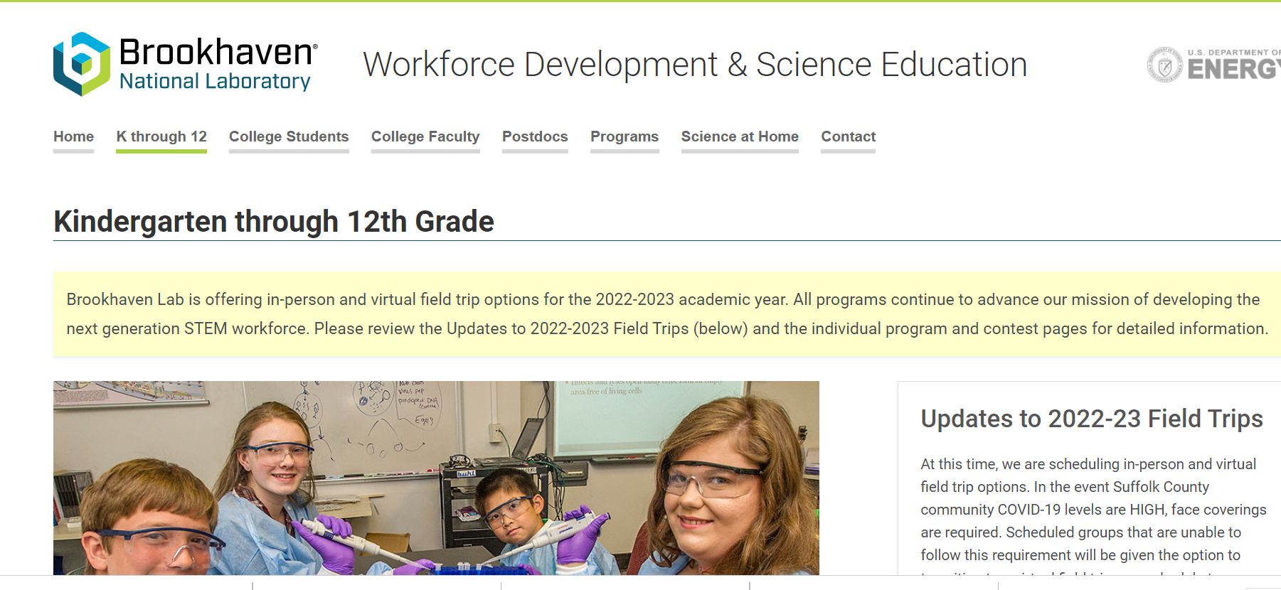
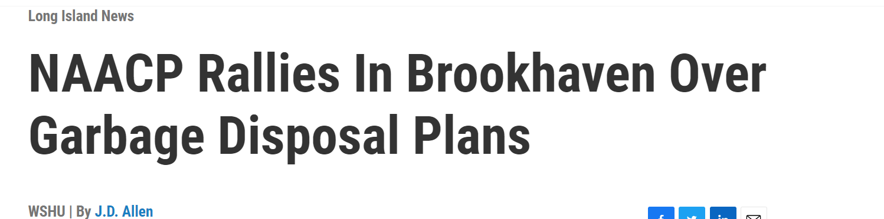
Science: Windows/Mirrors and Community Connections

Slide 11
CR-SE Framework: Teaching “Hard” and Honest History

Slide 12
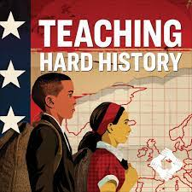
What are some “Hard” History Topics?
Teaching about issues related to slavery, lynching, Jim Crow, race, the Holocaust etc. includes addressing tough topics such as violence, murder, terrorism, racism, and more – not just as remnants of things long ago and far away, but also in how they are still at play in today’s society.
This can be challenging for teachers and students alike. To ensure effective and successful teaching and learning, preparation is key, otherwise, as Thomas Edison wisely said, “A good intention, with a bad approach, often leads to a poor result.”

Slide 13
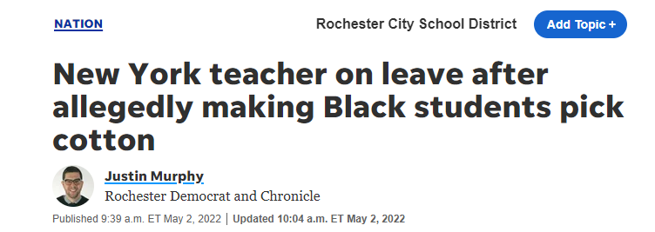
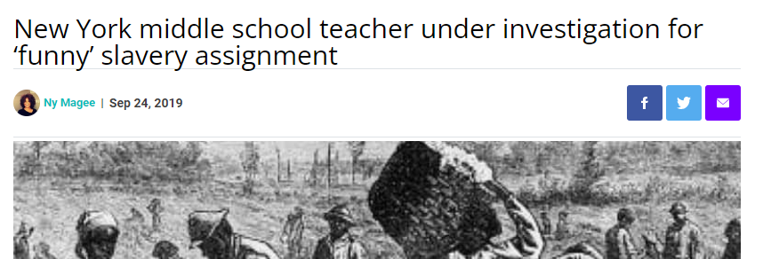
What is curricular harm?

Slide 14
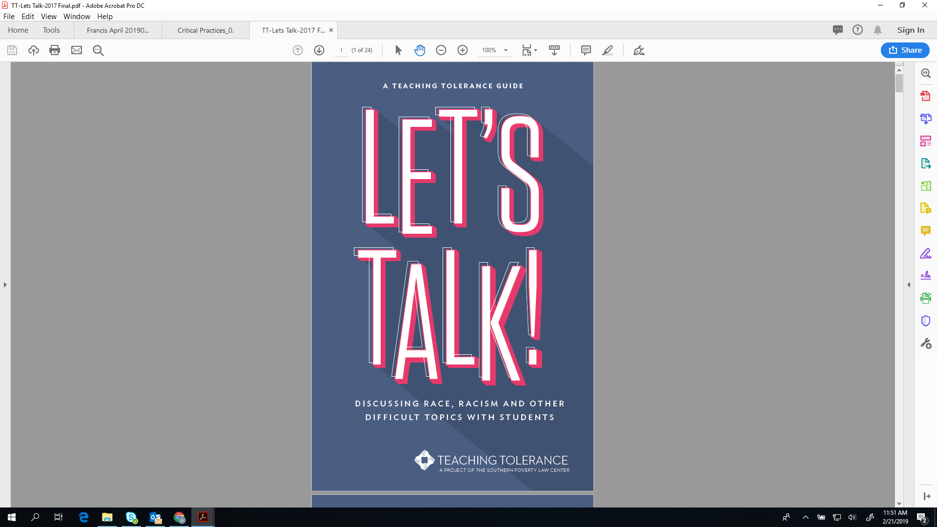
How can we avoid causing “harm” through the curriculum?
When preparing to cover issues pertaining to slavery, lynching, Jim Crow, issues of race, The Holocaust, etc., it is important that educators consider:
Their own biases and/or discomfort surrounding the issues.
Be willing to re-think, re-learn, and reflect.
Reach out to their network, colleagues and supervisors who will interested in exploring these themes , and develop partners and advocates with strong standing both within your school, the community, and at large. (i.e. NAACP, LI Jewish Community Relations Council, University Professors)
Know yourself, your school and community
Include social emotional strategies when lesson planning
Incorporate “accountable” talk strategies to help guide student conversations
https://k12database.unc.edu/wp-content/uploads/sites/31/2019/06/TipsControversialIssues.pdf

Slide 15
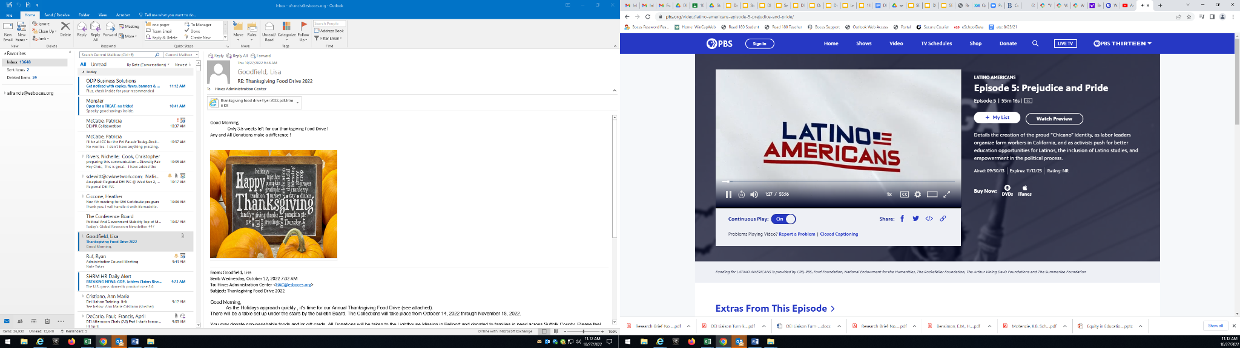

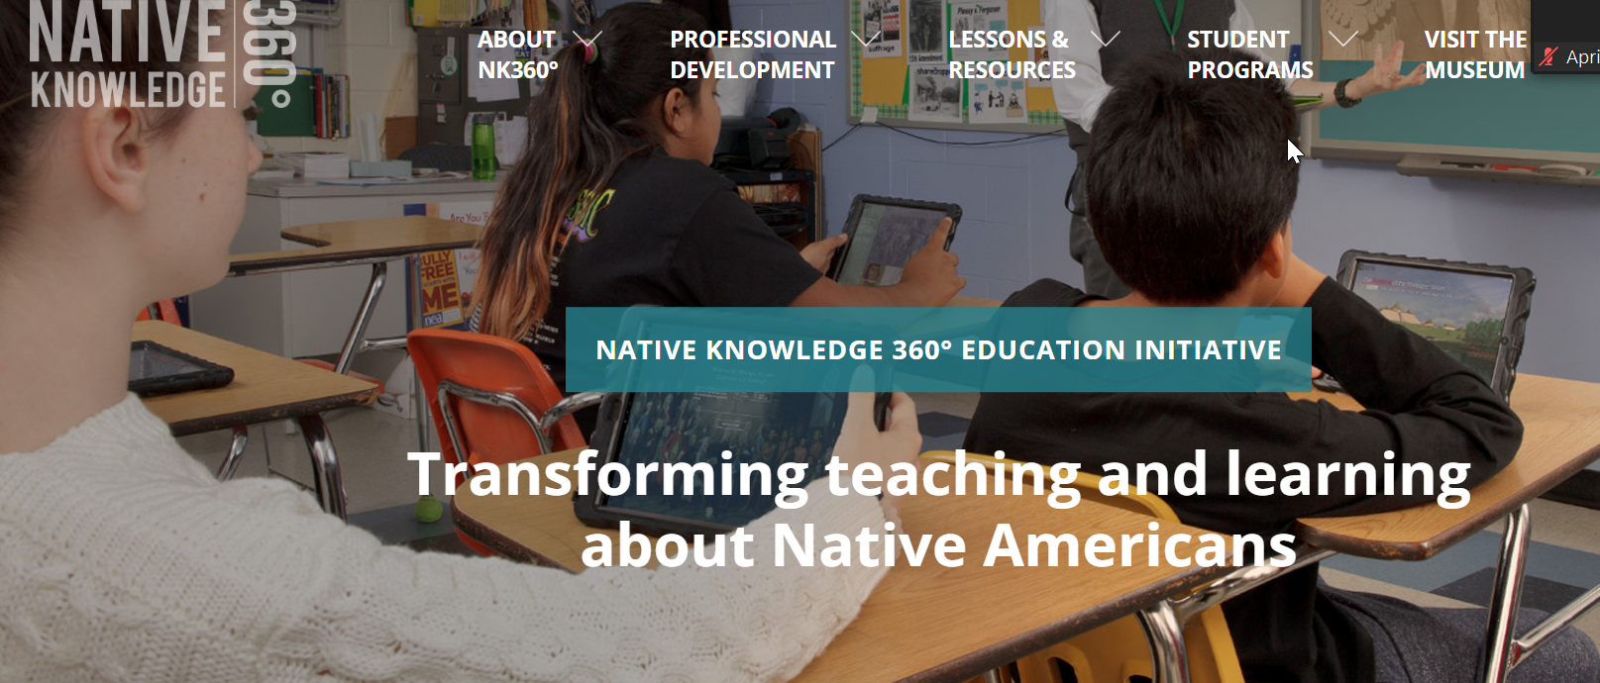
Inclusive Social Studies Curriculum: Asian American History, Latino-American History, Native American- Present Day
Notes:
Windows and Mirrors

Slide 16
Curriculum Audits with an Equity Lens
Notes:
Amanda

Slide 17
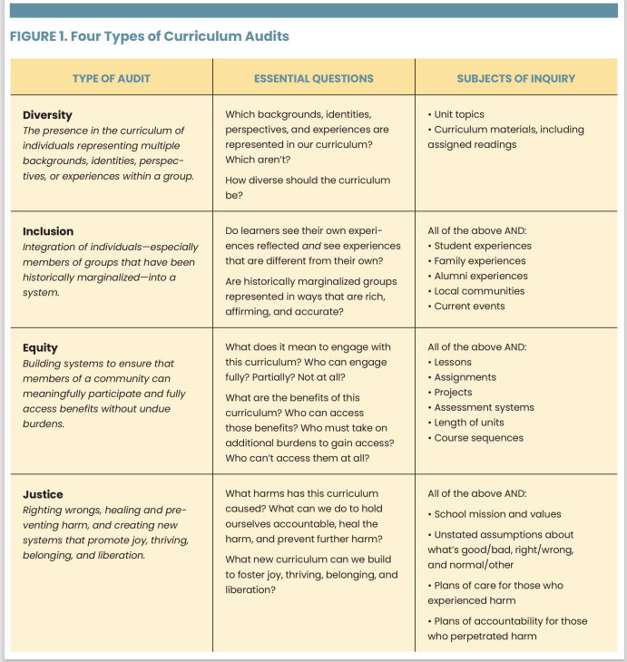
Types of Curriculum Audits
What is our focus?
Which backgrounds, identities, perspectives, and experiences are represented?

Slide 18
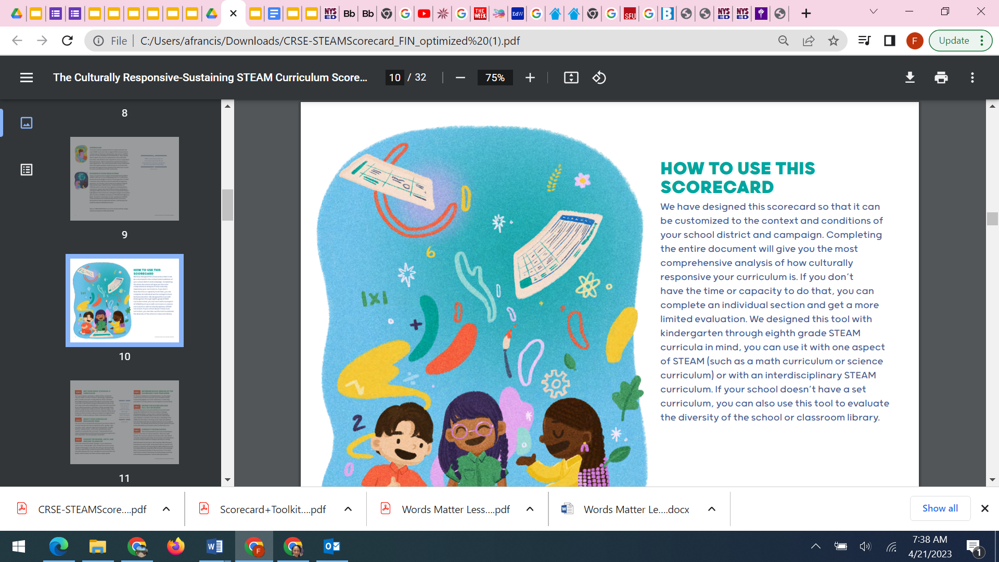
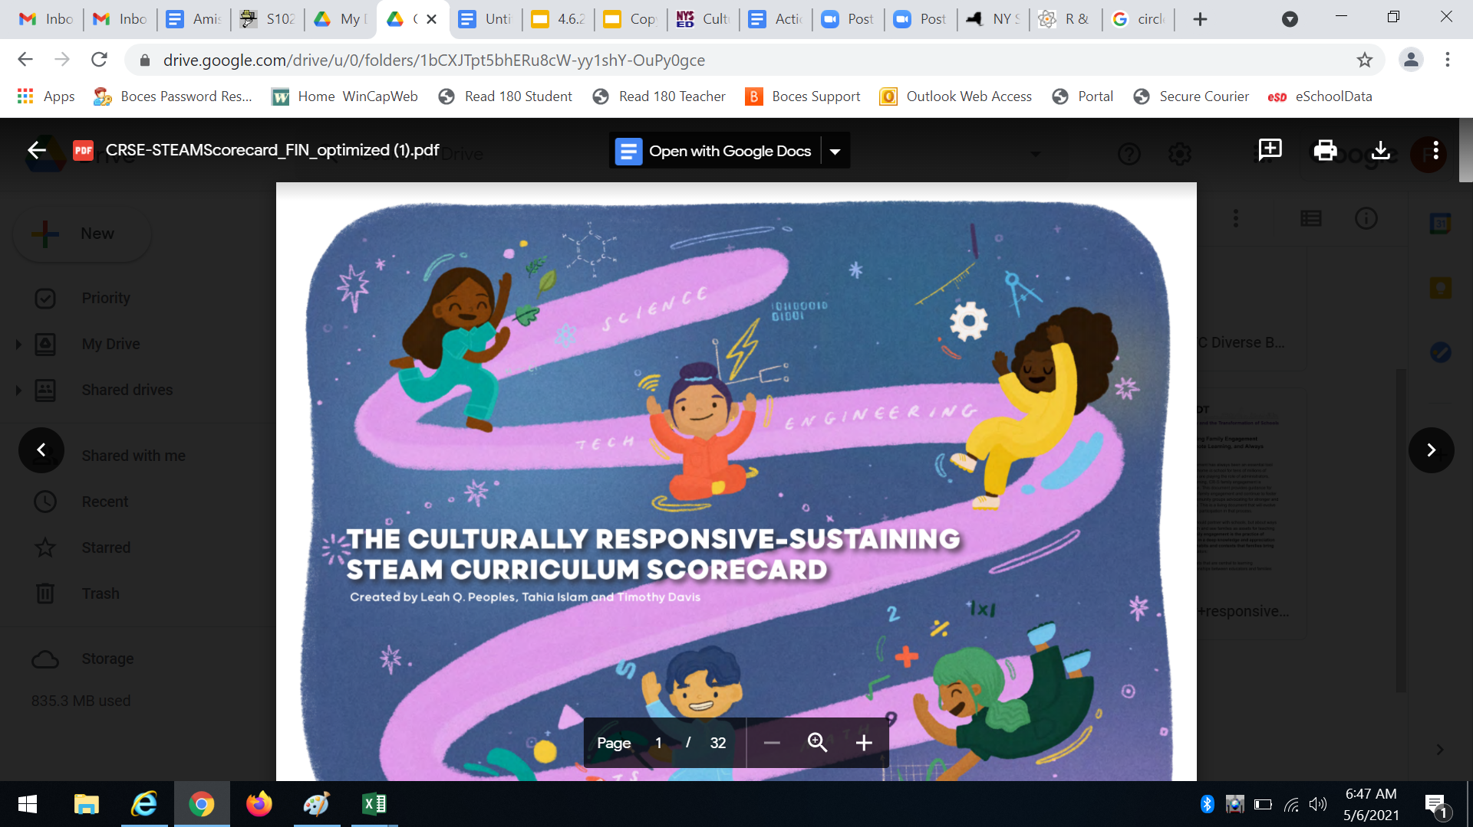
NYU Audit Tool: Curriculum Audit/Inventory Review
STEAM Curriculum self-audit
Developed by the NYU Metro Center

Slide 19
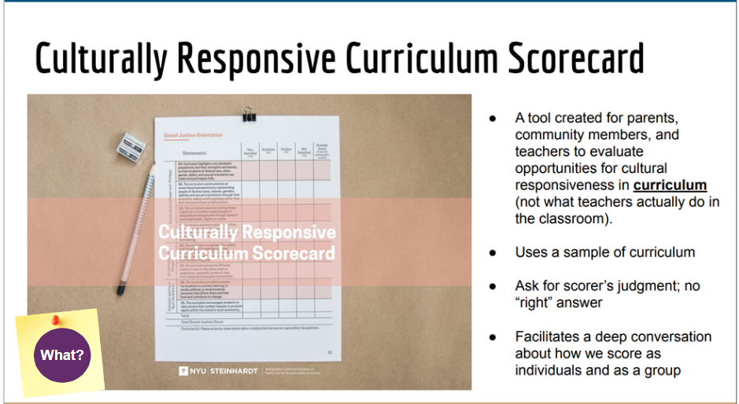
Overview of the Scorecard

Slide 20
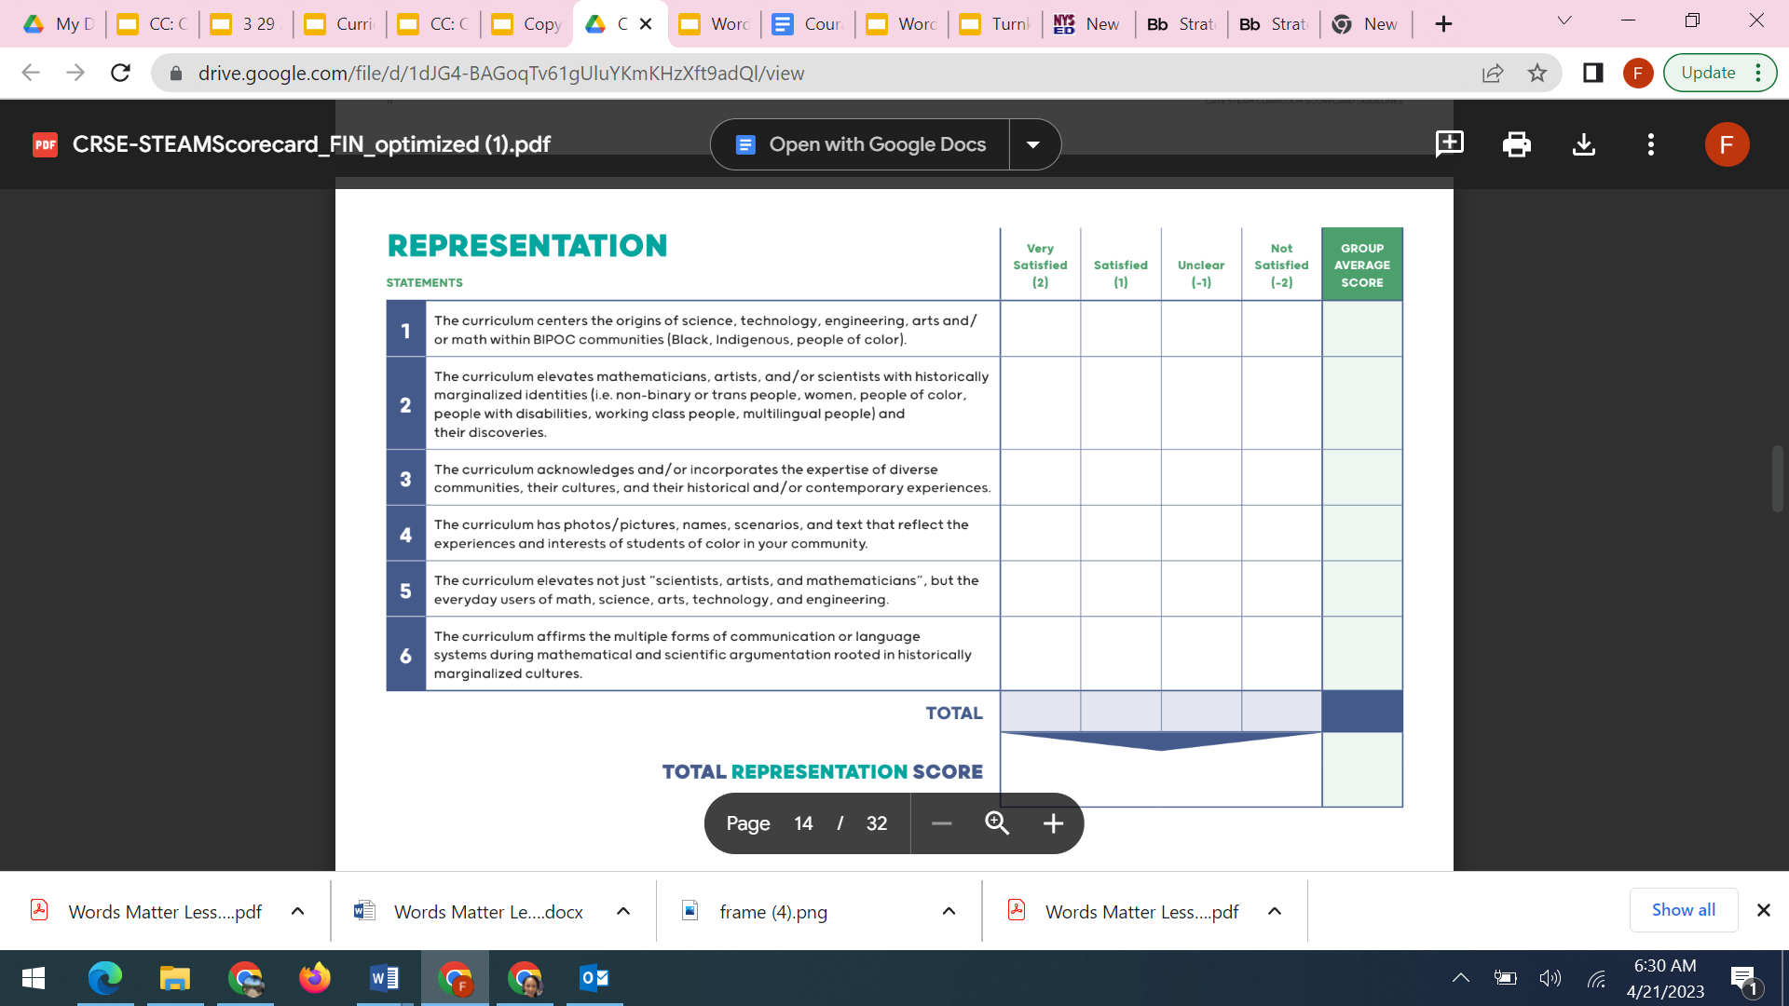
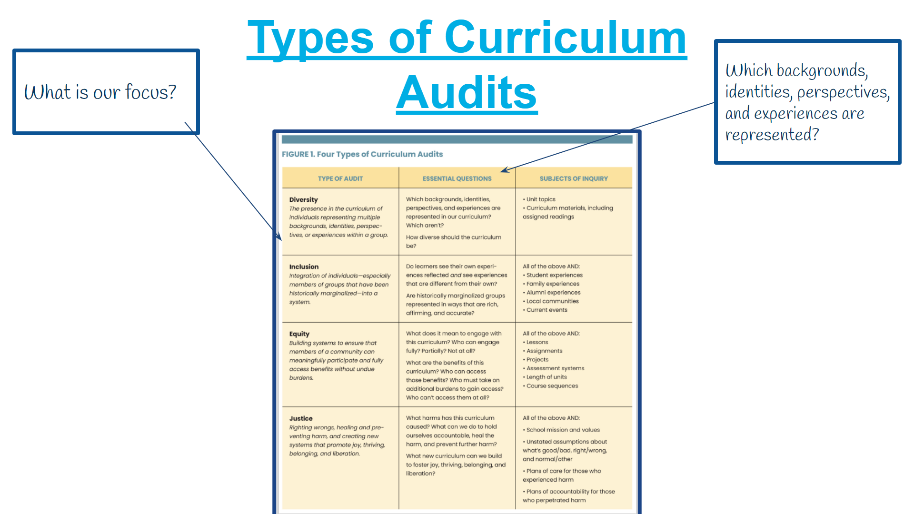
NYU Scorecard
Pg. 12

Slide 21
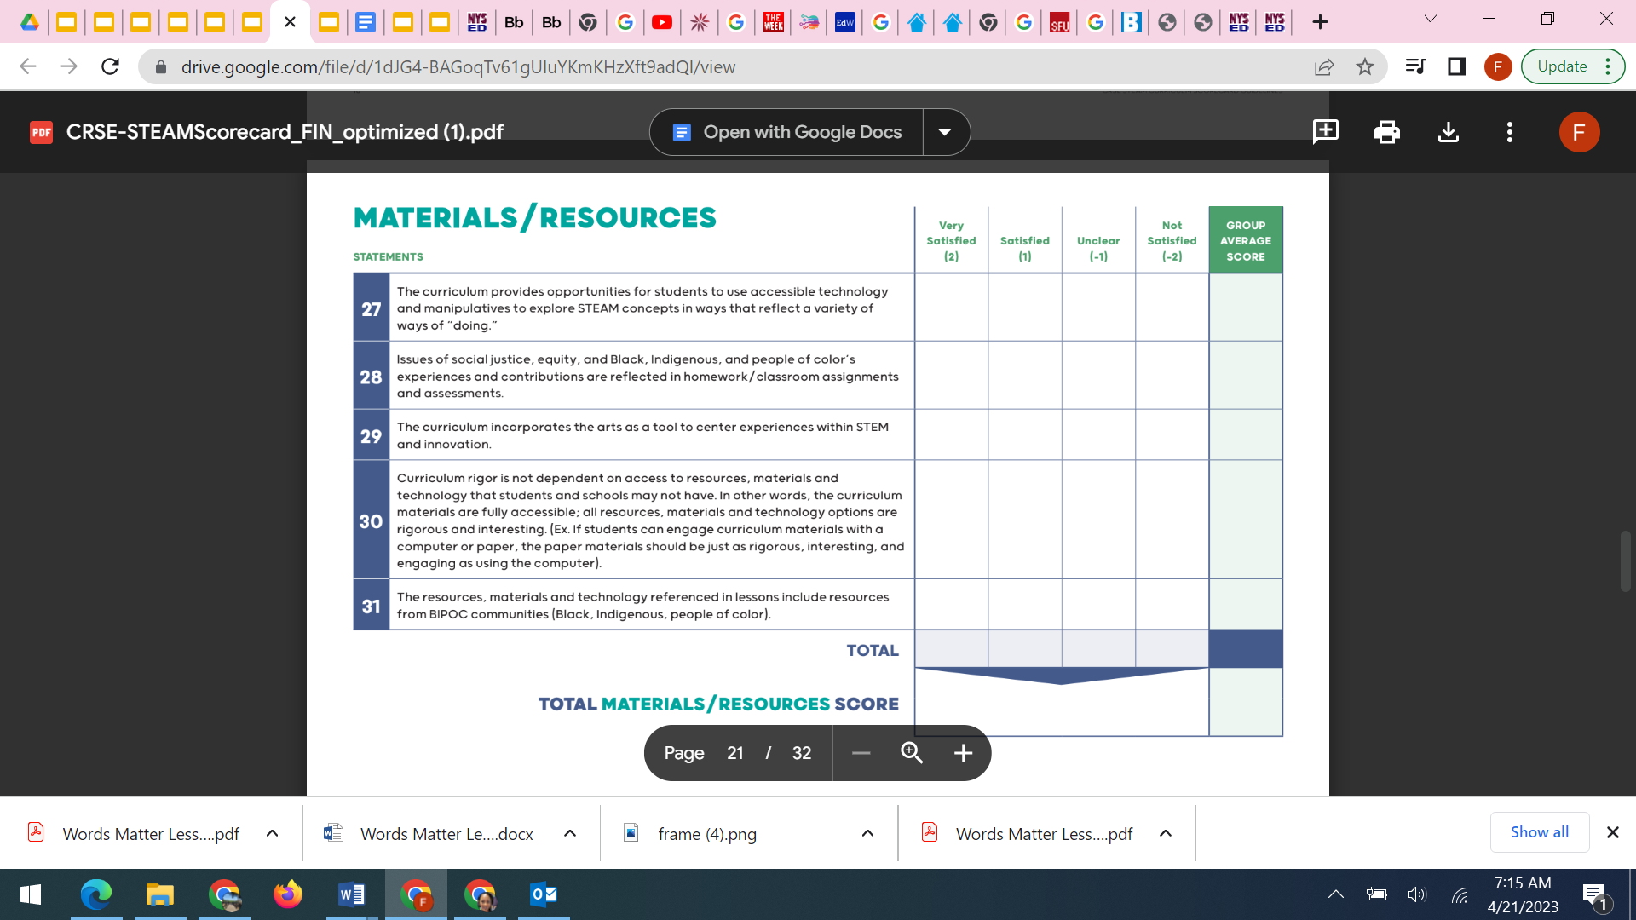
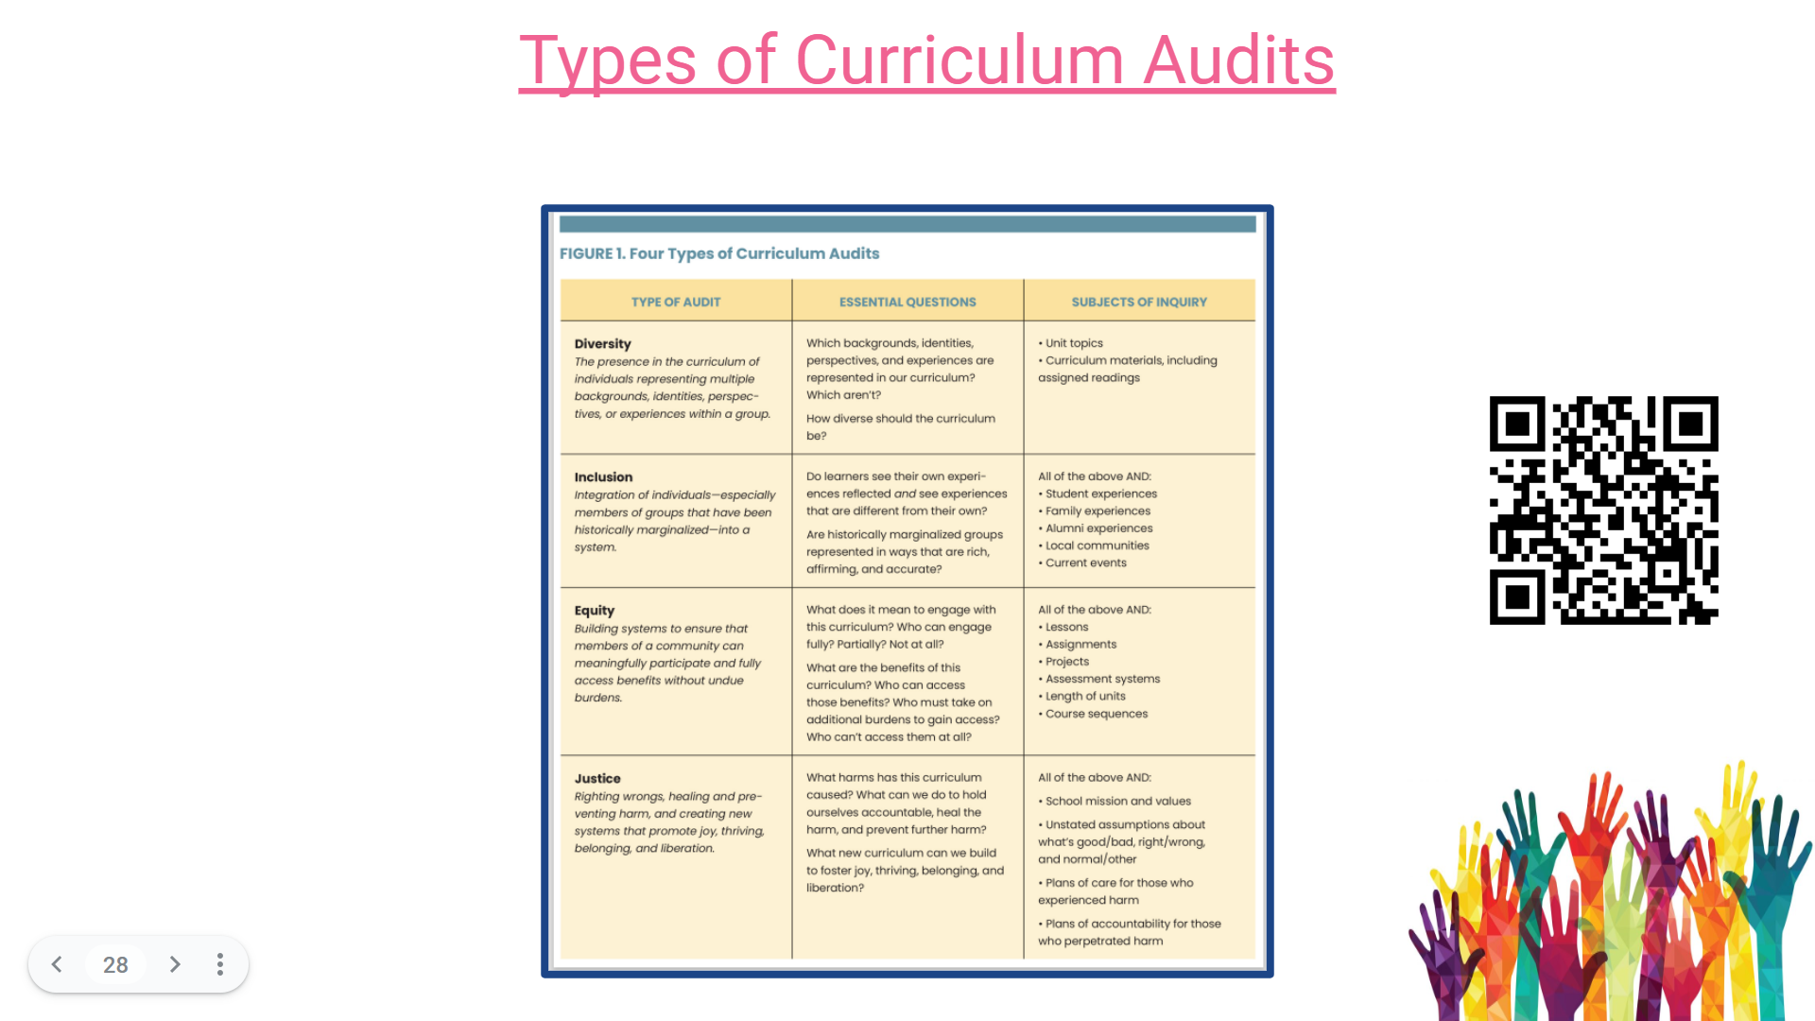
NYU Scorecard
Pg. 19

Slide 22
How do we start using the scorecards?
Step 1: Select your curriculum audit team members and select a lead scorer. (grade band levels)
Step 2: Gather Curriculum maps/textbooks/lab assignments/projects/homework assignments/student work and place the selected material with each audit team according to the grade band/s.
Step 3: All members from each team:
Choose curriculum materials to review
Review the statements on the Google form
Make sure the team understands each statement, and refer to the handouts/slides and answer any question…(You may pull me into your conversation if you have questions)
Chart key words, ideas and qualities from the statements that you will be looking for as you read/survey the curriculum.
Conduct the evaluation
Discuss findings with your team
Identify three areas of strength and three areas of growth (Record on chart paper)

Slide 23
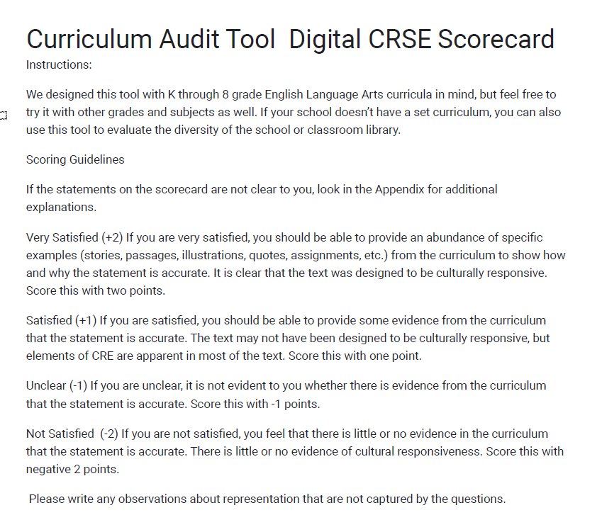
Digital Curriculum Audit Tool

Slide 24
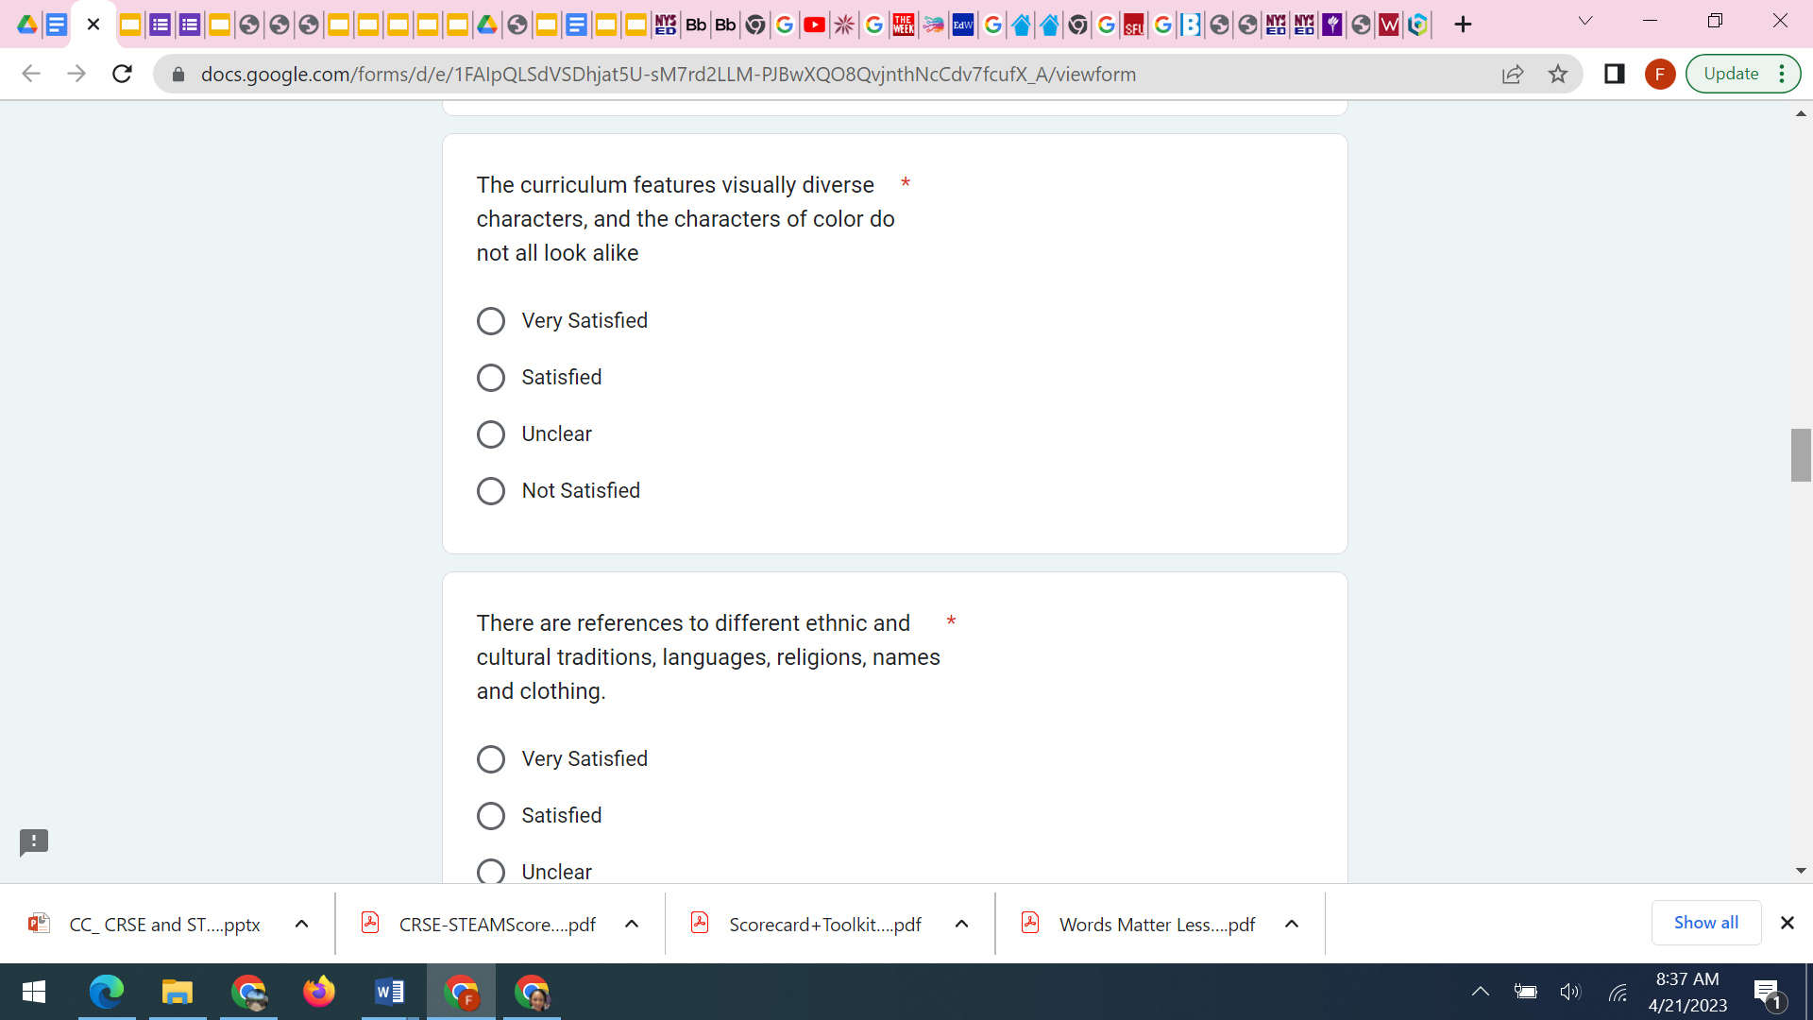
Sample Questions

Slide 25
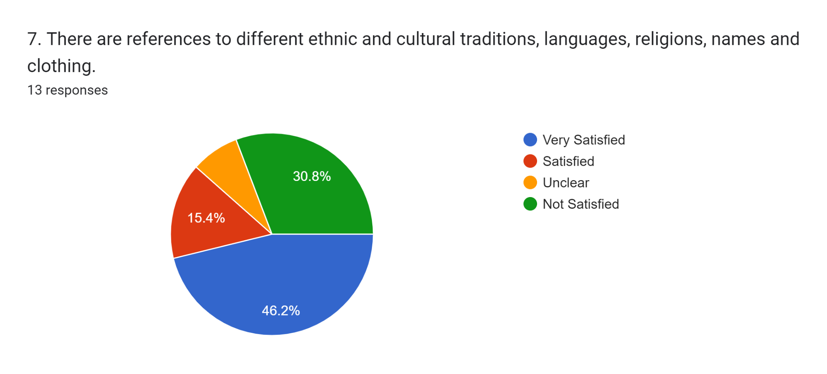
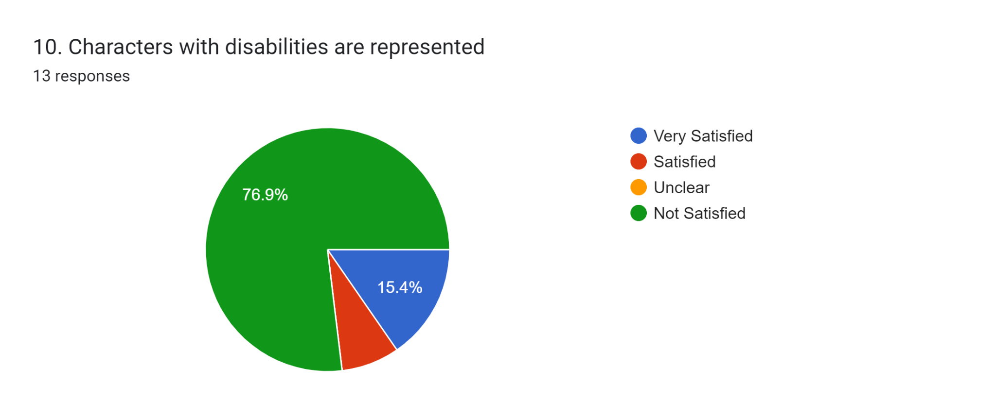
Sample Curriculum Audit with an Equity Lens Responses
Notes:
23

Slide 26
Follow-up
Debrief
Where are the strengths?
Where are the opportunities for growth?
Who is impacted by this new information?
What voices are missing from this conversation?
Plan
What are 2-3 critical areas we need to address based on this audit?
Who is needed to help plan for the improvements?
What is an ideal and practical time frame (inclusive of professional development)?

Slide 27
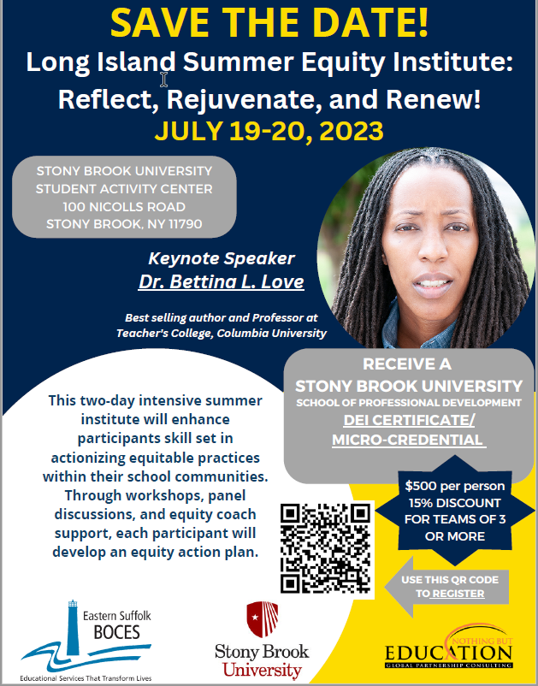
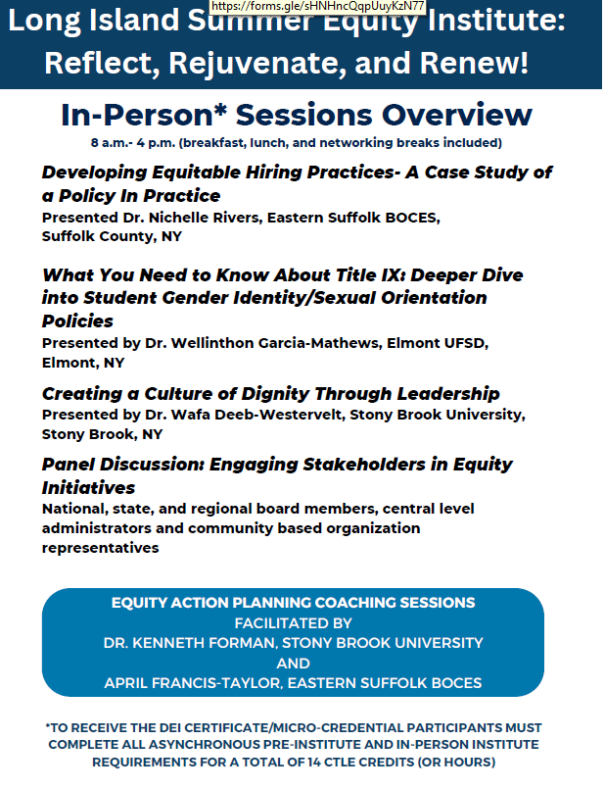
What are you leaving with today?
One word/A Phrase

